Slide 1
ECEN315: Lab bits and bobs (Yes, this is the technical term)

Slide 2
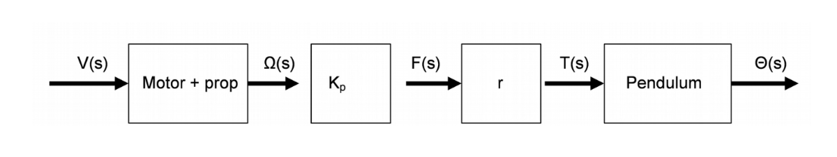
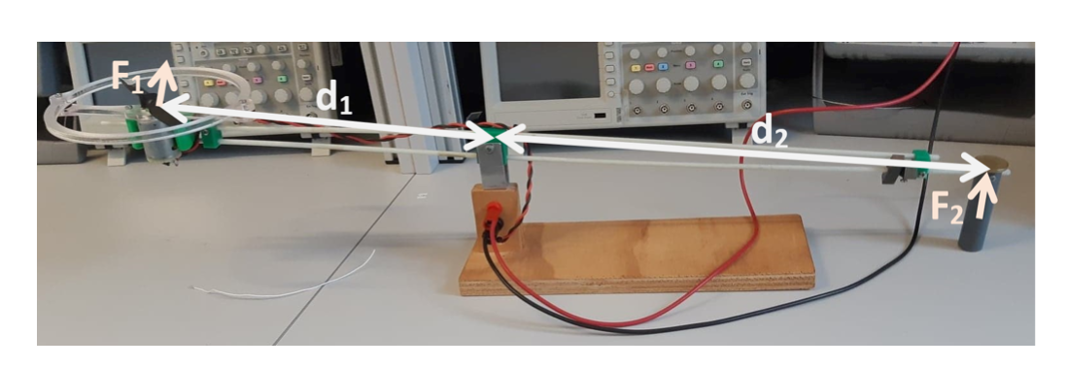

Block diagram of the system
Taking an approximate from a number of previous reports, $Kp≈0.0053$ with the lowest value I found being 0.002 and the highest being 0.009. This is approximate by using the device pictured below, changing the voltage applied across the motor, and using scales to measure the force applied. A graph is then plotted, and a linear approximation is made

Slide 3
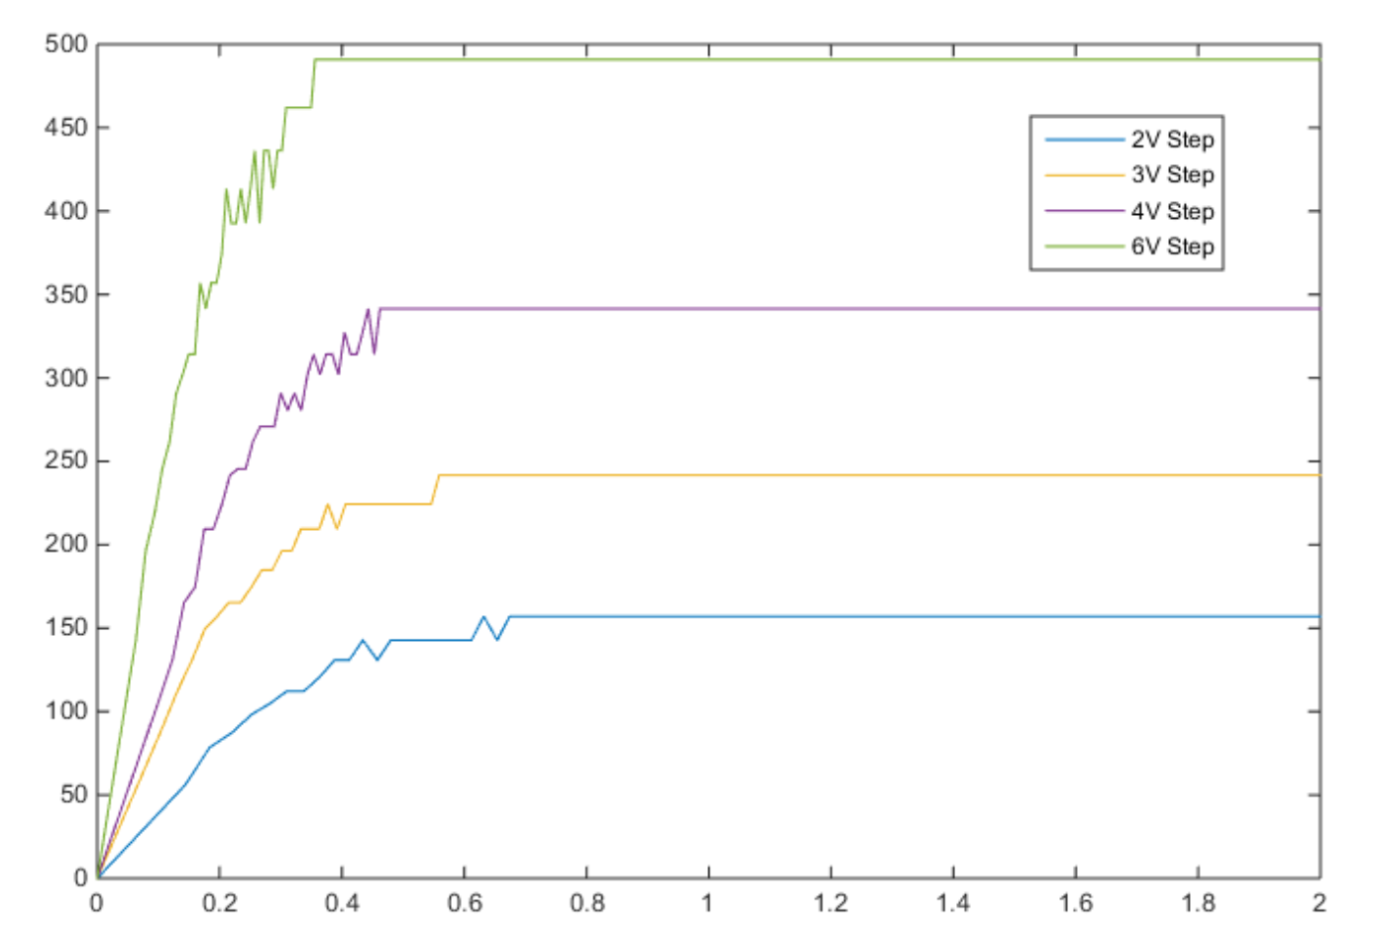
Motor output
Here is a measured output of a previous year’s motor to give you a rough idea. This is not a perfect plot, but it should give you some ballpark values.

