Slide 1
INTELLIGENT CLAIM FREQUENCY MODELING
Data-Driven Insights for Improved Pricing
AMAN JAIN
13.01.2025

Slide 2
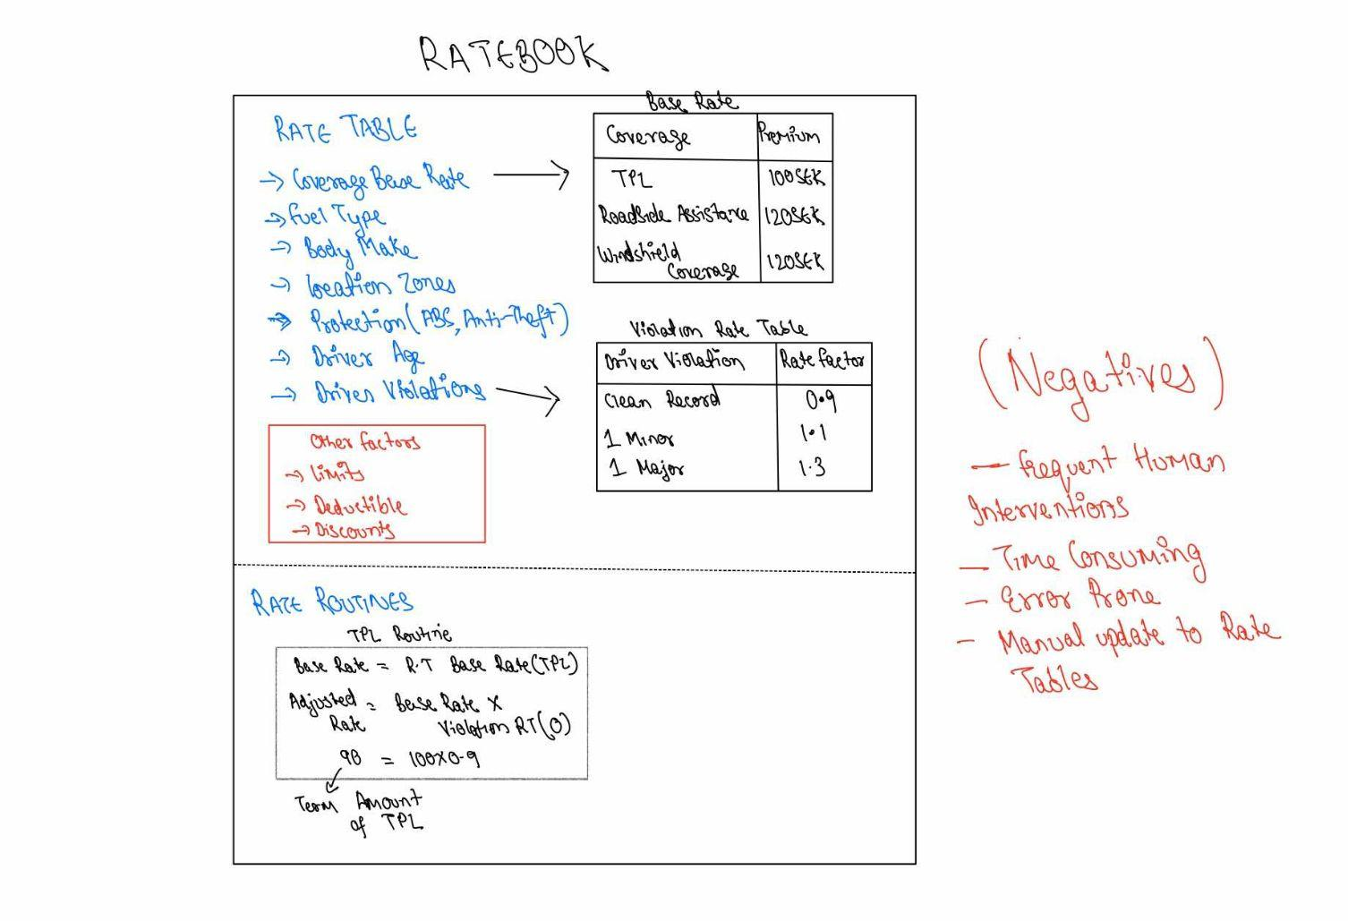
PROBLEM STATEMENT

Slide 3
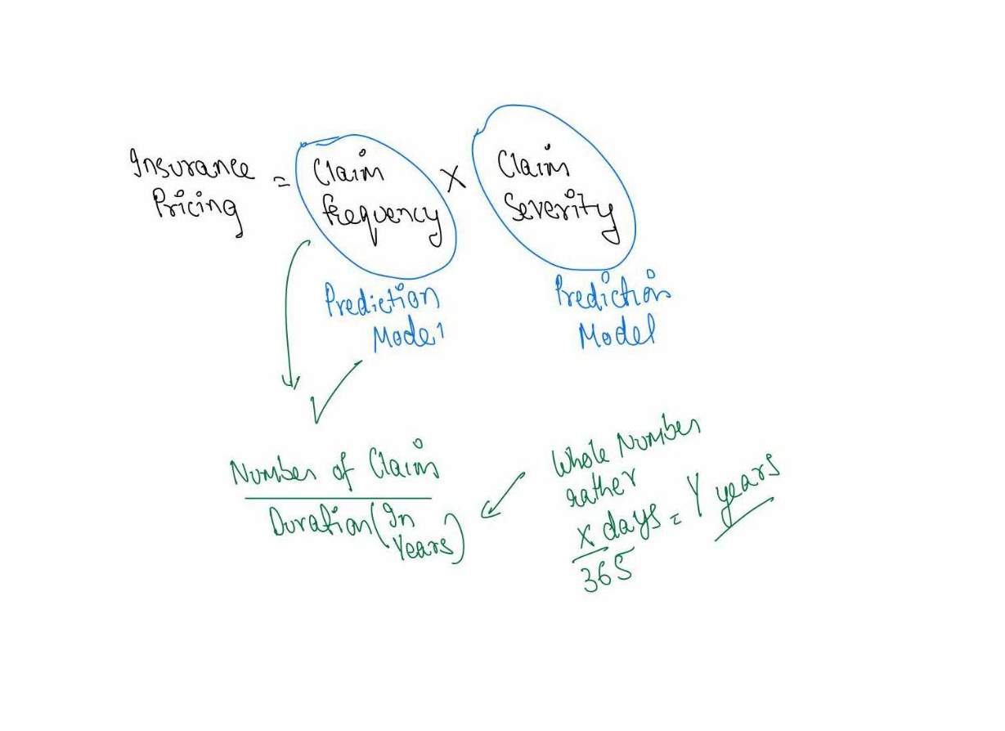
SOLUTION
AUTOMATE THE PRICING FRAMEWORK

Slide 4
DATA
● owner_age: the age of the owner
● owner_gender: the gender of the owner, M (male) or K (female).
● geo_zone: geographic zone numbered from 1 to 7, based on the address of the owner
● vehicle_class: a classification based on engine power, vehicle weight, 7 classes in total
● vehicle_age: vehicle age, between 0 and 99
● duration: the number of policy years
● n_claims: the number of claims
● claim_cost: the claim cost
n_claims | Claim_cost (Average)
1 | 18364
1 1 | 36645
2 | 39445
2 1 1 2 | 47000
2 2 | 76298
While exporting the data from the system it could be Claim Group, or Paid/Unpaid Claim

Slide 5
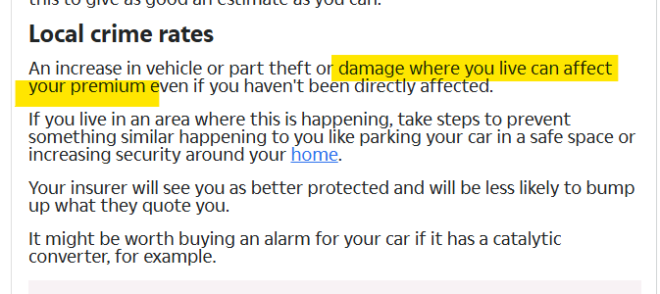
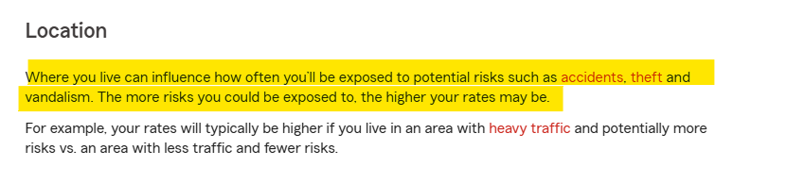
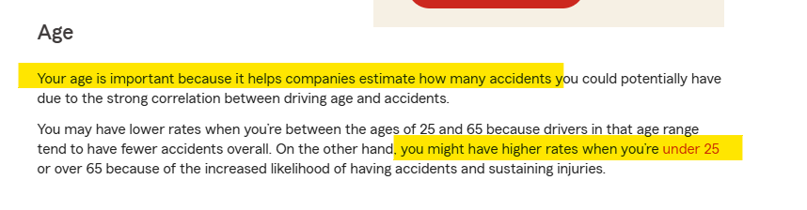
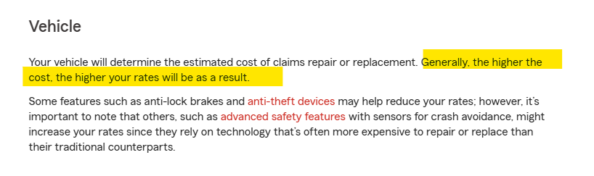
Researching About the Data

Slide 6
TOOLS AND TECHNIQUES
Tools:
Figma - for intuitive diagrams
Notability - Notes
Python (Pandas, Scikit-learn, Matplotlib/Seaborn).
Jupyter Notebook (Gemini AI Integrated - For utility scripts)
Libraries for Predictions (Linear Regression).
ChatGPT - for redirected towards the data/research papers
ResearchGate - For research papers
Google Slides - for presentation
Google Sheets - for exploring the datasets
Techniques:
Supervised Regression Technique
Linear Regression Model

Slide 7
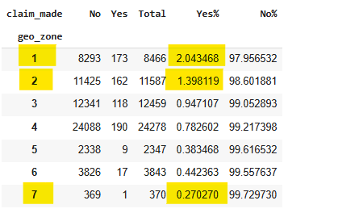
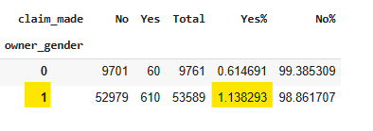
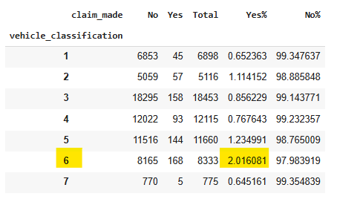
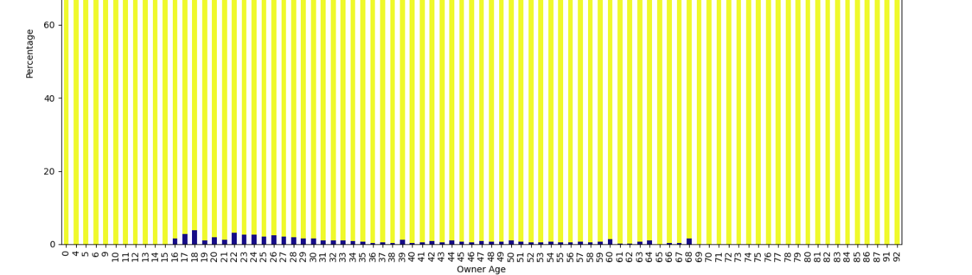
EXPLORING THE DATA

Slide 8
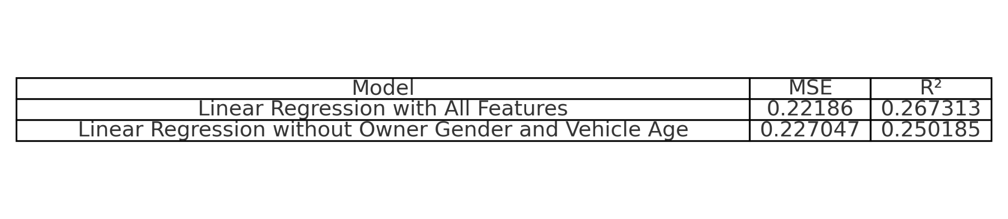
LINEAR REGRESSION METRICS

Slide 9
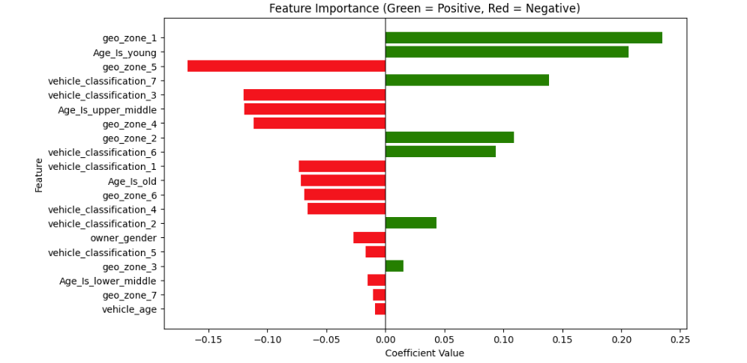
FEATURE IMPORTANCE

Slide 10
CONCLUSION
Conclusion:
Summary of key findings.
Geo Zone 1 is the riskiest and 5 is the safest
Young car owners tend to have more claims
With more time, the confidence on the model can be improved by hyper parameter tunings and more feature engineering

Slide 11
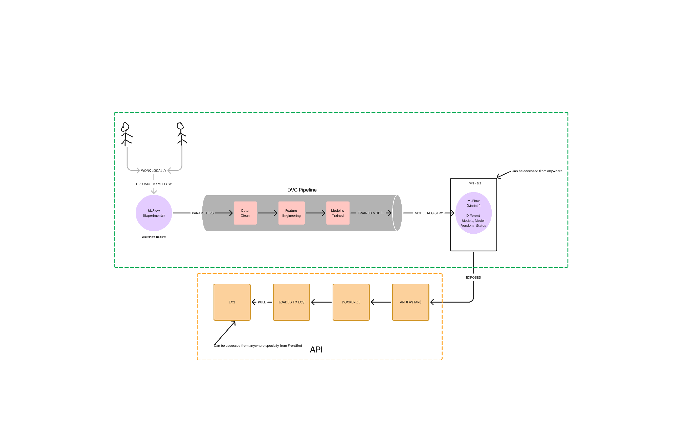
NEXT STEPS

Slide 12
THANK YOU

