Slide 1
Applications of Machine Learning in the Physical Sciences
Andrew Eisenhart
1/6/2020

Slide 2
Table of Contents
Personal Background
Computational Chemistry
Machine learning in Computational Chemistry
Example #1: A predictive model for dimer interactions
Example #2: A supplemental model for force field creation
Example #3: Making Machine learning easier through smart databasing
Personal goals

Slide 3
Personal Background
2011 – 2015 : B.S. Chemistry - Wheeling Jesuit University
2015 – Spring 2020 : PhD Computational Chemistry – University of Cincinnati
Simulations of condensed systems
Quantum based structure predictions
Ion solvation behaviors
2018 Fall - 2019 Fall : Research Assistant - UC Simulation Center (P&G)
Simulations of current marketed formulas seeking driving forces for temperature instabilities
Predict formula efficiency based upon micelle formation ( ML image recognition)

Slide 4
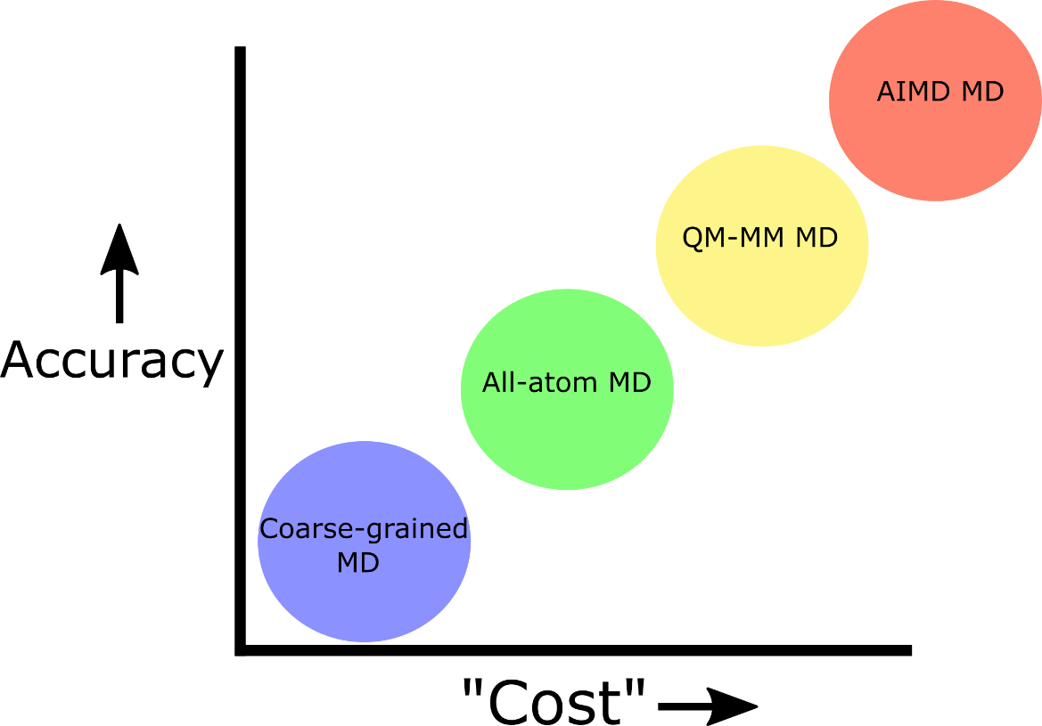
Overview of Computational Chemistry
Common methods in Comp. Chem.
Molecular Dynamics Simulations
Used to study large or dynamic systems
Ex. Chloride transport through a channel
Single Structure or Small Cluster Calculations
Used to study single molecule’s geometric or electronic properties
Ex. Preferred geometry of protein in vacuum or dielectric
Both methods face the same issues. Namely the trade off between accuracy and cost.

Slide 5
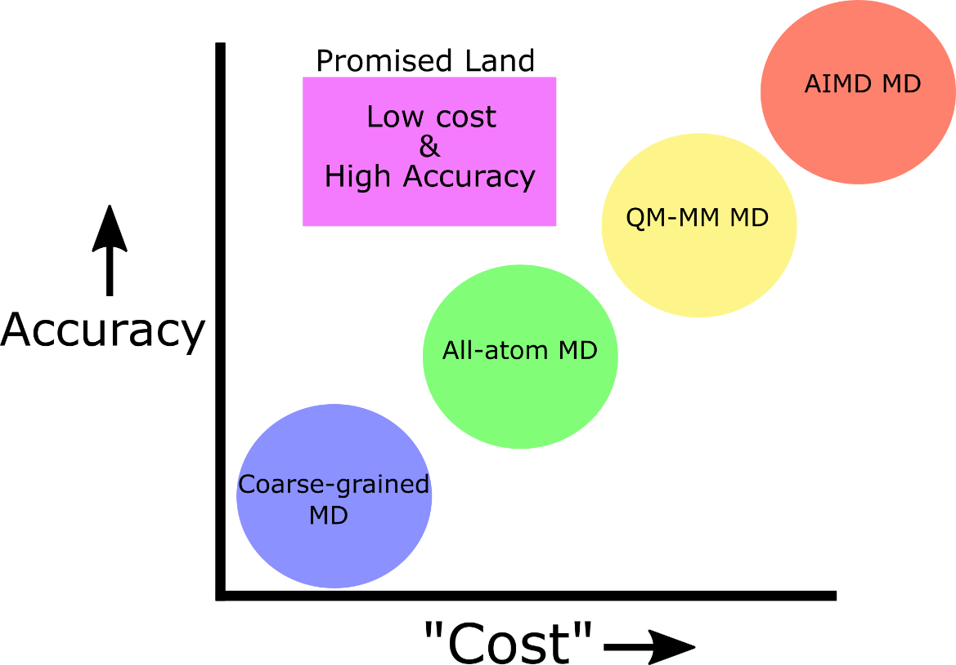
Where does machine learning fit?
How is ML used?
As a method replacement
Deep potentials (deepmd,DPMD)
Predictive models (deepchem)
As a method supplement
Correction factor predictions (Gaussian)
Smart molecular space exploration (MolDQN, dragon)
What challenges do ML models face?
In chemistry, ML models face the molecule problem
In general, ML models face the same issues as all statistical analysis; data input (volume and formatting), data cleanliness, and tendency for over concluding.
ML

Slide 6
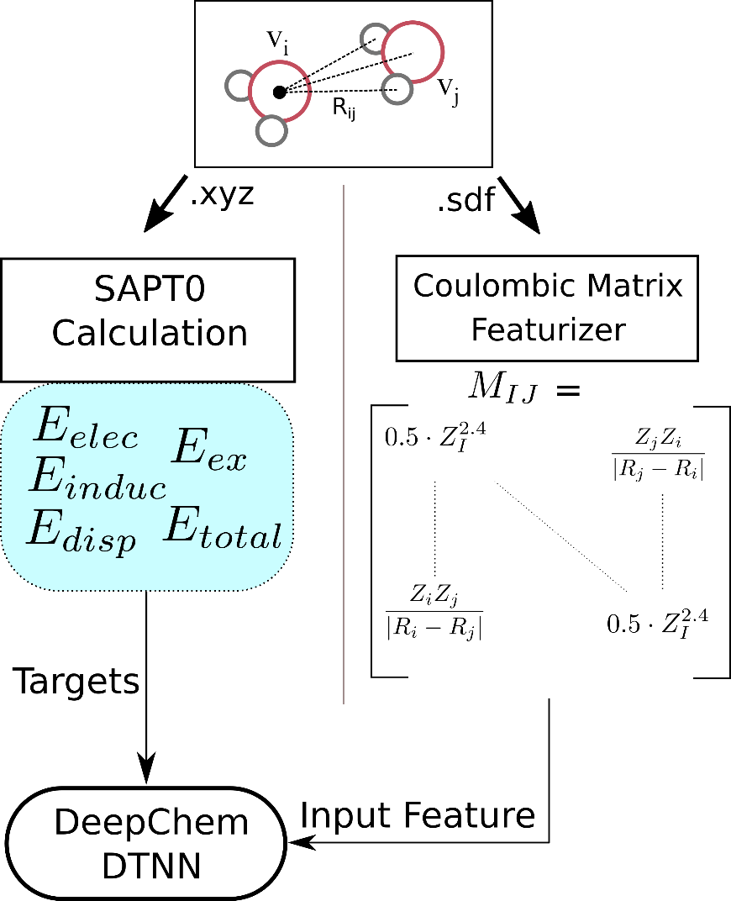
Example #1. Prediction of dimer interactions
Background: The interactions of two molecules can be used to infer many properties about one or both of the molecules, particularly useful when looking at binding interactions.
Enzyme – ligand, solvent – solute, drug – membrane, etc.
Problem: The calculations for these interactions can be expensive depending on the size and orientation preference of the molecules.
Our Goal: Show that a simple single representation can be used as input to predict the SAPT separated interactions of a homologous dimer pair.

Slide 7
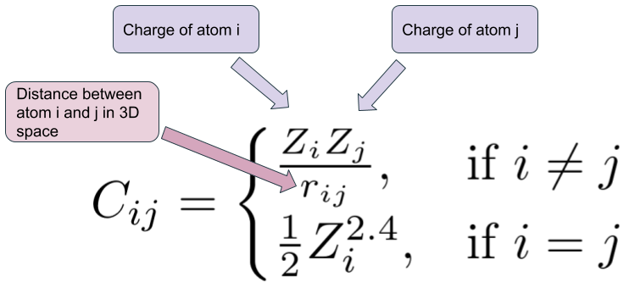
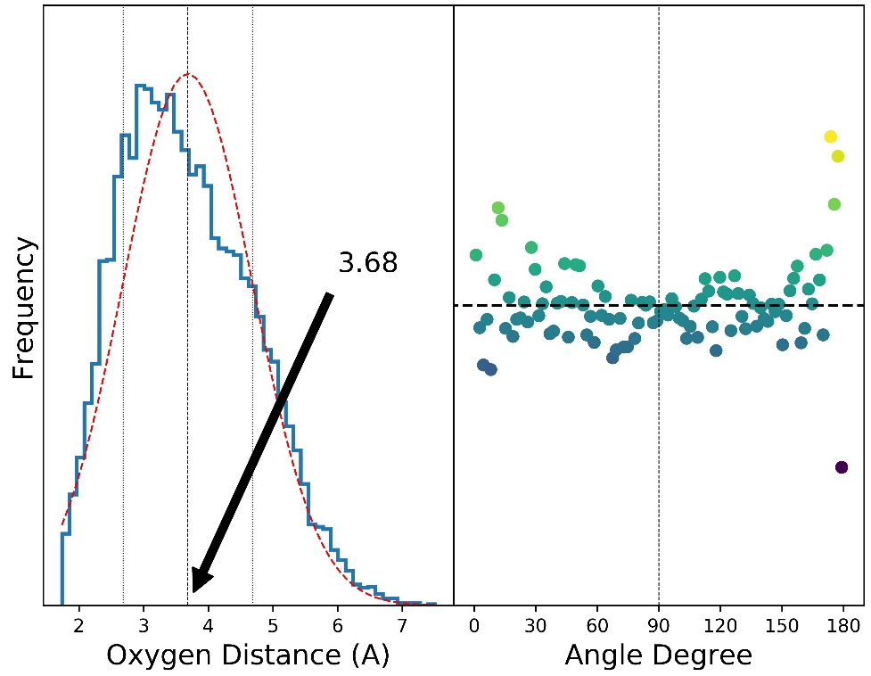
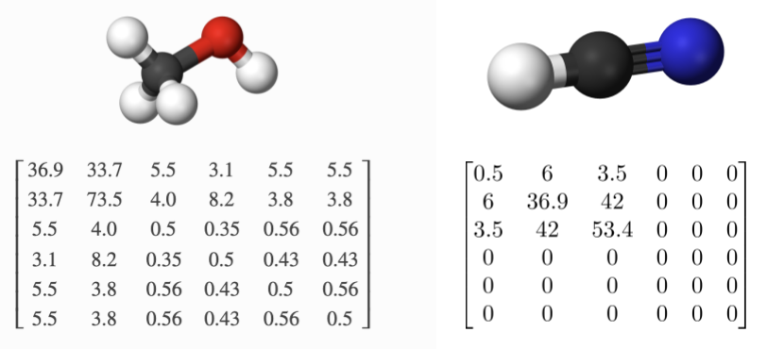
Where do you start?
Generate Data
10k calculations of a water dimer each monomer randomly orientated in the space.
Featurization
Translate the molecules into a format the computer understands.
In this example we use a padded coulomb matrix
The pairwise electrostatic potential energy of all pairs of atoms in a molecule (equation above)
https://towardsdatascience.com/teaching-ai-how-to-do-quantum-mechanics-8ea693b2fa8a

Slide 8
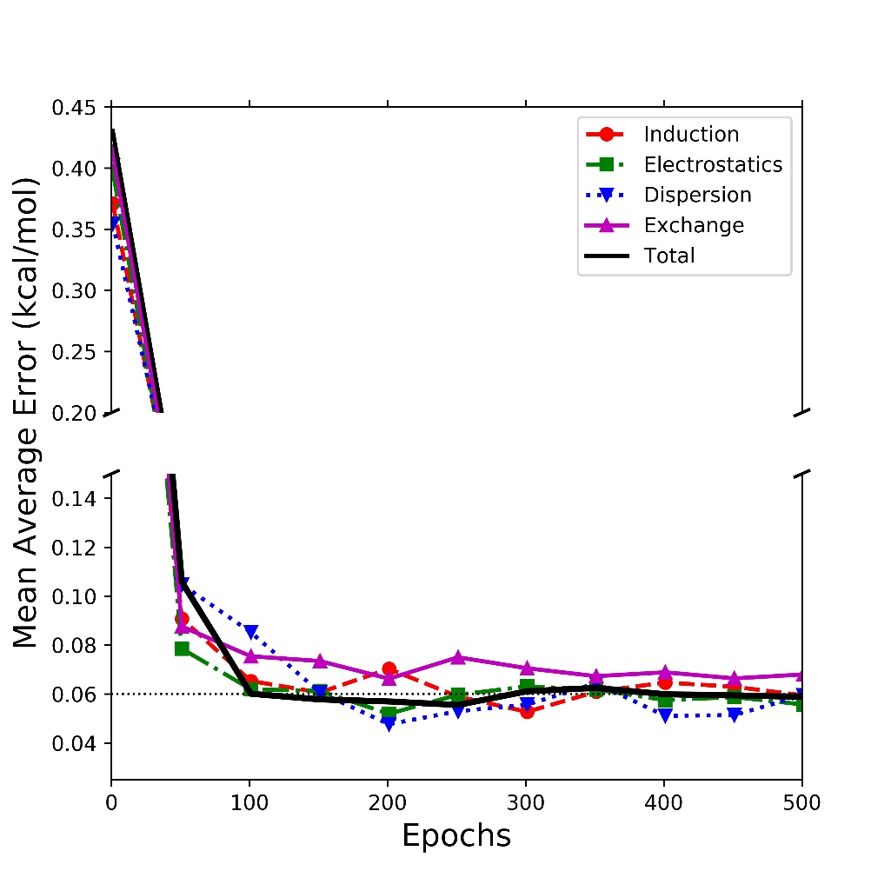
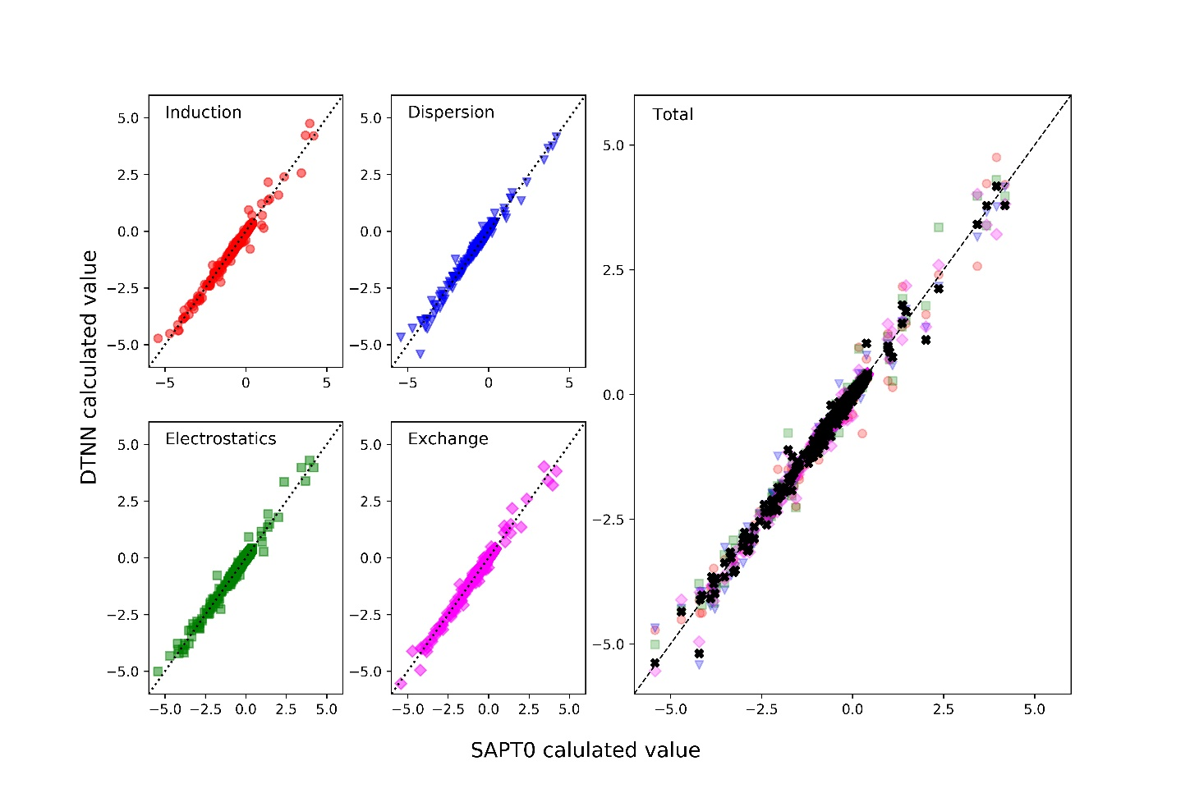
Model Performance
CM + DTNN vs SAPT0 DFT calculations
Mean Absolute Error (kcal/mol)

Slide 9
Take away
Predictive models in chemistry can replicate quantum derived properties to high degrees of accuracy.
Choose a featurization method that encompasses all of the information that you have (coulombic matices)
Employ a model framework that can take advantage of this information (Deep-tensor neural networks)

Slide 10
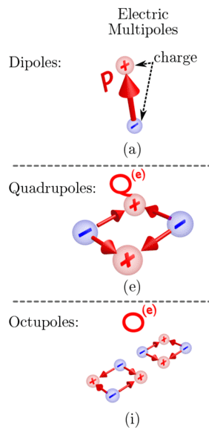
Example #2. A supplemental model for force field creation.
Background: Force fields are the mathematical descriptor behind molecular dynamics simulations. Can be very simple or very advanced in design. Many different varients
Problem: One modern force field model ( MDCM) which has seen great success modeling difficult system requires preliminary calculations for the electrostatic distributions (multipole moments). These calculations scale with the number of atoms.
Our Goal: Create a model that predicts the multipole moments of molecules of varying size and composition.
William Teal
Savinov, Vassili. (2014). Novel toroidal and superconducting metamaterials.

Slide 11
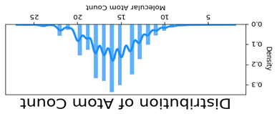
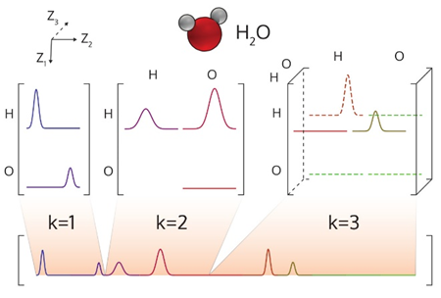
First questions
Generate Data
What level of theory is needed? (HF vs MP2)
How many samples are needed? (1k? 20k?)
Would training multiple models improve performance?
Atomic vs molecular outlook
Same questions as the previous example
How do you encode your information into a format usable by a ML model?
Smooth overlap of atomic positions (SOAP), Atom-centered symmetry functions (ACSFs), or Many Body Tensor Representation (MBTR - seen below)?
William Teal

Slide 12
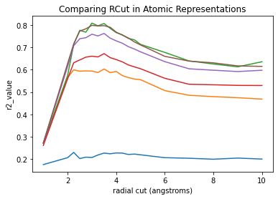
Model vs Featurization
Testing multiple featurizations
Use the same model vary only the featurization
Shows that the MBTR and the ACSF descriptors are the giving us the most accuracy.
Testing multiple models
Use the same featurization vary the model.
Shows that the Random forest model is the most accurate, and peaks with a rcut value of near 4.
 | MBTR | SOAP | ACSF
R² Value | 0.91 | 0.72 | 0.89
Adjusted R² | 0.89 | 0.73 | 0.88

Slide 13
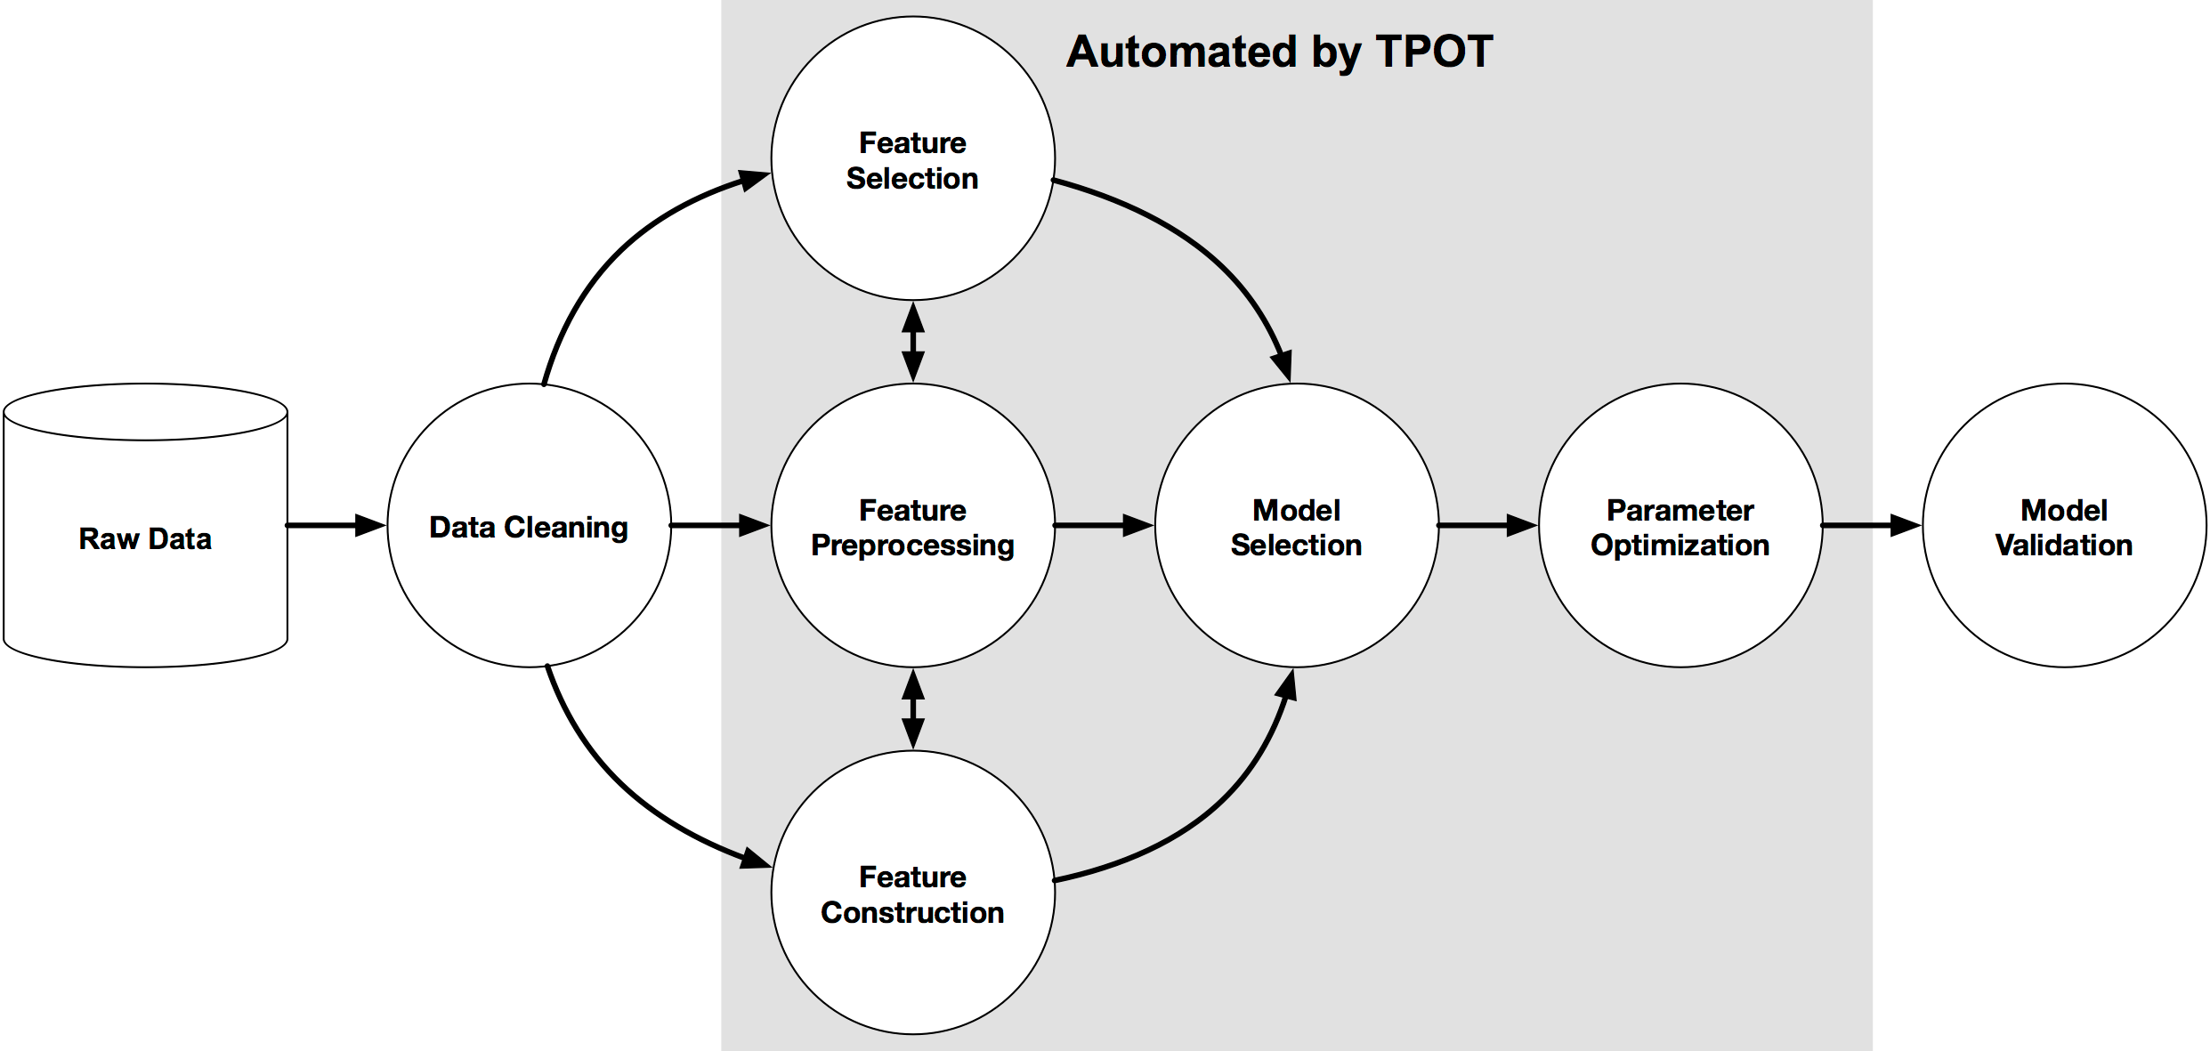
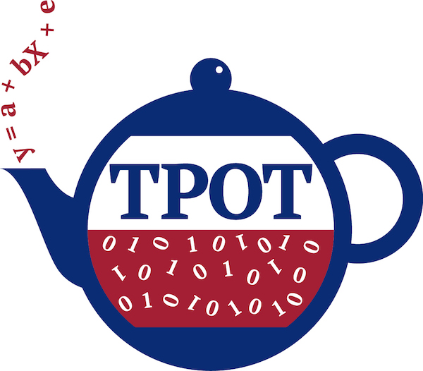
Is there a smarter way of doing this?
There is!
AutoMLs (Automated Machine Learning tools) have seen extensive development in the last 5 years.
Seek to automate the “boring” parts of machine learning.
http://epistasislab.github.io/tpot/

Slide 14
Model revisited using TPOT
Brown – TPOT found random forest model
Green – Our manually created random forest model
Same performance! With only the featurization done manually!

Slide 15
Take Away
Machine learning can be applied to “tangential” problems in Chemistry. Supplementing more traditional methods.
Tried and true methods for optimizing ML models and featurizations are very dependable, but modern solutions to these “problems” are becoming easier to use and more reliable.
In the end our model reproduced the targeted multipole moments with excellent accuracy

Slide 16
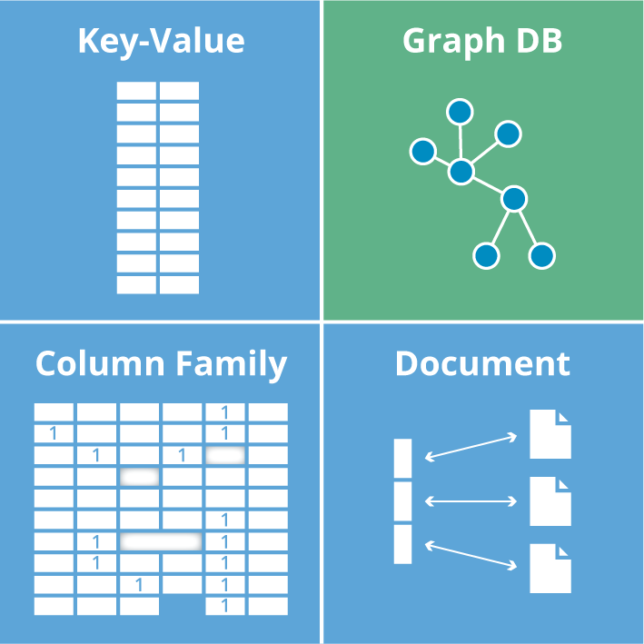
Example #3. Smart databasing in Chemistry
Background: Many new methods and featurization schemes are tested using standardized databases of chemicals (qm7-9, ESOL, Tox21 and many others).
Problem: These databases are only truly accessible by downloading, unpacking, and the formatting the data to your needs. This process is slow and places a large demand on local resources.
Our Goal: Display the flexibility of cloud databasing software for easy access of chemical databases and pre-calculated featurizations.

Slide 17

Why/Which cloud storage?
Advantages
Easy custodial management of data
New entries can be vetted and added quickly
Data can be accessed quickly from anywhere and any type of machine
Disadvantages
Can be costly
Requires internet connectivity
Learning curve
Which architecture to use?
SQL vs noSQL
Key-Value, graph DB, Column Family, or Document based?
Commercial software that offer utility, flexibility, and are cheap/free.

Slide 18
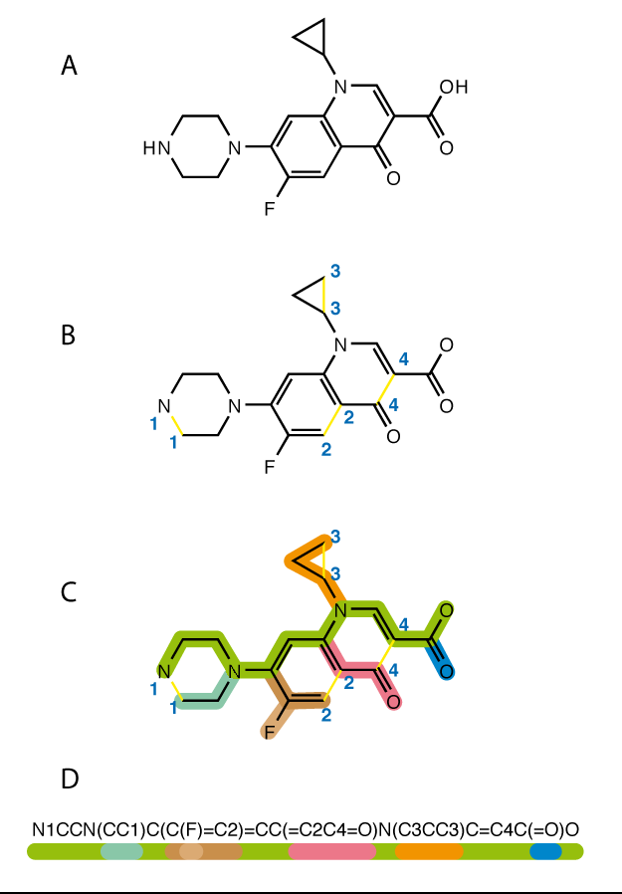
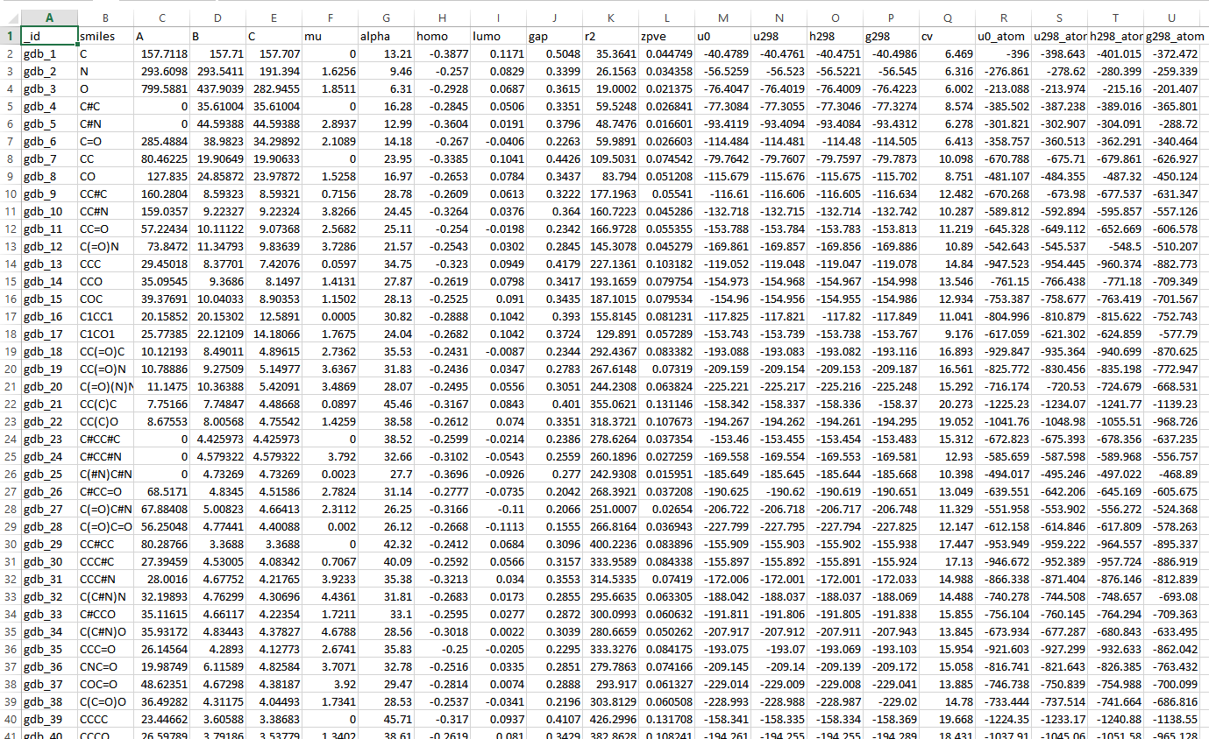
What does our data look like?
ESOL (quantum machine 9) dataset
1.8k organic molecules
Up to 25 atoms per molecule
C, H, N, S, F atoms
Freely available
Include SMILES codes, predicted solvation energy (DeltaE_{solv})

Slide 19
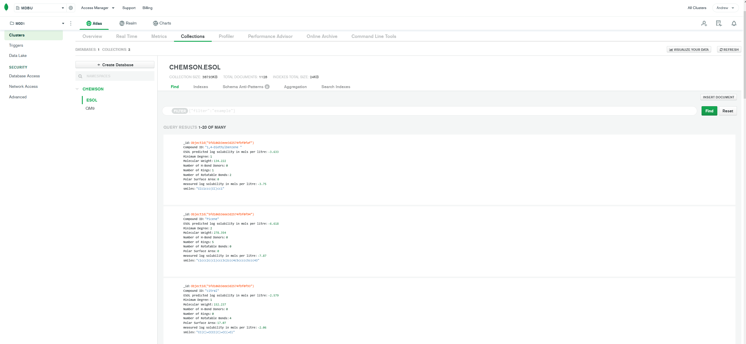

Slide 20
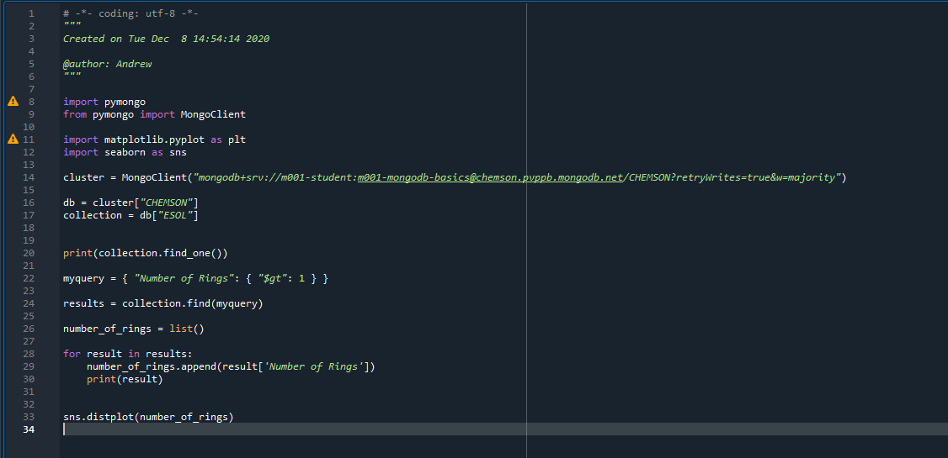
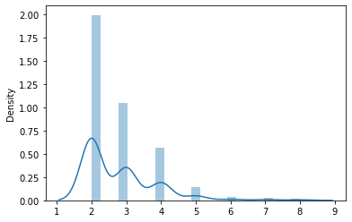
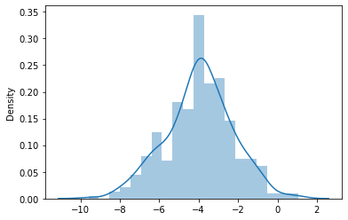
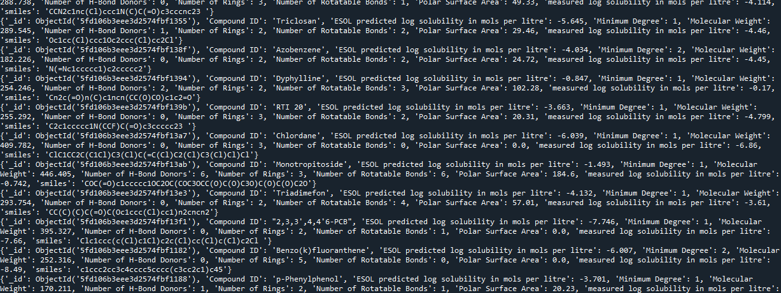
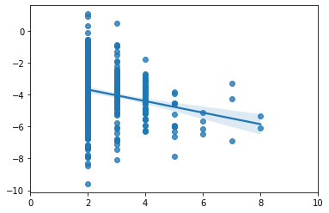
Number of rings
Predicted solvation energy
Is there a base connection?

Slide 21
Take Away
Cloud databasing can enable quick and easy data science on prohibitively large datasets. ESOL is 1.8k, but QM9 which was also looked at was 133K molecules
For Cheminformatics this allows us to skip the featurization step if included in the cloud dataset
Cloud databasing also allows us to curate and query our dataset more easily
Future direction
Interface this querying system with a molecular discovery program (MolDQN, dragoNN, etc)

Slide 22
My Personal Goals
Fulfilling problems to work on
Data centric
Real world impact
Collaborative environment
Responsibility for project direction and methods
My career in the data science field

Slide 23
What can I bring to Gravity?
My Relevant Skills
Big data Analytics
Big data Insights
Create Predictive models to assist in diagnosis, sample processing, or recommendation
Data visualization in real time (powerBI, tableau)
Proposed Projects
Short term: Analyze current data to identify and improve testing processes. Create automated reporting pipeline.
Medium term: Apply bleeding edge deep learning methods to next gen sequencing (NGs).
DeepVariant (Google)
Long term: Create predictive models to assist in patient medication recommendations.

Slide 24
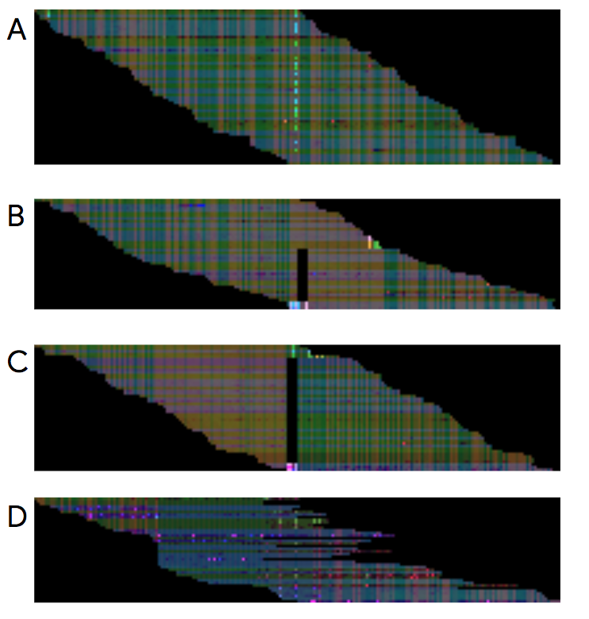
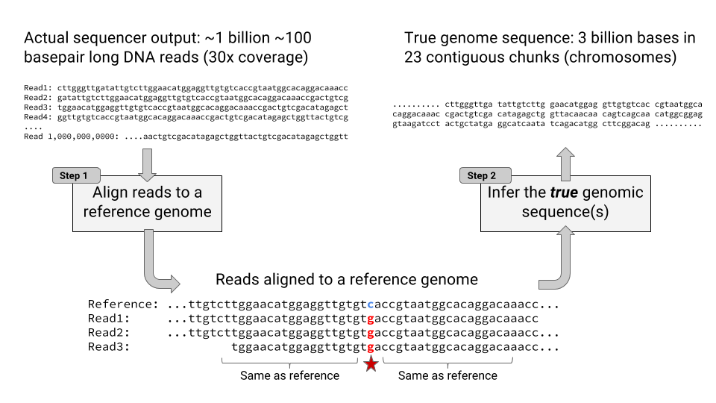
Medium term: Apply bleeding edge deep learning methods to next gen sequencing (NGs).
DeepVariant (Google)
Using Convolution and Deep Learning to increase variant identification accuracy
https://google.github.io/deepvariant/posts/2020-02-20-looking-through-deepvariants-eyes/
https://ai.googleblog.com/2017/12/deepvariant-highly-accurate-genomes.html

Slide 25
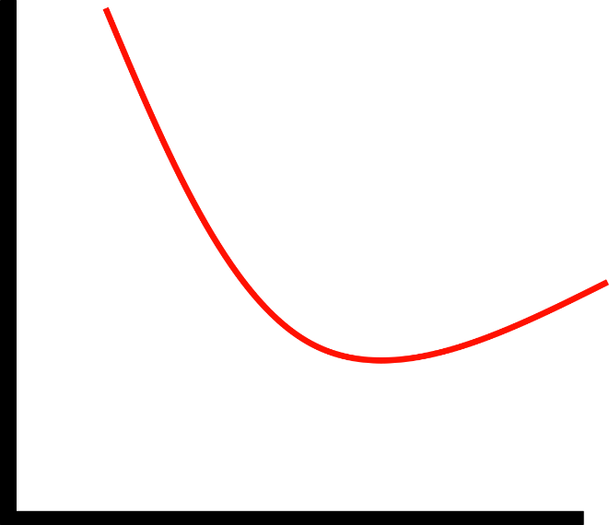
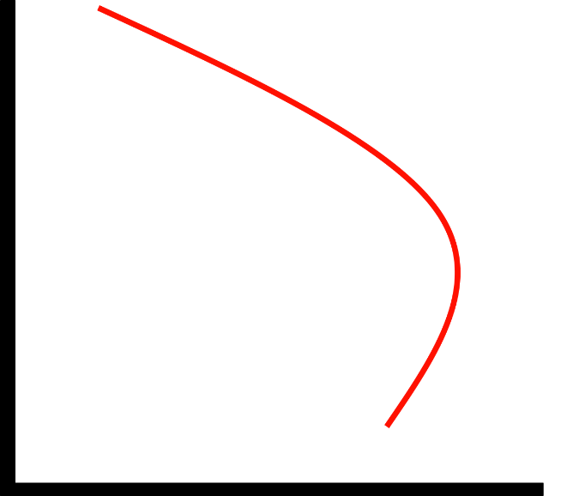

Training Population
Long term: Create predictive models to assist in patient medication recommendations.
Patient 1
Classifier model
for
Patient Data
Patient 2
Patient 3
Drug A
Patient 4
Patient 5
Training Dataset
Classifier model
for
Drug B
Genetic Information
Genetic testing
Ineffective
Ineffective
Test Population
Drug A
Drug B
New Patient
Variable y
Variable y
Effective
Effective
Variable x
Variable x
Result: Recommend Drug B but not A to the new patient

