Slide 1
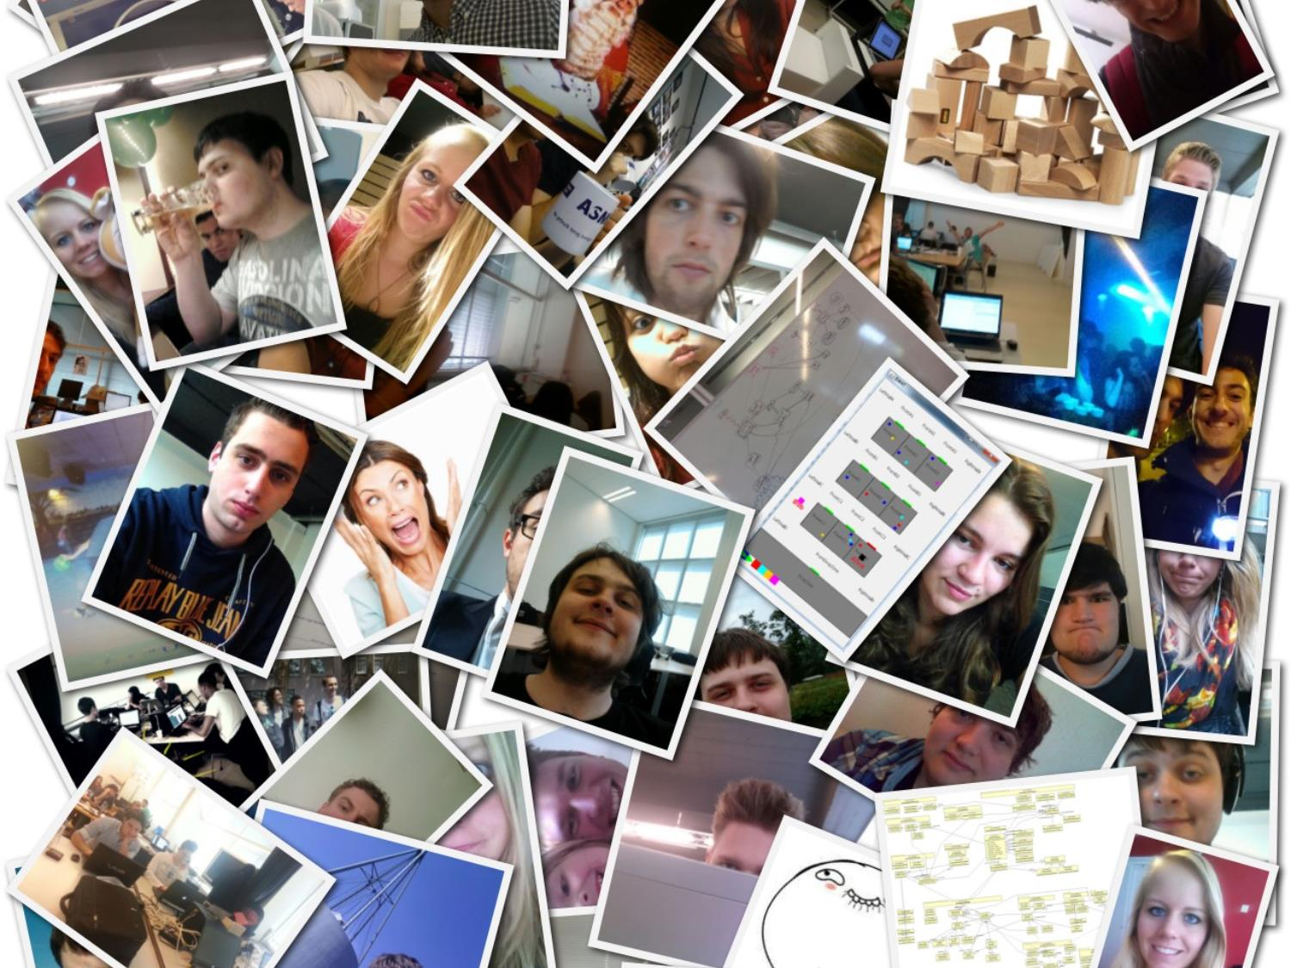

A Search and Rescue Mission
Context Project 2014
Everything's awesome, everything's cool when you're part of a team
Notes:
Tell about 19 students 1 group, working with team is awesome

Slide 2
Overview
Daniël Swaab
Situation
Refactor
Extend

Slide 3
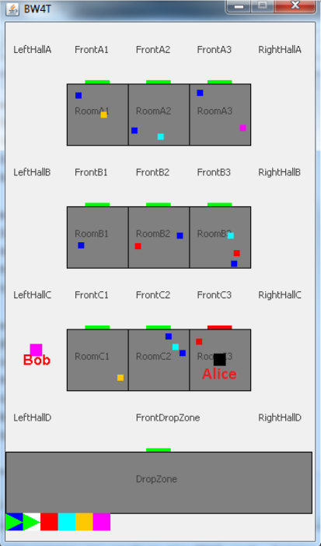
Everything's awesome, everything's cool when you're part of a team
  Structure:
  19 students
  1 team
Situation
Situation
Refactor
Refactor
Extend
Existing code base: BW4T
Extend

Slide 4

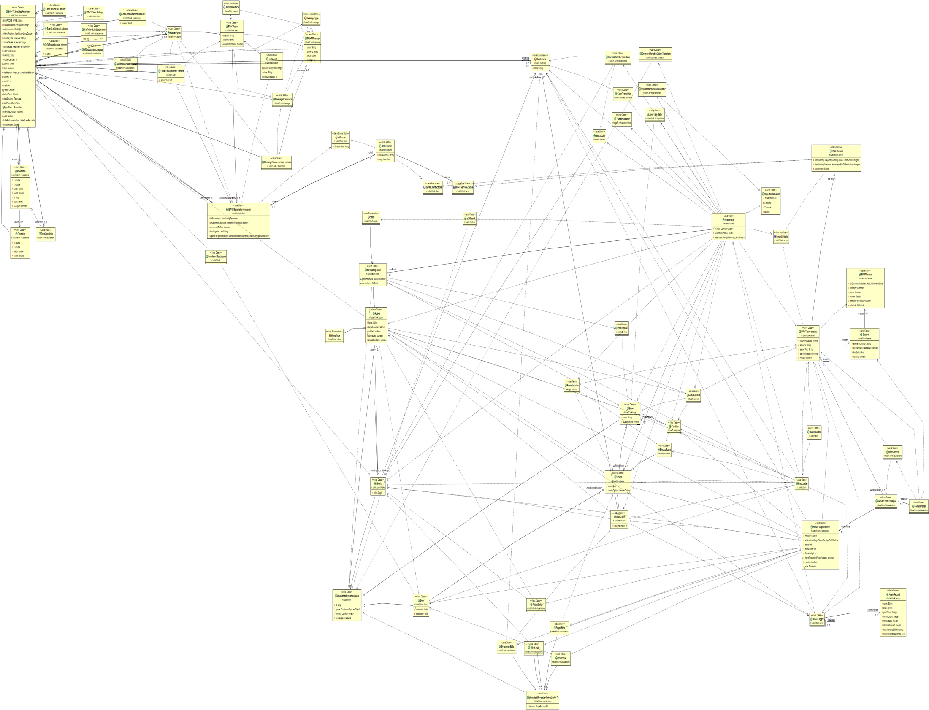
Concept: Crisis managment
Existing code base: BW4T
  1 Program
  5500 lines of code
  0 tests
Features:
  Pick-up/drop blocks
  Walk
  1 map
  1 type robot
  No robot-human interaction
Situation
Situation
Refactor
Refactor
Extend
Extend
Increase realism

Slide 5
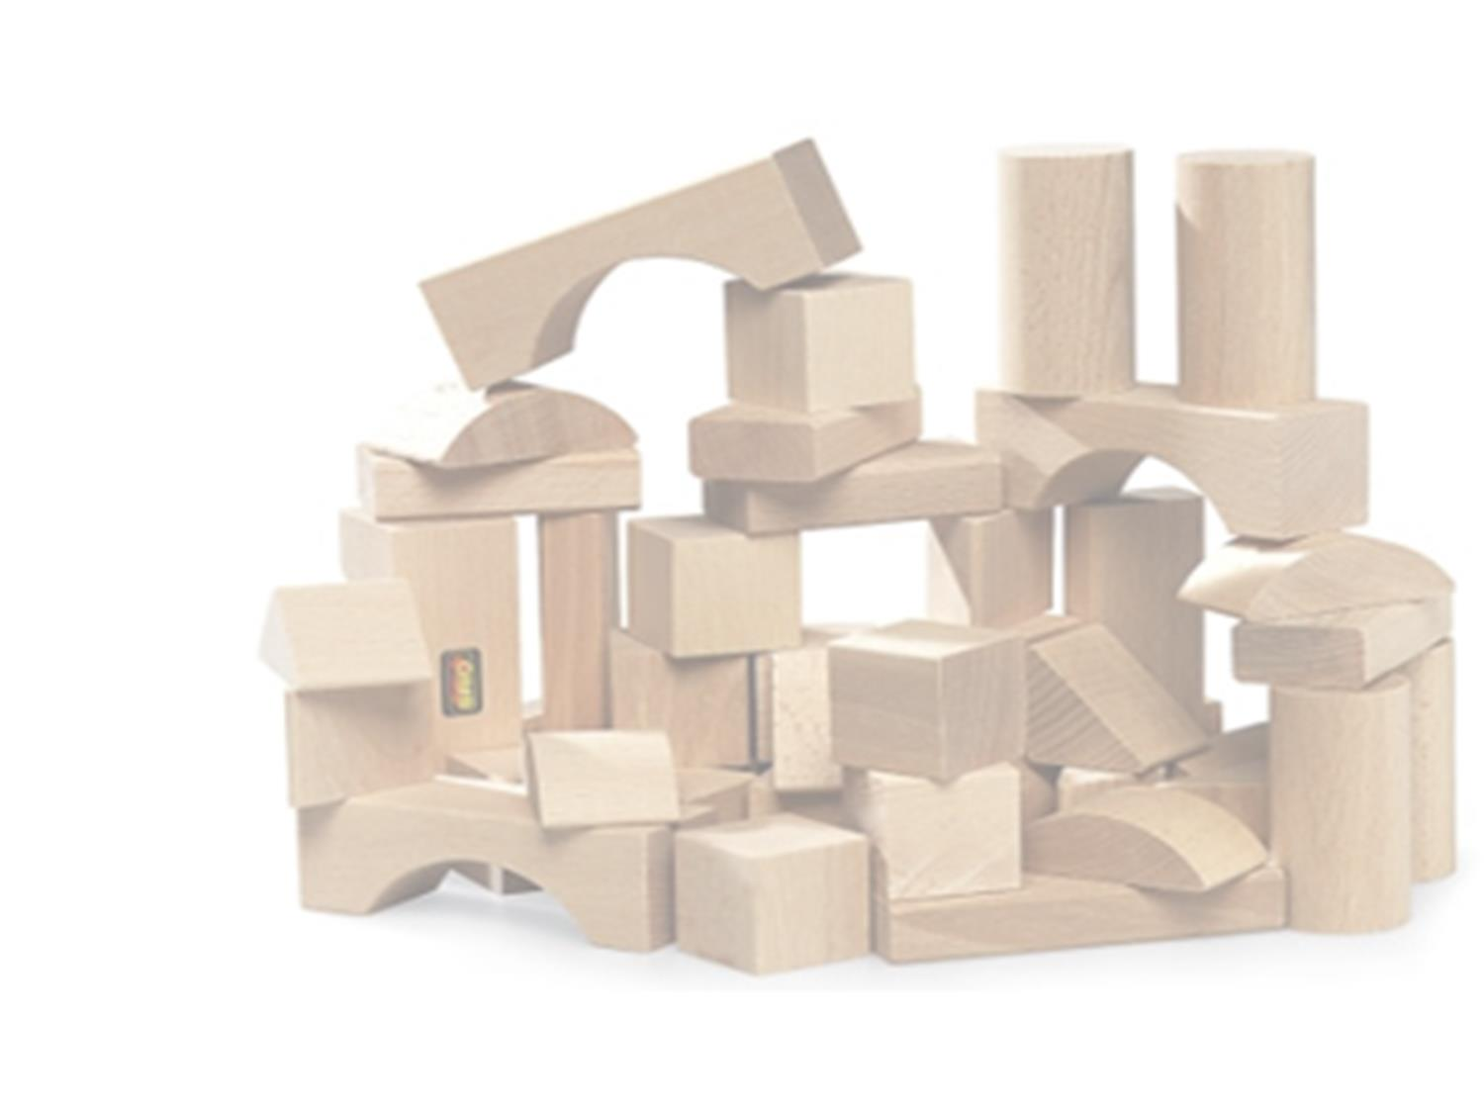
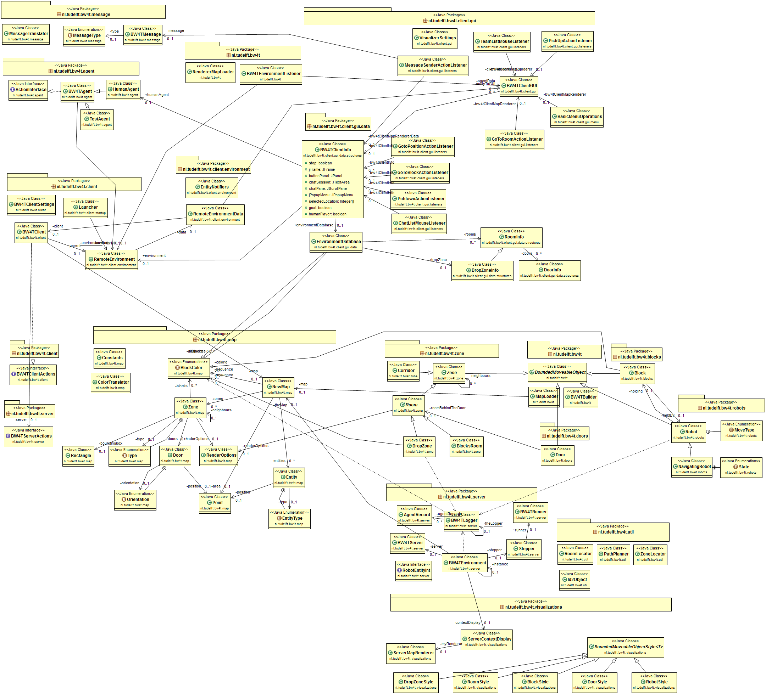
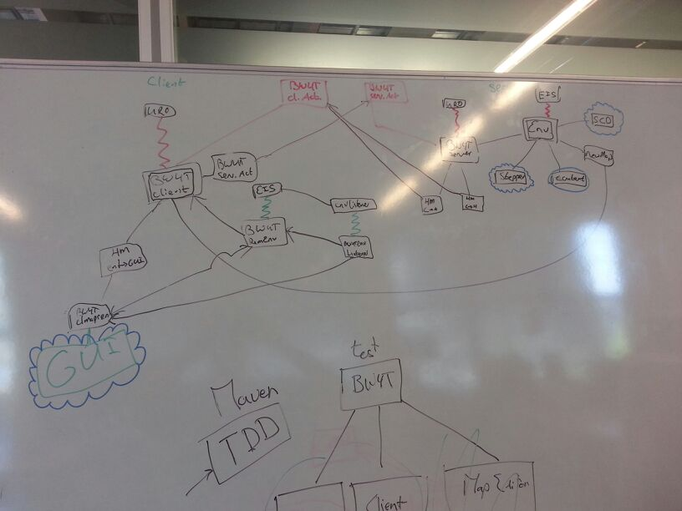


Exploration
Situation
Refactor
Extend

Slide 6
Imrpovement
  Tests: 0% -> 50 % line coverage
  Issues 650 -> 400
  Couplling
  Cohesion
  …
  (increase of line code by 300%)
Situation
Refactor
Extend

Slide 7

Environment store
Situation
Refactor
Extend

Slide 8
Scenario editor
Robot
Situation
Refactor
Extend

Slide 9
Bot editor
Epartner
Situation
Refactor
Extend

Slide 10
Human player gui?
Situation
Refactor
Extend

Slide 11
Last slide idea
1 Project
19 students
7 sprints
7 taarten
2 uur bowlen
Gestuurd mails naar de klant, coordinatoren en personen voor vragen. 119
Ontvange mails naar de klant, coordinatoren en personen voor vragen. 111
Commits: 2198
Tests: 747
Lines of code: 18,856
Pull requests:217
All nighters : 8
Notes:
We hadden het al over 1 project, 19 studenten en 7 weken, maar verder zijn er nog x-

Slide 12
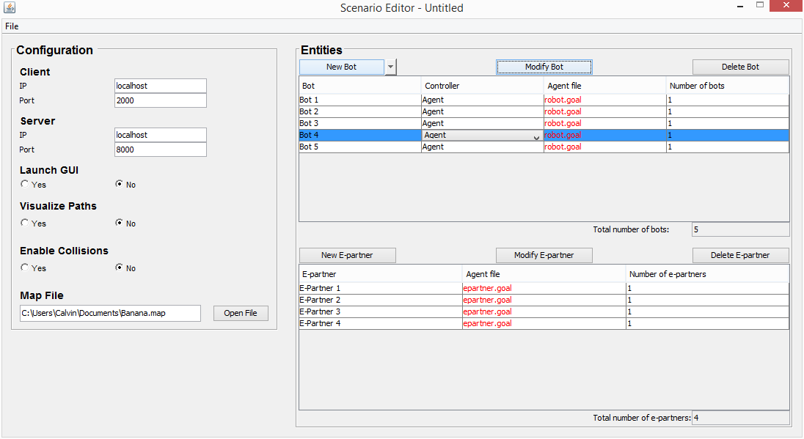
Scenario Editor
Notes:
Quickly mention the map and then go to environment store
But that ain’t all! (YEE-HAW) We wanted more than this boring map we see all the time. What if you were able to modify this map, and modify it entirely? There it is: the Environment Store.
Time: ~30 seconds.

Slide 13
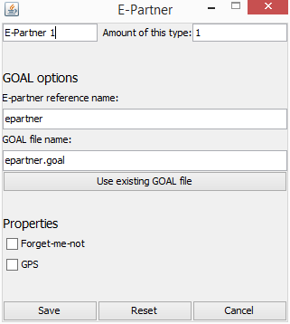
Epartners
Lame pickups
I really don’t know what else we could add here.
Notes:
Epartners…
Time: 1.5 min

