Slide 1
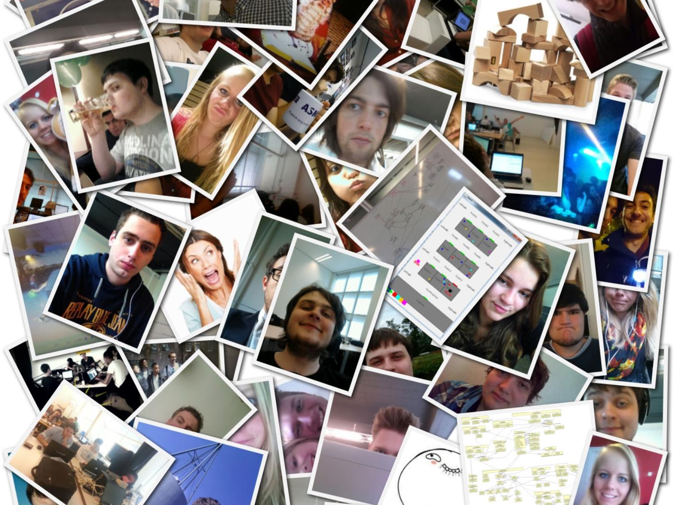

A Search and Rescue Mission
Context Project 2014
Everything's awesome, everything's cool when you're part of a team
Notes:
Tell about 19 students 1 group, working with team is awesome

Slide 2
Overview
Daniël Swaab
Situation
Refactor
Extend

Slide 3
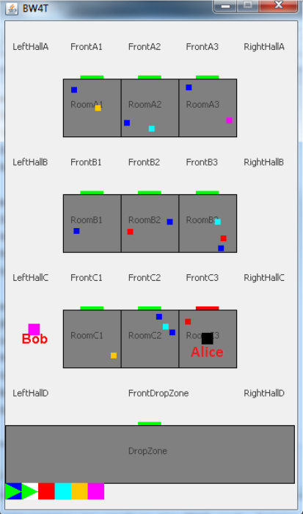
Everything's awesome, everything's cool when you're part of a team
  Structure:
  19 students
  1 team
Situation
Situation
Refactor
Refactor
Extend
Existing code base: BW4T
Extend

Slide 4

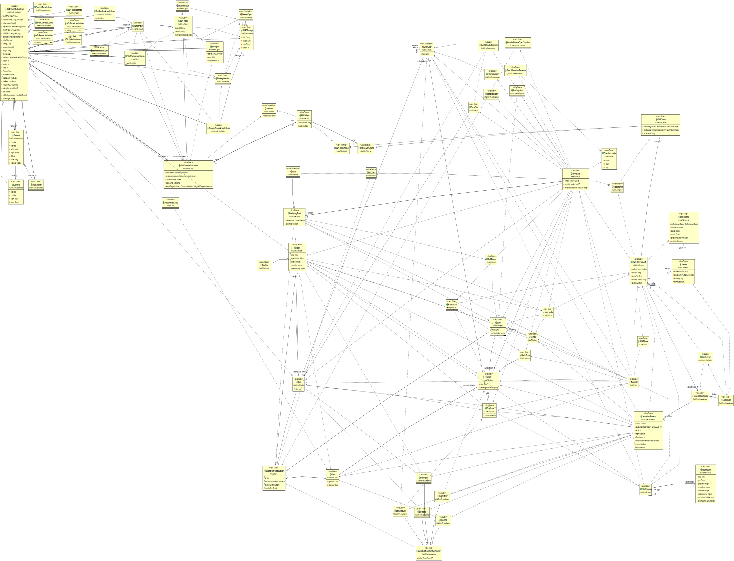
Concept: Crisis managment
Existing code base: BW4T
  1 Program
  5500 lines of code
  0 tests
Features:
  Pick-up/drop blocks
  Walk
  1 map
  1 type robot
  No robot-human interaction
Situation
Situation
Refactor
Refactor
Extend
Extend
Increase realism

Slide 5
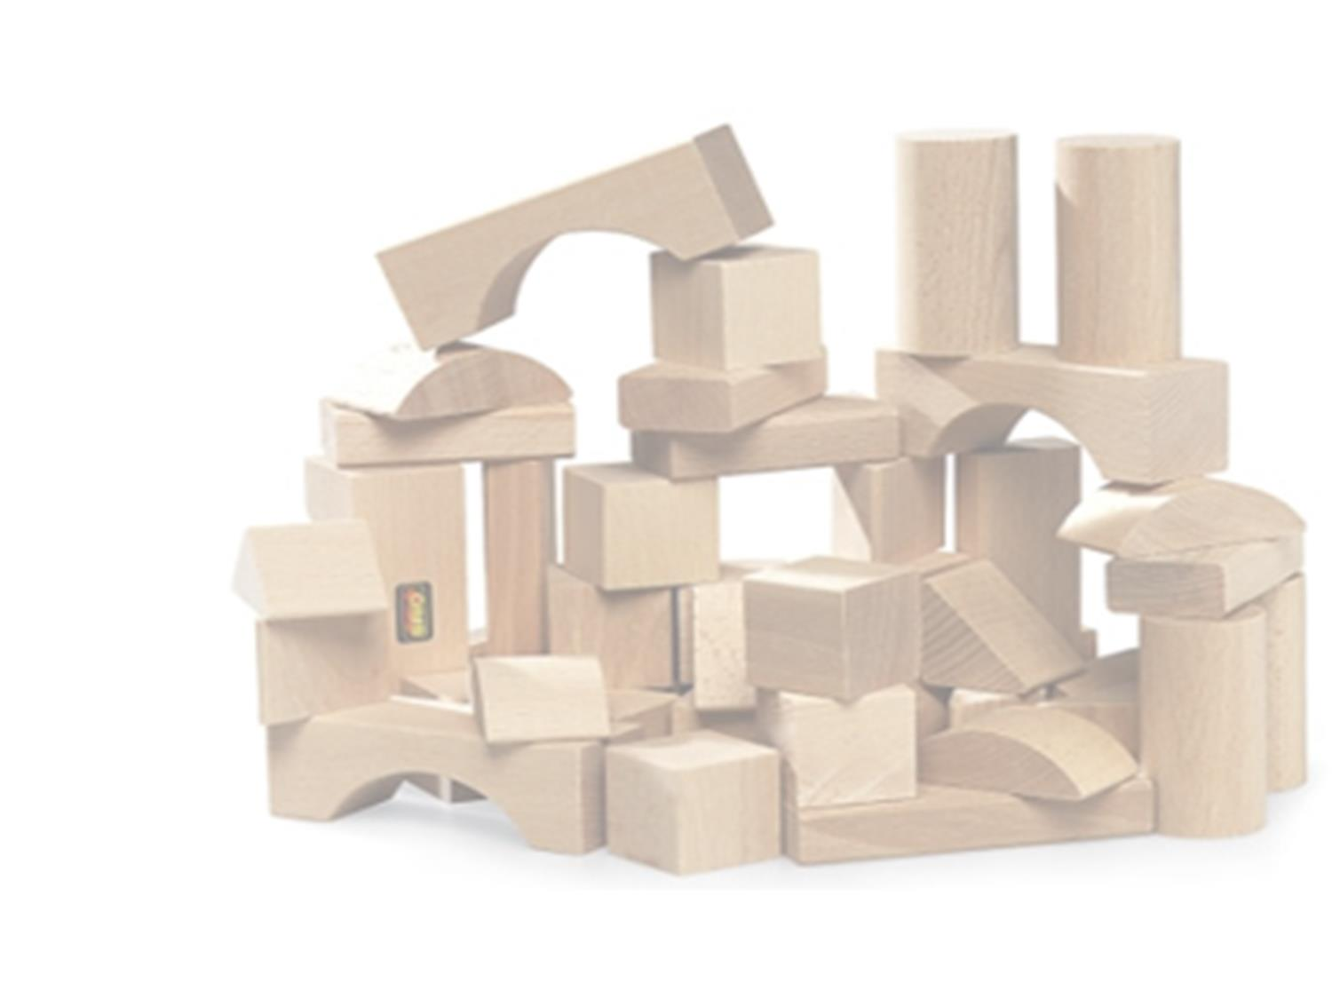
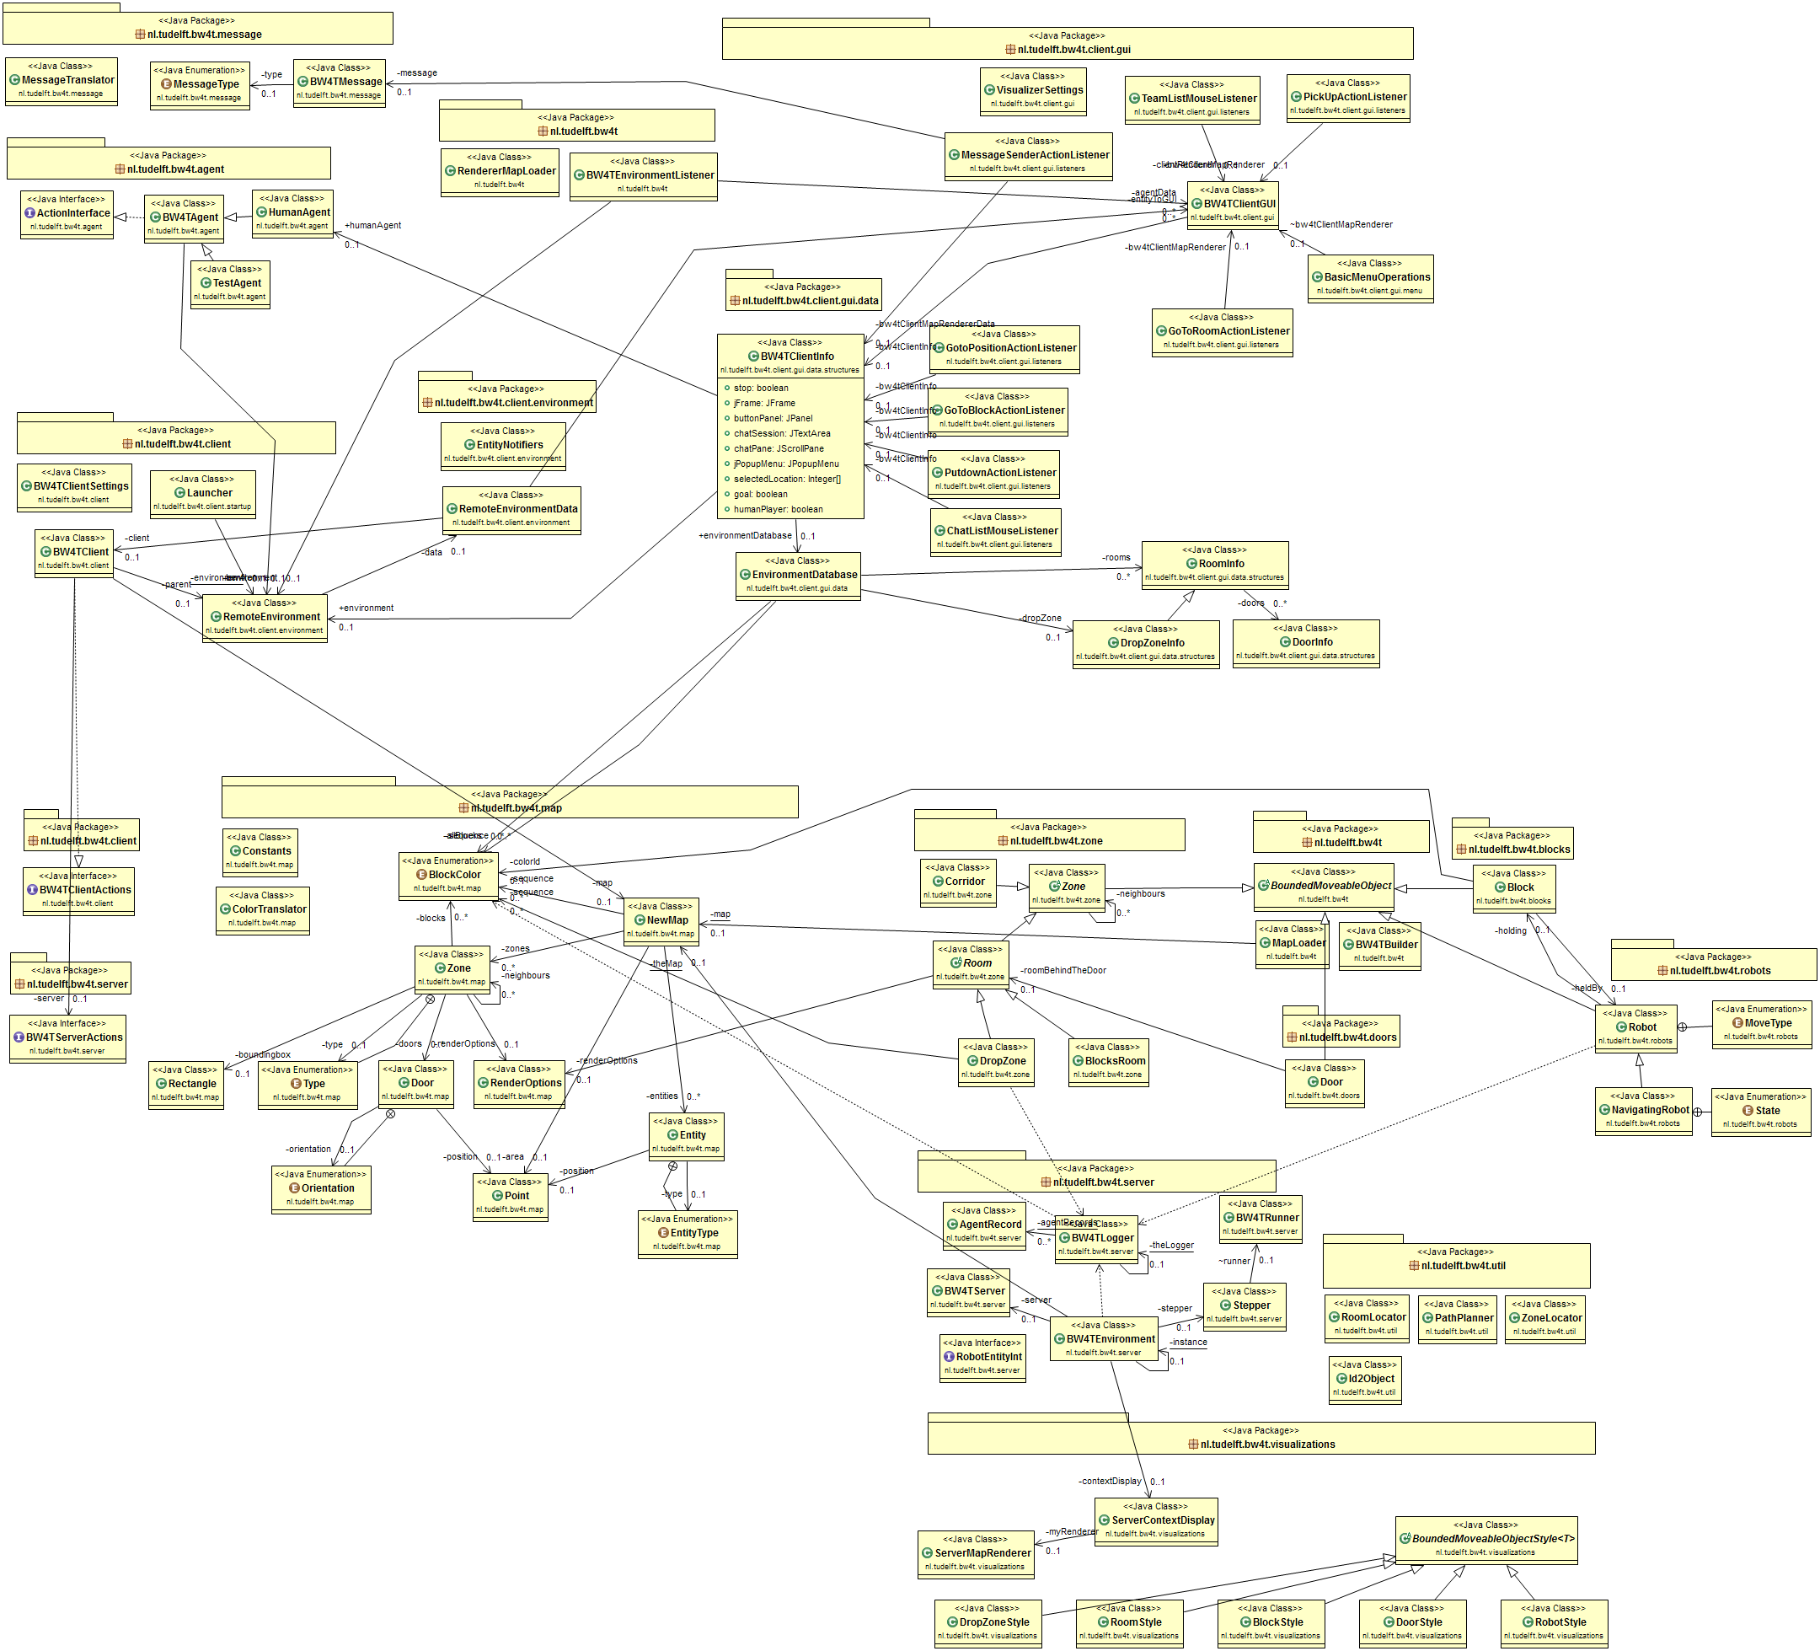
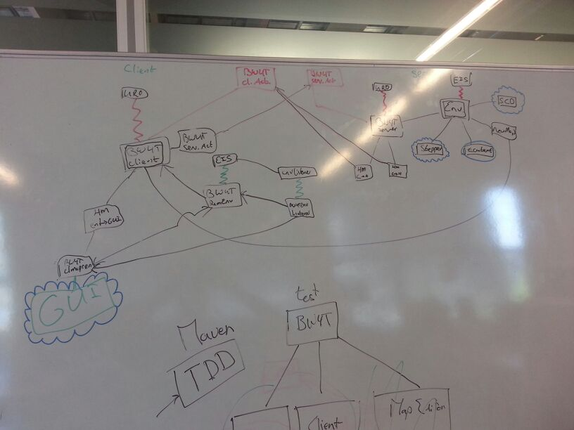


Exploration
Situation
Refactor
Extend

Slide 6
Imrpovement
  Tests: 0% -> 50 % line coverage
  Issues 650 -> 400
  Couplling
  Cohesion
  Complexity
  (increase of line code by 300%)
Situation
Refactor
Extend

Slide 7
Developed features
Scenario editor
  Bot editor-> handicaps
  Epartners->
Environment store
Pathfinding
Situation
Refactor
Extend
Notes:
Just the main features of the scenario editor. Don’t go too deep into the botstore functionality!
Ramble about the ease of use, especially how we used the personas and in the end did used tests based on these personas. But keep it short.
Mention the sending of the saved configuration file to the server, the exporting to mas, and the ability to reload a scenario.
TIME: ~ 2 mins.

Slide 8
Scenario Editor
Ease of use
Configure the connection parameters
Add, modify and delete bots & e-partners
Saving and loading scenario’s
Export to MAS2G project.
Fully integrated with the BW4T server and client.
Situation
Refactor
Extend
Notes:
Just the main features of the scenario editor. Don’t go too deep into the botstore functionality!
Ramble about the ease of use, especially how we used the personas and in the end did used tests based on these personas. But keep it short.
Mention the sending of the saved configuration file to the server, the exporting to mas, and the ability to reload a scenario.
TIME: ~ 2 mins.

Slide 9
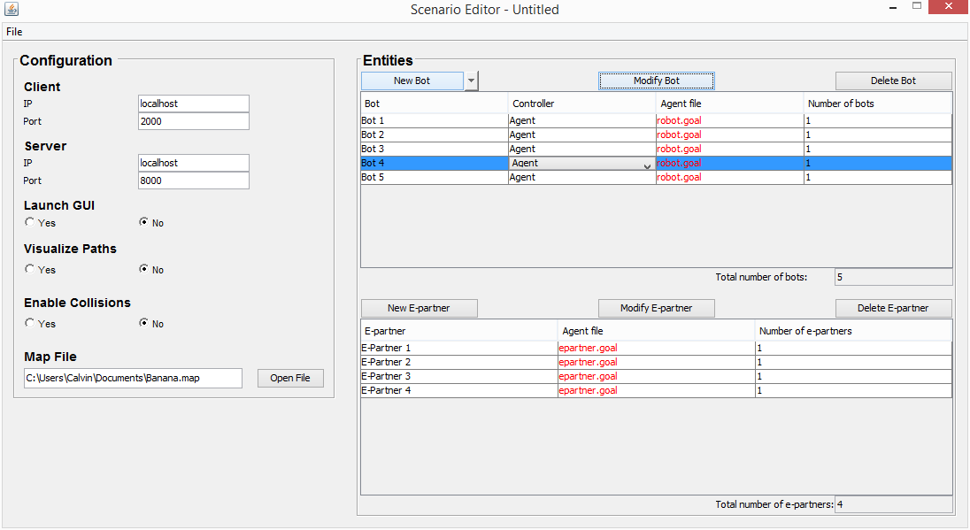
Scenario Editor
Notes:
DÉJÀ VU? That’s true! But it’s epartner time now. Not sure what to say? Just vaguely explain the idea.
Time: ~30 seconds.

Slide 10
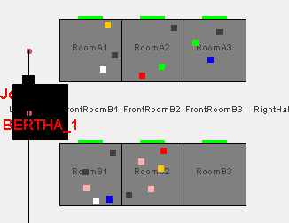
Bot Editor
Allows for the customization of the bots
Handicaps:
  Size
  Speed
  Gripper
  Battery capacity
  Colour blindness
  0
Situation
Refactor
Extend
Notes:
BOTSTORE:
Quicky go through the list, clicking as you go, or else I made the animation for nothing.
Suppose you are a bunch of researches in that specific domain. I mean – what would be the first thing you’d want to have made available for use? Wouldn’t it be nice to be able to customize your robots a little, instead of having this boring plain robot that runs around like an idiot?
Well, congratulations! We have designed a way to add different capabilities to our little robots, capabilities that enhance the robots’ abilities, as well as improve the physical realism of the system. There it is: the decorator pattern. I’d like to assume I do not need to explain what this design pattern entails…
Hypothetically, making robots better is always fun, but as the bunch of researchers that you are, you want to have realistic results from your observations. Let’s say you want to simulate a failing robot, no need to worry! We have added a couple of “handicaps”, if we can put it that way, such as too big, too small, too fast, too slow, no gripper (basically too retarded to pick up blocks), etc…
Ok, we have spoken of robots and making them better (or worse).
Go back to the scenario editor overview.
TIME: 2 mins max
But that ain’t all! (YEE-HAW) We wanted more than this boring map we see all the time. What if you were able to modify this map, and modify it entirely? There it is: the Environment Store.

Slide 11
Scenario Editor
Situation
Refactor
Extend
Notes:
Quickly mention the map and then go to environment store
But that ain’t all! (YEE-HAW) We wanted more than this boring map we see all the time. What if you were able to modify this map, and modify it entirely? There it is: the Environment Store.
Time: ~30 seconds.

Slide 12
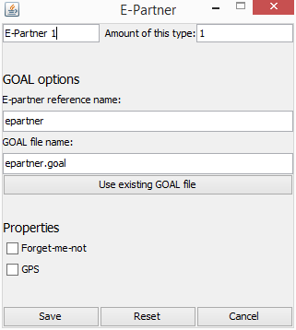
Epartners
Situation
Refactor
Extend
Notes:
Epartners…
Time: 1.5 min

Slide 13

Scenario editor
Situation
Refactor
Extend

Slide 14
Environment store
Situation
Refactor
Extend

Slide 15
Human player gui?
Situation
Situation
Refactor
Refactor
Extend
Extend

Slide 16

Pathfinding

Slide 17
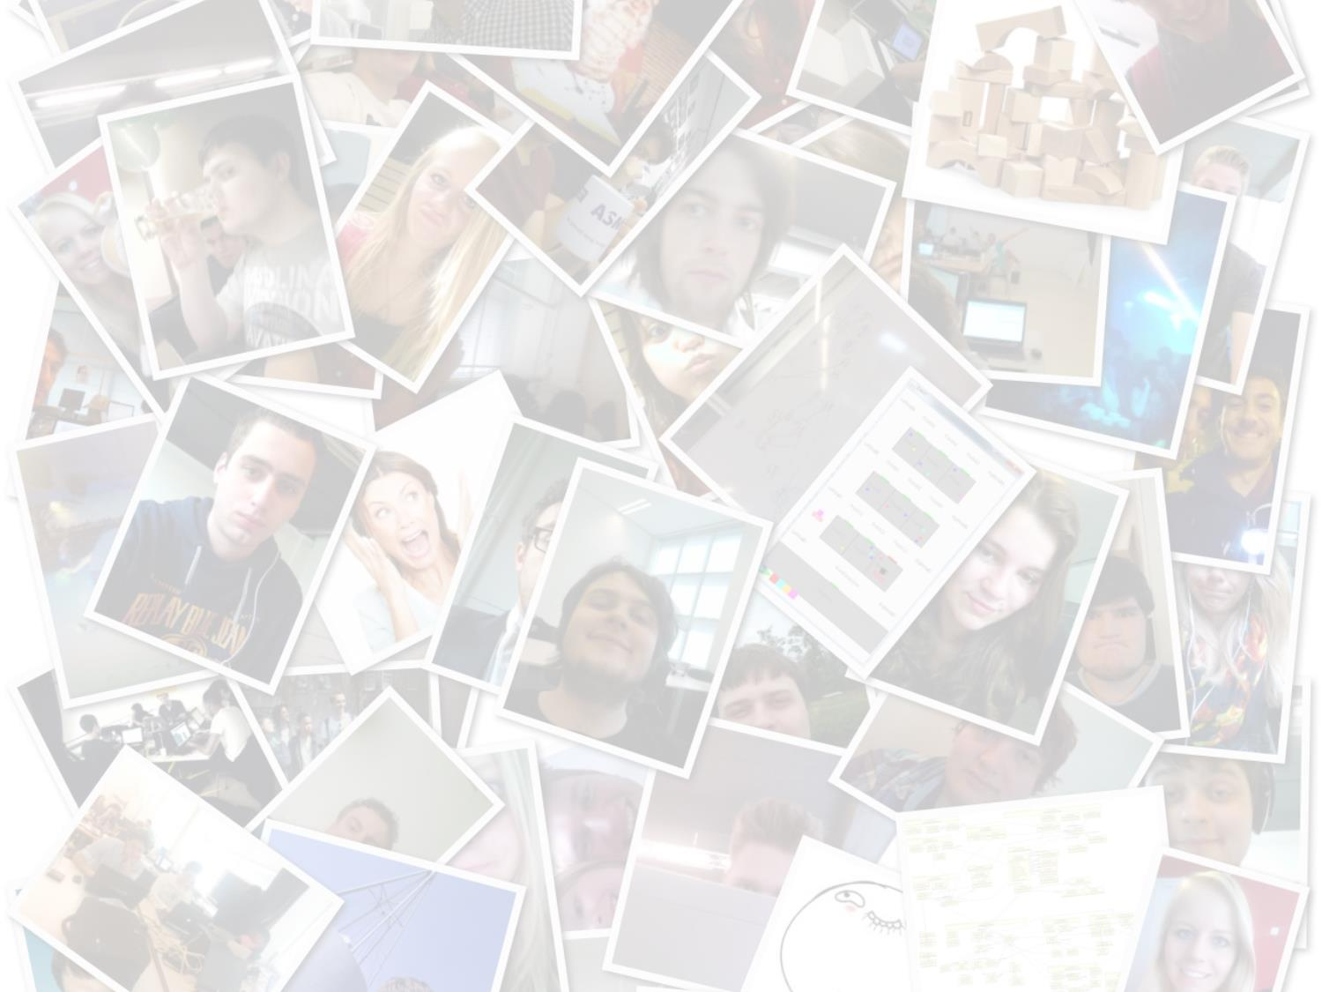
At this moment
1 Project
19 students
7 sprints
7 taarten
2 uur bowlen
119 Gestuurd mails
111 Ontvange mails
Commits: 2198
Tests: 747
Lines of code: 18,856
Pull requests:217
All nighters : 8
Notes:
We hadden het al over 1 project, 19 studenten en 7 weken, maar verder zijn er nog x-

