Slide 1
RECAP
Project Structure
Linked Folders
SW1/Fr
Marco Bürgi, Pascal Giger
Intro HS14

Slide 2
Project Structure - «Structure is anything»
motivation
easier to read
reuseable
easier to understand
separated

Slide 3
Project Structure
Header and Source Files
Include
I2C.h
Application.h
Source
I2C.c
Application.c

Slide 4
Common Files
Share Files between developers and projects
Master-Slave Project
Copy Project
Library Project

Slide 5
Copy Project
Master-Slave
Library Project
Project A
Source
main.c
Shared
I2C.c
I2C.h
Led.h
Led.c
Project B
Source
main.c
Shared
I2C.c
I2C.h
Led.h
Led.c
Project A
Source
main.c
…
Shared
I2C.c
I2C.h
Led.h
Led.c
…
Project B
Source
main.c
…
Library
Include
I2C.h
Led.h
src
I2C.c
Led.c
Project A
Source
main.c
…
…
Project B
Source
main.c
…

Slide 6
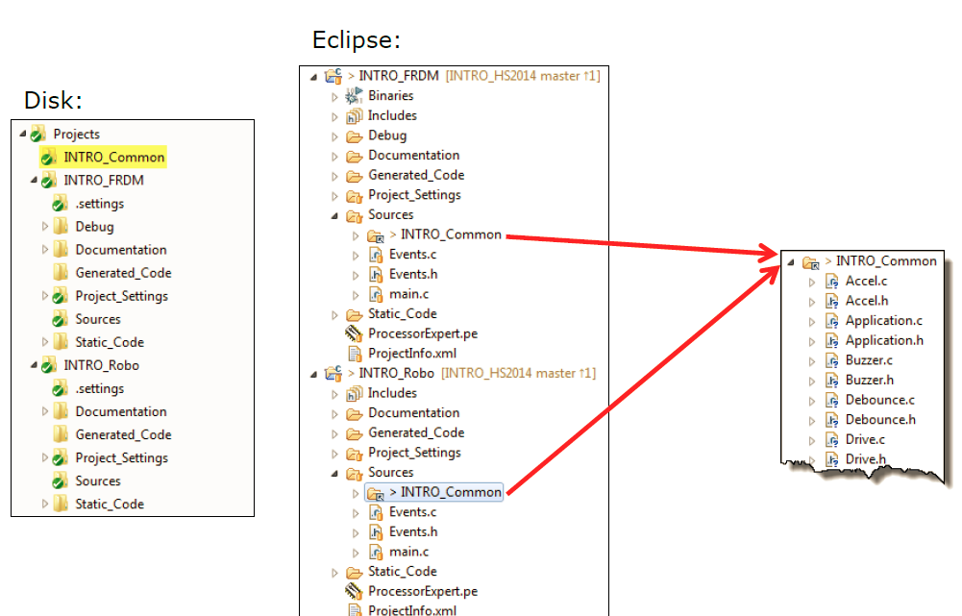
Common Folders with Link

Slide 7

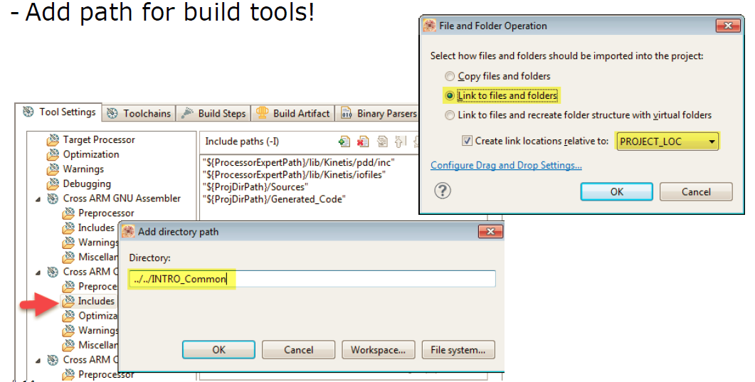
Eclipse: Linked Folder
Important: use a relative location
Create with: rightclick on project folder > properties
> C/C++ Build > Cross ARM C Compiler

Slide 8
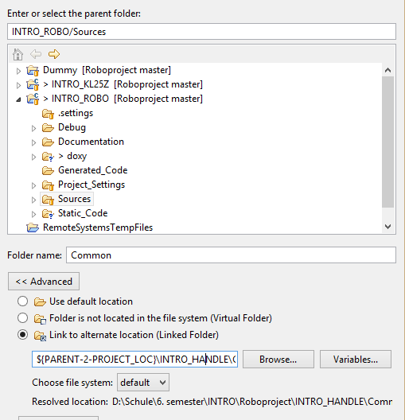
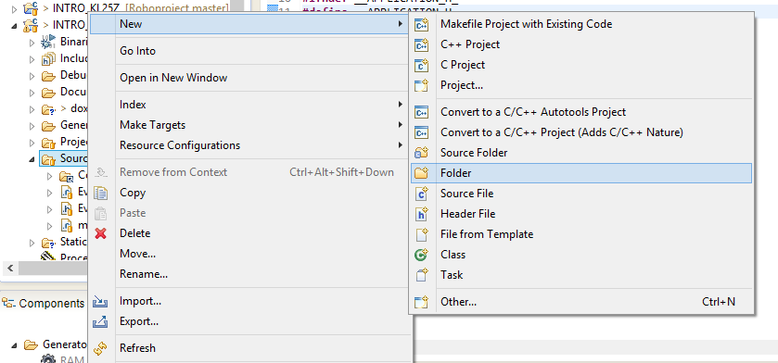
Eclipse: Linked Folder
Important: use a relative location as well

Slide 9
Eclipse: Linked Folder
Always use relative locations for shared linked folders
The following elements can be use for relative locations
../ - once per step
path variables ${PARENT-2-PROJECT_LOC} , ${PARENT-1 PROJECT_LOC}, ${PROJECT_LOC}
Create own path variables in:
project properties > Resources > Linked Resources > Path Variables

Slide 10
Questions
Which type of common files is used if all files should be stored at the same place?
Library Structure
Which type of common files have the disadvantage that changes need an be done in more than one file?
Copy Structure
name three reasons why project stould be structured?
easier to read
reusability
easier to understand

Slide 11
Questions
What do you need to add in the relative project location to move up one step in the folder directory?
../
${PARENT-1 PROJECT_LOC}
What happens if you share datas while use absolut project locations?
If your friend tries to compile he will have some troubles, if he don’t have exaclty the same path for the location

