Slide 1
RECAP
Project Structure
Linked Folders
Marco Bürgi, Pascal Giger
Intro HS14

Slide 2
Project Structure - «Structure is anything»
Motivation
bessere Lesbarkeit
Wiedeverwendbarkeit
einfacher verständlich
separiert

Slide 3
Project Structure
Header and Source Files
Include
I2C.h
Application.h
Source
I2C.c
Application.c

Slide 4
Common Files
Share Files between developers and projects
Master-Slave Project
Copy Project
Library Project

Slide 5
Copy Project
Master-Slave
Library Project
Project A
Source
main.c
Shared
I2C.c
I2C.h
Led.h
Led.c
Project B
Source
main.c
Shared
I2C.c
I2C.h
Led.h
Led.c
Project A
Source
main.c
…
Shared
I2C.c
I2C.h
Led.h
Led.c
…
Project B
Source
main.c
…
Library
Include
I2C.h
Led.h
src
I2C.c
Led.c
Project A
Source
main.c
…
…
Project B
Source
main.c
…

Slide 6
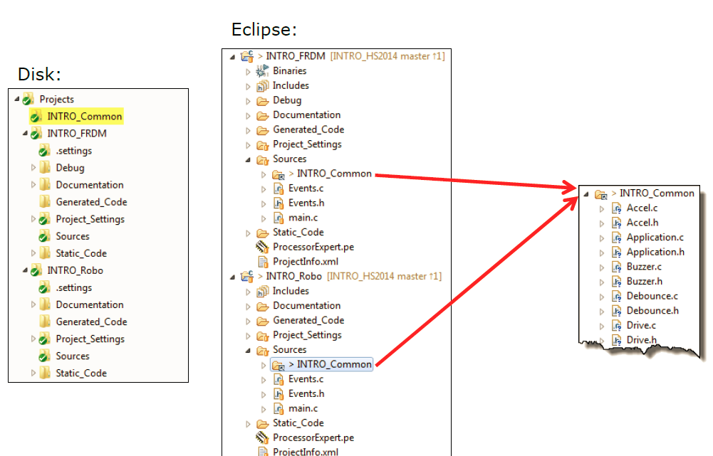
Common Folders with Link

Slide 7

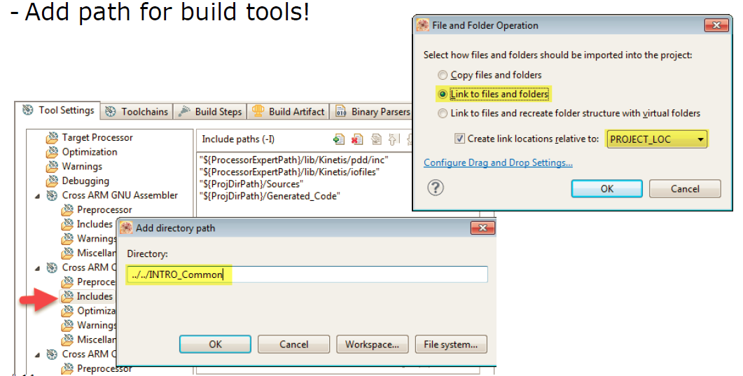
Eclipse: Linked Folder
Wichtig: relative Location angaben

Slide 8
Questions
Welche Art von Common Files ist geeignet wenn man alle Files an einem Ort halten möchte?
Welche Art von Common Files birgt den Nachteil das Änderungen mehrfach gemacht werden müssen?

