Slide 1
Who is the most multitasking person in the world?

Slide 2

Notes:
Answer is here. Yes absolutely. Yes it is Mommy.
I am also one of the multitasking moms. Studying in Phd and taking care of my family. I have 2 sons. One is nine years old, another one is 2 years old. When I thinking about the problems yesterday, the problems related my family came into my mind firstly. There are so many problems. From those I have chosen one problem related to the urban mobility. Which is carrying children from home to school or vice versa in a secure way. The most common option is that parents drive for carrying their children.

Slide 3
Problems
Spending time and money
Traffic jam
Emitting smokes …
Notes:
To do this, we spend much time and money. Moreover, If every family has a car for this purpose. It absolutely contributes traffic jam and air pollution. To solve that problem, I would like to develop mobility sharing online platform for parents.

Slide 4
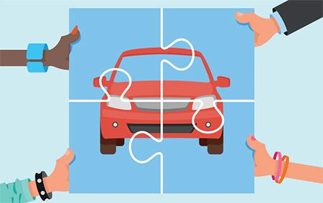
Mobility sharing online platform for parents

Slide 5
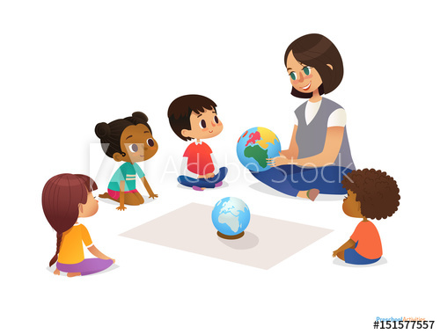
Mobility sharing online platform for parents
Same route
Education
Personal characteristic
Vehicle condition and etc.
Extensions
Sharing for nursing
Sharing duty for taking care of babies in the playground
Sharing their though
Teaching something each other such us cooking,
manicuring , computer skills
Notes:
To do this, they should find someone from this platform based on some criteria.
It is clear that the first criterion is same route from home to school or vise versa. Then might be …
I think 4 family is perfect for sharing their duties. They may switch this duty by a week. In this case, one family drive for carrying a week per month.
That is the main function of that platform. Maybe this platform can be extended in a different way. The mothers can take care their babies when they are going out for shopping, excising, studying and so on. In this case, They can find suitable partners from this platform. When going out, they left partner’s home. Next time, they can switch.
For example in next Sep, My family will settle in Budapest. My youngest son is 2 years and 3 months old. But kindergarten starts from 3 years old and we can’t afford private nursing service. My husband is also studying in Budapest. In this case, we are trying to find out solutions. If there is this kind of online platform, maybe we can find another student family. We can make schedule for taking care of babies. Also it is very mutual beneficial. It is better for kids development. They can play each other. It is better than playing parents. They can develop each other their own pace.

