Slide 1

Natural language processing – Classifying Disaster tweets
Ei Tanaka
Erika Pham
Jonathan Schild

Slide 2
Overview of Content
Competition Background
Data Preprocessing
Modelling & Analyses
Baseline Model – Ridge Classification
RNN
Pretrained language models – RoBERTa, DistilBERT, ELECTRA
Improvements
References

Slide 3
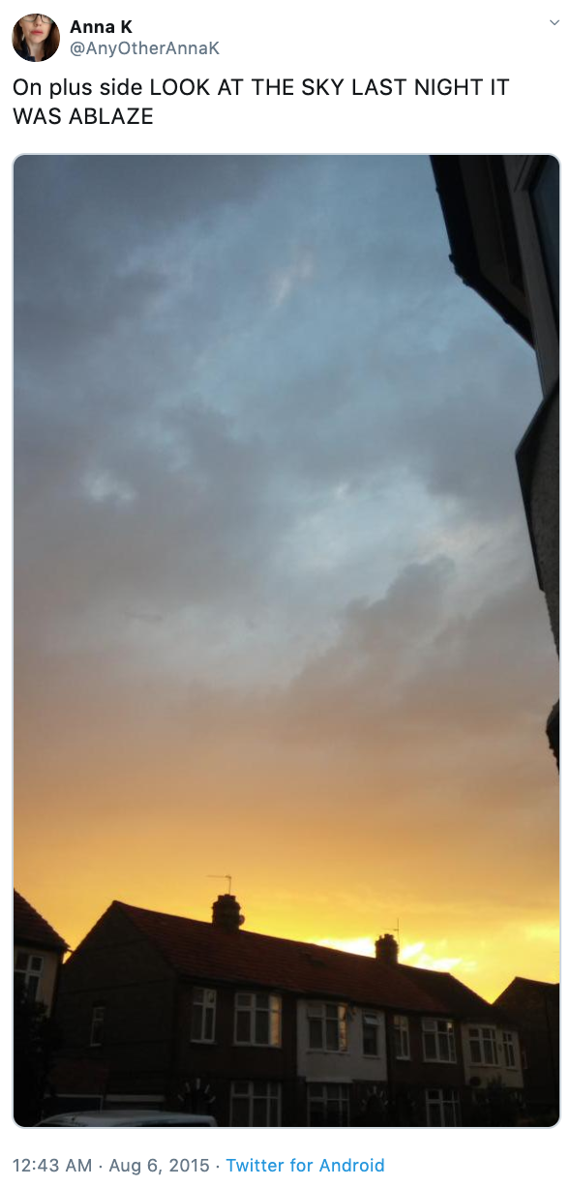
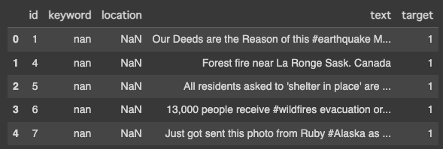
Competition background
Disaster Tweets Datasets
Features: 3 main features for each Tweet (Text, Keywords, and Location)
Target: Binary Class label denotes whether a tweet is about a real disaster (1) or not (0)
Table 1: The first 5 rows with 3 features and 1 target of Disaster Tweet datasets
- The goal of this Kaggle Competition is using the features to predict the tweet is about a real disaster or not.
Figure 1: Kaggle Competition: Natural Language Processing with Disaster Tweet

Slide 4
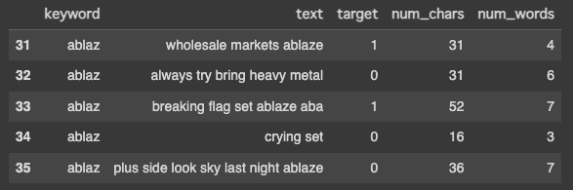
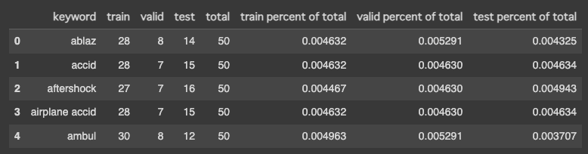
Data preprocessing
Loading the Data
Transforming the data: Standardize the data type
Cleaning the data
Removal of unnecessary information: URLs, non-alphabetic characters
Preprocessing keywords: replaced any percentage signs in the keywords with spaces, removed any numeric characters and made all the text lowercase.
Text normalization: lemmatization (for example, 'running' becomes 'run’), stemming
Removing Stop words: removed common words ('the', 'and', 'is', etc.)
Discarding irrelevant columns and rows: removed the 'id' and 'location' columns from our dataset
Splitting the test, validation, and test data
Table 2: The training data after cleaning
Table 3: The first 5 keywords with distribution for each data set

Slide 5
Modeling and analysis – Ridge Classification
Baseline model – taken from tutorial notebook for the competition
Quickly vectorize the text, then feed into training
Accuracy is 0.754, F1-score is 0.70
F1-score is better than original model – data preprocessing important for model performance

Slide 6
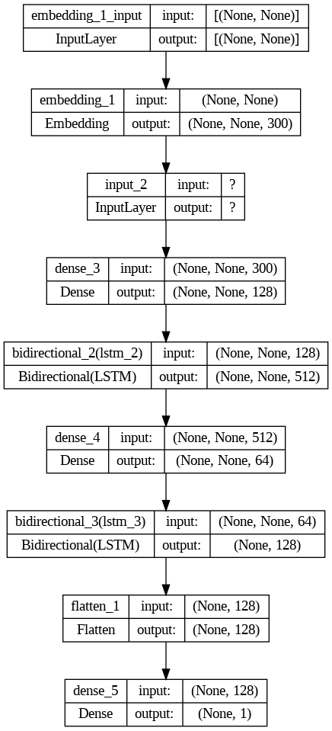
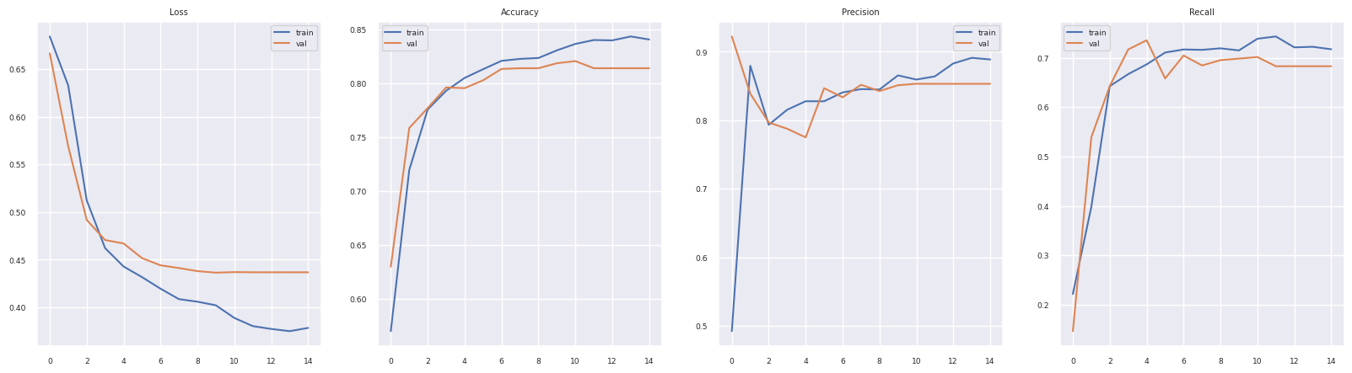
Modeling and Analysis-RNN
Model
Two inputs: tweet text and keyword data
Stacked bidirectional LSTM layers
Return_sequences TRUE
Relu activation function in hidden layer(s)
Dropout rates between .1 and .2
Adam learning rate .0001
Total params: 2,161,117
Callbacks
Early stopping
Learning rate .0001 reduction on plateau
Performance
Optimal epoch 10/30
accuracy: 0.8308
val_loss: 0.4364
val_accuracy: 0.8188
val_precision: 0.8512
val_recall: 0.6986
F1: 0.77

Slide 7
Modeling and Analysis - Roberta
Model
Input: tweet text
MLP head: 2 linear layers
ReLU for 1st layer, Sigmoid for 2nd
Adam optimizer, 0.00001 learning rate
Performance
training accuracy: 0.847
Training F1: 0.818
val_loss: 0.398
val_accuracy: 0.846
val_F1: 0.808
Builds upon BERT (Bidirectional Encoder Representations from Transformers), which is a transformer-based pretrained language model developed by Google in 2018
RoBERTa (Robustly Optimized BERT Pretraining Approach) was introduced by Facebook AI in 2019
RoBERTa is trained on more data. Also uses larger mini-batches, removes the next-sentence prediction objective, and allows training for more epochs
Model pipeline taken from another participant of the competition, with adjustments implemented for this project

Slide 8
Modeling and Analysis - Distilbert
DistilBERT is a compressed and distilled version of BERT.
It was introduced by Hugging Face, an NLP company, as a more lightweight and computationally efficient alternative to BERT.
Retains over 95% of BERT's language understanding capabilities while being 60% faster and having 40% fewer parameters

Slide 9
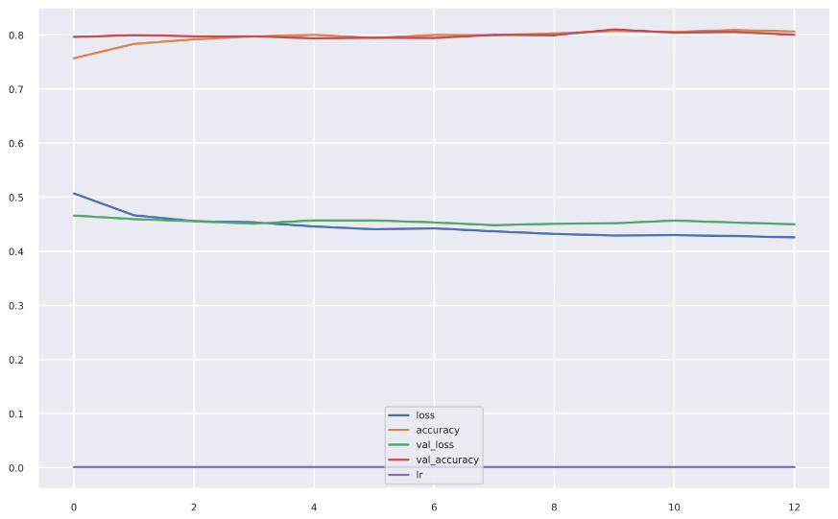
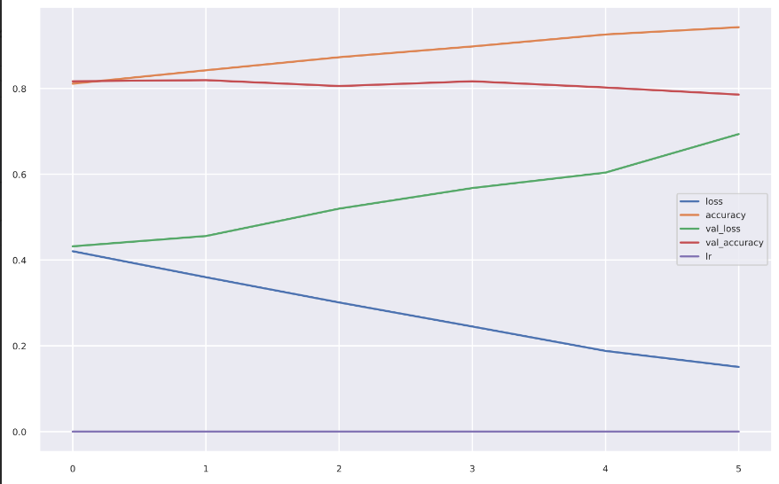
Modeling and Analysis - Distilbert
Before Unfreezing
Model
Inputs: Tweet text and keyword data
Architecture: Transformer-based, with DistilBERT as the core, pre-trained on English text
Optimizer: AdamW with learning rate of 0.001
Callbacks
Saved the best model during training
Early Stopping
Reduced the learning rate when model performance plateaued
Performance
Upon unfreezing pre-trained layers and additional training:
Peak performance at epoch 1/10
Training loss: 0.4205
Training accuracy: 0.8112
Validation loss: 0.4320
Validation accuracy: 0.8168
After Unfreezing

Slide 10
Modeling and Analysis - ELEctra
Builds upon BERT and GPT models, incorporating their best features.
Introduced by Google Research in 2020.
Unique training method: Identifies replaced tokens in a sentence.
Utilizes all input tokens for training, unlike BERT.
Enhanced efficiency through modifications like generator-discriminator setup.

Slide 11
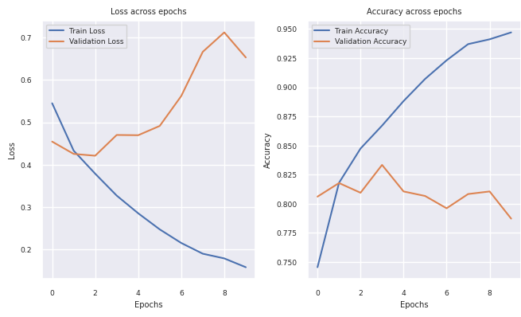
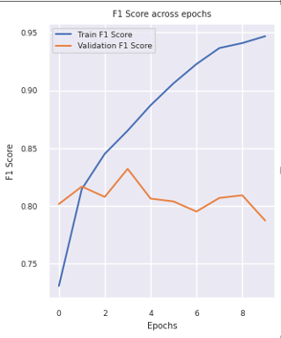
Modeling and Analysis - ELECtra
Model
Two inputs: Tweet text and keyword data
Transformer-based architecture using Google's pre-trained ELECTRA model
Optimizer: AdamW optimizer with learning rate: 0.000075
Callbacks
Functions defined for calculation of accuracy and F1 scores
Evaluation on validation data after each epoch
Optimal performance monitoring with metrics
Performance
Optimal performance at epoch 4/10
Training loss: 0.285
Training accuracy: 0.888
Training F1 Score: 0.865
Validation loss: 0.470
Validation accuracy: 0.833
Validation F1 score: 0.832

Slide 12
Conclusion & Improvement
Model | Training Acc | Training F1 | Val Acc. | Val F1
Ridge | na | na | 0.754 | 0.70
RNN | 0.831 | 0.793 | 0.819 | 0.77
RoBERTa | 0.847 | 0.818 | 0.846 | 0.808
DistilBERT | 0.811 |  | 0.817
ELECTRA | 0.888 | 0.865 | 0.833 | 0.832
RoBERTA performed the best, with validation accuracy of 0.846 and F1-score of 0.808
More hyperparameter tuning could improve results
Find a way to utilize keyword and location

Slide 13
References
Culliton, P. (2019, December 20). NLP getting started tutorial. Kaggle. https://www.kaggle.com/code/philculliton/nlp-getting-started-tutorial/notebook
Filzmoser, N. (2023, January 21). Disaster tweet classification with Roberta and pytorch. Auroria. https://www.auroria.io/nlp-disaster-tweet-text-classification-roberta-pytorch/
Hugging face – the AI community building the future. Hugging Face –. (n.d.). https://huggingface.co/
Natural language processing with disaster tweets. Kaggle. (n.d.). https://www.kaggle.com/competitions/nlp-getting-started

