Slide 1

Natural language processing – Classifying Disaster tweets
Ei Tanaka
Erika Pham
Jonathan Schild

Slide 2
Overview of Content
Competition Background
Data Preprocessing
Modelling & Analyses
Improvements
References

Slide 3
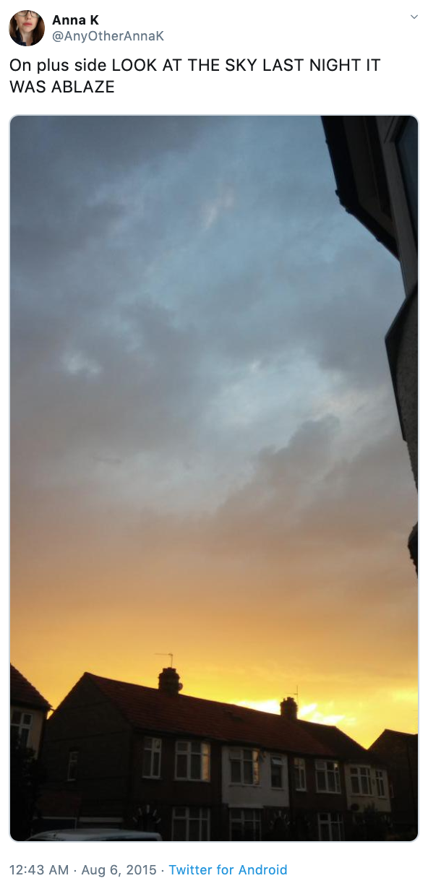
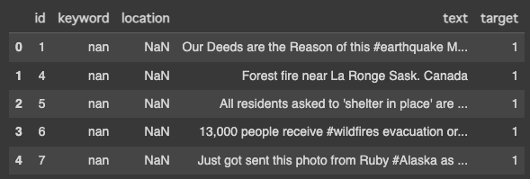
Competition background
Disaster Tweets Datasets
Features: 3 main features for each Tweet (Text, Keywords, and Location)
Target: Binary Class label denotes whether a tweet is about a real disaster (1) or not (0)
Table 1: The first 5 rows with 3 features and 1 target of Disaster Tweet datasets
- The goal of this Kaggle Competition is using the features to predict the tweet is about a real disaster or not.
Figure 1: Kaggle Competition: Natural Language Processing with Disaster Tweet

Slide 4
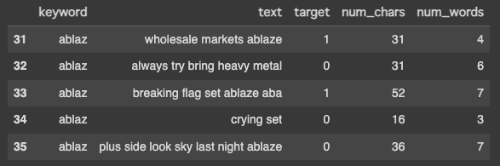
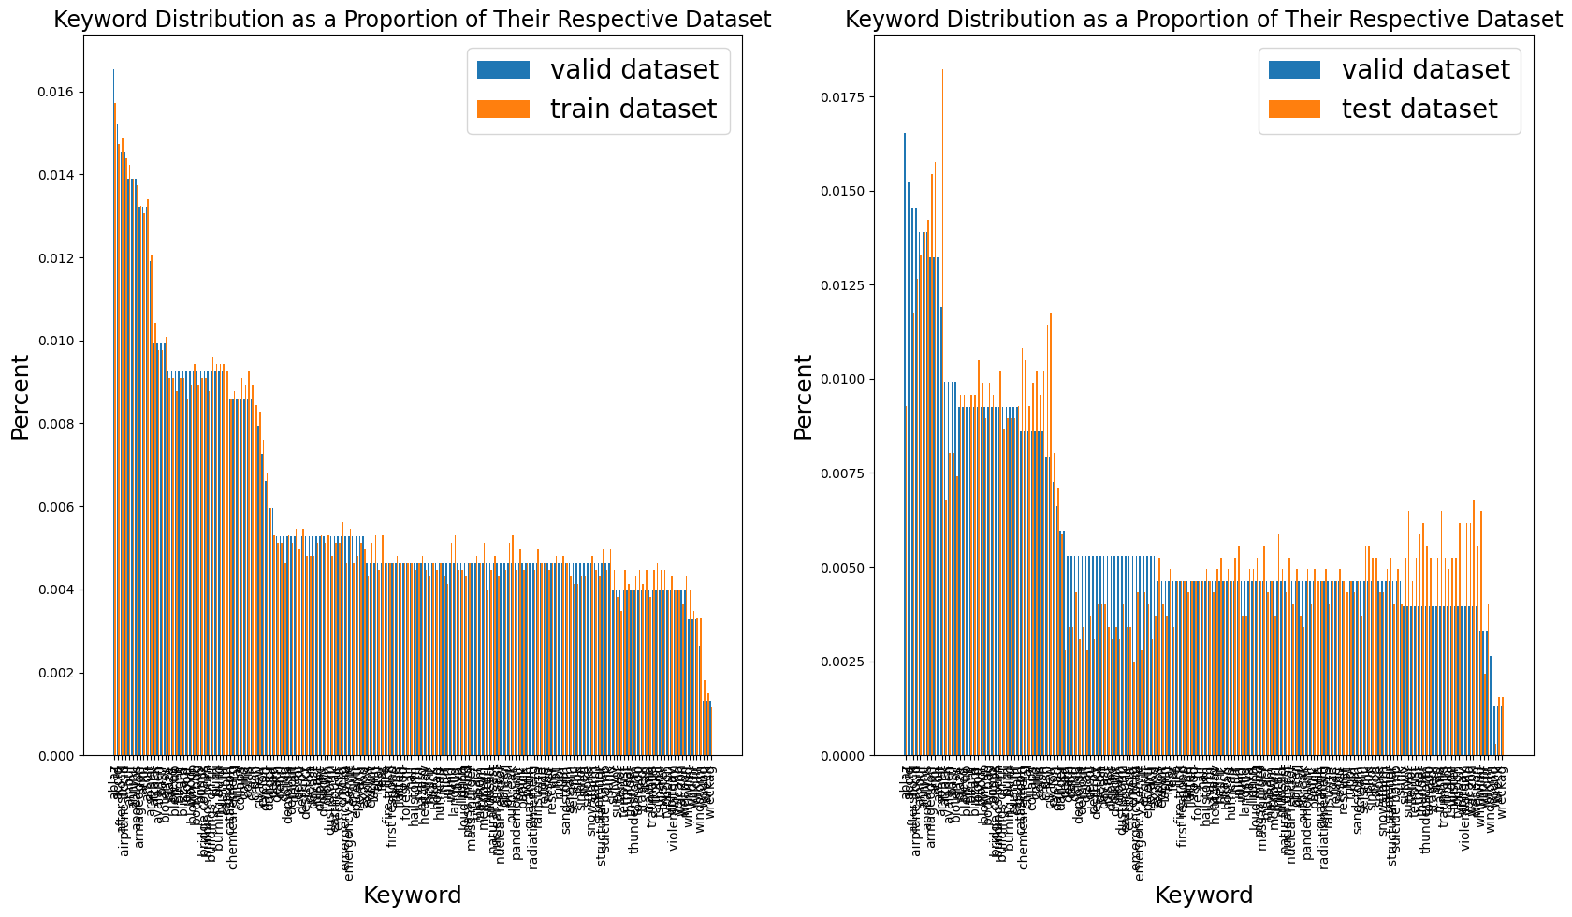
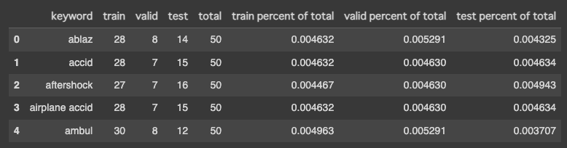
Data preprocessing
Setting up the data
Cleaning the data
Removal of URLs, non-alphabetic characters, unnecessary spaces; lowercase all text
Text normalization: lemmatization → stemming
Removing uncommon/stop words ('the', 'and', 'is', etc.)
Discarding irrelevant columns and rows: removed the 'id' and 'location' columns from our dataset
Splitting the test, validation, and test data
Stratify by both target and keyword
Target balance:
Training: 43% disaster (1)
Validation: 43% disaster (1)
Keyword
166 unique keywords; same for all datasets
Table 2: The training data after cleaning
Table 3: The first 5 keywords with distribution for each data set

Slide 5
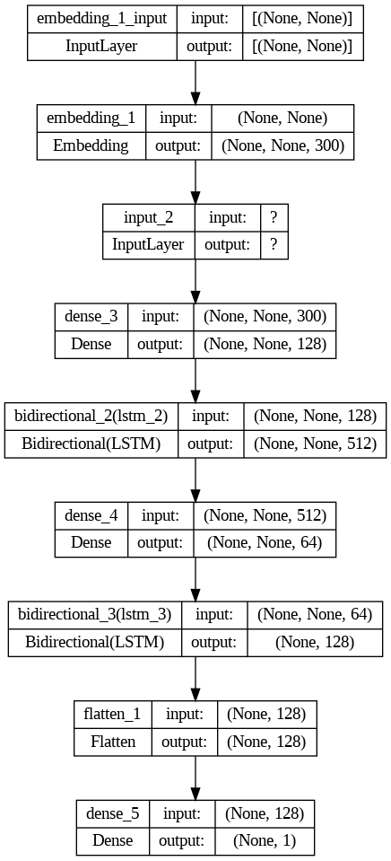
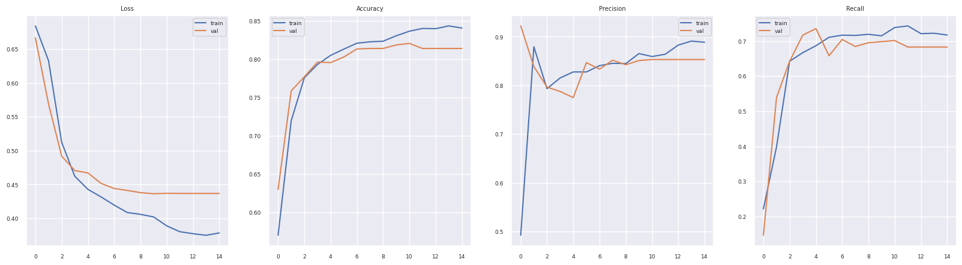
Modeling and Analysis-RNN
Model
Two inputs: tweet text and keyword data
Stacked bidirectional LSTM layers
Return_sequences TRUE
Relu activation function in hidden layer(s)
Dropout rates between .1 and .2
Adam learning rate .0001
Total params: 2,161,117
Callbacks
Early stopping
Learning rate .0001 reduction on plateau
Performance
Optimal epoch 10/30
accuracy: 0.8308
val_loss: 0.4364
val_accuracy: 0.8188
val_precision: 0.8512
val_recall: 0.6986
F1: 0.77

Slide 6
Modeling and Analysis

Slide 7
Modeling and Analysis

Slide 8
Improvement

Slide 9
References

