Slide 1
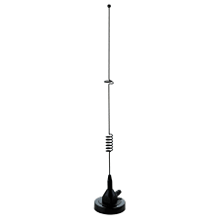
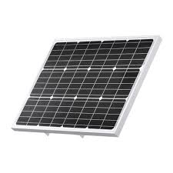
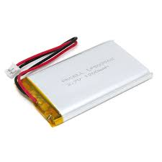
Sensor Box BOM
Box 50 X 50 6 ILS
PCB 5 ILS
Power Supp. 0.5 ILS
Processor (STM32C011J4M6) 2 ILS
Others 1 ILS
Total: ~ 15 ILS
Cell Antenna
Solar Panel
Main System
Control Board
Wi-Fi, Bluetooth, Lora, RS485, Cellular
4 wire multidrop RS485 sensor line (Power, GND, RS+, RS-)
Battery
…
Sensor
1 Box
Sensor
2 Box
Sensor
N Box
Sensor
Sensor
Sensor

