Slide 1
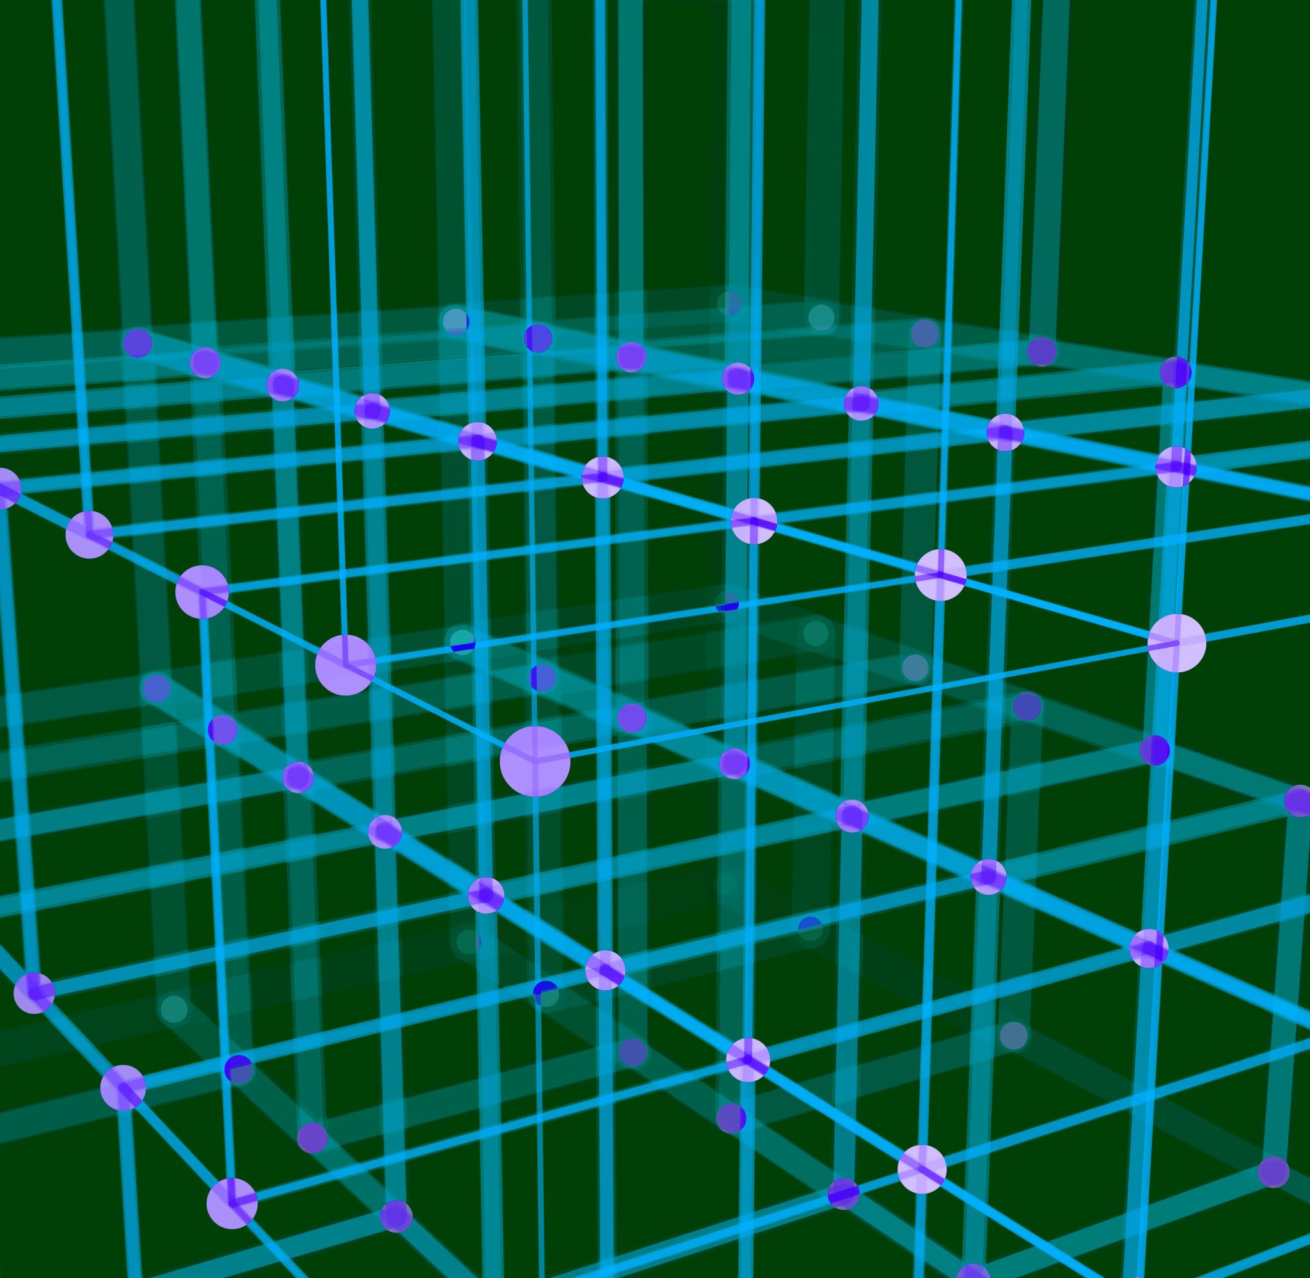
Quantization Algorithms

Slide 2
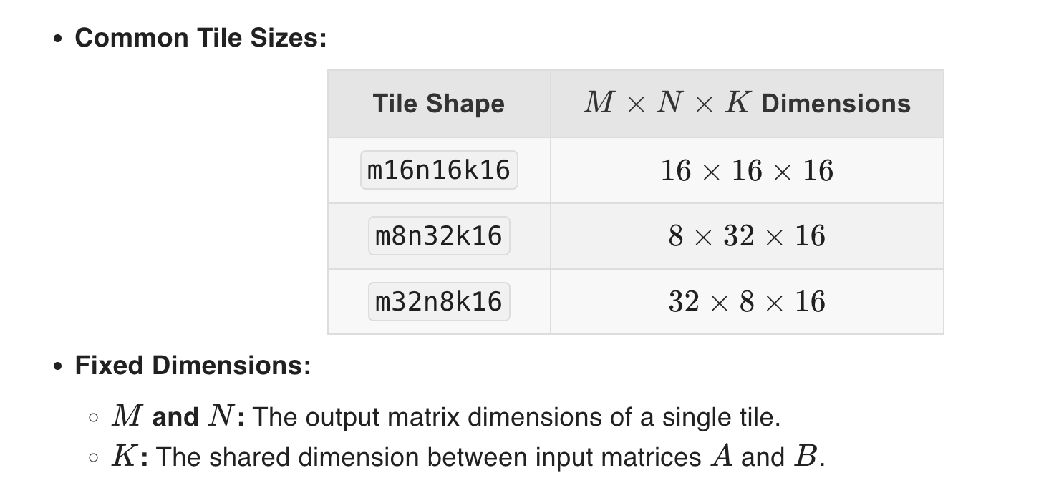
Matrix Multiply in int8
Warp Level Matrix Multiply-Accumulate Instructions
I focused on 16x16x16
From Nvidia documentation

Slide 3

Quantizing Float matrices to int8
$A∈M_{m×k}\left(ℝ\right)$ and $B∈M_{n×k}\left(ℝ\right)$
We want to perform $C=AB^{T}∈M_{m×n}\left(ℝ\right)$
For example: $m$ is the number of sample, $k$ is the input dimension and $n$ is the output dimension.

Slide 4

Quantizing Float matrices to int8 – ctd
Normalize each row of $A$ and $B$ so that the range is from $α$ to $β$.
Eg. ${\left(s_{A}\right)}_{i}=\frac{β−α}{\max\left(A_{i,:}\right)−\min\left(A_{i,:}\right)}$
Set ${\left(q_{A}\right)}_{i,j}=round\left(α+s_{A}\left(A_{i,j}−\min\left(A_{i,:}\right)\right)\right)$
$A≈\frac{q_{A}−α}{s_{A}}+\min\left(A_{i,:}\right)=\frac{1}{s_{A}}\left(q_{A}+\left(s_{A}\min\left(A_{i,:}\right)−α\right)\right)$
Set $b_{A}=s_{A}\min\left(A_{i,:}\right)−α$ (bias term)
Then $A≈\frac{1}{s_{A}}\left(q_{A}+b_{A}\right)$.
Note that $b_{A}$ is broadcasted and is a diagonal matrix times the all-ones matrix.

Slide 5

Quantizing Float matrices to int8 – ctd
$C=AB^{T}≈\left(\frac{1}{s_{A}}\left(q_{A}+b_{A}\right)\right){\left(\frac{1}{s_{B}}\left(q_{B}+b_{B}\right)\right)}^{T}$ $=\frac{1}{s_{A}s_{B}}\left(q_{A}q_{B}^{T}+b_{A}\left(q_{B}+b_{B}\right)+q_{A}b_{B}^{T}\right)$
$q_{A}b_{B}^{T}$ could be performed over integers as $b_{B}^{}$ is basically an all-ones matrix.
$b_{A}\left(q_{B}+b_{B}\right)$ is somewhat more complicated to perform over integers naively.
Either way, complexity of error terms is $O\left(n^{2}\right)$ because of the structure of the bias terms.

Slide 6
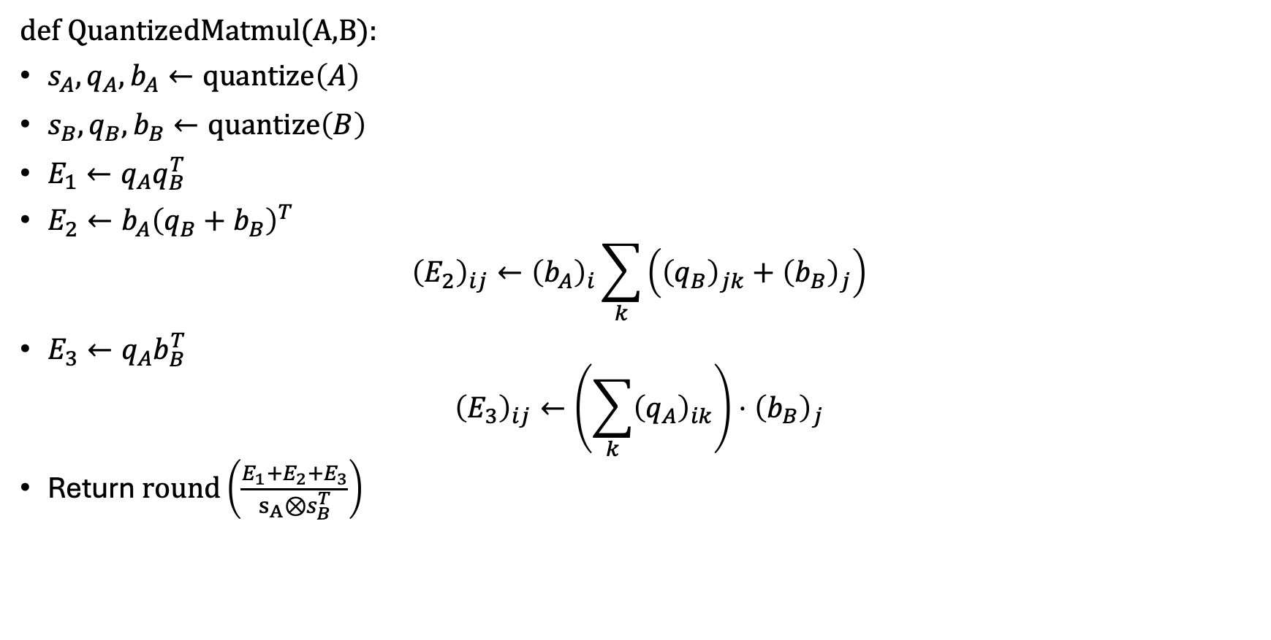
Pseudo-code
def QuantizedMatmul(A,B):
$s_{A},q_{A},b_{A}←quantize\left(A\right)$
$s_{B},q_{B},b_{B}←quantize\left(B\right)$
$E_{1}←q_{A}q_{B}^{T}$
$E_{2}←b_{A}{\left(q_{B}+b_{B}\right)}^{T}$ ${\left(E_{2}\right)}_{ij}←{\left(b_{A}\right)}_{i}\sum_{k}{\left({\left(q_{B}\right)}_{jk}+{\left(b_{B}\right)}_{j}\right)}$
$E_{3}←q_{A}b_{B}^{T}$ ${\left(E_{3}\right)}_{ij}←\left(\sum_{k}{{\left(q_{A}\right)}_{ik}}\right)⋅{\left(b_{B}\right)}_{j}$
Return $round\left(\frac{E_{1}+E_{2}+E_{3}}{s_{A}⊗s_{B}^{T}}\right)$

Slide 7
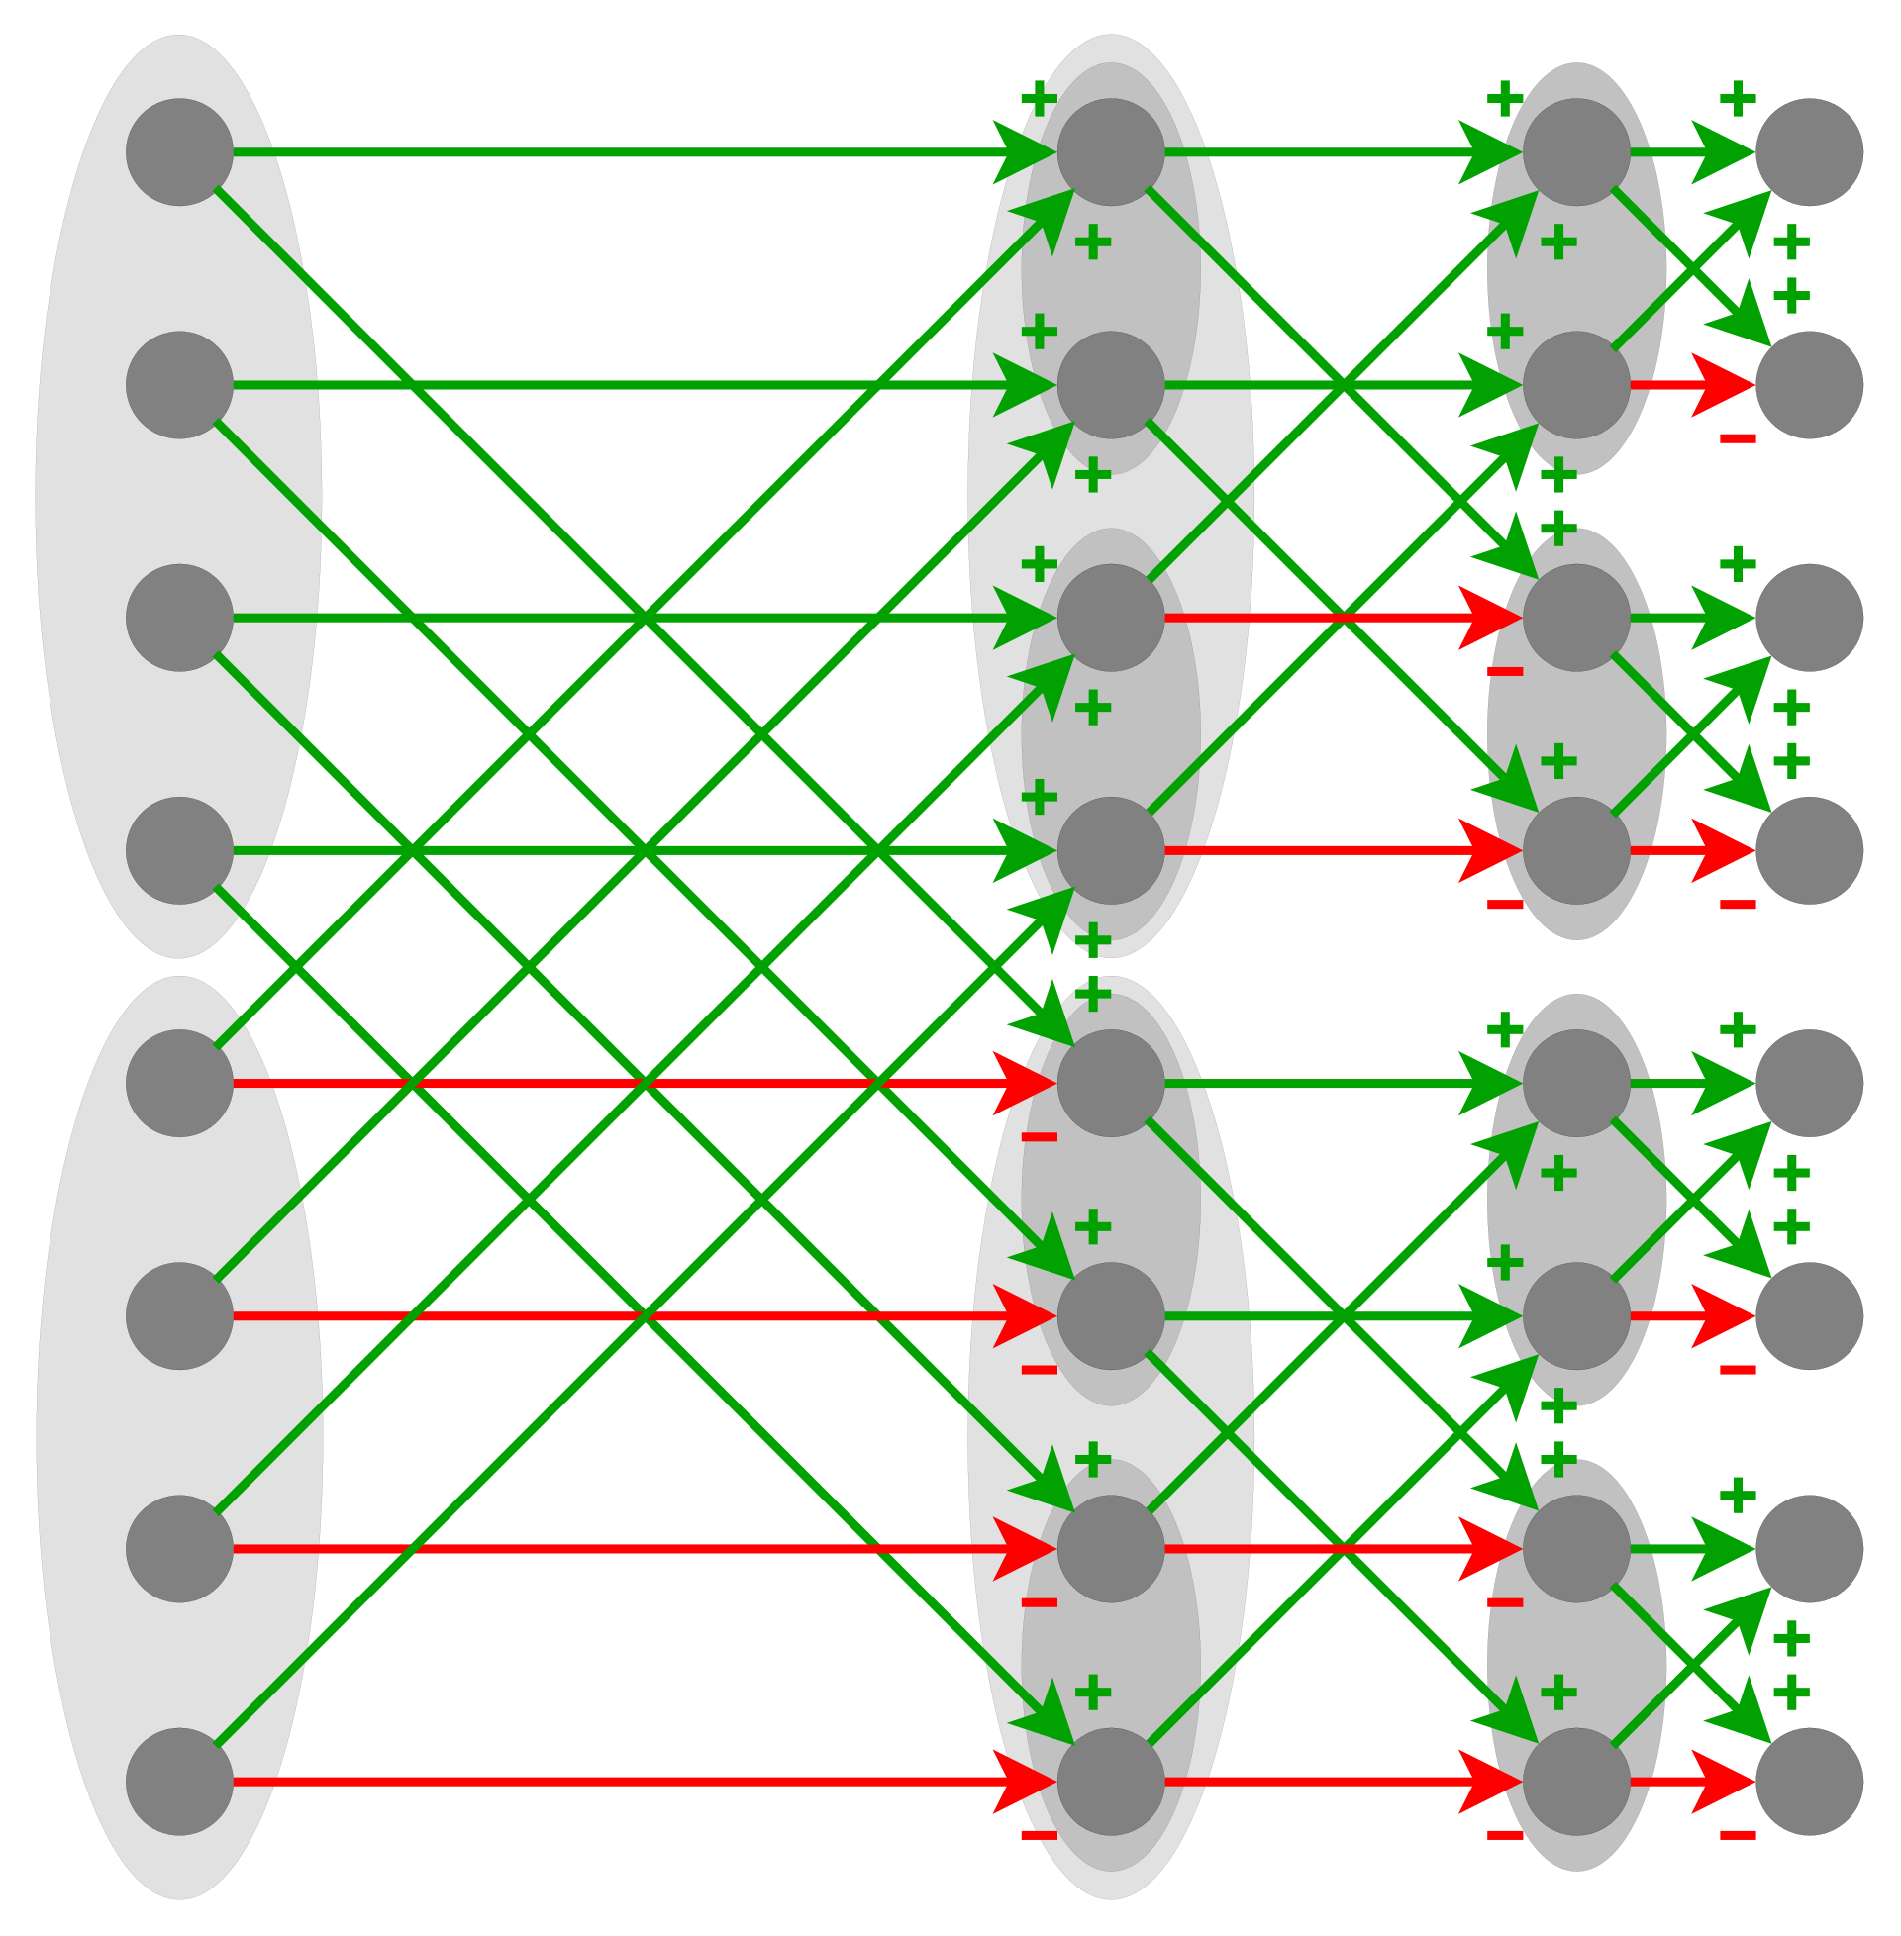
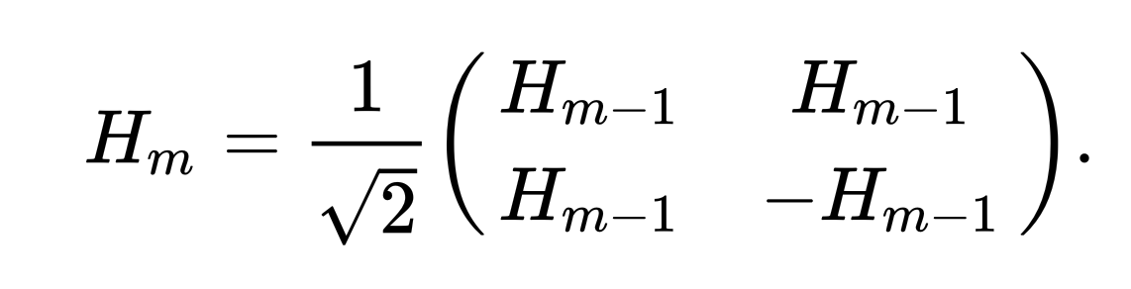
Fast Hadamard-Walsh Transform
Operate on pairs at each layer
Logarithmic depth

Slide 8
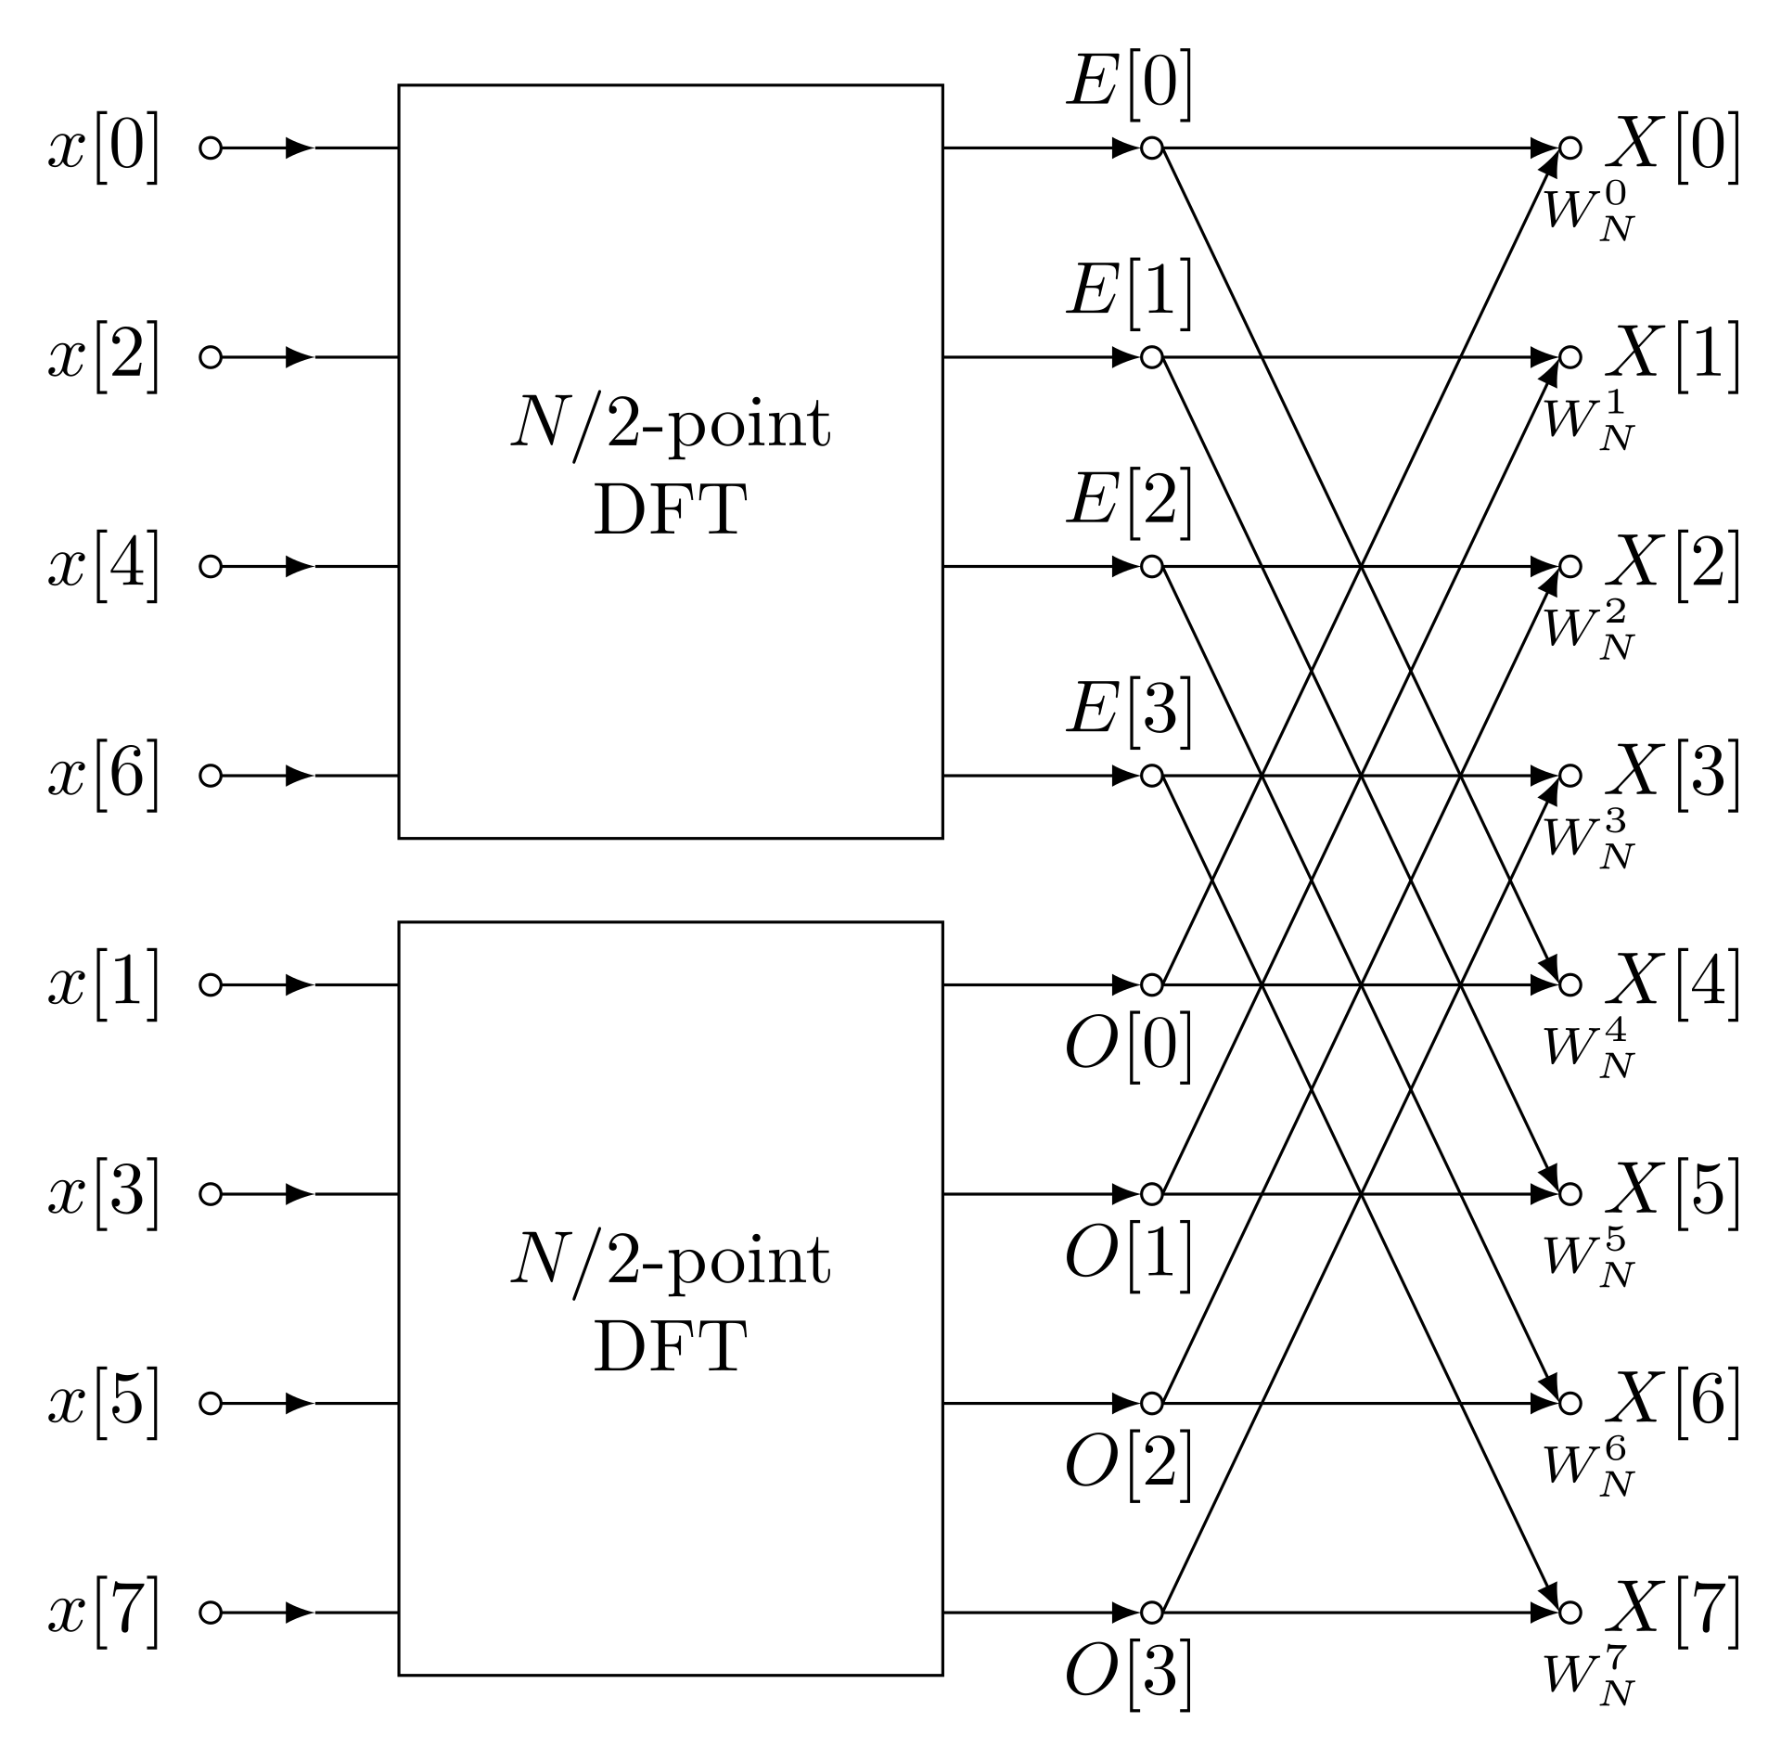
Fast Fourier Transform

Slide 9
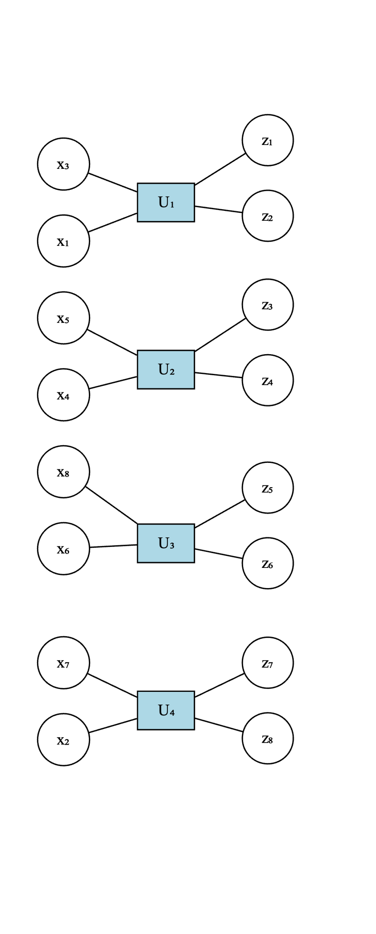

Generalized Transform
Idea 3: Use make matrix dependent on the state of blockchain (and a nonce).
At each layer $L$, apply a permutation $σ_{L}∈S_{n}$
Multiply each pair of numbers by a random matrix, i.e. apply a block-matrix operation $U_{L}∈ ⊗_{i=1}^{\frac{n}{2}}O\left(2\right)$
In general we decompose $n=p_{1}⋅p_{2}⋅…⋅p_{k}$ and apply at each layer
$$U_{L}∈ ⊗_{i=1}^{\frac{n}{p_{L}}}O\left(p_{L}\right)$$

Slide 10
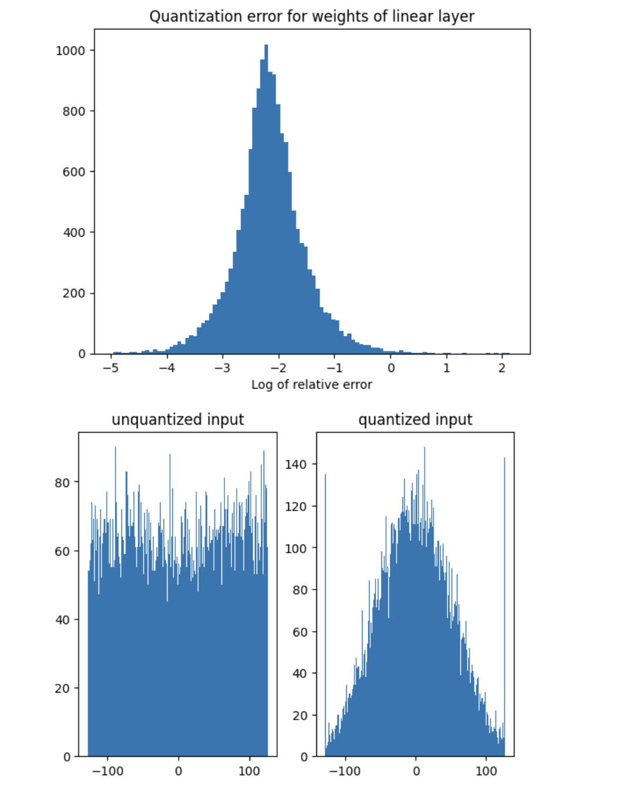
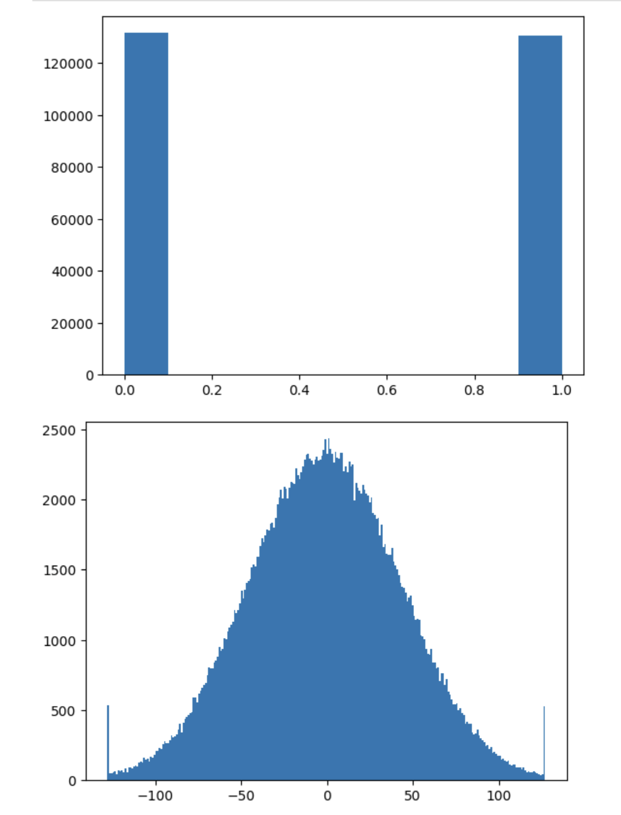
Generalized Transform – Results
Random matrices sampled uniformly from -128 to 127
Random matrices sampled uniformly from {0, 1}

Slide 11
Generalized Transform – Hypothesis
Generalized Transform creates ”close” to entry-wise normal matrix on random enough matrices.
On Identity matrix, we get a log-normal distribution (product of random elements tends to a log-normal distribution).
It is generally difficult to find correlations between tiles after the generalized transform is applied.

Slide 12
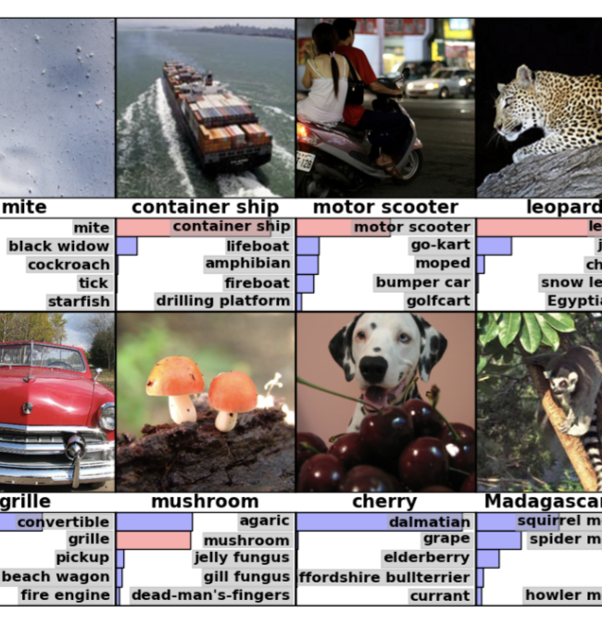
Neural Networks
I chose ViTs for the experiment of differing sizes.
ViTs have ~66% of the parameters in linear layers. Easy to swap for quantized layers.
vit_b_16 - 330MB, vit_b_32 - 340MB, vit_l_16 - 1.2GB.
ImageNet dataset – 1000 classes, classification task.

Slide 13
Layer | Size (M)
encoder.layers.encoder_layer_X.mlp.X.weight | 56.62
encoder.layers.encoder_layer_X.self_attention.in_proj_weight | 21.23
encoder.layers.encoder_layer_X.self_attention.out_proj.weight | 7.08
heads.head.weight | 0.77
conv_proj.weight | 0.59
encoder.pos_embedding | 0.15
encoder.layers.encoder_layer_X.mlp.X.bias | 0.05
encoder.layers.encoder_layer_X.self_attention.in_proj_bias | 0.03
encoder.layers.encoder_layer_X.ln_X.weight | 0.02
encoder.layers.encoder_layer_X.ln_X.bias | 0.02
encoder.layers.encoder_layer_X.self_attention.out_proj.bias | 0.01
heads.head.bias | 0.0
class_token | 0.0
conv_proj.bias | 0.0
encoder.ln.weight | 0.0
encoder.ln.bias | 0.0

Slide 14
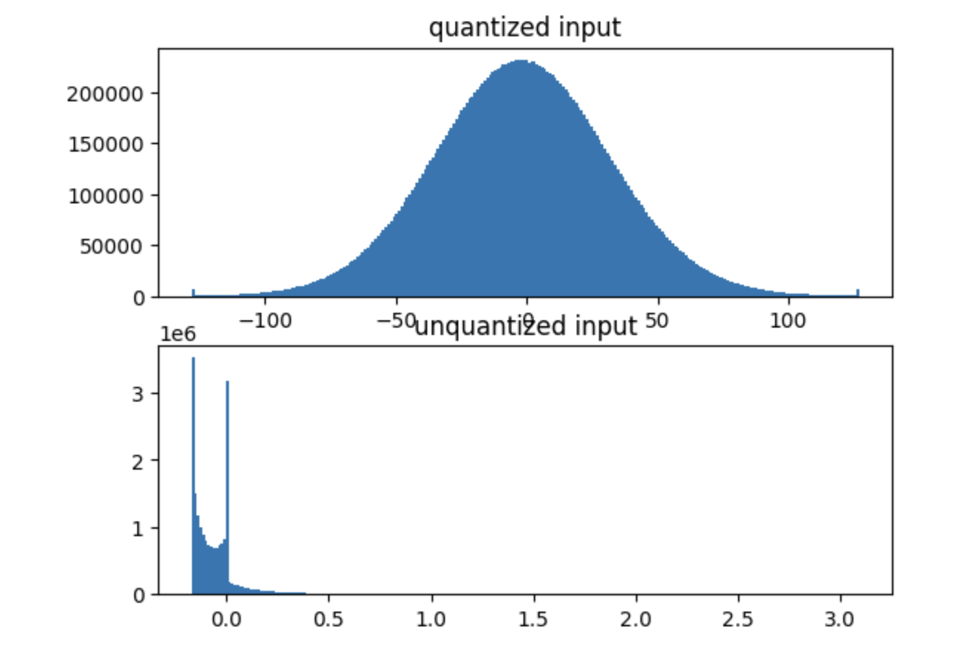
Generalized Transform – Results (on real world NN)

Slide 15
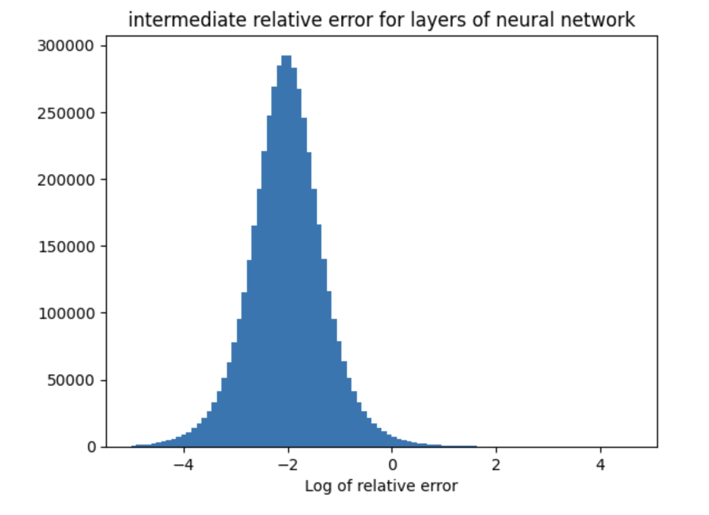
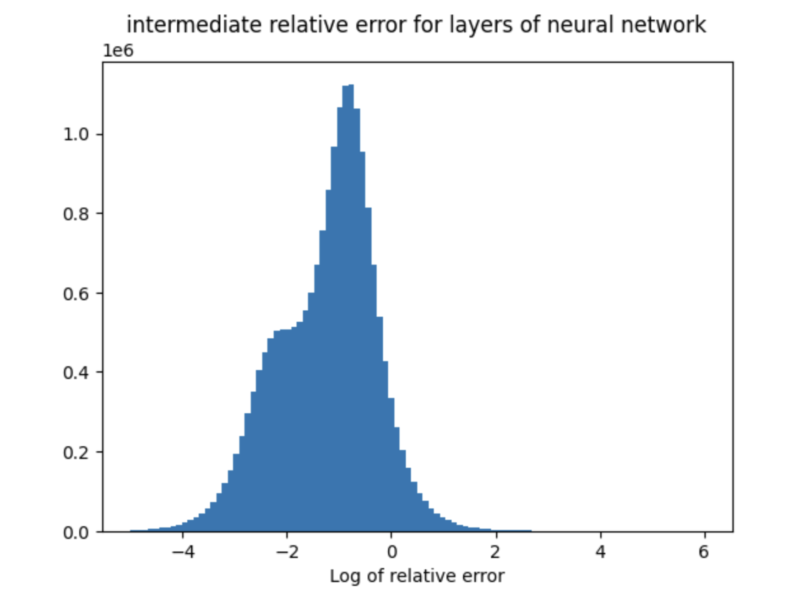
vit_b_16, range=256

Slide 16
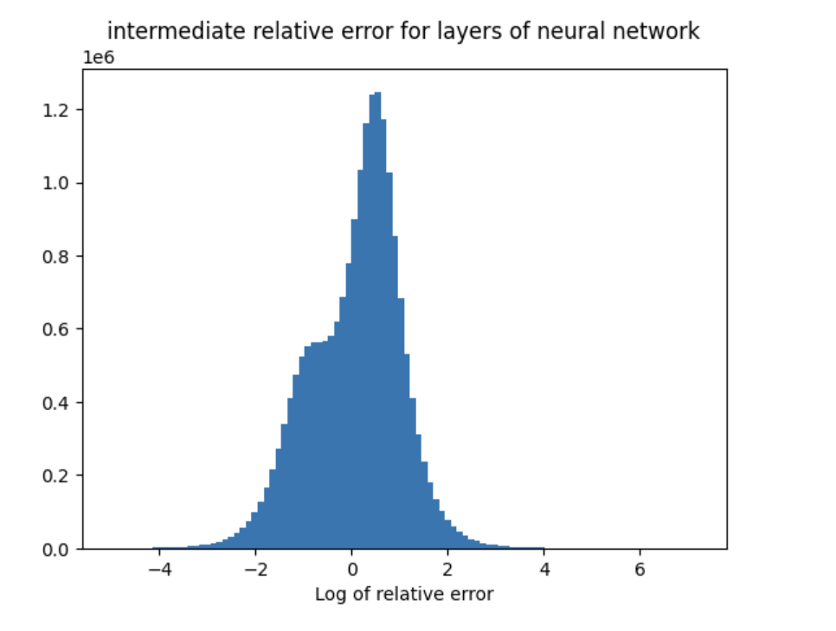
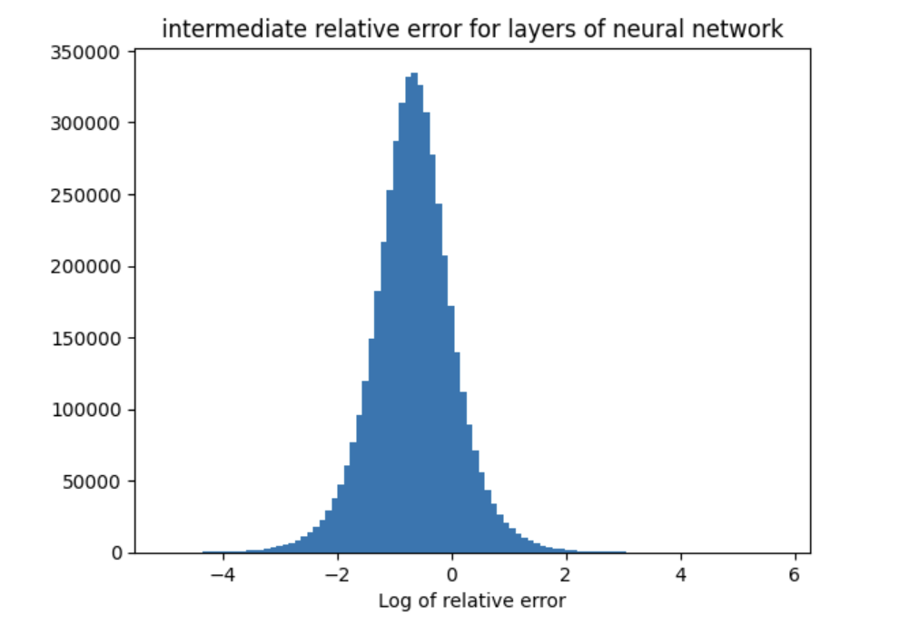
vit_b_16, range=16

Slide 17
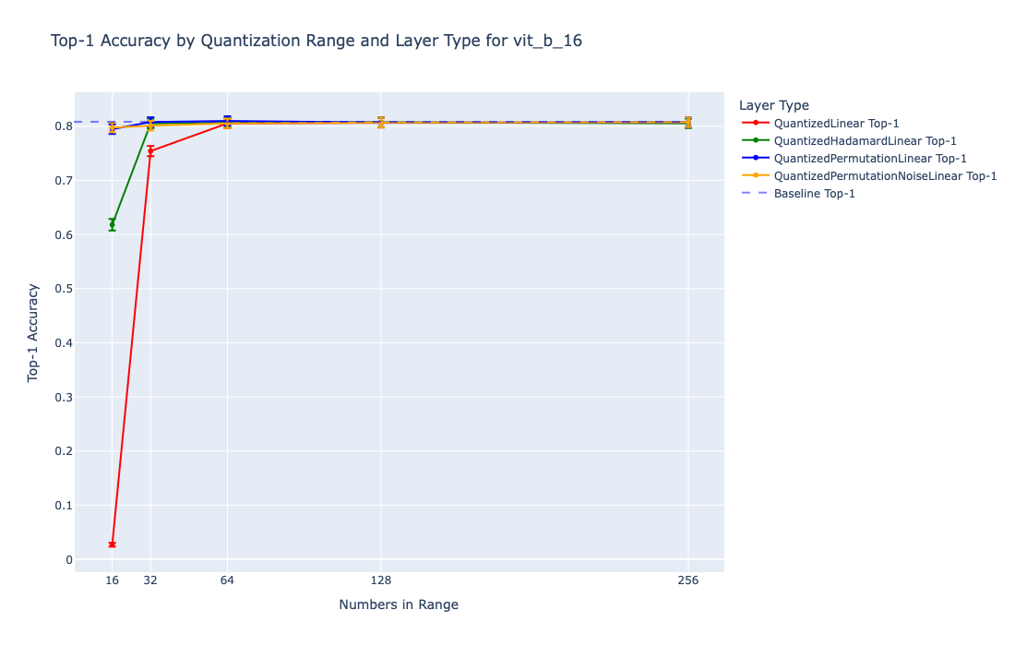

Accuracy Results
Full Results

Slide 18
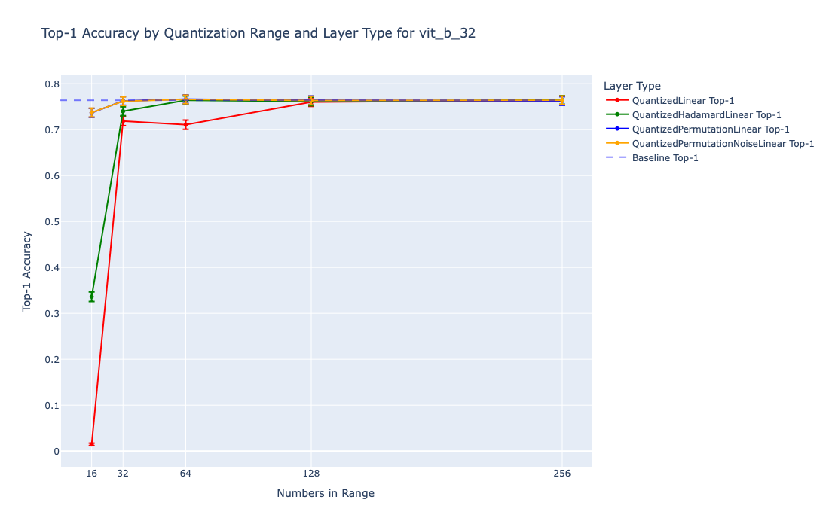
Accuracy Results

Slide 19
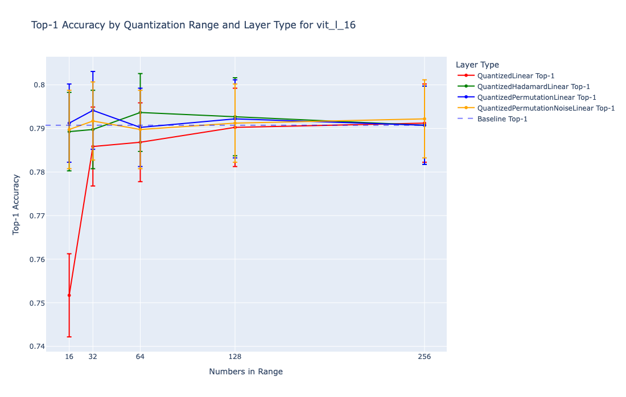
Accuracy Results

Slide 20
Future Directions
Quantization Aware Training instead of Post-Training Quantization.
Symmetric Quantization.
Performance, make overhead as low as possible.
Quantize specific layers for optimal performance/overhead.
Derive theoretical guarantees.

Slide 21
Thanks for listening!

