Slide 1

Waiting Times
NHS Scotland
MS984 Data Analytics in Practice | Case Study 2 | Group 3

Slide 2
Contents
01
Introduction
02
Methodologies
03
Conclusion
Introduce the problems and context of NHS Scotland
Involve step-by-step processing

Slide 3
01
Introduction
Introduce the problems of
NHS Scotland

Slide 4
01 | Context
NHS Workforce
Workload
High vacancy rates impact service quality, often arising from recruitment difficulties and low employee retention due to competitive wages.
Growing demand surpasses capacity, leading to prolonged waiting times and burdening healthcare professionals.
Waiting Times
Health Inequalities
Crucial indicators of service capability, highlighting systemic inefficiencies and aiding performance monitoring.
Health service quality affects public perception and socio-economic factors.
Limited funding growth due to UK Government austerity measures impacts service quality.

Slide 5
01 | The Problem
NHS Scotland faces a sustainability crisis due to a capacity/demand imbalance, stemming from various factors such as system inefficiencies, workforce shortages, low government investment, and infrastructure inadequacies.

Slide 6
90%
patients receive therapy referrals only after 18 weeks,
revealing the severity of the waiting time issue.

Slide 7
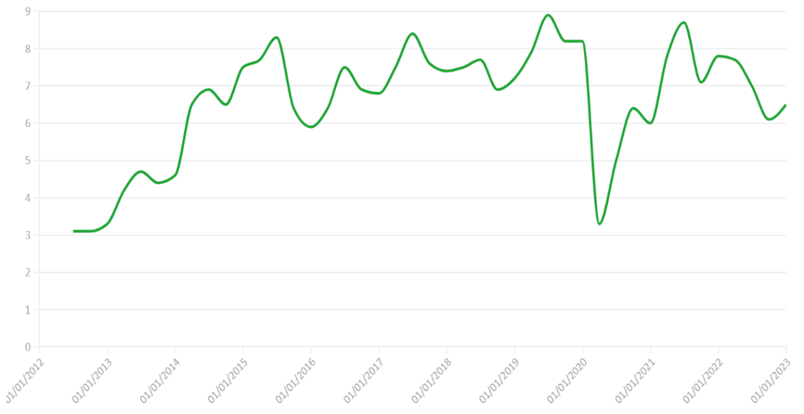
NHS Workforce
987
654
Last 3 years
32
1
0
NHS Scotland Vacancy Rates (Sep 2012 - Dec 2022)

Slide 8
02
Methodologies
Involve step-by-step processing

Slide 9
02 | Step-by-Step
Phase 3
Phase 2
Phase 1
Model Evaluation
Implementaion
Integration with Scheduling System
Continuous Improment
Demand Prediction
GP Availability Prediction
Data Collection and Processing
Exploration Data Analysis (EDA)

Slide 10
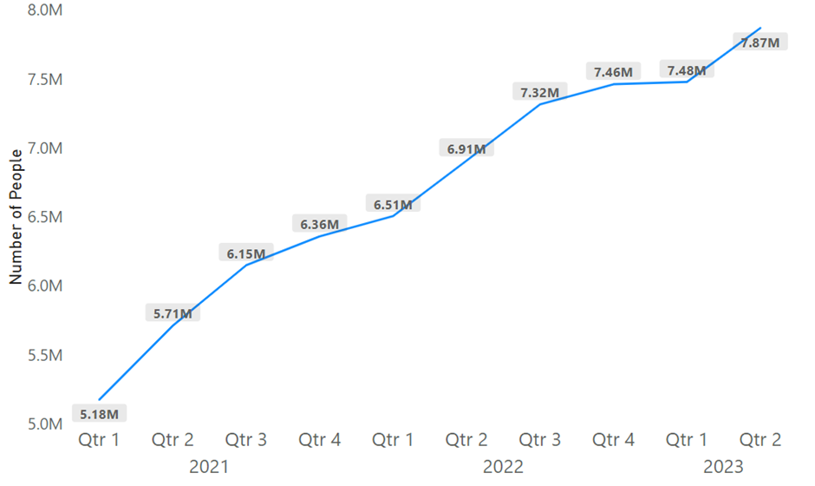
Phase 1 - Data Collection and Processing
To gain an insight on how NHS Scotland is meeting its service demand, it was compared to the distribution of ongoing waits quarterly for the last 3 years.
It can be clearly seen that the number of patients waiting increased quickly from 5.18 million to 7.87 million between 2021 and June 2023.
Number of Ongoing Waits in Scotland (2021 – Jun 2023)

Slide 11
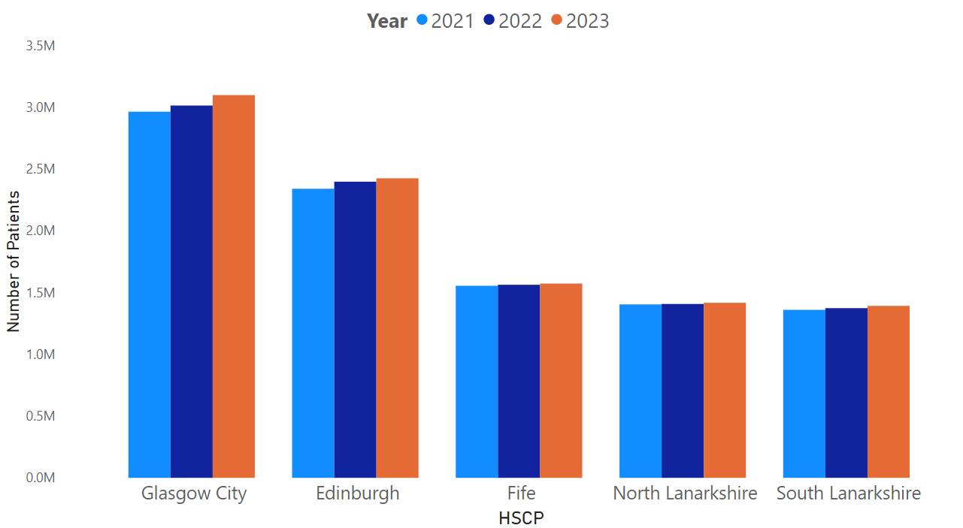
Phase 1 - Data Collection and Processing
To gain a deeper understanding of the demand, we have taken one single HSCP which contains several GPs. For this instance, we have taken Glasgow city as a sample.
It has been identified a dramatic increase in the number of patients in Glasgow City over the course of three years, rising from approximately 2.9 million patients in 2021 to 3.1 million patients in 2023
Top 5 Highest Number of Ongoing Waits in Scotland (2021 – Jun 2023)

Slide 12
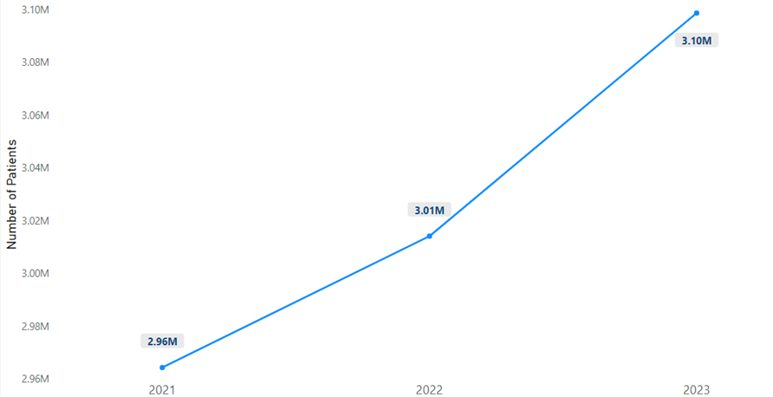
Phase 1 - Exploration Data Analysis (EDA)
To gain a deeper understanding of the demand, we have taken one single HSCP which contains several GPs. For this instance, we have taken Glasgow city as a sample.
The chart illustrates a dramatic increase in the number of patients in Glasgow City over the course of three years, increasing from approximately 2.9 million patients in 2021 to 3.1 million patients in 2023.
Number of Patients in Glasgow City Over a Period of 3 Years (2021 – 2023)

Slide 13
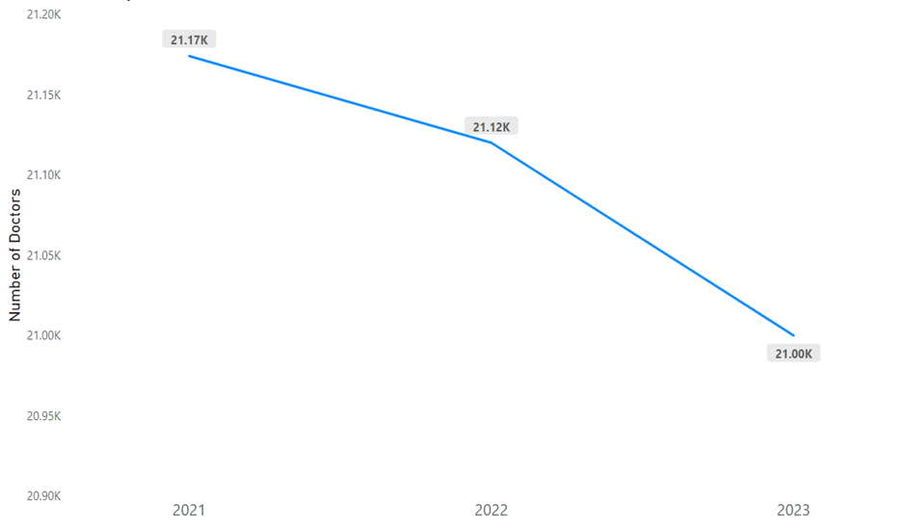
Phase 1 - Exploration Data Analysis (EDA)
To gain a deeper understanding of workforce in healthcare
It has been identified a declining trend in number of doctors in Scotland from year 2021 to 2023.
Number of doctors in Scotland (2021-2023)

Slide 14
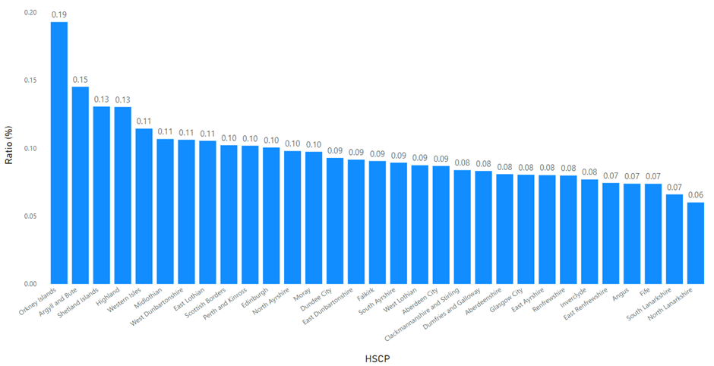
To gain insight into the patient load per doctor in Scotland
0.19%
This chart represents the patient-to-doctor ratio for each Health and Social Care Partnership (HSCP) in Scotland in the third quarter of 2023.
For example, in Orkney Islands, there are 19 patients per doctor.
orkney Islands
Ratio (%) Between No. Patients and No. Doctor by Health and Social Care Partnership (HSCP) in Scotland (2023 Quarter 3)

Slide 15
02 | Proposed Solution
Predicting demand and supply
Optimizing available workforce
To work with the available workforce, it is necessary that we optimizie it for better utlization of workforce and also meet increasing patient demand.
ARIMA is a powerful time series analysis technique used for modelling and forecasting patient demand.

Slide 16
Phase 2 - Demand Prediction
Steps
Based on the analysis we were able to come to the quarterly demand of the past years.
Taking the past three year's demand in account future patient demand was predicted.
The best fit according to the historical pattern, the ARIMA model was suitable.

Slide 17
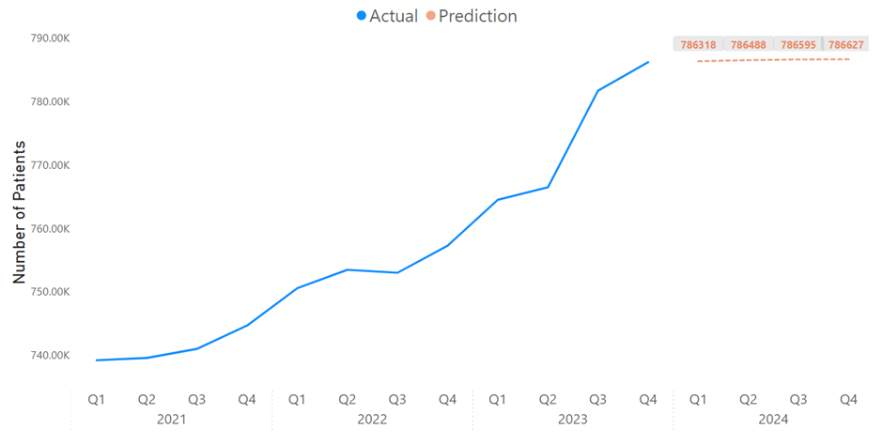
Phase 2 - Demand Prediction
Utilizing Time Series Forecasting Techniques to predict patients
The graph depicts a predicted increase in the number of patients in next year (2024).
It indicates a remained growing future demand.
Figure. The Prediction Number of Patients Using Time Series Forecasting Techniques in Next Year (2024) in Glasgow City, Scotland

Slide 18
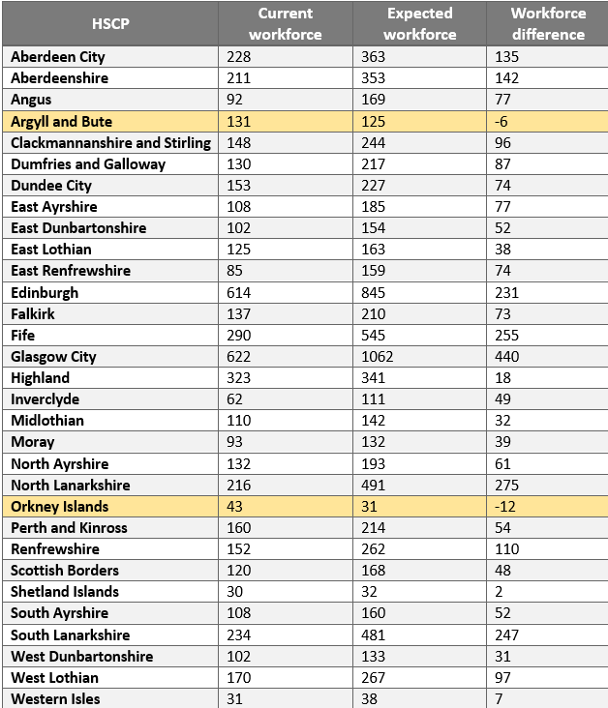
Phase 2 - GP Prediction
The study results the outlining of current and expected workforce and the difference of workforce among Glasgow HSCPs.
Highlighted in yellow are Argyll and Bute and Orkney Islands HSCPs which denotes a negative workforce difference of (-6) and (-12) workforce correspondingly.
This means there are 18 doctors available to give services in other HSCPs within Glasgow to cover projected demand.
Table. Workforce projected values, Glasgow 2024

Slide 19
03
Conclusion

Slide 20
03 | Conclusion
Scheduling appointments and managing doctors' availability across multiple General Practices (GPs) significantly impacts the healthcare sector.
Achieving optimal health systems necessitates leveraging technology, patient-centered care, and efficient resource allocation.
Data-driven assessments and a commitment to patient satisfaction are crucial for successful implementation.
Adapting new technologies and strategies is essential for maintaining high-quality care while managing doctor availability and appointments amidst evolving healthcare landscapes.

Slide 21
Thank you
Do you have any questions?
Atharva Abhijit Joshi
Aravinthkumar Pattaiyan
Hrutuja Mangesh Patkar
Kittinat Anathamsombat
Katherine Gisela Enríquez Donado
Abu Huraira
Eitika Sharma
Credits: Special thanks to Slidesgo for providing the template and includes icons by Flaticon,
and infographics & images by Freepik for this presentation

