Slide 1

Note: The data and information in this document is reflective of a hypothetical situation and client. This document is to be used for KPMG Virtual Internship purposes only.
Sprocket Central Pty Ltd
Data analytics approach
[Virtual Internship] - [Engagement Manager], [Senior Consultant], [Junior Consultant]

Slide 2
Note: The data and information in this document is reflective of a hypothetical situation and client. This document is to be used for KPMG Virtual Internship purposes only.
DATA MODEL BUILD
Introduction
Data Exploration
Model Development
Interpretation

Slide 3
Note: The data and information in this document is reflective of a hypothetical situation and client. This document is to be used for KPMG Virtual Internship purposes only.
Introduction
This presentation is an attempt by KPMG’S data analytics team to provide best possible analysis to datasets provided by Sprocket Central Pty Ltd in ways that they can improve their sales.
The New Customer List data set shows the potential new customers that the organization had in the past three months. It consists of 1000 rows and 14 columns.
DOB column is blank for 17 customers.
106 customers haven’t specified their job titles and job industry category is n/a for 165 customers.
There are 4 unnamed fields iin the data
All these data inaccuracies has been treated.

Slide 4
Note: The data and information in this document is reflective of a hypothetical situation and client. This document is to be used for KPMG Virtual Internship purposes only.
Data Exploration
Place headline insight or information here. This should be the most important point for this slide.
There is not a huge difference when it comes to gender, but still females tend to buy more of bikes and bicycles than males

Slide 5
Note: The data and information in this document is reflective of a hypothetical situation and client. This document is to be used for KPMG Virtual Internship purposes only.
Data Exploration
Bar graph representing no of potential customers from 3 states in Australia belonging to different job categories.
In all the three states, the maximum number of customers belong to the Financial services, health and manufacturing sector.

Slide 6
Note: The data and information in this document is reflective of a hypothetical situation and client. This document is to be used for KPMG Virtual Internship purposes only.
Data Exploration
Bar graph represents the past 3 years sales in different age groups from 3 states
The customers in the age group of 30–40 and 40–50 have made the maximum number of purchases in the past 3 years.

Slide 7
Note: The data and information in this document is reflective of a hypothetical situation and client. This document is to be used for KPMG Virtual Internship purposes only.
Data Exploration
The Bar graph represents the number of transactions that were done in each brand category.
The highest sales being for Solex, followed by Giant Bicycles and WeareA2B with almost the same number of transactions.

Slide 8
Note: The data and information in this document is reflective of a hypothetical situation and client. This document is to be used for KPMG Virtual Internship purposes only.
Data Exploration
This bar graph represents the line of transportation for each product.
It can be concluded that for each brand maximum transactions has been done for products transported via the standard line compared to the products being transported through road, mountain or touring lines.

Slide 9
Australian Bureau of Statistics main form of transport used on usual trip to work or full-time study, persons who work or study full-time- 2012
Data Exploration
Among the three states- New South Wales, Victoria, Queensland;
Victoria has the highest number of bicycle users.

Slide 10
Note: The data and information in this document is reflective of a hypothetical situation and client. This document is to be used for KPMG Virtual Internship purposes only.
Model Development
We have used KMeans-clustering algorithm for data modelling.
This algorithm typically groups the data points into k clusters which helps us discover the underlying patterns in the data set. Cluster refers to a group of data points segregated together due to certain similarities between them. The algorithm identifies k number of centroids and then allocates every data point to the nearest centroid, while keeping the centroids as small as possible.
We have applied this unsupervised clustering algorithm on 2 fields- ages, and their past 3 years purchases.

Slide 11
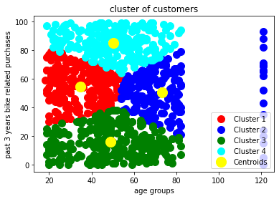
Note: The data and information in this document is reflective of a hypothetical situation and client. This document is to be used for KPMG Virtual Internship purposes only.
Model Development
In the first model, the main customer attraction should be the customers belong to the green cluster between the age group of 20–40 and making the highest number of purchases

Slide 12
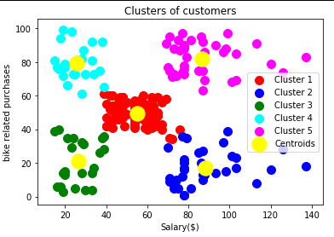
Note: The data and information in this document is reflective of a hypothetical situation and client. This document is to be used for KPMG Virtual Internship purposes only.
Model Development
In the second model customers belonging to the cluster 5 should be reached out highly since they have both a high salary and make more purchases as well.

Slide 13
Note: The data and information in this document is reflective of a hypothetical situation and client. This document is to be used for KPMG Virtual Internship purposes only.
Interpretation
The new customers belong to the three states of Australia , Queensland having 208 potential customers, New South Wales having 452 customers and Victoria City having 234 customers.
In all the three states, the maximum number of customers belong to the Financial services, health and manufacturing sector. Hence the client should focus on reaching more customers belong to these industries.
The customers in the age group of 30–40 and 40–50 have made the maximum number of purchases in the past 3 years.
The client should focus more on increasing the sale of products of the brand Solex and should consider making certain improvements in terms of quality issues for the other brands to maximize market outreach and profit.
It can be concluded that for each brand maximum transactions has been done for products transported via the standard line compared to the products being transported through road, mountain or touring lines.

Slide 14
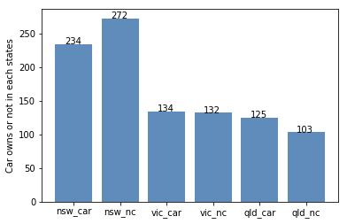
Note: The data and information in this document is reflective of a hypothetical situation and client. This document is to be used for KPMG Virtual Internship purposes only.
Interpretation
NSW should be considered the most since numbers of customers don’t own cars is significantly larger than that own.

Slide 15
Note: The data and information in this document is reflective of a hypothetical situation and client. This document is to be used for KPMG Virtual Internship purposes only.
References
-Datasets by Sprocket Central Pty Ltd
-Attached data analysis workbook in excel
-Python for Model Development
-Tableau for interpretations

