Slide 1
Urban Accessibility for Children: Playground Availability in Berlin
Sharmin Islam

Slide 2
Problem & Motivation
Problem
Urban districts in Berlin show unequal access to public playgrounds.
Some districts have high numbers of children (0–14) but relatively fewer playgrounds, limiting opportunities for play, physical activity, and social interaction.
Why this matters
Child wellbeing & health: Playgrounds support physical, mental, and social development.
Urban equity: Uneven distribution creates spatial inequality across districts.
Urban planning: District-level indicators help planners allocate infrastructure more effectively

Slide 3
State-of-the-Art and Research Gap
State-of-the-Art Approaches
GIS-based district-level analysis using administrative boundaries
OpenStreetMap (OSM) for mapping public playground locations
Indicator-based mapping (playgrounds per 1,000 children)
Integration of official demographic statistics (children aged 0–14)
Limitations of existing approaches
City-level averages hide district-level inequality
Lack of simple indicators for equitable planning

Slide 4
Goals & Objectives
Goals
Quantify playground availability across Berlin districts
Compare supply (playgrounds) with demand (children aged 0–14)
Identify districts with unequal access to child-friendly infrastructure
My project
Combines: Playground locations from OpenStreetMap District boundaries (Bezirke) from Berlin open data Children population (0–14) from official statistics | Methods: Aggregated playground counts per district using QGIS Joined demographic data to district polygons Calculated a key indicator: Playgrounds per 1,000 children
Output: A district-level comparison table A choropleth map showing relative playground availability across Berlin Clear evidence of which districts are relatively underserved

Slide 5
Data Set
How did I find the data?
Playground locations from OpenStreetMap (Geofabrik – Berlin)
District boundaries from ODIS Berlin
Child population (0–14) from Statistik Berlin-Brandenburg
What’s missing?
Playground size, quality, and accessibility
and Distance-based access (walking time)
Socio-economic and environmental factors
Who prepared the data?
OSM data: Volunteer-based, open-source contributors and data is mostly accurate
Boundaries & population: Official Berlin government institutions and data are highly reliable
Can more data be added?
Yes: accessibility networks, playground quality, tree cover, and social indicators

Slide 6
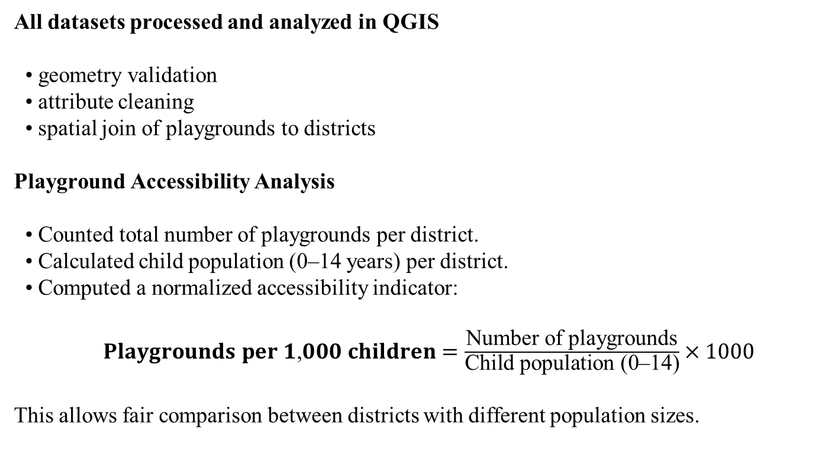
Methods: Exploratory Spatial Analysis (EDA)
All datasets processed and analyzed in QGIS
• geometry validation
• attribute cleaning
• spatial join of playgrounds to districts
Playground Accessibility Analysis
• Counted total number of playgrounds per district.
• Calculated child population (0–14 years) per district.
• Computed a normalized accessibility indicator:
$\text{Playgrounds} \text{per} \text{1}\text{,}\text{000} \text{children}=\frac{\text{Number} \text{of} \text{playgrounds}}{\text{Child} \text{population}\text{ (}\text{0}\text{–}\text{14}\text{)}}×1000$
This allows fair comparison between districts with different population sizes.

Slide 7
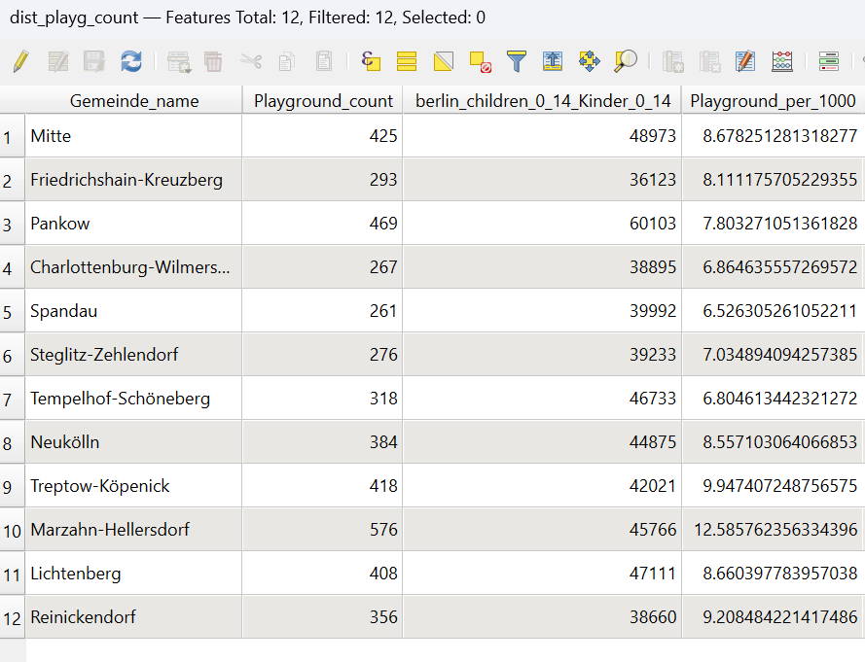
Results and Discussion
Figure: Playground Access per 1,000 Children (Berlin Districts)
Playground access varies notably across Berlin districts
Highest access: Marzahn-Hellersdorf (≈ 12.6 playgrounds / 1,000 children)
Lowest access: Spandau (≈ 6.5 playgrounds / 1,000 children)

Slide 8
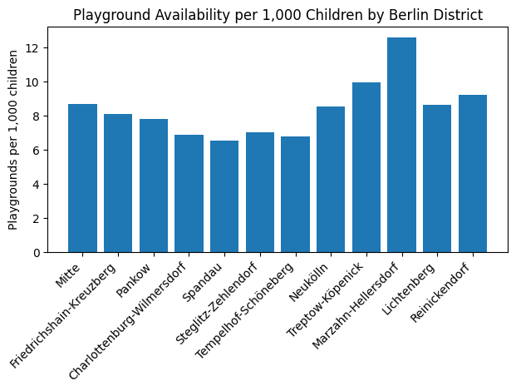
Results and Discussion
Central districts (e.g. Mitte, Friedrichshain-Kreuzberg) show medium levels despite high population
Indicates unequal spatial distribution of playground infrastructure

Slide 9
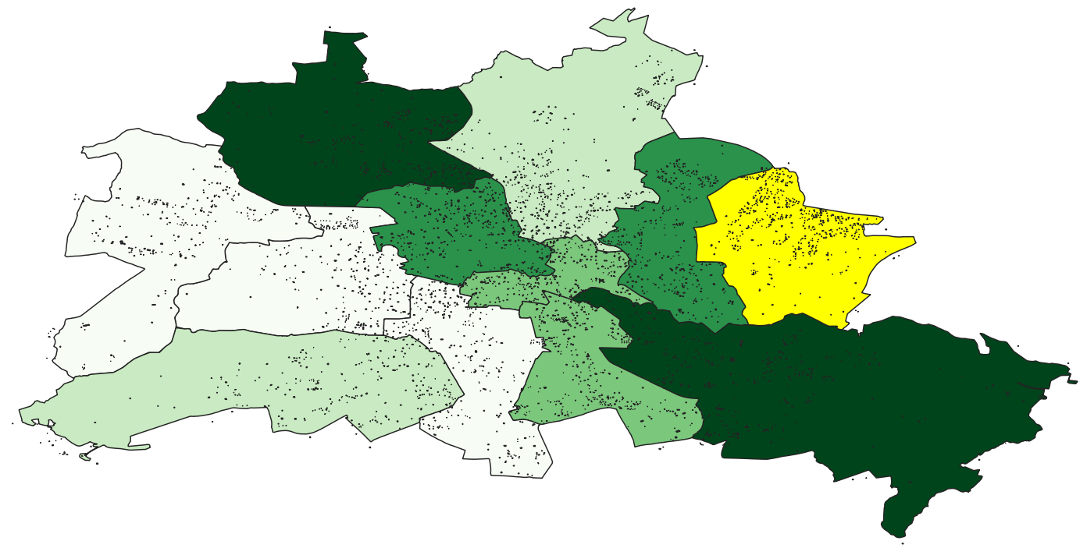
Unequal Access to Playgrounds across Berlin Districts
Dark green → High playgrounds per 1,000 children
Light green / yellow → Medium to low availability
Black dots → Individual playground locations (OSM)
Playground access is uneven across Berlin.
Inner-city districts face lower availability than outer areas

Slide 10
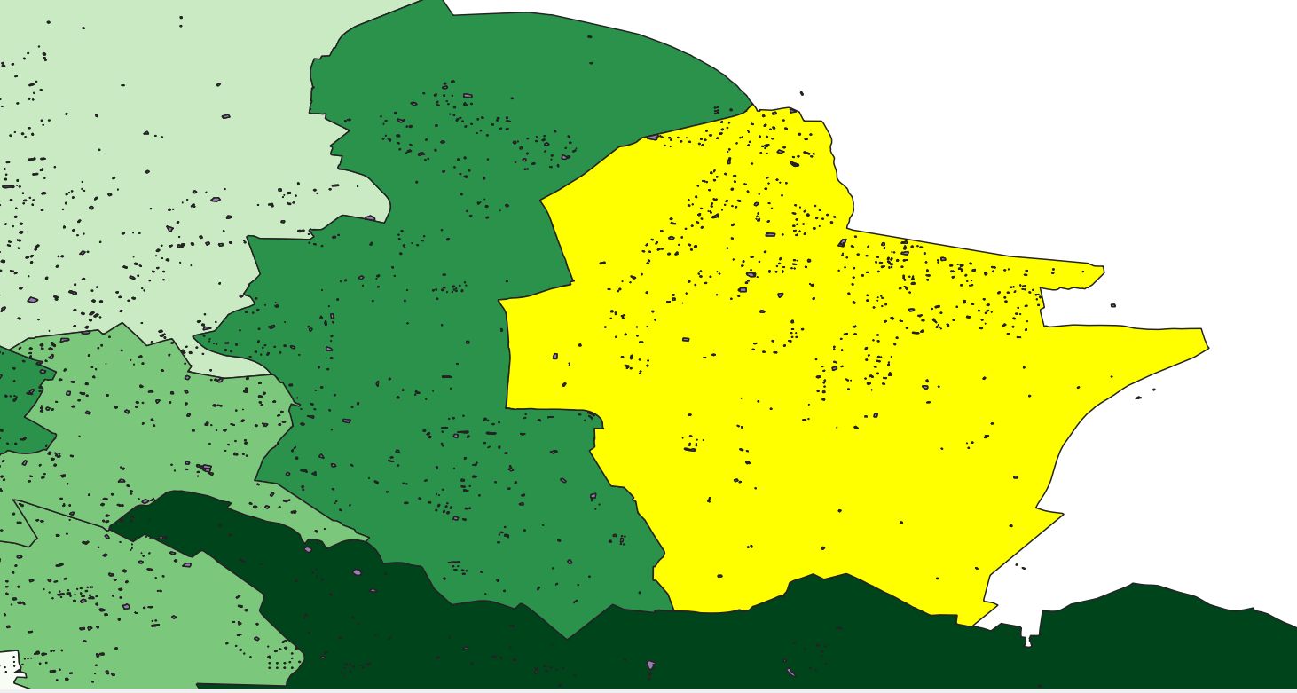
Unequal Access to Playgrounds across Berlin Districts
Child-friendly infrastructure is not evenly accessible city-wide

Slide 11
Recommendations & Future Work
Prioritize inner-city playgrounds with low availability for targeted interventions
Introduce temporary shade structures in heat-exposed playgrounds during summer months
Increase tree planting with large canopy species near playgrounds and school zones
Integrate child population density and basic socio-demographic indicators in planning
Extend this GIS-based approach to other public facilities and cities for comparison

Slide 12
References
OpenStreetMap Playground Data (via Geofabrik):
https://download.geofabrik.de/europe/germany/berlin.html
Berlin District Boundaries (Bezirke):
https://daten.odis-berlin.de/de/dataset/bezirksgrenzen
Population Statistics (Children 0–14):
https://www.statistik-berlin-brandenburg.de/bevoelkerung/demografie/bevoelkerungsstand
OpenStreetMap Project:
https://www.openstreetmap.org
QGIS Documentation:
https://docs.qgis.org
Github Link
https://github.com/eity24/playground_availability_berlin_urbanTech

Slide 13
Questions?
Thank you

