Slide 1
Predicting Electronic Band Gaps of Crystalline Materials from Composition and Structure
Elene Ivaniashvili
Brown University – Data Science 1030
23 October 2025
Github link

Slide 2
Introduction
Goal:
Predict the band gap (eV) of inorganic crystals using only compositional + structural descriptors
Why it matters:
Band gap governs conductivity → semiconductors vs insulators vs metals.
Crucial for materials discovery in photovoltaics, batteries, etc.
Problem type:
Regression

Slide 3
Introduction
Dataset:
Matbench MP Gap (Materials Project 2020 subset)
106 k crystals; each record = structure + PBE band gap
Data Collection:
DFT-computed (PBE functional) results curated via Materials Project API
Challenges
Large dataset: ≈ 106 k crystals → high-dimensional features
Non-iid systems: chemically and structurally correlated (shared elements, prototypes, and DFT biases)

Slide 4
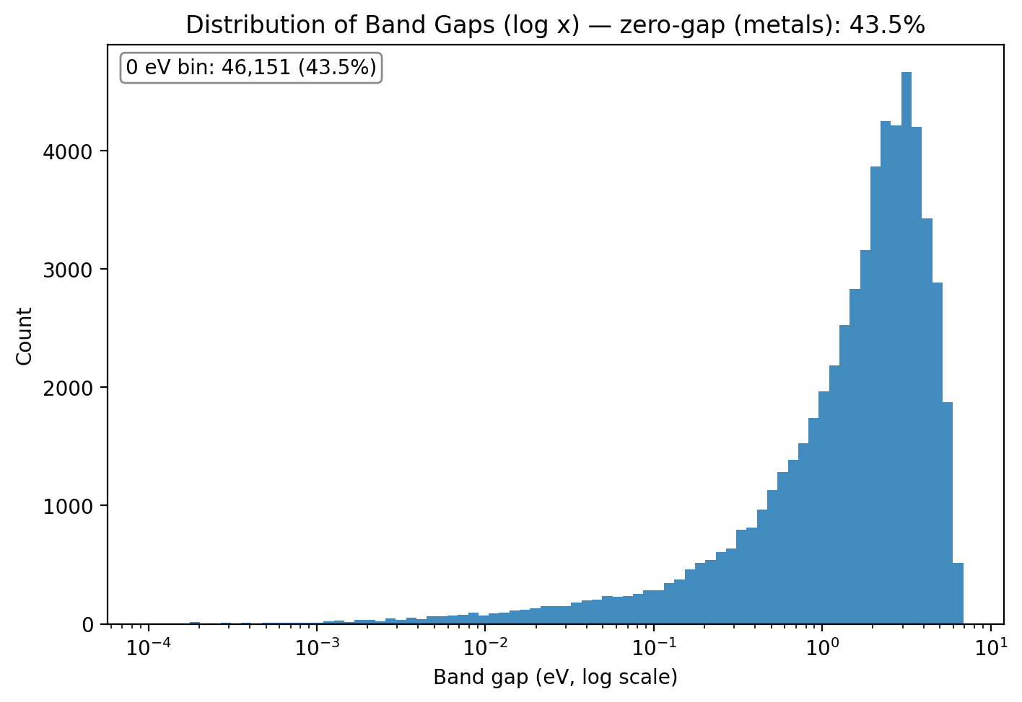
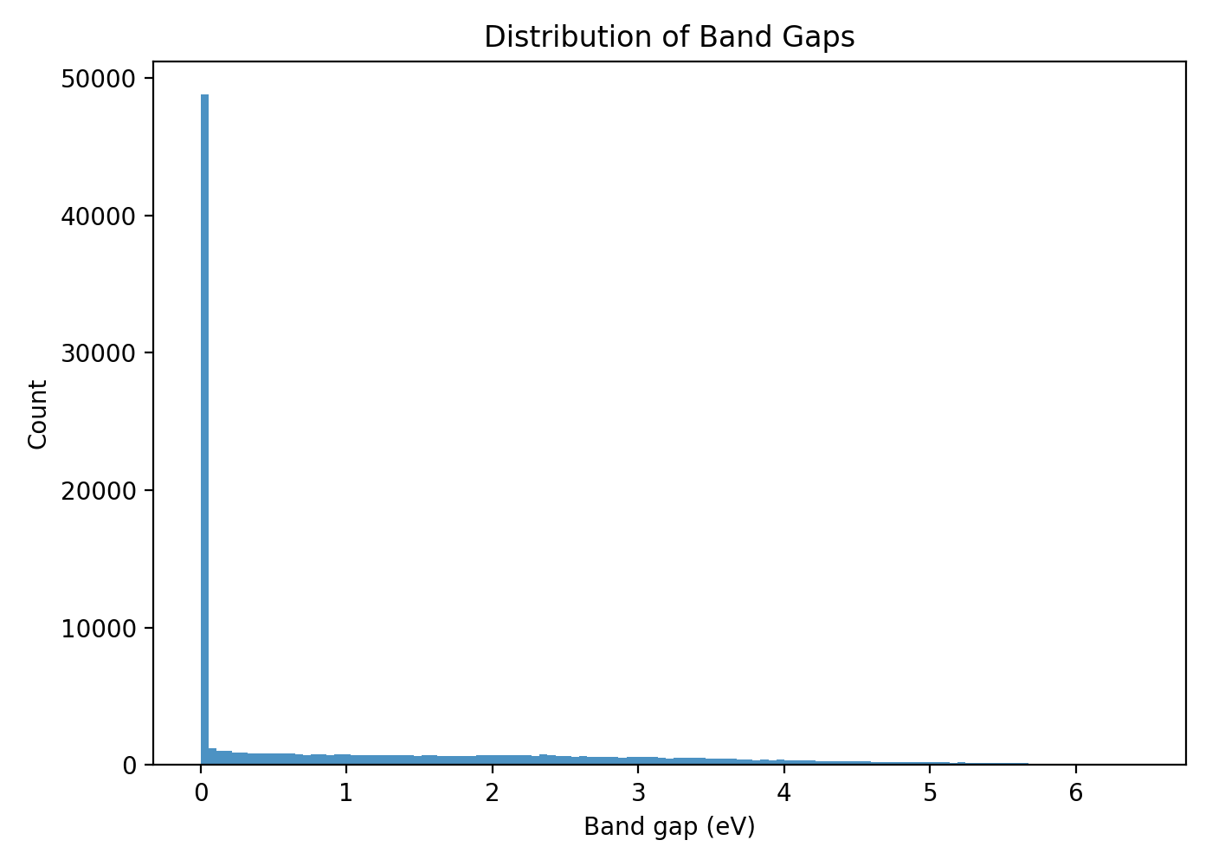
Band Gap Distributions
The sharp spike at 0 eV indicates many metallic or semi-metallic systems.
The log-scaled histogram reveals the continuous spread of non-metallic systems from 10⁻³ eV up to > 6 eV.
The broad peak corresponds to typical semiconductors, while the tail marks wide-gap insulators.
Overall, the log-skewed, heavy-tailed shape is characteristic of crystalline inorganic materials (Matbench MP).

Slide 5
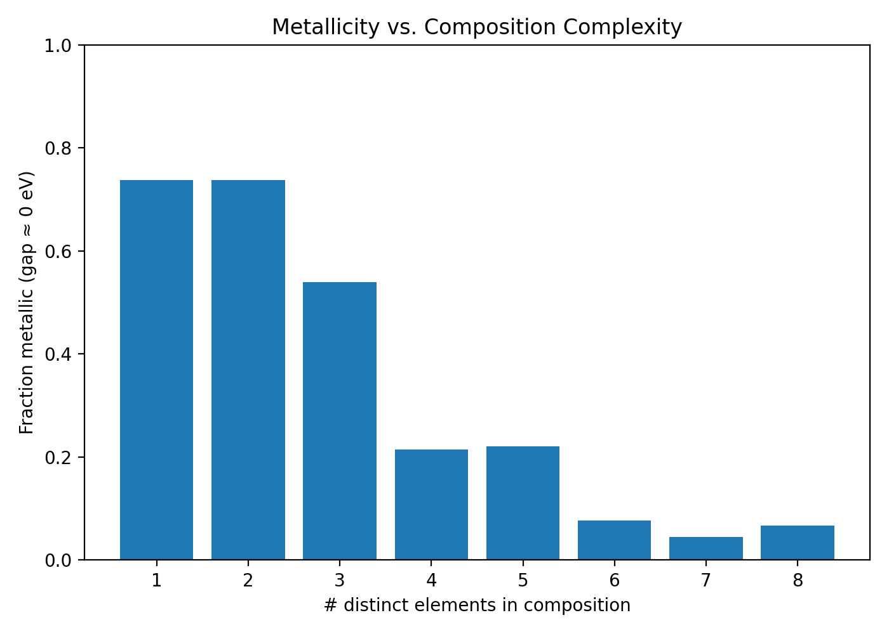
Metalicity vs. Composition Complexity
1- and 2-element systems are metallic ~70 % of the time.
As chemical complexity increases (3 + elements), metallicity drops sharply.
Suggests alloy-like simple compounds favor delocalized electrons, while complex multi-component oxides often open a band gap.

Slide 6
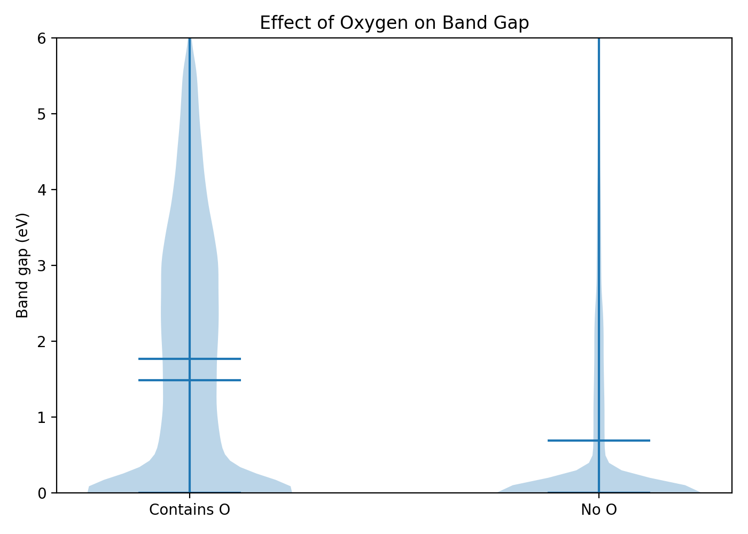
Oxygen Effect
Compounds containing oxygen exhibit clearly larger band gaps.
Oxygen’s high electronegativity and ionic bonding stabilize valence orbitals, effectively widening the energy separation between valence and conduction bands.
O-free compounds cluster near zero, confirming metallic/semimetallic behavior.

Slide 7
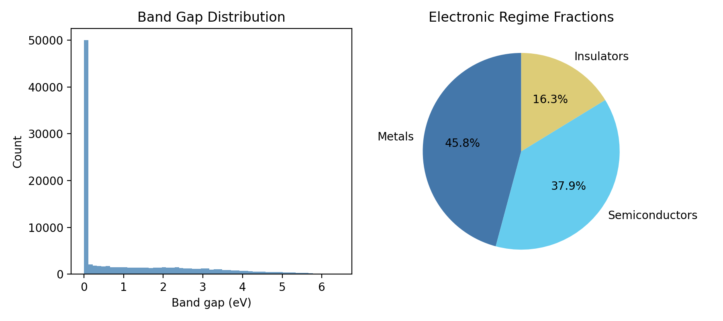
Summary Statistics
 | Metric | Value
0 | Rows | 106113
1 | Mean (eV) | 1.214627
2 | Median (eV) | 0.2738
3 | std (eV) | 1.598966
4 | Min (eV) | 0.0
5 | Max (eV) | 9.7212
6 | Metals (<0.05 eV) | 45.83%
7 | Semiconductors (0.05–3 eV) | 37.90%
8 | Insulators (≥3 eV) | 16.27%
9 | Median # elements | 3.0
10 | Share with O | 49.03%

Slide 8

Featurization
Goal: turn each crystal into fixed-length, physics-meaningful numeric descriptors.
Featurizers used (Matminer):
ElementFraction (one column per element) → captures stoichiometry.
Magpie elemental-property statistics (min/max/range/mean/avg_dev/mode over periodic-table properties) → captures trends in bonding, size, valence, etc.
Feature counts:
118 ElementFraction columns (H…Og)
132 Magpie columns
= 250 total features used downstream
Why this combo: EF encodes what elements and how much; Magpie encodes how those elements tend to behave. Together they reflect both composition and underlying physics important for band gaps.

Slide 9
Preprocessing
Features in scope: 250 total (EF + Magpie); target = band_gap_eV
keep all columns; record missing/zero patterns only
Custom NaN-Aware Scaling
Goal: standardize features (≈0 mean, ≈1 std on train) without altering NaNs or failing on constant columns
Fit: uses np.nanmean / np.nanstd on train → ignores NaNs when estimating mean/std
Transform: X_scaled = (X − mean) / scale
Preserves NaNs (no hidden imputation)
Safe for constant features

Slide 10
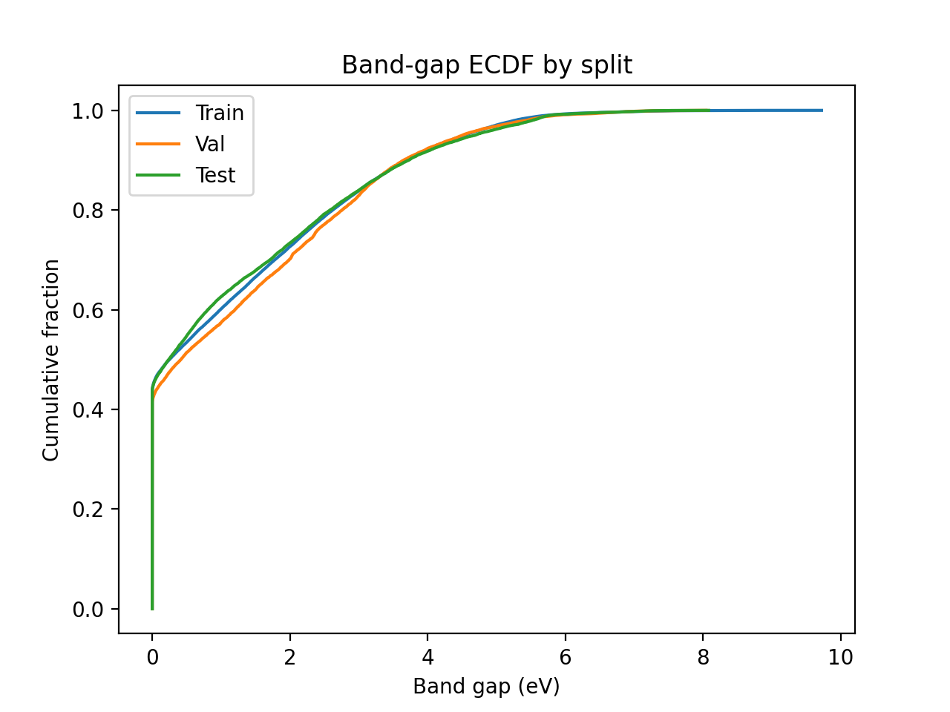
Split Strategy
Method: Two-stage grouped + stratified split using StratifiedGroupKFold (fallback: GroupShuffleSplit)
Groups: by chemical system (e.g., “Li–Fe–O”)
Strata: by band-gap deciles
Goal: Ensure chemically related compositions never cross splits and each subset has a balanced band-gap distribut
Why this split: Prevents information overlap between chemically similar compounds and maintains fair, representative testing
Split | Number of Samples | Mean (eV) | Std (eV)
Train | 66403 | 1.21 | 1.59
Validation | 17545 | 1.28 | 1.60
Test | 22165 | 1.19 | 1.62

Slide 11
Missing Values
True NaNs: none detected across train/val/test (0.0% missing rate)
Zero patterns (ElementFraction): 118 EF features contain mostly or entirely zeros → represents absence of elements, not missing data
Constant columns: 34 EF features are constant (= 0) across all samples → chemically valid (no compounds include those elements)
Interpretation:
Zeros = structural information (element not present)
Missingness tracked for transparency (missing_report.json, zeros_*.csv)

