Slide 1


Data import and visualization with dataPrep: : CHEAT SHEET
Get started
Data import
Outliers
Function for importing and preparing data
Function for removing outliers
Install: devtools::install_git("https://github.com/eivinkas/dataPrep.git", force = TRUE) Load:
library(dataPrep) Add new functions: Add new functions to the GitHub repository: https://github.com/eivinkas/dataPrep/tree/main/R
jatos2r()
removeOutliers()
Export results from JATOS. Save as .txt file.
Example newDf = removeOutliers( df,
numerosity = "numerosity",
answer = "answer",
rt = "rt",
workerID = "workerID",
minRT = 500,
maxRT = Inf,
minCor = 0.3,
iqrFactor = 4,
printSummary = TRUE,
plotOutliers = TRUE,
positionOutliers = "remove" )
Parameters # import data :
json datafile in .txt format (e.g., data exported from JATOS).
filename :
filename in .rds format of output file.
# clean data from_col:
select a column...
trial_name:
... select all names in that column that shall be included. All other rows will be deleted. If ‘all’: select every non-NA row.
col_name:
... select the columns to be
included in the final data set. allow_duplicates:
Some parameters appear
for several trials (e.g., RT appears
typically several times). List those
parameters here.
delete_trial_index:
Delete all data from trial indeces
listed in this vector.
# Output
output_raw:
If TRUE, construct .rds file of data
before cleaning.
output_clean:
If TRUE, construct .rds file of data
after cleaning.
Example
df = jatos2r( data = datafile.txt,
filename = "filename.rds",
from_col = c('trialName', 'trial_type'),
trial_name = list(c('all'), 'survey-likert'),
col_name = list(c('all')),
allow_duplicates = c('rt', 'time_elapsed', 'response'),
delete_trial_index = c(8,10,12),
output_raw = FALSE,
output_clean = TRUE )
Parameters df : Data frame: input data
numerosity: String: column with numerosity data.
response: String: column with participant response data.
rt: String: column with response time.
workerID: String: column with workerID.
minRT: Numeric: Remove outliers: RTs less than minRT.
maxRT: Numeric: Remove outliers: RTs more than maxRT.
minCor: Numeric: Remove persons with numerosity-to- answer correlation lower than minCor.
iqrFactor: Numeric: Remove routliers. Responses <> median +/- iqrFactor*iqr
printSummary: Logical: If TRUE, print summary data.
plotOutliers: Logical: If TRUE, plot outliers (persons only).
positionOutliers: String: put outliers on "top" or "bottom" of original data frame. If "remove": remove outliers.
Explanation
From column ‘trialName’, find ‘all’ trials (e.g., ‘browserCheck, screenCalibration, dotMaskTrial, strategyMC). Collect data from all these trials.
In addition, collect data from all rows containing ‘survey-likert’ in the ‘trial_type’ – column.
Trial index 8,10,12 were training-trials. We do not need the data from these. Remove those rows.
Default Settings
minRT = 500,
maxRT = Inf,
minCor = 0.3,
iqrFactor = 4,

Slide 2
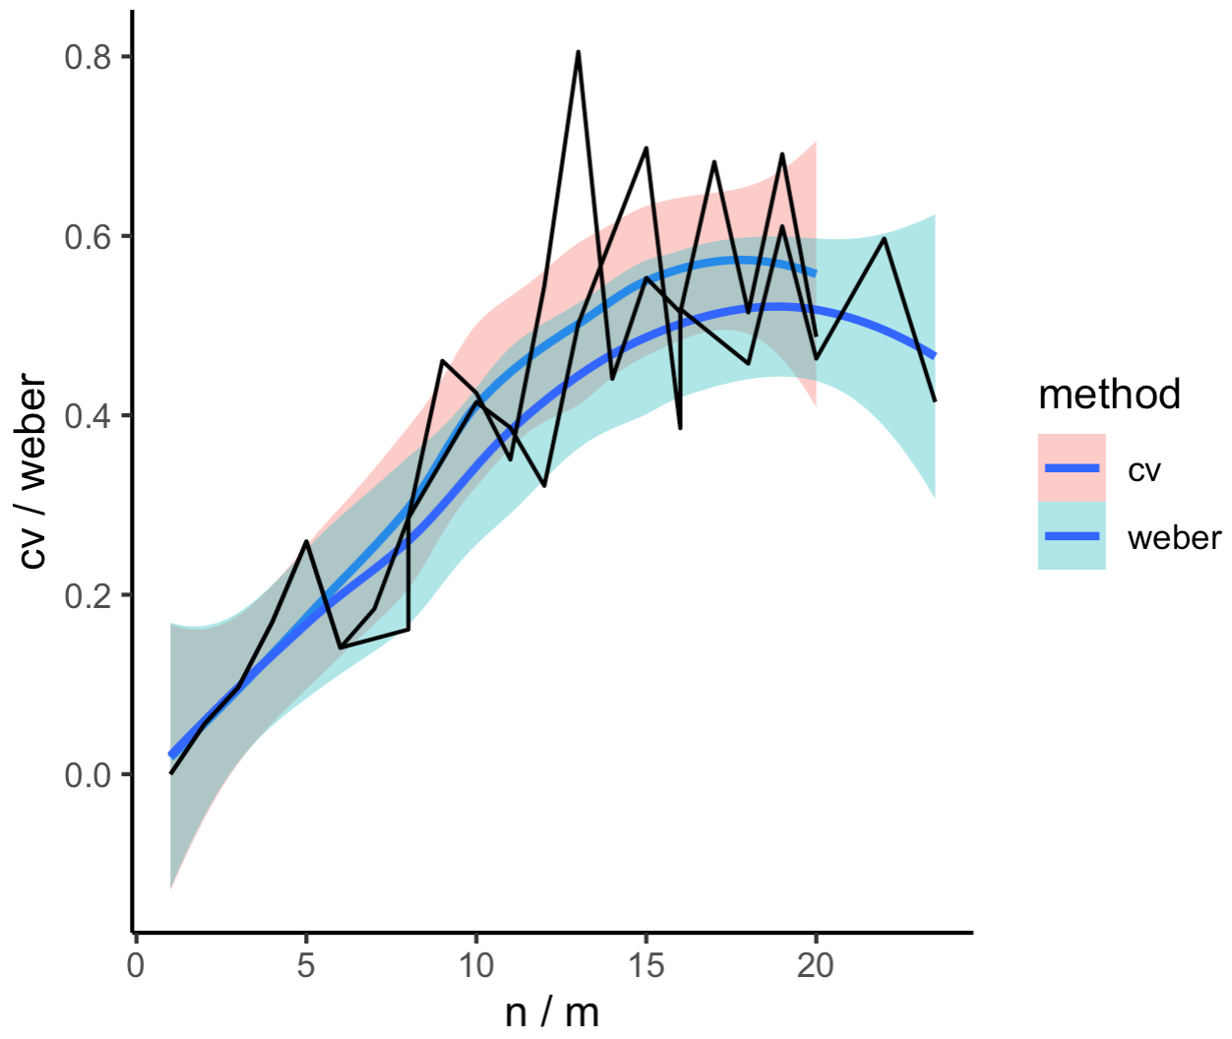
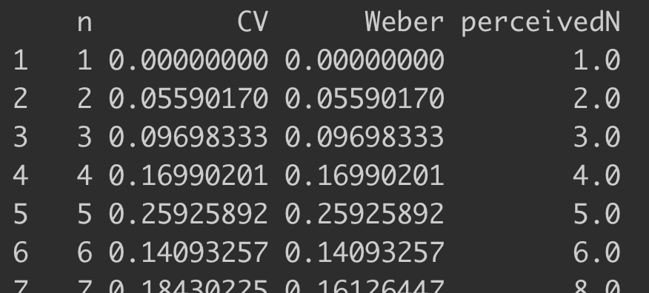
Data import and visualization with dataPrep: : CHEAT SHEET
Weber
Function for calculating CV and Weber’s fraction
weberMeasure()
CV : SD / actual numerosity
Weber’s Fraction : SD / perceived numerosity
Parameters df : Data frame : input data
numerosity: String: column with numerosity data.
answer: String: column with participant response data.
central: String: "median" or "mean».
plot: Logical: If TRUE, plot CV curves.
Example
# load data dat1 <- readRDS("~/Documents/GitHub/dataPrep/R/example.rds")
# Calculate CV and Weber’s fraction
weber = weberMeasure(
dat1,
numerosity = »numerosity",
answer = "answer",
central = "median",
plot = TRUE
)
Output

