Slide 1
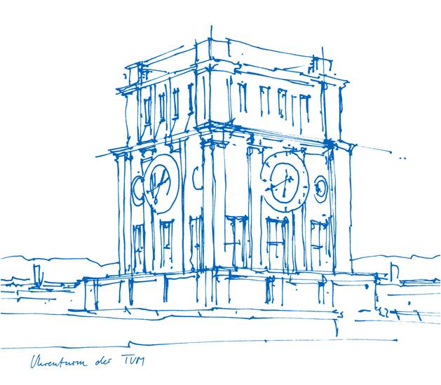
Playing Atari with Deep Reinforcement Learning
Paul Vorderbrügge, Sebastian Rogg, Luca Bozzetti
Technische Universität München
TUM School of Computation, Information and Technology
Seminar - Decision Making Algorithms
09. Juli 2025

Slide 2
Outline
Foundations
Algorithm
Code
Results & Outlook

Slide 3
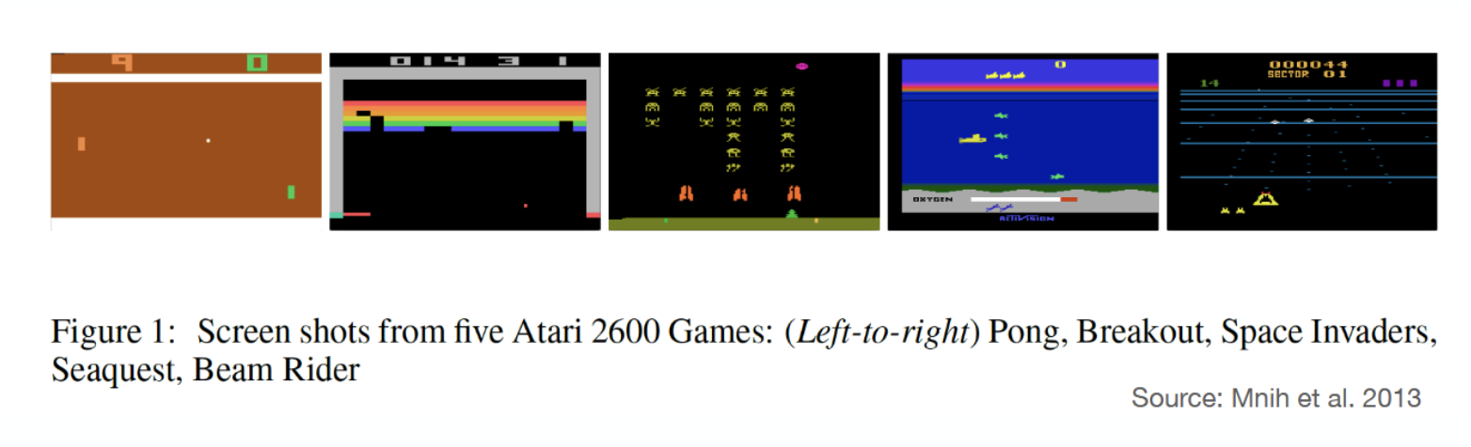
Overview
First deep learning model to learn control policies directly from high-dimensional sensory input (i.e. images) using reinforcement learning.
Prior to this work: hand-engineered features, incorporating large prior knowledge about the problem with simple (e.g. linear) value functions

Slide 4
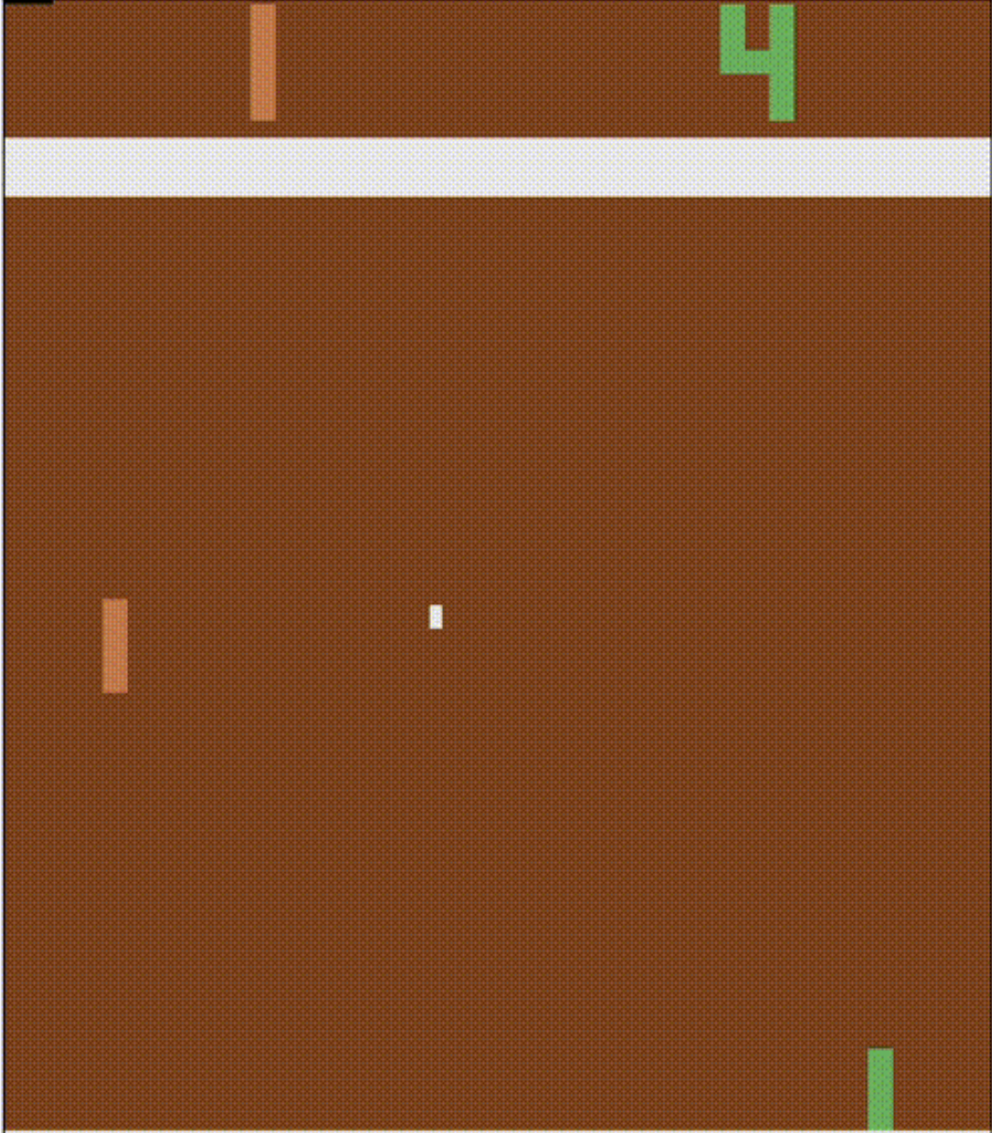
Motivation - Why Raw Input?
GO UP
Model
DO NOTHING
GO DOWN
Model doesn’t need prior knowledge of the problem
Models' performance isn’t reliant on the quality of a hand-crafted feature
Easily applicable to different problems (the same model used for all games)
Learns just like a human

Slide 5
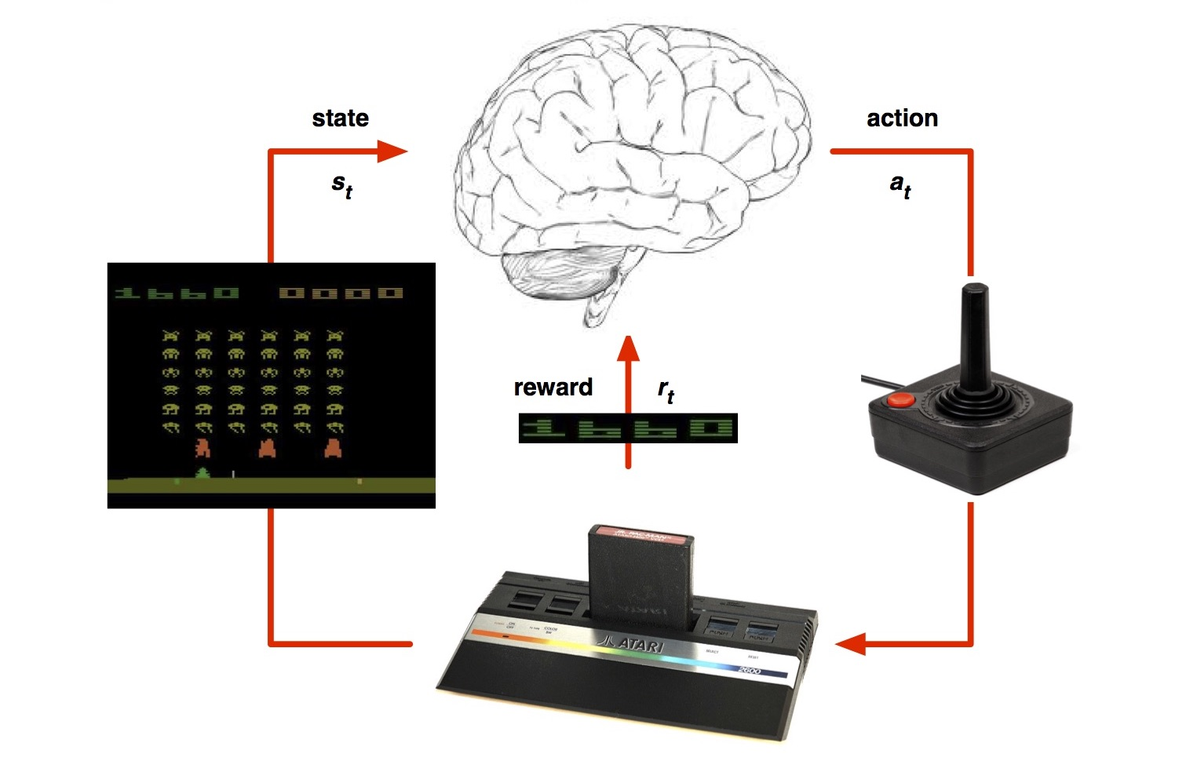


The RL Problem
Agent
At each time step $t$:
Agent chooses action $a_{t}$from a set of legal actions $A = \{1,…, K\}$
Atari Emulator runs the action and returns next state $s_{t+1}$and reward $r_{t}$
Goal: select actions to maximise (discounted) future reward defined as

Slide 6
State
First idea: just use a frame as a state
Problem: Where is the ball going?

Slide 7
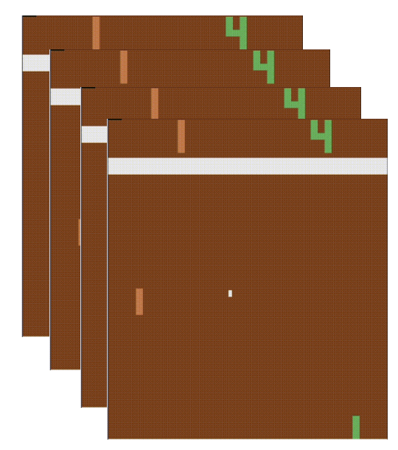
State
Stack 4 frames as one state
This accounts for velocity

Slide 8
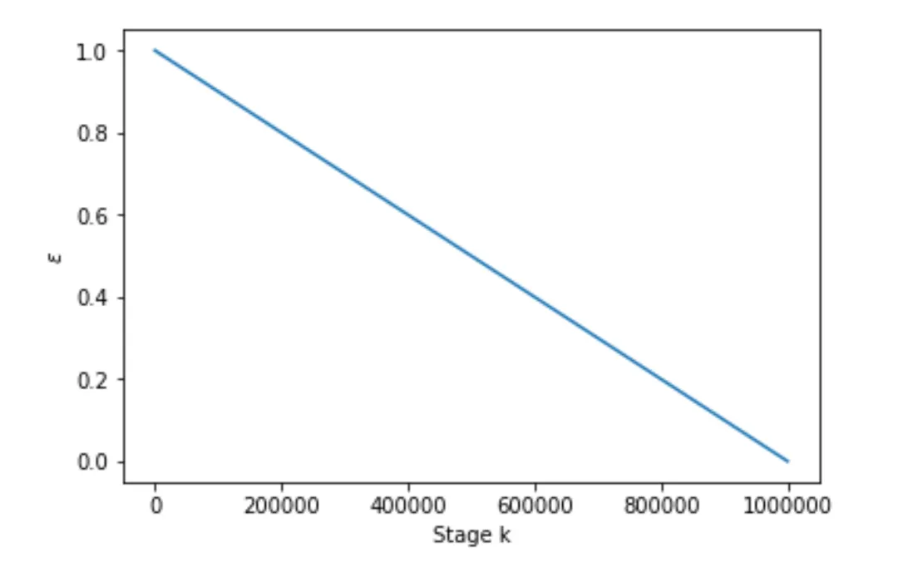
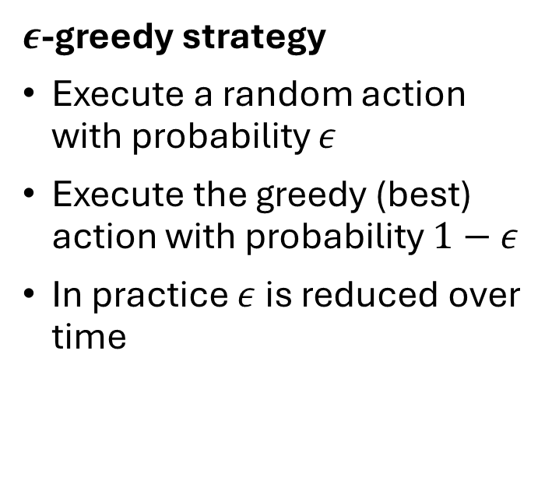
Exploration vs. Exploitation
$ε$-greedy strategy
Execute a random action with probability $ε$
Execute the greedy (best) action with probability $1−ε$
In practice $ε$is reduced over time

Slide 9


Q-Learning
Old concept (1989) but not successfully combined with DL before
Q-function maps {state, action} pairs to future reward:
Optimal q-function maps {state, action} pairs to the max expected reward achievable by any policy:

Slide 10
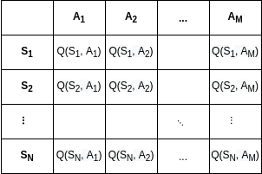

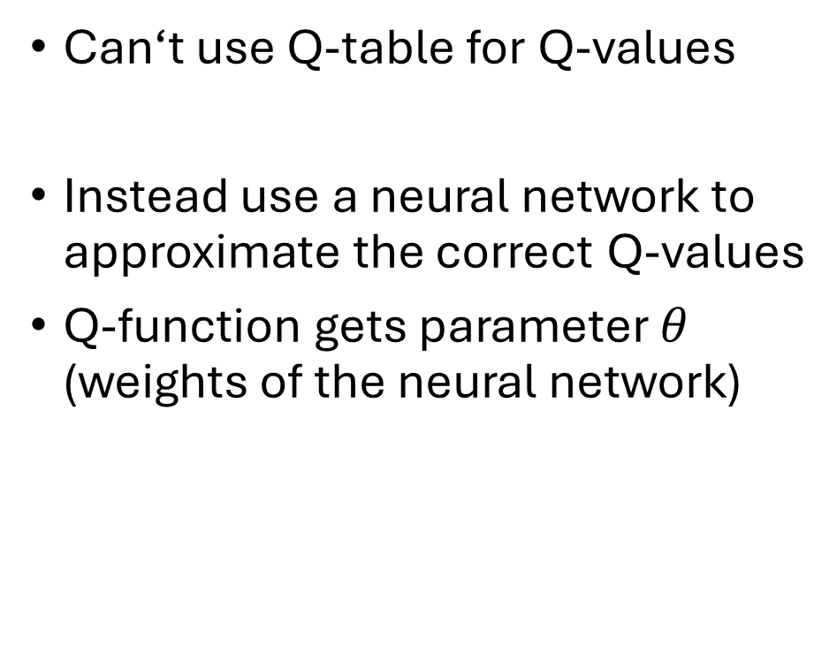
Q-Learning
Can‘t use Q-table for Q-values
Instead use a neural network to approximate the correct Q-values
Q-function gets parameter $θ$ (weights of the neural network)

Slide 11


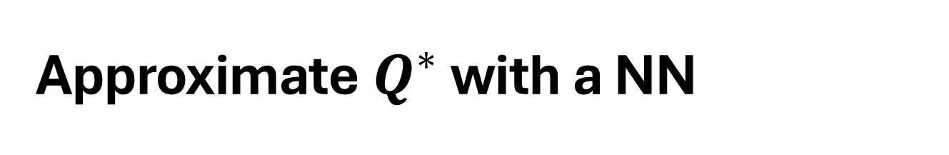
Approximate $Q^{∗}$ with a NN
Training:
Q-Network is trained by minimising a loss function:
with the target defined as:
through gradient descent

Slide 12
Gradient Descent

Slide 13
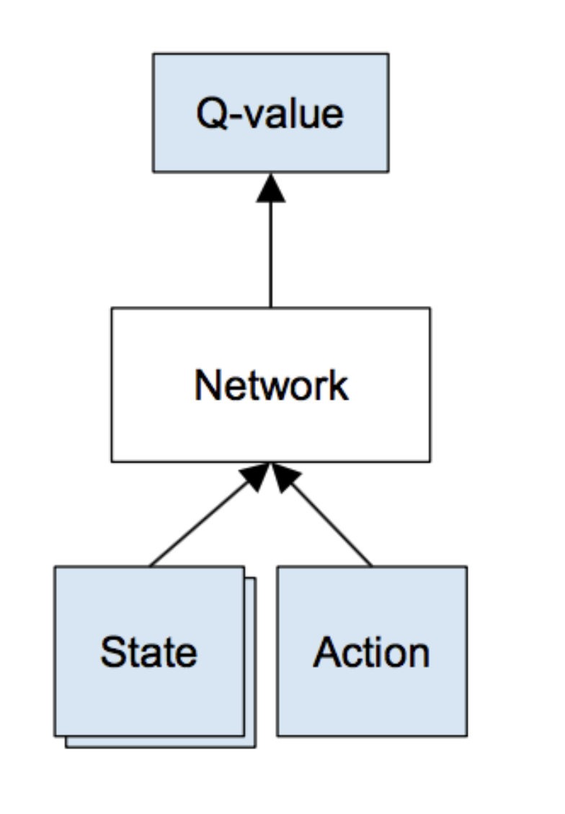
Deep Q-Learning
Naive idea:
Load state and action into neural network get its Q-value – repeat for all actions
Execute action with best Q-value and get reward
Train network based on gathered information <s, a, r, s’>

Slide 14
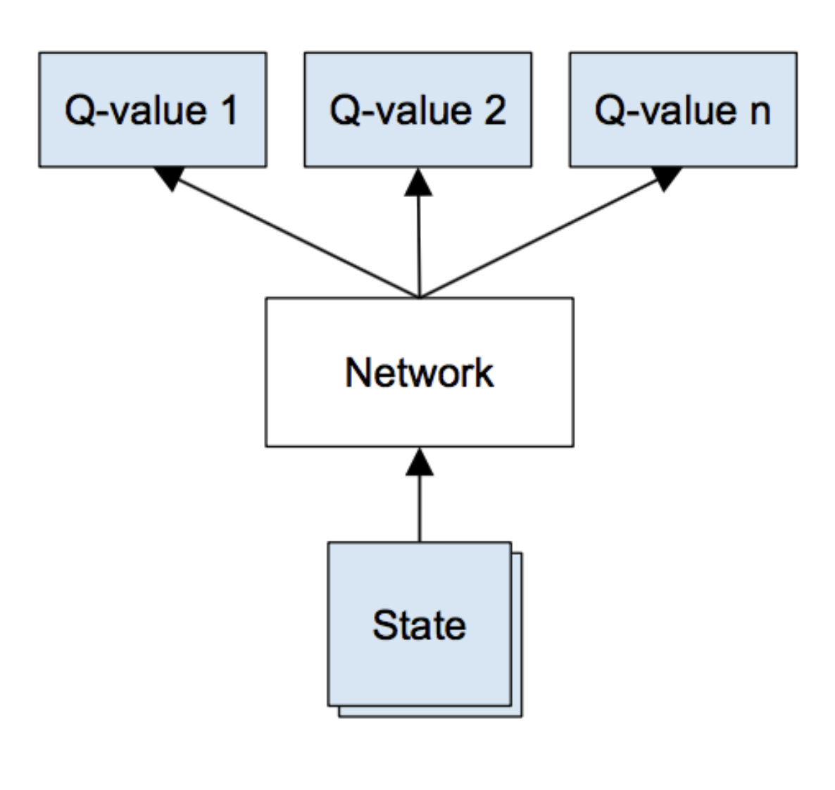
Deep Q-Learning
Better idea:
Load state into neural network get vector of Q-values
Execute action with best Q-value and get reward
Train network based on gathered information <s, a, r, s’>

Slide 15
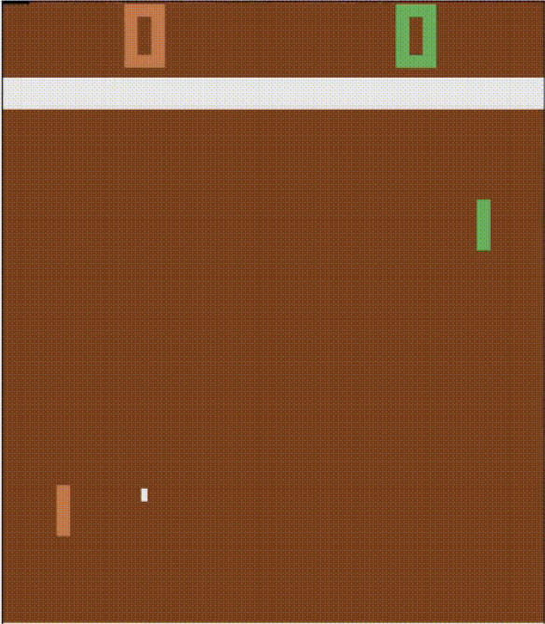
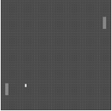

State
Working with 210x160 px and 128 RGB palette is demanding
Grayscale
Down-sampling 110x84 px
Crop 84x84 px
$φ₁=φ(s₁)$

Slide 16
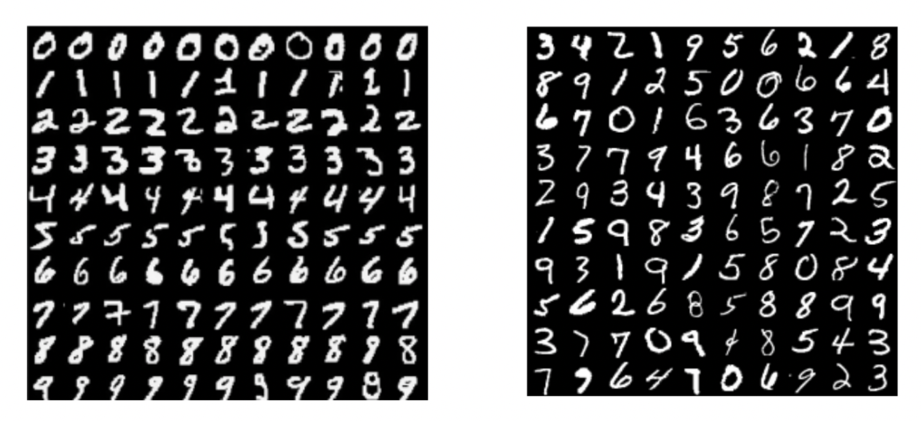
Training - feed in states and learn?
DL assumes data samples are i.i.d.
In RL: sequence of highly correlated states; data distribution changes as policy changes

Slide 17
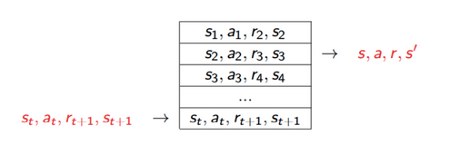

Training - feed in states and learn?
Solution: Experience replay in a replay memory $D$ (Long-Ji Lin, 1993)
Store agent’s experiences <s, a, r, s’>
Random sampling breaks correlation
Update $D$

Slide 18

Alg. 1: Deep Q-learning with Experience Replay
Initialize replay memory 𝒟 to capacity $N$
Initialize action-value function $Q$ with random weights
for episode = 1, $M$ do Initialize sequence $s₁=\{x₁\}$
Preprocess sequence $φ₁=φ(s₁)$ for t = 1, $T$ do With probability $ε$ select a random action $aₜ$ Otherwise select $aₜ=argmaxₐ Q^{∗}\left(φ\left(sₜ\right), a; θ\right)$ Execute action $aₜ$ in emulator and observe reward $rₜ$ and image $xₜ₊₁$ Set $sₜ₊₁=sₜ, aₜ, xₜ₊₁$ and preprocess $φₜ₊₁ = φ(sₜ₊₁)$ Store transition $(φₜ, aₜ, rₜ, φₜ₊₁)$ in 𝒟 Sample random minibatch of transitions $(φⱼ, aⱼ, rⱼ, φⱼ₊₁)$ from 𝒟 Set $y_{j}= \left\{\begin{aligned}r_{j} \text{for} \text{terminal} φ_{j+1} \\ r_{j}+ γ \max_{a^{′}}Q\left(φ_{j+1}, a^{′};θ\right) \text{for} \text{non}\text{−}\text{terminal} φ_{j+1}\end{aligned}\right.$
perform a gradient descent step on ${\left(yⱼ − Q\left(φⱼ, aⱼ; θ\right)\right)}^{2}$ end for end for

Slide 19
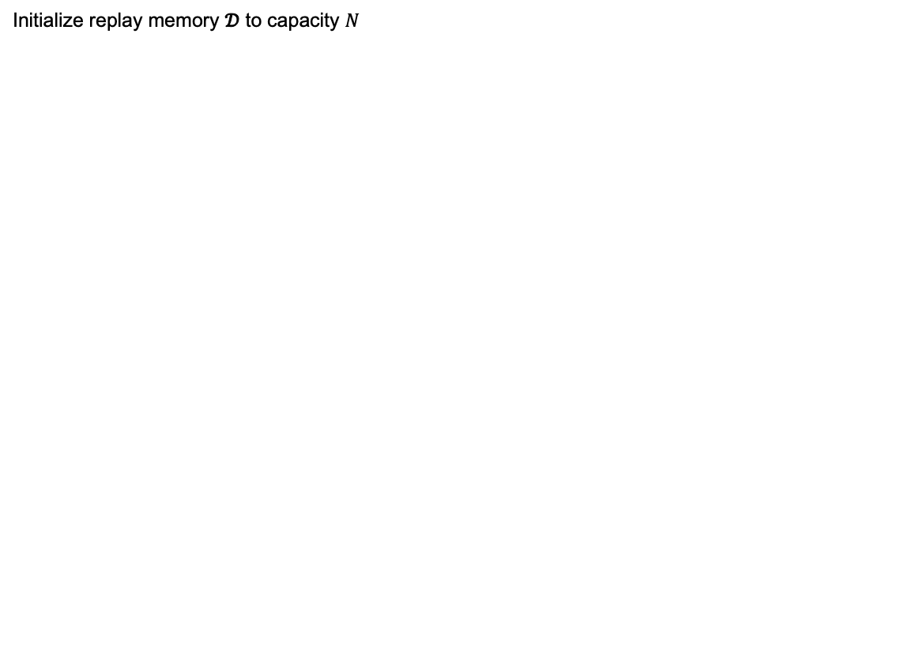
Alg. 1: Deep Q-learning with Experience Replay
Initialize replay memory 𝒟 to capacity $N$
Initialize action-value function $Q$ with random weights
for episode = 1, $M$ do Initialize sequence $s₁=\{x₁\}$
Preprocess sequence $φ₁=φ(s₁)$ for t = 1, $T$ do With probability $ε$ select a random action $aₜ$ Otherwise select $aₜ=argmaxₐ Q^{∗}\left(φ\left(sₜ\right), a; θ\right)$ Execute action $aₜ$ in emulator and observe reward $rₜ$ and image $xₜ₊₁$ Set $sₜ₊₁=sₜ, aₜ, xₜ₊₁$ and preprocess $φₜ₊₁ = φ(sₜ₊₁)$ Store transition $(φₜ, aₜ, rₜ, φₜ₊₁)$ in 𝒟 Sample random minibatch of transitions $(φⱼ, aⱼ, rⱼ, φⱼ₊₁)$ from 𝒟 Set $y_{j}= \left\{\begin{aligned}r_{j} \text{for} \text{terminal} φ_{j+1} \\ r_{j}+ γ \max_{a^{′}}Q\left(φ_{j+1}, a^{′};θ\right) \text{for} \text{non}\text{−}\text{terminal} φ_{j+1}\end{aligned}\right.$
perform a gradient descent step on ${\left(yⱼ − Q\left(φⱼ, aⱼ; θ\right)\right)}^{2}$ end for end for
Replay Memory
1
...
N

Slide 20
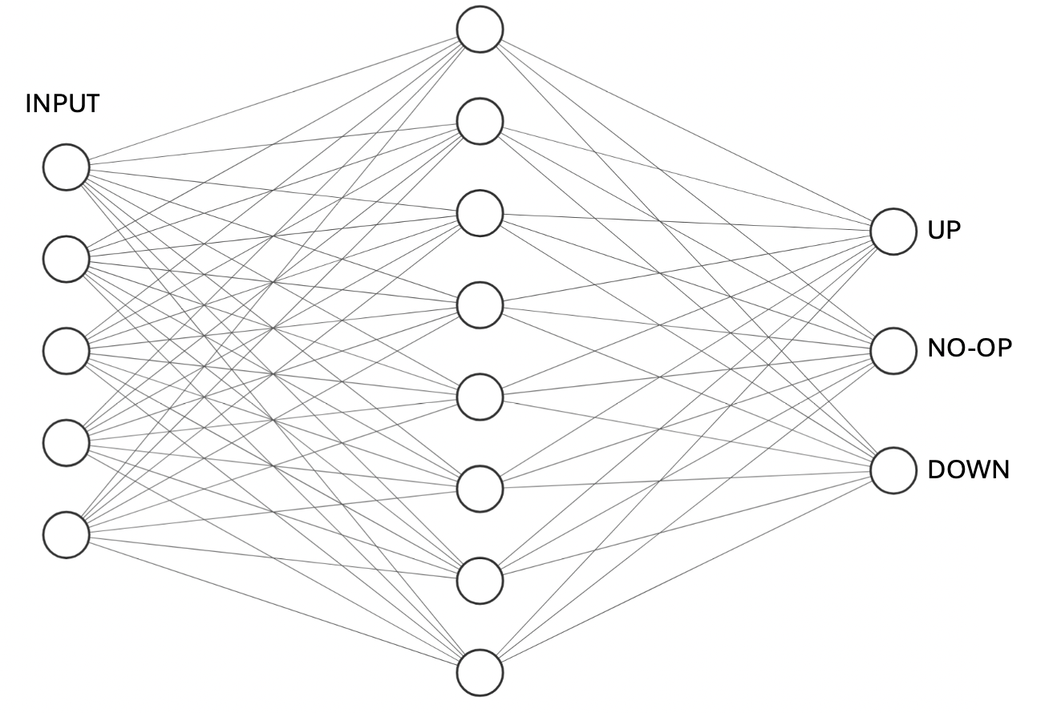
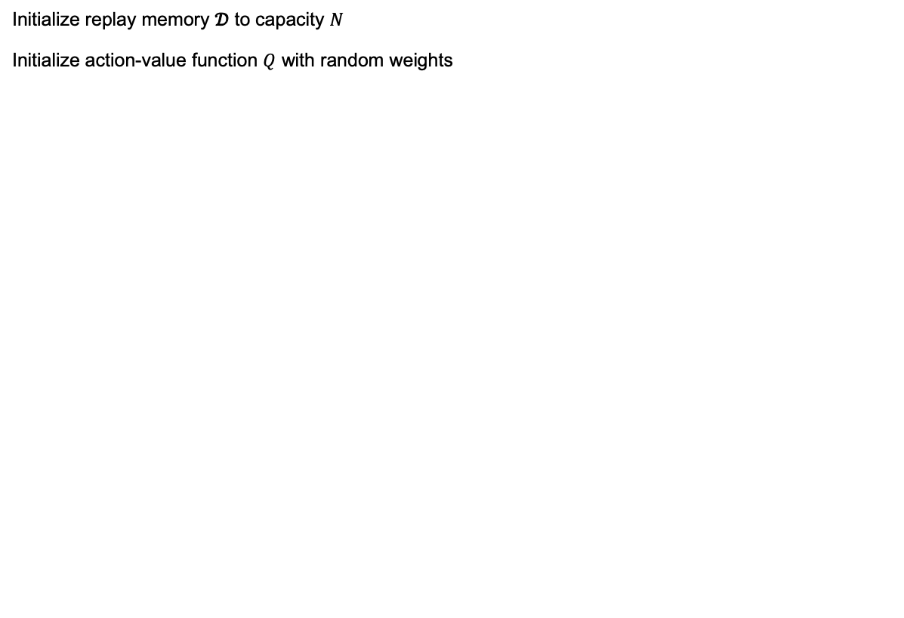
Alg. 1: Deep Q-learning with Experience Replay
Initialize replay memory 𝒟 to capacity $N$
Initialize action-value function $Q$ with random weights
for episode = 1, $M$ do Initialize sequence $s₁=\{x₁\}$
Preprocess sequence $φ₁=φ(s₁)$ for t = 1, $T$ do With probability $ε$ select a random action $aₜ$ Otherwise select $aₜ=argmaxₐ Q^{∗}\left(φ\left(sₜ\right), a; θ\right)$ Execute action $aₜ$ in emulator and observe reward $rₜ$ and image $xₜ₊₁$ Set $sₜ₊₁=sₜ, aₜ, xₜ₊₁$ and preprocess $φₜ₊₁ = φ(sₜ₊₁)$ Store transition $(φₜ, aₜ, rₜ, φₜ₊₁)$ in 𝒟 Sample random minibatch of transitions $(φⱼ, aⱼ, rⱼ, φⱼ₊₁)$ from 𝒟 Set $y_{j}= \left\{\begin{aligned}r_{j} \text{for} \text{terminal} φ_{j+1} \\ r_{j}+ γ \max_{a^{′}}Q\left(φ_{j+1}, a^{′};θ\right) \text{for} \text{non}\text{−}\text{terminal} φ_{j+1}\end{aligned}\right.$
perform a gradient descent step on ${\left(yⱼ − Q\left(φⱼ, aⱼ; θ\right)\right)}^{2}$ end for end for

Slide 21
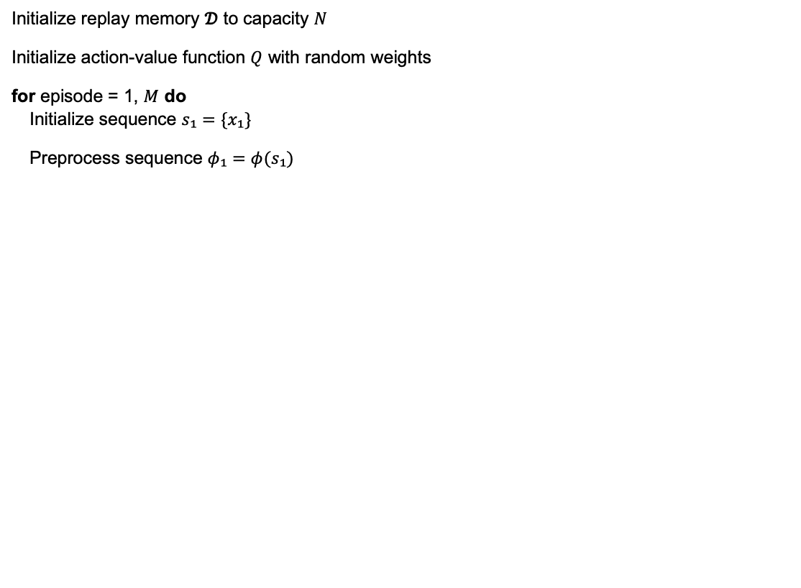
Alg. 1: Deep Q-learning with Experience Replay
Initialize replay memory 𝒟 to capacity $N$
Initialize action-value function $Q$ with random weights
for episode = 1, $M$ do Initialize sequence $s₁=\{x₁\}$
Preprocess sequence $φ₁=φ(s₁)$ for t = 1, $T$ do With probability $ε$ select a random action $aₜ$ Otherwise select $aₜ=argmaxₐ Q^{∗}\left(φ\left(sₜ\right), a; θ\right)$ Execute action $aₜ$ in emulator and observe reward $rₜ$ and image $xₜ₊₁$ Set $sₜ₊₁=sₜ, aₜ, xₜ₊₁$ and preprocess $φₜ₊₁ = φ(sₜ₊₁)$ Store transition $(φₜ, aₜ, rₜ, φₜ₊₁)$ in 𝒟 Sample random minibatch of transitions $(φⱼ, aⱼ, rⱼ, φⱼ₊₁)$ from 𝒟 Set $y_{j}= \left\{\begin{aligned}r_{j} \text{for} \text{terminal} φ_{j+1} \\ r_{j}+ γ \max_{a^{′}}Q\left(φ_{j+1}, a^{′};θ\right) \text{for} \text{non}\text{−}\text{terminal} φ_{j+1}\end{aligned}\right.$
perform a gradient descent step on ${\left(yⱼ − Q\left(φⱼ, aⱼ; θ\right)\right)}^{2}$ end for end for

Slide 22
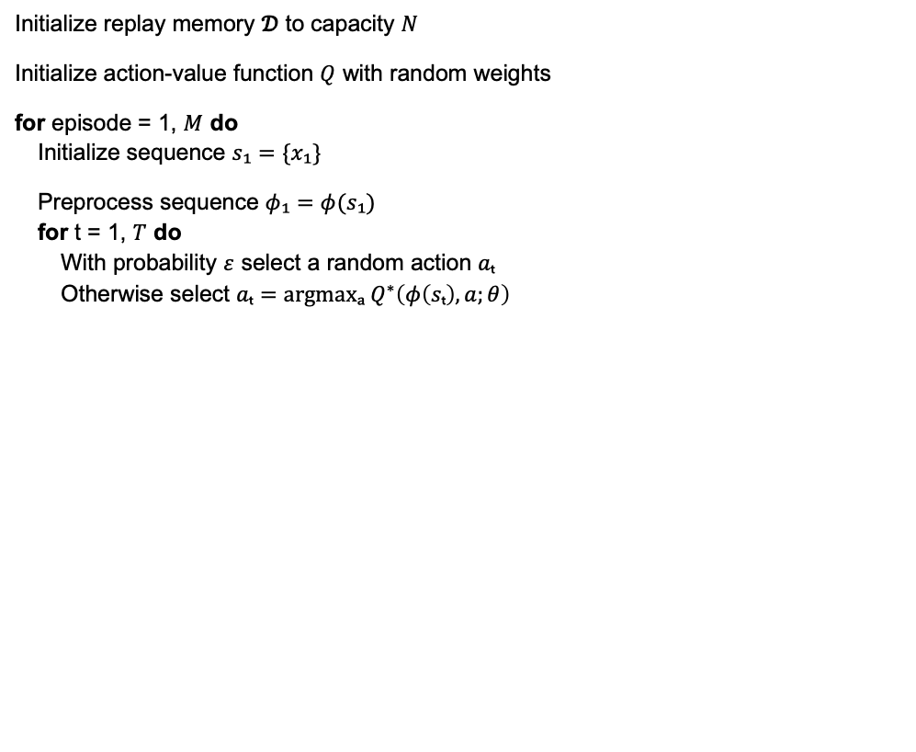
Alg. 1: Deep Q-learning with Experience Replay
Initialize replay memory 𝒟 to capacity $N$
Initialize action-value function $Q$ with random weights
for episode = 1, $M$ do Initialize sequence $s₁=\{x₁\}$
Preprocess sequence $φ₁=φ(s₁)$ for t = 1, $T$ do With probability $ε$ select a random action $aₜ$ Otherwise select $aₜ=argmaxₐ Q^{∗}\left(φ\left(sₜ\right), a;θ\right)$ Execute action $aₜ$ in emulator and observe reward $rₜ$ and image $xₜ₊₁$ Set $sₜ₊₁=sₜ, aₜ, xₜ₊₁$ and preprocess $φₜ₊₁ = φ(sₜ₊₁)$ Store transition $(φₜ, aₜ, rₜ, φₜ₊₁)$ in 𝒟 Sample random minibatch of transitions $(φⱼ, aⱼ, rⱼ, φⱼ₊₁)$ from 𝒟 Set $y_{j}= \left\{\begin{aligned}r_{j} \text{for} \text{terminal} φ_{j+1} \\ r_{j}+ γ \max_{a^{′}}Q\left(φ_{j+1}, a^{′};θ\right) \text{for} \text{non}\text{−}\text{terminal} φ_{j+1}\end{aligned}\right.$
perform a gradient descent step on ${\left(yⱼ − Q\left(φⱼ, aⱼ; θ\right)\right)}^{2}$ end for end for
22

Slide 23
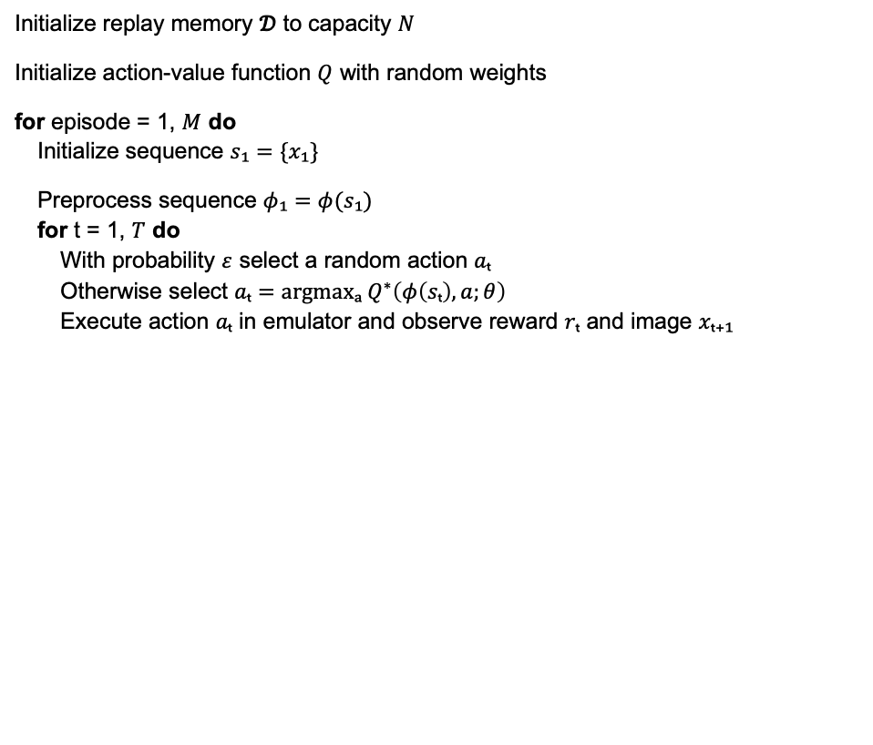
Alg. 1: Deep Q-learning with Experience Replay
Initialize replay memory 𝒟 to capacity $N$
Initialize action-value function $Q$ with random weights
for episode = 1, $M$ do Initialize sequence $s₁=\{x₁\}$
Preprocess sequence $φ₁=φ(s₁)$ for t = 1, $T$ do With probability $ε$ select a random action $aₜ$ Otherwise select $aₜ=argmaxₐ Q^{∗}\left(φ\left(sₜ\right), a;θ\right)$ Execute action $aₜ$ in emulator and observe reward $rₜ$ and image $xₜ₊₁$ Set $sₜ₊₁=sₜ, aₜ, xₜ₊₁$ and preprocess $φₜ₊₁ = φ(sₜ₊₁)$ Store transition $(φₜ, aₜ, rₜ, φₜ₊₁)$ in 𝒟 Sample random minibatch of transitions $(φⱼ, aⱼ, rⱼ, φⱼ₊₁)$ from 𝒟 Set $y_{j}= \left\{\begin{aligned}r_{j} \text{for} \text{terminal} φ_{j+1} \\ r_{j}+ γ \max_{a^{′}}Q\left(φ_{j+1}, a^{′};θ\right) \text{for} \text{non}\text{−}\text{terminal} φ_{j+1}\end{aligned}\right.$
perform a gradient descent step on ${\left(yⱼ − Q\left(φⱼ, aⱼ; θ\right)\right)}^{2}$ end for end for

Slide 24
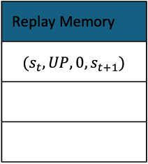
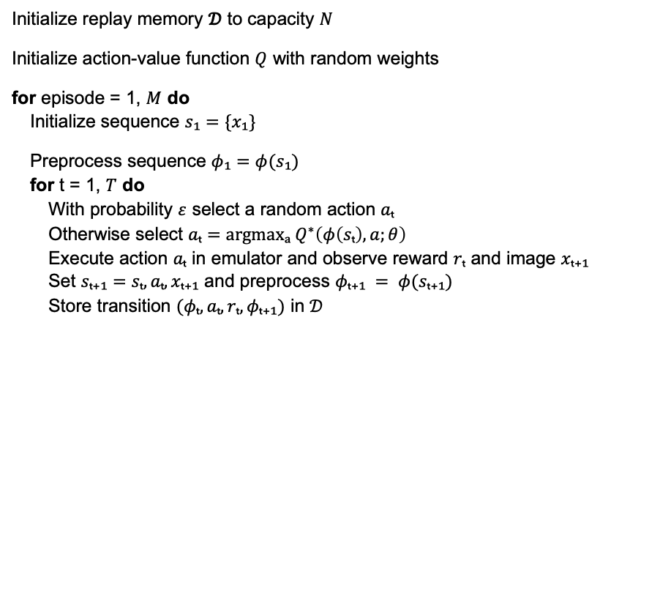
Alg. 1: Deep Q-learning with Experience Replay
Initialize replay memory 𝒟 to capacity $N$
Initialize action-value function $Q$ with random weights
for episode = 1, $M$ do Initialize sequence $s₁=\{x₁\}$
Preprocess sequence $φ₁=φ(s₁)$ for t = 1, $T$ do With probability $ε$ select a random action $aₜ$ Otherwise select $aₜ=argmaxₐ Q^{∗}\left(φ\left(sₜ\right), a;θ\right)$ Execute action $aₜ$ in emulator and observe reward $rₜ$ and image $xₜ₊₁$ Set $sₜ₊₁=sₜ, aₜ, xₜ₊₁$ and preprocess $φₜ₊₁ = φ(sₜ₊₁)$ Store transition $(φₜ, aₜ, rₜ, φₜ₊₁)$ in 𝒟 Sample random minibatch of transitions $(φⱼ, aⱼ, rⱼ, φⱼ₊₁)$ from 𝒟 Set $y_{j}= \left\{\begin{aligned}r_{j} \text{for} \text{terminal} φ_{j+1} \\ r_{j}+ γ \max_{a^{′}}Q\left(φ_{j+1}, a^{′};θ\right) \text{for} \text{non}\text{−}\text{terminal} φ_{j+1}\end{aligned}\right.$
perform a gradient descent step on ${\left(yⱼ − Q\left(φⱼ, aⱼ; θ\right)\right)}^{2}$ end for end for
Replay Memory
$$(s_{t},UP, 0, s_{t+1})$$
24

Slide 25
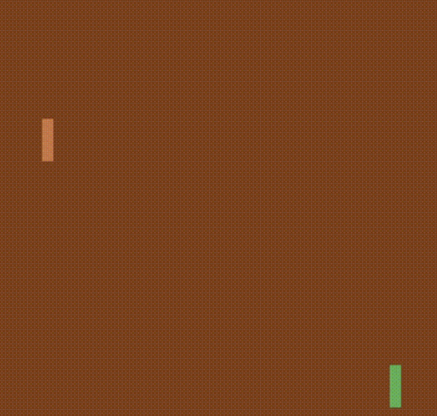


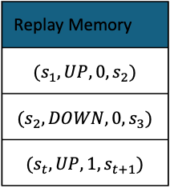
Alg. 1: Deep Q-learning with Experience Replay
Initialize replay memory 𝒟 to capacity $N$
Initialize action-value function $Q$ with random weights
for episode = 1, $M$ do Initialize sequence $s₁=\{x₁\}$
Preprocess sequence $φ₁=φ(s₁)$ for t = 1, $T$ do With probability $ε$ select a random action $aₜ$ Otherwise select $aₜ=argmaxₐ Q^{∗}\left(φ\left(sₜ\right), a;θ\right)$ Execute action $aₜ$ in emulator and observe reward $rₜ$ and image $xₜ₊₁$ Set $sₜ₊₁=sₜ, aₜ, xₜ₊₁$ and preprocess $φₜ₊₁ = φ(sₜ₊₁)$ Store transition $(φₜ, aₜ, rₜ, φₜ₊₁)$ in 𝒟 Sample random minibatch of transitions $(φⱼ, aⱼ, rⱼ, φⱼ₊₁)$ from 𝒟 Set $y_{j}= \left\{\begin{aligned}r_{j} \text{for} \text{terminal} φ_{j+1} \\ r_{j}+ γ \max_{a^{′}}Q\left(φ_{j+1}, a^{′};θ\right) \text{for} \text{non}\text{−}\text{terminal} φ_{j+1}\end{aligned}\right.$
perform a gradient descent step on ${\left(yⱼ − Q\left(φⱼ, aⱼ; θ\right)\right)}^{2}$ end for end for
Replay Memory
$$(s_{1},UP, 0, s_{2})$$
$$(s_{2},DOWN, 0, s_{3})$$
$$(s_{t},UP, 1, s_{t+1})$$

Slide 26
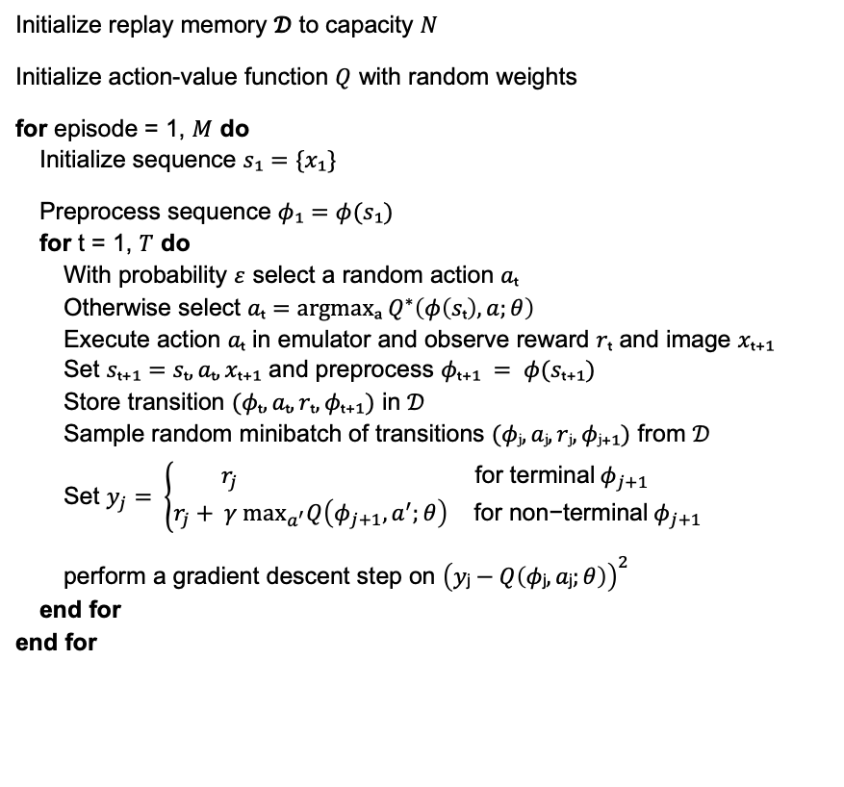
Alg. 1: Deep Q-learning with Experience Replay
Initialize replay memory 𝒟 to capacity $N$
Initialize action-value function $Q$ with random weights
for episode = 1, $M$ do Initialize sequence $s₁=\{x₁\}$
Preprocess sequence $φ₁=φ(s₁)$ for t = 1, $T$ do With probability $ε$ select a random action $aₜ$ Otherwise select $aₜ=argmaxₐ Q^{∗}\left(φ\left(sₜ\right), a;θ\right)$ Execute action $aₜ$ in emulator and observe reward $rₜ$ and image $xₜ₊₁$ Set $sₜ₊₁=sₜ, aₜ, xₜ₊₁$ and preprocess $φₜ₊₁ = φ(sₜ₊₁)$ Store transition $(φₜ, aₜ, rₜ, φₜ₊₁)$ in 𝒟 Sample random minibatch of transitions $(φⱼ, aⱼ, rⱼ, φⱼ₊₁)$ from 𝒟 Set $y_{j}= \left\{\begin{aligned}r_{j} \text{for} \text{terminal} φ_{j+1} \\ r_{j}+ γ \max_{a^{′}}Q\left(φ_{j+1}, a^{′};θ\right) \text{for} \text{non}\text{−}\text{terminal} φ_{j+1}\end{aligned}\right.$
perform a gradient descent step on ${\left(yⱼ−Q\left(φⱼ, aⱼ;θ\right)\right)}^{2}$ end for end for
Replay Memory
$$(s_{1},UP, 0, s_{2})$$
$$(s_{2},DOWN, 0, s_{3})$$
$$(s_{t},UP, 1, s_{t+1})$$
26

Slide 27
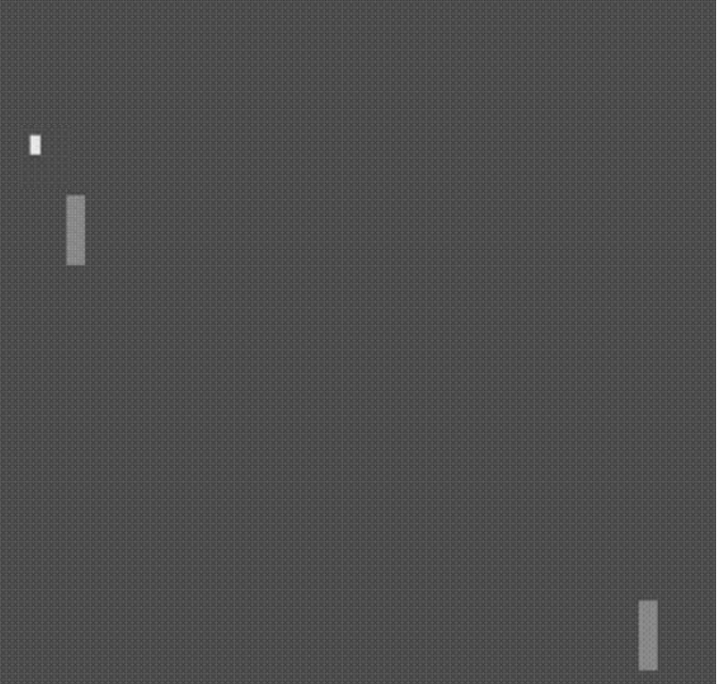
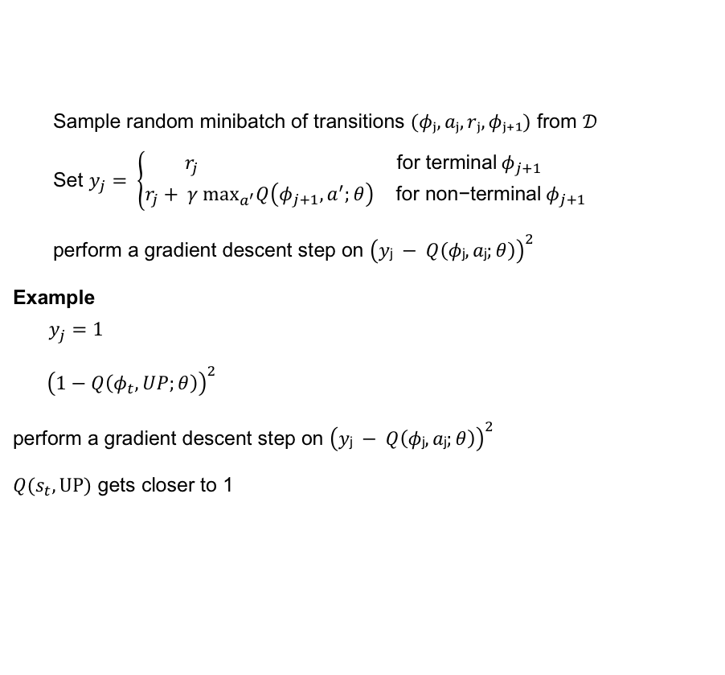
Alg. 1: Deep Q-learning with Experience Replay
Sample random minibatch of transitions $(φⱼ, aⱼ, rⱼ, φⱼ₊₁)$ from 𝒟 Set $y_{j}= \left\{\begin{aligned}r_{j} \text{for} \text{terminal} φ_{j+1} \\ r_{j}+ γ \max_{a^{′}}Q\left(φ_{j+1}, a^{′};θ\right) \text{for} \text{non}\text{−}\text{terminal} φ_{j+1}\end{aligned}\right.$
perform a gradient descent step on ${\left(yⱼ − Q\left(φⱼ, aⱼ;θ\right)\right)}^{2}$ end for
Example end$y_{j}=1$
${\left(1−Q\left(φ_{t},UP;θ\right)\right)}^{2}$
perform a gradient descent step on ${\left(yⱼ − Q\left(φⱼ, aⱼ;θ\right)\right)}^{2}$
$Q(s_{t}, UP)$ gets closer to 1
Replay Memory
$$(s_{1},UP, 0, s_{2})$$
$$(s_{2},DOWN, 0, s_{3})$$
$$(s_{t},UP, 1, s_{t+1})$$
27

Slide 28
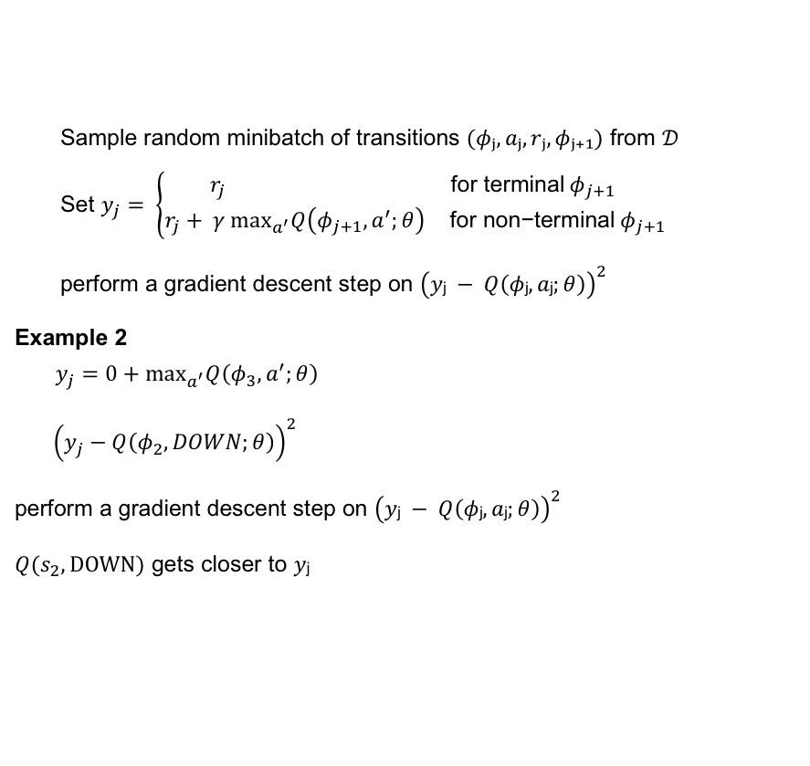
Alg. 1: Deep Q-learning with Experience Replay
Sample random minibatch of transitions $(φⱼ, aⱼ, rⱼ, φⱼ₊₁)$ from 𝒟 Set $y_{j}= \left\{\begin{aligned}r_{j} \text{for} \text{terminal} φ_{j+1} \\ r_{j}+ γ \max_{a^{′}}Q\left(φ_{j+1}, a^{′};θ\right) \text{for} \text{non}\text{−}\text{terminal} φ_{j+1}\end{aligned}\right.$
perform a gradient descent step on ${\left(yⱼ − Q\left(φⱼ, aⱼ;θ\right)\right)}^{2}$ end for
Example 2 end$y_{j}=0+\max_{a^{′}}Q\left(φ_{3}, a^{′};θ\right)$
${\left(y_{j}−Q\left(φ_{2},DOWN;θ\right)\right)}^{2}$
perform a gradient descent step on ${\left(yⱼ − Q\left(φⱼ, aⱼ;θ\right)\right)}^{2}$
$Q(s_{2}, DOWN)$ gets closer to $yⱼ$
Replay Memory
$$(s_{1},UP, 0, s_{2})$$
$$(s_{2},DOWN, 0, s_{3})$$
$$(s_{t},UP, 1, s_{t+1})$$
28

Slide 29
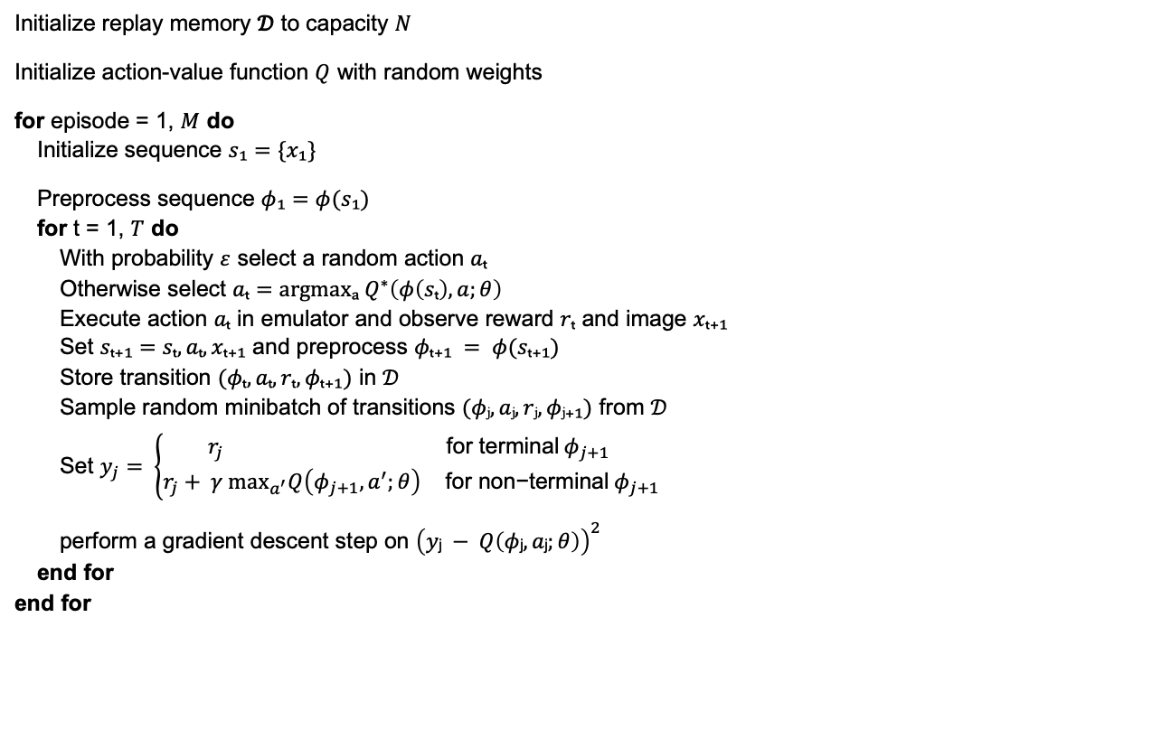
Alg. 1: Deep Q-learning with Experience Replay
Initialize replay memory 𝒟 to capacity $N$
Initialize action-value function $Q$ with random weights
for episode = 1, $M$ do Initialize sequence $s₁=\{x₁\}$
Preprocess sequence $φ₁=φ(s₁)$ for t = 1, $T$ do With probability $ε$ select a random action $aₜ$ Otherwise select $aₜ=argmaxₐ Q^{∗}\left(φ\left(sₜ\right), a;θ\right)$ Execute action $aₜ$ in emulator and observe reward $rₜ$ and image $xₜ₊₁$ Set $sₜ₊₁=sₜ, aₜ, xₜ₊₁$ and preprocess $φₜ₊₁ = φ(sₜ₊₁)$ Store transition $(φₜ, aₜ, rₜ, φₜ₊₁)$ in 𝒟 Sample random minibatch of transitions $(φⱼ, aⱼ, rⱼ, φⱼ₊₁)$ from 𝒟 Set $y_{j}= \left\{\begin{aligned}r_{j} \text{for} \text{terminal} φ_{j+1} \\ r_{j}+ γ \max_{a^{′}}Q\left(φ_{j+1}, a^{′};θ\right) \text{for} \text{non}\text{−}\text{terminal} φ_{j+1}\end{aligned}\right.$
perform a gradient descent step on ${\left(yⱼ − Q\left(φⱼ, aⱼ;θ\right)\right)}^{2}$ end for end for

Slide 30
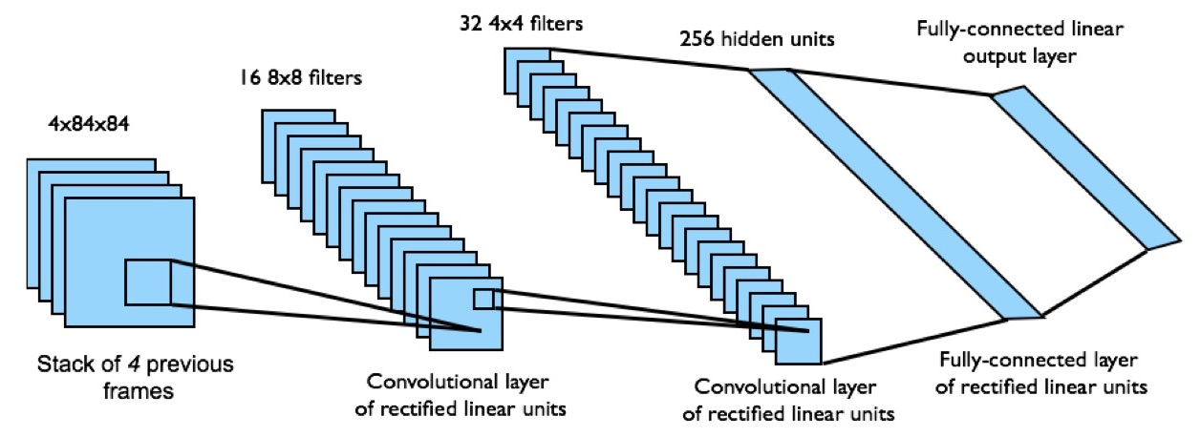
DEEP Q-NETWORK ARCHITECTURE

Slide 31

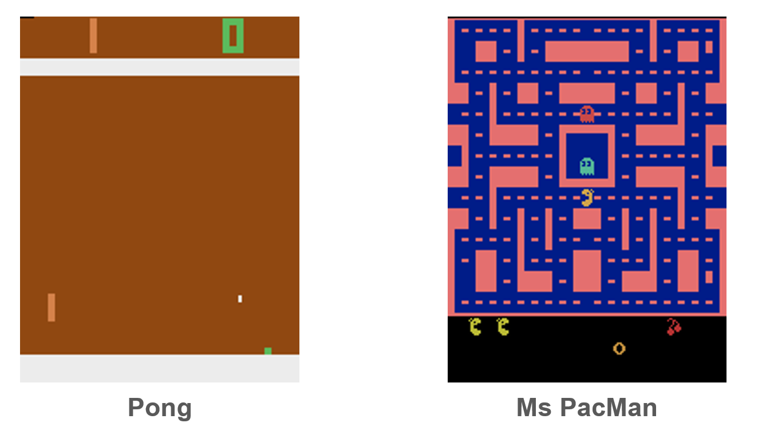
Gymnasium Atari Environments (ALE)

Slide 32
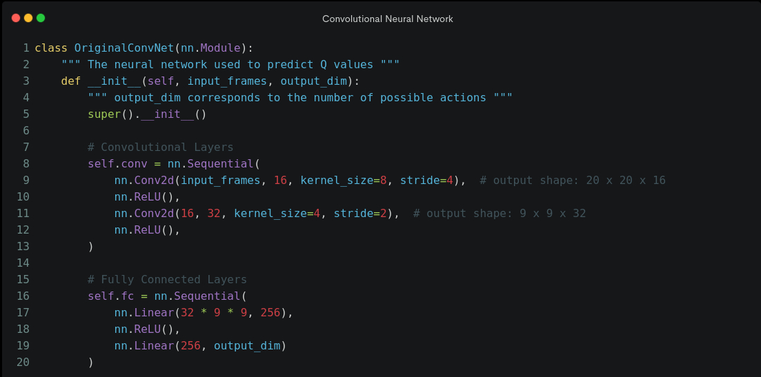
Convolutional Neural Network

Slide 33
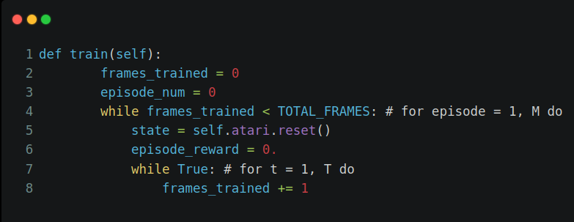
Initialization and Loops

Slide 34
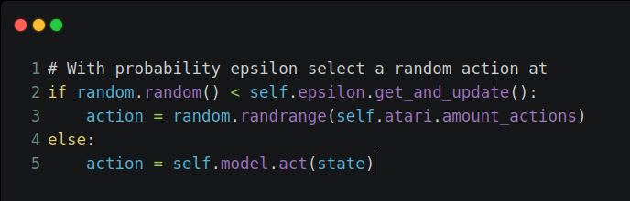
Epsilon-Greedy Strategy

Slide 35
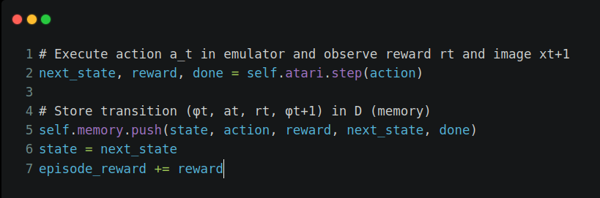
Execute action and store in replay memory

Slide 36
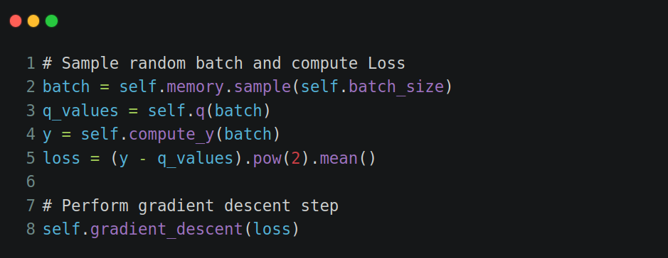
Sample Transaction and perform Gradient Descent

Slide 37
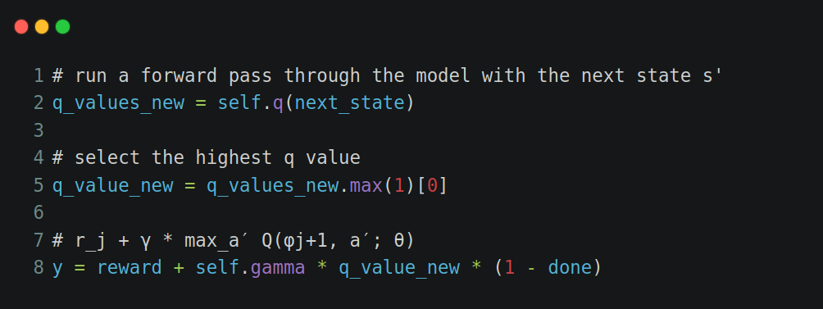
How to compute Y (Optimal Q Prediction)

Slide 38
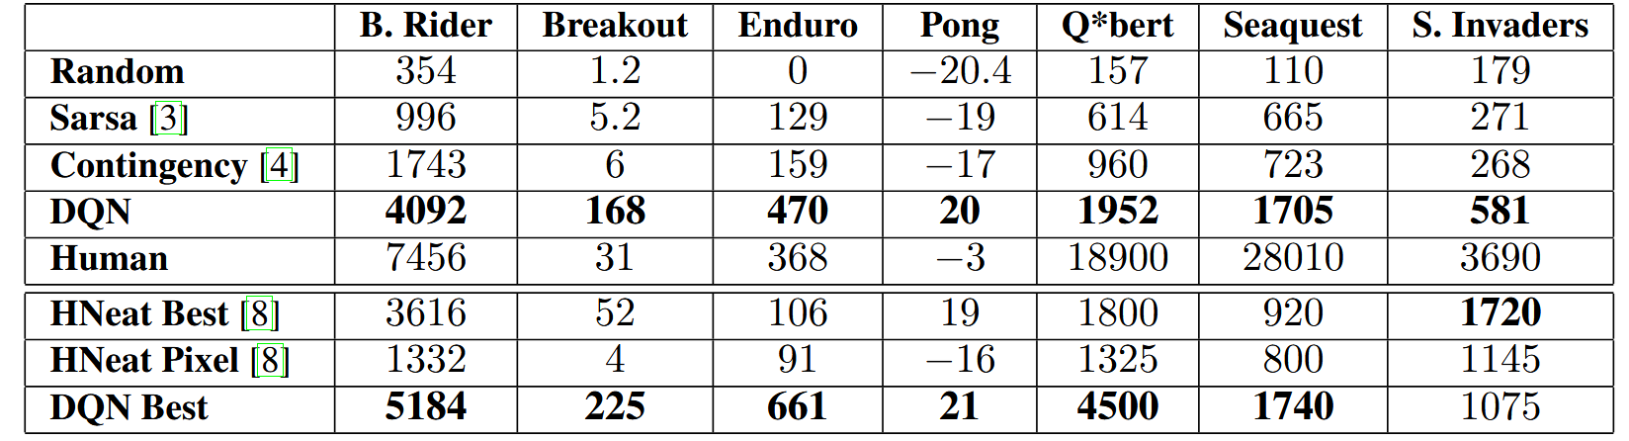

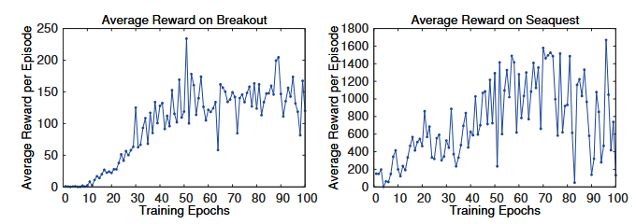
Results

Slide 39
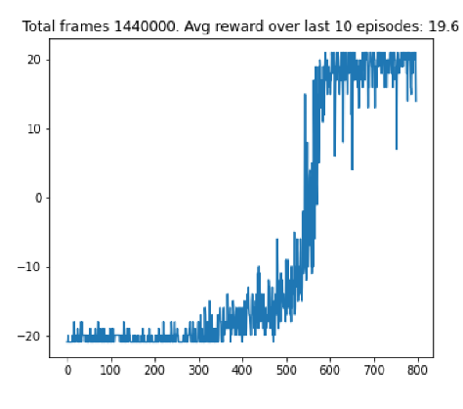
Our Results (Pong)

Slide 40
Our Results (Pong)
400 episodes 600 episodes 800 episodes

Slide 41
Our Results (Pong)

Slide 42
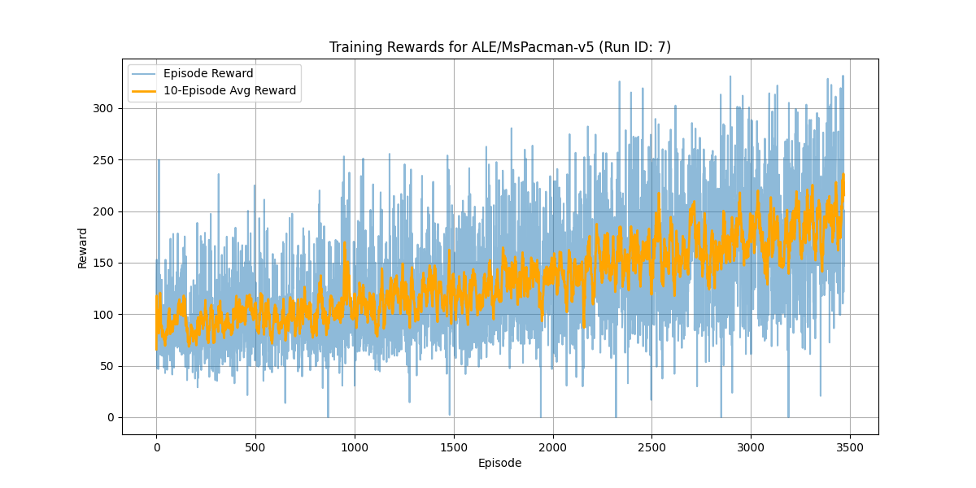
Our Results (PacMan)

Slide 43
Limitations & Subsequent Work

Slide 44

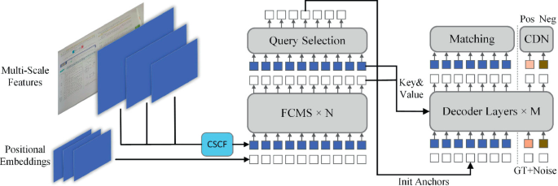
Network Layout and Size
Convolutional Neural Network
(6*10^5 Parameters)
vs.
Modern Image Classifier
(Up to 8*10^6 Parameters)

Slide 45
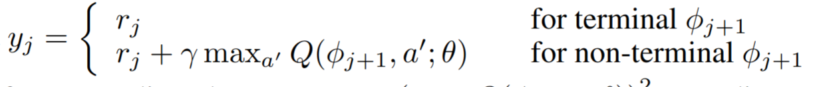
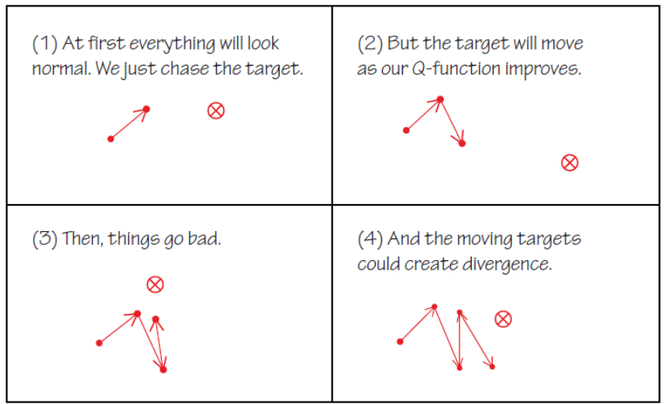
Loss/Reward Calculation

Slide 46
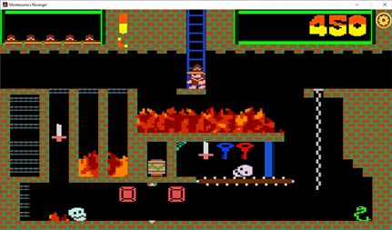
Limitations
Montezumas Revenge

Slide 47

Subsequent Work (DeepMind)

Slide 48

Questions?

