Slide 1
Strategic Analysis of Hulu’s Streaming Content Portfolio
hulu
Ei Yadana

Slide 2
Project Overview
This project applies business intelligence methods to Streaming Video on Demand (SVoD) data through cleaning, exploring, and analyzing content libraries across four major platforms, then translating findings into a focused growth strategy for Hulu.
Methodology
1
Data Cleaning
ETL on movie & TV datasets across all four platforms
2
Exploratory Analysis
Dataset
15,551
FOCUS
PLATFORM
Trends by genre, release year, and platform
hulu
movie & TV titles analyzed across
Netflix, Hulu, Prime Video & Disney+
3
Platform Analysis: Hulu
Content mix, ratings, and competitive position
Deep-dive into content mix, quality, and competitive position to shape the recommendations ahead.
4
4
Strategic Recommendations
Strategic actions grounded in the data
platforms benchmarked side-by-side
on volume, genre mix & quality
Tools: Python (Pandas, NumPy, Matplotlib), Jupyter Notebook

Slide 3




Industry Landscape
Porter’s Five Forces: Streaming Industry
Competitive Rivalry
Competition is intense as established streaming providers continuously invest in exclusive content, technology, advertising, and pricing strategies to attract and retain subscribers in a saturated market.
Very High
Threat of New Entrants
The streaming industry has high barriers to entry because companies must invest heavily in technology, original content, licensing, and marketing. Established brands also benefit from large subscriber bases and economies of scale, making it difficult for new firms to compete.
Moderate
Bargaining Power of Suppliers
Content creators, production studios, and sports leagues own valuable intellectual property, allowing them to negotiate higher licensing fees and lower production costs. Streaming companies rely on premium content to attract and retain subscribers.
High
Bargaining Power of Buyers
Very High
Consumers can easily compare streaming platforms and switch subscriptions with minimal cost. This gives customers strong influence over pricing, content quality, and overall user experience.
Threat of Substitutes
Streaming services compete with alternative entertainment options such as social media, online video platforms, gaming, cable television, and free streaming services, all of which compete for consumers' time and spending.
Very High

Slide 4
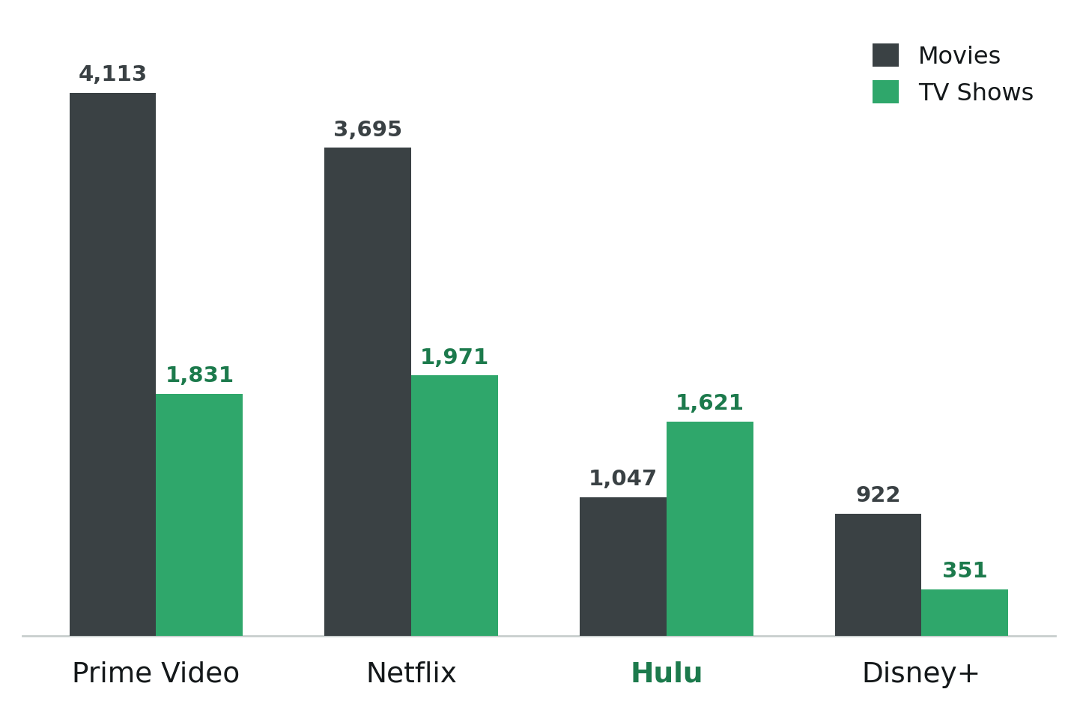
Hulu’s Position in the Streaming Market
Total Catalog Size
Prime Video
Prime Video
5,944
5,944
Netflix
Netflix
5,666
5,666
Hulu
Hulu
2,668
2,668
Disney+
Disney+
1,273
Hulu ranks third in catalog size, but its TV-heavy library (1,621 TV shows vs. 1,047 movies) reflects a strategic focus on viewer engagement and long-term subscriber retention.
Content volume by platform and type (Movie vs. TV Show)

Slide 5
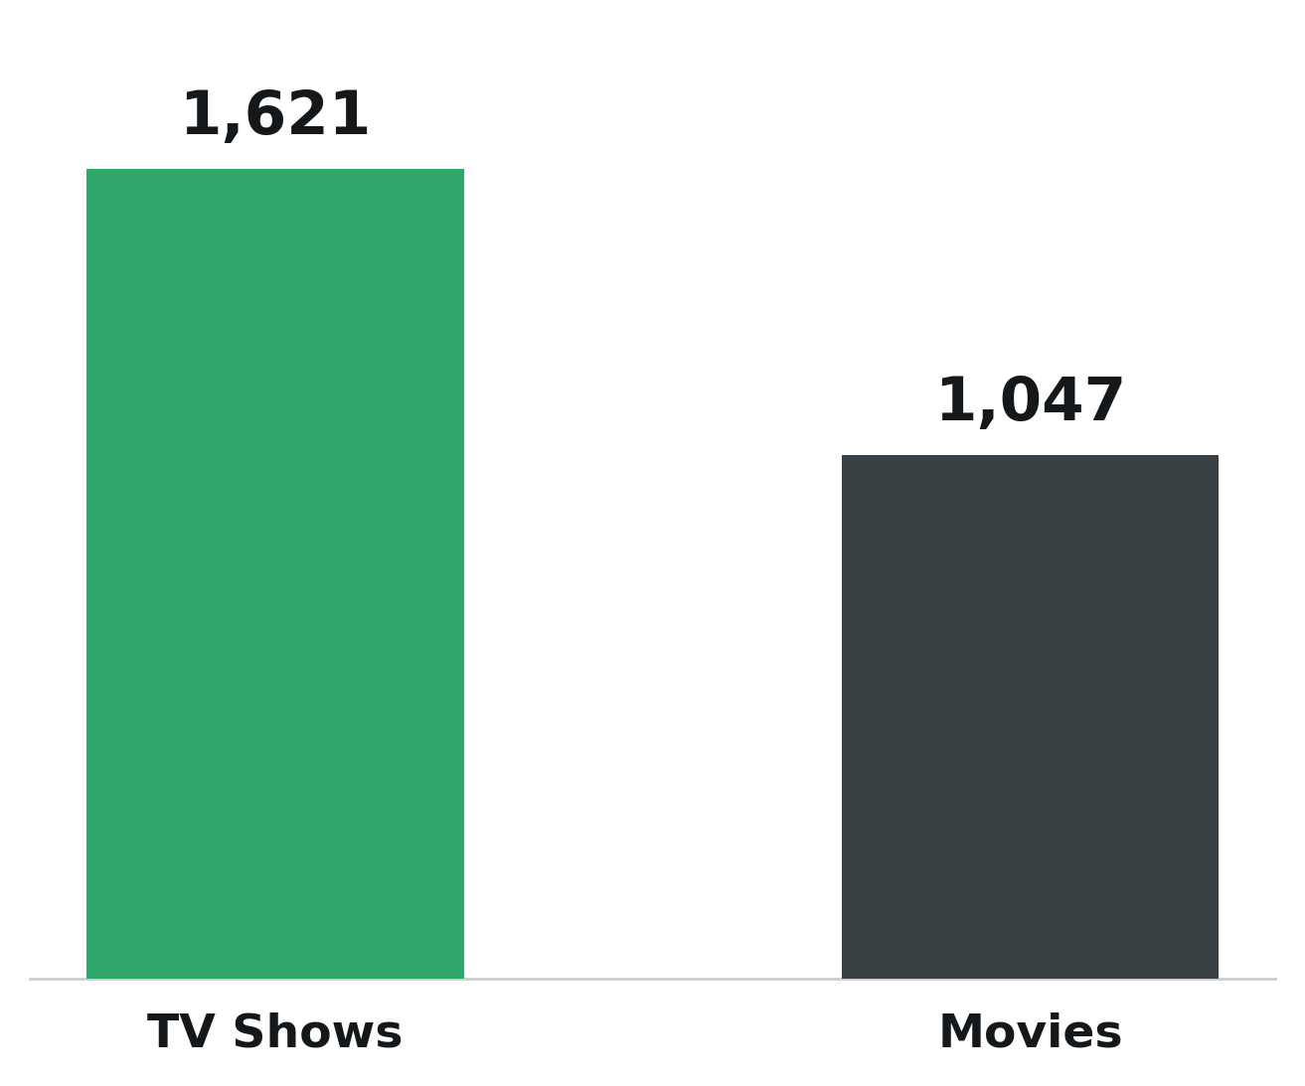
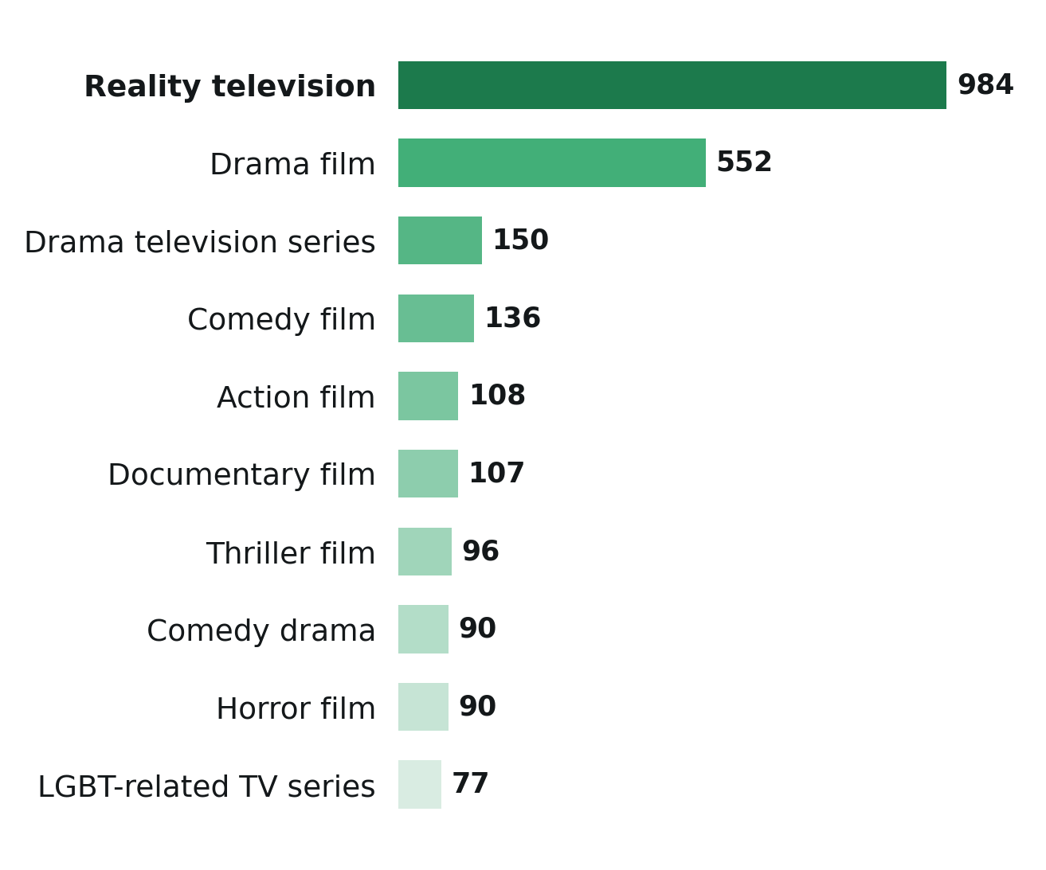
Platform Strategy Analysis: Hulu
A TV-Centric, Reality & Drama-Driven Library
Hulu's content portfolio emphasizes TV series, particularly reality and drama, to increase viewer engagement and strengthen subscriber retention.
Hulu: Movie vs. TV Show (count)
Hulu: Top 10 genres
61%
of Hulu's catalog consists of TV shows (1,621 of 2,668 titles), reinforcing its position as a TV-first streaming platform.
41%
of Hulu’s top-10 genre mix is reality television (984 titles), making it the platform’s dominant genre category.

Slide 6
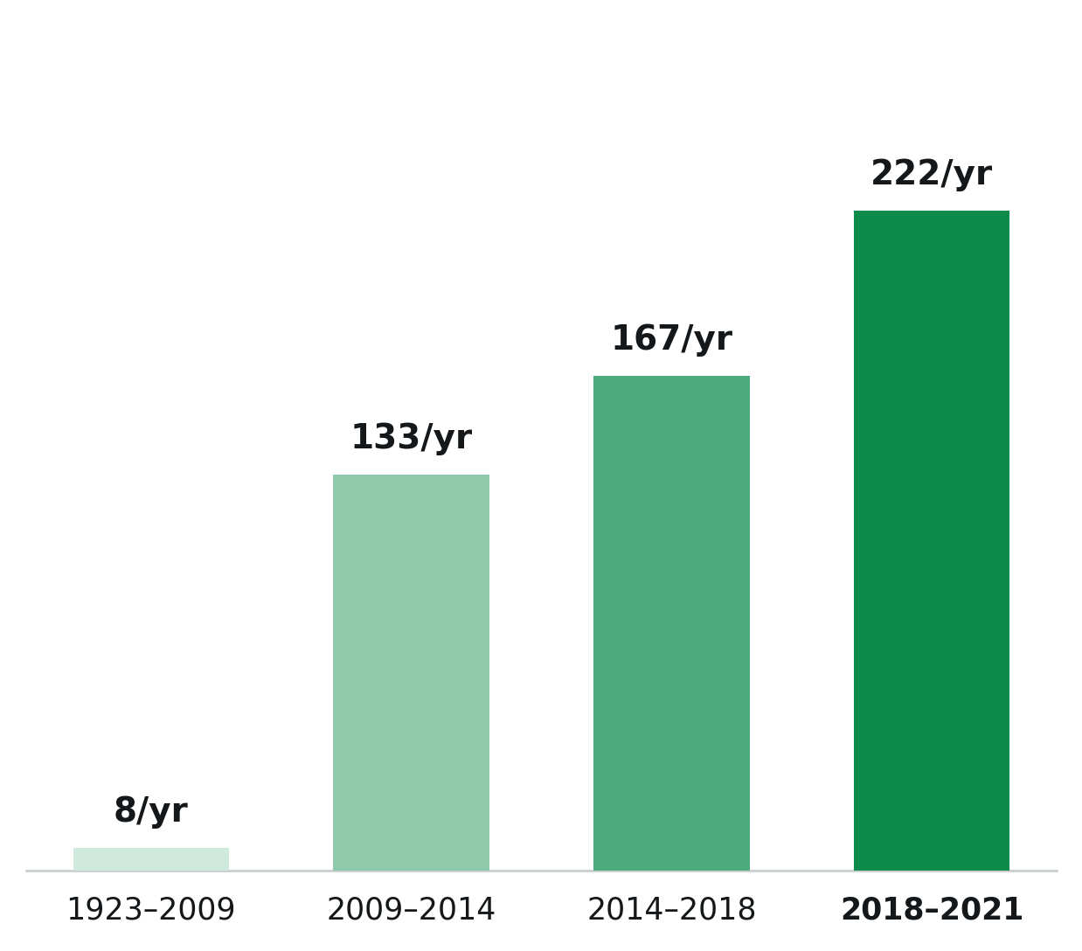


Modern Content, Built Around Same-Week TV
2014
75%
Median release year
of titles released 2009 or later
Hulu's catalog emphasizes recent, newer releases over legacy content, reinforcing its strategy as a destination for current TV programming and Disney Bundle subscribers.
Next-Day TV Strategy
Same-week streaming of network shows (SNL, Grey’s Anatomy, The Bachelor) positions Hulu as the bridge between cable and streaming.
Disney Bundle Strategy
Packaged with Disney+ and ESPN+, Hulu covers family, sports, and general entertainment in one subscription, boosting retention.
Average new titles per year, by release-year quartile

Slide 7
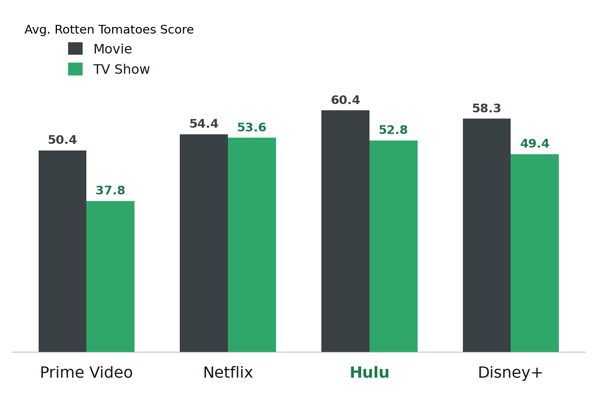
Hulu Leads on Critic Quality, Not Just Volume
60.4
Movies
Highest of all 4 platforms, ahead of Disney+ (58.3), Netflix (54.4), and Prime Video (50.4).
52.8
TV Shows
2nd highest, just behind Netflix (53.6), and well ahead of Disney+ (49.4) and Prime Video (37.8).
Hulu’s smaller catalog doesn’t come at the cost of quality; it earns some of the highest critic scores in the category, a real edge to build on as it expands its library.
Average Rotten Tomatoes score by platform and type

Slide 8
SWOT Analysis: Hulu’s Competitive Position
+
Strengths
–
Weaknesses
Distinct identity in Reality TV & Drama, the hardest genres to replicate
Multiple revenue streams (subscriptions, advertising, Live TV)
Bundled offerings with Disney+ and ESPN
Highest average movie quality Rotten Tomatoes score (60.4) of any major platform
Smaller global presence than major competitors
Lower content variety, making it easier for subscribers to switch to competitors with larger catalogs
Smallest library of the four platforms (2,668 titles)
↑
Opportunities
!
Threats
Grow the ad-supported tier to capture price-sensitive users
Expansion of Disney bundle offerings
Use genre-quality data to guide next licensing investments
Development of exclusive original content
Netflix and Prime Video offer significantly larger content libraries while maintaining competitive review scores
Subscriber churn and loss of market share if consumers prioritize platforms offering greater content variety

Slide 9
Key Insights about Hulu
✓
TV-first Platform in a Movie-Driven Streaming Market
✓
Concentrated Content Portfolio
Hulu differentiates itself with a TV-centric content strategy, unlike competitors with broader or movie-heavy catalogs.
Reality TV and Drama represent over 50% of Hulu's catalog, supporting a targeted strategy centered on audience engagement within high-demand genres.
✓
Small Library, High Quality
✓
Focus over Scale
Hulu's catalog is a fraction of Netflix's or Prime Video's size, yet its movies carry the highest average critic score of any major platform.
Data and SWOT analysis point to the same strategy: Hulu should compete through differentiation, not catalog scale.

Slide 10




Strategic Recommendation
Recommendation: Invest in exclusive original content and broaden Hulu’s library through strategic licensing, especially in underrepresented genres and release periods.
INSIGHT
Hulu consistently achieves higher average content ratings than competing platforms but offers a smaller content library than Netflix and Prime Video.
STRATEGIC IMPLICATION
Hulu’s reputation for high-quality programming creates a strong competitive advantage, but its smaller catalog may limit its ability to attract and retain subscribers seeking greater content variety.
ACTION
Hulu should invest in expanding its portfolio of exclusive original content while broadening its content library through strategic licensing, particularly in underrepresented genres and release periods.
OUTCOME
Expanding both the quality and variety of Hulu’s content would strengthen its competitive position, improve subscriber retention, attract new audiences, and reduce the risk of customers switching to competitors with larger libraries.

Slide 11
Expected Impact of Strategic Recommendation
More exclusive originals & targeted licensing in movies, family content, and pre-2010 classics
↓
Stronger content differentiation and broader audience appeal
↓
Higher viewer engagement and increased Disney+ bundle adoption
↓
Higher subscriber retention, subscriber growth, and lower churn
↓
Higher subscriber base and annual revenue

Slide 12
Expected Impact of Strategic Recommendation
Revenue = Total Subscribers × Avg. Monthly Revenue per User × 12
Metric
Today
Projected Impact (+7%)
Estimated Annual Revenue Increase:
Total subscribers
64.1M
68.6M
+$650M
Avg. monthly revenue per user
$12.29
$12.29
Annual revenue
$9.45B
$9.87B
A 7% increase in subscribers through stronger content offerings could generate approximately $650M in additional annual revenue, reinforcing content investment as a key growth driver for Hulu.

Slide 13
Expected Outcome for Hulu
1
2
3
4
Higher Retention
Incremental Revenue
Broader Household Reach
A More Distinct, Clearer Brand Positioning
Next-day TV drives daily engagement and strengthen viewer loyalty
Ad-tier growth and bundling expand revenue opportunities
Targeted movie & family investment narrows the gap with Disney+ and Netflix
Reinforced Hulu’s position as the home for drama & reality TV, strengthening differentiation rather than competing directly with Netflix’s scale

