Slide 1

UTKARSH KUMAR
2021TT11167
tt1211167@iitd.ac.in
+919771226219

Slide 2





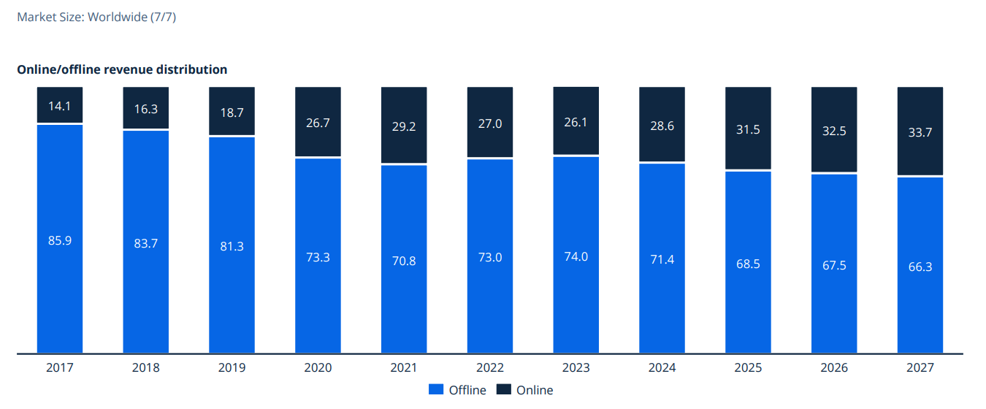




PROBLEM : Shopping for clothes online is time-consuming compared to offline. Poor fit, lack of visualization, and decision fatigue lead to frequent returns, causing dissatisfaction for customers and losses for sellers.
"Shopping for clothes online often feels overwhelming—not just for me, but for many of my friends as well. Browsing through multiple stores, comparing prices across platforms, and figuring out which clothes will actually fit or look good can be exhausting. The process is especially isolating when shopping alone, and I often hesitate to place an order because I’m unsure about the fit or how the clothes will look in real life. Finding a solution to this problem would make a big difference for me.“
Why Solving this Problem is Critical ?
High return rates are a major challenge. Around 20-30% of apparel orders are returned, costing us ₹100-₹300 per return in logistics and handling. A ₹1,000 product return can wipe out most of our margin, especially if the item can't be resold as new. Practices like bracketing, where customers order multiple sizes to try and return the rest, add to this issue, straining profitability.
$1.7 Trillion global online apparel market (2024)
Low conversion rate: 2% (vs. 30% in offline retail)
35% return rate in online apparel
$150 - $200 Billion
lost annually due to high return.
- Ashok Gupta, Online seller
Potential Impact upon solving
Online Sales Skyrocket, Signaling Rapid Growth Amid Offline Apparel Market Dominance.
Reduce returns by 50%–60%, saving around $80–$90 billion.
Enhance customer engagement by providing a more realistic shopping experience.
Encourage impulsive buying behaviors.
Increase online acceptance rates, driving higher customer revenue.
.

Slide 3
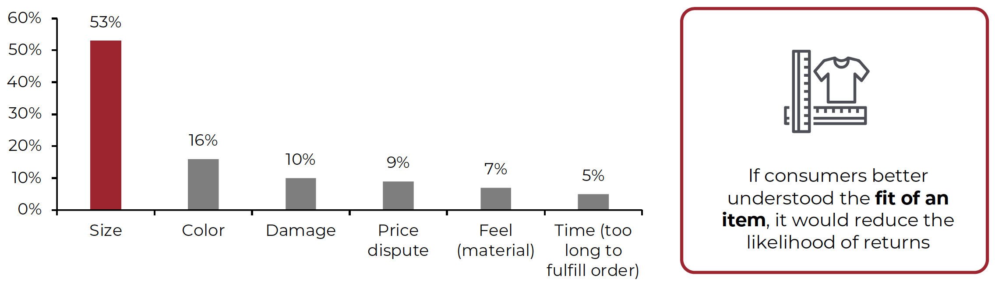
Problem identification – Why Time consuming / decision fatigue
Stakeholder Analysis
Ankita – Online Shoppers
Age – 25
Less clarity over what she wants.
Hard to visualize clothes on the body with the model sometimes.
Hard to decide on size as different brands have different size measurements.
Too many options create decision fatigue compared to offline .
Online VS Offline customer Journey
Online | Offline
Start browsing on app with unlimited options | Start browsing in store with limited option
Limited help available from friends via online chats (not feasible). | Easily recommendation available by store staff and friends
Cannot try clothes; rely on images, size charts, and reviews, making it hard to assess fit and look. | Physically try clothes to check fit, comfort, and looks
Self-decision mostly, but often based on incomplete or insufficient information. | Additional feedback from friends or self-decision
Order placed ( 2% acceptance rate) | Final purchase ( 30 % acceptance rate)
Return 35 times out 100 order | Only return 10 times out of 100
This Helps them clarify what they want in offline, leading to easier decisions and more efficient purchases.
Reason
Root causes in Online
Lack of personalized advice
No way to try on clothes.
Difficulty in understanding personal preferences or making confident choices
If we could solve this problem, then choosing clothes becomes fast, and shoppers can make a confident buy, which reduce return.

Slide 4
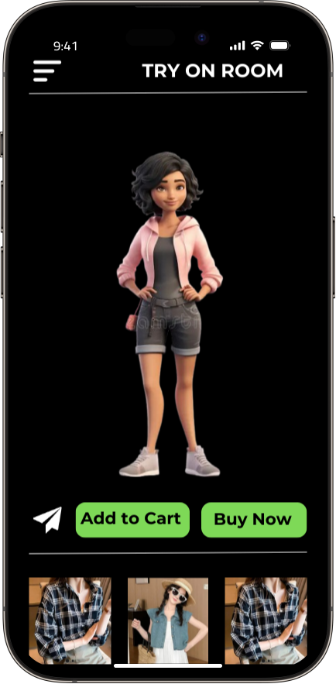
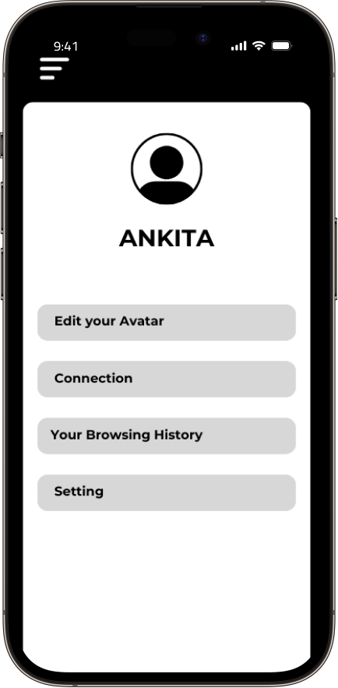

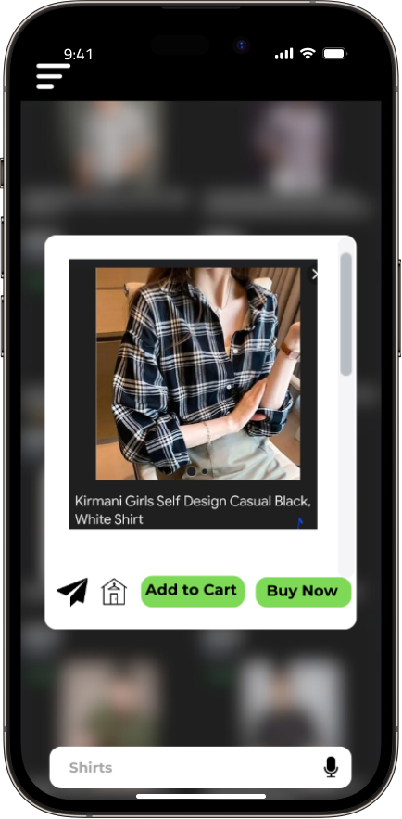
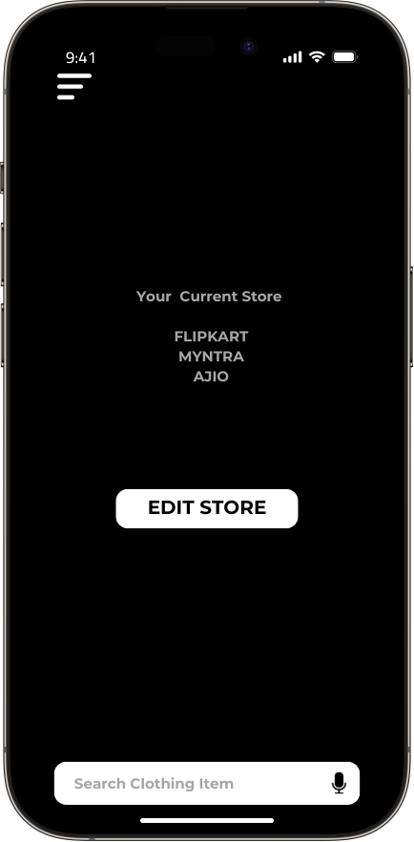
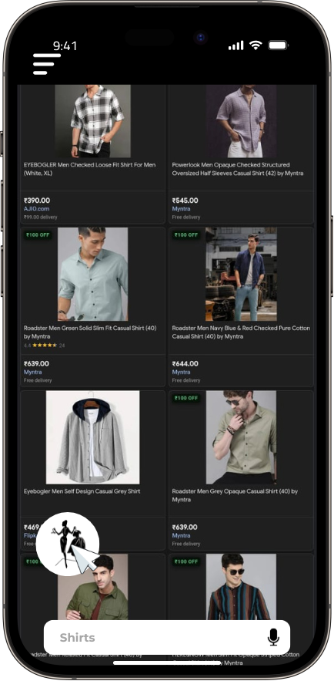
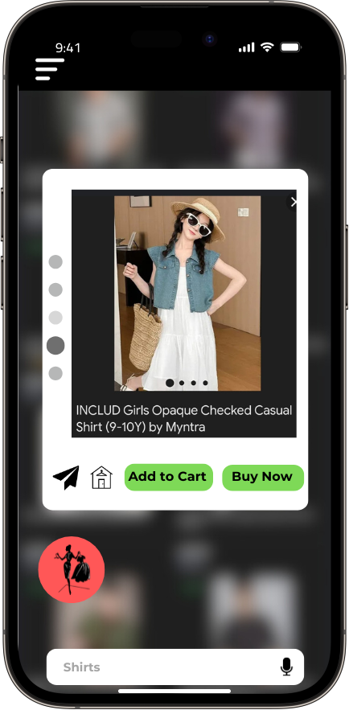
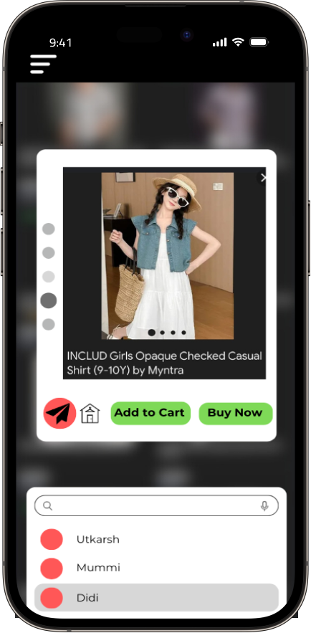
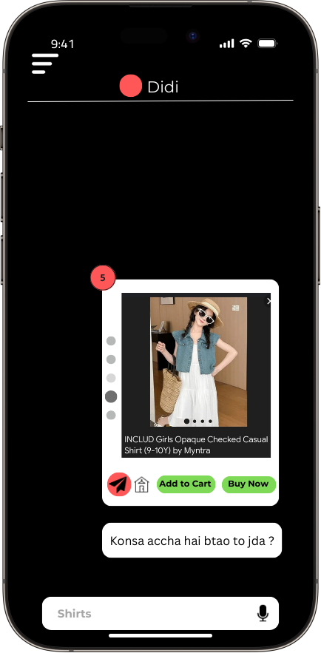
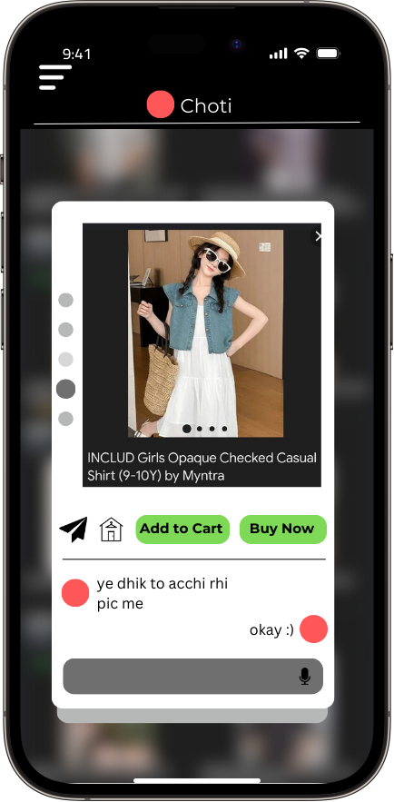
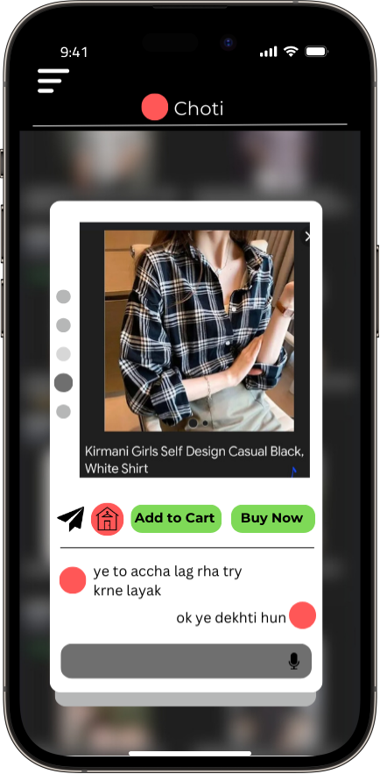

Solution – A personalized app
Solution: A personalized app integrated with online apparel stores, featuring an AI advising system, a one-to-one chat feature where users can share images and start threads to discuss specific items, and a seamless try-on system for visualization and fit check.
Choose Own
TRY ON CLOTHES
User Onboard
Try on room
OR
Placed Order / Add to Cart / Ditch
Details about user profile what it carry
- What information we want a little info about that
AI Advisor
Search Outfit
Chat feature
Wireframe of working of APP
AI recommend some clothes
Share with friends for advice
One – to one chat for each clothes

Slide 5
How all features works ?
#1 AI Advising System : Acts as a virtual fashion advisor, offering personalized guidance
Selects and recommends the top 10–15 clothing options from the page for easy decision-making.
Pre-trained with shopper-specific data:
Skin tone and facial structure for aesthetic matching.
Body measurements (size and fit).
Past behavior and purchase history for tailored recommendations.
Enhances the shopping experience by reducing time and boosting confidence in purchase decisions.
#2 One to One Chatting and Sharing Feature : Allows users to start a dedicated thread to discuss and get feedback on a specific apparel item.
Enables focused conversations, avoiding the confusion that often arises when using general chat platforms like WhatsApp or Instagram.
Keeps all discussions about an item organized in one place for easy reference.
Enhances decision-making by offering a seamless and quick feedback channel with loved ones.
Technology
Involved
The AI system personalizes clothing recommendations using machine learning algorithms like collaborative filtering, content-based filtering, and neural networks, tailored to user profiles, preferences, and past behavior.
It adapts continuously with reinforcement learning and leverages NLP technologies like BERT and GPT for understanding user feedback, along with sentiment analysis and entity recognition.
This advanced integration ensures dynamic, evolving fashion advice that aligns with individual preferences.

Slide 6
How all features works ?
#3 Virtual Try-On Feature : Enables shoppers to try on different clothing combinations on their personalized avatars for better visualization and fit.
Metrices
North Star metrics : Return rates should be reduced by at least 40%.
Pre-designed 3D models are assigned to each shopper based on their profile, including size, height, and fit.
The system allows users some flexibility to modify dimensions if needed.
HEART | Goal | Signal | Metrics
Happiness | Improve customer satisfaction | Positive feedback and recommendations, High user ratings | NPS, Average Ratings & Reviews
Engagement | Increase user interaction | Frequent usage of features, High interaction with AI advisor | D/M Active Users, Session Duration, Feature Usage Rate
Adoption | Boost user acquisition | Increase in new sign-ups, Users engaging with the product | Number of New Users, Activation Rate
Retention | Enhance user loyalty | Low churn rate, High return rate of users | Churn Rate, Repeat Usage Rate, Retention Rate
Task Success | Maximize successful transactions | High completion of purchases, Low return rate of purchased items | Conversion Rate, Return Rate
Technology involved
Utilizes WebSocket for seamless two-way messaging and RESTful APIs for efficient message delivery.
Leverages NoSQL databases (e.g., MongoDB, Firebase) for dynamic chat data storage and fast retrieval.
Integrates image recognition tools for sharing clothing images and securely stores them using cloud solutions like AWS S3.
Uses 3D modeling (Blender 3D/Unity) and pose estimation (OpenPose) to create lifelike avatars and align clothing with body posture in real-time.
Employs AR technologies (ARKit/ARCore) to overlay clothing on avatars via mobile devices, ensuring a seamless virtual try-on experience.
Leverages cloud infrastructure (AWS/Google Cloud) for 3D rendering and real-time simulations, ensuring smooth performance.

Slide 7
Pitfall and Mitigations
Processing Speed – The system could experience slowdowns due to the complexity of simulating virtual try-ons and accurate clothing fits, but advancements like quantum computing could mitigate this in the future.
Technical Glitch
Privacy Concerns
PITFALLS
PITFALLS
AI may sometimes offer inaccurate recommendations, negatively affecting user experience, particularly with sizing or outfit suggestions
Users need to share sensitive personal data (e.g., body measurements) online, raising concerns about data security and potential misuse.
MITIGATIONS
MITIGATIONS
Will add block chain and quantime proof security
Will add block chain and quantime proof security
Future Projections
Fashion NFTs: Designers can create unique NFT outfits that shoppers can purchase for their digital twins, allowing for exclusive digital fashion ownership and sharing on social media platforms.
In-Game Integration: Gamers can use their digital twins in video games, customizing them with NFT outfits for a unique appearance in various gaming worlds, enhancing their gaming experience and personal expression.
Metaverse Engagement: As virtual worlds grow, users can interact using their digital twins, showcasing personalized outfits and participating in virtual events, fashion shows, or social gatherings.
Augmented Reality Experiences: Users can participate in AR fashion shows or events where they can showcase their digital twin outfits in real-time, interacting with other users and brands in immersive environments.

