Slide 1


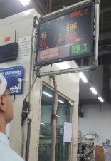
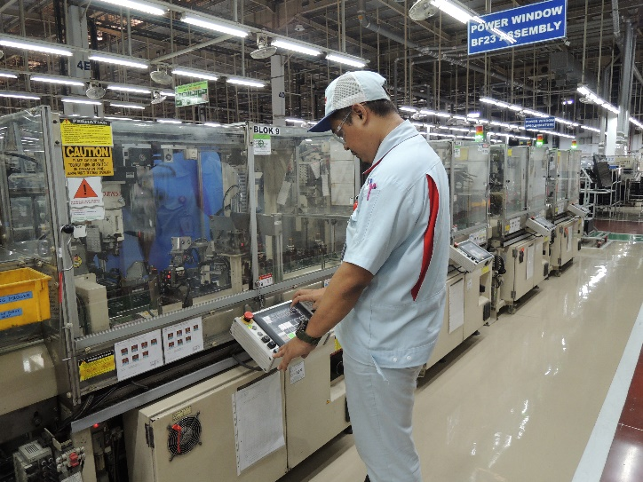
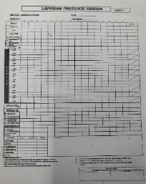
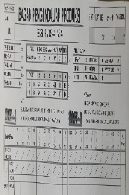
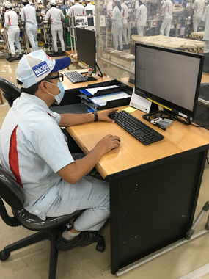








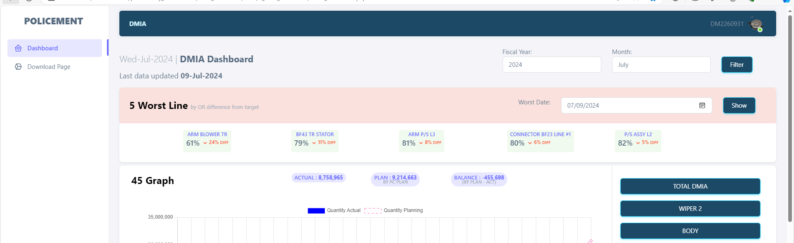

AUTO E-DEKIDAKA
Background
Progress
Low data accuracy and muda process due to two human manual input
Preparation
Development
Trial & Error
Implementation
Flow Before
Jul W1 - Jul W2
Jul W3 - Aug W5
Sep W1 - Sep W2
Sep W3 - Sep W4
Dekidaka
MUDA Process
Concept Auto E-Dekidaka
Create Main Dashboard
Laporan Produksi Harian
Software Installation & Device
Export Features, excel, csv, pdf , and print
Monitor
Database & Website Design
Combine Table
Panel
Login system & roles
Take Output from Stock in
Hourly Announcement
looks at the machine Panel / Monitor
Manual Written on 2 check sheet
Double input to excel
The progress is 46%, on schedule
Total Man Hours per Leader = 35’
Current Issues
Flow Target
AUTO
Integrated with POLICEMENT, MILOS, STOCKIN, IoT Dashboard, MP Control
Crash New Program with existing program to take data qty (Stock In)
Triger in line without IoT Dashboard
Scan Finish Good
Take Output
E-DEKIDAKA
Need data correctly for get data accuracy
Leader manually input on E-Dekidaka (only : losstime & Working Time)
Feature
CT, OR, TT, Kousu, Target
Report Dekidaka in files
Control & history Dekidaka
Formula
Next
Get data losstime from IoT Dashboard
Total Man Hours per Leader = 10’
Detail Dashboard

Slide 2
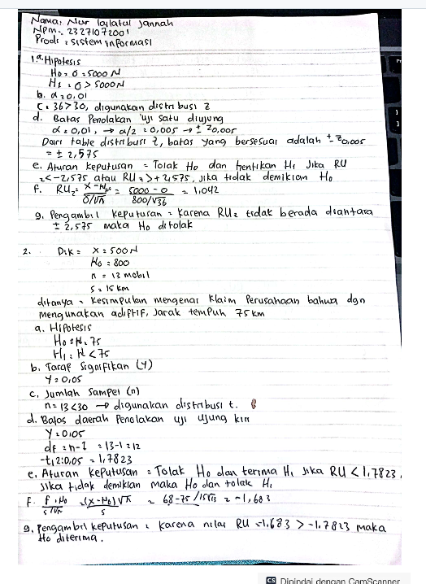
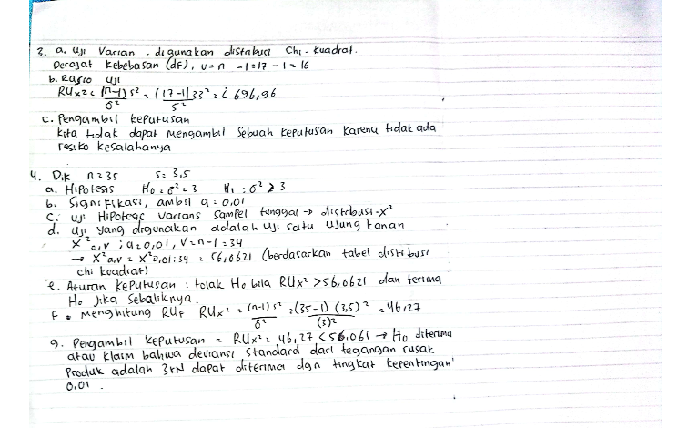

Slide 3
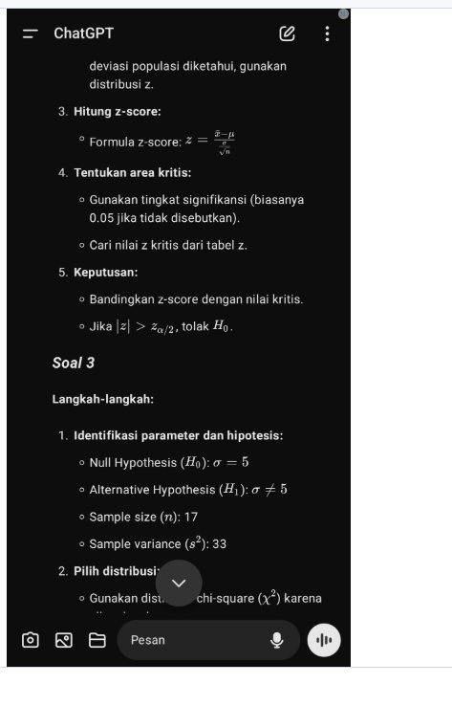
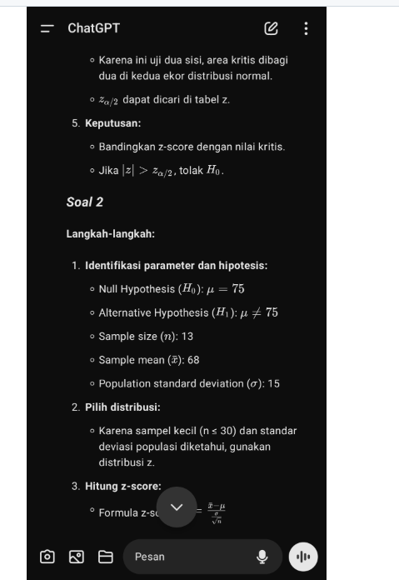
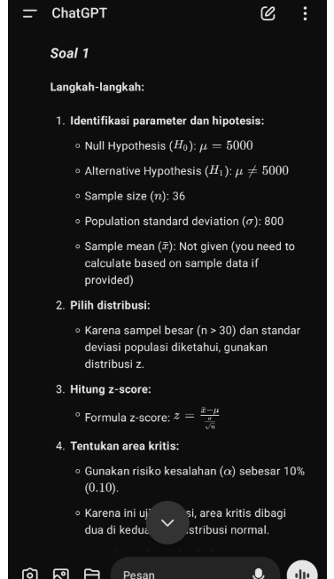

Slide 4
