Slide 1
Memory Hierarchy (Ⅲ)

Slide 2
Outline
Cache memory
  Set associative caches
  Fully associative caches
  Issues with writes
  Performance impact of cache parameters
  Write cache friendly codes
  Matrix multiplication
  Memory mountain
Suggested Reading: 6.4, 6.5, 6.6

Slide 3
Set associative caches
Characterized by more than one line per set
valid
tag
cache block
set 0:
E=2 lines per set
valid
tag
cache block
valid
tag
cache block
set 1:
valid
tag
cache block
• • •
valid
tag
cache block
set S-1:
valid
tag
cache block

Slide 4
Accessing set associative caches
Set selection
  identical to direct-mapped cache
valid
tag
cache block
set 0:
valid
tag
cache block
Selected set
valid
tag
cache block
set 1:
valid
tag
cache block
• • •
valid
tag
cache block
t bits
s bits
b bits
set S-1:
valid
tag
cache block
0 0 0 0 1
m-1
tag
set index
0
block offset

Slide 5
Accessing set associative caches
Line matching and word selection
  must compare the tag in each valid line in the selected set.
=1?
(1) The valid bit must be set.
0
1
2
3
4
5
6
7
1
1001
selected set (i):
1
0110
w₀
w₁
w₂
w₃
(2) The tag bits in one
of the cache lines must
match the tag bits in
the address
(3) If (1) and (2), then
cache hit, and
block offset selects
starting byte.
= ?
t bits
s bits
b bits
0110
i
100
m-1
tag
set index
0
block offset

Slide 6
Associative Cache
Cache
  16 lines
  4-byte line size
  2-way set associative
Tag
Index
Offset
11
10
9
8
7
6
5
4
3
2
1
0

Slide 7
Simple Memory System Cache
Idx | Tag | Valid | B0 | B1 | B2 | B3
0 | 19 | 1 | 99 | 11 | 23 | 11
0 | 15 | 0 | – | – | – | –
1 | 1B | 1 | 00 | 02 | 04 | 08
1 | 36 | 0 | – | – | – | –
2 | 32 | 1 | 43 | 6D | 8F | 09
2 | 0D | 1 | 36 | 72 | F0 | 1D
3 | 31 | 0 | – | – | – | –
3 | 16 | 1 | 11 | C2 | DF | 03

Slide 8
Simple Memory System Cache
Idx | Tag | Valid | B0 | B1 | B2 | B3
4 | 24 | 1 | 3A | 00 | 51 | 89
4 | 2D | 0 | – | – | – | –
5 | 2D | 1 | 93 | 15 | DA | 3B
5 | 0B | 0 | – | – | – | –
6 | 12 | 0 | – | – | – | –
6 | 16 | 1 | 04 | 96 | 34 | 15
7 | 13 | 1 | 83 | 77 | 1B | D3
7 | 14 | 0 | – | – | – | –

Slide 9
Address Translation Example
Address: 0x354
Tag
Index
Offset
11
10
9
8
7
6
5
4
3
2
1
0
0
0
1
1
0
1
0
1
0
1
0
0
  Offset: 0x0 Index: 0x05 Tag: 0x1A
  Hit? No

Slide 10
Set Associative Cache Simulation
s=1
Example
M=16 byte addresses
B=2 bytes/block, S=2 sets, E=2 entry/set
t=2
b=1
xx
x
x
Address trace (reads):
0 [0000] 1 [0001] 13 [1101] 8 [1000] 0 [0000]
set
v
tag
data
0
0
0
0
1
0
1
0

Slide 11
Set Associative Cache Simulation
s=1
Example
M=16 byte addresses
B=2 bytes/block, S=2 sets, E=2 entry/set
t=2
b=1
xx
x
x
Address trace (reads):
0 [0000] 1 [0001] 13 [1101] 8 [1000] 0 [0000]
miss
(1)
0 [0000] (miss)
v
tag
data
1
00
m[0]m[1]
0
0
0

Slide 12
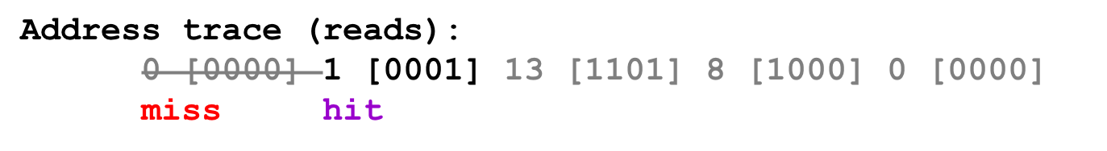
Set Associative Cache Simulation
s=1
Example
M=16 byte addresses
B=2 bytes/block, S=2 sets, E=2 entry/set
t=2
b=1
xx
x
x
(2)
1 [0001] (hit)
set
v
tag
data
0
1
00
m[0]m[1]
0
0
1
0
1
0

Slide 13
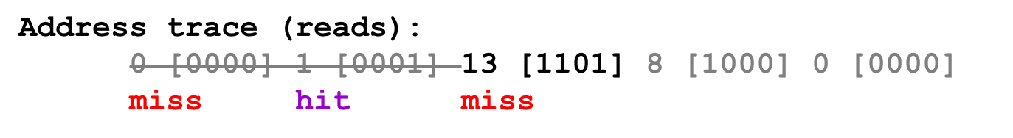
Set Associative Cache Simulation
s=1
Example
M=16 byte addresses
B=2 bytes/block, S=2 sets, E=2 entry/set
t=2
b=1
xx
x
x
(3)
13 [1101] (miss)
set
v
tag
data
0
1
00
m[0]m[1]
0
0
11
m[12]m[13]
1
1
1
0

Slide 14
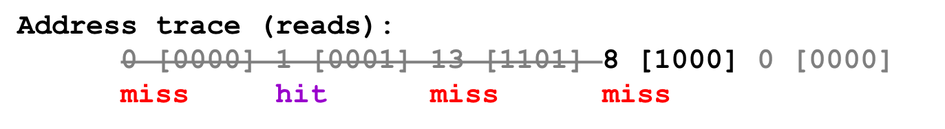
Set Associative Cache Simulation
s=1
Example
M=16 byte addresses
B=2 bytes/block, S=2 sets, E=2 entry/set
t=2
b=1
xx
x
x
(4)
8 [1000] (miss)LRU
set
v
tag
data
0
1
10
m[8]m[9]
0
1
11
m[12]m[13]
1
1
1
0

Slide 15
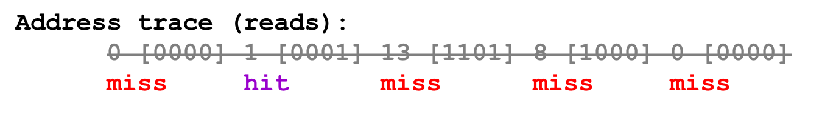
Set Associative Cache Simulation
s=1
Example
M=16 byte addresses
B=2 bytes/block, S=2 sets, E=2 entry/set
t=2
b=1
xx
x
x
(5)
0 [0000] (miss) LRU
set
v
tag
data
0
1
10
m[8]m[9]
0
1
00
m[0]m[1]
1
1
1
0

Slide 16
Line Replacement on Misses
If all the cache lines of the set are valid
  Which line is selected to be evicted ?
LFU (least-frequently-used)
  Replace the line that has been referenced the fewest times over some past time window
LRU (least-recently-used)
  Replace the line that was last accessed the furthest in the past
All of these policies require additional time and hardware

Slide 17
Fully associative caches
Characterized by all of the lines in the only one set
No set index bits in the address
valid
tag
cache block
set 0:
valid
tag
cache block
E=C/B lines in
the one and only set
…
valid
tag
cache block
t bits
b bits
tag
block offset

Slide 18
Accessing fully associative caches
Word selection
  must compare the tag in each valid line
=1?
(1) The valid bit must be set.
0
1
2
3
4
5
6
7
1
1001
0
0110
1
0110
w₀
w₁
w₂
w₃
0
1110
(2) The tag bits in one
of the cache lines must
match the tag bits in
the address
= ?
(3) If (1) and (2), then
cache hit, and
block offset selects
starting byte.
t bits
b bits
0110
100
m-1
tag
0
block offset

Slide 19
Issues with Writes
Write hits
  Write through
    Cache updates its copy
    Immediately writes the corresponding cache block to memory
  Write back
    Defers the memory update as long as possible
    Writing the updated block to memory only when it is evicted from the cache
    Maintains a dirty bit for each cache line

Slide 20
Issues with Writes
Write misses
  Write-allocate
    Loads the corresponding memory block into the cache
    Then updates the cache block
  No-write-allocate
    Bypasses the cache
    Writes the word directly to memory
Combination
  Write through, no-write-allocate
  Write back, write-allocate (modern implementation)

Slide 21
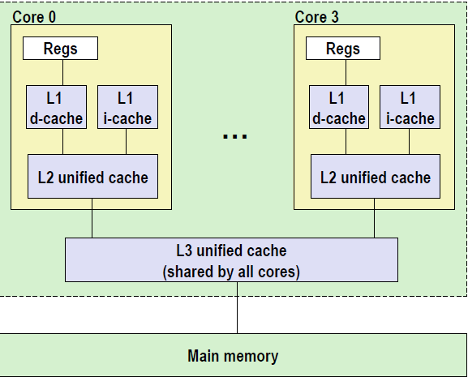
Multi-level caches
L1 d-cache, i-cache
32k 8-way
Access: 4 cycles
L2 unified-cache
258k 8-way
Access: 11 cycles
Block size
64 bytes for all cache
L3 unified-cache
8M 16-way
Access: 30~40 cycles

Slide 22
Cache performance metrics
Miss Rate
  fraction of memory references not found in cache (misses/references)
  Typical numbers:
    3-10% for L1
    Can be quite small (<1%) for L2, depending on size
Hit Rate
  fraction of memory references found in cache (1 - miss rate)

Slide 23
Cache performance metrics
Hit Time
  time to deliver a line in the cache to the processor (includes time to determine whether the line is in the cache)
  Typical numbers:
    1-2 clock cycles for L1 (4 cycles in core i7)
    5-10 clock cycles for L2 (11 cycles in core i7)
Miss Penalty
  additional time required because of a miss
    Typically 50-200 cycles for main memory (Trend: increasing!)

Slide 24
What does Hit Rate Mean?
Consider
  Hit Time: 2 cycles
  Miss Penalty: 200 cycles
  Average access time:
  Hit rate 99%: 2*0.99 + 200*0.01 = 4 cycles
  Hit rate 97%: 2*0.97 + 200*0.03 = 8 cycles
This is why “miss rate” is used instead of “hit rate”

Slide 25
Cache performance metrics
Cache size
  Hit rate vs. hit time
Block size
  Spatial locality vs. temporal locality
Associativity
  Thrashing
  Cost
  Speed
  Miss penalty
Write strategy
  Simple, read misses, fewer transfer

Slide 26
Writing Cache-Friendly Code
Principles
  Programs with better locality will tend to have lower miss rates
  Programs with lower miss rates will tend to run faster than programs with higher miss rates

Slide 27
Writing Cache-Friendly Code
Basic approach
  Make the common case go fast
    Programs often spend most of their time in a few core functions.
    These functions often spend most of their time in a few loops
  Minimize the number of cache misses in each inner loop

Slide 28
Writing Cache-Friendly Code
(pp. 650)
int sumvec(int v[N])
{
int i, sum = 0 ;
for (i = 0 ; i < N ; i++)
sum += v[i] ;
return sum ;
}
Temporal locality,
These variables are usually put in registers
v[i]
i=0
i= 1
i= 2
i= 3
i= 4
i= 5
i= 6
i= 7
Access order,
[h]it or [m]iss
1[m]
2[h]
3[h]
4[h]
5[m]
6[h]
7[h]
8[h]

Slide 29
Writing cache-friendly code
Temporal locality
  Repeated references to local variables are good because the compiler can cache them in the register file

Slide 30
Writing cache-friendly code
Spatial locality
  Stride-1 references patterns are good because caches at all levels of the memory hierarchy store data as contiguous blocks
Spatial locality is especially important in programs that operate on multidimensional arrays

Slide 31
Writing cache-friendly code
Example (pp. 651, M=4, N=8)
int sumarrayrows(int a[M][N])
{
int i, j, sum = 0 ;
for (i = 0 ; i < M ; i++)
for ( j = 0 ; j < N ; j++ )
sum += a[i][j] ;
return sum ;
}

Slide 32
Writing cache-friendly code
a[i][j] | j=0 | j= 1 | j= 2 | j= 3 | j= 4 | j= 5 | j= 6 | j= 7
i=0 i=1 i=2 i=3 | 1[m] 9[m] 17[m] 25[m] | 2[h] 10[h] 18[h] 26[h] | 3[h] 11[h] 19[h] 27[h] | 4[h] 12[h] 20[h] 28[h] | 5[m] 13[m] 21[m] 29[m] | 6[h] 14[h] 22[h] 30[h] | 7[h] 15[h] 23[h] 31[h] | 8[h] 16[h] 24[h] 32[h]

Slide 33
Writing cache-friendly code
Example (pp. 651, M=4, N=8)
int sumarraycols(int a[M][N])
{
int i, j, sum = 0 ;
for ( j = 0 ; j < N ; j++ )
for ( i = 0 ; i < M ; i++ )
sum += a[i][j] ;
return sum ;
}

Slide 34
Writing cache-friendly code
a[i][j] | j=0 | j= 1 | j= 2 | j= 3 | j= 4 | j= 5 | j= 6 | j= 7
i=0 i=1 i=2 i=3 | 1[m] 2[m] 3[m] 4[m] | 5[m] 6[m] 7[m] 8[m] | 9[m] 10[m] 11[m] 12[m] | 13[m] 14[m] 15[m] 16[m] | 17[m] 18[m] 19[m] 20[m] | 21[m] 22[m] 23[m] 24[m] | 25[m] 26[m] 27[m] 28[m] | 29[m] 30[m] 31[m] 32[m]

Slide 35
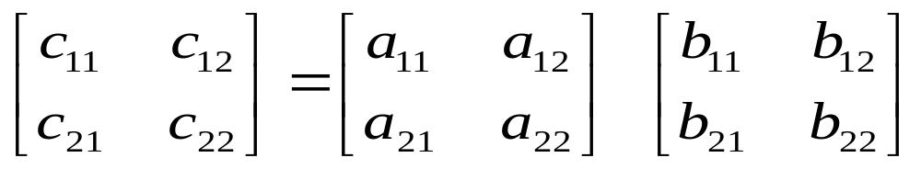
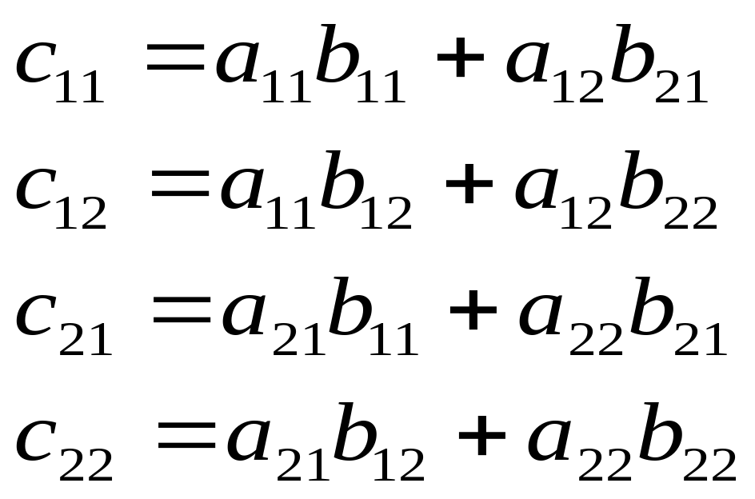
Matrix Multiplication

Slide 36
Matrix Multiplication Implementation
/* ijk */
for (i=0; i<n; i++) {
for (j=0; j<n; j++) {
c[i][j] = 0.0;
for (k=0; k<n; k++)
c[i][j] += a[i][k] * b[k][j];
}
}
O(n³)adds and multiplies
Each n² elements of A and B is read n times

Slide 37
Matrix Multiplication
Assumptions:
  Each array is an n×n array of double, with size 8
  There is a single cache with a 32-byte block size ( B=32 )
  The array size n is so large that a single matrix row does not fit in the L1 cache
  The compiler stores local variables in registers, and thus references to local variables inside loops do not require any load and store instructions.

Slide 38
Matrix Multiplication
/* ijk */
for (i=0; i<n; i++) {
for (j=0; j<n; j++) {
sum = 0.0;
for (k=0; k<n; k++)
sum += a[i][k] * b[k][j];
c[i][j] = sum;
}
}
Variable sum
held in register

Slide 39
Matrix multiplication (ijk)
/* ijk */
for (i=0; i<n; i++) {
for (j=0; j<n; j++) {
sum = 0.0;
for (k=0; k<n; k++)
sum += a[i][k] * b[k][j];
c[i][j] = sum;
}
}
Inner loop:
(*,j)
(i,j)
(i,*)
A
B
C
Row-wise
Column-wise
Fixed
Misses per Inner Loop Iteration:
  A B C
  0.25 1.0 0.0
  2 loads, 0 stores
  misses/iter = 1.25

Slide 40
Matrix multiplication (jik)
/* jik */
for (j=0; j<n; j++) {
for (i=0; i<n; i++) {
sum = 0.0;
for (k=0; k<n; k++)
sum += a[i][k] * b[k][j];
c[i][j] = sum;
}
}
Inner loop:
(*,j)
(i,j)
(i,*)
A
B
C
Row-wise
Column-wise
Fixed
Misses per Inner Loop Iteration:
  A B C
  0.25 1.0 0.0
  2 loads, 0 stores
  misses/iter = 1.25

Slide 41
Matrix multiplication (kij)
/* kij */
for (k=0; k<n; k++) {
for (i=0; i<n; i++) {
r = a[i][k];
for (j=0; j<n; j++)
c[i][j] += r * b[k][j];
}
}
Inner loop:
(i,k)
(k,*)
(i,*)
A
B
C
Fixed
Row-wise
Row-wise
Misses per Inner Loop Iteration:
  A B C
  0.0 0.25 0.25
  2 loads, 1 store
  misses/iter = 0.5

Slide 42
Matrix multiplication (ikj)
/* ikj */
for (i=0; i<n; i++) {
for (k=0; k<n; k++) {
r = a[i][k];
for (j=0; j<n; j++)
c[i][j] += r * b[k][j];
}
}
Inner loop:
(i,k)
(k,*)
(i,*)
A
B
C
Fixed
Row-wise
Row-wise
Misses per Inner Loop Iteration:
  A B C
  0.0 0.25 0.25
  2 loads, 1 store
  misses/iter = 0.5

Slide 43
Matrix multiplication (jki)
/* jki */
for (j=0; j<n; j++) {
for (k=0; k<n; k++) {
r = b[k][j];
for (i=0; i<n; i++)
c[i][j] += a[i][k] * r;
}
}
Inner loop:
(*,k)
(*,j)
(k,j)
A
B
C
Column -wise
Fixed
Column-wise
Misses per Inner Loop Iteration:
  A B C
  1.0 0.0 1.0
  2 loads, 1 store
  misses/iter = 2.0

Slide 44
Matrix multiplication (kji)
/* kji */
for (k=0; k<n; k++) {
for (j=0; j<n; j++) {
r = b[k][j];
for (i=0; i<n; i++)
c[i][j] += a[i][k] * r;
}
}
Inner loop:
(*,k)
(*,j)
(k,j)
A
B
C
Column -wise
Fixed
Column-wise
Misses per Inner Loop Iteration:
  A B C
  1.0 0.0 1.0
  2 loads, 1 store
  misses/iter = 2.0

Slide 45
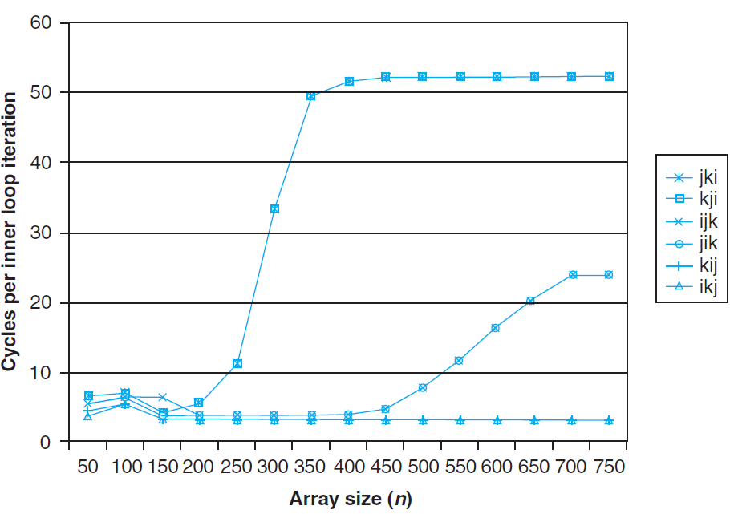
Pentium matrix multiply performance

Slide 46
Pentium matrix multiply performance
The performance difference is
  almost 20 times for the same application
Pairs of versions have almost identical measured performance
  with the same number of memory references and misses per
The worst memory behavior versions run significantly slower than the other versions
  in terms of the number of accesses and misses per iteration

Slide 47
Pentium matrix multiply performance
Miss rate, in this case, is a better predictor of performance than the total number of memory accesses.
The performance of the fastest pair of versions (kij and ikj) is constant
  the array is much larger than any of the cache
The prefetching hardware is
  smart enough to recognize the stride-1 access
  fast enough to keep up with memory accesses in the tight inner loop

Slide 48
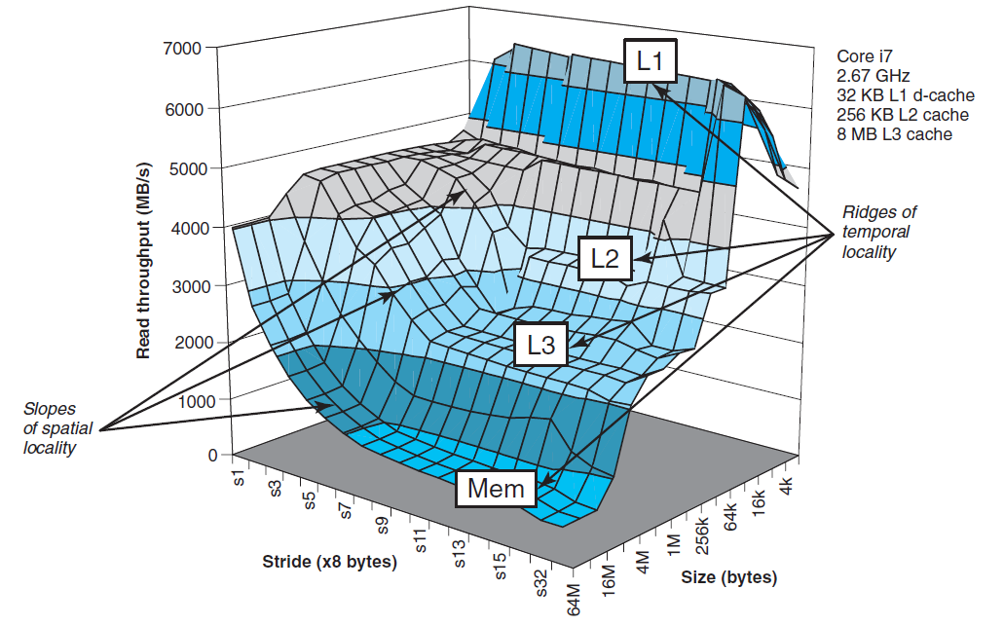
The Memory Mountain

Slide 49
The Memory Mountain
Read throughput (read bandwidth)
  The rate that a program reads data from the memory system
Memory mountain
  A two-dimensional function of read bandwidth versus temporal and spatial locality
  Characterizes the capabilities of the memory system for each computer

Slide 50
Memory mountain main routine
/* mountain.c - Generate the memory mountain. */
#define MINBYTES (1 << 11) /* Working set size ranges from 2 KB */
#define MAXBYTES (1 << 26) /* ... up to 64 MB */
#define MAXSTRIDE 64 /* Strides range from 1 to 64 */
#define MAXELEMS MAXBYTES/sizeof(double)
double data[MAXELEMS]; /* The array we'll be traversing */

Slide 51
Memory mountain main routine
int main()
{
int size; /* Working set size (in bytes) */
int stride; /* Stride (in array elements) */
double Mhz; /* Clock frequency */
init_data(data, MAXELEMS); /* Initialize each element in data to 1 */
Mhz = mhz(0); /* Estimate the clock frequency */

Slide 52
Memory mountain main routine
for (size = MAXBYTES; size >= MINBYTES; size >>= 1) {
for (stride = 1; stride <= MAXSTRIDE; stride++)
printf("%.1f\t", run(size, stride, Mhz));
printf("\n");
}
exit(0);
}

Slide 53
Memory mountain test function
/* The test function */
void test (int elems, int stride) {
int i ;
double result = 0.0 ;
volatile double sink;
for (i = 0; i < elems; i += stride)
result += data[i];
sink = result; /* So compiler doesn't optimize away the loop */
}

Slide 54
Memory mountain test function
/* Run test (elems, stride) and return read throughput (MB/s) */
double run (int size, int stride, double Mhz)
{
double cycles;
int elems = size / sizeof(double);
test (elems, stride); /* warm up the cache */
cycles = fcyc2(test, elems, stride, 0); /* call test (elems,stride) */
return (size / stride) / (cycles / Mhz); /* convert cycles to MB/s */
}

Slide 55
The Memory Mountain
Data
  Size
    MAXBYTES(64M) bytes or MAXELEMS(8M) doubles
  Partially accessed
    Working set: from 64MB to 2KB
    Stride: from 1 to 64

Slide 56
The Memory Mountain

Slide 57
Ridges of temporal locality
Slice through the memory mountain with stride=16
  illuminates read throughputs of different caches and memory

Slide 58
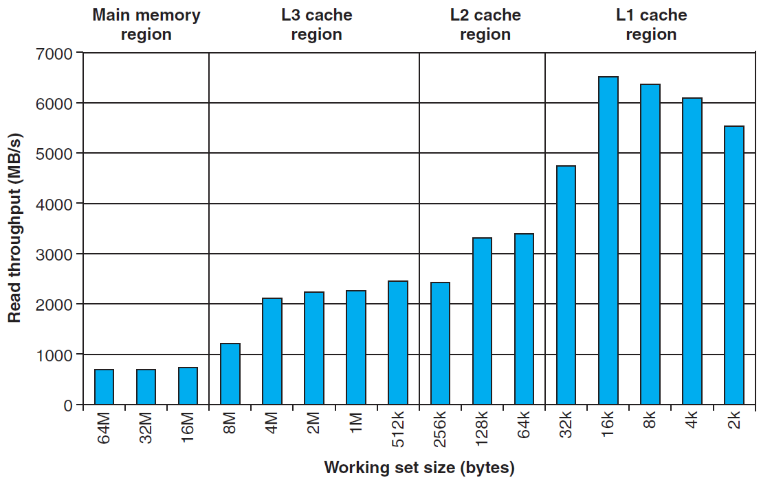
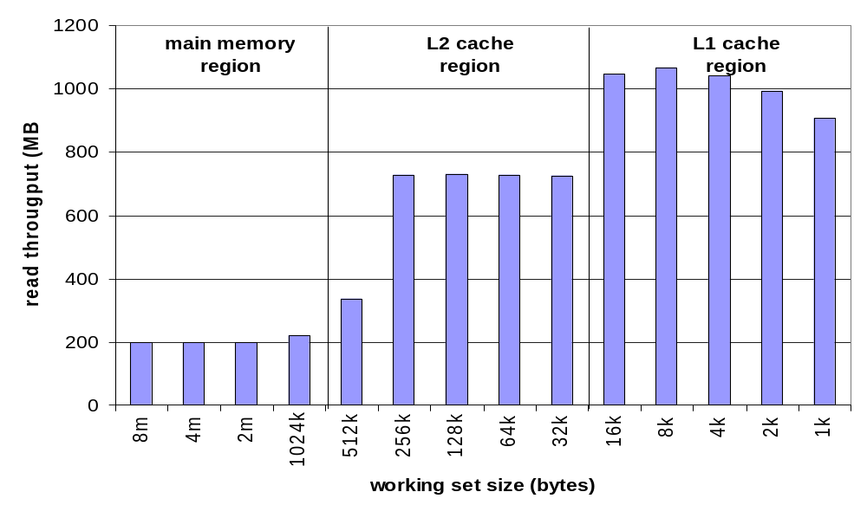
Ridges of temporal locality

Slide 59
A slope of spatial locality
Slice through memory mountain with size=4M
  shows cache block size.

Slide 60
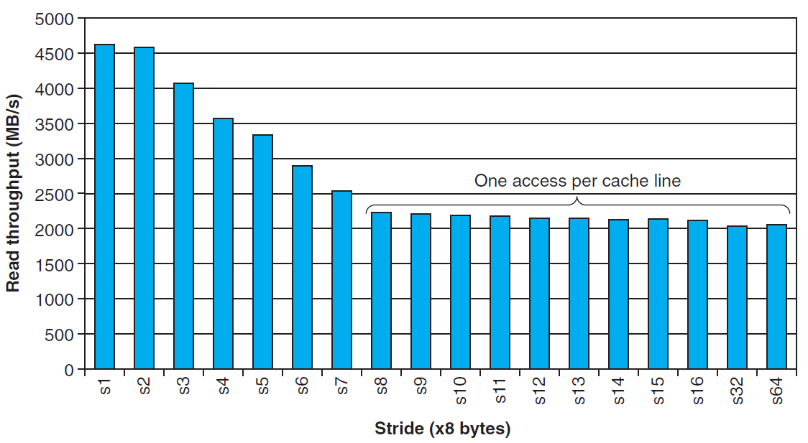
A slope of spatial locality

