Slide 1
Process Scheduling
Introduction

Slide 2
Outline
Workload Assumption
Turnaround time
FIFO, SJF, STCF
Response time
Round Robin
Incorporating I/O
Suggested reading: 7

Slide 3
Mechanism and Policy
Mechanisms
  Low-level methods or protocols
    that implement a needed piece of functionality
  Examples
    context switch (time-sharing)
    Paging
Policies
  Intelligence resides on top of the mechanisms
  algorithms for making some kind of decision
  Examples
    Scheduling policy (decide to run which process)
    Replacement policy(decide which page to be replaced)

Slide 4
Workload Assumptions
Each job runs for the same amount of time
All jobs arrive at the same time
Once started, each job runs to completion
All jobs only use the CPU
  i.e., they perform no I/O
The run-time of each job is known
Above assumptions are unrealistic
  Will be relaxed one by one

Slide 5
Turnaround time
Metric
  is just something we use to measure something
Scheduling metrics
  there are a number of different metrics that make sense in scheduling
The turnaround time
  the time at which the job completes minus the time at which the job arrived in the system
  T_{turnaround} = T_{completion} − T_{arrival}
  Because for now T_{arrival} = 0 and hence T_{turnaround} = T_{completion}

Slide 6
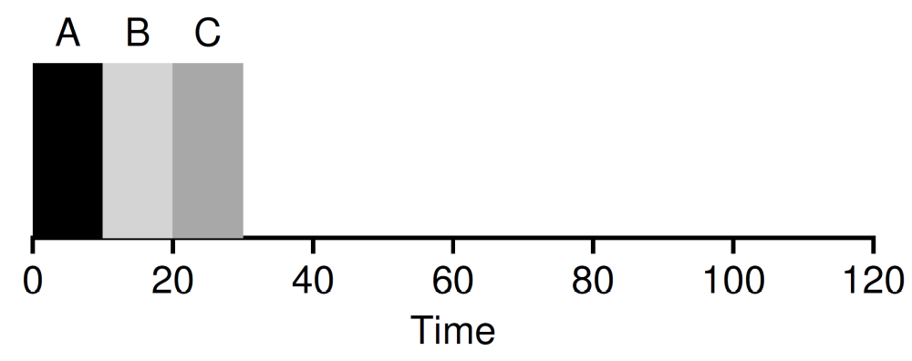
First In, First Out (FIFO)
Also known as First Come, First Served (FCFS)
It is clearly simple and thus easy to implement
Examples
  Jobs A, B, C. Each runs for 10s
  Turnaround time is (10+20+30)/3=20

Slide 7
Workload Assumptions
×
Each job runs for the same amount of time
All jobs arrive at the same time
Once started, each job runs to completion
All jobs only use the CPU
  i.e., they perform no I/O
The run-time of each job is known
Above assumptions are unrealistic
  Will be relaxed one by one

Slide 8
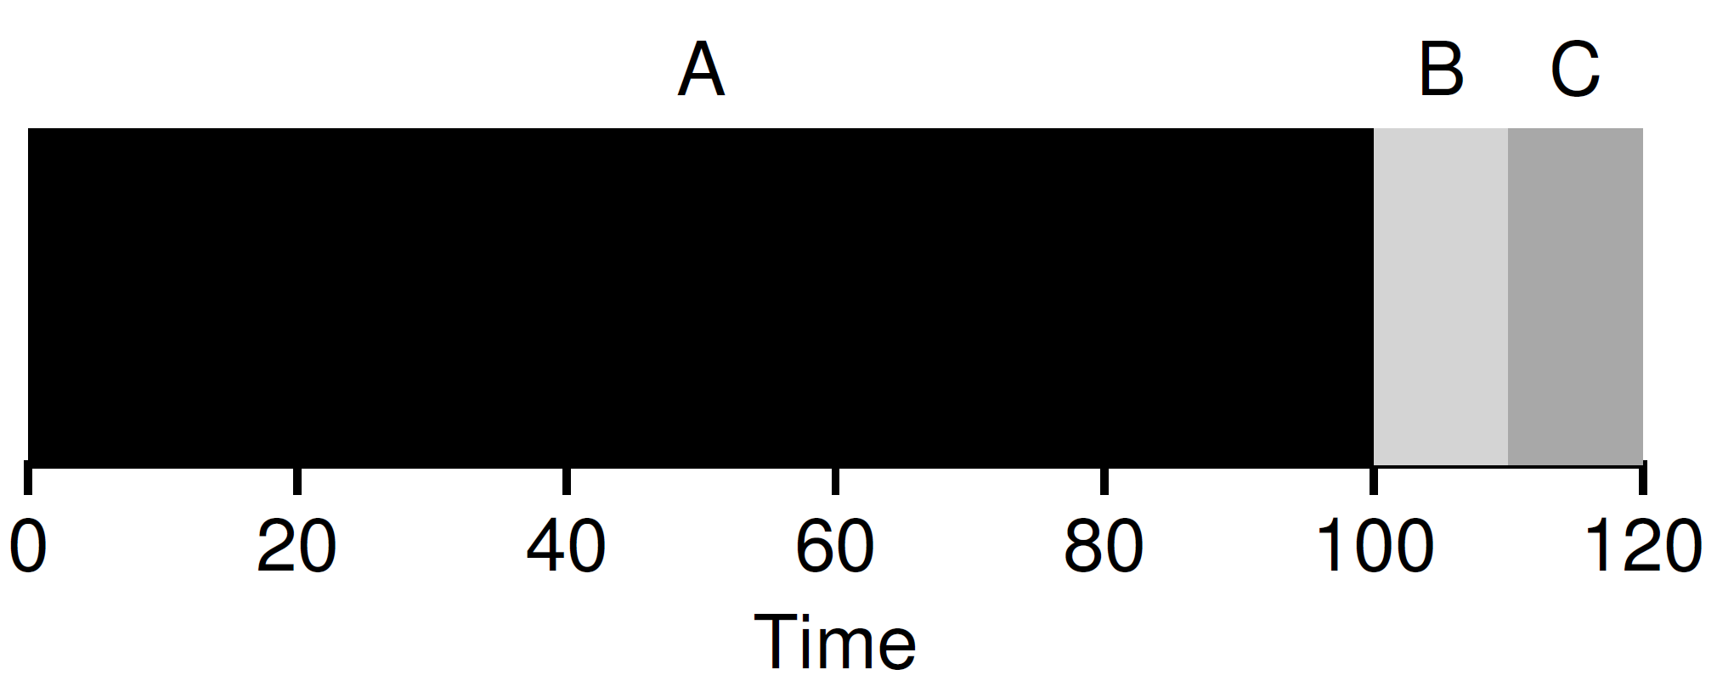
First In, First Out (FIFO)
Job A runs for 100s. Job B and C run for 10s
  Turnaround time is (100+110+120)/3=110
Convey Effect
  a number of relatively-short potential consumers of a resource get queued behind a heavyweight resource consumer

Slide 9
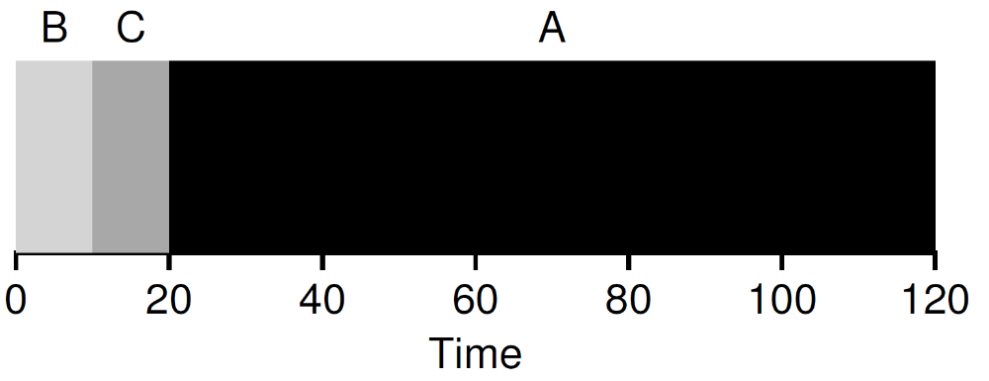
Shortest Job First (SJF)
Runs the shortest job first
  then the next shortest, and so on
  optimal
Examples
  Job A runs for 100s. Job B and C run for 10s
  Turnaround time is (10+20+120)/3=50

Slide 10
Workload Assumptions
×
Each job runs for the same amount of time
All jobs arrive at the same time
Once started, each job runs to completion
All jobs only use the CPU
  i.e., they perform no I/O
The run-time of each job is known
Above assumptions are unrealistic
  Will be relaxed one by one
×

Slide 11
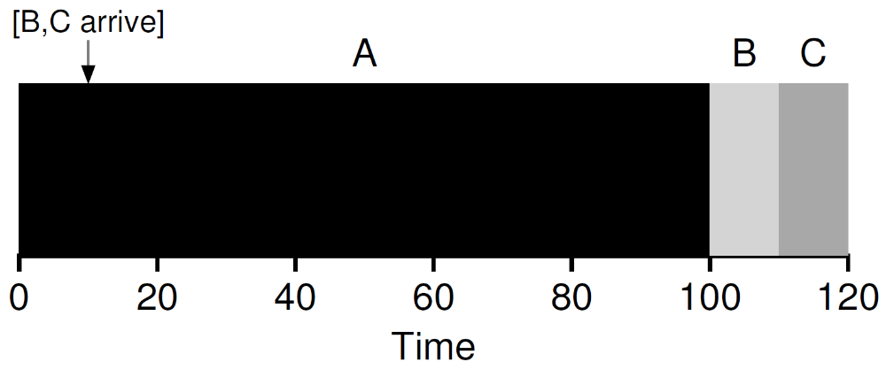
Shortest Job First (SJF)
Assume A arrives at t = 0 and needs to run for 100 seconds, whereas B and C arrive at t = 10 and each need to run for 10 seconds
Turnaround time (100+100+110)/3=103.33s

Slide 12
Workload Assumptions
×
Each job runs for the same amount of time
All jobs arrive at the same time
Once started, each job runs to completion
All jobs only use the CPU
  i.e., they perform no I/O
The run-time of each job is known
Above assumptions are unrealistic
  Will be relaxed one by one
×
×

Slide 13
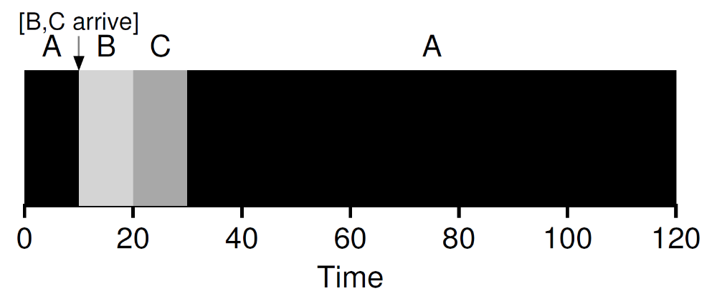
Shortest Time-to-Completion First (STCF)
STCF
  Any time a new job enters the system
  the STCF scheduler determines
    which of the remaining jobs (including the new job) has the least time left, and schedules that one
Preempt A when B and C arrived
  Turnaround time is (10+20+120)/3=50

Slide 14
Response time
In the time sharing systems
  Many users are interactive with computers
  Each user does not want to wait too long
Response time
  the time from when the job arrives in a system to the first time it is scheduled
  T_{response} = T_{firstturn} − T_{arrival}
Example
  T_{response} = (0+0+10)/3=3.33

Slide 15
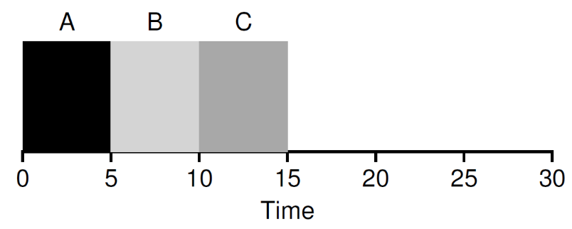
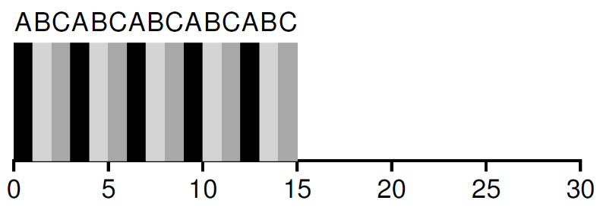
Round Rabin
Mechanism
  Run a job for a time slice
  Switch to the next job in the run queue
  Repeat until the jobs are finished
Time slice
      scheduling quantum
      a multiple of the timer-interrupt period (10ms)

Slide 16
Round Rabin
Switching cost
  Save and restore context
  Flushing TLB
  Flushing the hardware pipelines ( or out of order execution states)
Amortization
  Do not switch too shortly
  May increase the response time
  Must do some trade-off

Slide 17
Round Rabin vs. SJF
SJF
  Best for turnaround time
    (5+10+15)/3=10
  Worse for response time
    (0+5+10)/3=5
SJF
  Worse for turnaround time
    (13+14+15)/3=14
  Better for response time
    (0+1+2)/3=1
Must some trade-off

Slide 18
Workload Assumptions
×
Each job runs for the same amount of time
All jobs arrive at the same time
Once started, each job runs to completion
All jobs only use the CPU
  i.e., they perform no I/O
The run-time of each job is known
Above assumptions are unrealistic
  Will be relaxed one by one
×
×
×

Slide 19
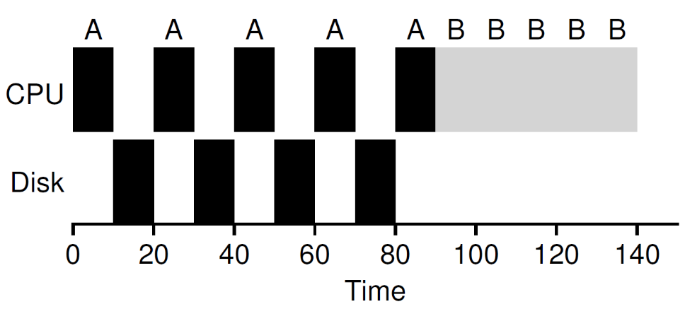
Incorporating I/O
Example
  Job A and B run on CPU for 50s each
  Job A does 4 I/O operations (10s each)
  The poor schedule does as follows

Slide 20
Incorporating I/O
When a job initiates an I/O request
  A system call is invoked
  The job is blocked (by kernel)
  Another job is scheduled to CPU
When a job completes an I/O request
  An interrupt is sent to CPU
  The job becomes ready to run
  The schedule determines which job to be scheduled
Overlap I/O and CPU
  Maximize the utilization of systems

Slide 21
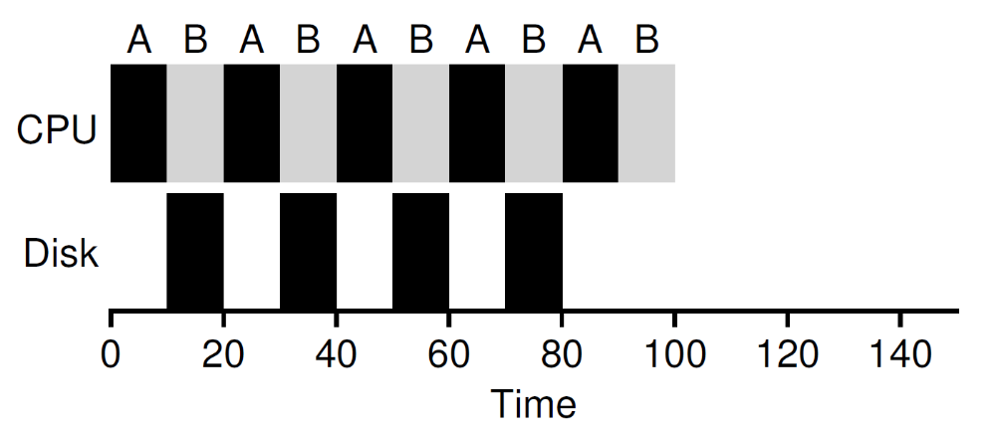
Incorporating I/O
How should the scheduler treat each job?
  Treat each CPU burst as a job
Example
  Treat each 10-ms sub-job of A as an independent job
  Doing overlap better

Slide 22
Workload Assumptions
×
Each job runs for the same amount of time
All jobs arrive at the same time
Once started, each job runs to completion
All jobs only use the CPU
  i.e., they perform no I/O
The run-time of each job is known
When the last assumption is relaxed
  what can we do?
×
×
×

