Slide 1
Process Scheduling

Slide 2
Outline
Multi-Level Feedback Queue Scheduler
Proportional-Share Scheduler
Multiprocessor(Multicore) Scheduler
Suggested reading: 8、9, 10

Slide 3
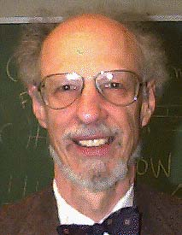
Introduction
Corbato
  introduced it with others in 1962 in a system known as the Compatible Time-Sharing System (CTSS)
  Won the ACM Turing Award in 1990
    because of CTSS and the later work on Multics

Slide 4
Primary Goal of the MLFQ
MLFQ would like to both
  optimize the turnaround time without a priori knowledge of job length
  minimize the response time
How to schedule without perfect knowledge
  The scheduler can learn the characteristics of the jobs it is running as the system runs,
  and thus make better scheduling decisions

Slide 5
Learning from History
Systems that learn from the past to predict the future
  The multi-level feedback queue
  hardware branch predictors
  caching algorithms
Such approaches work when jobs have phases of behavior and are thus predictable
Must be careful with such techniques
  they can easily be wrong and drive a system to make worse decisions than they would have with no knowledge at all

Slide 6
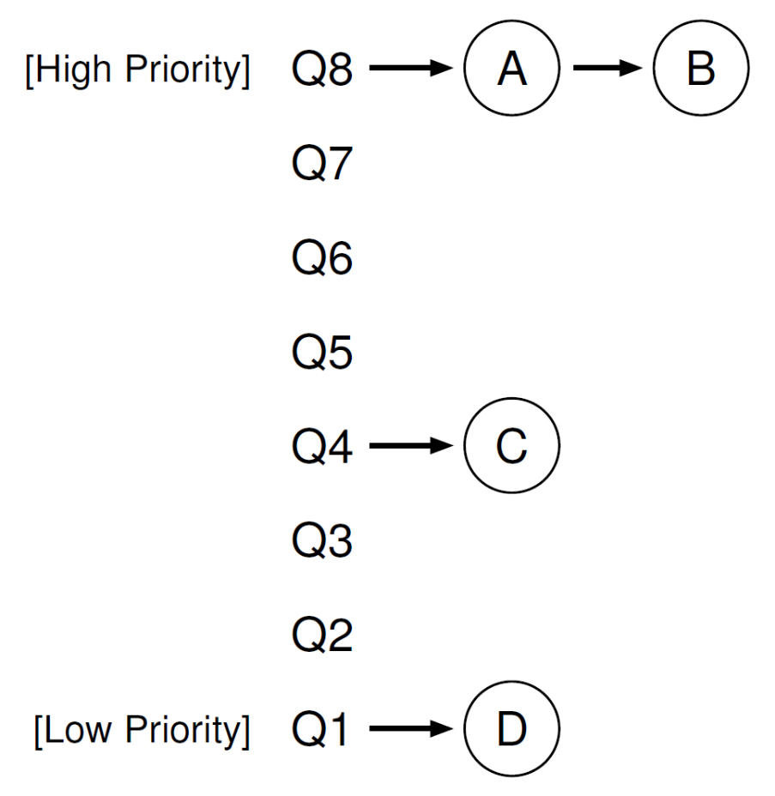
Basic Rules
A number of distinct queues
  each assigned a different priority level
A job that is ready to run is on a single queue
Rule 1: If Priority(A) > Priority(B), A runs (B doesn’t)
Rule 2: If Priority(A) = Priority(B), A & B run in RR

Slide 7
How to Change Priority
Our workload is a mix of
  interactive jobs that are short-running
    and may frequently relinquish the CPU
  and some longer-running “CPU-bound” jobs
    need a lot of CPU time
    response time isn’t important
Rule 3: When a job enters the system, it is placed at the highest priority
Rule 4a: If a job uses up an entire time slice while running, its priority is reduced
Rule 4b: If a job gives up the CPU before the time slice is up, it stays at the same priority level.

Slide 8
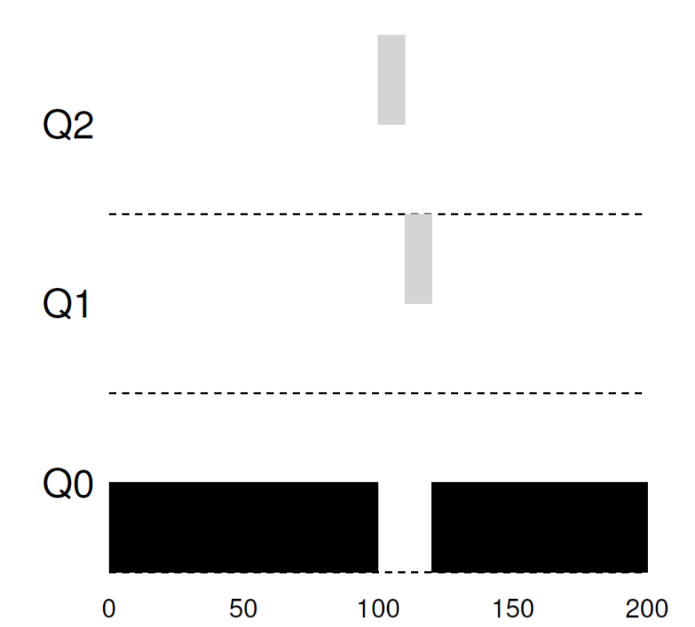
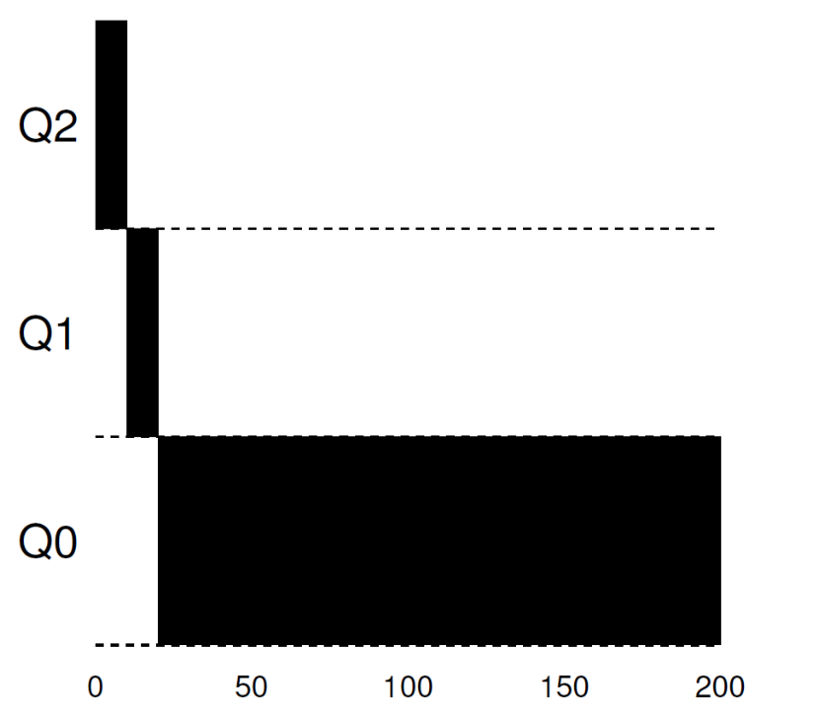
Examples
1. A single long running job
2. Along Came A Short Job

Slide 9
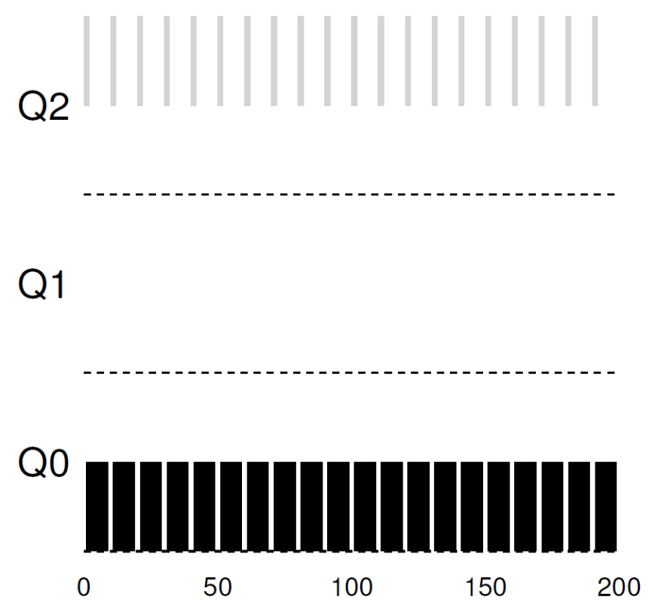
Examples
3. A mixed I/O-intensive and CPU-intensive workload

Slide 10
Notes
When a job arrives, the MLFQ
  first assumes it might be a short job
    Thus giving the job high priority
If it actually is a short job
  it will run quickly and complete
If it is not a short job
  it will slowly move down the queues
  soon prove itself to be a long-running process
If it is an interactive job doing a lot of I/O
  it will relinquish the CPU before its time slice is complete
  simply keep it at the same level without penalizing

Slide 11
Problems
starvation
  If there are “too many” interactive jobs in the system, they will combine to consume all CPU time
  long-running jobs will never receive any CPU time
Gaming scheduler attack
  before the time slice is over, issue an I/O operation and thus relinquish the CPU
  the job remains in the same queue, and thus gain a higher percentage of CPU time.
  This may lead to nearly monopolize the CPU
programs may change its behavior over time
  what were CPU bound may transit to a phase of interactivity

Slide 12
Priority Boost
Rule 5: After some time period S, move all the jobs in the system to the topmost queue
Processes are guaranteed not to starve
  sitting in the top queue, a job will eventually receive service
  because it shares the CPU with other high-priority jobs in a round-robin fashion
If a CPU-bound job has become interactive
  the scheduler treats it properly
  once it has received the priority boost

Slide 13
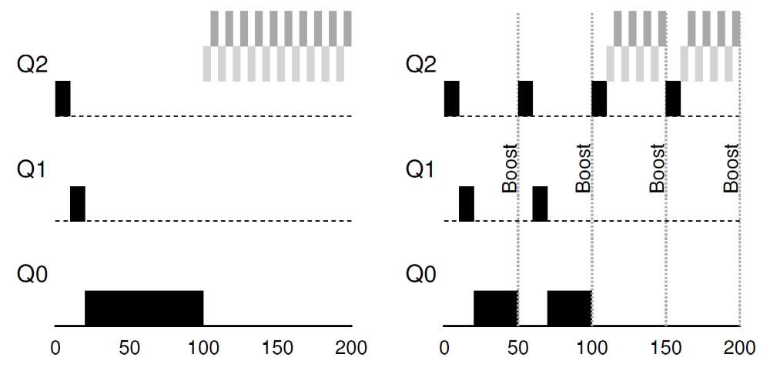
Priority Boost

Slide 14
Better Accounting
Rule 4: Once a job uses up its time allotment at a given level (regardless of how many times it has given up the CPU), its priority is reduced
The scheduler
  keeps track of the percentage of the time slice a process used at a given level
  once a process has used its allotment, it is demoted to the next priority queue

Slide 15
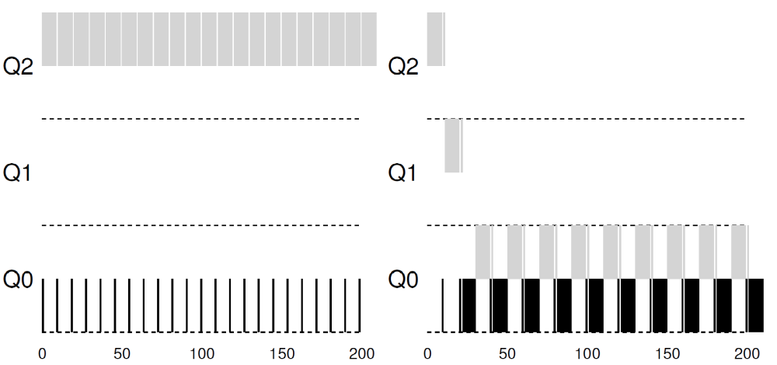
Better Accounting

Slide 16
Tuning MLFQ
How to parameterize a MLFQ scheduler
  how many queues should there be?
  How big should the time slice be per queue?
  How often should priority be boosted in order to avoid starvation and account for changes in behavior?
Tuning the scheduler
  only doing experience with typical workloads
  will lead to a satisfactory balance

Slide 17
Tuning MLFQ
Most MLFQ variants allow for varying time-slice length across different queues
The high-priority queues are given short time slices
  They are comprised of interactive jobs after all
  Quickly alternating between them makes sense
The low-priority queues are given longer time slices
  They contain long-running jobs that are CPU-bound
  Longer time slice works well

Slide 18
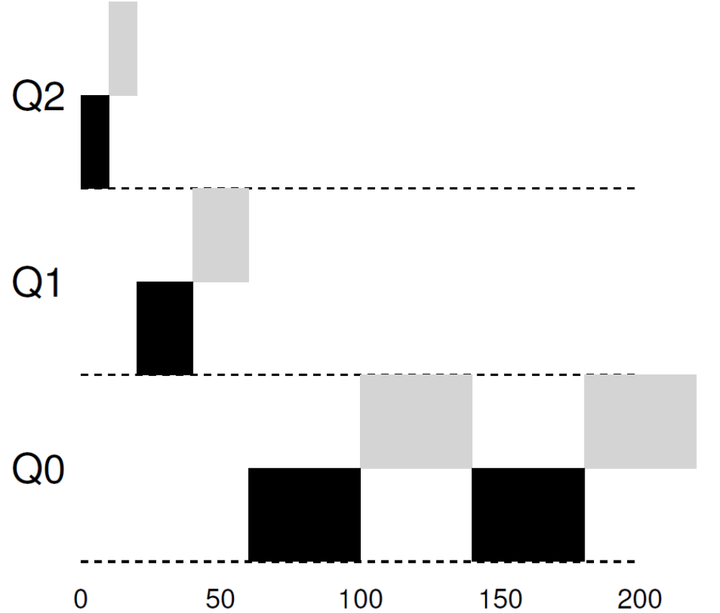
Lower Priority, Longer Quanta

Slide 19
OUSTERHOUT’S LAW
VOO-DOO CONSTANTS
  require some form of black magic to set them correctly
Avoiding voo-doo constants is a good idea whenever possible
  Unfortunately, it is often difficult
  One could try to make the system learn a good value
    but that too is not straightforward
The frequent result:
  a configuration file filled with default parameter values
  a seasoned administrator can tweak when something isn’t quite working correctly

Slide 20
Solaris MLFQ implementation
The Time-Sharing scheduling class(TS)
Particularly easy to configure
  provides a set of tables that determine exactly how the priority of a process is altered throughout its lifetime
    how long each time slice is, and how often to boost the priority of a job
    an administrator can muck with this table in order to make the scheduler behave in different ways

Slide 21
Solaris MLFQ implementation
Default values for the table are
  60 queues
  slowly increasing time-slice lengths
    from 20 milliseconds (highest priority)
    to a few hundred milliseconds (lowest)
  priorities boosted around every 1 second or so.

Slide 22
Other implementations
Decay-usage
  the FreeBSD scheduler (version 4.3)
  uses a formula to calculate the current priority level of a job
    basing on how much CPU the process has used
  usage is decayed over time
  providing the desired priority boost in a different manner than described herein.

Slide 23
Other implementations
Some schedulers
  reserve the highest priority levels for operating system work
  typical user jobs can never obtain the highest levels of priority in the system
Some systems
  allow some user advice to help set priorities;
  for example, using the command-line utility nice
    you can increase or decrease the priority of a job
    and thus increase or decrease its chances of running at any given time

Slide 24
Summary
Rule 1: If Priority(A) > Priority(B), A runs (B doesn’t).
Rule 2: If Priority(A) = Priority(B), A & B run in RR.
Rule 3: When a job enters the system, it is placed at the highest priority (the topmost queue).
Rule 4: Once a job uses up its time allotment at a given level (regardless of how many times it has given up the CPU), its priority is reduced (i.e., it moves down one queue).
Rule 5: After some time period S, move all the jobs in the system to the topmost queue.

Slide 25
Summary
MLFQ
  Observes the execution of a job and prioritizes it accordingly
    instead of demanding a priori knowledge of the nature of a job
  Manages to achieve the best of both worlds
    it can deliver excellent overall performance similar to SJF/STCF) for short-running interactive jobs
    it is fair and makes progress for long-running CPU-intensive workloads
Many systems use a form of MLFQ as their base scheduler
  BSD, Solaris, Windows NT and subsequent Windows operating systems

Slide 26
Proportional-Share Scheduler
A scheduler might try to guarantee that each job obtain a certain percentage of CPU time
  Fair-share
Lottery Scheduling
  every so often, hold a lottery to determine which process should get to run next;
  processes that should run more often should be given more chances to win the lottery

Slide 27
Tickets Represent Your Share
Tickets
  represent the share of a resource that a process (or user or whatever) should receive
The percent of tickets that a process has
  represents its share of the system resource in question
An example
  two processes, A and B
  A has 75 tickets while B has only 25
  what we would like is for
    A to receive 75% of the CPU
    and B the remaining 25%

Slide 28
Lottery Scheduler
Lottery scheduling achieves this probabilistically
  not deterministically
  by holding a lottery every so often
    say, every time slice
Holding a lottery is straightforward:
  the scheduler must know how many total tickets there are
    in the above example, there are 100
  The scheduler then picks a winning ticket
    which is a number from 0 to 99 in the above example

Slide 29
Example
Assuming
  A holds tickets 0 through 74 and B 75 through 99
The winning ticket simply determines whether A or B runs.
  The scheduler then loads the state of that winning process and runs it
Here is an example output of a lottery scheduler’s winning tickets
Here is the resulting schedule
the longer these two jobs compete, the more likely they are to achieve the desired percentages

Slide 30
Ticket Currency
Currency allows a user with a set of tickets
  to allocate tickets among their own jobs in whatever currency they would like
  the system then automatically converts said currency into the correct global value
Example
  users A and B have each been given 100 tickets
  User A is running two jobs, A1 and A2, and gives them each 500 tickets (out of 1000 total) in User A’s own currency
  User B is running only 1 job and gives it 10 tickets (out of 10 total)

Slide 31
Ticket Transfer
A process can temporarily hand off its tickets to another process
In a client/server setting
  a client sends a message to a server asking it to do some work on the client’s behalf
  the client can pass the tickets to the server and thus try to maximize the performance of the server while the server is handling the client’s request
  When finished, the server then transfers the tickets back to the client and all is as before

Slide 32
Ticket Inflation
A process can temporarily raise or lower the number of tickets it owns
Make little sense
  in a competitive scenario with processes that do not trust one another
  can be applied in an environment where a group of processes trust one another
A process knows it needs more CPU time
  it can boost its ticket value as a way to reflect that need to the system,
  all without communicating with any other processes

Slide 33
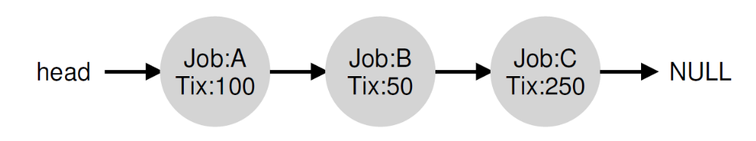
Lottery Implementation
Simple
  a good random number generator to pick the winning ticket
  a data structure to track the processes of the system (e.g., a list),
  the total number of tickets
Example
  Pick the number 300

Slide 34
1 // counter: used to track if we’ve found the winner yet
2 int counter = 0;
3
4 // winner: use some call to a random number generator to
5 // get a value, between 0 and the total # of tickets
6 int winner = getrandom(0, totaltickets);
7
8 // current: use this to walk through the list of jobs
9 node_t *current = head;
10
11 // loop until the sum of ticket values is > the winner
12 while (current) {
13 counter = counter + current->tickets;
14 if (counter > winner)
15 break; // found the winner
16 current = current->next;
17 }
18 // ’current’ is the winner: schedule it...

Slide 35
Lottery Implementation
It might generally be best to organize the list in sorted order
  from the highest number of tickets to the lowest
  the ordering does not affect the correctness of the algorithm
  it does ensure in general that the fewest number of list iterations are taken,
    especially if there are a few processes that possess most of the tickets

Slide 36
Fairness Study
Example
  two jobs competing against one another
  each with the same number of tickets (100)
  each with same run time R which we will vary
unfairness metric U
  the time the first job completes
  divided by
  the time the second job completes
  If R = 10, and the first job finishes at time 10 and the second job at 20
    U =10/20= 0.5
  When both jobs finish at nearly the same time, U will be quite close to 1 (our goal)

Slide 37
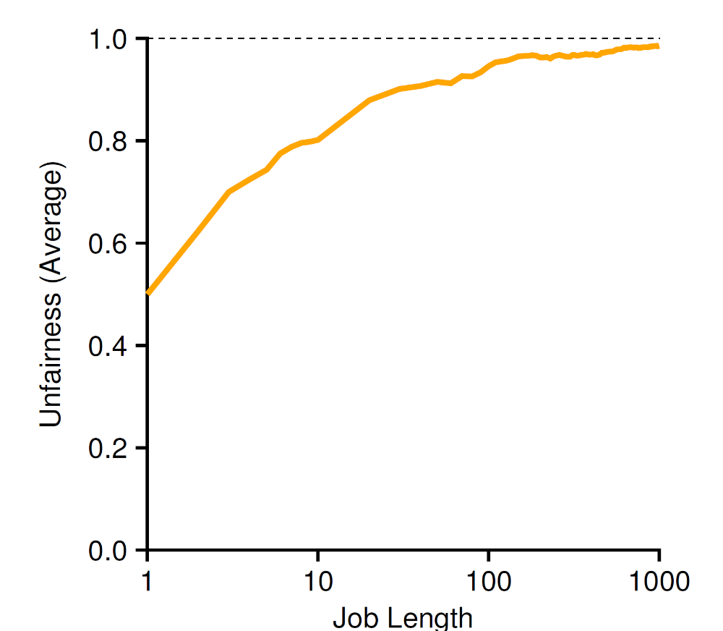
Fairness Study

Slide 38
Fairness Study
the average unfairness as the length of the two jobs
  R is varied from 1 to 1000 over thirty trials
When the job length is not very long,
  average unfairness can be quite severe
As the jobs run for a significant number of time slices
  the lottery scheduler approaches the desired outcome

Slide 39
How To Assign Tickets?
This problem is a tough one
One approach is to assume that the users know best
  each user is handed some number of tickets
  a user can allocate tickets to any jobs they run as desired
Given a set of jobs,
  the “ticket-assignment problem” remains open

Slide 40
Stride Scheduling
a deterministic fair-share scheduler
Each job in the system has a stride
  inverse in proportion to the number of tickets it has
Tickets number of jobs A, B, and C
  100, 50, and 250
Stride values for A, B, and C
  100, 200, and 40
  by 10,000

Slide 41
Stride Scheduling
Pass value
  Each job has a counter initialized as 0
  It is increased by its stride, every time the job runs
The scheduler uses the stride and pass to schedule processes
  pick the process to run that has the lowest pass value so far
Pseudo code
  current = remove_min(queue); // pick client with minimum pass
  schedule(current); // use resource for quantum
  current->pass += current->stride; // compute next pass using stride
  insert(queue, current); // put back into the queue

Slide 42
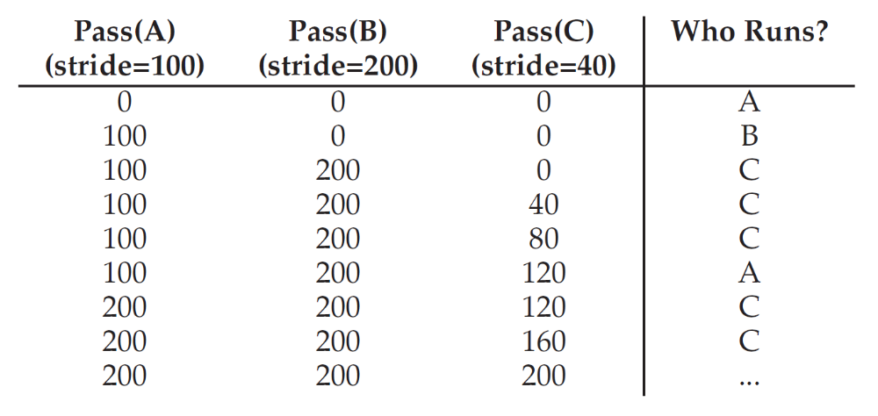
Stride Scheduling
Deterministic as desired

Slide 43
Why Use Lottery Scheduling
No global state!
What should the pass value will be
  when a new job enters in the middle of our stride scheduling example above
Lottery makes it much easier to incorporate new processes in a sensible manner

Slide 44
Multiprocessor(Multicore) Scheduling
New issues
  Cache Coherence
  Synchronization
  Cache Affinity

Slide 45
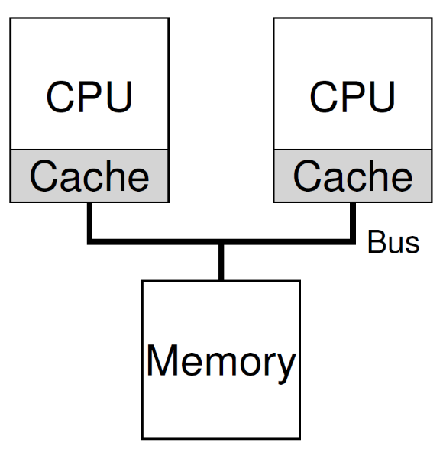
Cache Coherence
CPU1
  Read the data D from address A
  Copied D to its cache
  Updated D to D’ in its cache
CPU2
  Read the data from address A
  The data should be D’
  However the value in the memory with the address A is still D (write back policy)

Slide 46
Cache Coherence
Bus snooping
  Monitoring memory access
  Each cache pays attention to memory updates by observing the bus
  It will notice the change
  Either invalidate its copy or updates it
The basic idea applies to the write back cache also

Slide 47
Synchronization
1 typedef struct __Node_t {
2 int value;
3 struct __Node_t *next;
4 } Node_t;
5
6 int List_Pop() {
7 Node_t *tmp = head; // remember old head ...
8 int value = head->value; // ... and its value
9 head = head->next; // advance head to next pointer
10 free(tmp); // free old head
11 return value; // return value at head
12 }

Slide 48
Synchronization
Threads on two CPUs enter this routine at the same time
  Thread 1 executes the first line
    it will have the current value of head stored in its private tmp variable
  Thread 2 then executes the first line as well
    it also will have the same value of head stored in its own private tmp variable
Instead of each thread removing an element from the head of the list,
  each thread will try to remove the same head element
  leading to all sorts of problems
    double free, returning the same data value twice

Slide 49
Cache Affinity
A process, when run on a particular CPU,
  builds up a fair bit of state in the caches (and TLBs) of the CPU
The next time the process runs,
  it is often advantageous to run it on the same CPU,
  as it will run faster if some of its state is already present in the caches on that CPU
If the process runs on a different CPU
  the performance of the process will be worse
  as it will have to reload the state each time it runs

Slide 50
Single-Queue Scheduling
single-queue multiprocessor scheduling
  SQMS for short
  put all jobs that need to be scheduled into a single queue
Pro (simplicity)
  do not require much work to
    take an existing policy that picks the best job to run next
    adapt it to work on more than one CPU
      where it might pick the best two jobs to run if there are two CPUs, for example

Slide 51
Single-Queue Scheduling
CON
  Poor scalability
    Must use lock to ensure the correctness
    Lock increases contention when number of cores grows
      More and more time must spend on lock acquiring
  Not cache affinity

Slide 52
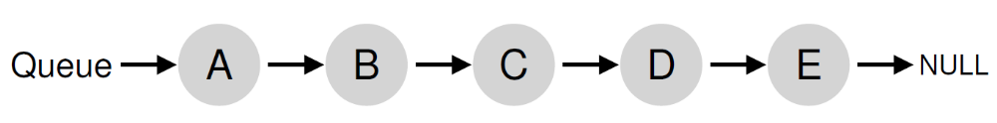
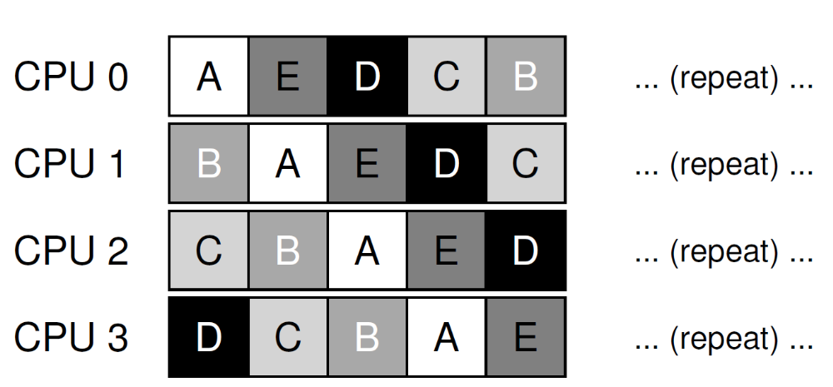
Not Cache Affinity
Example

Slide 53
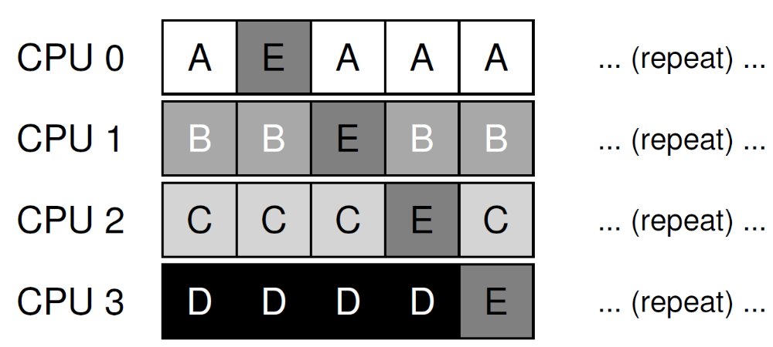
Cache Affinity
Try an affinity mechanism
  to make it more likely that
  process will continue to run on the same CPU if possible
  Implementing such a scheme can be complex

