Slide 1
Multiprocessor Scheduler

Slide 2
Outline
Multiprocessor(Multicore) Scheduler
Suggested reading: 10

Slide 3
Multiprocessor(Multicore) Scheduling
New issues
  Cache Coherence
  Synchronization
  Cache Affinity

Slide 4
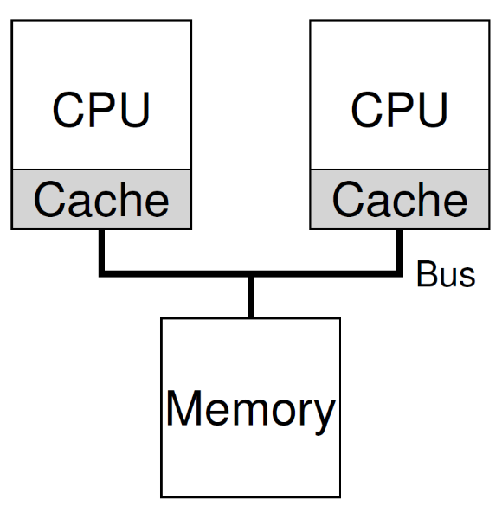
Cache Coherence
CPU1
  Read the data D from address A
  Copied D to its cache
  Updated D to D’ in its cache
CPU2
  Read the data from address A
  The data should be D’
  However the value in the memory with the address A is still D (write back policy)

Slide 5
Cache Coherence
Bus snooping
  Monitoring memory access
  Each cache pays attention to memory updates by observing the bus
  It will notice the change
  Either invalidate its copy or updates it
The basic idea applies to the write back cache also

Slide 6
Synchronization
1 typedef struct __Node_t {
2 int value;
3 struct __Node_t *next;
4 } Node_t;
5
6 int List_Pop() {
7 Node_t *tmp = head; // remember old head ...
8 int value = head->value; // ... and its value
9 head = head->next; // advance head to next pointer
10 free(tmp); // free old head
11 return value; // return value at head
12 }

Slide 7
Synchronization
Threads on two CPUs enter this routine at the same time
  Thread 1 executes the first line
    it will have the current value of head stored in its private tmp variable
  Thread 2 then executes the first line as well
    it also will have the same value of head stored in its own private tmp variable
Instead of each thread removing an element from the head of the list,
  each thread will try to remove the same head element
  leading to all sorts of problems
    double free, returning the same data value twice

Slide 8
Cache Affinity
A process, when run on a particular CPU,
  builds up a fair bit of state in the caches (and TLBs) of the CPU
The next time the process runs,
  it is often advantageous to run it on the same CPU,
  as it will run faster if some of its state is already present in the caches on that CPU
If the process runs on a different CPU
  the performance of the process will be worse
  as it will have to reload the state each time it runs

Slide 9
Single-Queue Scheduling
single-queue multiprocessor scheduling
  SQMS for short
  put all jobs that need to be scheduled into a single queue
Pro (simplicity)
  do not require much work to
    take an existing policy that picks the best job to run next
    adapt it to work on more than one CPU
      where it might pick the best two jobs to run if there are two CPUs, for example

Slide 10
Single-Queue Scheduling
CON
  Poor scalability
    Must use lock to ensure the correctness
    Lock increases contention when number of cores grows
      More and more time must spend on lock acquiring
  Not cache affinity

Slide 11
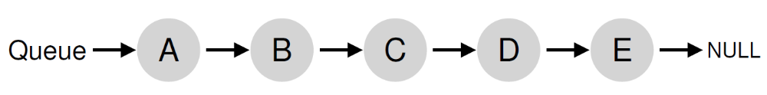
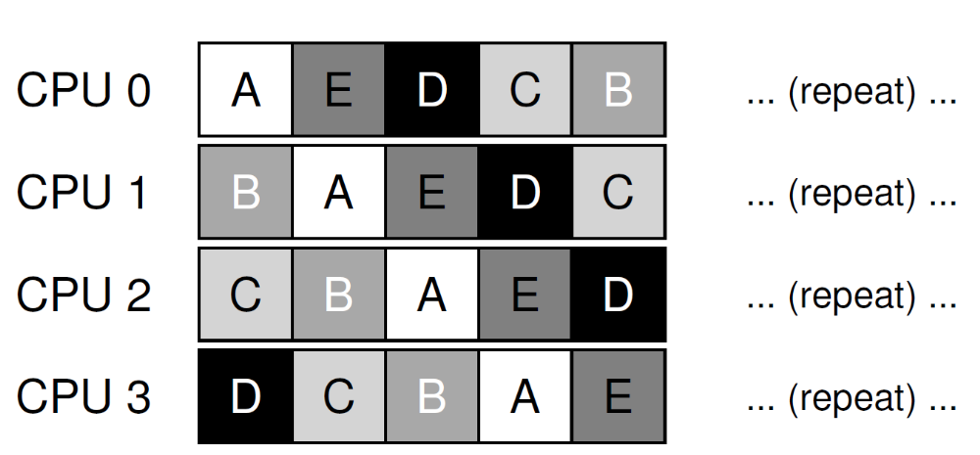
Not Cache Affinity
Example

Slide 12
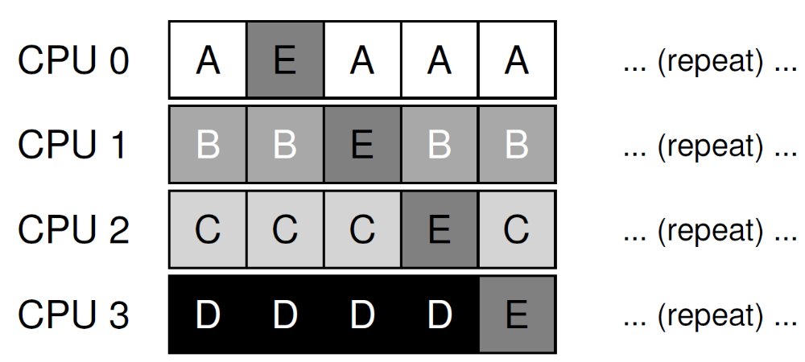
Cache Affinity
Try an affinity mechanism
  to make it more likely that
  process will continue to run on the same CPU if possible
  Implementing such a scheme can be complex

Slide 13
Multi-Queue Scheduling
multi-queue multiprocessor scheduling (MQMS)
  Using multiple queues(e.g., one per CPU)
  Each queue follows a particular scheduling discipline
  Each job is placed on exactly one scheduling queue
    according to some heuristic
      Random
      Picking one with fewer jobs than others
  Each queue is scheduled essentially independently
    avoid the synchronization problem

Slide 14
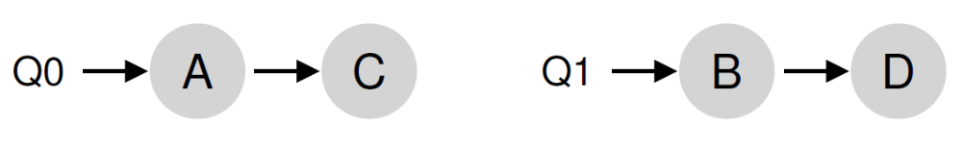
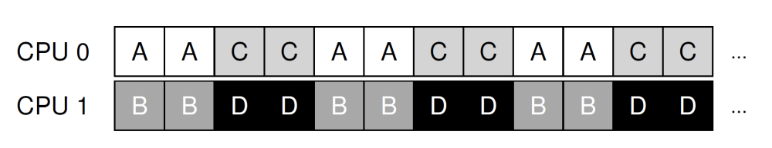
Example
There are two CPUs (labeled CPU0 and CPU1)
  Each queue uses round-robin policy

Slide 15
Multi-Queue Scheduling
Pros
  It should be inherently more scalable
    As the number of CPUs grows
      so too does the number of queues
      lock and cache contention should not become a central problem
  It intrinsically provides cache affinity
    jobs stay on the same CPU
    thus reap the advantage of reusing cached contents therein

Slide 16
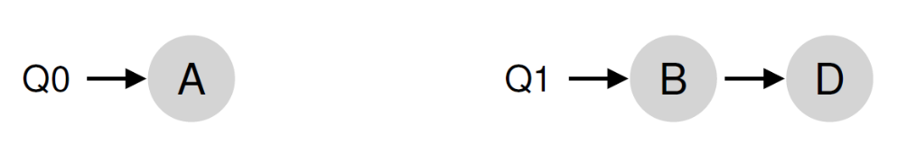
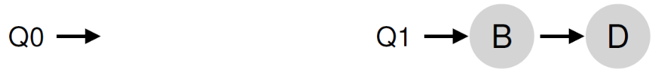
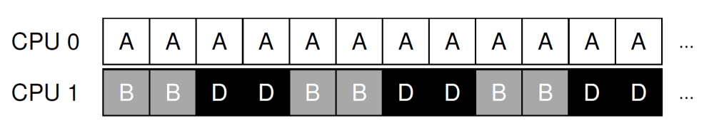
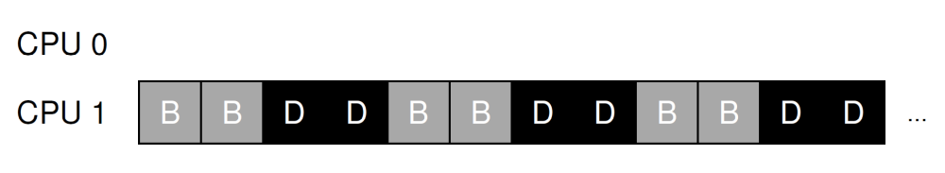
Multi-Queue Scheduling
Cons
  It is load imbalance
Example
  Two CPUs: CPU0, CPU1
  Four jobs: A,B, C,D with C finished
  A gets twice as much CPU time as B and D
  Even worse, if A finished, CPU0 becomes idle

Slide 17
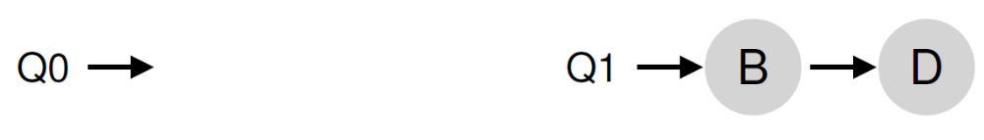
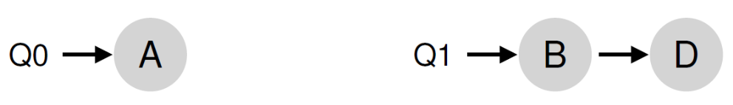
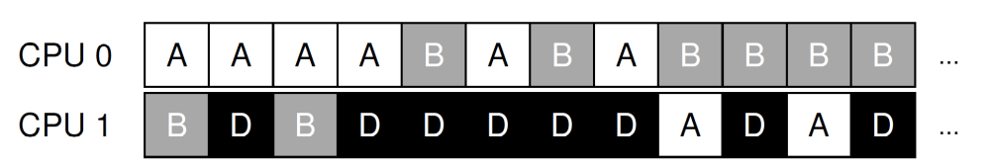
Job Migration
Migrate a job from one CPU to another
  True load balance can be achieved
Example
  Migrate B or D to another queue
  continuous migration of one or more jobs

Slide 18
Work Stealing
Source queue
  that is low on jobs
Source queue occasionally peeks at another (target) queue if
  the target is notably more full than the source,
  if yes, the source “steals” one or more jobs from the target
How often do the source peak the target?
  Too often, suffer from high overhead and have trouble scaling
  Not too often, suffer from severe load imbalances

Slide 19
Linux Multiprocessor Schedulers
The O(1) scheduler
  multiple queues
  priority-based scheduler
The Completely Fair Scheduler (CFS)
  multiple queues
  a deterministic proportional-share approach
the BF Scheduler (BFS)
  single-queue
  proportional-share based on a more complicated scheme known as
    Earliest Eligible Virtual Deadline First (EEVDF)

Slide 20

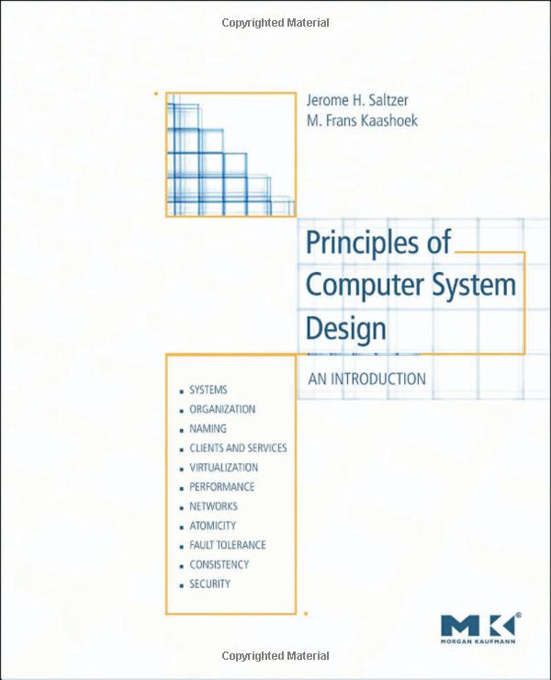
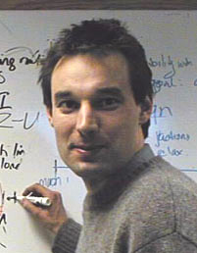
Suggestion Reading 6.3
Jerome H. Saltzer
MIT教授
美国工程院院士
Frans Kaashoek

Slide 21
Disk Scheduling
Goal
  Minimize time spent waiting on disk mechanisms
    Moving the disk arm
    Waiting for sector to rotate under disk heads
  Fairness
    Should not make requests wait too long

Slide 22
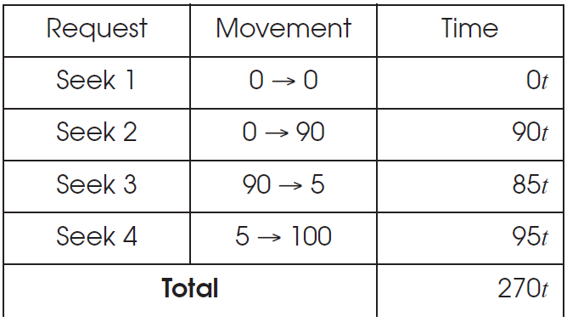
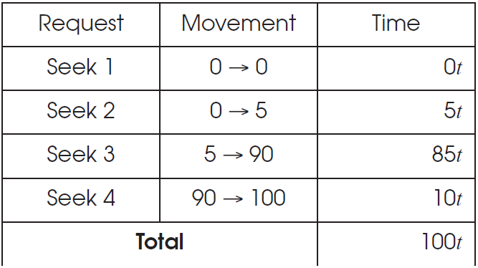
Disk Scheduling Goals

Slide 23
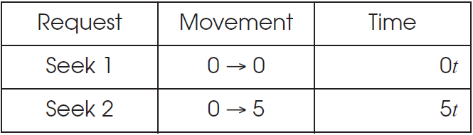
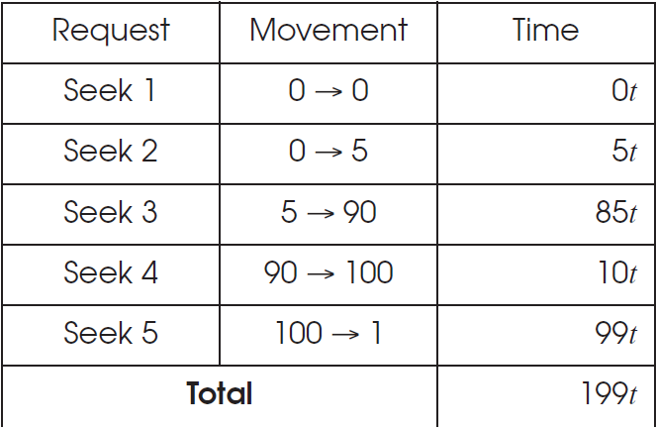
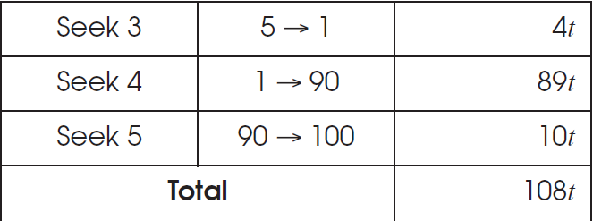
Disk Scheduling Goals
Shortest-Seek-First
Elevator Algorithm

Slide 24
Replacement Policy

Slide 25
Outline
Cache Management
The Optimal Replacement Policy
The FIFO Policy
The Random Policy
The LRU Policy
Workload Studies
Implementation Issues
Suggested reading: 22

Slide 26
Cache Management
Terminologies
  AMAT：Average memory access time
  T_{M}：cost of accessing memory, around 100ns
  T_{D}：cost of accessing disk, around 10ms
  P_{hit}： hit rate
  P_{miss}: miss rate
AMAT = (P_{Hit} · T_{M}) + (P_{Miss} · T_{D})
Miss rate means a lot
  AMAT = 100ns*0.9 + 10ms*0.1= 1.00009 ms
  AMAT = 100ns*0.999 + 10ms*0.001= 10.0999 μs
The cost of disk access is so high
  A tiny miss rate will quickly dominate the AMAT

Slide 27
The Optimal Replacement Policy
The best possible replacement policy
  developed by Belady many years ago
  replacing the page that will be accessed furthest in the future
  hard to implement
  incredibly useful as a comparison point in simulation or other studies

Slide 28
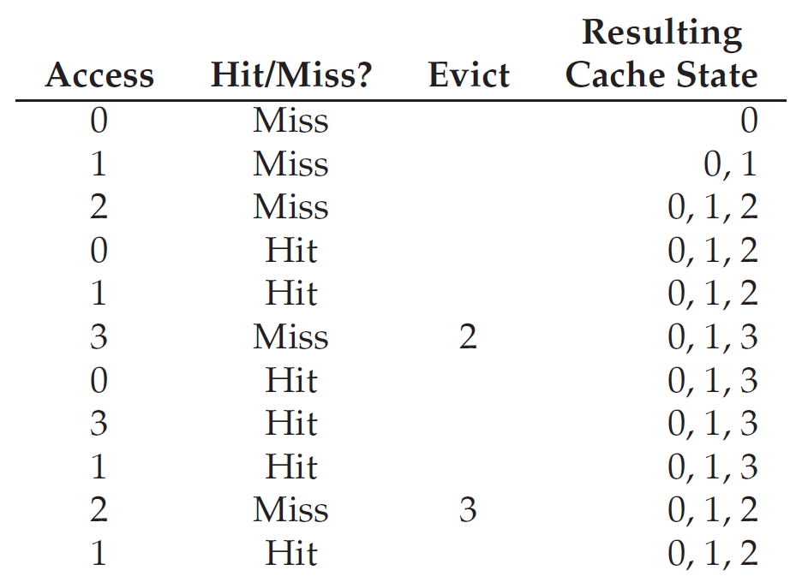
Example
Trace:0, 1, 2, 0, 1, 3, 0, 3, 1, 2, 1
  Hit rate = 6/11 = 54.5%

Slide 29
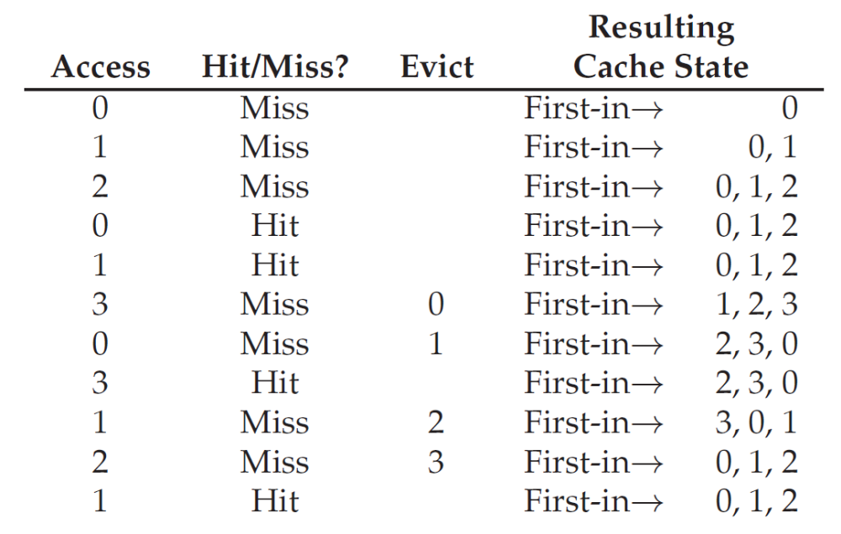
First-In, First-Out Replacement Policy
Hate rate = 4/11 =36.4%

Slide 30
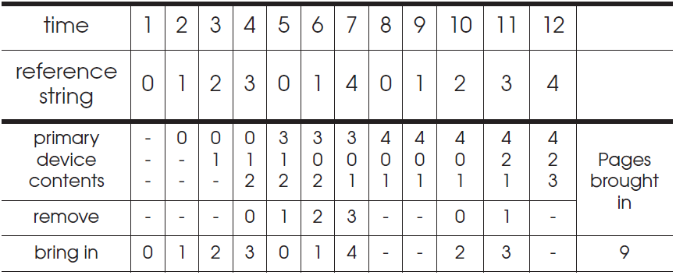
Belady’s Anomaly
The reference trace is 0,1,2,3,0,1,4,0,1,2,3,4

Slide 31
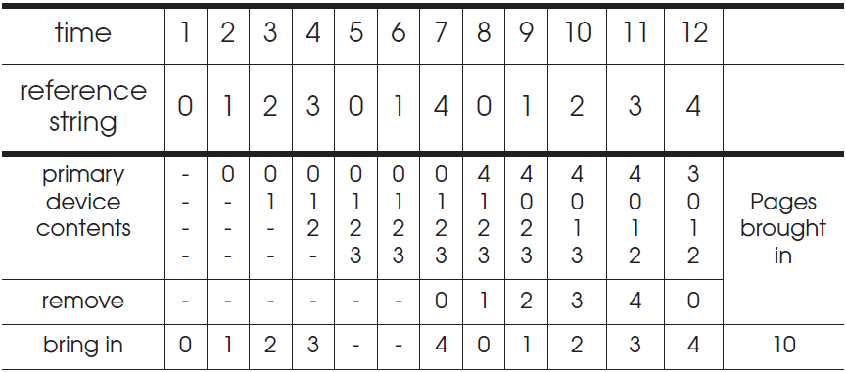
Belady's Anomaly
Increase of missing-page exception numbers with a larger primary device capacity

Slide 32
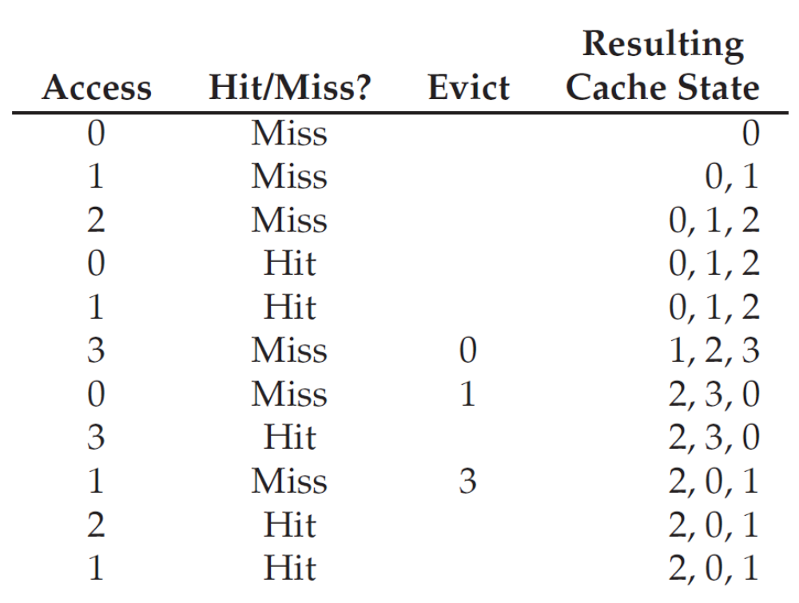
Random Replacement Policy
Hate rate = 5/11 =45.5%

Slide 33
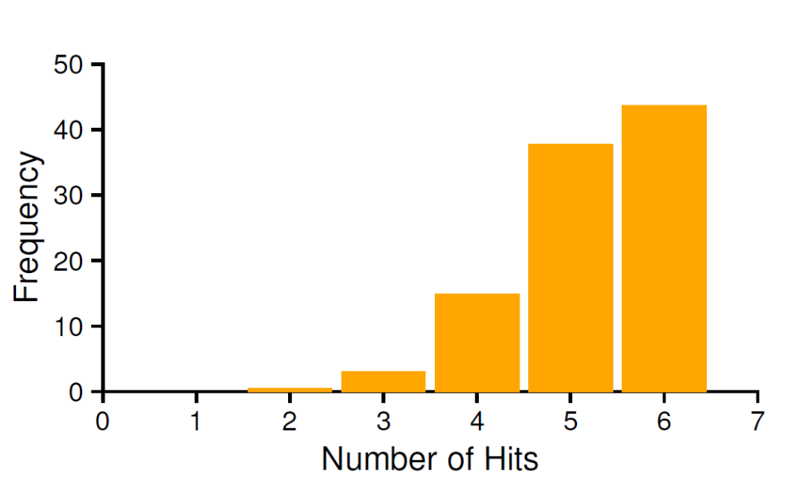
Random Replacement Policy
How many hits Random achieves
  over 10,000 trials
  each with a different random seed
  over 40%of the time Random is as good as optimal

Slide 34
LRU Replacement Policy
Lean on the past and use history as our guide
  Frequency
    if a page has been accessed many times, perhaps it should not be replaced as it clearly has some value
    Least-Frequently-Used (LFU)
      Replace the least-frequently used page
  Recency of access
    the more recently a page has been accessed, perhaps the more likely it will be accessed again
    Least-Recently-Used (LRU)
      Replace the least-recently-used page

Slide 35
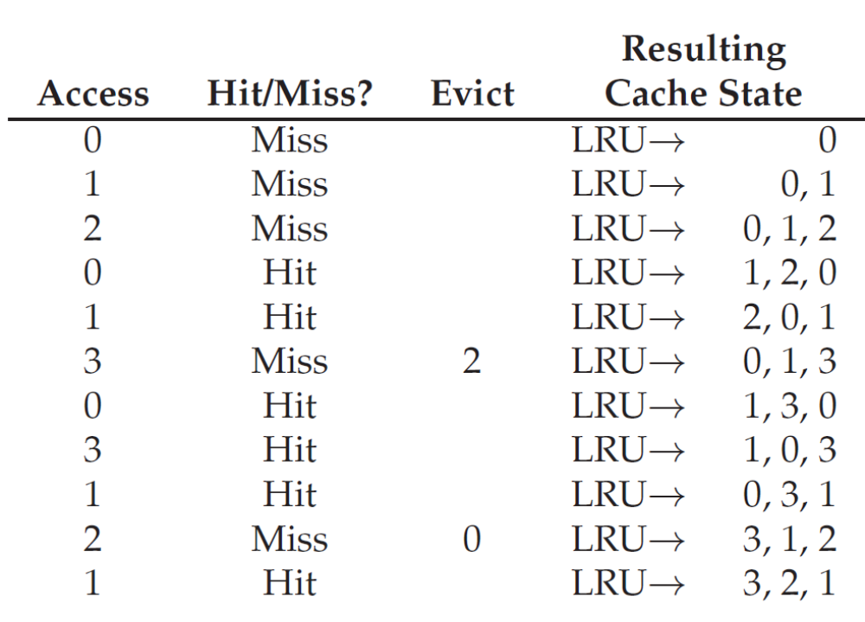
LRU Replacement Policy
Hate rate = 6/11 =54.5%

Slide 36
Stack Algorithms
Subset property
  For the optimal policy, at all times
  the pages it keeps in the 3-page memory
  is a subset of that it keeps in the 4-page memory
No Belady’s anomaly if subset property holds
  At all times and
  For every possible capacity of primary device
  It creates a total ordering for pages at a given time

Slide 37
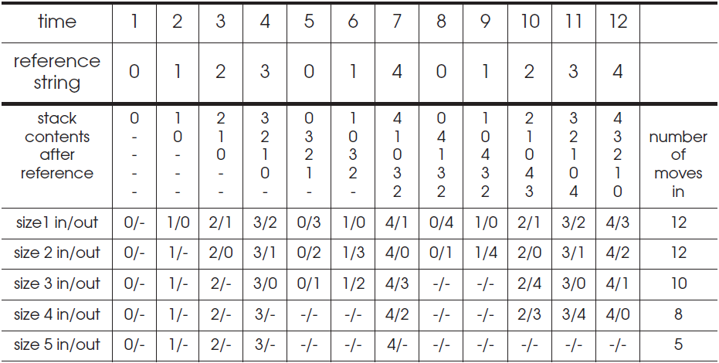
Stack Algorithms for LRU
It can perform a simulation for all possible primary memory size with a single pass through a given reference string

Slide 38
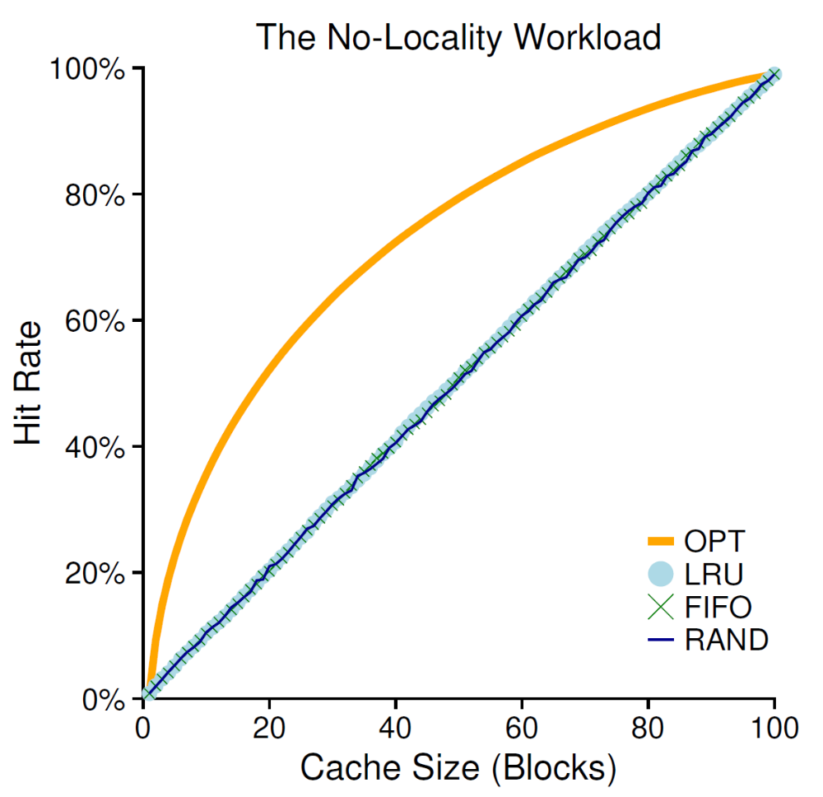
Random Access Workload
the workload
  accesses 100 unique pages over time
  choosing the next page to refer to at random
  overall 10,000 pages are accessed

Slide 39
Random Access Workload
It doesn’t matter much which realistic policy you are using
  LRU, FIFO, and Random all perform the same
  the hit rate exactly determined by the size of the cache
When the cache is large enough to fit the entire workload
  it also doesn’t matter which policy you use
  all policies (even Random) converge to a 100% hit rate when all the referenced blocks fit in cache

Slide 40
Random Access Workload
Optimal performs noticeably better than the realistic policies
  peeking into the future if it were possible
  does a much better job of replacement

Slide 41
“80-20” Workload
Hot pages
  80% of the references
  is about to 20% of the pages
Cold pages
  the remaining 20% of the references
  is about the remaining 80% of the pages
Example
  there are a total 100 unique pages
  “hot” pages are referred to most of the time
  “cold” pages the remainder.

Slide 42
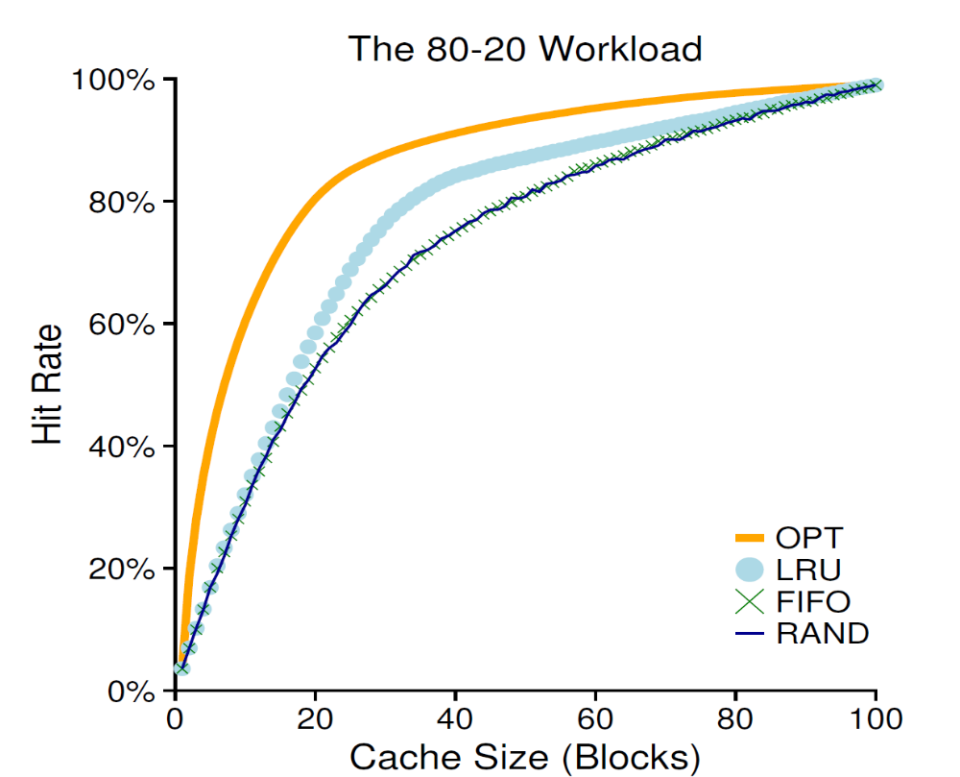
“80-20” Workload

Slide 43
“80-20” Workload
both random and FIFO do reasonably well
LRU does better
  it is more likely to hold onto the hot pages
  those pages have been referred to frequently in the past
  they are likely to be referred to again in the near future
Optimal does best
  showing that LRU’s historical information is not perfect
Does LRU do better than random an FIFO?
  It depends

Slide 44
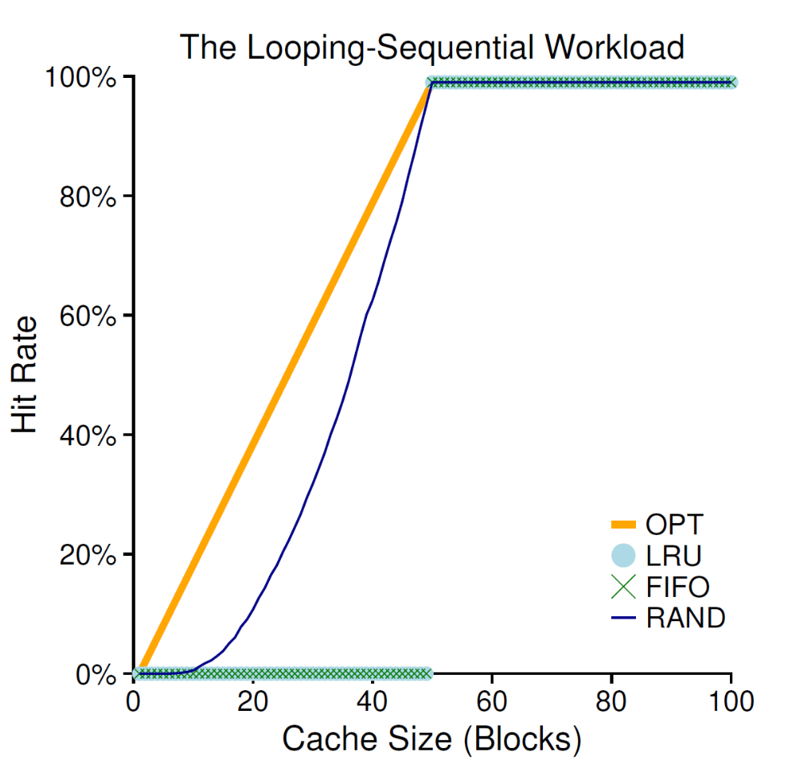
“Looping Sequential” Workload
Refer to 50 pages in sequence
  start at 0, then 1, ..., up to page 49,
  repeat those accesses
  for a total of 10,000 accesses to 50 unique pages

Slide 45
“Looping Sequential” Workload
Common in many applications such as databases
A worst case for both LRU and FIFO
  kick out older pages
  these older pages are going to be accessed sooner than the pages that the policies prefer to keep in cache
  even with a cache of size 49, hit rate remains 0%
Random fares notably better
  not quite approaching optimal, but at least achieving a non-zero hit rate
  not having weird corner-case behaviors
  used as TLB replacement policy

Slide 46
How to implement LRU?
Hardware should put a time stamp on each physical page whenever it is accessed
When evicting, it should sort the pages by their time stamps
It may be too many pages to be sorted
  One million pages for 4GB memory with 4KB page-size

Slide 47
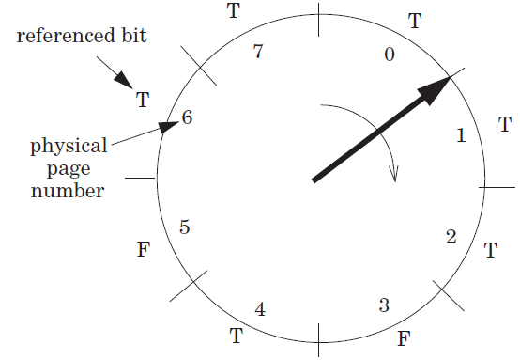
Clock Algorithm
Access bit
  a hardware bit for each page
  Set to true when accessed
  Pages are organized as a clock
Start from a position
  Move clockwise and checks the bit page-wise
  If T, clear to F
  Otherwise, choose as the victim and stop

Slide 48
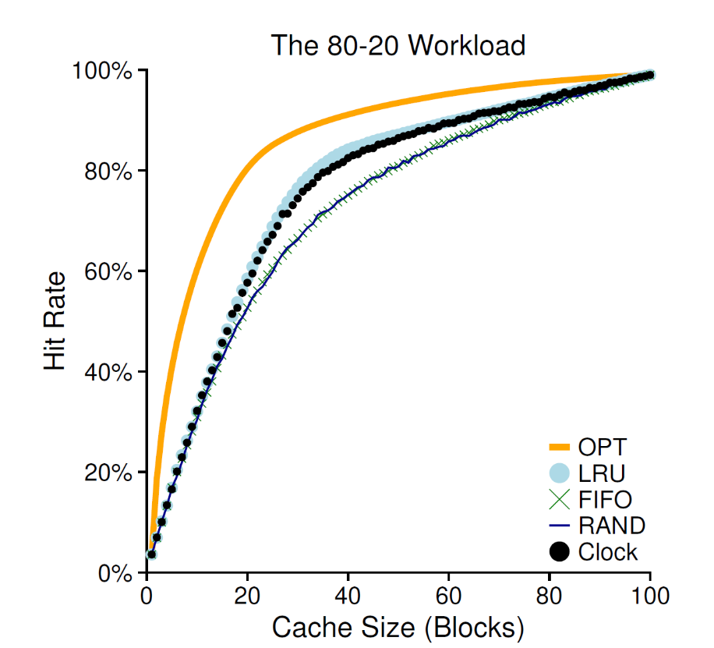
Clock Algorithm
It doesn’t do quite as well as perfect LRU
It does better than approaches that don’t consider history at all
It can use dirty bit to reduce disk writing furthur

Slide 49
Page Selection Policies
When to bring pages into memory?
  Demand paging
  Prefetching
    the OS could
      guess a page is about to be used
      and bring it in ahead of time
  Clustering (grouping)
    Set two numbers as low/high water mark
      when available page number is less than the low water mark,
      OS begins to evict pages
      until the number of available pages reaches the high water mark

Slide 50
Control Thrashing
admission control
  not to run some processes
  hope to reduce working sets (the pages that they are using actively) to fit in memory
out-of-memory killer
  A daemon
  choose a memory intensive process and kill it
  thus reducing memory
  it kills the X server and thus renders any applications requiring the display unusable

Slide 51
Level 1, Level 2 and Level 3 Page Table Entry
63
62
52
51
12
11
9
8
7
6
5
4
3
2
1
0
XD
Unused
Page table physical base addr
Unused
G
PS
A
CD
WT
U/S
R/W
P=1
Available for OS (page table location in secondary storage)
P=0
XD Disable or enable instruction fetches
Base addr 40 most significant bits of base address of child page
table (forces page tables to be 4KB aligned)
G global page (don’t evict from TLB on task switch)
PS Page size either 4K or 2M or 1G(may set to 1 only for
Level 2 or level 3 PTEs)
A Reference bit (set by MMU on reads and writes, cleared
by software)
CD Cache disabled(1) or enabled(0) for child page table
WT Write-through or write-back cache policy
U/S User or supervisor(kernel) mode access permission
R/W Read-only or read-write access permissiom
P Child page table present in memory(1) or not(0)

Slide 52
Level 4 Page Table Entry
63
62
52
51
12
11
9
8
7
6
5
4
3
2
1
0
XD
Unused
Page table physical base addr
Unused
G
D
A
CD
WT
U/S
R/W
P=1
Available for OS (page table location in secondary storage)
P=0
XD Disable or enable instruction fetches
Base addr 40 most significant bits of base address of child page
table (forces page tables to be 4KB aligned)
G global page (don’t evict from TLB on task switch)
D Dirty bit (Set by MMU on writes, cleared by software)
A Reference bit (set by MMU on reads and writes, cleared
by software)
CD Cache disabled(1) or enabled(0) for child page table
WT Write-through or write-back cache policy
U/S User or supervisor(kernel) mode access permission
R/W Read-only or read-write access permissiom
P Child page table present in memory(1) or not(0)

Slide 53
Level 2 and Level 3 Page Table Entry
63
62
52
51
12
11
9
8
7
6
5
4
3
2
1
0
XD
Unused
Page table physical base addr
Unused
G
D
A
CD
WT
U/S
R/W
P=1
Available for OS (page table location in secondary storage)
P=0
XD Disable or enable instruction fetches
Base addr 40 most significant bits of base address of child page
table (forces page tables to be 4KB aligned)
G global page (don’t evict from TLB on task switch)
D Dirty bit (used in Level 2 or level 3 PTEs for page
size 2M or 1G respectively)
A Reference bit (set by MMU on reads and writes, cleared
by software)
CD Cache disabled(1) or enabled(0) for child page table
WT Write-through or write-back cache policy
U/S User or supervisor(kernel) mode access permission
R/W Read-only or read-write access permissiom
P Child page table present in memory(1) or not(0)

Slide 54
Linux Virtual Memory System
Process-specific data structures
(e.g. task and mm structs,
page tables, kernel stack)
Different for
each process
Kernel
virtual
memory
Physical memory
Identical for
each process
Kernel code and data
User stack
%esp
Memory mapped region
for shared libraries
Process
virtual
memory
brk
Run-time heap (via malloc)
Uninitialized data (.bss)
Initialized data (.data)
Program text (.text)
x08048000 (32)
x40000000 (64)

Slide 55
How to Evict Page Table
20
12
It is physical address accessed
Each physical address has a virtual counter part
VPN
VPO
VPN1
VPN2
Mem
PDE
p=0
PDBR
Page directory
Disk
PTE
p=0
data
Page table
Data page

