Slide 1
Performance
Design for Performance

Slide 2
Performance Metrics
★ Capacity/Utilization
★ Latency
★ Throughput

Slide 3
Performance Metrics: Capacity/Utilization
Capacity – Size or amount of a service
  Blocks on storage or memory devices
  Cycles on a processor
  Requests per second for a web server
  Bits per second on a network link
Utilization – Fraction of capacity used by a workload
  CPU is 50% busy, rest in idle loop
  75% of disk blocks are allocated
  Webserver is running at 20% of capacity
  20% of the time network is busy

Slide 4
Performance Metrics: Latency
Request
Service
The time it takes from start to finish
Webserver – Time from request to response
Network – Time from send() until receive() done
Procedure – Time from call until return
For a multi-step process (e.g. Step A and Step B)
Latency_{A+B} ≥ LatencyA + Latency_{B}
Stage-1
Stage-1
…
Stage-n
Response

Slide 5
Performance Metrics: Throughput
Rate at which work is done
Webserver – Requests per second
Network – Bytes per second
Procedure – Calls per second
Pipeline of modules
Thoughput_{A+B} ≤ minimum(Throughput_{A}, Throughput_{B})
Bottleneck
1000
100
10

Slide 6
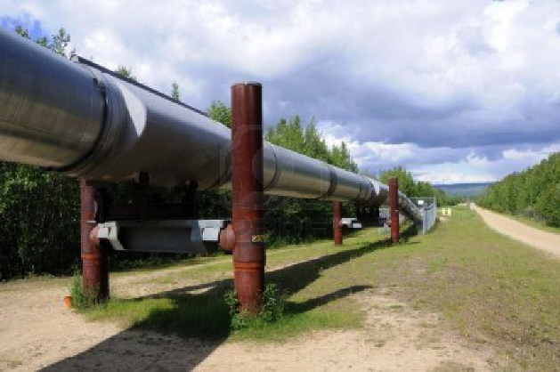

Examples
The Performance Metrics of an Oilfield
  Capacity: the total oil reserves
  Latency: from the source to the destine
  Throughput: barrels per second
The Performance Metrics of an Oilfield
  Capacity: CPUs, disks, memory
  Latency: seconds per user request
  Throughput: user’ requests per second

Slide 7
Relationship between Latency & Throughput
When processing is serial:
Throughput = 1 / (Latency)
When processing is parallel:
Throughput has no direct relationship with latency
How to improve throughput?
Reduce latency & Increase paralleling

Slide 8
Example: Water Pipe
Latency:
- How long does it take for water entering one end to exit the other end
- Factors: Length of the pipe and water speed
- Units: Seconds
Throughput:
- How much water per second is moving through the pipe
- Factors: Diameter of the pipe and water speed
- Units: Gallons/second

Slide 9
Iterative Approach to Performance
Measure the system: Make sure there is really a problem
Identify the performance bottleneck: Like root cause analysis
Model the proposed enhancement:
  Assume bottleneck is removed
  Identify next bottleneck: we can know how much improvement
    If not significant, stop (reconsider the whole design or revisit the requirement)
Measure the new system
  Does the change meet the expectation. If not, revisit step 1-3
Go to step 1 until the performance meets the required level

Slide 10
Improving Bottlenecks
Latency is the harder of the problems
  Frequently fundamental limits
  Speed of CPU
  Speed of communication link (e.g., light)
Throughput frequently is a resource limit
  Example: Buy a fatter pipe but it costs more
  Famous saying: You can buy throughput but you can’t bribe god

Slide 11
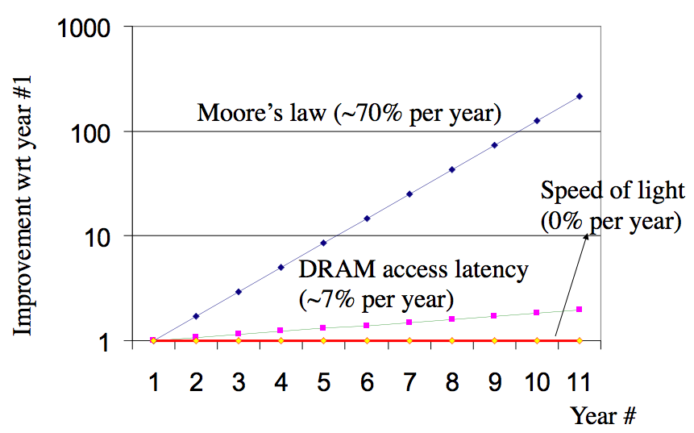
Latency Improves Slowly

Slide 12
Fast Path for Latency Optimizations
Request
Use knowledge of the workload
Make the common cases faster
if (WorksOnFastPath(request))
DoFastCase(request);
Else
DoNormalCase(request);
E.g., cache hit VS. cache miss
Stage-1
Slow path
Fast path
Stage-2
Stage
…
Stage-n
Response

Slide 13
Fast Path for Latency Optimizations
AverageLatency = Frequency_{fast} x Latency_{fast} + Frequency_{slow} x Latency_{slow}
Is introducing a fast path worth the effort?
  depends on the difference of latency,
  and the frequency using fast path,
  which is dependent on the workload
_x0013_
Many workloads don’t have a uniform distribution of requests,
  thus introducing a fast path works well

Slide 14
Caching – Classic Fast Path
Use knowledge of workload: memory abstractions
- Keep common requests in a fast local memory
- Check the local memory every access
CPU cache – Cache 1ns, Memory 100ns, 90% hit rate
- AverageLatency = 0.9 x 1ns + 0.1 x 100ns = 10.9 ns (100ns -> 10.9ns)
Used everywhere there are memory abstractions
- Processors, file systems, TLBs, browsers, DNS, etc.

Slide 15
Another Fast Path Example
Consider a request stream of different types
Some are very simple and some are very complex
Optimization:
if (FastPath(request)) {
Handle simple cases in highly optimized code
} else {
Handle request in full generality
}

Slide 16
Reducing Latency using Concurrency
Example: Google search engine
- Splits the index of the Web up in n pieces, each piece on a machine
- Frontend sends copies of requests and combines the response
If subtasks are independent to each other
- Can use n threads to get a speedup of n
- Hard to get the ideal speedup
- 10 months a woman -> 1 month 10 women?
Index Node
Frontend
Index Node
Index Node

Slide 17
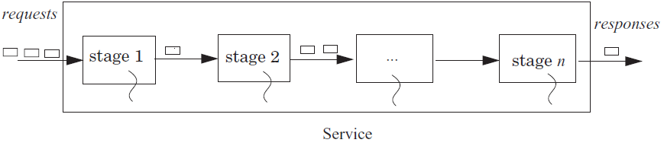
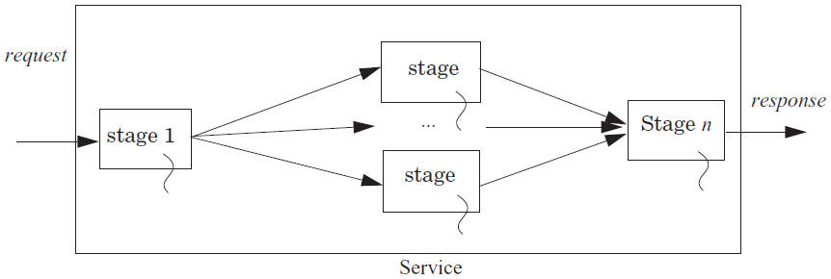
Using Concurrency to Improve Throughput

Slide 18
Hide Latency by Overlapping
Fetch (5 units) and process (5 units) 2 blocks (20 units)
- Fetch B1; Process B1; Fetch B2; Process B2;
Fetch 2 blocks asynchronously (15 units)
Fetch B1
Overlap Fetch B2 and Process B1
Process B2
Processors prefetching memory requests
- File systems prefetching files
- Browser prefetching pages
Fetch B1
Process B1
Fetch B2
Process B2
Fetch B1
Process B1
Process B2
Fetch B2

Slide 19
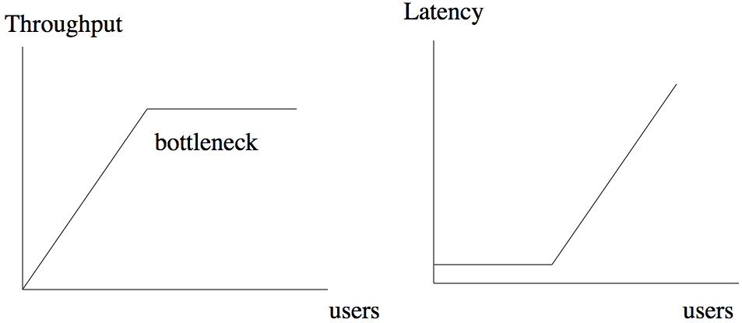
Heavily-loaded systems: Requests queue up

Slide 20
Queuing and Overload
Offered load: the rate of arrival of requests for service
Overload: whenever the offered load is greater than the capacity of a service for some duration
  E.g., 7 threads on 3 processors, must wait in queue (RUNNABLE)
The queuing theory
  Unit is the average service time
  The waiting time in a queue: 1/(1-ρ), ρ is the utilization
  Once the utilization approaches 1, the delay will grow without bound

Slide 21
Queuing and Overload
If overload appears short period of time
- A queue handles short bursts of too much demand by time-averaging with adjacent periods when there is excess capacity
If overload persists over long periods of time
- Increase the capacity of the system
- Shed load: reduce or limit the offered load

Slide 22
Fighting Bottlenecks

Slide 23
Why Performance Bottleneck?
1. Physical limitation
- Speed of light
- The capacity of memory
- …
2. Sharing
- Several users share a device
- Several clients share a server

Slide 24
Fixing a Bottleneck
Get faster hardware
Fix application: better algorithm, fewer features (not in CSE)
General system techniques:
– Batching
– Caching
– Concurrency
– Scheduling
Application
System
Hardware

Slide 25
Batching
Frequently it is possible to group requests for more efficiency
- Amortize overheads of processing
- Schedule requests for better performance
Examples: N messages vs. one message with N requests Disks:
- Always transfer a bunch of bytes (sector or block)
- Schedule the disk motions

Slide 26
Dallying
Procrastination sometimes helps
- Temp files – deleted before written to disk
Examples:
- Caches – Write back policy: Write absorption
- Database transactions – group commit
- Might hold your ATM request until others arrive to do batching

Slide 27
Speculation
Guessing at an operation and performing it ahead a time
- Need to be able to undo changes if wrong
Examples:
- Processors guess at branches, memory access
- File systems guess at next file block needed (prefetching)
- Easier if space of possibilities is small
- Branch prediction versus value prediction

Slide 28
Challenges
Batching, dallying, and speculation introduce complexity
- They introduce concurrency
- Coordination is difficult to get right

Slide 29
Case: I/O Bottleneck

Slide 30
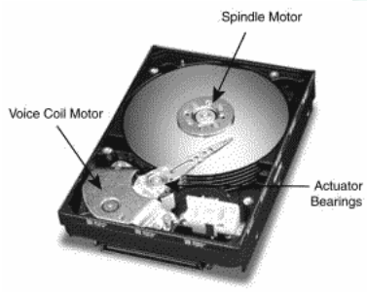
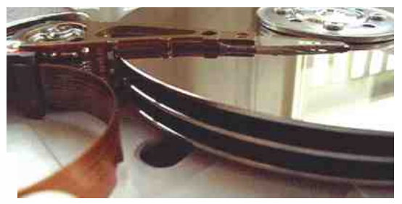
The I/O Bottleneck
Bits read from a disk encounter two potential transfer rate limits
- The rate at which bits spin under the heads on their way to a buffer
- The rate at which the I/O channel or I/O bus can transfer the contents

Slide 31
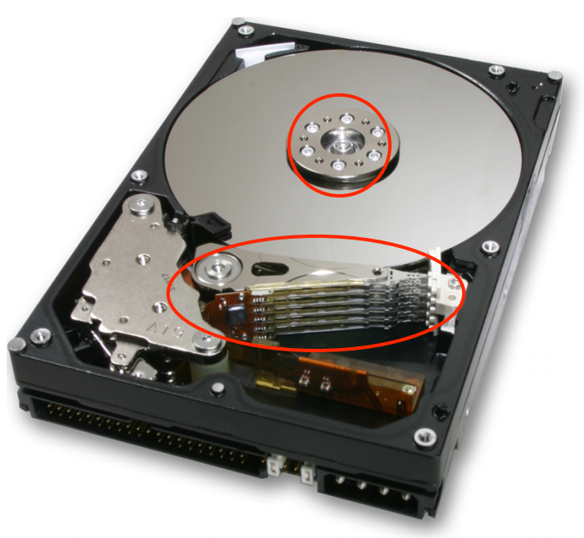
The I/O Bottleneck
The average seek latency: about 8 milliseconds
- The time to move the head over 1/3 of the disk
The average rotational latency: 4.17 milliseconds
- The disks spin at 7200 rotations/minute
- One rotation every 8.33 milliseconds
- On average, the disk has to wait a half rotation for the desired block to be under the disk head

Slide 32
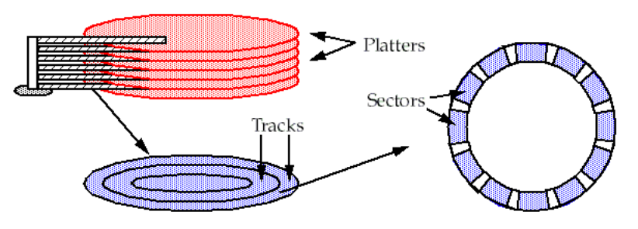
A typical modern 400 gigabyte disk
Has 16,383 cylinders, or about 24 megabytes per cylinder
Would have 8 two-sided platters and thus 16 read/write heads
Would be 24/16 = 1.5 megabytes per track
When rotating at 7200 revolutions per minute
The bits will go by a head at 180 megabytes per second

Slide 33
Bottleneck
The Integrated Device Electronics (IDE) bus: 66 MB/S is common
The Serial ATA-3 bus: 6 Gbps
With IDE bus: The electronics would be the bottleneck at 66 MB/S
With SATA-3 bus: The mechanics would be the bottleneck at 180 MB/S

Slide 34
Latency of 4-KB Data Accessing (Using IDE)
Read a 4 kilobyte block chosen at random takes:
avg seek time + avg rotation latency + transmission of 4 kilobytes
= 8 + 4.17 + (4 / (66 × 1024)) × 1000 milliseconds
= 8 + 4.17 + 0.06 milliseconds
= 12.23 milliseconds
The throughput for reading randomly-chosen blocks one by one is:
= 1000/12.23 × 4 kilobytes per second
= 327 kilobytes/second

Slide 35
Round-1
1 in ← OPEN (“in”, READ) // open “in” for reading
2 out ← OPEN (“out”, WRITE) // open “out” for reading
3
4 while not ENDOFFILE (in) do
5 block ← READ (in, 4096) // read 4 kilobyte block from in
6 block ← COMPUTE (block) // compute for 1 millisecond
7 WRITE (out, block, 4096) // write 4 kilobyte block to out
8 CLOSE (in)
9 CLOSE (out)
reading 4 kilobyte + 1 millisecond of computation + writing 4 kilobyte
= 12.23 + 1+ 12.23 milliseconds
= 25.46 milliseconds

Slide 36
Round-2
Modify the file system
- to layout the blocks of a file contiguously
- to prefetch an entire track of data on each read
Average seek time + 1 rotational delay
= 8 + 8.33 milliseconds = 16.33 milliseconds

Slide 37
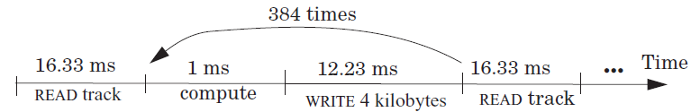
Round-2
File system issues 1 read request per 384 (1.5 MB per track / 4 KB) loop iterations
The average time for 384 iterations is:
reading 1536 kilobyte + 384× (1 millisecond of computation + writing 4 kilobyte)
= 16.33 + 384 × (1 + 12.23) millisecond
= 16.33 + 5080.32 milliseconds
= 5096.65 milliseconds.
Thus, the average time for a loop iteration is 5096.65/384 = 13.27 milliseconds

Slide 38
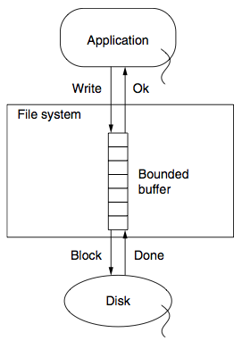
Round-3
Improve by dallying & batching write requests
Write to buffer in RAM and flush when buffer is full
Latency = (16.33 + 384 + 16.33)/384 milliseconds
= 1.09 milliseconds

Slide 39
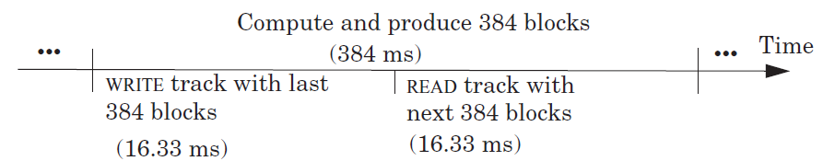
Round-4
Prefetch the next track before the appliction calls the 385th READ
Overlap computation and I/O completely
The average time around the loop is 1 millisecond
The bottleneck now is the CPU

Slide 40
Tradeoff between Reliability and Performance
A buffer without write-through
- can provide substantial performance improvements
- but can lose on reliability
- If the computer system fails before the file system has written out data to the disk, some data is lost
How long to delay writes, the longer means:
- the larger the opportunity for higher performance
- but the greater the probability that data will be lost
- if, for example, the power fails and the volatile RAM resets

Slide 41
Performance Optimization
An engineer may design an optimization, implement it, and,
- design another optimization, implement it, and,
- design another optimization, implement it, and…
Take a whole systems views
- Much time wasted optimizing things that don’t need to be optimized
- Brute force & d(technology)/dt
It’s difficult to keep the “law of diminishing returns” in mind

Slide 42
The Law of Diminishing Returns
The more one improves some measure of goodness, the more effort the next improvement will require.
“Bottlenecks occur in surprising places, so don't try to second guess and put in a speed hack until you have proven that's where the bottleneck is.”
--- Rob Pike
“The First Rule of Program Optimization: Don't do it. The Second Rule of Program Optimization (for experts only!): Don't do it yet.”
--- Michael A. Jackson

