Slide 1


Instructor
臧斌宇
Email: byzang@sjtu.edu.cn
Office phone: 13917124245
Make an appointment
陈榕
Email: rongchen@sjtu.edu.cn
Office phone: 13661816826

Slide 2
Teaching Assistants
姚友阳、董致远、沈斯杰、余倩倩
  软件楼3-408
双周周三习题课（18:00-20:00)
  东上院 306/307/308/309
期中期末考试

Slide 3
Prelimiary Grading
Exams(70%)
  Mid term (35%)
  Final (35%)
  All exams are open books/open notes.
Labs (24%)
  4 labs (6% each)
Home work(6%)

Slide 4
Linking

Slide 5
Outline
What is linking and why linking
Complier driver
Input & output for the Static linking
Suggested reading: 7.1~7.4

Slide 6
Monolithic source file
main.c
ASCII source file
Translator
binary executable object file
(memory image on disk)
p
Problems:
  efficiency: small change requires complete recompilation
  modularity: hard to share common functions (e.g. printf)

Slide 7
main.c | swap.c
/*main.c */ void swap() ; int buf[2] = {1, 2}; Int main() { swap() ; return 0 ; } | /*swap.c */ extern int buf[]; int *bufp0 = &buf[0] int *bufp1 ; void swap() { int temp ; int bufp1 = &buf[1]; temp = *bufp0 ; *bufp0 = *bufp1 ; *bufp1 = temp ; }

Slide 8
Separate Compilation
main.c
swap.c
Translators
Translators
separately compiled relocatable object files
main.o
swap.o
Linker (ld)
executable object file
(contains code and data for all functions defined in main.c and swap.c)
p

Slide 9
What is linker
Linking is the process of
  collecting and combining various pieces of code and data into a single executable file
Executable file
  Can be loaded (copied) into memory and executed.

Slide 10
What is linker
Linking can be performed
  at compile time, when the source code is translated into machine code by the linker
  at load time, when the program is loaded into memory and executed by the loader
  at run time, by application programs.

Slide 11
Compiler Drivers
Coordinates all steps in the translation and linking process
  Typically included with each compilation system (e.g., gcc)
  Invokes
    preprocessor (cpp)
    compiler (cc1)
    assembler (as),
    linker (ld).
  Passes command line args to appropriate phases

Slide 12
Example
unix> gcc -O2 -g -o p main.c swap.c
cpp [args] main.c /tmp/main.i
cc1 /tmp/main.i main.c -O2 [args] -o /tmp/main.s
as [args] -o /tmp/main.o /tmp/main.s
<similar process for swap.c>
ld -o p [system obj files] /tmp/main.o /tmp/swap.o
unix>

Slide 13
main.c | swap.c
/*main.c */ void swap() ; int buf[2] = {1, 2}; Int main() { swap() ; return 0 ; } | /*swap.c */ extern int buf[]; int *bufp0 = &buf[0] int *bufp1 ; void swap() { int temp ; int bufp1 = &buf[1]; temp = *bufp0 ; *bufp0 = *bufp1 ; *bufp1 = temp ; }

Slide 14
Example
Two functions
  main() and swap()
Three global variables
  buf, bufp0 which are initialized explicitly
  bufp1 implicitly initialized to 0

Slide 15
Example
.file "swap.c"
.globl bufp0
.data
.align 4
.type bufp0, @object
.size bufp0, 4
bufp0:
.long buf
.comm bufp1,4,4
.text
.globl swap
.type swap, @function
define
reference

Slide 16
Example
swap:
pushl %ebp
movl %esp, %ebp
subl $16, %esp
movl $buf+4, bufp1
movl bufp0, %eax
movl (%eax), %eax
movl %eax, -4(%ebp)
movl bufp0, %eax
movl bufp1, %edx
movl (%edx), %edx
movl %edx, (%eax)
movl bufp1, %eax
movl -4(%ebp), %edx
movl %edx, (%eax)
leave
ret
define
reference

Slide 17
Static linking
Input
  A relocatable object files and command line arguments
Output
  Fully linked executable object file that can be loaded and run

Slide 18
Example
unix> gcc -O2 -g -o p main.c swap.c
cpp [args] main.c /tmp/main.i
cc1 /tmp/main.i main.c -O2 [args] -o /tmp/main.s
as [args] -o /tmp/main.o /tmp/main.s
<similar process for swap.c>
ld -o p [system obj files] /tmp/main.o /tmp/swap.o
unix>

Slide 19
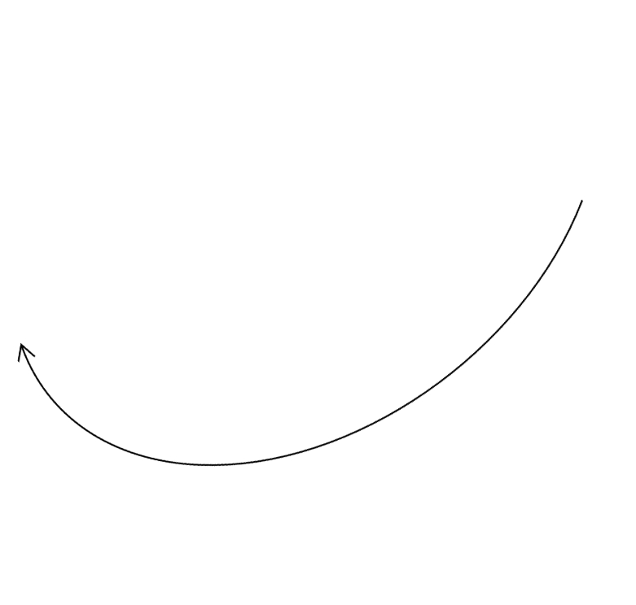
Relocatable Object Files(main.o)
Define (main)
00<main>:
00: 55 push %ebp
01: 89 e5 mov %esp, %ebp
03: 83 ec 08 sub $0x8, %esp
06: e8 fc ff ff ff call 0x-4 <swap>
0b: 31 c0 xor %eax, %eax
0d: 89 ec mov %ebp, %esp
0f: 5d pop %ebp
10: c3 ret
11: 90 nop
12: 90 nop
13: 90 nop
Reference
(swap)

Slide 20
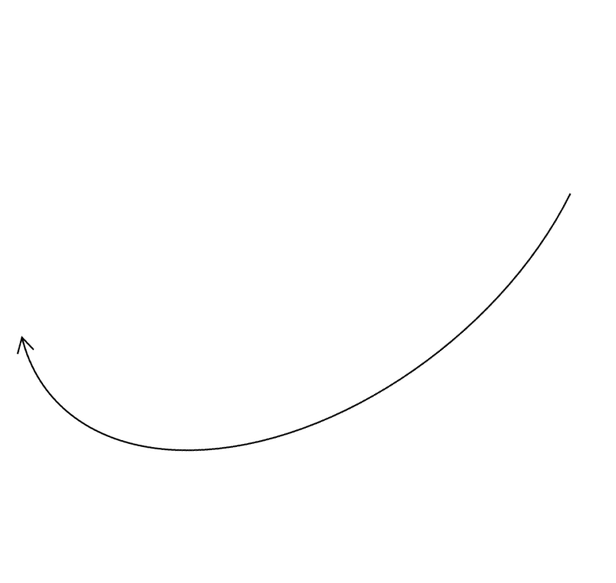
Relocatable Object Files(main.o)
Define (buf)
00 <buf>:
00: 01 00 00 00 02 00 00 00

Slide 21

Relocatable Object Files(swap.o)
bufp0
References
buf[1]
00<swap>:
00: 55 push %ebp
01: 8b 15 00 00 00 00 mov 0x0, %edx get bufp0
07: a1 04 00 00 00 mov 0x4, %eax get buf[1]
0c: 89 e5 mov %esp, %ebp
0e: c7 05 04 00 00 00 movl $0x4, 0x0
14: 00 00 00 00 bufp1 = &buf[1]
18: 89 ec mov %ebp, %esp
1a: 8b 0a mov (%edx), %ecx
1c: 80 02 mov %eax, (%edx)
1e: a1 00 00 00 00 mov 0x0, %eax get bufp1
23: 89 08 mov %ecx, (%eax)

Slide 22
Relocatable Object Files(swap.o)
25: 5d pop %ebp
26: c3 ret
00<bufp0>:
00: 00 00 00 00
00<bufp1>:
Reference
(buf)

Slide 23
Relocatable Object Files
Relocatable object file
  Contain binary code and data in a form that can be combined with other relocatable object files to create an executable file
Sections
  Various code and data sections
  Instructions are in one section
  Initialized global variables are in one section
  Uninitialized global variables are in one section

Slide 24
Linking (Symbol resolution)
External reference:
  Reference to a symbol defined in another object file
  The external references are values close to 0 in the relocatable object files in the previous example
Symbol resolution
  Resolves external references

Slide 25
Executable Object Files
080483b4<main>:
080483b4: 55 push %ebp
080483b5: 89 e5 mov %esp, %ebp
080483b7: 83 ec 08 sub $0x8, %esp
080483ba: e8 09 00 00 00 call 80483c8 <swap>
080483bf: 31 c0 xor %eax, %eax
080483c1: 89 ec mov %ebp, %esp
080483c3: 5d pop %ebp
080483c4: c3 ret
080483c5: 90 nop
080483c6: 90 nop
080483c7: 90 nop

Slide 26
Executable Object Files
080483c8<swap>:
80483c8: 55 push %ebp
80483c9: 8b 15 5c 94 04 08 mov 0x804945c, %edx get *bufp0
80483cf: a1 58 94 04 08 mov 0x8049458, %edx get buf[1]
80483d4: 89 e5 mov %esp, %ebp
80483d6: c7 05 48 95 04 08 movl $0x8049458, 0x8049548
80483de: 58 94 04 08 bufp1 = &buf[1]
80483e0: 89 ec mov %ebp, %esp
80483e2: 8b 0a mov (%edx), %ecx
80483e4: 80 02 mov %eax, (%edx)
80483e6: a1 48 95 04 08 mov 0x8049548, %eax get *bufp1
80483eb: 89 08 mov %ecx, (%eax)
80483ed: 5d pop %ebp
80483ee: c3 ret

Slide 27
Executable Object Files
08049454 <buf>:
8049454: 01 00 00 00 02 00 00 00
0804945c<bufp0>:
804945c: 54 94 04 08
08049548<bufp1>:

Slide 28
Executable object file
Contains binary code and data in a form that can be copied directly into memory and executed

Slide 29
Relocation
Relocates symbols
  from their relative locations in the .o files
  to new absolute positions in the executable
    main in the 0 pos of the .txt section in main.o to 080483b4 in p
    buf in the 0 pos of the .data section in main.o to 08049454 in p
    swap in the 0 pos of the .txt section in swap.o to 080483c8 in p
    bufp0 in the 0 pos of the .data section in swap.o to 0804945c in p
    bufp1 in the 0 pos of the .bss section in swap.o to 08049548 in p

Slide 30
Relocation
Updates all references to these symbols to reflect their new positions
  e8 fc ff ff ff → e8 09 00 00 00 call 80483c8 <swap>
  a1 04 00 00 00 → a1 58 94 04 08 mov 0x8049458, %edx
  00<bufp0>:
  00: 00 00 00 00
  ↓
  0804945c<bufp0>:
  804945c: 54 94 04 08

Slide 31
Object files
Relocatable object file
Executable object file
Shared object file
  A special type of relocatable object file that can be loaded into memory and linked dynamically, at either load time or run time

Slide 32
Executable and Linkable Format (ELF)
Standard binary format for object files
Derives from AT&T System V Unix
  later adopted by BSD Unix variants and Linux
One unified format for relocatable object files (.o), executable object files, and shared object files (.so)
  generic name: ELF binaries
Better support for shared libraries than old a.out formats.

Slide 33
ELF object file format
ELF header
Program header table
(required for executables)
.text section
.data section
.bss section
.symtab
.rel.txt
.rel.data
.debug
.line
.strtab
Section header table
(required for relocatables)

