Slide 1
Archive files and Loading

Slide 2
Outline
Multiple Defined Global Symbol
Archive Files (static libraries)
Executable Object Files
Loading
Suggested reading: 7.6, 7.8, 7.9

Slide 3
Multiply Defined Global Symbols
Strong:
  Functions and initialized global variables
Weak:
  Uninitialized global variables
Rules:
  Multiple strong symbols are not allowed
  Given a strong symbol and multiple weak symbols, choose the strong symbol
  Given multiple weak symbols, choose any of the weak symbol

Slide 4
Multiply Defined Global Symbols
/*foo1.c*/
int main()
{
return 0;
}
/*bar1.c*/
int main()
{
return 0;
}
/*foo2.c*/
int x=15213;
int main()
{
return 0;
}
/*bar2.c*/
int x=15213;
void f()
{
}

Slide 5
Multiply Defined Global Symbols
/*foo3.c*/
#include <stdio.h>
void f();
int x=15213;
int main()
{
f();
printf(“x=%d\n”,x)
return 0;
}
/*bar3.c*/
int x ;
void f()
{
x = 15212 ;
}

Slide 6
Multiply Defined Global Symbols
/*foo4.c*/
#include <stdio.h>
void f();
int x;
int main()
{
x=15213
f();
printf(“x=%d\n”,x)
return 0;
}
/*bar4.c*/
int x ;
void f()
{
x = 15212 ;
}

Slide 7
Multiply Defined Global Symbols
/*foo5.c*/
#include <stdio.h>
void f();
int x=15213;
int y=15212;
int main()
{
f();
printf(“x=0x%x y=0x%x \n”,
x, y) ;
return 0;
}
/*bar5.c*/
double x ;
void f()
{
x = -0.0 ;
}
gcc –fno-common

Slide 8
Packaging commonly used functions
How to package functions commonly used by programmers?
  math, I/O, memory management, string manipulation, etc.

Slide 9
Packaging commonly used functions
Awkward, given the linker framework so far:
  Option 1: Put all functions in a single source file
    programmers link big object file into their programs
    space and time inefficient
  Option 2: Put each function in a separate source file
    programmers explicitly link appropriate binaries into their programs
    more efficient, but burdensome on the programmer

Slide 10
Packaging commonly used functions
Solution: static libraries (.a archive files)
  concatenate related relocatable object files into a single file with an index (called an archive)
  enhance linker so that it tries to resolve unresolved external references by looking for the symbols in one or more archives
  If an archive member file resolves reference, link into executable
gcc main.c /usr/lib/libm.a /usr/libc.a
gcc main.c -lm

Slide 11
Example (1/3)
(a) addvec.o
void addvec(int *x, int *y, int *z, int n)
{
int i;
for (i = 0; i < n; i++)
z[i] = x[i] + y[i];
}

Slide 12
Example (2/3)
(b) multvec.o
void multvec(int *x, int *y, int *z, int n)
{
int i;
for (i = 0; i < n; i++)
z[i] = x[i] * y[i];
}
unix> gcc -c addvec.c multvec.c
unix> ar rcs libvector.a addvec.o multvec.o

Slide 13
Example (3/3)
/* main2.c */
#include <stdio.h>
#include "vector.h“
int x[2] = {1, 2};
int y[2] = {3, 4};
int z[2];
int main()
{
addvec(x, y, z, 2);
printf("z = [%d %d]\n", z[0], z[1]);
return 0;
}

Slide 14
Static Linked Libraries
main2.c
vector.h
libc.a
Translators(cc1, as)
libvector.a
printf.o and any other modules called by printf.o
main2.o
addvec
Linker (ld)
p2
Fully linked executable object code file
unix> gcc -O2 -c main2.c
unix> gcc -static -o p2 main2.o ./libvector.a

Slide 15
Creating static libraries
atoi.c
printf.c
random.c
Translator
Translator
...
Translator
atoi.o
printf.o
random.o
Archiver (ar)
libc.a
C standard library
Archiver allows incremental updates:
  recompile function that changes and replace .o file in archive.
ar rcs libc.a atoi.o printf.o … random.o

Slide 16
Using static libraries
E:
  relocatable object files that will be merged to form the executable
U:
  Unresolved symbols
D:
  Symbols that have been defined in previous input files
Initially all are empty

Slide 17
Using static libraries
Scan .o files and .a files in the command line order.
When scan an object file f,
  Add f to E
  Updates U, D
When scan an archive file f,
  Resolve U
  If m is used to resolve symbol, m is added to E
  Update U, D using m

Slide 18
Using static libraries
If any entries in the unresolved list at end of scan, then error
Problem:
  command line order matters!
  Moral: put libraries at the end of the command line.

Slide 19
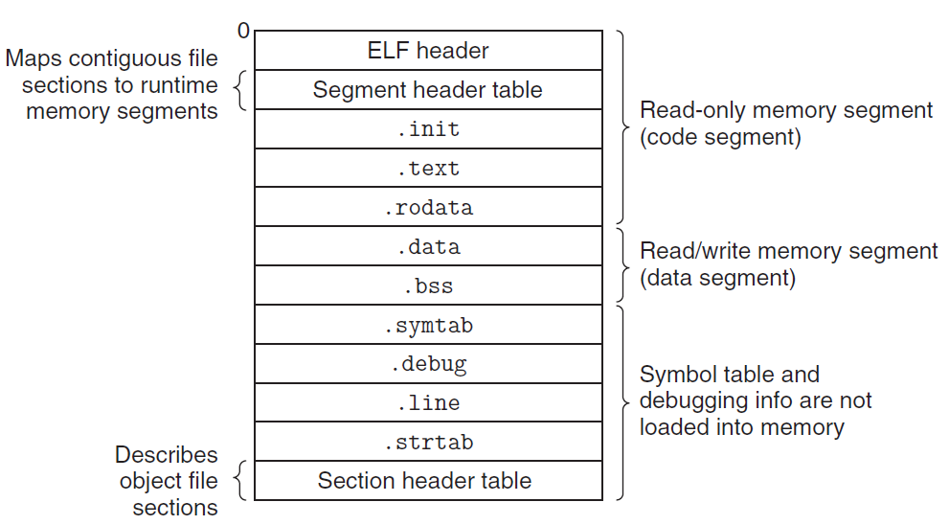
Executable Object Files

Slide 20
ELF Header
typedef struct{
unsigned char e_ident[ 16 ] ;
unsigned short e_type ;
unsigned short e_machine ;
unsigned int e _version ;
unsigned int e_entry ;
unsigned int e _phoff ;
unsigned int e _shoff ;
unsigned int e _flags ;
unsigned int e _ehsize ; /* header size in bytes */
unsigned int e_phentsize ;
unsigned short e _phnum ;
unsigned short e _shentsize ;
unsigned short e _shnum ;
unsigned short e _shstrndx ;
} Elf32_Ehdr ;

Slide 21
Executable Object File Header
ELF header
  Overall information
  Entry point
  Program (Segment) header table information
    Starting point
    Size
    Size of each entry
    Number of entries

Slide 22
Executable Object File Segment Header Table
typedef struct {
unsigned int p_type ;
unsigned int p_offset ;
unsigned int p_vaddr ;
unsigned int p_paddr ;
unsigned int p_filesz ;
unsigned int p_memsz ;
unsigned int p_flags ;
unsigned int p_align ;
} Elf32_phdr ;

Slide 23
Executable Object File Segment Header Table
p_type
  PT_LOAD (1): loadable segment
p_offset
  Offset from the beginning of the file to the first byte in the segment
p_vaddr
  The virtual address of the first byte in the segment
p_paddr
  Not very useful

Slide 24
Executable Object File Segment Header Table
p_filesz
  Segment size in the object file (≤p_memsz)
p_memsz
  Segment size in the memory (≥p_filesz)
p_flags
  Run time permissions (rwx)
p_align
  Alignment requirement for the beginning address of the segment
  Usually 2**12 (4k)

Slide 25
Executable Object Files

Slide 26
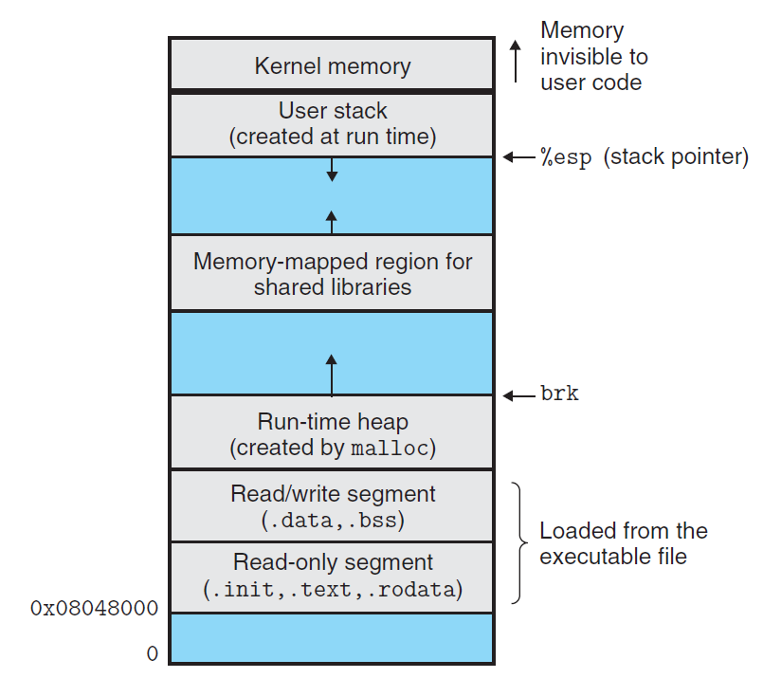

Slide 27
ELF format
Read only code segment
LOAD off 0x00000000 vaddr 0x08048000
paddr 0x08048000 align 2**12
filesz 0x00000448 memsz 0x00000448 flags r-x
Read/write data segment
LOAD off 0x00000448 vaddr 0x08049448
paddr 0x08049448 align 2**12
filesz 0x000000e8 memsz 0x00000104 flags rw
Difference between filesz and memsz means the uninitialized data in .bss
.init section contains a small function _init called by program’s initialization code

Slide 28
Startup code
Address
  _start, the entry point of the program
Defined in the crt1.o
Same for all C program
0x080480c0<_start>: /* Entry point in .text */
call _libc_init_first /* startup code in .text */
call _init /* startup code in .init */
call atexit /* startup code in .text */
call main /* application main routines */
call _exit /* return control to OS */
/* Control never reaches here */

Slide 29
Loading
Unix> ./p
Loader
  Memory-resident operating system code
  Invoked by call the execve function
  Copy the code and data in the executable object file from disk into memory
  Jump to the entry point
  Run the program

