Slide 1
Loading & Dynamic Link

Slide 2
Outline
Dynamic Linking
Position Independent Code (PIC)
Loading and Linking Shared Libraries from applications
Suggested reading: 7.8~7.12

Slide 3
Disadvantages of Static Libraries
Minor bug fixes of system libraries require each application to explicitly relink
Duplicate lots of common code in the executable files
  e.g., every C program needs the standard C library
Duplicate lots of code in the memory

Slide 4
Shared Libraries
Synonym
  Shared object on Linux, denoted by .so suffix
  DLL (dynamic link libraries) on Windows
What sharing means
  Only one .so file for a particular library
  Code and data in the .so file are shared by all of the executable object files that reference the library

Slide 5
Shared Libraries
Generate the shared libraries
Unix> gcc –shared –fPIC –o libvector.so addvec.c multvec.c
    –shared: creating a shared object
    –fPIC: crating the position independent code

Slide 6
Partially Linking
main2.c
vector.h
libc.so
libvector.so
Translators(cc1, as)
main2.o
Relocation and symbol table info
Linker (ld)
p2
Partially linked executable object code file
Partially link with shared libraries
Unix>gcc –o p2 main2.c ./libvector.so

Slide 7
Partially Linking
Which parts in libvector.so are copied into p2
  The code and data sections No
  Relocation and symbol table information Some

Slide 8
Dynamically linking
p2
Partially linked executable object code file
libc.so
libvector.so
Loader(execve)
Code and data
Dynamic Linker(ld-linux.so)
Fully linked executable in memory

Slide 9
Dynamically linking
Done by execve() & ld-linux.so
  Copy code and data of libc.so and libvector.so into to memory segment
  Relocate any references in p2 to symbols defined by libc.so and libvector.so
After linking, the locations of the shared libraries are fixed and do not change during the execution time
How to find the ld-linux.so
  The pathname of the ld-linux.so is contained in the .interp segment of p2

Slide 10
Executable Object File Segment Header Table
typedef struct {
unsigned int p_type ;
unsigned int p_offset ;
unsigned int p_vaddr ;
unsigned int p_paddr ;
unsigned int p_filesz ;
unsigned int p_memsz ;
unsigned int p_flags ;
unsigned int p_align ;
} Elf32_phdr ;

Slide 11
Dynamically linking
.interp segment
  p_type = PT_INTERP (3)
  the location and size of a null-terminated path name to invoke as an interpreter
  It may not occur more than once in a file
  It must precede any loadable segment entry
.dynamic section
  sh_type = SHT_DYNAMIC
  Holds various data
  The structure residing at the beginning of the section holds the addresses of other dynamic linking information

Slide 12
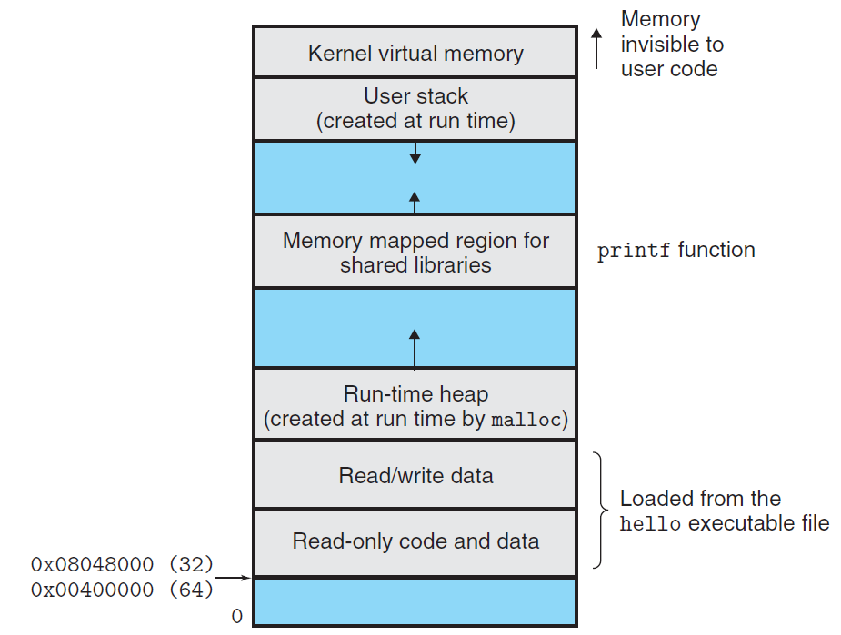
Memory mapped region for shared libraries

Slide 13
Linking at Running Time
Loading and Linking Shared Libraries from Applications
  Done explicitly by user with dlopen() in Linux
Unix>gcc –rdynamic –O2 –o p3 dll.c -ldl

Slide 14
Linking at Running Time
#include <dlfcn.h>
void *dlopen(const char *filename, int flag) ;
returns: ptr to handle if OK, NULL on error
void *dlsym(void *handle, char *symbol) ;
returns: ptr to symbol if OK, NULL on error
int dlclose(void *handle) ;
returns: 0 if OK, -1 on error
const char dlerror(void) ;
returns: errormsg if previous call to
dlopen, dlysym, or dlclose failed,
NULL if previous call was OK

Slide 15
#include <stdio.h>
#include <dlfcn.h>
int x[2] = { 1, 2} ;
int y[2] = { 3, 4} ;
int z[2];
int main()
{
void *handle;
void (*addvec)(int *, int *, int *, int ) ;
char *error ;

Slide 16
/*dynamically load the shared library that contains addvec() */
handle = dlopen(“./libvector.so”, RTLD_LAZY) ;
if (!handle) {
fprintf(stderr, “%s\n”, dlerror()) ;
exit() ;
}
/*get a pointer to the addvec() function we just loaded */
addvec = dlsym(handle, “addvec”) ;
if ( (error = dlerror()) != NULL ) {
fprintf(stderr, “%s\n”, error) ;
exit(1) ;
}

Slide 17
/* Now we can call addvec() just like any other function */
addvec(x, y, z, 2)
printf(“z=[%d, %d]\n”, z[0], z[1]) ;
/* unload the shared library */
if (dlclose(handle) <0) {
fprintf(stderr, “%s\n”, dlerror()) ;
exit(1) ;
}
return 0 ;
}

Slide 18
Position-Independent Code (PIC)
Allow multiple running processes to share the same library code
  Save precious memory resource
Naïve: assign a dedicated address
  Inefficient use of the address space
  Difficult to manage
Better: load and execute at any address
  Position-independent code (PIC)
  gcc with -fPIC

Slide 19
Position-Independent Code (PIC)
Position-Independent Code (PIC)
  Internally-defined procedures (OK)
    PC-relative reference
  Externally-defined procedures and reference to global variable (NO)
    Indirect reference
    Global offset table (GOT)
      Private
      At the beginning of .data

Slide 20
Position-Independent Code (PIC)
PIC Data References
call L1
L1: popl %ebx
addl $VAROFF, $ebx
movl (%ebx), %eax
movl (%eax), %eax
  Performance disadvantages (5 instr)
  An additional memory reference to the GOT
  An additional register to hold GOT entry

Slide 21
Position-Independent Code (PIC)
PIC Function Calls
call L1
L1: popl %ebx
addl $PROCOFF, $ebx
call *(%ebx)
  Performance disadvantages (4 instr)
  Optimization: lazy binding

Slide 22
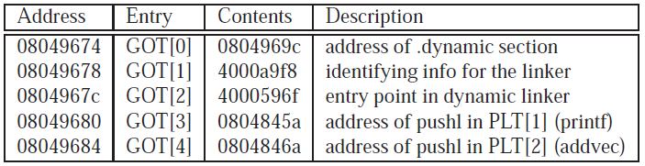
Position-Independent Code (PIC)
Lazy Binding
  Global Offset Table (GOT)
    .data
  Procedure Linkage Table (PLT)
    .text

Slide 23
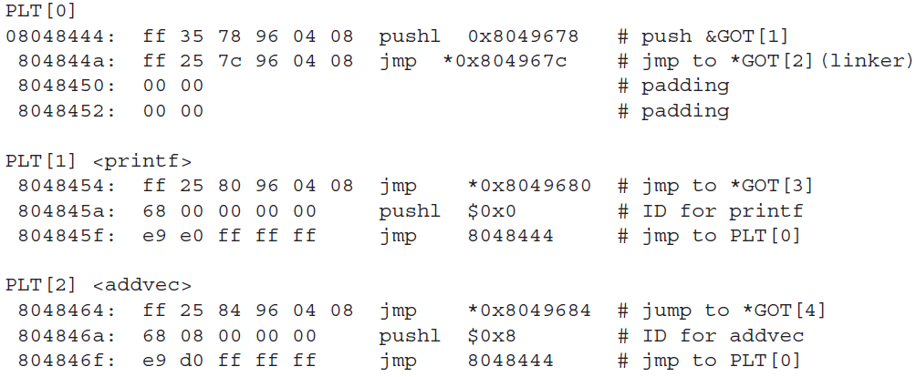
Position-Independent Code (PIC)
PLT
Call addvec
1

Slide 24
Position-Independent Code (PIC)
PLT
Call addvec
2
1

Slide 25
Position-Independent Code (PIC)
PLT
Call addvec
2
3
1

Slide 26
Position-Independent Code (PIC)
PLT
Call addvec
4
2
3
1

Slide 27
Position-Independent Code (PIC)
PLT
Call addvec
4
5

Slide 28
Position-Independent Code (PIC)
PLT
Call addvec
4
5
6

Slide 29
Position-Independent Code (PIC)
PLT
Call addvec
7
6

Slide 30
Position-Independent Code (PIC)
PLT
Call addvec
8

Slide 31
Position-Independent Code (PIC)
PLT
Call addvec
9
xxxxxxx

