Slide 1
Alignment

Slide 2
Outline
Alignment
  Chap 3.9

Slide 3
Alignment
Alignment restrictions
  The address for some type of object must be a multiple of some value k (typically 2, 4, or 8)
  Simplify the hardware design of the interface between the processor and the memory system

Slide 4
Alignment
In IA32
  hardware will work correctly regardless of the alignment of data
  Aligned data can improve memory system performance

Slide 5
Alignment
Linux alignment restriction
  1-byte data types are able to have any address
  2-byte data types must have an address that is multiple of 2
  Any larger data types must have an address that is multiple of 4

Slide 6
Alignment
Alignment is enforced by
  Making sure that every data type is organized and allocated in such a way that every object within the type satisfies its alignment restrictions.
malloc()
  Returns a generic pointer that is void *
  Its alignment requirement is 4

Slide 7
Alignment
Structure data type
  may need to insert gaps in the field allocation
  may need to add padding to the end of the structure

Slide 8

Simple Example
struct xxx {
int i;
char c;
double d;
};
struct xxx x[2];
0x00
&x[0].i
0x04
&x[0].c
gap
0x08
&x[0].d
0x0C
0x10
&x[1].i
0x14

Slide 9

Complex Example
0x00
&x[0].s
struct xxx {
short s;
char c0;
int i;
long l;
char c1;
char a[2];
double d;
char c2;
};
struct xxx x[2];
&x[0].c0
0x04
&x[0].i
0x08
&x[0].l
0x0C
&x[0].c1
&x[0].a[0]
&x[0].a[1]
0x10
&x[0].d
0x14
&x[0].c2
padding
0x18
0x1C
&x[1].s

Slide 10
Array
struct ccc {
char c1;
char a[3];
char c2;
};
struct ccc c[2];
0x00
&c[0].c1
&c[0].a[0]
0x04
&c[0].c2
&c[1].c1
&c[1].a[0]
0x08
&c[1].c2
0x0C
0x10
0x14

Slide 11
Array
struct ccc {
char c1;
short a[3];
char c2;
};
struct sss s[2];
0x00
&s[0].c1
&s[0].a[0]
0x04
0x08
&s[0].c2
&s[1].c1
0x0C
&s[1].a[0]
0x10
&s[1].c2
0x14

Slide 12
Array
struct iii {
char c1;
int a[3];
char c2;
};
struct iii i[2];
0x00
&s[0].c1
0x04
&x[0].i
0x08
0x0C
0x10
&s[0].c2
0x14
&s[1].c1

Slide 13
Understanding Pointers

Slide 14
Outline
Understanding Pointers
Suggested reading
  Chap 3.10

Slide 15
Pointers
Every pointer has a type
  If the object has type T
    A pointer to this object has type T *
  Special void * type
    Represents a generic pointer
  malloc returns a generic pointer
Every pointer has a value

Slide 16
Pointers
Pointers are created with the & operator
  Applied to lvalue expression
    Lvalue expression can appear on the left side of assignment
Pointers are dereferenced with the operator *
  The result is a value having the type associated with the pointer
Arrays and pointers are closed related
  The name of array can be viewed as a pointer constant
  ip[0] is equivalent to *ip

Slide 17
Pointer Arithmetic
Addition and subtraction
  p+i , p-i (result is a pointer)
  p-q (result is a int)
Referencing & dereferencing
  *p, &E
Subscription
  A[i], *(A+i)

Slide 18
Example
static char daytab[2][13] = {
{0, 31, 28, 31, 30, 31, 30, 31, 31, 30, 31, 30, 31},
{0, 31, 29, 31, 30, 31, 30, 31, 31, 30, 31, 30, 31}
}
/* day_of_year: set day of year from month & day */
int day_of_year(int year, int month, int day)
{
int i, leap;
leap = (year%4 == 0 && year%100 != 0
|| year%400 ==0);
for (i = 1; i < month; i++)
day += daytab[leap][i];
return day;
}

Slide 19
Example
/* month_day: set month, day from day of year */
int month_day(int year, int yearday,
int *pmonth, int *pday)
{
int i, leap;
leap = (year%4 == 0 && year%100 != 0
|| year%400 ==0);
for (i = 1; yearday > daytab[leap][i] ; i++)
yearday -= daytab[leap][i];
*pmonth = i;
*pday = yearday;
}

Slide 20
Pointer Array
/* month_name: return name of n-th month */
int month_name(int n)
{
static char *name[] = {
“Illegal month”,
“January”, “February”, “March”,
“April”, “May”, “June”,
“July”, “August”, “September”,
“October”, “November”, “December”
};
return (n < 1 || n > 12) ? name[0] : name[n];
}

Slide 21
Pointer Array
Illegal month\0
January\0
February\0
March\0
April\0
May\0
June\0
July\0
August\0
September\0
October\0
November\0
December\0

Slide 22
Command-line Arguments
argv:
$echo hello, world
$hello, world
#include <stdio.h>
/* echo command-line arguments */
int main(int argc, char *argv[])
{
int i ;
for (i = 1; i < argc ; i++)
printf(“%s%s”, argv[i],
(i < argc-1) ? “ ” : “”);
printf(“\n”) ;
return 0;
}
NULL
echo\0
Hello,\0
World\0

Slide 23
Command-line Arguments
#include <stdio.h>
/* echo command-line arguments ; 2nd version*/
int main(int argc, char *argv[])
{
while (--argc > 0)
printf(“%s%s”, ++argv, (argc > 1) ? “ ” : “”);
printf(“\n”);
return 0;
}
or
printf((argc > 1) ? “%s ” : “%s”, ++argv);

Slide 24
Pointer to Function
#include <stdlib.h>
/* numcmp: compare s1 and s2 numerically */
int numcmp(char *s1, char *s2)
{
double v1, v2;
v1 = atof(s1);
v2 = atof(s2);
if (v1 < v2) return -1;
else if ( v1 > v2 ) return 1;
else return 0;
}

Slide 25
Pointer to Function
#include <stdio.h>
#include <string.h>
{
...
int numeric = 0, (*cmp)(void *, void *);
char *s1, *s2;
...
if (...) numeric = 1 ;
...
cmp = (int (*)(void *, void *))
(numeric ? numcmp : strcmp);
(*cmp)(s1, s2);
...
}

Slide 26
Pointers can point to functions
void (*f)(int *)
f is a pointer to function
The function taken int * as argument
The return type of the function is void
Assignment makes f point to func
  f = func
Notice the precedence of the operators
  void *f(int *) declares f is a function
    (void *) f(int *)

Slide 27
Pointer Declaration
char **argv ;
int (*daytab)[13]
int (*comp)()
char (*(*x())[])()
  Function returning pointer to array[ ] of pointer to function returning char
char (*(*x[3])())[5]
  Array[3] of pointer to function returning pointer to array[5] of char

Slide 28
C operators
Operators Associativity
() [] -> . ++ -- left to right
! ~ ++ -- + - * & (type) sizeof right to left
* / % left to right
+ - left to right
<< >> left to right
< <= > >= left to right
== != left to right
& left to right
^ left to right
| left to right
&& left to right
|| left to right
?: right to left
= += -= *= /= %= &= ^= != <<= >>= right to left
, left to right
Note: Unary +, -, and * have higher precedence than binary forms

Slide 29
Parameter Passing
Call by value
  f(xp)
Call by reference
  f(&xp)

Slide 30
Buffer Overflow

Slide 31
Out-of-Bounds Memory References
1 /* Implementation of library function gets() */
2 char *gets(char *s)
3 {
4 int c;
5 char *dest = s;
6 int got_char = 0 ; /Has at least one character been read? */
7 while ((c = getchar()) != ’\n’ && c != EOF) {
8 *dest++ = c; /* No bounds checking */
9 gotchar = 1;
10 }
11 *dest++ = ’\0’; /* Terminate String */
12 if (c == EOF && !gotchar)
13 return NULL; /* End of file or error */
14 return s;
15 }

Slide 32
Out-of-Bounds Memory References
14 /* Read input line and write it back */
15 void echo()
16 {
17 char buf[8]; /* Way too small ! */
18 gets(buf);
19 puts(buf);
20 }

Slide 33
Out-of-Bounds Memory References
Return address
Saved %ebp
Saved %ebx
[7] | [6] | [5] | [4]
[3] | [2] | [1] | [0]
Stack frame
for caller
%ebp
Stack frame
for echo
buf

Slide 34
Out-of-Bounds Memory References
Return address
Saved %ebp
[11] | [10] | [9] | [8]
[7] | [6] | [5] | [4]
[3] | [2] | [1] | [0]
Stack frame
for caller
%ebp
Stack frame
for echo
buf

Slide 35
Out-of-Bounds Memory References
Return address
[15] | 1[4] | [13] | [12]
[11] | [10] | [9] | [8]
[7] | [6] | [5] | [4]
[3] | [2] | [1] | [0]
Stack frame
for caller
%ebp
Stack frame
for echo
buf

Slide 36
Out-of-Bounds Memory References
[19] | [18] | [17] | [16]
[15] | 1[4] | [13] | [12]
[11] | [10] | [9] | [8]
[7] | [6] | [5] | [4]
[3] | [2] | [1] | [0]
Stack frame
for caller
%ebp
Stack frame
for echo
buf

Slide 37
Malicious Use of Buffer Overflow
Stack
after call to gets()
void foo(){
bar();
...
}
return
address
A
foo stack frame
void bar() {
char buf[64];
gets(buf);
...
}
B
data
written
by
gets()
pad
exploit
code
bar stack frame
B

Slide 38
The Famous Internet Worm of November 1988
To gain access to many of the computers across the Internet
  4 different ways
  One was a buffer overflow attack on the fingerd
Hundreds of machines were effectively paralyzed
The author of the worm was caught and prosecuted. He was sentenced to
  3 years probation
  400 hours of community service
  and a $10,500 fine

Slide 39
The Famous Internet Worm of November 1988
Steps
  invoked finger with an appropriate string
  Made a process at a remote site have a buffer overflow
  executed code that gave the worm access to the remote system
  The worm replicated itself and consumed virtually all of the machine’s computing resources

Slide 40

Morris Worm
Robert Tappan Morris
  born November 8, 1965
  a professor at MIT
  He is the son of Robert Morris
    the former chief scientist at the National Computer Security Center
      a division of the National Security Agency (NSA)

Slide 41
Stack Randomization
1 int main() {
2 int local;
3 printf("local at %p\n", &local);
4 return 0;
5 }
Running the code 10,000 times on a Linux (maybe 2.6.16) machine in 32-bit mode
the addresses ranged from
  0xff7fa7e0 to 0xffffd7e0
  A range of around 2²³

Slide 42
Stack Randomization
Running in 64-bit mode on the newer machine
The addresses ranged from
  0x7fff00241914 to 0x7ffffff98664
  A range of nearly 2³²
Address-space layout randomization (ASLR)
  each time a program is run
  different parts of the program are loaded into different regions of memory
    code, data, heap data, library code, stack

Slide 43
Stack Randomization
Nop sled
  a program “slides” through a long sequence of “nop”
Nop
  no operation instruction
Include a “nop sled” before the actual exploit code
  If insert 256-byte nop sled
  Need to guess 2¹⁵ starting addresses (no too much) for 32-bit machine
  Still have too many 2²⁴ for 64-bit machine

Slide 44
Stack Corruption Detection
Return address
Saved %ebp
Saved %ebx
Canary
[7] | [6] | [5] | [4]
[3] | [2] | [1] | [0]
Stack frame
for caller
%ebp
Stack frame
for echo
buf

Slide 45
Stack Corruption Detection
1 echo:
2 pushl %ebp
3 movl %esp, %ebp
4 pushl %ebx
5 subl $20, %esp
6 movl %gs:20, %eax Retrieve canary
7 movl %eax, -8(%ebp) Store on stack
8 xorl %eax, %eax Zero out register
9 leal -16(%ebp), %ebx Compute buf as %ebp-16
10 movl %ebx, (%esp) Store buf at top of stack
11 call gets Call gets
12 movl %ebx, (%esp) Store buf at top of stack
13 call puts Call puts

Slide 46
Stack Corruption Detection
14 movl -8(%ebp), %eax Retrieve canary
15 xorl %gs:20, %eax Compare to stored value
16 je .L19 If =, goto ok
17 call __stack_chk_fail Stack corrupted!
18 .L19: ok:
19 addl $20, %esp Normal return ...
20 popl %ebx
21 popl %ebp
22 ret
%gs:20
  Segmented addressing which appeared in 80286 and seldom used today
  It is marked as read only

Slide 47
Limiting Executable Code Regions
Page
  4k bytes
  As a protected unit by OS
  Should be marked as “readable”, “writable” and “executable”
    3 bits are required
Originally Intel merged the “readable” and “executable” into one
  The exploit code in the stack can be executed
AMD introduced “NX” in X86-64
  Now there 3 bits
  How about “JIT”?

Slide 48
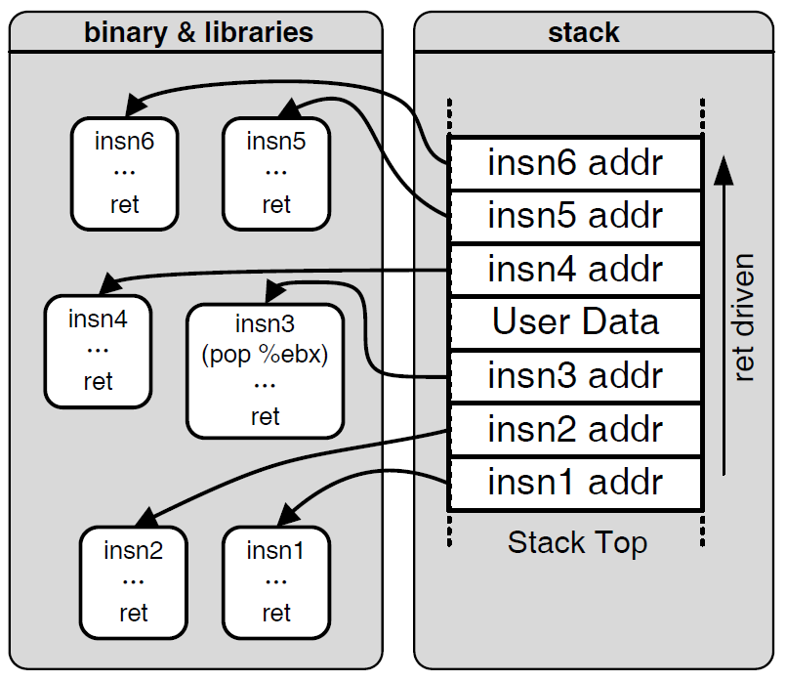

Motivation: Code Reuse Attack

Slide 49
Code Reuse Attack
Return-oriented Programming
  Find code gadgets in existed code base (e.g. libc)
  Push address of gadgets on the stack
  Leverage ‘ret’ to connect code gadgets
  No code injection
Solutions
  Return-less kernels
  Heuristic means
Address C
Address B
Address A
return addr
0101011010
saved ebp
A
0101011010
B
0101011010
C
0101011010

