Slide 1

Jetstream - A self-provisioned, scalable science and engineering cloud environment Craig Stewart ORCID ID 0000-0003-2423-9019 Jetstream Principal Investigator Executive Director, Indiana University Pervasive Technology Institute
A national science & engineering cloud
funded by the National Science Foundation
Award #ACI-1445604

Slide 2
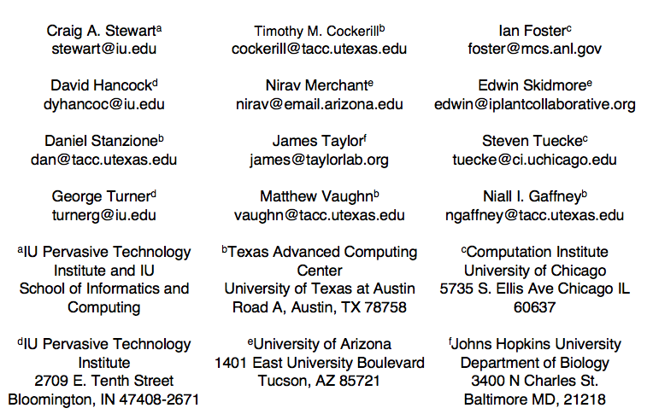

Slide 3
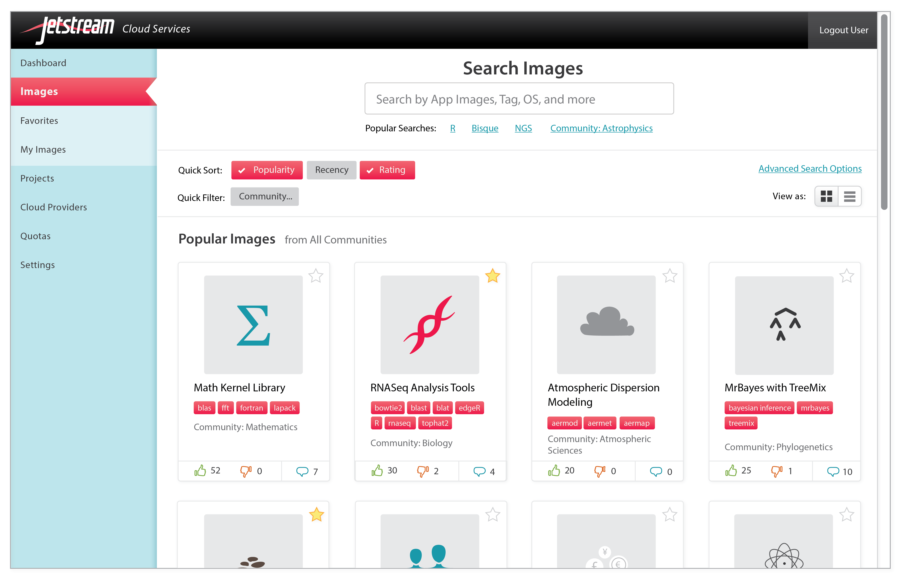

Slide 4
Jetstream characteristics
First production cloud for science and engineering research across all areas of NSF-supported activity
Interactive computing and data analysis resources “on demand”
Focus on ease-of-use, broad accessibility
VM library, custom VMs, or “private computing system”
Not every cloud computing service one might be able to buy from AWS
Reproducibility: Store, publish via IUScholarWorks (DOI)
Will support persistent gateways (iPlant, Galaxy, generic “SciGAP” build-a-gateway image)

Slide 5
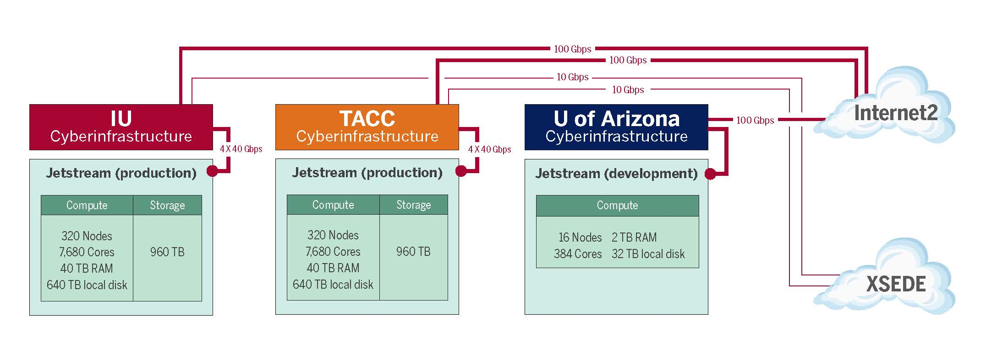
Jetstream System Overview
Geographically distributed cloud; 0.5 PetaFLOPS
Globus for large-scale file transfer, authentication

Slide 6
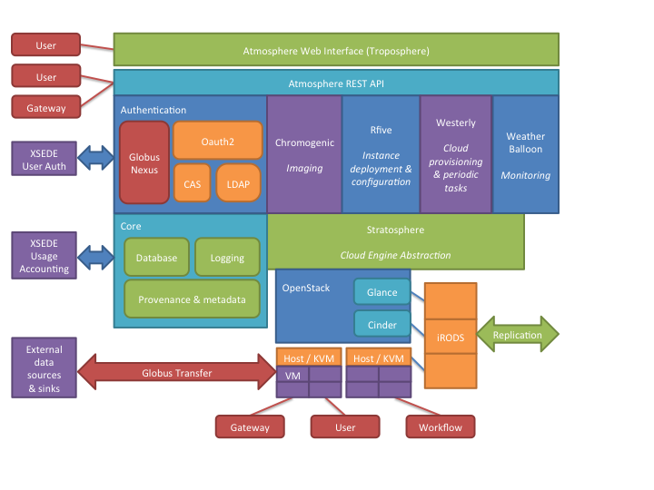
Software Stack: Metal to Atmosphere

Slide 7
Use cases drawn from science domains
Biology: iPlant and Galaxy VMs, enabling access to and use of new analytical codes in various modalities
Earth Science: VMs capable of requesting NSIDC data and running common routines to enable more effective research and better analyses of data
Field Station Research: VM-based data collection and analysis tools to support data sharing and collaboration
GIS: Deliver the CyberGIS toolkit and provide access to ArcGIS in a VM using IU’s existing site license
Network Science: Build VMs with CIShell tool builders to deliver network analysis tools interactively
Social Sciences: Create VMs that allow selection of data from the Odum Institute in a way that retains provenance and version information
Whatever you do, probably…unless you run large-scale MPI codes or HTC workloads!

Slide 8
Needs based on mode of use
Campus bridging. An old XSEDE use case: the ability to initiate an interactive computing session, detach with it running, and re-attach and continue working. Jetstream VM image featuring a user-friendly virtual Linux desktop running on Jetstream with screen images delivered to tablet devices on cellular connections or to older PCs on slow networks.
Enable use of proprietary software.
Facilitate reproducible data analyses.
Enhance ease of science gateway deployment. Provide a gateway builder’s toolkit, including VMs with commonly used workflow engines installed and ready to configure, XSEDE tools, and a platform for persistently hosting web services.
Visualization and analysis. Many researchers would like to interactively use visualization.

Slide 9
21st-century workforce development
Specialized virtual Linux desktops and applications to enable research and research education at small colleges and universities
HBCUs (Historically Black Colleges and Universities)
MSIs (Minority Serving Institutions)
Tribal colleges
Higher-ed institutions in EPSCoR States

Slide 10
“Long tail” of the NSF XD Ecosystem
Capability class machines
Traditional HPC, HTC systems
A self-provisioned, scalable science & engineering cloud environment
Notes:
In the atmosphere the Jetstream lies at the border of two different air masses
At the border of the existing NSF-funded XD program and advanced CI resources and users who have not previously used such NSF funded infrastructure before

Slide 11
Challenges in implementation
Well, it’s an FOAK
Allocations
Appropriate use
Scope of user community
Depending on existing community structures and XSEDE

Slide 12
Newest news
Done
Test system in acceptance testing at IU
Program Execution Plan has passed peer review and been conveyed by DACI (Division of Advanced Cyberinfrastructure) to DGA (Division of Grants and Awards) for modification of award instrument
SOW with vendor (Dell) has been executed
Production system has been ordered
Planned
Friendly user mode by SC15
Early operations mode Jan – Mar 2016

Slide 13















Jetstream Partner Organizations
Initial construction
(funded partners)
Management & Operations partners
Application / community lead partners

Slide 14
Citation, Acknowledgments, & Disclaimers
Please cite as Stewart, C.A. 2015. Jetstream Overview – XSEDE ‘15 Panel - New and emerging US cyberinfrastructure resources Presentation. XSEDE’15, July 26 - 30, 2015, St. Louis, MO, USA. http://hdl.handle.net/2022/20338. Jetstream is supported by NSF award 1445604 (Craig Stewart, PI)
XSEDE is supported by NSF award 1053575 (John Towns, UIUC, PI)
This work was also supported by the Indiana University Pervasive Technology Institute, which was initiated with major funding from the Lilly Endowment, Inc.
Any opinions, findings and conclusions or recommendations expressed in this material are those of the author(s) and do not necessarily reflect the views of the National Science Foundation (NSF) or other supporting organizations.
Except where otherwise noted, by inclusion of a source url or some other note, the contents of this presentation are © by the Trustees of Indiana University. This content is released under the Creative Commons Attribution 3.0 Unported license (http://creativecommons.org/licenses/by/3.0/). This license includes the following terms: You are free to share – to copy, distribute and transmit the work and to remix – to adapt the work under the following conditions: attribution – you must attribute the work in the manner specified by the author or licensor (but not in any way that suggests that they endorse you or your use of the work). For any reuse or distribution, you must make clear to others the license terms of this work.

