Slide 1
Optimizing the Location of a New Seattle-based Coffee Shop
Evan Jahrman
August 16th, 2021
Applied Data Science Capstone

Slide 2
Problem Statement
Context:
Seattle is known for its MANY great coffee shops
Many zip codes with varying:
Population densities
Cultural identities
Target Audience:
Entrepreneur opening a new Seattle coffee shop
Problem:
Which zip codes can support another coffee shop profitably?

Slide 3
Experimental Approach
Gather:
Zip codes
Population data
Latitude and longitudes
Venue information
Use k-means clustering to identify similar neighbors
Within each cluster, identify which zip code has the least coffee shops per capita

Slide 4
Data Collection
Zip Code | Latitude | Longitude | Population
98034 | 47.71577 | -122.214 | 40407
98101 | 47.6109 | -122.336 | 10238
98102 | 47.63714 | -122.322 | 20756
98103 | 47.67826 | -122.338 | 45911
98104 | 47.60188 | -122.329 | 13095
Data extracted using Pandas and Beautiful Soup
Sources:
Population Data - https://www.zipdatamaps.com/zipcodes-seattle-wa
Location Data - https://gist.githubusercontent.com/erichurst/7882666/raw/5bdc46db47d9515269ab12ed6fb2850377fd869e/US%2520Zip%2520Codes%2520from%25202013%2520Government%2520Data

Slide 5
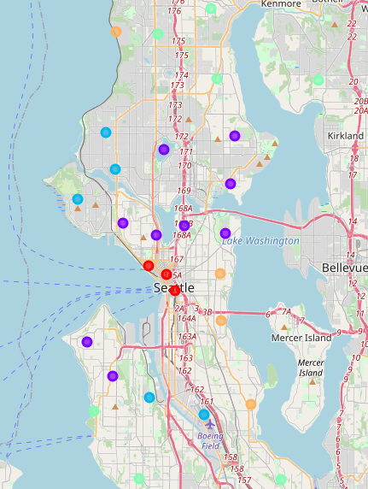
Clustering
Found venues within 3.2 km of each zip code
Sorted by type of venue
Below:
Most common venues in five zip codes
Right:
Seattle zip codes color-coded by cluster
ZIP | 1st Most Common Venue | 2nd Most Common Venue | 3rd Most Common Venue | 4th Most Common Venue
98034 | Coffee Shop | Sushi Restaurant | Sandwich Place | Pizza Place
98101 | Hotel | Coffee Shop | Bakery | Sandwich Place
98102 | Coffee Shop | Park | American Restaurant | Bakery
98103 | Coffee Shop | Bar | Ice Cream Shop | Park
98104 | Hotel | Vietnamese Restaurant | Cocktail Bar | Coffee Shop

Slide 6
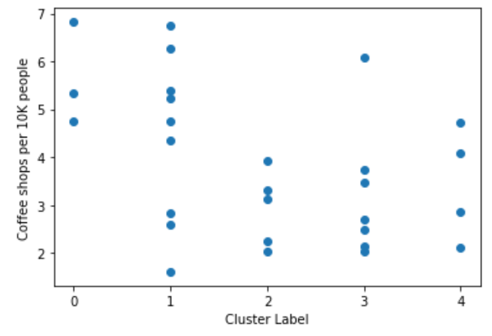
Areas of Reduced Competition
Goal: Find zip code with least coffee shops per capita in each cluster
Left – Coffee shops per 10,000 people returned for most promising zip codes
Right – Measure of variability within each cluster
ZIP | Population | coffee per capita | Cluster Labels
98105 | 43924 | 1.593662 | 1
98118 | 42731 | 2.106199 | 4
98121 | 12628 | 4.751346 | 0
98133 | 44555 | 2.019975 | 3
98199 | 19686 | 2.031901 | 2

Slide 7
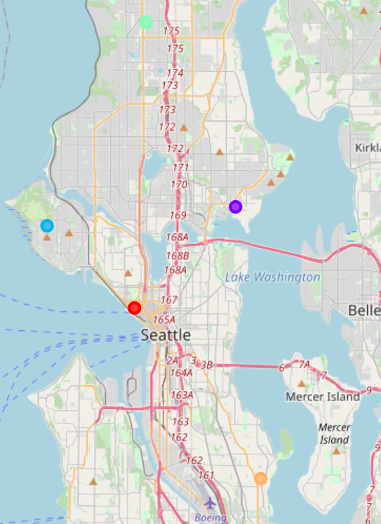
Setting up Shop
Conclusions
Right – Location of five optimal zip codes
Clustering neighborhoods controlled for culture/needs of community
Calculating coffee shops controlled for population density
Future Work
Include effect of typical commutes on coffee shop selection

Slide 8
Thank you!

