Slide 1
Partnerships & Alliances Molecular Diagnostics
Prof. K. K. Jain MD, FRACS, FFPM
CEO, Jain PharmaBiotech
Blaesiring 7, 4057 Basel, Switzerland
Colloquim B: Strategies for Business Success
IBC Molecular Diagnostics Meets Therapeutics
Boston, 4 June 2002

Slide 2
Molecular Diagnostic Technologies
Genomic technologies
Polymerase chain reaction (PCR)
Non-PCR amplification technologies
Biochips and microarrays
Immunodiagnostics
Proteodiagnostics
In vivo diagnostic technologies

Slide 3
Applications of Molecular Diagnostics
Population screening and epidemiology
Public health and preventive medicine
Diagnosis of diseases: genetic, infections, cancer etc
Pharmacogenetics
Drug development
Integration of diagnosis with therapeutics
Development of personalized medicines

Slide 4
Alliances in Molecular Diagnostics: Definitions
Two types of alliances/agreements:
Collaboration is used to mean an arrangement where two parties are conducting joint research or development of a technology or product
License is used for the granting of intellectual property rights (IPRs).
The boundaries between the two types of agreement are not clearcut because collaboration is likely to involve cross-licensing of IPRs and the licensing often involves some collaboration between the parties.

Slide 5
Licensing in Molecular Diagnostics
Scope of licensing: The rights and the area of application should be defined precisely at the start.
Exclusivity: ‘Exclusive’ means that only the licensee can use the licensed rights, ‘sole’ means that both licensee and licensor can use the rights, wheres the term ‘non-exclusive’ leaves open the possibility of licensing to another party.
Although the licensor retains the ownership of the rights, the licensee has the rights to the use of the technology and any modifications made in it.

Slide 6
Financial Aspects of Molecular Diagnostics Alliances
Up-front payment: This is the lump-sum cost to the licensee of buying into a license or a technology.
‘Milestone’ payments: These are sums payable on reaching a certain stage in development of the product, e.g. the move from research to clinical development. Used more in case of drugs and rarely in case of tests.
Royalties: The most common arrangement in licensing a diagnostic technology is royalty on product sales. The licensee pays it only if sales are made.
Financial support of R & D: The funding party, usually a pharmaceutical company, may provide funds to the molecular diagnostic company in return for certain rights to the product. In case of government and academic grants, less strings are attached.

Slide 7
Joint Ventures in Molecular Diagnostics
Two parties may start a joint venture to develop a particular molecular diagnostic technology. Some features of this are:
Both parties may contribute to the costs of development
It might involve combining of technologies of the contributing parties
It might be a new technology which does not fit into the technology platform of either participant
Funding may be from venture capital
Plans for the commercialization of the product are usually made in advance

Slide 8
Parties in Molecular Diagnostic Collaborations
Molecular diagnostic companies may form collaborations with a variety of partners including:
Pharmaceutical companies
Biotechnology companies (genomics, proteomics, etc)
Other molecular diagnostic companies
Laboratories providing diagnostic services
Universities
Government agencies/ institutions

Slide 9
Types of Molecular Diagnostic Deals
Licensing of technologies
Financing of clinical development of tests
Combining technologies
Providing diagnostic component of integrated therapy
Providing diagnostic services
Molecular diagnostic R & D
Marketing of tests

Slide 10
Material for Study of Molecular Diagnostic Collaborations
New collaborations from 2000-2002 (May)
Categorization of collaboration according to type of alliance and companies involved
Follow-up of collaborations from pre-2000 period
Financial values of collaborations where available

Slide 11
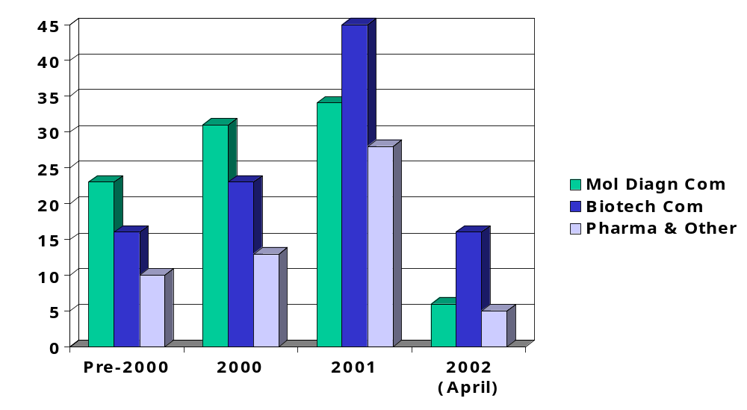
Partners in 250 Collaborations of Molecular Diagnostics
© Jain PharmaBiotech

Slide 12
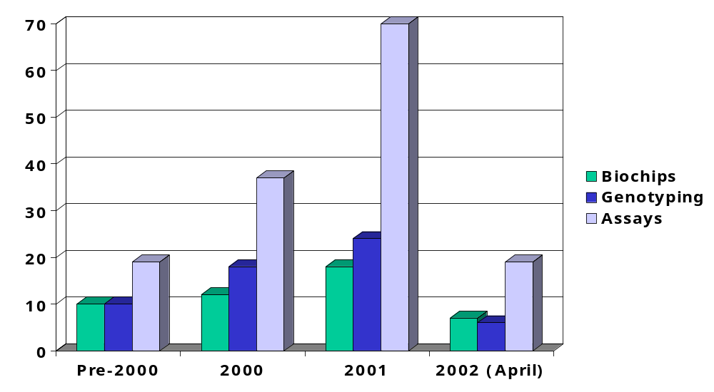
250 Molecular Diagnostic Collaborations: Technologies
© Jain PharmaBiotech

Slide 13
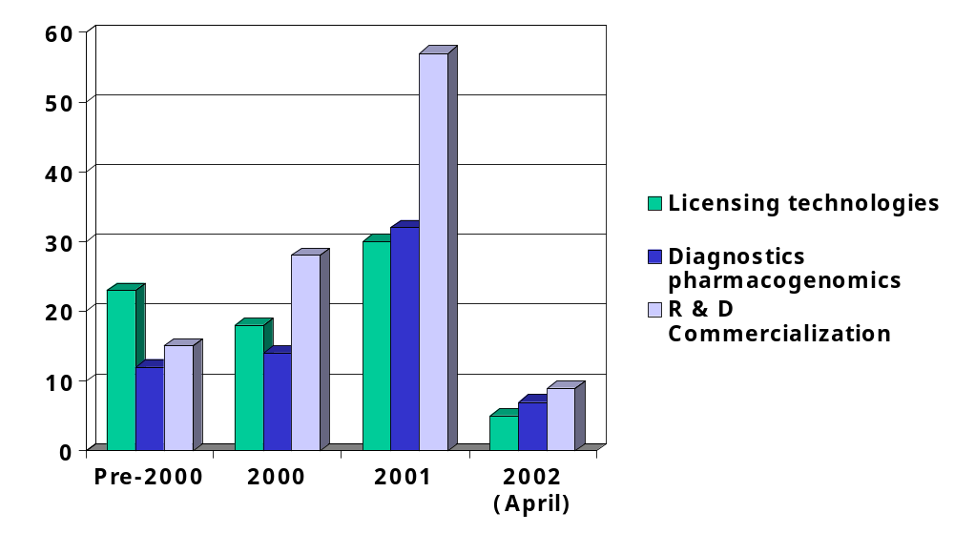
Areas of 250 Collaborations in Molecular Diagnostics
© Jain PharmaBiotech

Slide 14
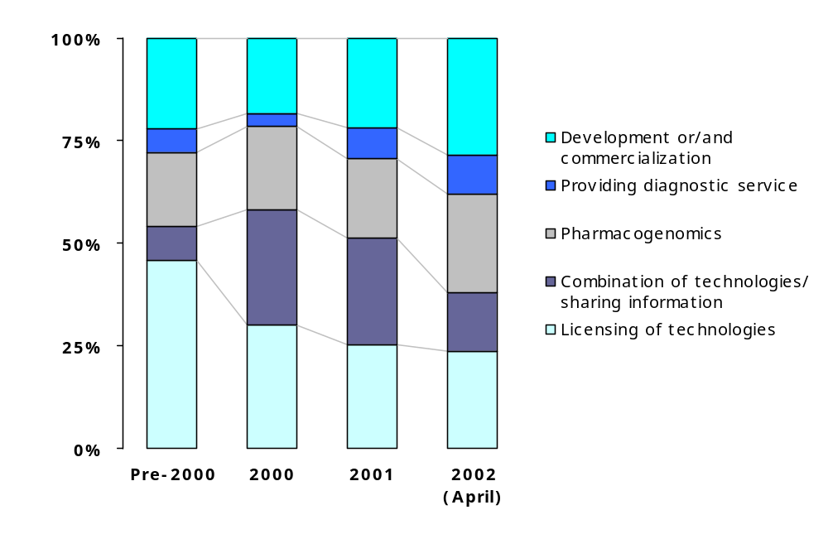
Proportion of Various Applications in Molecular Diagnostic Collaborations
© Jain PharmaBiotech

Slide 15
Case Studies of Molecular Diagnostic Collaborations
Selected case studies of collaborations are being presented to illustrate some points of collaborations
Names to be filled in

Slide 16
Molecular Diagnostic Acquisitions
Company | Acquired | Year | Amount
BD Biosciences | Clontech | 1999 | $200 million
Abbott | Vysis | 2001 | $355 million
Applied Biosystems | Boston Probes | 2001 | $32 million
bioMérieux | Organon Teknika | 2001 | ?
Cytyc Corporation | Digene | 2002 | $553 million

Slide 17
Diagnostic Capital Fund
Bayer and Burrill & Co
In January 2002, Bayer Diagnostics and Burrill & Company formed the $50-million Burrill Diagnostics Capital Fund with the following aims:
To provide innovative diagnostic technology companies with funds to fully exploit the application of novel, bio-based technologies
To provide growth capital to product-based companies
The fund will focus on emerging high-growth areas such as device miniaturization, pharmacogenomic testing and non-invasive testing, and application these technologies to disease diagnosis and improvement of healthcare

Slide 18
Molecular Diagnostic Collaborations: Conclusions
Conclusion 1

Slide 19
Areas with Opportunities for Collaborations for Molecular Diagnostic Companies
Research & Development with support of larger biotechnology or pharmaceutical companies
Integration of diagnostics with therapeutics in collaboration with pharmaceutical companies
Development of personalized medicine in collaboration with pharmaceutical companies
Service laboratories for application of tests

