Slide 1



CONNECTED PLATFORM STRATEGY / MRM DIGITAL COMMUNITY PLATFORM
Connect people’s reasons to use the platform
A person should understand why another feature helps them—and choose whether to cross into it.
“I came here to teach. Why would I volunteer?”
START WITH A REAL PERSON
MAKE THE HANDOFF USEFUL
SHOW VALUE ON BOTH SIDES
Their current role, goal and reason to
consider a second service.
A relevant invitation, consent and a clear
next action—not just a menu link.
Explain what the person gains and what
the recipient or service gains.
15 proposed bridges · 2 complete journeys · role boundaries · implementation priorities
MRM / ZYLAX TECHNOLOGIES
PROPOSED PRODUCT DESIGN · OPTIONAL PARTICIPATION · SEPARATE ROLE APPROVALS
01 / 24
Notes:
{
"purpose": "Supplement the existing feature explanations with actor motivation and reciprocal value.",
"status": "All new cross-feature invitations and rules are proposals requiring product validation."
}

Slide 2
USER-VALUE CONNECTIONS / MRM DIGITAL COMMUNITY PLATFORM
A Quran teacher chooses a second way to serve
Learning centre → voluntary support participation → a subject-relevant offer a seeker can assess.
01
02
03
Teacher’s reason
Bridge experience
Seeker’s reason
“I want to use my Quran expertise to support
someone beyond a scheduled class.”
Invite the teacher to offer Quran support;
reuse consented expertise and complete
volunteer checks.
“This approved volunteer is also an approved
Quran teacher. I can see why the match is
relevant.”
DOES EVERY TEACHER NEED VOLUNTEERING?
WHAT DOES THE TEACHER BADGE MEAN?
No. It becomes relevant when they choose to offer support.
Relevant approved expertise—not guaranteed safety or automatic case access.
MRM / ZYLAX TECHNOLOGIES
PROPOSED PRODUCT DESIGN · OPTIONAL PARTICIPATION · SEPARATE ROLE APPROVALS
02 / 24

Slide 3
CONNECTED USER JOURNEYS / MRM DIGITAL COMMUNITY PLATFORM
How the user journeys connect
Read each row as a reason to move between services. Select an outlined card to explore its bridge.
TEACHER
Teach a topic
Offer relevant help
Support a seeker
Already using learning
Opt in + volunteer approval
Relevant credentials visible
VOLUNTEER
Identify a skill gap
Take useful training
Return to service
A real duty needs preparation
Assess readiness separately
Approved for suitable work
SEEKER
Ask for guidance
Choose a suitable class
Request continuity
Learning need is expressed
Consent + language + level
Optional mentoring
LEARNER
Discover a programme
Build confidence
Choose to contribute
From an approved topic
Learn at their chosen pace
Apply separately to volunteer
MRM TEAM
See aggregate demand
Commission learning
Refer willing people
Protect individual identities
Match teachers to a real gap
Measure usefulness, not pressure
MRM / ZYLAX TECHNOLOGIES
PROPOSED PRODUCT DESIGN · OPTIONAL PARTICIPATION · SEPARATE ROLE APPROVALS
03 / 24
Notes:
{
"reading": "Each row shows actor motivation and an actionable handoff. Nodes are not unrestricted data access."
}

Slide 4
USER-VALUE CONNECTIONS / MRM DIGITAL COMMUNITY PLATFORM
A connection is useful only when the person needs it
Feature completeness does not require forcing every person through every service.
YES—WHEN THERE IS A REAL REASON
NO—WHEN THE SECOND SERVICE ADDS NO VALUE
A teacher wants to contribute; a volunteer needs preparation; a
seeker asks for learning help.
A teacher only wants to teach; a reader only wants Quran; a seeker
needs immediate practical help.
Relevant invitation
Voluntary transition
Why this action, for this person, at this point?
Can they decline without losing their original service?
Useful context
Bounded authority
What chosen information saves them from starting again?
Which new checks apply before the next role or record opens?
MRM / ZYLAX TECHNOLOGIES
PROPOSED PRODUCT DESIGN · OPTIONAL PARTICIPATION · SEPARATE ROLE APPROVALS
04 / 24

Slide 5
PROPOSED USER JOURNEY 01 / MRM DIGITAL COMMUNITY PLATFORM
A teacher can turn expertise into relevant care
Learning centre → Volunteer support | An approved Quran teacher
“I teach Quran. I would also like to help someone who needs personal guidance.”
USE WHEN
NOT REQUIRED WHEN
Offer volunteering when the teacher wants to give support beyond scheduled
classes.
A teacher may only publish and teach. Volunteering stays optional.
01
02
03
04
Teaching profile
Choose to help
Volunteer approval
Relevant support match
Approved topics and languages
establish relevant expertise.
An invitation offers Quran-related
support; the teacher opts in.
MRM checks suitability, training,
capacity and case boundaries.
The seeker sees approved teaching
credentials and accepts the offer.
CARRY FORWARD
KEEP SEPARATE
VALUE ON BOTH SIDES
With consent: approved teacher status, verified
subject, languages and public profile.
Teacher payment does not buy case access. No
private student records are shared.
The seeker can judge relevant expertise; the teacher
gains a meaningful way to serve. Credentials support
confidence, not a guarantee of safety.
SUCCESS: Eligible teachers opting in → approved volunteers → accepted subject-relevant matches.
MRM / ZYLAX TECHNOLOGIES
PROPOSED PRODUCT DESIGN · OPTIONAL PARTICIPATION · SEPARATE ROLE APPROVALS
05 / 24
Notes:
{
"key": "teacher_support",
"title": "A teacher can turn expertise into relevant care",
"pair": "Learning centre → Volunteer support",
"person": "An approved Quran teacher",
"need": "“I teach Quran. I would also like to help someone who needs personal guidance.”",
"yes": "Offer volunteering when the teacher wants to give support beyond scheduled classes.",
"no": "A teacher may only publish and teach. Volunteering stays optional.",
"steps": [
[
"Teaching profile",
"Approved topics and languages establish relevant expertise."
],
[
"Choose to help",
"An invitation offers Quran-related support; the teacher opts in."
],
[
"Volunteer approval",
"MRM checks suitability, training, capacity and case boundaries."
],
[
"Relevant support match",
"The seeker sees approved teaching credentials and accepts the offer."
]
],
"carry": "With consent: approved teacher status, verified subject, languages and public profile.",
"separate": "Teacher payment does not buy case access. No private student records are shared.",
"benefit": "The seeker can judge relevant expertise; the teacher gains a meaningful way to serve. Credentials support confidence, not a guarantee of safety.",
"signal": "Eligible teachers opting in → approved volunteers → accepted subject-relevant matches.",
"priority": "FIRST",
"related": [
"volunteer_training",
"seeker_class",
"mentoring_support"
],
"page": 5
}

Slide 6
PROPOSED USER JOURNEY 02 / MRM DIGITAL COMMUNITY PLATFORM
A volunteer can learn before accepting a new task
Volunteer support → Learning centre | A volunteer offered unfamiliar work
“I want to help, but I need preparation for this kind of support.”
USE WHEN
NOT REQUIRED WHEN
Recommend an approved course when a real duty requires a skill or refresher.
Existing qualified volunteers do not repeat irrelevant classes; no blanket course
requirement.
01
02
03
04
Readiness gap
Relevant training
Learning evidence
Return to duty
The volunteer or coordinator
identifies a specific skill gap.
Open the approved course with
topic and required outcome
explained.
Record completion; assess
readiness separately where
needed.
MRM updates eligibility and offers
suitable work after approval.
CARRY FORWARD
KEEP SEPARATE
VALUE ON BOTH SIDES
Course reference, completion and separately
assessed competencies, with appropriate visibility.
Completion alone is not volunteer approval.
Private learning notes stay private.
Volunteers get practical preparation; seekers
receive help from people approved for the task.
SUCCESS: Training completion → assessed readiness → eligible task acceptance; monitor support quality.
MRM / ZYLAX TECHNOLOGIES
PROPOSED PRODUCT DESIGN · OPTIONAL PARTICIPATION · SEPARATE ROLE APPROVALS
06 / 24
Notes:
{
"key": "volunteer_training",
"title": "A volunteer can learn before accepting a new task",
"pair": "Volunteer support → Learning centre",
"person": "A volunteer offered unfamiliar work",
"need": "“I want to help, but I need preparation for this kind of support.”",
"yes": "Recommend an approved course when a real duty requires a skill or refresher.",
"no": "Existing qualified volunteers do not repeat irrelevant classes; no blanket course requirement.",
"steps": [
[
"Readiness gap",
"The volunteer or coordinator identifies a specific skill gap."
],
[
"Relevant training",
"Open the approved course with topic and required outcome explained."
],
[
"Learning evidence",
"Record completion; assess readiness separately where needed."
],
[
"Return to duty",
"MRM updates eligibility and offers suitable work after approval."
]
],
"carry": "Course reference, completion and separately assessed competencies, with appropriate visibility.",
"separate": "Completion alone is not volunteer approval. Private learning notes stay private.",
"benefit": "Volunteers get practical preparation; seekers receive help from people approved for the task.",
"signal": "Training completion → assessed readiness → eligible task acceptance; monitor support quality.",
"priority": "FIRST",
"related": [
"teacher_support",
"learner_volunteer",
"capacity_learning"
],
"page": 6
}

Slide 7
PROPOSED USER JOURNEY 03 / MRM DIGITAL COMMUNITY PLATFORM
A support conversation can open the right learning path
Support requests → Learning centre | A seeker asking for Quran-reading help
“I need a patient beginner class, in my language, at a time I can attend.”
USE WHEN
NOT REQUIRED WHEN
Suggest a class when learning addresses the person’s expressed need and they
want it.
Urgent welfare support continues independently. No class enrolment is required
for aid.
01
02
03
04
Expressed need
Consent to refer
Suitable programme
Optional enrolment
The assigned helper asks whether
learning support would be useful.
The seeker selects a goal, language
and availability to share.
Show approved beginner classes
and relevant teacher credentials.
The seeker joins; the helper sees
only the agreed referral status.
CARRY FORWARD
KEEP SEPARATE
VALUE ON BOTH SIDES
Chosen learning goal, language, availability and
referral ID; share only what is needed.
No full case narrative, financial circumstances or
private chat enters a teacher profile.
The seeker receives a practical next step; teachers
reach learners who want the programme.
SUCCESS: Consented referrals → suitable enrolments → attendance and seeker-reported usefulness.
MRM / ZYLAX TECHNOLOGIES
PROPOSED PRODUCT DESIGN · OPTIONAL PARTICIPATION · SEPARATE ROLE APPROVALS
07 / 24
Notes:
{
"key": "seeker_class",
"title": "A support conversation can open the right learning path",
"pair": "Support requests → Learning centre",
"person": "A seeker asking for Quran-reading help",
"need": "“I need a patient beginner class, in my language, at a time I can attend.”",
"yes": "Suggest a class when learning addresses the person’s expressed need and they want it.",
"no": "Urgent welfare support continues independently. No class enrolment is required for aid.",
"steps": [
[
"Expressed need",
"The assigned helper asks whether learning support would be useful."
],
[
"Consent to refer",
"The seeker selects a goal, language and availability to share."
],
[
"Suitable programme",
"Show approved beginner classes and relevant teacher credentials."
],
[
"Optional enrolment",
"The seeker joins; the helper sees only the agreed referral status."
]
],
"carry": "Chosen learning goal, language, availability and referral ID; share only what is needed.",
"separate": "No full case narrative, financial circumstances or private chat enters a teacher profile.",
"benefit": "The seeker receives a practical next step; teachers reach learners who want the programme.",
"signal": "Consented referrals → suitable enrolments → attendance and seeker-reported usefulness.",
"priority": "FIRST",
"related": [
"teacher_support",
"learning_mentor",
"mentoring_support"
],
"page": 7
}

Slide 8
PROPOSED USER JOURNEY 04 / MRM DIGITAL COMMUNITY PLATFORM
A Quran reader can find help for a specific learning goal
Quran utility → Learning centre | A person using Quran reading tools
“I can read this passage, but I want help with pronunciation or meaning.”
USE WHEN
NOT REQUIRED WHEN
Offer a discreet learning action after the person explicitly asks for help on a
topic.
Reading alone remains complete. Do not infer poor skill or send unsolicited
judgments.
01
02
03
04
Ask for guidance
Choose learning goal
Relevant discovery
Return to practice
The reader chooses Learn this topic
or Get reading help.
They select beginner reading,
recitation or an approved topic.
Show approved teachers or
programmes matching language
and level.
After learning, a saved link returns
to the selected passage.
CARRY FORWARD
KEEP SEPARATE
VALUE ON BOTH SIDES
Only the user-selected passage, learning goal and
preferred language.
No private reading history or worship-tracker
record is shared with a teacher.
Daily use can become purposeful learning;
teachers receive clearer learner intent.
SUCCESS: User-initiated learning opens → relevant enrolments → return to chosen practice.
MRM / ZYLAX TECHNOLOGIES
PROPOSED PRODUCT DESIGN · OPTIONAL PARTICIPATION · SEPARATE ROLE APPROVALS
08 / 24
Notes:
{
"key": "quran_class",
"title": "A Quran reader can find help for a specific learning goal",
"pair": "Quran utility → Learning centre",
"person": "A person using Quran reading tools",
"need": "“I can read this passage, but I want help with pronunciation or meaning.”",
"yes": "Offer a discreet learning action after the person explicitly asks for help on a topic.",
"no": "Reading alone remains complete. Do not infer poor skill or send unsolicited judgments.",
"steps": [
[
"Ask for guidance",
"The reader chooses Learn this topic or Get reading help."
],
[
"Choose learning goal",
"They select beginner reading, recitation or an approved topic."
],
[
"Relevant discovery",
"Show approved teachers or programmes matching language and level."
],
[
"Return to practice",
"After learning, a saved link returns to the selected passage."
]
],
"carry": "Only the user-selected passage, learning goal and preferred language.",
"separate": "No private reading history or worship-tracker record is shared with a teacher.",
"benefit": "Daily use can become purposeful learning; teachers receive clearer learner intent.",
"signal": "User-initiated learning opens → relevant enrolments → return to chosen practice.",
"priority": "NEXT",
"related": [
"learning_mentor",
"seeker_class",
"learner_volunteer"
],
"page": 8
}

Slide 9
PROPOSED USER JOURNEY 05 / MRM DIGITAL COMMUNITY PLATFORM
A learner can ask for continuity after a class
Learning centre → Mentoring | A learner who wants individual follow-up
“The class helped. I would like someone to guide my next steps.”
USE WHEN
NOT REQUIRED WHEN
Offer mentoring after a learner requests ongoing guidance or a teacher offers
approved capacity.
Class enrolment does not enrol a person into mentoring or open private
messaging automatically.
01
02
03
04
Request follow-up
Available mentor
Mutual acceptance
Ongoing guidance
The learner chooses a goal after
the programme.
Show approved mentors relevant to
topic, language and permitted
boundaries.
The mentor has capacity; the
learner agrees to contact and
expectations.
Open the authorised relationship
and optional agreed check-ins.
CARRY FORWARD
KEEP SEPARATE
VALUE ON BOTH SIDES
Chosen programme, learning goal and agreed
availability; selected progress only with consent.
No automatic access to class rosters, aid cases or
private worship records.
Learners gain continuity; mentors support people
whose needs match their expertise.
SUCCESS: Follow-up requests → mutually accepted matches → useful agreed check-ins.
MRM / ZYLAX TECHNOLOGIES
PROPOSED PRODUCT DESIGN · OPTIONAL PARTICIPATION · SEPARATE ROLE APPROVALS
09 / 24
Notes:
{
"key": "learning_mentor",
"title": "A learner can ask for continuity after a class",
"pair": "Learning centre → Mentoring",
"person": "A learner who wants individual follow-up",
"need": "“The class helped. I would like someone to guide my next steps.”",
"yes": "Offer mentoring after a learner requests ongoing guidance or a teacher offers approved capacity.",
"no": "Class enrolment does not enrol a person into mentoring or open private messaging automatically.",
"steps": [
[
"Request follow-up",
"The learner chooses a goal after the programme."
],
[
"Available mentor",
"Show approved mentors relevant to topic, language and permitted boundaries."
],
[
"Mutual acceptance",
"The mentor has capacity; the learner agrees to contact and expectations."
],
[
"Ongoing guidance",
"Open the authorised relationship and optional agreed check-ins."
]
],
"carry": "Chosen programme, learning goal and agreed availability; selected progress only with consent.",
"separate": "No automatic access to class rosters, aid cases or private worship records.",
"benefit": "Learners gain continuity; mentors support people whose needs match their expertise.",
"signal": "Follow-up requests → mutually accepted matches → useful agreed check-ins.",
"priority": "NEXT",
"related": [
"seeker_class",
"mentoring_support",
"teacher_support"
],
"page": 9
}

Slide 10
PROPOSED USER JOURNEY 06 / MRM DIGITAL COMMUNITY PLATFORM
A mentor can refer needs beyond the teaching relationship
Mentoring → Support requests | A mentor hearing about a practical difficulty
“This learner needs help that I am not authorised or qualified to provide.”
USE WHEN
NOT REQUIRED WHEN
Offer a supported referral when the person wants help outside the mentor’s
remit.
A mentor does not investigate welfare issues or browse existing private cases.
01
02
03
04
Recognise the limit
Person chooses help
MRM triage
Bounded follow-up
The mentor explains the relevant
support route without promising an
outcome.
The learner opens or agrees to a
minimal support referral.
Authorised staff assess urgency,
eligibility and the appropriate
response.
The mentor sees only the referral
status the person agreed to share.
CARRY FORWARD
KEEP SEPARATE
VALUE ON BOTH SIDES
Consent, chosen category, contact preference and
minimum agreed context.
No blanket case access. Safeguarding disclosures
follow the approved escalation policy.
The person reaches qualified help; the mentor can
stay within a clear teaching role.
SUCCESS: Accepted referrals → triaged requests → completed handoffs without excess disclosure.
MRM / ZYLAX TECHNOLOGIES
PROPOSED PRODUCT DESIGN · OPTIONAL PARTICIPATION · SEPARATE ROLE APPROVALS
10 / 24
Notes:
{
"key": "mentoring_support",
"title": "A mentor can refer needs beyond the teaching relationship",
"pair": "Mentoring → Support requests",
"person": "A mentor hearing about a practical difficulty",
"need": "“This learner needs help that I am not authorised or qualified to provide.”",
"yes": "Offer a supported referral when the person wants help outside the mentor’s remit.",
"no": "A mentor does not investigate welfare issues or browse existing private cases.",
"steps": [
[
"Recognise the limit",
"The mentor explains the relevant support route without promising an outcome."
],
[
"Person chooses help",
"The learner opens or agrees to a minimal support referral."
],
[
"MRM triage",
"Authorised staff assess urgency, eligibility and the appropriate response."
],
[
"Bounded follow-up",
"The mentor sees only the referral status the person agreed to share."
]
],
"carry": "Consent, chosen category, contact preference and minimum agreed context.",
"separate": "No blanket case access. Safeguarding disclosures follow the approved escalation policy.",
"benefit": "The person reaches qualified help; the mentor can stay within a clear teaching role.",
"signal": "Accepted referrals → triaged requests → completed handoffs without excess disclosure.",
"priority": "FIRST",
"related": [
"seeker_class",
"teacher_support",
"specialist_referral"
],
"page": 10
}

Slide 11
PROPOSED USER JOURNEY 07 / MRM DIGITAL COMMUNITY PLATFORM
A learning event can invite a separate service role
Learning events → Volunteer duties | A Halaqa attendee or teacher
“I am attending this event. Can I help with registration or accessibility?”
USE WHEN
NOT REQUIRED WHEN
Offer clearly defined event tasks when organisers need capacity and the person
opts in.
Attending a class never creates a duty. An event helper does not gain case
access.
01
02
03
04
Event participation
Choose a duty
Coordinator confirms
Event service
The person views an approved
programme and its support needs.
They select a suitable task, time
window and required checks.
Check eligibility and avoid conflict
with the person’s class time.
Show a separate duty card,
instructions and attendance
confirmation.
CARRY FORWARD
KEEP SEPARATE
VALUE ON BOTH SIDES
Event ID, chosen slot, contact consent and
role-specific eligibility.
Class attendance and duty acceptance are
separate records; no attendee list is exported.
Organisers gain willing capacity; participants have
a specific, manageable way to contribute.
SUCCESS: Opt-in duty requests → conflict-free confirmations → completed event tasks.
MRM / ZYLAX TECHNOLOGIES
PROPOSED PRODUCT DESIGN · OPTIONAL PARTICIPATION · SEPARATE ROLE APPROVALS
11 / 24
Notes:
{
"key": "event_volunteer",
"title": "A learning event can invite a separate service role",
"pair": "Learning events → Volunteer duties",
"person": "A Halaqa attendee or teacher",
"need": "“I am attending this event. Can I help with registration or accessibility?”",
"yes": "Offer clearly defined event tasks when organisers need capacity and the person opts in.",
"no": "Attending a class never creates a duty. An event helper does not gain case access.",
"steps": [
[
"Event participation",
"The person views an approved programme and its support needs."
],
[
"Choose a duty",
"They select a suitable task, time window and required checks."
],
[
"Coordinator confirms",
"Check eligibility and avoid conflict with the person’s class time."
],
[
"Event service",
"Show a separate duty card, instructions and attendance confirmation."
]
],
"carry": "Event ID, chosen slot, contact consent and role-specific eligibility.",
"separate": "Class attendance and duty acceptance are separate records; no attendee list is exported.",
"benefit": "Organisers gain willing capacity; participants have a specific, manageable way to contribute.",
"signal": "Opt-in duty requests → conflict-free confirmations → completed event tasks.",
"priority": "NEXT",
"related": [
"learner_volunteer",
"volunteer_training",
"feed_learning"
],
"page": 11
}

Slide 12
PROPOSED USER JOURNEY 08 / MRM DIGITAL COMMUNITY PLATFORM
An inspiring post can lead to a relevant programme
Community updates → Learning centre | A reader interested in an approved topic
“This article is useful. Where can I learn this with a teacher?”
USE WHEN
NOT REQUIRED WHEN
Attach a specific approved programme when it genuinely expands on the post.
Not every post needs a conversion. General announcements can stand alone.
01
02
03
04
Relevant approved post
Purposeful invitation
Programme context
Voluntary participation
An author explains a topic with a
clear source and audience.
Read programme details or Meet
the teacher explains the next step.
Open topic, level, language, date
and access information.
The reader chooses enrolment and
can return to the original post.
CARRY FORWARD
KEEP SEPARATE
VALUE ON BOTH SIDES
Post ID, topic and linked programme; aggregate
referral attribution where agreed.
No sensitive-case targeting, fabricated
testimonials or automatic enrolment.
Readers can act on genuine interest; teachers
reach an appropriate audience.
SUCCESS: Post-to-programme opens → relevant enrolments; monitor usefulness and opt-outs.
MRM / ZYLAX TECHNOLOGIES
PROPOSED PRODUCT DESIGN · OPTIONAL PARTICIPATION · SEPARATE ROLE APPROVALS
12 / 24
Notes:
{
"key": "feed_learning",
"title": "An inspiring post can lead to a relevant programme",
"pair": "Community updates → Learning centre",
"person": "A reader interested in an approved topic",
"need": "“This article is useful. Where can I learn this with a teacher?”",
"yes": "Attach a specific approved programme when it genuinely expands on the post.",
"no": "Not every post needs a conversion. General announcements can stand alone.",
"steps": [
[
"Relevant approved post",
"An author explains a topic with a clear source and audience."
],
[
"Purposeful invitation",
"Read programme details or Meet the teacher explains the next step."
],
[
"Programme context",
"Open topic, level, language, date and access information."
],
[
"Voluntary participation",
"The reader chooses enrolment and can return to the original post."
]
],
"carry": "Post ID, topic and linked programme; aggregate referral attribution where agreed.",
"separate": "No sensitive-case targeting, fabricated testimonials or automatic enrolment.",
"benefit": "Readers can act on genuine interest; teachers reach an appropriate audience.",
"signal": "Post-to-programme opens → relevant enrolments; monitor usefulness and opt-outs.",
"priority": "NEXT",
"related": [
"learning_mentor",
"quran_class",
"consented_story"
],
"page": 12
}

Slide 13
PROPOSED USER JOURNEY 09 / MRM DIGITAL COMMUNITY PLATFORM
Repeated support needs can shape better programmes
Support operations → Learning planning | An MRM programme coordinator
“We repeatedly receive beginner-learning requests in a language with little capacity.”
USE WHEN
NOT REQUIRED WHEN
Use restricted aggregate demand to commission a programme for an evidenced
gap.
Do not publish identifiable case examples or infer demand from a tiny sensitive
group.
01
02
03
04
Aggregate need
Plan a response
Publish programme
Measure the response
Authorised staff group agreed
categories, languages and waiting
demand.
MRM chooses a topic and suitable
approved teacher capacity.
Create a public description without
beneficiary identities.
Track programme capacity,
consented referrals and unmet
demand.
CARRY FORWARD
KEEP SEPARATE
VALUE ON BOTH SIDES
Only approved aggregate demand, programme
requirements and non-identifying outcomes.
Case files and individual identities never enter a
public programme brief.
Learning supply responds to real community
needs; support teams gain a useful referral option.
SUCCESS: Demand gap → commissioned capacity → suitable referrals; review remaining unmet need.
MRM / ZYLAX TECHNOLOGIES
PROPOSED PRODUCT DESIGN · OPTIONAL PARTICIPATION · SEPARATE ROLE APPROVALS
13 / 24
Notes:
{
"key": "capacity_learning",
"title": "Repeated support needs can shape better programmes",
"pair": "Support operations → Learning planning",
"person": "An MRM programme coordinator",
"need": "“We repeatedly receive beginner-learning requests in a language with little capacity.”",
"yes": "Use restricted aggregate demand to commission a programme for an evidenced gap.",
"no": "Do not publish identifiable case examples or infer demand from a tiny sensitive group.",
"steps": [
[
"Aggregate need",
"Authorised staff group agreed categories, languages and waiting demand."
],
[
"Plan a response",
"MRM chooses a topic and suitable approved teacher capacity."
],
[
"Publish programme",
"Create a public description without beneficiary identities."
],
[
"Measure the response",
"Track programme capacity, consented referrals and unmet demand."
]
],
"carry": "Only approved aggregate demand, programme requirements and non-identifying outcomes.",
"separate": "Case files and individual identities never enter a public programme brief.",
"benefit": "Learning supply responds to real community needs; support teams gain a useful referral option.",
"signal": "Demand gap → commissioned capacity → suitable referrals; review remaining unmet need.",
"priority": "NEXT",
"related": [
"volunteer_training",
"seeker_class",
"teacher_support"
],
"page": 13
}

Slide 14
PROPOSED USER JOURNEY 10 / MRM DIGITAL COMMUNITY PLATFORM
A verified outcome can invite responsible participation
Service outcomes → Community updates | A beneficiary willing to share an experience
“I want to thank the programme, but I want control over what people can see.”
USE WHEN
NOT REQUIRED WHEN
Publish a verified, consented story with an appropriate participation destination.
Assistance and recognition never depend on agreeing to publicity.
01
02
03
04
Separate invitation
Specific consent
Review and publish
Relevant invitation
After service, staff offer an optional
story process with no effect on aid.
Agree wording, images, visibility
and the withdrawal process.
Check accuracy, minimisation and
moderation before publication.
Readers can discover a real class or
apply to volunteer.
CARRY FORWARD
KEEP SEPARATE
VALUE ON BOTH SIDES
Only approved story assets and programme links
under the documented consent.
No case narrative, identity number or location is
copied by default; no guaranteed outcomes.
The storyteller controls disclosure; readers see
credible reasons to participate.
SUCCESS: Consent compliance, correction requests and relevant participation; never reward forced stories.
MRM / ZYLAX TECHNOLOGIES
PROPOSED PRODUCT DESIGN · OPTIONAL PARTICIPATION · SEPARATE ROLE APPROVALS
14 / 24
Notes:
{
"key": "consented_story",
"title": "A verified outcome can invite responsible participation",
"pair": "Service outcomes → Community updates",
"person": "A beneficiary willing to share an experience",
"need": "“I want to thank the programme, but I want control over what people can see.”",
"yes": "Publish a verified, consented story with an appropriate participation destination.",
"no": "Assistance and recognition never depend on agreeing to publicity.",
"steps": [
[
"Separate invitation",
"After service, staff offer an optional story process with no effect on aid."
],
[
"Specific consent",
"Agree wording, images, visibility and the withdrawal process."
],
[
"Review and publish",
"Check accuracy, minimisation and moderation before publication."
],
[
"Relevant invitation",
"Readers can discover a real class or apply to volunteer."
]
],
"carry": "Only approved story assets and programme links under the documented consent.",
"separate": "No case narrative, identity number or location is copied by default; no guaranteed outcomes.",
"benefit": "The storyteller controls disclosure; readers see credible reasons to participate.",
"signal": "Consent compliance, correction requests and relevant participation; never reward forced stories.",
"priority": "LATER",
"related": [
"feed_learning",
"learner_volunteer",
"capacity_learning"
],
"page": 14
}

Slide 15
PROPOSED USER JOURNEY 11 / MRM DIGITAL COMMUNITY PLATFORM
A local utility can surface a genuinely useful gathering
Prayer / nearby places → Learning events | A person checking prayer times or a mosque
“Is there an approved beginner Halaqa near this place?”
USE WHEN
NOT REQUIRED WHEN
Offer nearby programmes when the person requests local learning information.
Prayer times remain usable without events, location sharing or an account
where supported.
01
02
03
04
Local intent
Explore gatherings
Check relevance
Choose to attend
The person selects a mosque or
manually chosen area.
A separate action requests
approved programmes nearby.
Show venue, date, topic, language
and accessibility information.
The person enrols and optionally
enables programme reminders.
CARRY FORWARD
KEEP SEPARATE
VALUE ON BOTH SIDES
Selected venue or area and chosen programme;
prefer manual area selection when sufficient.
No background location tracking or attendance
inference from prayer-tool use.
Daily tools create relevant discovery; local
organisers reach interested participants.
SUCCESS: User-requested local discovery → suitable event enrolments → confirmed attendance.
MRM / ZYLAX TECHNOLOGIES
PROPOSED PRODUCT DESIGN · OPTIONAL PARTICIPATION · SEPARATE ROLE APPROVALS
15 / 24
Notes:
{
"key": "prayer_event",
"title": "A local utility can surface a genuinely useful gathering",
"pair": "Prayer / nearby places → Learning events",
"person": "A person checking prayer times or a mosque",
"need": "“Is there an approved beginner Halaqa near this place?”",
"yes": "Offer nearby programmes when the person requests local learning information.",
"no": "Prayer times remain usable without events, location sharing or an account where supported.",
"steps": [
[
"Local intent",
"The person selects a mosque or manually chosen area."
],
[
"Explore gatherings",
"A separate action requests approved programmes nearby."
],
[
"Check relevance",
"Show venue, date, topic, language and accessibility information."
],
[
"Choose to attend",
"The person enrols and optionally enables programme reminders."
]
],
"carry": "Selected venue or area and chosen programme; prefer manual area selection when sufficient.",
"separate": "No background location tracking or attendance inference from prayer-tool use.",
"benefit": "Daily tools create relevant discovery; local organisers reach interested participants.",
"signal": "User-requested local discovery → suitable event enrolments → confirmed attendance.",
"priority": "LATER",
"related": [
"event_volunteer",
"feed_learning",
"quran_class"
],
"page": 15
}

Slide 16
PROPOSED USER JOURNEY 12 / MRM DIGITAL COMMUNITY PLATFORM
A learner can choose a path from participation to contribution
Learning participation → Volunteer application | A learner who wants to give back
“This helped me. I want to support others when I am ready.”
USE WHEN
NOT REQUIRED WHEN
Offer an optional volunteer path after the person expresses interest in
contributing.
Learning progress, religiosity or aid receipt never creates an obligation to
volunteer.
01
02
03
04
Interest in service
Relevant preparation
Apply and assess
Start within limits
The learner chooses a suitable
contribution area.
Show actual role expectations and
optional or required preparation.
Reuse consented profile details;
complete separate volunteer
checks.
Approved volunteers accept
bounded work with coordinator
support.
CARRY FORWARD
KEEP SEPARATE
VALUE ON BOTH SIDES
Selected interests, contact details and relevant
assessed skills with consent.
A certificate, course attendance or worship streak
does not confer service authority.
Learners gain an achievable contribution route;
MRM grows prepared, willing capacity.
SUCCESS: Interest → applications → approvals → sustained suitable service; watch burden and dropout.
MRM / ZYLAX TECHNOLOGIES
PROPOSED PRODUCT DESIGN · OPTIONAL PARTICIPATION · SEPARATE ROLE APPROVALS
16 / 24
Notes:
{
"key": "learner_volunteer",
"title": "A learner can choose a path from participation to contribution",
"pair": "Learning participation → Volunteer application",
"person": "A learner who wants to give back",
"need": "“This helped me. I want to support others when I am ready.”",
"yes": "Offer an optional volunteer path after the person expresses interest in contributing.",
"no": "Learning progress, religiosity or aid receipt never creates an obligation to volunteer.",
"steps": [
[
"Interest in service",
"The learner chooses a suitable contribution area."
],
[
"Relevant preparation",
"Show actual role expectations and optional or required preparation."
],
[
"Apply and assess",
"Reuse consented profile details; complete separate volunteer checks."
],
[
"Start within limits",
"Approved volunteers accept bounded work with coordinator support."
]
],
"carry": "Selected interests, contact details and relevant assessed skills with consent.",
"separate": "A certificate, course attendance or worship streak does not confer service authority.",
"benefit": "Learners gain an achievable contribution route; MRM grows prepared, willing capacity.",
"signal": "Interest → applications → approvals → sustained suitable service; watch burden and dropout.",
"priority": "NEXT",
"related": [
"volunteer_training",
"event_volunteer",
"teacher_support"
],
"page": 16
}

Slide 17
PROPOSED USER JOURNEY 13 / MRM DIGITAL COMMUNITY PLATFORM
A volunteer can connect a person to the right specialist
Volunteer support → Specialist referral | A volunteer whose assigned case exceeds their remit
“I can accompany this person, but their next need requires authorised expertise.”
USE WHEN
NOT REQUIRED WHEN
Route through MRM when a need exceeds the volunteer’s approved
competence.
The app never treats a teaching badge as legal, medical or financial
accreditation.
01
02
03
04
Recognise a boundary
Staff review
Approved handoff
Keep continuity
The volunteer records a minimal
referral request on their authorised
case.
MRM checks consent, urgency and
the appropriate referral pathway.
Share necessary information with
an authorised partner under policy.
Track acknowledgement and next
ownership; the volunteer sees
permitted status.
CARRY FORWARD
KEEP SEPARATE
VALUE ON BOTH SIDES
Minimum agreed referral context, consent and
case/reference ID to authorised recipients.
No public case broadcast, unapproved partner
access or assumption of specialist credentials.
The seeker avoids repeating the story unnecessarily;
the volunteer avoids unsafe overreach.
SUCCESS: Appropriate referrals → acknowledged handoffs → clear next owner and follow-up.
MRM / ZYLAX TECHNOLOGIES
PROPOSED PRODUCT DESIGN · OPTIONAL PARTICIPATION · SEPARATE ROLE APPROVALS
17 / 24
Notes:
{
"key": "specialist_referral",
"title": "A volunteer can connect a person to the right specialist",
"pair": "Volunteer support → Specialist referral",
"person": "A volunteer whose assigned case exceeds their remit",
"need": "“I can accompany this person, but their next need requires authorised expertise.”",
"yes": "Route through MRM when a need exceeds the volunteer’s approved competence.",
"no": "The app never treats a teaching badge as legal, medical or financial accreditation.",
"steps": [
[
"Recognise a boundary",
"The volunteer records a minimal referral request on their authorised case."
],
[
"Staff review",
"MRM checks consent, urgency and the appropriate referral pathway."
],
[
"Approved handoff",
"Share necessary information with an authorised partner under policy."
],
[
"Keep continuity",
"Track acknowledgement and next ownership; the volunteer sees permitted status."
]
],
"carry": "Minimum agreed referral context, consent and case/reference ID to authorised recipients.",
"separate": "No public case broadcast, unapproved partner access or assumption of specialist credentials.",
"benefit": "The seeker avoids repeating the story unnecessarily; the volunteer avoids unsafe overreach.",
"signal": "Appropriate referrals → acknowledged handoffs → clear next owner and follow-up.",
"priority": "FIRST",
"related": [
"mentoring_support",
"seeker_class",
"volunteer_training"
],
"page": 17
}

Slide 18
PROPOSED USER JOURNEY 14 / MRM DIGITAL COMMUNITY PLATFORM
Public discovery can continue into the same service journey
Website → App participation | A visitor reading a programme or volunteer opportunity
“I want this exact programme, not to start again on a generic home screen.”
USE WHEN
NOT REQUIRED WHEN
Preserve the public destination across install, sign-in and eligibility checks
where feasible.
Public information stays accessible; installation is not needed just to read it.
01
02
03
04
Specific public page
Keep the destination
Required checks only
Resume the action
The visitor chooses a programme,
volunteer role or support route.
Carry a non-sensitive link or short
reference through entry.
Sign in or apply when the selected
action requires it.
Return to the same programme or
application with current availability.
CARRY FORWARD
KEEP SEPARATE
VALUE ON BOTH SIDES
Public destination ID and safe campaign/source
reference; no private case data in URLs.
No secrets in deep links. Expired programmes
receive an honest alternative.
Visitors keep their intent; MRM loses fewer people
between discovery and participation.
SUCCESS: Destination retained → intended action completed; test installation and expired-link paths.
MRM / ZYLAX TECHNOLOGIES
PROPOSED PRODUCT DESIGN · OPTIONAL PARTICIPATION · SEPARATE ROLE APPROVALS
18 / 24
Notes:
{
"key": "website_journey",
"title": "Public discovery can continue into the same service journey",
"pair": "Website → App participation",
"person": "A visitor reading a programme or volunteer opportunity",
"need": "“I want this exact programme, not to start again on a generic home screen.”",
"yes": "Preserve the public destination across install, sign-in and eligibility checks where feasible.",
"no": "Public information stays accessible; installation is not needed just to read it.",
"steps": [
[
"Specific public page",
"The visitor chooses a programme, volunteer role or support route."
],
[
"Keep the destination",
"Carry a non-sensitive link or short reference through entry."
],
[
"Required checks only",
"Sign in or apply when the selected action requires it."
],
[
"Resume the action",
"Return to the same programme or application with current availability."
]
],
"carry": "Public destination ID and safe campaign/source reference; no private case data in URLs.",
"separate": "No secrets in deep links. Expired programmes receive an honest alternative.",
"benefit": "Visitors keep their intent; MRM loses fewer people between discovery and participation.",
"signal": "Destination retained → intended action completed; test installation and expired-link paths.",
"priority": "FIRST",
"related": [
"feed_learning",
"learner_volunteer",
"seeker_class"
],
"page": 18
}

Slide 19
PROPOSED USER JOURNEY 15 / MRM DIGITAL COMMUNITY PLATFORM
Service experience can guide a person’s next development step
Volunteer review → Learning development | A volunteer reflecting with a coordinator
“What did I do well, and what training would help me contribute better?”
USE WHEN
NOT REQUIRED WHEN
Use an agreed private review to recommend learning or future duties.
Do not convert volunteer hours or popularity into teaching approval or public
expertise claims.
01
02
03
04
Review service
Agree development
Choose learning
Assess progression
The volunteer and authorised
coordinator reflect on a completed
duty.
Select a specific skill goal without
copying beneficiary details.
Offer an approved course or
mentor relevant to that goal.
Review learning and suitability
before any new responsibility.
CARRY FORWARD
KEEP SEPARATE
VALUE ON BOTH SIDES
Agreed skill goal and restricted competency
evidence; public recognition only by policy.
No beneficiary story or private feedback on public
profiles; no automatic teacher badge.
Volunteers see a development path; MRM builds
capacity with evidence rather than rank.
SUCCESS: Agreed plans → useful training → assessed competence; track wellbeing as well as retention.
MRM / ZYLAX TECHNOLOGIES
PROPOSED PRODUCT DESIGN · OPTIONAL PARTICIPATION · SEPARATE ROLE APPROVALS
19 / 24
Notes:
{
"key": "recognition_growth",
"title": "Service experience can guide a person’s next development step",
"pair": "Volunteer review → Learning development",
"person": "A volunteer reflecting with a coordinator",
"need": "“What did I do well, and what training would help me contribute better?”",
"yes": "Use an agreed private review to recommend learning or future duties.",
"no": "Do not convert volunteer hours or popularity into teaching approval or public expertise claims.",
"steps": [
[
"Review service",
"The volunteer and authorised coordinator reflect on a completed duty."
],
[
"Agree development",
"Select a specific skill goal without copying beneficiary details."
],
[
"Choose learning",
"Offer an approved course or mentor relevant to that goal."
],
[
"Assess progression",
"Review learning and suitability before any new responsibility."
]
],
"carry": "Agreed skill goal and restricted competency evidence; public recognition only by policy.",
"separate": "No beneficiary story or private feedback on public profiles; no automatic teacher badge.",
"benefit": "Volunteers see a development path; MRM builds capacity with evidence rather than rank.",
"signal": "Agreed plans → useful training → assessed competence; track wellbeing as well as retention.",
"priority": "LATER",
"related": [
"volunteer_training",
"learner_volunteer",
"learning_mentor"
],
"page": 19
}

Slide 20
COMPLETE USER JOURNEY / MRM DIGITAL COMMUNITY PLATFORM
Teacher journey: teaching becomes an optional way to serve
One account can support two approved roles. The person chooses whether to use both.
01
02
03
04
Arrive to teach
Approved expertise
Optional invitation
Apply as volunteer
Apply through the learning centre.
MRM approves subject and teacher
status.
“Would you like to offer support in
Quran?”
Agree availability and complete
separate checks.
05
06
07
Relevant match
Accepted support
Continue or pause
No volunteering?
Teaching continues
normally.
A permitted offer shows approved
expertise.
Seeker accepts; limited case
access opens.
Teacher controls capacity;
coordinator reviews outcomes.
MRM / ZYLAX TECHNOLOGIES
PROPOSED PRODUCT DESIGN · OPTIONAL PARTICIPATION · SEPARATE ROLE APPROVALS
20 / 24
Notes:
{
"teacher_subscription": "Teacher publishing entitlement remains separate; it does not grant volunteer approval, case access or guaranteed matching."
}

Slide 21
COMPLETE USER JOURNEY / MRM DIGITAL COMMUNITY PLATFORM
Seeker journey: support can open a chosen learning path
Learning complements assistance when useful. It is never a condition for receiving help.
01
02
03
04
Ask for help
Appropriate helper
Choose learning
Suitable programme
A seeker requests beginner Quran
guidance.
MRM matches an approved
volunteer; teacher expertise may
be relevant.
The seeker accepts an optional
referral.
Topic, level, language and timing
match the chosen goal.
05
06
07
Learn and follow up
Continue independently
Contribute if desired
Declines learning?
Support stays
available under normal
eligibility.
Attend; request mentoring only if
useful.
Return to Quran tools and the
selected practice.
A later volunteer application
remains separate and optional.
MRM / ZYLAX TECHNOLOGIES
PROPOSED PRODUCT DESIGN · OPTIONAL PARTICIPATION · SEPARATE ROLE APPROVALS
21 / 24

Slide 22
PRODUCT PRIORITIES / MRM DIGITAL COMMUNITY PLATFORM
Build the strongest bridges first
Sequence by user value and dependence on agreed policy—not by drawing the largest possible network.
FIRST
NEXT
LATER
Clear service handoffs and role boundaries
Relevant discovery and development
paths
Needs stronger operational evidence or
consent design
05 Learning centre → Volunteer support
08 Quran utility → Learning centre
14 Service outcomes → Community updates
06 Volunteer support → Learning centre
09 Learning centre → Mentoring
15 Prayer / nearby places → Learning events
07 Support requests → Learning centre
11 Learning events → Volunteer duties
19 Volunteer review → Learning development
10 Mentoring → Support requests
12 Community updates → Learning centre
17 Volunteer support → Specialist referral
13 Support operations → Learning planning
18 Website → App participation
16 Learning participation → Volunteer application
MRM / ZYLAX TECHNOLOGIES
PROPOSED PRODUCT DESIGN · OPTIONAL PARTICIPATION · SEPARATE ROLE APPROVALS
22 / 24
Notes:
{
"priority": "Editorial recommendation, not an agreed delivery commitment. Validate with teachers, volunteers, seekers and MRM operations."
}

Slide 23
SHARED PRODUCT RULES / MRM DIGITAL COMMUNITY PLATFORM
Reuse helpful context; grant each role separately
One person can be a learner, teacher and volunteer. Each relationship still has its own approval and permissions.
ONE PERSON
SEPARATE ROLES
Reuse an account and consented profile details. Do not create a new identity for
every feature.
Teacher approval, publishing entitlement and volunteer eligibility are
independent states.
EXPLICIT RELATIONSHIPS
VISIBLE RELEVANCE
An enrolment, mentor acceptance, duty confirmation or case assignment gives
a bounded relationship.
Show approved subject expertise and status on a support offer—not private
learning or worship records.
CONTROLLED CONTEXT
SAFE EXIT AND RETURN
Carry selected goals, public programme IDs or referral status. Record who
consented to what.
Decline, pause or leave the second journey without losing the original service;
handle revoked roles.
MRM / ZYLAX TECHNOLOGIES
PROPOSED PRODUCT DESIGN · OPTIONAL PARTICIPATION · SEPARATE ROLE APPROVALS
23 / 24
Notes:
{
"suggested_records": [
"person",
"role approval",
"subject credential",
"volunteer eligibility",
"programme enrolment",
"mentor relationship",
"case assignment",
"consented referral"
],
"server_rule": "Recheck current status at display, acceptance and record access. A badge is descriptive, not an authorisation token."
}

Slide 24
DECISIONS AND ACCEPTANCE / MRM DIGITAL COMMUNITY PLATFORM
Validate that each bridge earns its place
Agree the product behaviour, then test it with the people who would actually cross between services.
PRODUCT DECISIONS
USER VALUE TEST
Confirm visible teacher credentials, volunteer checks, invitation
timing, referral ownership and consent wording.
Can a teacher, volunteer or seeker explain why the suggested
second service helps—and decline it easily?
MEANINGFUL FLOW TESTS
RECIPROCAL OUTCOME
Declining keeps teaching available. Payment grants no case access.
Revoked credentials stop appearing as current. Expired links recover
honestly.
Measure appropriate accepted handoffs and user-reported
usefulness. Do not optimise pressure to enrol, volunteer or disclose.
A connected platform helps a person take the right next step for their goal.
MRM / ZYLAX TECHNOLOGIES
PROPOSED PRODUCT DESIGN · OPTIONAL PARTICIPATION · SEPARATE ROLE APPROVALS
24 / 24

Slide 25
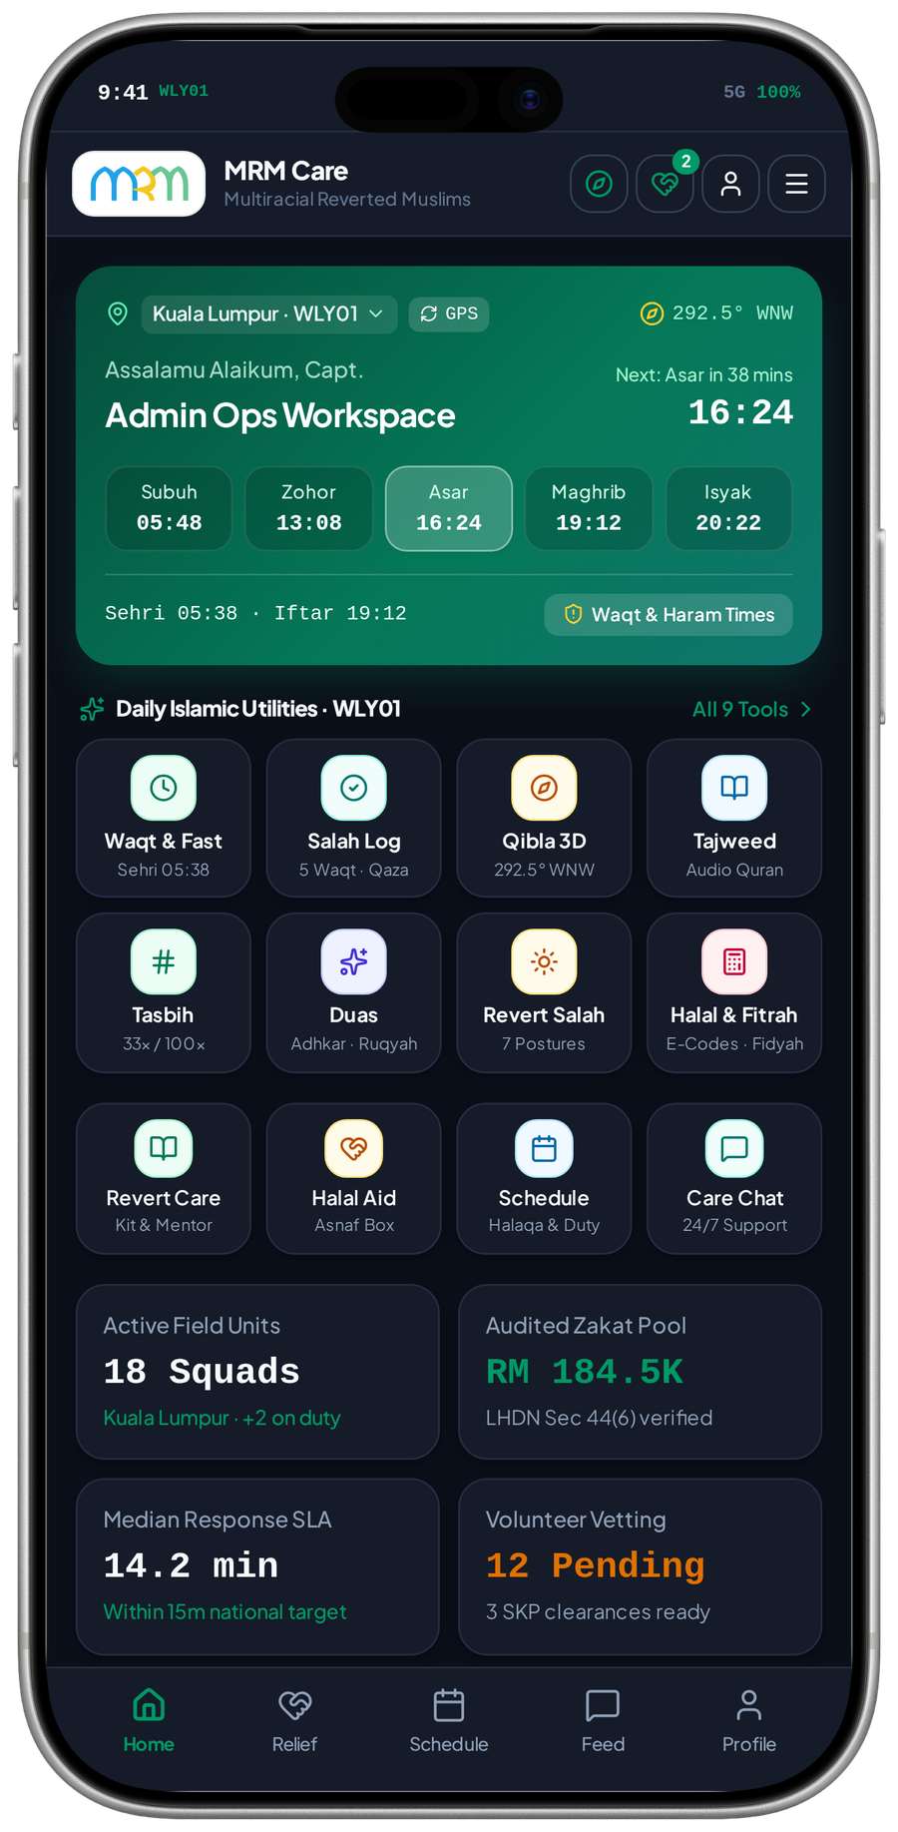
PLATFORM VISION / MRM DIGITAL COMMUNITY PLATFORM
MRM: faith, learning and care, connected
A digital platform for all Muslims, with dedicated support for reverts and people who need assistance.
Bismillahirrahmanirrahim
Every feature should make
the next experience better.
Daily practice opens the door. Trusted learning builds participation.
Connected service turns a need into accountable care.
FAITH / Useful every day
LEARNING / Approved knowledge
CARE / Responsible follow-up
OPERATIONS / A service MRM can run
MVP 48 · Admin Home · dark-theme state
A connected specification, supported by audited MVP visuals and explicit feature relationships.
MRM / ZYLAX TECHNOLOGIES
PROPOSED CONNECTIONS / MVP UI DOES NOT VERIFY BACKEND BEHAVIOUR
01 / 72

Slide 26
WHY THIS PLATFORM / MRM DIGITAL COMMUNITY PLATFORM
The value comes from the connections
The proposal creates an operating service across mobile apps, a public website, administration and shared backend.
Useful every day
Trusted participation
Prayer, Quran and daily guidance give Muslims reasons to return beyond a one-off request.
Reviewed teachers, verified volunteers and controlled publication make the next action clearer.
Accountable care
Sustainable operations
A request leads to triage, a confirmed assignment, follow-up and an auditable outcome.
Teacher entitlements and sponsor placements support revenue without gating core assistance.
Success should be measured through real participation, reliable service completion and MRM’s operational capacity.
MRM / ZYLAX TECHNOLOGIES
PROPOSED CONNECTIONS / MVP UI DOES NOT VERIFY BACKEND BEHAVIOUR
02 / 72

Slide 27
NAVIGATION / MRM DIGITAL COMMUNITY PLATFORM
A presentation you can explore by outcome
Start with the overall network, then follow a feature into its detailed dependencies, users and value.
01 Overall platform
02 Individual feature maps
03 End-to-end journeys
Page 05
The principal cross-feature paths.
Pages 06–52
47 primary capability networks and their importance.
Pages 53–56
Care, learning, daily use and event delivery.
04 Extended concepts
05 Delivery & acceptance
06 Evidence & connection index
Pages 57–61
Five financial / impact concepts, clearly qualified.
Pages 62–65
Sequencing, ownership, checks and decisions.
Pages 66–72
Source review, traceability and next steps.
Feature nodes and index entries are clickable in PowerPoint and PDF. Every footer returns here.
MRM / ZYLAX TECHNOLOGIES
PROPOSED CONNECTIONS / MVP UI DOES NOT VERIFY BACKEND BEHAVIOUR
03 / 72

Slide 28
AUDIENCE & VALUE / MRM DIGITAL COMMUNITY PLATFORM
All Muslims can benefit; specialised support stays focused
Different journeys share an identity foundation while keeping permissions and personal information separate.
Everyday Muslim users
Members / support seekers
Volunteers / applicants
Daily tools, approved resources and programme discovery.
Safe requests, personal updates and relevant guidance.
A defined approval route and suitable service opportunities.
Teachers / mentors
MRM staff
Partners / sponsors
Approved teaching and explicit publishing entitlements.
Duty-based queues, decisions, oversight and controlled reports.
Approved referral coordination and accountable recognition.
A role is not a paywall. Paying, earning rank or choosing a demo persona does not create staff privileges.
MRM / ZYLAX TECHNOLOGIES
PROPOSED CONNECTIONS / MVP UI DOES NOT VERIFY BACKEND BEHAVIOUR
04 / 72

Slide 29
OVERALL FEATURE NETWORK / MRM DIGITAL COMMUNITY PLATFORM
The overall network: features hand off real work
Identity, publishing and participation converge through permission checks, accountable records and relevant updates.
Identity & verified roles
gates
Request & matching
confirms
Confirmed assignment
records
Case / service history
Account, approval and visibility
Triage and eligible volunteer offer
Permitted contact and progress
Outcome, closure and follow-up
binds
Approved teacher
qualifies
Verified plan rights
permits
Moderated publishing
publishes
Classes & calendar
Credentials and professional role
Teacher-only publishing privileges
Approved posts and programmes
Registration, sessions and updates
updates
reminds
Daily tools / website
opens
Search & discovery
finds
Join, apply or request
triggers
Safe alerts & activity
Relevant public entry points
Find approved content / services
Take the relevant permitted action
Open the authorised next step
Cross-cutting checks: consent • role / record permissions • content approval • audit • recoverable state
MRM / ZYLAX TECHNOLOGIES
PROPOSED CONNECTIONS / MVP UI DOES NOT VERIFY BACKEND BEHAVIOUR
05 / 72

Slide 30
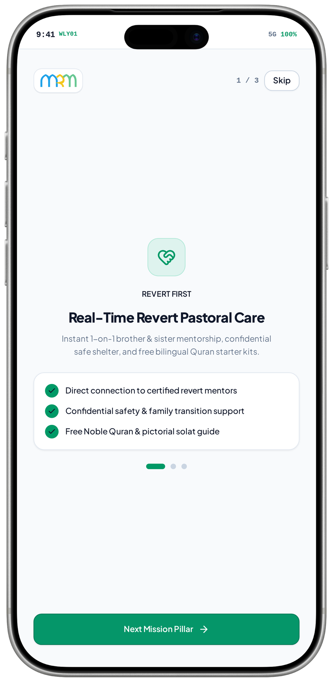
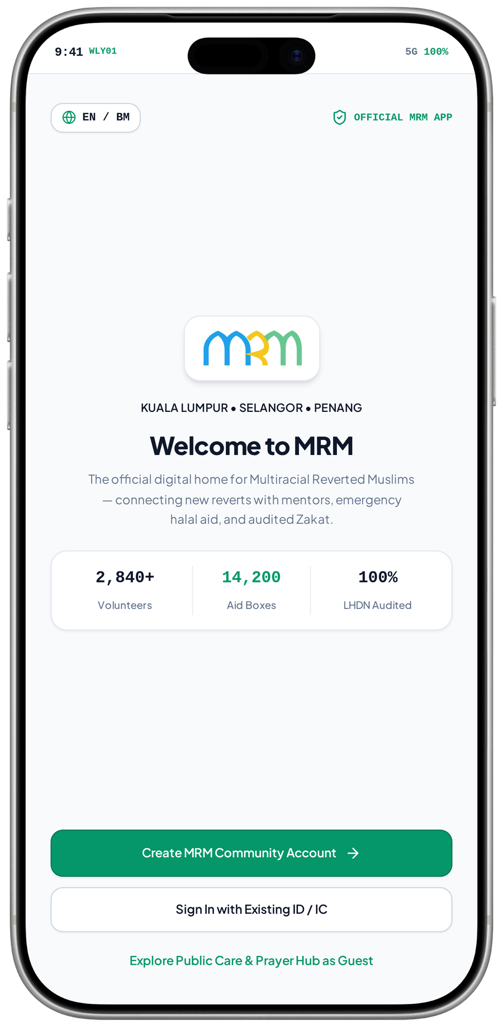
FEATURE NETWORK / MRM DIGITAL COMMUNITY PLATFORM
Welcome people into the right journey
Clear entry paths turn public interest into learning, participation or a safe request for help.
Observed entry screens · proposed routing
Public website
Welcome & onboarding
Guest discovery
introduces
opens
Mission, programmes and participation routes
Explain benefits and entry choices
Approved public tools and resources
localises
invites
Language preference
Account registration
Role application
routes
Use approved EN / BM content
Create identity for personal services
Choose seeker, volunteer or teacher route
CRITICAL CONNECTION TO GET RIGHT
MVP 02 · Onboarding · care pillar
MVP 03 · Welcome and guest entry
Language preference → Welcome & onboarding → Guest discovery
Measure after implementation: Guest-to-service progression; onboarding completion
MRM / ZYLAX TECHNOLOGIES
PROPOSED CONNECTIONS / MVP UI DOES NOT VERIFY BACKEND BEHAVIOUR
06 / 72
Notes:
{
"feature": "entry",
"owner": "MRM + Zylax",
"scope": "Observed entry screens \u00b7 proposed routing",
"why": "Clear entry paths turn public interest into learning, participation or a safe request for help.",
"measure": "Guest-to-service progression; onboarding completion",
"decision": "Screens retain revert-focused wording; platform positioning remains for all Muslims.",
"screen_evidence": [
"Onboarding \u00b7 care pillar",
"Welcome and guest entry"
],
"connections": [
[
"Public website",
"introduces",
"Welcome & onboarding"
],
[
"Welcome & onboarding",
"opens",
"Guest discovery"
],
[
"Language preference",
"localises",
"Welcome & onboarding"
],
[
"Welcome & onboarding",
"invites",
"Account registration"
],
[
"Account registration",
"routes",
"Role application"
]
]
}
Screen UI is evidence of a visual state, not tested persistence, permissions, live APIs, religious approval, tax certification, payment or production impact. Only corrected Drive images are used.

Slide 31
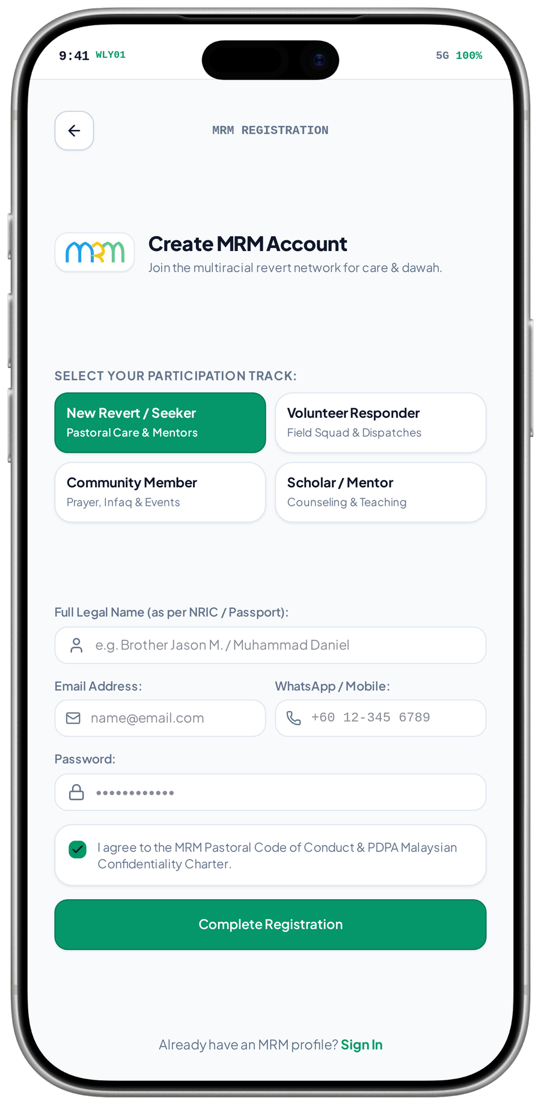
FEATURE NETWORK / MRM DIGITAL COMMUNITY PLATFORM
Registration connects identity, consent and participation
A single identity supports several authorised roles without duplicating accounts or exposing private records.
Observed participation-track form · approval flow proposed
Welcome / guest route
Account registration
Account & profile
starts
creates
Personal service needs a registered identity
Contact details and required verification
Maintain the person’s ordinary details
requires
enables
updates
Terms & privacy consent
Role application
MRM verification
reviews
Approved notice and participation conditions
Apply for volunteer or teacher privileges
Approve privileged roles independently
CRITICAL CONNECTION TO GET RIGHT
Terms & privacy consent → Account registration → Account & profile
MVP 04 · Registration · participation tracks
Measure after implementation: Registration completion; consent capture; duplicate-account handling
MRM / ZYLAX TECHNOLOGIES
PROPOSED CONNECTIONS / MVP UI DOES NOT VERIFY BACKEND BEHAVIOUR
07 / 72
Notes:
{
"feature": "registration",
"owner": "MRM + Zylax",
"scope": "Observed participation-track form \u00b7 approval flow proposed",
"why": "A single identity supports several authorised roles without duplicating accounts or exposing private records.",
"measure": "Registration completion; consent capture; duplicate-account handling",
"decision": "Selecting a track is an application, not instant verified access.",
"screen_evidence": [
"Registration \u00b7 participation tracks"
],
"connections": [
[
"Welcome / guest route",
"starts",
"Account registration"
],
[
"Terms & privacy consent",
"requires",
"Account registration"
],
[
"Account registration",
"creates",
"Account & profile"
],
[
"Account registration",
"enables",
"Role application"
],
[
"Role application",
"reviews",
"MRM verification"
],
[
"MRM verification",
"updates",
"Account & profile"
]
]
}
Screen UI is evidence of a visual state, not tested persistence, permissions, live APIs, religious approval, tax certification, payment or production impact. Only corrected Drive images are used.

Slide 32
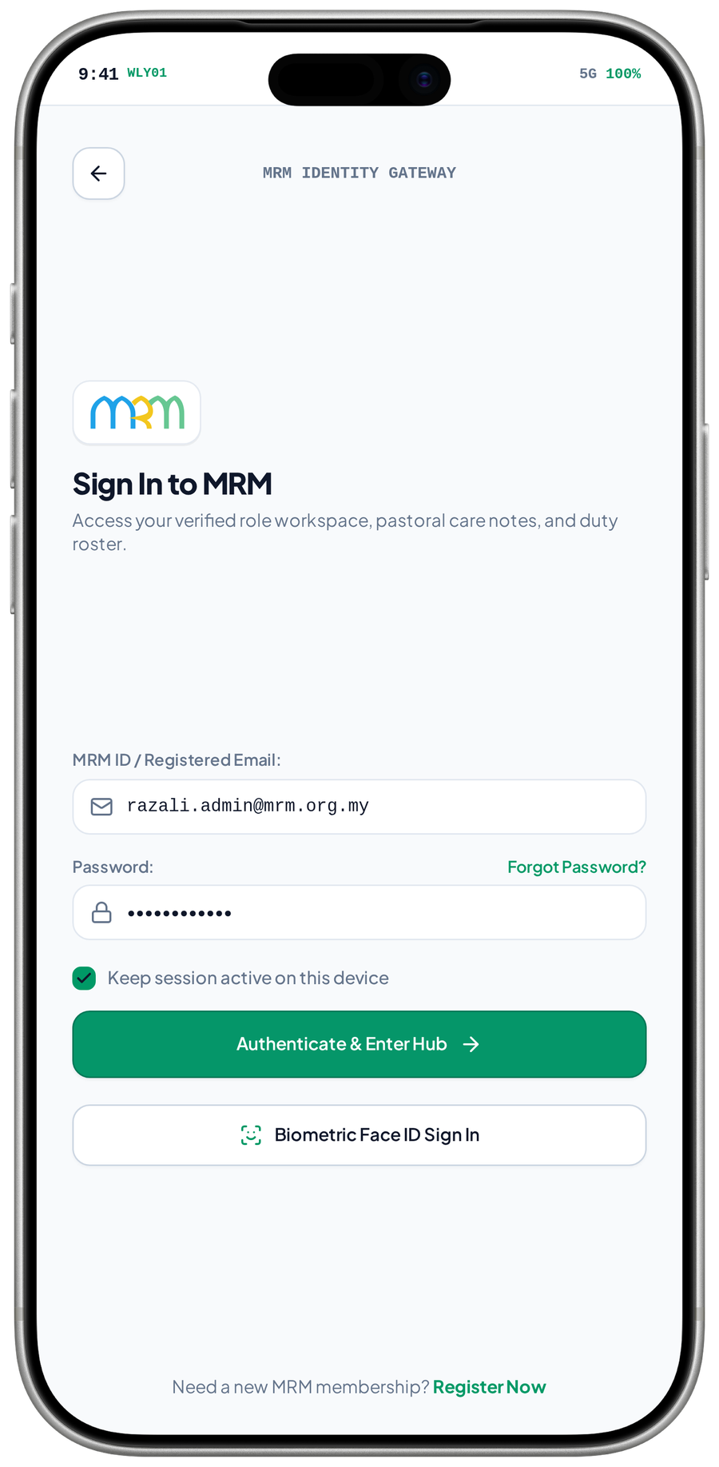
FEATURE NETWORK / MRM DIGITAL COMMUNITY PLATFORM
Sign-in connects the person to authorised records
Secure recovery and session checks preserve access to ongoing cases and learning without weakening permissions.
Observed sign-in UI · Face ID not independently verified
Registered identity
Sign-in & recovery
Role-aware workspace
identifies
opens
Existing account and recovery channel
Authenticate or recover the account
Show permitted services and actions
restores
creates
requests
Recovery / device checks
Authenticated session
Record authorisation
checks
Re-establish the legitimate user
Expiry, sign-out and supported device lock
Check each requested case or file
CRITICAL CONNECTION TO GET RIGHT
Recovery / device checks → Sign-in & recovery → Role-aware workspace
MVP 05 · Sign-in form
Measure after implementation: Successful recovery; session expiry; denied-access tests
MRM / ZYLAX TECHNOLOGIES
PROPOSED CONNECTIONS / MVP UI DOES NOT VERIFY BACKEND BEHAVIOUR
08 / 72
Notes:
{
"feature": "authentication",
"owner": "MRM + Zylax",
"scope": "Observed sign-in UI \u00b7 Face ID not independently verified",
"why": "Secure recovery and session checks preserve access to ongoing cases and learning without weakening permissions.",
"measure": "Successful recovery; session expiry; denied-access tests",
"decision": "",
"screen_evidence": [
"Sign-in form"
],
"connections": [
[
"Registered identity",
"identifies",
"Sign-in & recovery"
],
[
"Recovery / device checks",
"restores",
"Sign-in & recovery"
],
[
"Sign-in & recovery",
"opens",
"Role-aware workspace"
],
[
"Sign-in & recovery",
"creates",
"Authenticated session"
],
[
"Authenticated session",
"checks",
"Record authorisation"
],
[
"Role-aware workspace",
"requests",
"Record authorisation"
]
]
}
Screen UI is evidence of a visual state, not tested persistence, permissions, live APIs, religious approval, tax certification, payment or production impact. Only corrected Drive images are used.

Slide 33
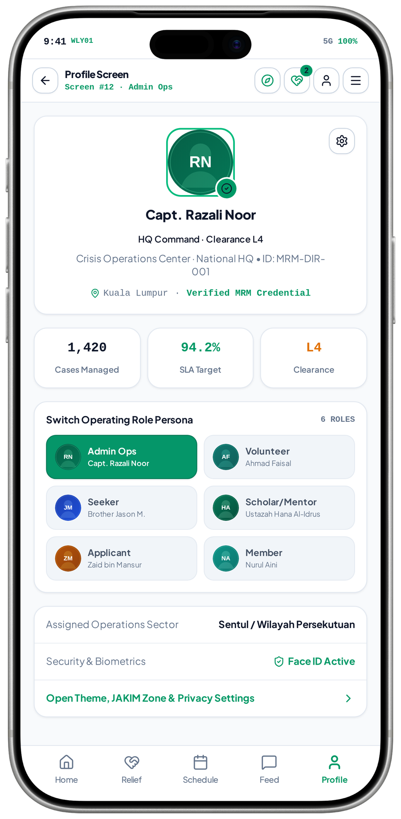
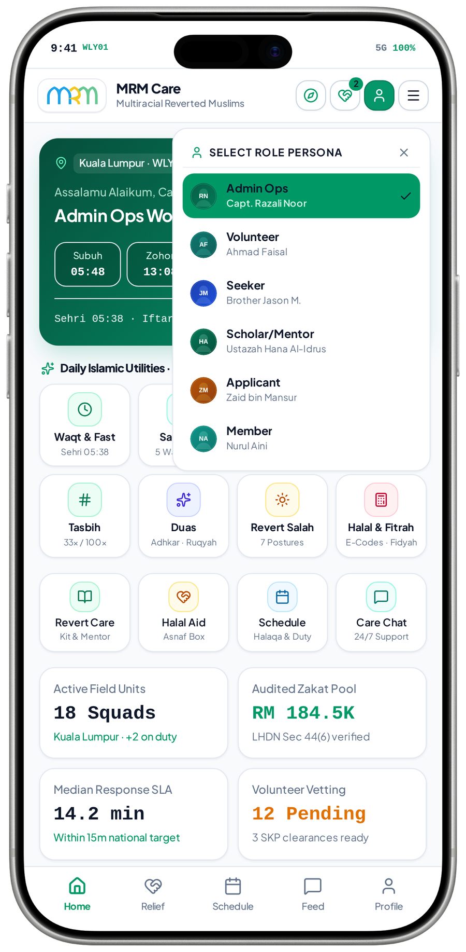
FEATURE NETWORK / MRM DIGITAL COMMUNITY PLATFORM
Profile and roles connect trust to the right workspace
Role approval controls service access; changing the visible persona must never grant new privileges.
Observed profile and role-picker modal · server permissions unverified
Account identity
Approved role record
Relevant workspace
binds
selects
One person may hold several roles
MRM decisions govern privileged access
Member, teacher, volunteer or staff view
approves
constrains
requests
Verification decisions
Visibility rules
Permitted case / content
filters
Volunteer / teacher / staff authority
Role, gender and record sensitivity
Return only authorised information
CRITICAL CONNECTION TO GET RIGHT
MVP 12 · Profile / role summary
MVP 45 · Role-picker modal
Verification decisions → Approved role record → Relevant workspace
Measure after implementation: Correct role activation; revoked-access and profile-change tests
MRM / ZYLAX TECHNOLOGIES
PROPOSED CONNECTIONS / MVP UI DOES NOT VERIFY BACKEND BEHAVIOUR
09 / 72
Notes:
{
"feature": "roles",
"owner": "MRM + Zylax",
"scope": "Observed profile and role-picker modal \u00b7 server permissions unverified",
"why": "Role approval controls service access; changing the visible persona must never grant new privileges.",
"measure": "Correct role activation; revoked-access and profile-change tests",
"decision": "The demo\u2019s clearance labels and profile statistics are illustrative, not verified credentials.",
"screen_evidence": [
"Profile / role summary",
"Role-picker modal"
],
"connections": [
[
"Account identity",
"binds",
"Approved role record"
],
[
"Verification decisions",
"approves",
"Approved role record"
],
[
"Approved role record",
"selects",
"Relevant workspace"
],
[
"Approved role record",
"constrains",
"Visibility rules"
],
[
"Visibility rules",
"filters",
"Permitted case / content"
],
[
"Relevant workspace",
"requests",
"Permitted case / content"
]
]
}
Screen UI is evidence of a visual state, not tested persistence, permissions, live APIs, religious approval, tax certification, payment or production impact. Only corrected Drive images are used.

Slide 34
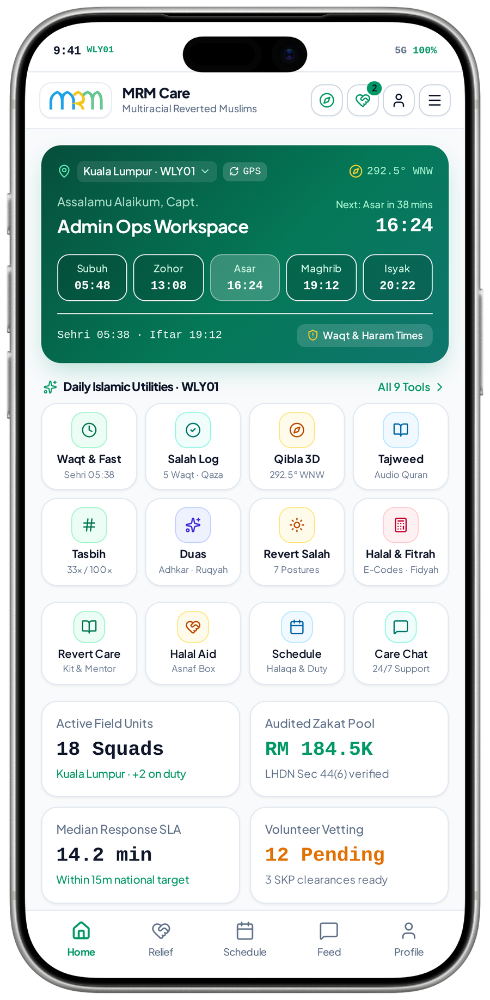
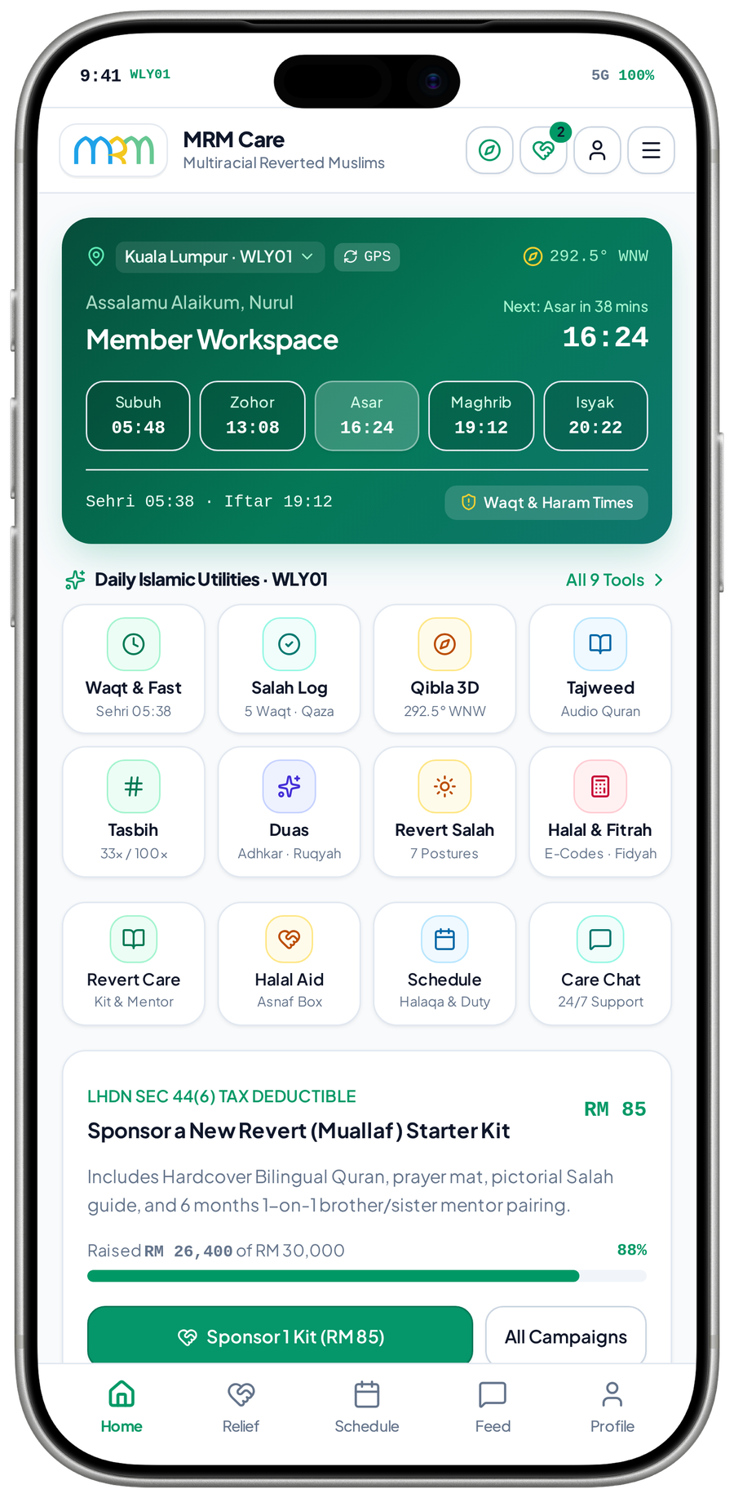
FEATURE NETWORK / MRM DIGITAL COMMUNITY PLATFORM
Home connects daily value to meaningful action
A relevant home screen helps people move from routine practice into learning or contribution without navigating separate systems.
Observed Admin Ops and Member home states · role differences shown
Location & preferences
Role-aware home
Daily Islamic tools
configures
opens
Approved area and display choices
Present appropriate daily and service entries
Prayer, Quran and approved guidance
controls
routes
Approved role / access
Service entry points
Assigned work / programme
limits
continues
Limit operational actions to eligible accounts
Request help, learn or contribute
Open the authorised next task
CRITICAL CONNECTION TO GET RIGHT
MVP 06 · Admin Ops Home
MVP 34 · Member workspace
Approved role / access → Role-aware home → Daily Islamic tools
Measure after implementation: Entry-point use; task completion by authorised role
MRM / ZYLAX TECHNOLOGIES
PROPOSED CONNECTIONS / MVP UI DOES NOT VERIFY BACKEND BEHAVIOUR
10 / 72
Notes:
{
"feature": "home",
"owner": "MRM + Zylax",
"scope": "Observed Admin Ops and Member home states \u00b7 role differences shown",
"why": "A relevant home screen helps people move from routine practice into learning or contribution without navigating separate systems.",
"measure": "Entry-point use; task completion by authorised role",
"decision": "Shown figures, response targets and audit claims are demo content.",
"screen_evidence": [
"Admin Ops Home",
"Member workspace"
],
"connections": [
[
"Location & preferences",
"configures",
"Role-aware home"
],
[
"Approved role / access",
"controls",
"Role-aware home"
],
[
"Role-aware home",
"opens",
"Daily Islamic tools"
],
[
"Role-aware home",
"routes",
"Service entry points"
],
[
"Approved role / access",
"limits",
"Service entry points"
],
[
"Service entry points",
"continues",
"Assigned work / programme"
]
]
}
Screen UI is evidence of a visual state, not tested persistence, permissions, live APIs, religious approval, tax certification, payment or production impact. Only corrected Drive images are used.

Slide 35
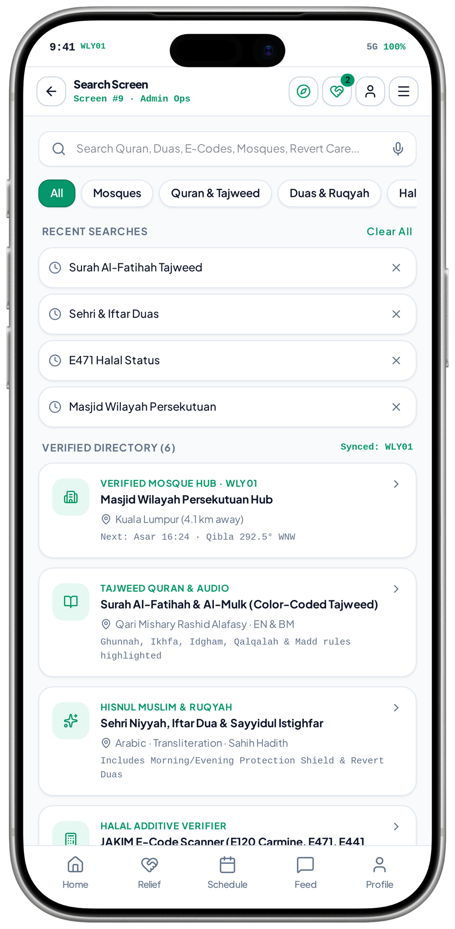
FEATURE NETWORK / MRM DIGITAL COMMUNITY PLATFORM
Discovery connects a need to an approved service
One search route can help a user find relevant learning, a mosque or support while respecting private-profile restrictions.
Observed utility / mosque search · programme links proposed
User need / query
Search & discovery
Approved public results
queries
returns
Topic, area or type of support
Apply relevant categories and filters
Mosques, programmes and resources
filters
selects
opens
Visibility / moderation
Programme / service detail
Registration / request
continues
Exclude private or unapproved records
Understand eligibility and next action
Join a class or enter the correct support route
CRITICAL CONNECTION TO GET RIGHT
Visibility / moderation → Search & discovery → Approved public results
MVP 09 · Search: utilities and local places
Measure after implementation: Relevant-result selection; zero-result recovery; visibility tests
MRM / ZYLAX TECHNOLOGIES
PROPOSED CONNECTIONS / MVP UI DOES NOT VERIFY BACKEND BEHAVIOUR
11 / 72
Notes:
{
"feature": "search",
"owner": "MRM + Zylax",
"scope": "Observed utility / mosque search \u00b7 programme links proposed",
"why": "One search route can help a user find relevant learning, a mosque or support while respecting private-profile restrictions.",
"measure": "Relevant-result selection; zero-result recovery; visibility tests",
"decision": "A public result is not evidence of approved volunteer-map access.",
"screen_evidence": [
"Search: utilities and local places"
],
"connections": [
[
"User need / query",
"queries",
"Search & discovery"
],
[
"Visibility / moderation",
"filters",
"Search & discovery"
],
[
"Search & discovery",
"returns",
"Approved public results"
],
[
"Approved public results",
"opens",
"Registration / request"
],
[
"Search & discovery",
"selects",
"Programme / service detail"
],
[
"Programme / service detail",
"continues",
"Registration / request"
]
]
}
Screen UI is evidence of a visual state, not tested persistence, permissions, live APIs, religious approval, tax certification, payment or production impact. Only corrected Drive images are used.

Slide 36
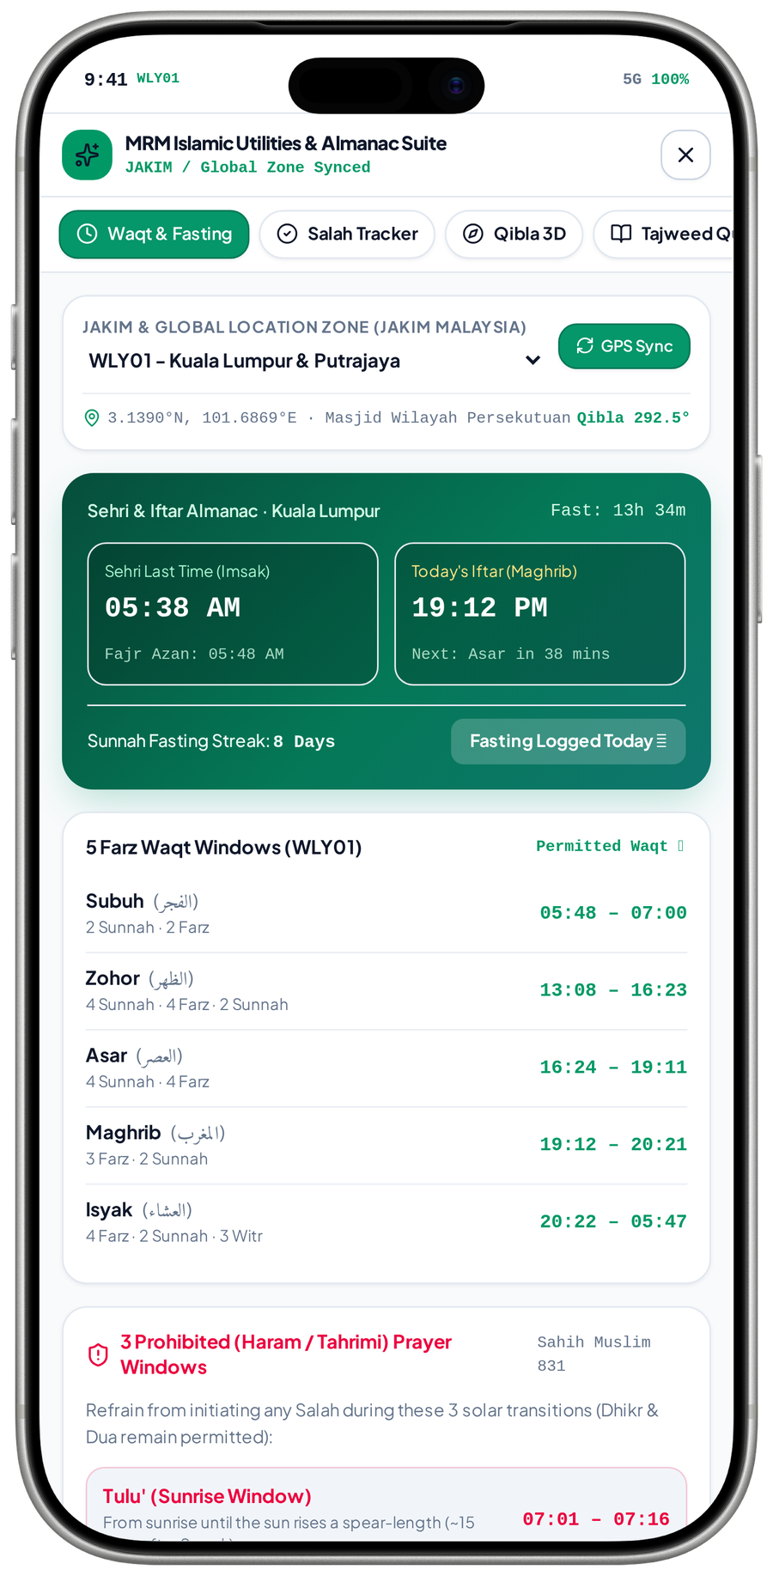
FEATURE NETWORK / MRM DIGITAL COMMUNITY PLATFORM
Prayer times connect location, calendar and reminders
Consistent local settings make daily practice useful and prevent conflicting times across the app.
Observed Waqt, fasting and prayer-window interface
Location preference
Approved prayer schedule
Daily prayer display
selects
feeds
Permission or supported manual area
MRM-approved local source / method
Relevant local times and guidance
aligns
validates
schedules
Calculation / local policy
Prayer reminder scheduling
Ramadan timetable
Approved adjustments and conventions
User preference and approved local schedule
Use consistent approved local times
CRITICAL CONNECTION TO GET RIGHT
Calculation / local policy → Approved prayer schedule → Daily prayer display
MVP 21 · Waqt, fasting and prayer windows
Measure after implementation: Source accuracy; denied-location fallback; reminder accuracy
MRM / ZYLAX TECHNOLOGIES
PROPOSED CONNECTIONS / MVP UI DOES NOT VERIFY BACKEND BEHAVIOUR
12 / 72
Notes:
{
"feature": "prayer",
"owner": "MRM content lead + Zylax",
"scope": "Observed Waqt, fasting and prayer-window interface",
"why": "Consistent local settings make daily practice useful and prevent conflicting times across the app.",
"measure": "Source accuracy; denied-location fallback; reminder accuracy",
"decision": "Source and local conventions need approval. \u201cJAKIM / global synced\u201d labels do not establish verified API connectivity.",
"screen_evidence": [
"Waqt, fasting and prayer windows"
],
"connections": [
[
"Location preference",
"selects",
"Approved prayer schedule"
],
[
"Calculation / local policy",
"validates",
"Approved prayer schedule"
],
[
"Approved prayer schedule",
"feeds",
"Daily prayer display"
],
[
"Approved prayer schedule",
"schedules",
"Prayer reminder scheduling"
],
[
"Approved prayer schedule",
"aligns",
"Ramadan timetable"
]
]
}
Screen UI is evidence of a visual state, not tested persistence, permissions, live APIs, religious approval, tax certification, payment or production impact. Only corrected Drive images are used.

Slide 37
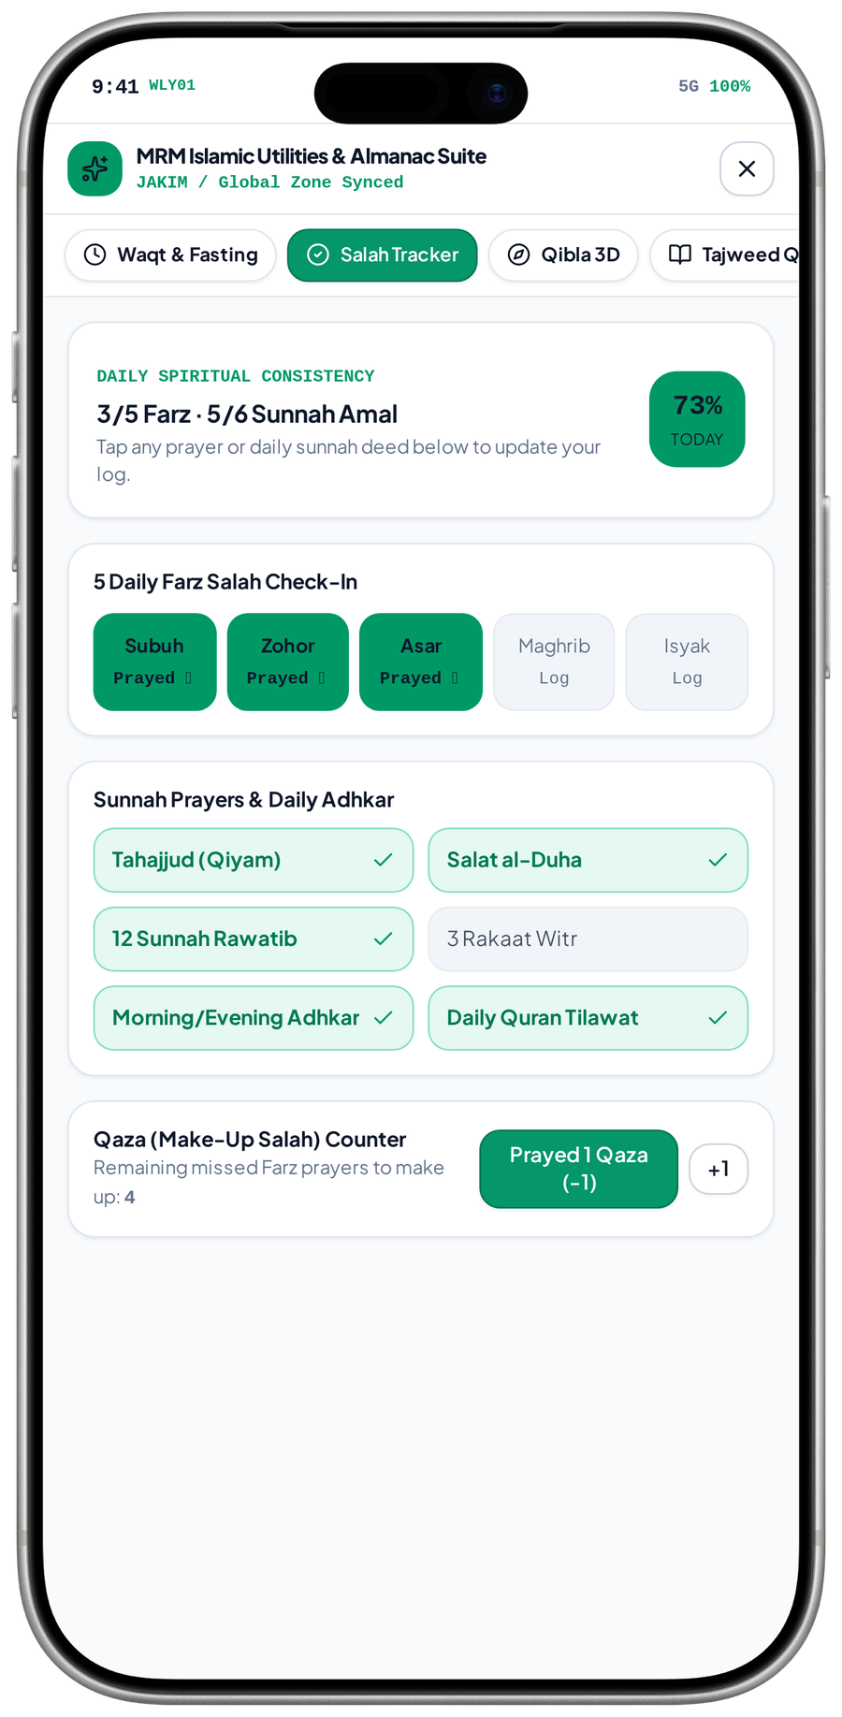
FEATURE NETWORK / MRM DIGITAL COMMUNITY PLATFORM
Prayer tracking connects practice to a private personal record
A private log supports consistency without exposing personal worship or turning it into a public ranking.
Observed private check-in, sunnah and Qaza-counter UI
Daily prayer schedule
Private Salah tracker
Personal practice history
context
records
Use the same local prayer context
User-chosen Farz, Sunnah and Qaza check-ins
Private, correctable progress
protects
links
Privacy & user control
Salah / dua guidance
Continued daily practice
supports
No public worship score or role privilege
Relevant approved learning support
Return to tools at the person’s choice
CRITICAL CONNECTION TO GET RIGHT
Privacy & user control → Private Salah tracker → Personal practice history
MVP 22 · Private Salah / Qaza tracker
Measure after implementation: Log persistence; private visibility; daily reset and correction
MRM / ZYLAX TECHNOLOGIES
PROPOSED CONNECTIONS / MVP UI DOES NOT VERIFY BACKEND BEHAVIOUR
13 / 72
Notes:
{
"feature": "tracker",
"owner": "MRM + Zylax",
"scope": "Observed private check-in, sunnah and Qaza-counter UI",
"why": "A private log supports consistency without exposing personal worship or turning it into a public ranking.",
"measure": "Log persistence; private visibility; daily reset and correction",
"decision": "Prototype percentages and counts are sample state; persistence and religious rules need verification.",
"screen_evidence": [
"Private Salah / Qaza tracker"
],
"connections": [
[
"Daily prayer schedule",
"context",
"Private Salah tracker"
],
[
"Privacy & user control",
"protects",
"Private Salah tracker"
],
[
"Private Salah tracker",
"records",
"Personal practice history"
],
[
"Private Salah tracker",
"links",
"Salah / dua guidance"
],
[
"Salah / dua guidance",
"supports",
"Continued daily practice"
]
]
}
Screen UI is evidence of a visual state, not tested persistence, permissions, live APIs, religious approval, tax certification, payment or production impact. Only corrected Drive images are used.

Slide 38
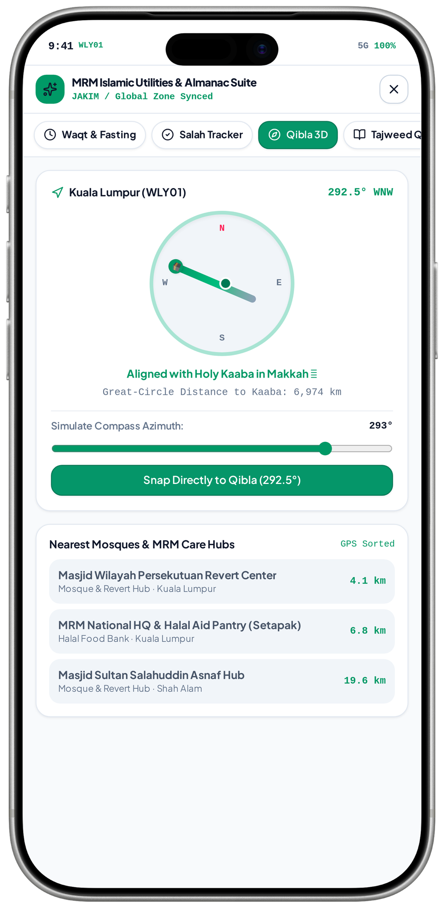
FEATURE NETWORK / MRM DIGITAL COMMUNITY PLATFORM
Qibla and mosque discovery connect practice to place
Useful local guidance makes the app relevant beyond assistance, while keeping volunteer-location data separately protected.
Observed compass simulation and nearby-place list
Location / manual area
Qibla & mosque tools
Nearby mosque details
locates
shows
User-authorised geographic context
Device capability and approved place data
General place information, not private profiles
validates
supports
discovers
Approved data / calibration
Prayer guidance
Programme discovery
connects
Source and sensor limitations are explicit
Link to appropriate daily practice
Find relevant approved learning or events
CRITICAL CONNECTION TO GET RIGHT
Approved data / calibration → Qibla & mosque tools → Nearby mosque details
MVP 23 · Compass simulation + place list
Measure after implementation: Direction guidance; permission fallback; place-data accuracy
MRM / ZYLAX TECHNOLOGIES
PROPOSED CONNECTIONS / MVP UI DOES NOT VERIFY BACKEND BEHAVIOUR
14 / 72
Notes:
{
"feature": "mosques",
"owner": "MRM + Zylax",
"scope": "Observed compass simulation and nearby-place list",
"why": "Useful local guidance makes the app relevant beyond assistance, while keeping volunteer-location data separately protected.",
"measure": "Direction guidance; permission fallback; place-data accuracy",
"decision": "The screenshot includes Simulate Compass Azimuth. It is not proof of live sensor accuracy, 3D navigation or real-time user tracking.",
"screen_evidence": [
"Compass simulation + place list"
],
"connections": [
[
"Location / manual area",
"locates",
"Qibla & mosque tools"
],
[
"Approved data / calibration",
"validates",
"Qibla & mosque tools"
],
[
"Qibla & mosque tools",
"shows",
"Nearby mosque details"
],
[
"Qibla & mosque tools",
"supports",
"Prayer guidance"
],
[
"Nearby mosque details",
"discovers",
"Programme discovery"
],
[
"Prayer guidance",
"connects",
"Programme discovery"
]
]
}
Screen UI is evidence of a visual state, not tested persistence, permissions, live APIs, religious approval, tax certification, payment or production impact. Only corrected Drive images are used.

Slide 39
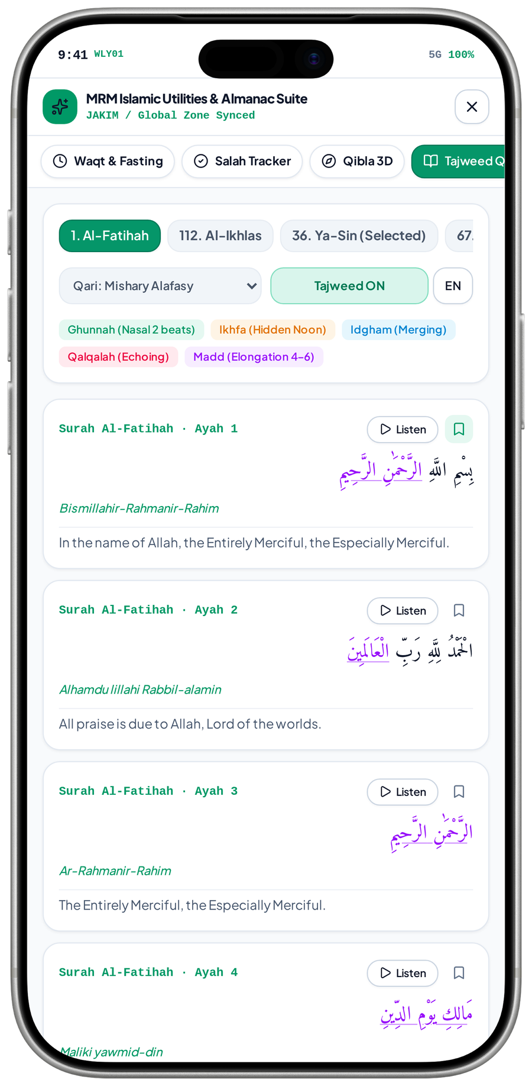
FEATURE NETWORK / MRM DIGITAL COMMUNITY PLATFORM
Quran connects trusted content to continued learning
Reading and recitation become more valuable when users can continue into approved explanations and classes.
Observed Al-Fatihah text, reciter and tajweed controls
Religious sources & rights
Quran & recitation
Approved learning resources
authorises
links
Approved text, translation and audio
Reading, approved tajweed, translation and recitation
Related lessons and programme details
publishes
supports
encourages
Content administration
Offline / cache settings
Repeat daily use
enables
Review references, edits and availability
Only supported content and rights
Reliable access to approved material
CRITICAL CONNECTION TO GET RIGHT
Content administration → Quran & recitation → Approved learning resources
MVP 24 · Al-Fatihah text / reciter controls
Measure after implementation: Content-source validation; recitation delivery; learning continuation
MRM / ZYLAX TECHNOLOGIES
PROPOSED CONNECTIONS / MVP UI DOES NOT VERIFY BACKEND BEHAVIOUR
15 / 72
Notes:
{
"feature": "quran",
"owner": "MRM content approver + Zylax",
"scope": "Observed Al-Fatihah text, reciter and tajweed controls",
"why": "Reading and recitation become more valuable when users can continue into approved explanations and classes.",
"measure": "Content-source validation; recitation delivery; learning continuation",
"decision": "The content shown is Al-Fatihah; a Ya-Sin selected-tab label conflicts with the verses. Confirm tab behaviour, content and rights.",
"screen_evidence": [
"Al-Fatihah text / reciter controls"
],
"connections": [
[
"Religious sources & rights",
"authorises",
"Quran & recitation"
],
[
"Content administration",
"publishes",
"Quran & recitation"
],
[
"Quran & recitation",
"links",
"Approved learning resources"
],
[
"Quran & recitation",
"supports",
"Offline / cache settings"
],
[
"Offline / cache settings",
"enables",
"Repeat daily use"
],
[
"Approved learning resources",
"encourages",
"Repeat daily use"
]
]
}
Screen UI is evidence of a visual state, not tested persistence, permissions, live APIs, religious approval, tax certification, payment or production impact. Only corrected Drive images are used.

Slide 40
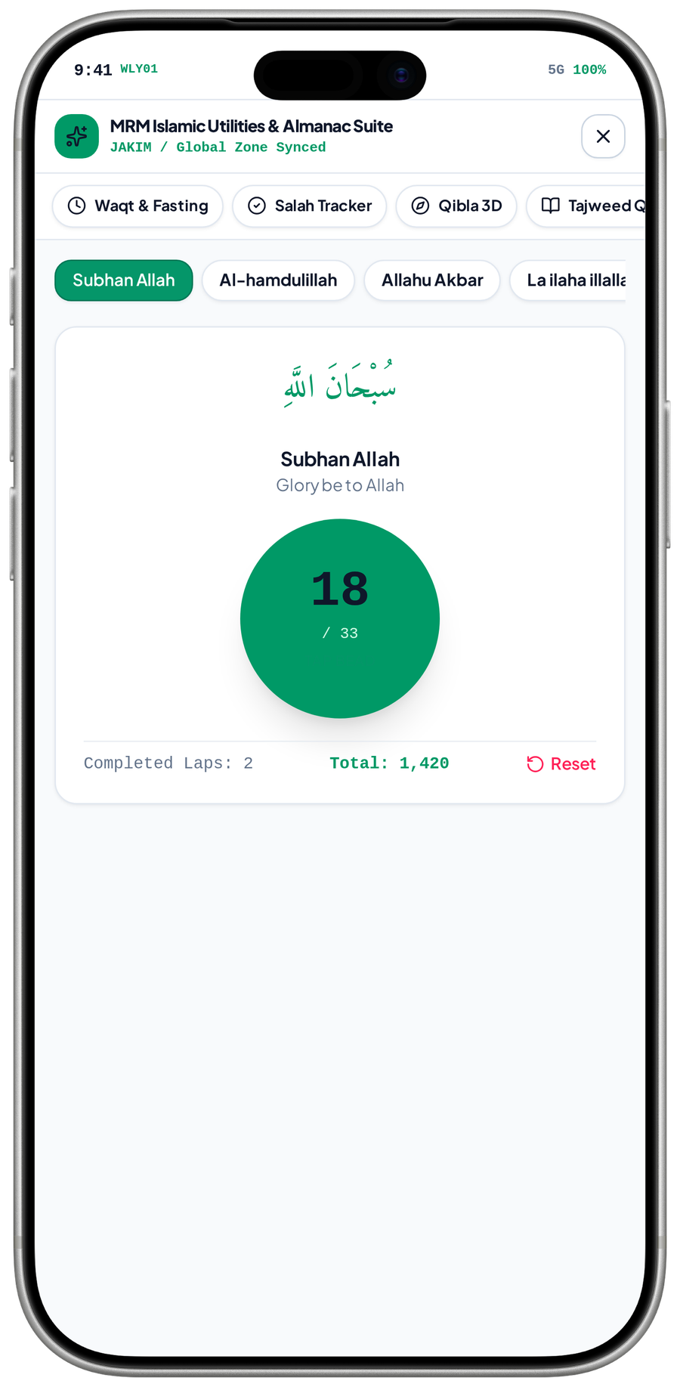
FEATURE NETWORK / MRM DIGITAL COMMUNITY PLATFORM
Digital tasbih connects remembrance to simple, private interaction
A focused counter supports repeated practice while relevant guidance remains grounded in approved content.
Observed tasbih phrase and counter view
Approved dhikr wording
Digital tasbih counter
Private local history
grounds
records
Religious references and translations
Selected phrase, target and reset
Only supported, user-controlled state
sets
opens
User target / preference
Dua / remembrance library
Daily utility return
supports
Choose supported repetition controls
Find related approved material
Resume personal practice
CRITICAL CONNECTION TO GET RIGHT
User target / preference → Digital tasbih counter → Private local history
MVP 25 · Digital tasbih counter
Measure after implementation: Counter increment / reset; selected phrase; private state persistence
MRM / ZYLAX TECHNOLOGIES
PROPOSED CONNECTIONS / MVP UI DOES NOT VERIFY BACKEND BEHAVIOUR
16 / 72
Notes:
{
"feature": "tasbih",
"owner": "MRM + Zylax",
"scope": "Observed tasbih phrase and counter view",
"why": "A focused counter supports repeated practice while relevant guidance remains grounded in approved content.",
"measure": "Counter increment / reset; selected phrase; private state persistence",
"decision": "Displayed laps / totals are sample state; no public faith scoring or guaranteed religious outcome.",
"screen_evidence": [
"Digital tasbih counter"
],
"connections": [
[
"Approved dhikr wording",
"grounds",
"Digital tasbih counter"
],
[
"User target / preference",
"sets",
"Digital tasbih counter"
],
[
"Digital tasbih counter",
"records",
"Private local history"
],
[
"Digital tasbih counter",
"opens",
"Dua / remembrance library"
],
[
"Dua / remembrance library",
"supports",
"Daily utility return"
]
]
}
Screen UI is evidence of a visual state, not tested persistence, permissions, live APIs, religious approval, tax certification, payment or production impact. Only corrected Drive images are used.

Slide 41
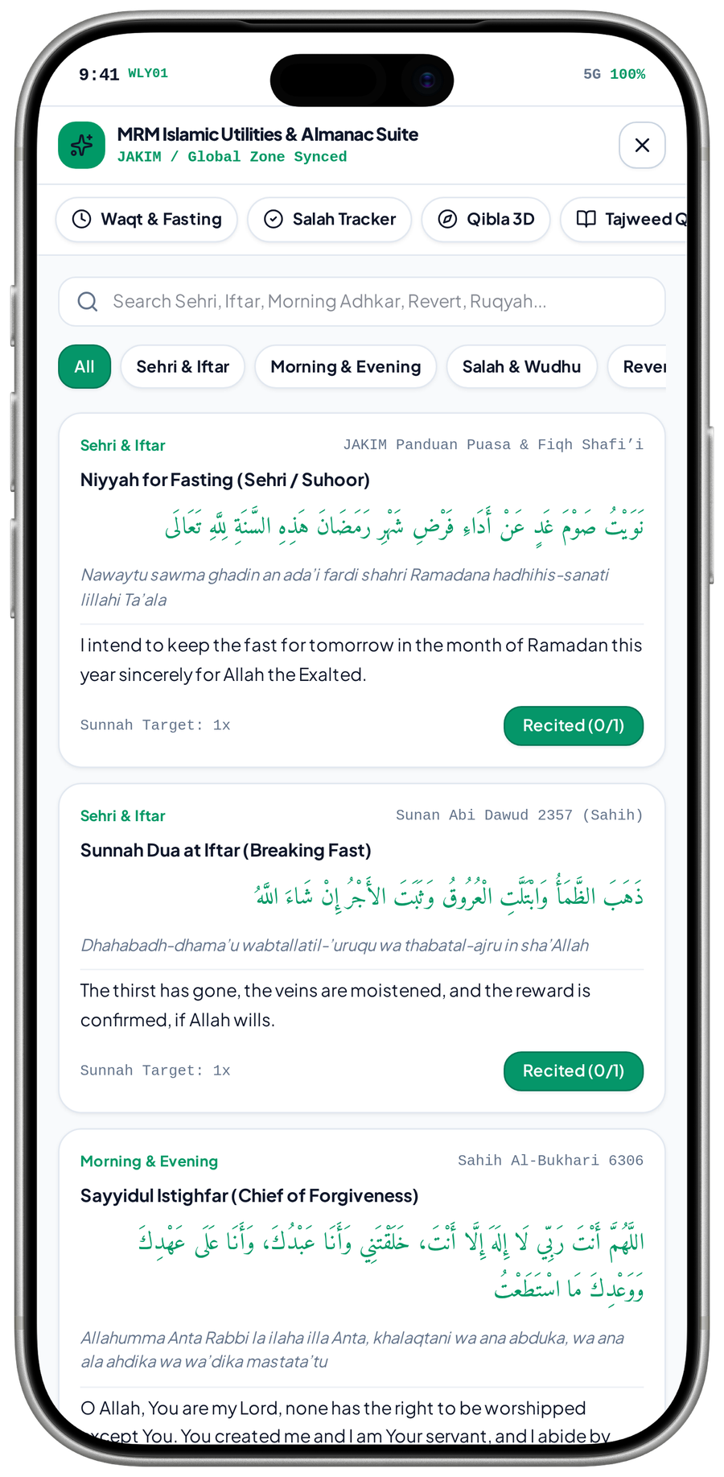
FEATURE NETWORK / MRM DIGITAL COMMUNITY PLATFORM
Dua discovery connects a situation to an approved reference
Searchable, categorised supplications make the daily library useful and keep correction and source review visible.
Observed dua categories, text and reference labels
Situation / search
Dua / adhkar library
Approved learning detail
finds
explains
Daily need, prayer or fasting context
Topic, wording, translation and reference
Understand the relevant guidance
approves
supports
Religious source review
Optional personal practice
Relevant daily tool
returns
References, translations and corrections
Supported counter or saved state
Return to prayer, fasting or remembrance
CRITICAL CONNECTION TO GET RIGHT
Religious source review → Dua / adhkar library → Approved learning detail
MVP 26 · Dua categories and references
Measure after implementation: Search relevance; source approval; recitation-state behaviour
MRM / ZYLAX TECHNOLOGIES
PROPOSED CONNECTIONS / MVP UI DOES NOT VERIFY BACKEND BEHAVIOUR
17 / 72
Notes:
{
"feature": "dua",
"owner": "MRM + Zylax",
"scope": "Observed dua categories, text and reference labels",
"why": "Searchable, categorised supplications make the daily library useful and keep correction and source review visible.",
"measure": "Search relevance; source approval; recitation-state behaviour",
"decision": "The presence of a hadith citation does not demonstrate a separate full Hadith-reader module.",
"screen_evidence": [
"Dua categories and references"
],
"connections": [
[
"Situation / search",
"finds",
"Dua / adhkar library"
],
[
"Religious source review",
"approves",
"Dua / adhkar library"
],
[
"Dua / adhkar library",
"explains",
"Approved learning detail"
],
[
"Dua / adhkar library",
"supports",
"Optional personal practice"
],
[
"Optional personal practice",
"returns",
"Relevant daily tool"
]
]
}
Screen UI is evidence of a visual state, not tested persistence, permissions, live APIs, religious approval, tax certification, payment or production impact. Only corrected Drive images are used.

Slide 42
FEATURE NETWORK / MRM DIGITAL COMMUNITY PLATFORM
Hadith and references connect content to accountable approval
A governed content library keeps daily tools consistent and gives learners a route to deeper understanding.
Approved scope · proposed connections
Approved references
Dua / dhikr / hadith
Relevant learning
grounds
deepens
Arabic, translations and source decisions
Organised daily guidance
Approved explanation or class
organises
reports
Content categories
Correction / withdrawal
Published utility library
updates
Find material by topic and purpose
MRM can remove inaccurate material
Visible content follows approval state
CRITICAL CONNECTION TO GET RIGHT
Content categories → Dua / dhikr / hadith → Relevant learning
Measure after implementation: Source review; content correction; relevant-resource access
MRM / ZYLAX TECHNOLOGIES
PROPOSED CONNECTIONS / MVP UI DOES NOT VERIFY BACKEND BEHAVIOUR
18 / 72
Notes:
{
"feature": "remembrance",
"owner": "MRM content approver",
"scope": "Approved scope \u00b7 proposed connections",
"why": "A governed content library keeps daily tools consistent and gives learners a route to deeper understanding.",
"measure": "Source review; content correction; relevant-resource access",
"decision": "Sifat Names and Haram Codes remain template-library items subject to separate source and use review.",
"screen_evidence": [],
"connections": [
[
"Approved references",
"grounds",
"Dua / dhikr / hadith"
],
[
"Content categories",
"organises",
"Dua / dhikr / hadith"
],
[
"Dua / dhikr / hadith",
"deepens",
"Relevant learning"
],
[
"Dua / dhikr / hadith",
"reports",
"Correction / withdrawal"
],
[
"Correction / withdrawal",
"updates",
"Published utility library"
]
]
}
Screen UI is evidence of a visual state, not tested persistence, permissions, live APIs, religious approval, tax certification, payment or production impact. Only corrected Drive images are used.

Slide 43
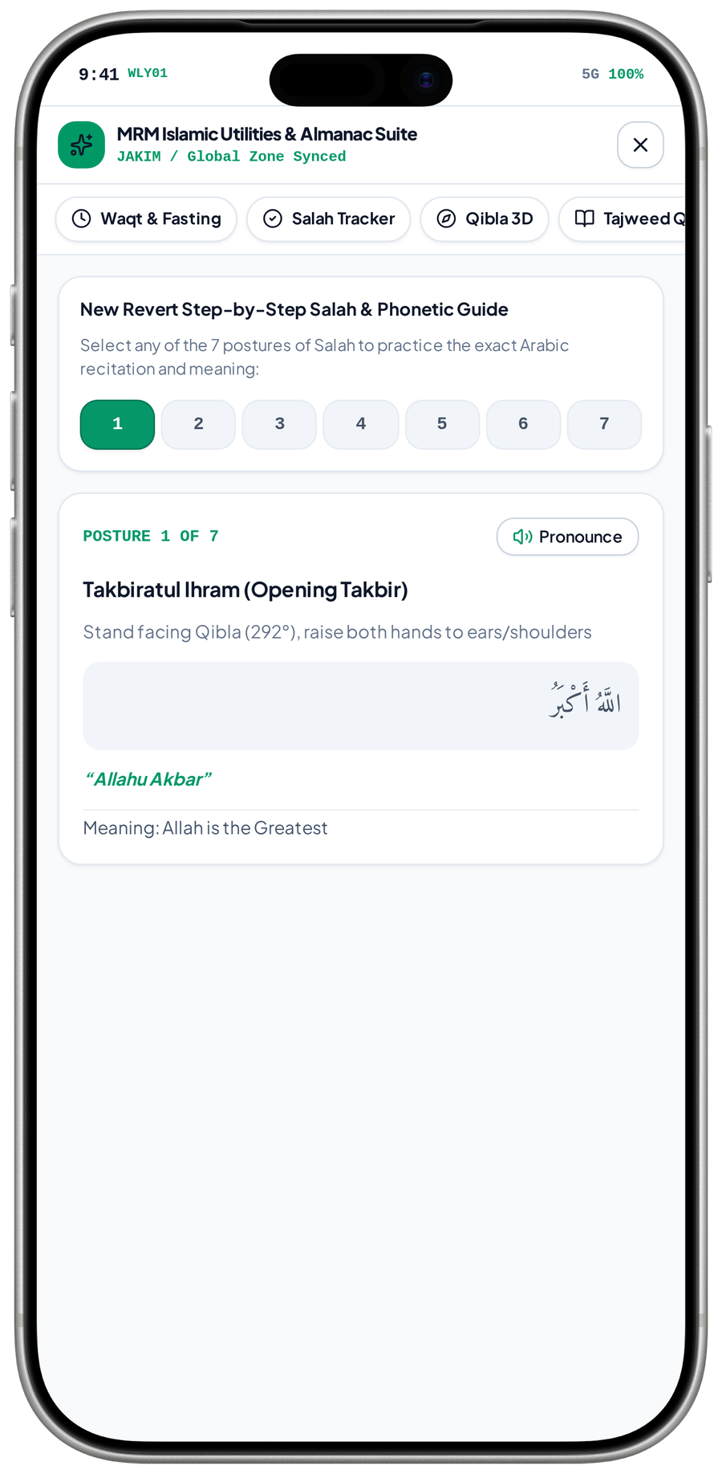
FEATURE NETWORK / MRM DIGITAL COMMUNITY PLATFORM
Salah guidance connects learning to daily practice
A step-by-step guide gives beginners a practical next step and links learning to the same prayer and direction context.
Observed posture 1 of 7 · pronounce control visible
Beginner / learning entry
Step-by-step Salah guide
Daily prayer practice
learns
practises
A person seeks practical prayer guidance
Approved postures, wording and meanings
Use the correct local time context
supports
asks
Qibla & content references
Mentor / class support
Private learning progress
supports
Direction guidance and approved material
An authorised teacher can explain further
Only agreed, consented progress visibility
CRITICAL CONNECTION TO GET RIGHT
Qibla & content references → Step-by-step Salah guide → Daily prayer practice
MVP 27 · Salah guide · posture 1 of 7
Measure after implementation: Posture navigation; approved text / audio; guidance-to-practice access
MRM / ZYLAX TECHNOLOGIES
PROPOSED CONNECTIONS / MVP UI DOES NOT VERIFY BACKEND BEHAVIOUR
19 / 72
Notes:
{
"feature": "salahguide",
"owner": "MRM + Zylax",
"scope": "Observed posture 1 of 7 \u00b7 pronounce control visible",
"why": "A step-by-step guide gives beginners a practical next step and links learning to the same prayer and direction context.",
"measure": "Posture navigation; approved text / audio; guidance-to-practice access",
"decision": "One captured posture is not proof that every posture, pronunciation or lesson works.",
"screen_evidence": [
"Salah guide \u00b7 posture 1 of 7"
],
"connections": [
[
"Beginner / learning entry",
"learns",
"Step-by-step Salah guide"
],
[
"Qibla & content references",
"supports",
"Step-by-step Salah guide"
],
[
"Step-by-step Salah guide",
"practises",
"Daily prayer practice"
],
[
"Step-by-step Salah guide",
"asks",
"Mentor / class support"
],
[
"Mentor / class support",
"supports",
"Private learning progress"
]
]
}
Screen UI is evidence of a visual state, not tested persistence, permissions, live APIs, religious approval, tax certification, payment or production impact. Only corrected Drive images are used.

Slide 44
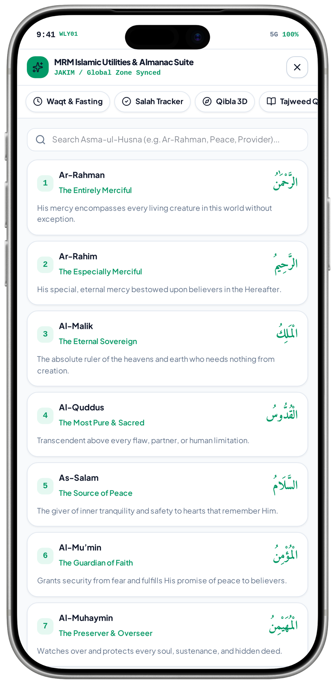
FEATURE NETWORK / MRM DIGITAL COMMUNITY PLATFORM
Asma-ul-Husna connects reference content to reflection and learning
A reviewed names library supports daily learning without inventing religious explanations or unsupported source claims.
Observed Asma-ul-Husna names and meanings
Approved references
Names & meanings library
Related approved learning
approves
deepens
MRM reviews names, Arabic and meanings
Readable, searchable reference content
Appropriate explanation or programme
finds
reports
Content categorisation
Correction / withdrawal
Published utility library
updates
Organise entries without altering meaning
Fix unapproved or inaccurate copy
Only reviewed content remains visible
CRITICAL CONNECTION TO GET RIGHT
Content categorisation → Names & meanings library → Related approved learning
MVP 28 · Asma-ul-Husna names / meanings
Measure after implementation: Approved names / meanings; search relevance; content correction
MRM / ZYLAX TECHNOLOGIES
PROPOSED CONNECTIONS / MVP UI DOES NOT VERIFY BACKEND BEHAVIOUR
20 / 72
Notes:
{
"feature": "asma",
"owner": "MRM + Zylax",
"scope": "Observed Asma-ul-Husna names and meanings",
"why": "A reviewed names library supports daily learning without inventing religious explanations or unsupported source claims.",
"measure": "Approved names / meanings; search relevance; content correction",
"decision": "Treat this as a distinct reference view, not a hadith reader or proof of religious approval.",
"screen_evidence": [
"Asma-ul-Husna names / meanings"
],
"connections": [
[
"Approved references",
"approves",
"Names & meanings library"
],
[
"Content categorisation",
"finds",
"Names & meanings library"
],
[
"Names & meanings library",
"deepens",
"Related approved learning"
],
[
"Names & meanings library",
"reports",
"Correction / withdrawal"
],
[
"Correction / withdrawal",
"updates",
"Published utility library"
]
]
}
Screen UI is evidence of a visual state, not tested persistence, permissions, live APIs, religious approval, tax certification, payment or production impact. Only corrected Drive images are used.

Slide 45
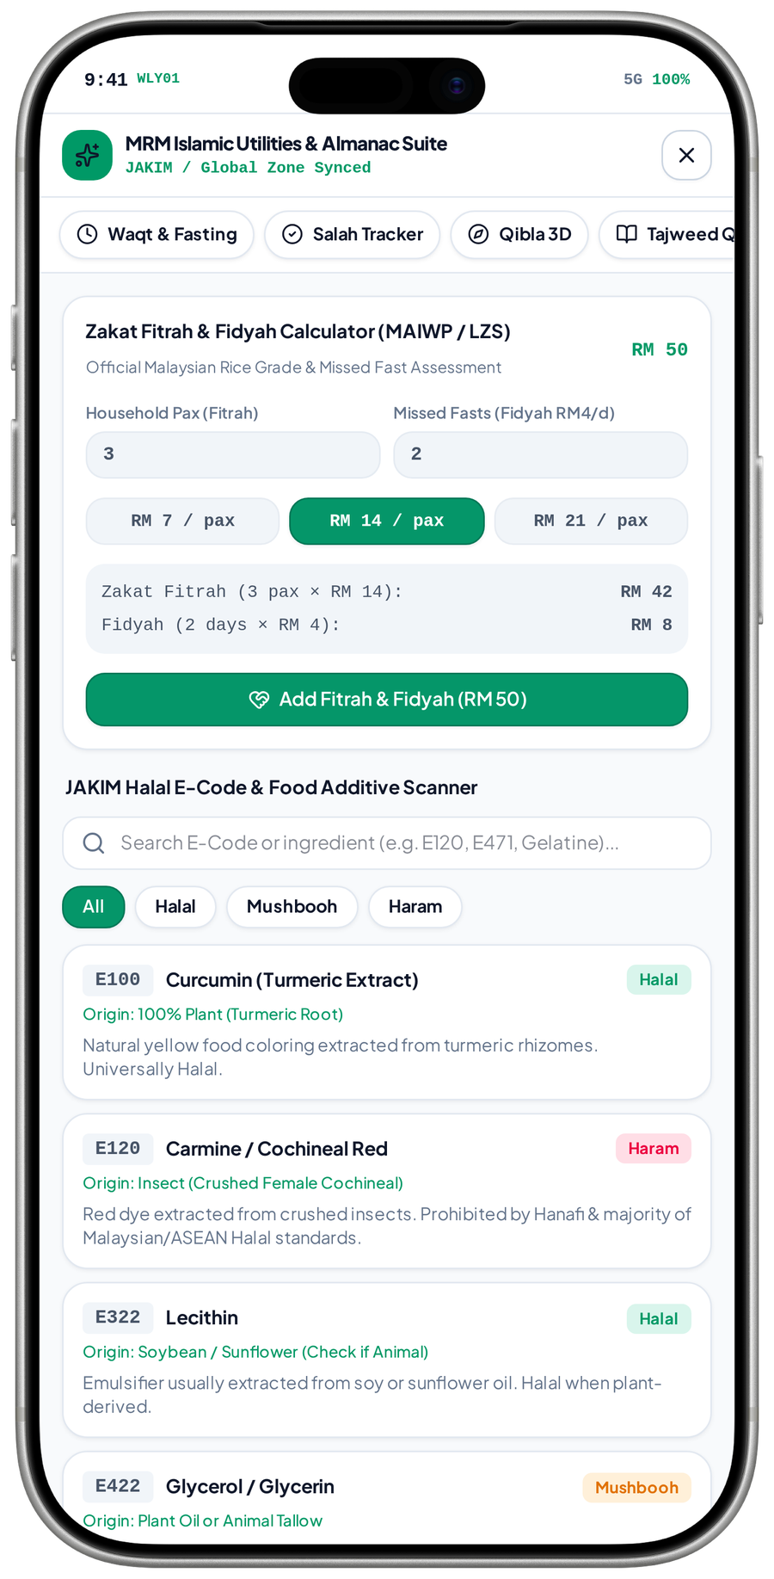
FEATURE NETWORK / MRM DIGITAL COMMUNITY PLATFORM
Ingredient guidance connects search to reviewed information
Useful ingredient information needs clear sourcing and limits; a prototype label cannot replace an authority’s certification.
Observed E-code list + Fitrah / Fidyah calculator concept
Ingredient / E-code query
Reviewed ingredient reference
Informational result
queries
returns
Search a named additive or ingredient
Approved source and contextual wording
Show source and applicable limitations
validates
explains
MRM content / source review
Religious learning / enquiry
Content correction
reports
Correct origin and context-dependent claims
Explain uncertainty and next steps
Update or withdraw inaccurate guidance
CRITICAL CONNECTION TO GET RIGHT
MRM content / source review → Reviewed ingredient reference → Informational result
MVP 29 · Ingredient reference + Fitrah concept
Measure after implementation: Source currency; query accuracy; visible qualification of results
MRM / ZYLAX TECHNOLOGIES
PROPOSED CONNECTIONS / MVP UI DOES NOT VERIFY BACKEND BEHAVIOUR
21 / 72
Notes:
{
"feature": "halal",
"owner": "MRM + Zylax",
"scope": "Observed E-code list + Fitrah / Fidyah calculator concept",
"why": "Useful ingredient information needs clear sourcing and limits; a prototype label cannot replace an authority\u2019s certification.",
"measure": "Source currency; query accuracy; visible qualification of results",
"decision": "Source 29 combines two utilities. Rates, classifications and \u201cJAKIM\u201d attribution require review; no authority API is established.",
"screen_evidence": [
"Ingredient reference + Fitrah concept"
],
"connections": [
[
"Ingredient / E-code query",
"queries",
"Reviewed ingredient reference"
],
[
"MRM content / source review",
"validates",
"Reviewed ingredient reference"
],
[
"Reviewed ingredient reference",
"returns",
"Informational result"
],
[
"Reviewed ingredient reference",
"explains",
"Religious learning / enquiry"
],
[
"Religious learning / enquiry",
"reports",
"Content correction"
]
]
}
Screen UI is evidence of a visual state, not tested persistence, permissions, live APIs, religious approval, tax certification, payment or production impact. Only corrected Drive images are used.

Slide 46
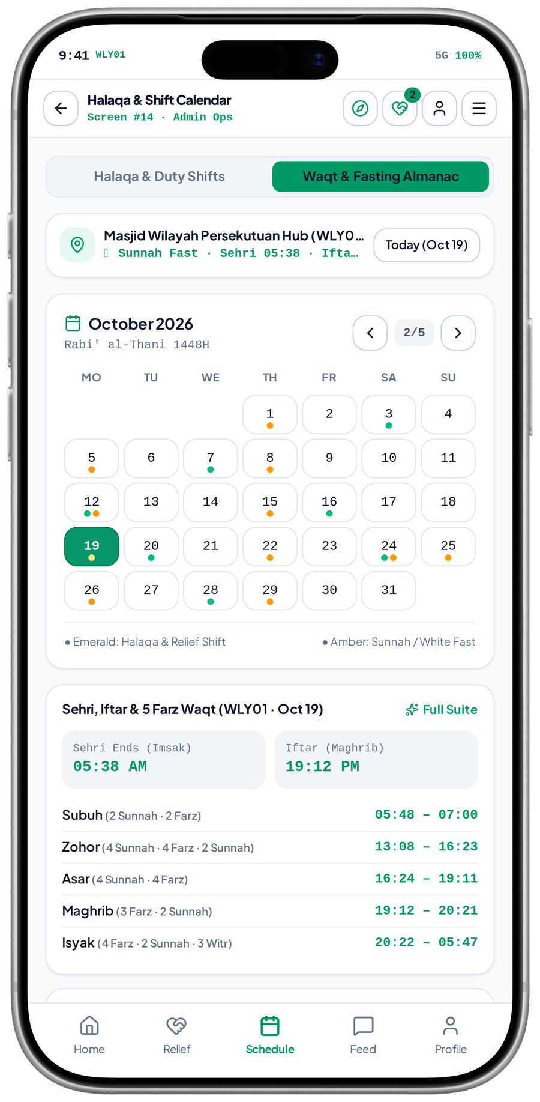
FEATURE NETWORK / MRM DIGITAL COMMUNITY PLATFORM
Hijri and Ramadan connect dates, prayer and programmes
Shared calendar conventions keep seasonal guidance and programme communication coherent.
Observed calendar almanac and local timetable
Local calendar convention
Hijri & Ramadan tools
Seasonal programme discovery
sets
highlights
Approved Hijri / local adjustments
Show the appropriate dates and schedule
Relevant classes and community events
aligns
informs
registers
Approved prayer times
Event / class calendar
Permitted reminders
schedules
Use the same local schedule
Programme dates and access details
Notify registered or eligible participants
CRITICAL CONNECTION TO GET RIGHT
Approved prayer times → Hijri & Ramadan tools → Seasonal programme discovery
MVP 39 · Calendar almanac / prayer schedule
Measure after implementation: Local-date review; timetable consistency; event reminder delivery
MRM / ZYLAX TECHNOLOGIES
PROPOSED CONNECTIONS / MVP UI DOES NOT VERIFY BACKEND BEHAVIOUR
22 / 72
Notes:
{
"feature": "islamic_calendar",
"owner": "MRM + Zylax",
"scope": "Observed calendar almanac and local timetable",
"why": "Shared calendar conventions keep seasonal guidance and programme communication coherent.",
"measure": "Local-date review; timetable consistency; event reminder delivery",
"decision": "This almanac includes religious dates and prayer times. Local date, calculation and highlighted-day conventions require review.",
"screen_evidence": [
"Calendar almanac / prayer schedule"
],
"connections": [
[
"Local calendar convention",
"sets",
"Hijri & Ramadan tools"
],
[
"Approved prayer times",
"aligns",
"Hijri & Ramadan tools"
],
[
"Hijri & Ramadan tools",
"highlights",
"Seasonal programme discovery"
],
[
"Hijri & Ramadan tools",
"informs",
"Event / class calendar"
],
[
"Seasonal programme discovery",
"registers",
"Permitted reminders"
],
[
"Event / class calendar",
"schedules",
"Permitted reminders"
]
]
}
Screen UI is evidence of a visual state, not tested persistence, permissions, live APIs, religious approval, tax certification, payment or production impact. Only corrected Drive images are used.

Slide 47
FEATURE NETWORK / MRM DIGITAL COMMUNITY PLATFORM
Zakat, Fitrah and Fidyah estimates connect guidance to responsible referral
Clear assumptions and method-specific inputs make estimates useful, while the authority retains every assistance eligibility decision.
Approved scope · proposed connections
Method-specific references
Informational estimate
Guidance / learning
governs
explains
Approved income/savings or Fitrah/Fidyah rules
Apply the selected, approved calculation method
Understand the estimate and its limits
calculates
signposts
Necessary calculator inputs
Assistance enquiry
Authority follow-up
refers
Income/savings or household / missed-fast data
A separate route for people needing help
Eligibility and disbursement stay external
CRITICAL CONNECTION TO GET RIGHT
Necessary calculator inputs → Informational estimate → Guidance / learning
Measure after implementation: Approved calculation checks; referral consent; correct authority wording
MRM / ZYLAX TECHNOLOGIES
PROPOSED CONNECTIONS / MVP UI DOES NOT VERIFY BACKEND BEHAVIOUR
23 / 72
Notes:
{
"feature": "estimate",
"owner": "MRM + Zylax",
"scope": "Approved scope \u00b7 proposed connections",
"why": "Clear assumptions and method-specific inputs make estimates useful, while the authority retains every assistance eligibility decision.",
"measure": "Approved calculation checks; referral consent; correct authority wording",
"decision": "Income/savings and Fitrah/Fidyah use different methods. Source 29 shows the latter; rates and authority decisions remain unverified.",
"screen_evidence": [],
"connections": [
[
"Method-specific references",
"governs",
"Informational estimate"
],
[
"Necessary calculator inputs",
"calculates",
"Informational estimate"
],
[
"Informational estimate",
"explains",
"Guidance / learning"
],
[
"Informational estimate",
"signposts",
"Assistance enquiry"
],
[
"Assistance enquiry",
"refers",
"Authority follow-up"
]
]
}
Screen UI is evidence of a visual state, not tested persistence, permissions, live APIs, religious approval, tax certification, payment or production impact. Only corrected Drive images are used.

Slide 48
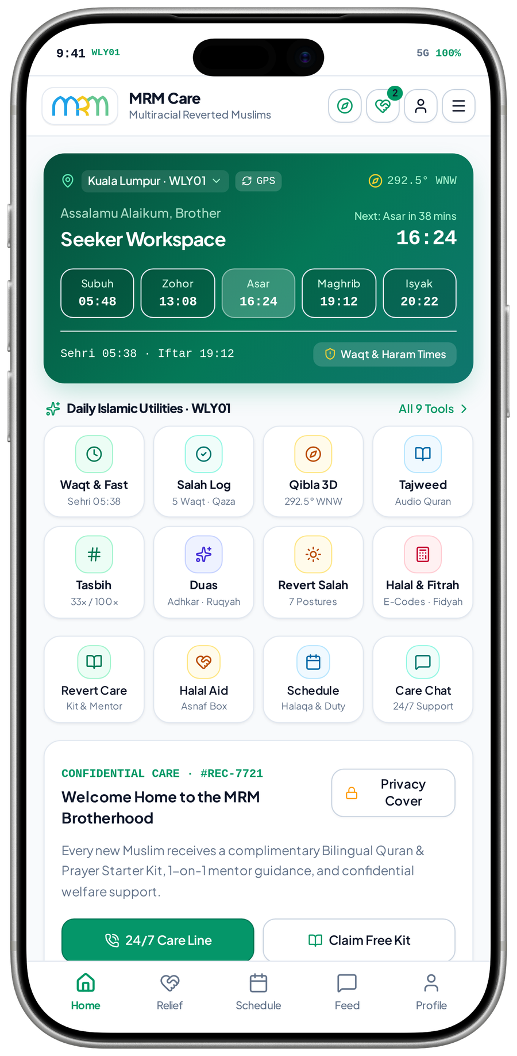
FEATURE NETWORK / MRM DIGITAL COMMUNITY PLATFORM
Help requests connect a personal need to a controlled response
A complete request lifecycle prevents the app becoming a contact form with no accountable follow-up.
Observed Seeker workspace · full request intake not shown
Member / service entry
Private request intake
MRM triage
starts
submits
A person seeks assistance
Category, urgency and safe contact
Check sensitivity and required response
routes
protects
updates
Consent & privacy rules
Eligible matching
Case status / activity
records
Minimum necessary information
Only routine permitted work is offered
The requester follows authorised progress
CRITICAL CONNECTION TO GET RIGHT
Consent & privacy rules → Private request intake → MRM triage
MVP 31 · Seeker workspace
Measure after implementation: Acknowledgement; triage completion; unresolved-request follow-up
MRM / ZYLAX TECHNOLOGIES
PROPOSED CONNECTIONS / MVP UI DOES NOT VERIFY BACKEND BEHAVIOUR
24 / 72
Notes:
{
"feature": "requests",
"owner": "MRM + Zylax",
"scope": "Observed Seeker workspace \u00b7 full request intake not shown",
"why": "A complete request lifecycle prevents the app becoming a contact form with no accountable follow-up.",
"measure": "Acknowledgement; triage completion; unresolved-request follow-up",
"decision": "Sensitive concerns use the restricted route; the ordinary request form is not shown in the latest pack.",
"screen_evidence": [
"Seeker workspace"
],
"connections": [
[
"Member / service entry",
"starts",
"Private request intake"
],
[
"Consent & privacy rules",
"protects",
"Private request intake"
],
[
"Private request intake",
"submits",
"MRM triage"
],
[
"MRM triage",
"routes",
"Eligible matching"
],
[
"MRM triage",
"updates",
"Case status / activity"
],
[
"Eligible matching",
"records",
"Case status / activity"
]
]
}
Screen UI is evidence of a visual state, not tested persistence, permissions, live APIs, religious approval, tax certification, payment or production impact. Only corrected Drive images are used.

Slide 49
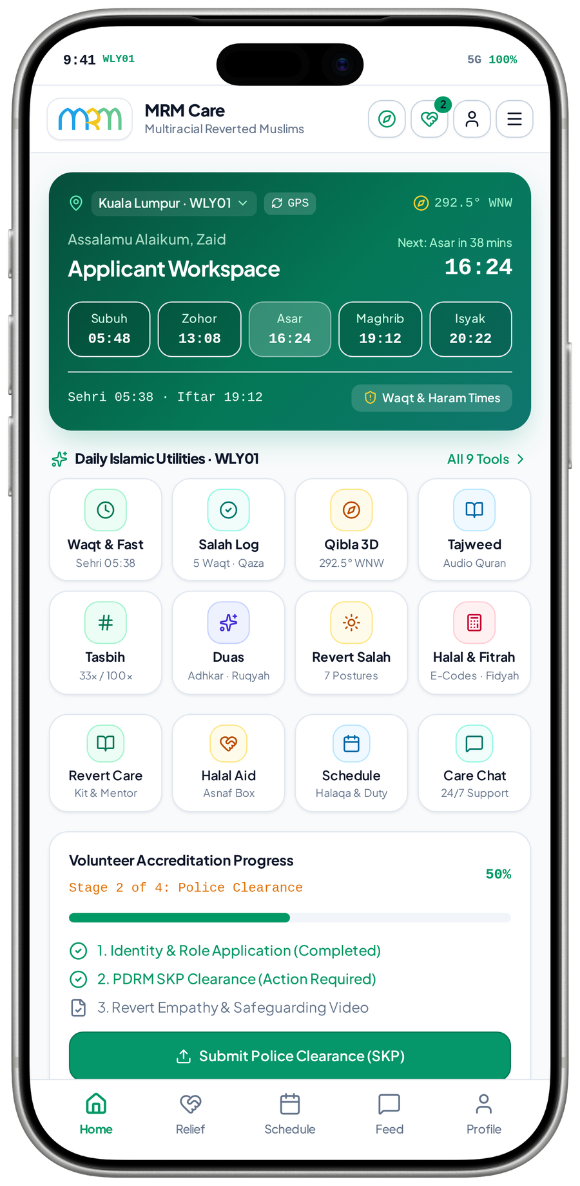
FEATURE NETWORK / MRM DIGITAL COMMUNITY PLATFORM
Volunteer verification connects willingness to trusted service
Documents and interview decisions must change real eligibility, not merely add a badge to a profile.
Observed Applicant progress · verification policy still requires MRM approval
Volunteer application
Evidence & interview review
Approved active volunteer
applies
decides
Skills, languages, area and availability
MRM checks documents and online interview
Decision, reason and review history
enables
supports
qualifies
Protected verification files
Eligible discovery / matching
Assigned work
offers
Restricted staff access and retention
Return only permitted service profiles
Approval alone does not expose all cases
CRITICAL CONNECTION TO GET RIGHT
Protected verification files → Evidence & interview review → Approved active volunteer
MVP 33 · Applicant verification progress
Measure after implementation: Review completion; interview record; suspension and access tests
MRM / ZYLAX TECHNOLOGIES
PROPOSED CONNECTIONS / MVP UI DOES NOT VERIFY BACKEND BEHAVIOUR
25 / 72
Notes:
{
"feature": "vetting",
"owner": "MRM + Zylax",
"scope": "Observed Applicant progress \u00b7 verification policy still requires MRM approval",
"why": "Documents and interview decisions must change real eligibility, not merely add a badge to a profile.",
"measure": "Review completion; interview record; suspension and access tests",
"decision": "The prototype shows police-clearance steps. These do not replace the agreed document review and online interview or establish MRM policy.",
"screen_evidence": [
"Applicant verification progress"
],
"connections": [
[
"Volunteer application",
"applies",
"Evidence & interview review"
],
[
"Protected verification files",
"supports",
"Evidence & interview review"
],
[
"Evidence & interview review",
"decides",
"Approved active volunteer"
],
[
"Approved active volunteer",
"enables",
"Eligible discovery / matching"
],
[
"Approved active volunteer",
"qualifies",
"Assigned work"
],
[
"Eligible discovery / matching",
"offers",
"Assigned work"
]
]
}
Screen UI is evidence of a visual state, not tested persistence, permissions, live APIs, religious approval, tax certification, payment or production impact. Only corrected Drive images are used.

Slide 50
FEATURE NETWORK / MRM DIGITAL COMMUNITY PLATFORM
Gender and nearby visibility connect policy to every result
Consistent server filtering prevents a protected profile leaking through search, maps, alerts or direct detail requests.
Approved scope · proposed connections
Approved role & profile
Visibility policy checks
Permitted discovery results
checks
filters
Verified access attributes
Agreed gender / role / record rules
Approximate area and approved fields
constrains
limits
requests
Location consent
Eligible alerts / matching
Authorised case contact
routes
No automatic exact-location sharing
Apply the same access boundary
Assignment and policy govern disclosure
CRITICAL CONNECTION TO GET RIGHT
Location consent → Visibility policy checks → Permitted discovery results
Measure after implementation: Cross-gender API tests; restricted detail and location tests
MRM / ZYLAX TECHNOLOGIES
PROPOSED CONNECTIONS / MVP UI DOES NOT VERIFY BACKEND BEHAVIOUR
26 / 72
Notes:
{
"feature": "gender",
"owner": "MRM + Zylax",
"scope": "Approved scope \u00b7 proposed connections",
"why": "Consistent server filtering prevents a protected profile leaking through search, maps, alerts or direct detail requests.",
"measure": "Cross-gender API tests; restricted detail and location tests",
"decision": "MRM must define controlled staff / teacher exceptions and precise role applicability.",
"screen_evidence": [],
"connections": [
[
"Approved role & profile",
"checks",
"Visibility policy checks"
],
[
"Location consent",
"constrains",
"Visibility policy checks"
],
[
"Visibility policy checks",
"filters",
"Permitted discovery results"
],
[
"Visibility policy checks",
"limits",
"Eligible alerts / matching"
],
[
"Permitted discovery results",
"requests",
"Authorised case contact"
],
[
"Eligible alerts / matching",
"routes",
"Authorised case contact"
]
]
}
Screen UI is evidence of a visual state, not tested persistence, permissions, live APIs, religious approval, tax certification, payment or production impact. Only corrected Drive images are used.

Slide 51
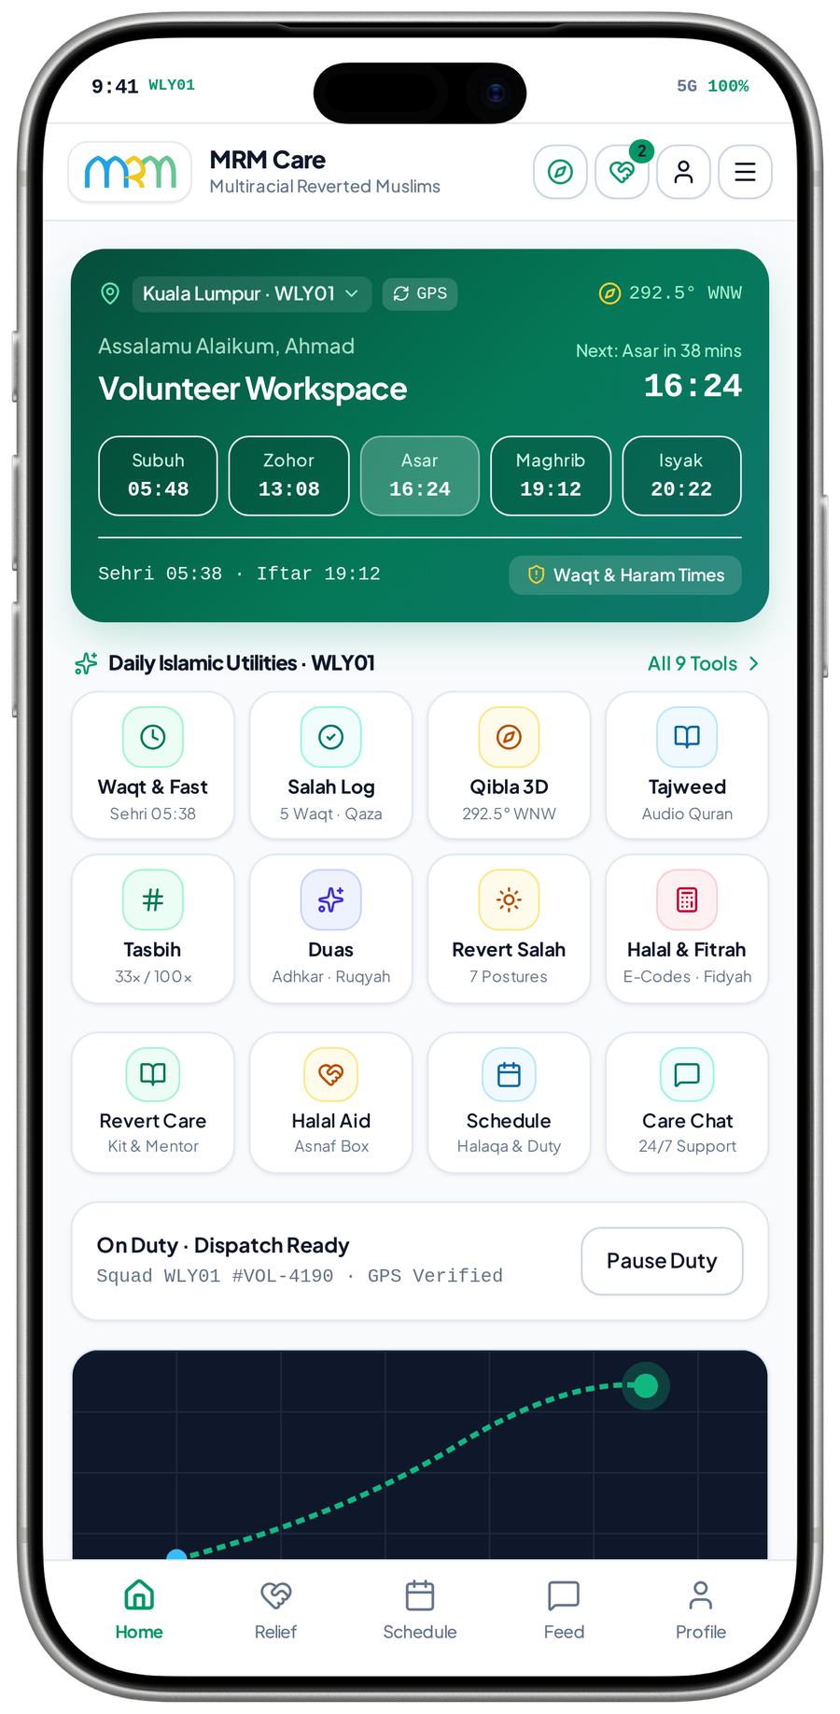
FEATURE NETWORK / MRM DIGITAL COMMUNITY PLATFORM
Matching connects a reviewed request to suitable capacity
Eligibility checks improve relevance and preserve confidentiality before any volunteer receives an offer.
Observed Volunteer on-duty workspace · actual matching not tested
Reviewed routine request
Eligibility matching
Limited volunteer offer
provides
offers
Category, area, language and urgency
Approved, active, available and permitted
Safe summary and approximate area
responds
qualifies
expires
Verified volunteer capacity
Assignment confirmation
Coordinator fallback
escalates
Skills, availability and gender rules
Seeker / coordinator accepts the match
Unanswered or unsuitable work is reviewed
CRITICAL CONNECTION TO GET RIGHT
Verified volunteer capacity → Eligibility matching → Limited volunteer offer
MVP 30 · Volunteer on-duty workspace
Measure after implementation: Eligible-offer delivery; unanswered-case handling; access tests
MRM / ZYLAX TECHNOLOGIES
PROPOSED CONNECTIONS / MVP UI DOES NOT VERIFY BACKEND BEHAVIOUR
27 / 72
Notes:
{
"feature": "matching",
"owner": "MRM + Zylax",
"scope": "Observed Volunteer on-duty workspace \u00b7 actual matching not tested",
"why": "Eligibility checks improve relevance and preserve confidentiality before any volunteer receives an offer.",
"measure": "Eligible-offer delivery; unanswered-case handling; access tests",
"decision": "Prototype \u201cnearest squad\u201d and 15-minute targets are not a guaranteed response service.",
"screen_evidence": [
"Volunteer on-duty workspace"
],
"connections": [
[
"Reviewed routine request",
"provides",
"Eligibility matching"
],
[
"Verified volunteer capacity",
"qualifies",
"Eligibility matching"
],
[
"Eligibility matching",
"offers",
"Limited volunteer offer"
],
[
"Limited volunteer offer",
"responds",
"Assignment confirmation"
],
[
"Limited volunteer offer",
"expires",
"Coordinator fallback"
],
[
"Assignment confirmation",
"escalates",
"Coordinator fallback"
]
]
}
Screen UI is evidence of a visual state, not tested persistence, permissions, live APIs, religious approval, tax certification, payment or production impact. Only corrected Drive images are used.

Slide 52
FEATURE NETWORK / MRM DIGITAL COMMUNITY PLATFORM
Assignments connect offers, contact, progress and closure
Confirmation creates accountable service access and lets MRM manage changes through to a verified outcome.
Approved scope · proposed connections
Eligible volunteer offer
Confirmed assignment
Permitted case contact
confirms
permits
An approved volunteer responds
Record the responsible participants
Only authorised details and conversation
supervises
tracks
Coordinator review
Case progress & closure
Verified recognition / reports
verifies
Resolve reassignment or safety concerns
Record follow-up and the service outcome
Award valid credit; aggregate outcomes
CRITICAL CONNECTION TO GET RIGHT
Coordinator review → Confirmed assignment → Permitted case contact
Measure after implementation: Confirmed assignment; reassignment; progress and closure records
MRM / ZYLAX TECHNOLOGIES
PROPOSED CONNECTIONS / MVP UI DOES NOT VERIFY BACKEND BEHAVIOUR
28 / 72
Notes:
{
"feature": "assignments",
"owner": "MRM + Zylax",
"scope": "Approved scope \u00b7 proposed connections",
"why": "Confirmation creates accountable service access and lets MRM manage changes through to a verified outcome.",
"measure": "Confirmed assignment; reassignment; progress and closure records",
"decision": "Closure and any service credit require a defined confirmation process, not self-awarded completion.",
"screen_evidence": [],
"connections": [
[
"Eligible volunteer offer",
"confirms",
"Confirmed assignment"
],
[
"Coordinator review",
"supervises",
"Confirmed assignment"
],
[
"Confirmed assignment",
"permits",
"Permitted case contact"
],
[
"Confirmed assignment",
"tracks",
"Case progress & closure"
],
[
"Case progress & closure",
"verifies",
"Verified recognition / reports"
]
]
}
Screen UI is evidence of a visual state, not tested persistence, permissions, live APIs, religious approval, tax certification, payment or production impact. Only corrected Drive images are used.

Slide 53
FEATURE NETWORK / MRM DIGITAL COMMUNITY PLATFORM
Confidential support connects concern to designated expertise
A restricted route protects sensitive faith and family information while retaining responsible follow-up.
Approved scope · proposed connections
Private concern
Restricted case intake
Designated personnel
submits
assigns
Safe contact and permitted description
Keep outside public discovery / broadcasts
MRM-authorised adviser or caseworker
restricts
coordinates
records
Consent & record permissions
Controlled follow-up
Case history / closure
closes
Access only for the agreed duty
Guidance, referral and case updates
Record only the permitted outcome
CRITICAL CONNECTION TO GET RIGHT
Consent & record permissions → Restricted case intake → Designated personnel
Measure after implementation: Unrelated-account denial; assigned-staff access; closure history
MRM / ZYLAX TECHNOLOGIES
PROPOSED CONNECTIONS / MVP UI DOES NOT VERIFY BACKEND BEHAVIOUR
29 / 72
Notes:
{
"feature": "private",
"owner": "MRM + Zylax",
"scope": "Approved scope \u00b7 proposed connections",
"why": "A restricted route protects sensitive faith and family information while retaining responsible follow-up.",
"measure": "Unrelated-account denial; assigned-staff access; closure history",
"decision": "No automated religious-status judgement and no general volunteer access to restricted cases.",
"screen_evidence": [],
"connections": [
[
"Private concern",
"submits",
"Restricted case intake"
],
[
"Consent & record permissions",
"restricts",
"Restricted case intake"
],
[
"Restricted case intake",
"assigns",
"Designated personnel"
],
[
"Restricted case intake",
"coordinates",
"Controlled follow-up"
],
[
"Designated personnel",
"records",
"Case history / closure"
],
[
"Controlled follow-up",
"closes",
"Case history / closure"
]
]
}
Screen UI is evidence of a visual state, not tested persistence, permissions, live APIs, religious approval, tax certification, payment or production impact. Only corrected Drive images are used.

Slide 54
FEATURE NETWORK / MRM DIGITAL COMMUNITY PLATFORM
Safeguarding connects a concern to a responsible action
Reporting, restrictions and escalation protect participation without implying guaranteed emergency response.
Approved scope · proposed connections
Conduct / danger concern
Safeguarding review
Account / contact restriction
reports
restricts
Report from an authorised service journey
Designated staff assess and record action
Stop unsafe contact or new work
guides
reviews
records
MRM escalation policy
Affected assignments
Protected incident history
follows up
Coverage, contacts and urgent guidance
Reassign or follow up existing work
Retain authorised evidence and outcome
CRITICAL CONNECTION TO GET RIGHT
MRM escalation policy → Safeguarding review → Account / contact restriction
Measure after implementation: Report handling; account restriction; open-assignment review
MRM / ZYLAX TECHNOLOGIES
PROPOSED CONNECTIONS / MVP UI DOES NOT VERIFY BACKEND BEHAVIOUR
30 / 72
Notes:
{
"feature": "safeguard",
"owner": "MRM + Zylax",
"scope": "Approved scope \u00b7 proposed connections",
"why": "Reporting, restrictions and escalation protect participation without implying guaranteed emergency response.",
"measure": "Report handling; account restriction; open-assignment review",
"decision": "The app supports coordination; immediate danger still requires the appropriate emergency service.",
"screen_evidence": [],
"connections": [
[
"Conduct / danger concern",
"reports",
"Safeguarding review"
],
[
"MRM escalation policy",
"guides",
"Safeguarding review"
],
[
"Safeguarding review",
"restricts",
"Account / contact restriction"
],
[
"Safeguarding review",
"reviews",
"Affected assignments"
],
[
"Account / contact restriction",
"records",
"Protected incident history"
],
[
"Affected assignments",
"follows up",
"Protected incident history"
]
]
}
Screen UI is evidence of a visual state, not tested persistence, permissions, live APIs, religious approval, tax certification, payment or production impact. Only corrected Drive images are used.

Slide 55
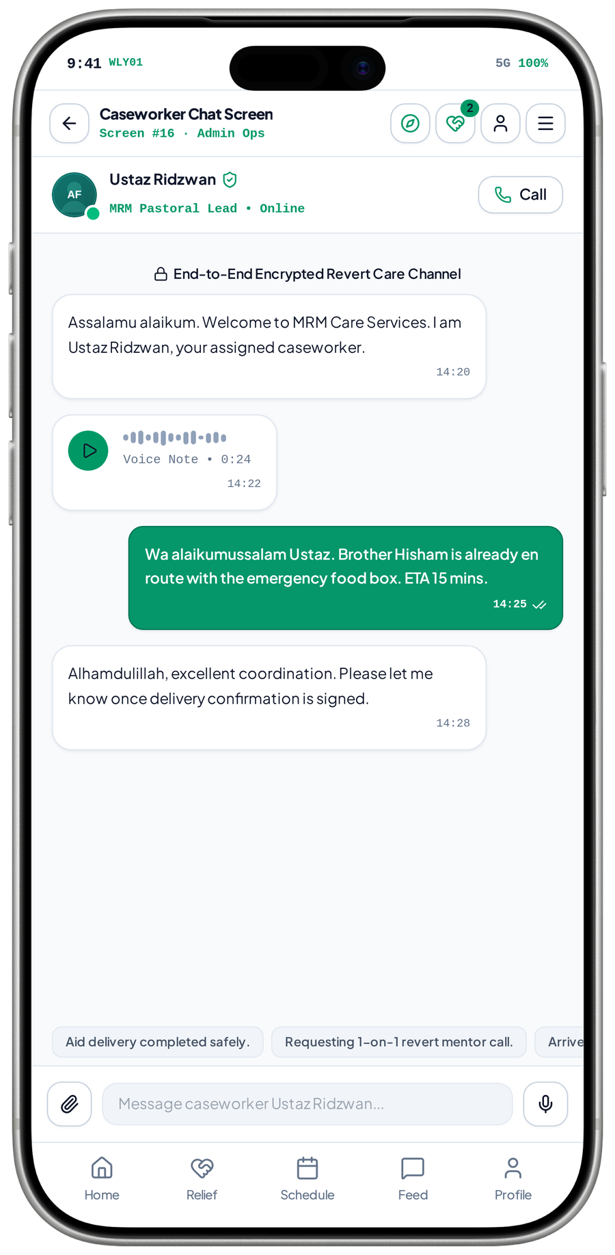
FEATURE NETWORK / MRM DIGITAL COMMUNITY PLATFORM
Case communication connects an assignment to follow-up
Conversation is useful when the right case and participants govern access, continuity and escalation.
Observed caseworker chat concept · implementation unverified
Authorised case / assignment
Case conversation
Progress / confirmation
opens
updates
A defined support relationship exists
Approved participants exchange updates
Relevant messages support follow-up
protects
reports
informs
Privacy & participant checks
Conduct report / escalation
Case closure policy
records
Recheck access after role / case changes
Route concerns to designated staff
Decide retention and further access
CRITICAL CONNECTION TO GET RIGHT
Privacy & participant checks → Case conversation → Progress / confirmation
MVP 16 · Caseworker conversation
Measure after implementation: Participant access; case linkage; report and closure behaviour
MRM / ZYLAX TECHNOLOGIES
PROPOSED CONNECTIONS / MVP UI DOES NOT VERIFY BACKEND BEHAVIOUR
31 / 72
Notes:
{
"feature": "chat",
"owner": "MRM + Zylax",
"scope": "Observed caseworker chat concept \u00b7 implementation unverified",
"why": "Conversation is useful when the right case and participants govern access, continuity and escalation.",
"measure": "Participant access; case linkage; report and closure behaviour",
"decision": "The screen\u2019s end-to-end encryption and response claims are not verified technical guarantees.",
"screen_evidence": [
"Caseworker conversation"
],
"connections": [
[
"Authorised case / assignment",
"opens",
"Case conversation"
],
[
"Privacy & participant checks",
"protects",
"Case conversation"
],
[
"Case conversation",
"updates",
"Progress / confirmation"
],
[
"Case conversation",
"reports",
"Conduct report / escalation"
],
[
"Progress / confirmation",
"informs",
"Case closure policy"
],
[
"Conduct report / escalation",
"records",
"Case closure policy"
]
]
}
Screen UI is evidence of a visual state, not tested persistence, permissions, live APIs, religious approval, tax certification, payment or production impact. Only corrected Drive images are used.

Slide 56
FEATURE NETWORK / MRM DIGITAL COMMUNITY PLATFORM
Zakat referrals connect consent, review and an external authority
A tracked handoff helps people follow an enquiry without presenting MRM as the eligibility or disbursement authority.
Approved scope · proposed connections
Enquiry + referral consent
MRM completeness review
Approved authority handoff
submits
refers
Need, region and safe contact
Check required information and evidence
Document recipient, reference and method
responds
governs
tracks
Partner sharing agreement
Referral status / follow-up
User update / reports
updates
Forms, permissions and authorised access
Record received, reviewed, referred or closed
Disclose permitted status; aggregate outcomes
CRITICAL CONNECTION TO GET RIGHT
Partner sharing agreement → MRM completeness review → Approved authority handoff
Measure after implementation: Complete referral record; permitted status update; partner response
MRM / ZYLAX TECHNOLOGIES
PROPOSED CONNECTIONS / MVP UI DOES NOT VERIFY BACKEND BEHAVIOUR
32 / 72
Notes:
{
"feature": "referral",
"owner": "MRM + Zylax",
"scope": "Approved scope \u00b7 proposed connections",
"why": "A tracked handoff helps people follow an enquiry without presenting MRM as the eligibility or disbursement authority.",
"measure": "Complete referral record; permitted status update; partner response",
"decision": "Direct API integration depends on confirmed access; zakat collection / disbursement remains outside the earlier proposal.",
"screen_evidence": [],
"connections": [
[
"Enquiry + referral consent",
"submits",
"MRM completeness review"
],
[
"Partner sharing agreement",
"governs",
"MRM completeness review"
],
[
"MRM completeness review",
"refers",
"Approved authority handoff"
],
[
"MRM completeness review",
"tracks",
"Referral status / follow-up"
],
[
"Approved authority handoff",
"responds",
"Referral status / follow-up"
],
[
"Referral status / follow-up",
"updates",
"User update / reports"
]
]
}
Screen UI is evidence of a visual state, not tested persistence, permissions, live APIs, religious approval, tax certification, payment or production impact. Only corrected Drive images are used.

Slide 57
FEATURE NETWORK / MRM DIGITAL COMMUNITY PLATFORM
Recognition connects verified service to continued contribution
Badges are credible when they reflect confirmed activity and do not override safeguarding or access rules.
Approved scope · proposed connections
Completed assignment / event
Service verification
Badges & service ranks
submits
awards
A qualifying contribution is recorded
Authorised confirmation under MRM criteria
Apply approved thresholds and periods
validates
records
encourages
MRM recognition criteria
Private service history
Volunteer engagement
supports
Eligibility, correction and appeal process
Show contribution without beneficiary details
Encourage responsible continued service
CRITICAL CONNECTION TO GET RIGHT
MRM recognition criteria → Service verification → Badges & service ranks
Measure after implementation: Verified-credit accuracy; corrections; recognition visibility
MRM / ZYLAX TECHNOLOGIES
PROPOSED CONNECTIONS / MVP UI DOES NOT VERIFY BACKEND BEHAVIOUR
33 / 72
Notes:
{
"feature": "recognition",
"owner": "MRM + Zylax",
"scope": "Approved scope \u00b7 proposed connections",
"why": "Badges are credible when they reflect confirmed activity and do not override safeguarding or access rules.",
"measure": "Verified-credit accuracy; corrections; recognition visibility",
"decision": "Rank does not grant sensitive-case priority or administrator permissions.",
"screen_evidence": [],
"connections": [
[
"Completed assignment / event",
"submits",
"Service verification"
],
[
"MRM recognition criteria",
"validates",
"Service verification"
],
[
"Service verification",
"awards",
"Badges & service ranks"
],
[
"Service verification",
"records",
"Private service history"
],
[
"Badges & service ranks",
"encourages",
"Volunteer engagement"
],
[
"Private service history",
"supports",
"Volunteer engagement"
]
]
}
Screen UI is evidence of a visual state, not tested persistence, permissions, live APIs, religious approval, tax certification, payment or production impact. Only corrected Drive images are used.

Slide 58
FEATURE NETWORK / MRM DIGITAL COMMUNITY PLATFORM
Teacher approval connects credentials to a governed teaching role
Learner trust depends on teacher review being independent of whether a person pays for publishing privileges.
Approved scope · proposed connections
Teacher application
Credential review
Approved teacher profile
applies
approves
Subjects, language, experience and evidence
MRM approves, declines or requests detail
Professional role; no private-case access
guides
qualifies
submits
MRM teaching standards
Teacher plan entitlement
Moderated programme / posts
allows
Religious review and evidence requirements
Publishing privileges remain separate
Content needs a publication decision
CRITICAL CONNECTION TO GET RIGHT
MRM teaching standards → Credential review → Approved teacher profile
Measure after implementation: Credential review; role approval; revoked-teacher access tests
MRM / ZYLAX TECHNOLOGIES
PROPOSED CONNECTIONS / MVP UI DOES NOT VERIFY BACKEND BEHAVIOUR
34 / 72
Notes:
{
"feature": "teacher",
"owner": "MRM + Zylax",
"scope": "Approved scope \u00b7 proposed connections",
"why": "Learner trust depends on teacher review being independent of whether a person pays for publishing privileges.",
"measure": "Credential review; role approval; revoked-teacher access tests",
"decision": "There is no dedicated teacher approval capture in the latest pack.",
"screen_evidence": [],
"connections": [
[
"Teacher application",
"applies",
"Credential review"
],
[
"MRM teaching standards",
"guides",
"Credential review"
],
[
"Credential review",
"approves",
"Approved teacher profile"
],
[
"Credential review",
"qualifies",
"Teacher plan entitlement"
],
[
"Approved teacher profile",
"submits",
"Moderated programme / posts"
],
[
"Teacher plan entitlement",
"allows",
"Moderated programme / posts"
]
]
}
Screen UI is evidence of a visual state, not tested persistence, permissions, live APIs, religious approval, tax certification, payment or production impact. Only corrected Drive images are used.

Slide 59
FEATURE NETWORK / MRM DIGITAL COMMUNITY PLATFORM
Teacher publishing connects expertise to discoverable learning
Moderation, plan allowances and clear publication states turn teacher opportunity into controlled learner value.
Approved scope · proposed connections
Approved teacher
Educational submission
MRM moderation
submits
reviews
Teaching role and profile are active
Post, teaching ad, class or recording
Review rights, quality and religious content
approves
permits
Valid plan entitlement
Approved publication
Search / website discovery
publishes
Enforce designated publishing allowances
Schedule, publish, revise or withdraw
Only approved visible material is returned
CRITICAL CONNECTION TO GET RIGHT
Valid plan entitlement → Educational submission → MRM moderation
Measure after implementation: Submission review; allowance enforcement; publication / withdrawal tests
MRM / ZYLAX TECHNOLOGIES
PROPOSED CONNECTIONS / MVP UI DOES NOT VERIFY BACKEND BEHAVIOUR
35 / 72
Notes:
{
"feature": "posts",
"owner": "MRM + Zylax",
"scope": "Approved scope \u00b7 proposed connections",
"why": "Moderation, plan allowances and clear publication states turn teacher opportunity into controlled learner value.",
"measure": "Submission review; allowance enforcement; publication / withdrawal tests",
"decision": "Teaching ads are labelled and kept out of private assistance screens.",
"screen_evidence": [],
"connections": [
[
"Approved teacher",
"submits",
"Educational submission"
],
[
"Valid plan entitlement",
"permits",
"Educational submission"
],
[
"Educational submission",
"reviews",
"MRM moderation"
],
[
"MRM moderation",
"approves",
"Approved publication"
],
[
"Approved publication",
"publishes",
"Search / website discovery"
]
]
}
Screen UI is evidence of a visual state, not tested persistence, permissions, live APIs, religious approval, tax certification, payment or production impact. Only corrected Drive images are used.

Slide 60
FEATURE NETWORK / MRM DIGITAL COMMUNITY PLATFORM
Teacher subscriptions connect revenue to explicit privileges
MRM can earn recurring teacher revenue while preserving free core assistance and volunteer participation.
Approved scope · proposed connections
Approved teacher role
Teacher plan selection
Applicable billing flow
qualifies
purchases
Credentials approved before paid privileges
MRM defines period and allowances
Use the required client-owned store setup
verifies
defines
MRM commercial policy
Verified entitlement
Permitted publishing
limits
Plan terms, prices and moderation rules
Check current rights on the server
Content still requires moderation
CRITICAL CONNECTION TO GET RIGHT
MRM commercial policy → Teacher plan selection → Applicable billing flow
Measure after implementation: Verified active plans; publishing-limit checks; correct expiry handling
MRM / ZYLAX TECHNOLOGIES
PROPOSED CONNECTIONS / MVP UI DOES NOT VERIFY BACKEND BEHAVIOUR
36 / 72
Notes:
{
"feature": "subscriptions",
"owner": "MRM + Zylax",
"scope": "Approved scope \u00b7 proposed connections",
"why": "MRM can earn recurring teacher revenue while preserving free core assistance and volunteer participation.",
"measure": "Verified active plans; publishing-limit checks; correct expiry handling",
"decision": "No invented plan tiers or prices. A configured no-charge teacher plan can precede paid activation.",
"screen_evidence": [],
"connections": [
[
"Approved teacher role",
"qualifies",
"Teacher plan selection"
],
[
"MRM commercial policy",
"defines",
"Teacher plan selection"
],
[
"Teacher plan selection",
"purchases",
"Applicable billing flow"
],
[
"Applicable billing flow",
"verifies",
"Verified entitlement"
],
[
"Verified entitlement",
"limits",
"Permitted publishing"
]
]
}
Screen UI is evidence of a visual state, not tested persistence, permissions, live APIs, religious approval, tax certification, payment or production impact. Only corrected Drive images are used.

Slide 61
FEATURE NETWORK / MRM DIGITAL COMMUNITY PLATFORM
Billing state connects payment events to the correct entitlement
Payment success, renewal and expiry must change privileges reliably without deleting the teacher’s identity or history.
Approved scope · proposed connections
Store purchase / renewal
Entitlement verification
Publishing permission
verifies
enforces
Applicable verified transaction event
Resolve current teacher-plan rights
Allow or pause the designated privileges
updates
preserves
records
Cancel / fail / restore
Account & content history
Billing oversight
supports
Handle supported lifecycle events
Preserve records under agreed policy
MRM reviews available reconciliation data
CRITICAL CONNECTION TO GET RIGHT
Cancel / fail / restore → Entitlement verification → Publishing permission
Measure after implementation: Payment verification; renewal / cancellation; restore and expiry tests
MRM / ZYLAX TECHNOLOGIES
PROPOSED CONNECTIONS / MVP UI DOES NOT VERIFY BACKEND BEHAVIOUR
37 / 72
Notes:
{
"feature": "billing",
"owner": "MRM + Zylax",
"scope": "Approved scope \u00b7 proposed connections",
"why": "Payment success, renewal and expiry must change privileges reliably without deleting the teacher\u2019s identity or history.",
"measure": "Payment verification; renewal / cancellation; restore and expiry tests",
"decision": "Teacher billing is distinct from donation payment prototypes; historical-content visibility needs a policy decision.",
"screen_evidence": [],
"connections": [
[
"Store purchase / renewal",
"verifies",
"Entitlement verification"
],
[
"Cancel / fail / restore",
"updates",
"Entitlement verification"
],
[
"Entitlement verification",
"enforces",
"Publishing permission"
],
[
"Entitlement verification",
"preserves",
"Account & content history"
],
[
"Publishing permission",
"records",
"Billing oversight"
],
[
"Account & content history",
"supports",
"Billing oversight"
]
]
}
Screen UI is evidence of a visual state, not tested persistence, permissions, live APIs, religious approval, tax certification, payment or production impact. Only corrected Drive images are used.

Slide 62
FEATURE NETWORK / MRM DIGITAL COMMUNITY PLATFORM
Learning connects approved content to participation and return visits
Discovery becomes sustained learning when programme details, access, reminders and recordings form one journey.
Approved scope · proposed connections
Approved teacher / content
Programme discovery
Registration / access rules
publishes
explains
MRM-approved learning material
Topic, language, teacher and schedule
Clearly state who can join and how
registers
discovers
Daily tools / search / website
Calendar & reminders
Live session / recording
permits
Multiple relevant entry points
Registered participants receive updates
Use approved links or hosted resources
CRITICAL CONNECTION TO GET RIGHT
Daily tools / search / website → Programme discovery → Registration / access rules
Measure after implementation: Programme access; registration; attendance / recording access
MRM / ZYLAX TECHNOLOGIES
PROPOSED CONNECTIONS / MVP UI DOES NOT VERIFY BACKEND BEHAVIOUR
38 / 72
Notes:
{
"feature": "learning",
"owner": "MRM + Zylax",
"scope": "Approved scope \u00b7 proposed connections",
"why": "Discovery becomes sustained learning when programme details, access, reminders and recordings form one journey.",
"measure": "Programme access; registration; attendance / recording access",
"decision": "Live teaching is not replaced with static posts; custom video infrastructure is not implied.",
"screen_evidence": [],
"connections": [
[
"Approved teacher / content",
"publishes",
"Programme discovery"
],
[
"Daily tools / search / website",
"discovers",
"Programme discovery"
],
[
"Programme discovery",
"explains",
"Registration / access rules"
],
[
"Registration / access rules",
"registers",
"Calendar & reminders"
],
[
"Calendar & reminders",
"permits",
"Live session / recording"
]
]
}
Screen UI is evidence of a visual state, not tested persistence, permissions, live APIs, religious approval, tax certification, payment or production impact. Only corrected Drive images are used.

Slide 63
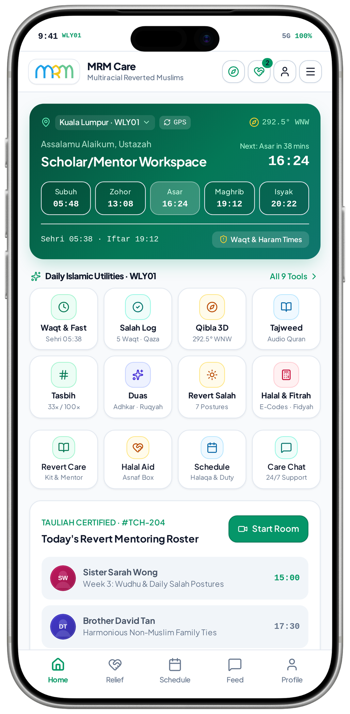
FEATURE NETWORK / MRM DIGITAL COMMUNITY PLATFORM
Mentorship connects an approved adviser to a defined learning need
Matching the right mentor to a programme or authorised support relationship adds continuity without exposing unrelated cases.
Observed Scholar / Mentor roster and Start Room control
Learning / support need
Approved mentor relationship
Session / programme roster
requests
schedules
Class need or permitted case referral
Defined assignment and permitted purpose
Only relevant learner and timing details
authorises
permits
Role & case permissions
Permitted contact
Follow-up / learning history
follows up
Teacher approval alone is insufficient for cases
Approved session link or case communication
Record only the agreed information
CRITICAL CONNECTION TO GET RIGHT
Role & case permissions → Approved mentor relationship → Session / programme roster
MVP 32 · Scholar / Mentor roster
Measure after implementation: Authorised mentor assignment; schedule access; confidential-record tests
MRM / ZYLAX TECHNOLOGIES
PROPOSED CONNECTIONS / MVP UI DOES NOT VERIFY BACKEND BEHAVIOUR
39 / 72
Notes:
{
"feature": "mentoring",
"owner": "MRM + Zylax",
"scope": "Observed Scholar / Mentor roster and Start Room control",
"why": "Matching the right mentor to a programme or authorised support relationship adds continuity without exposing unrelated cases.",
"measure": "Authorised mentor assignment; schedule access; confidential-record tests",
"decision": "This is a mentor workspace, not evidence of teacher subscriptions, credential approval or a working video room.",
"screen_evidence": [
"Scholar / Mentor roster"
],
"connections": [
[
"Learning / support need",
"requests",
"Approved mentor relationship"
],
[
"Role & case permissions",
"authorises",
"Approved mentor relationship"
],
[
"Approved mentor relationship",
"schedules",
"Session / programme roster"
],
[
"Approved mentor relationship",
"permits",
"Permitted contact"
],
[
"Permitted contact",
"follows up",
"Follow-up / learning history"
]
]
}
Screen UI is evidence of a visual state, not tested persistence, permissions, live APIs, religious approval, tax certification, payment or production impact. Only corrected Drive images are used.

Slide 64
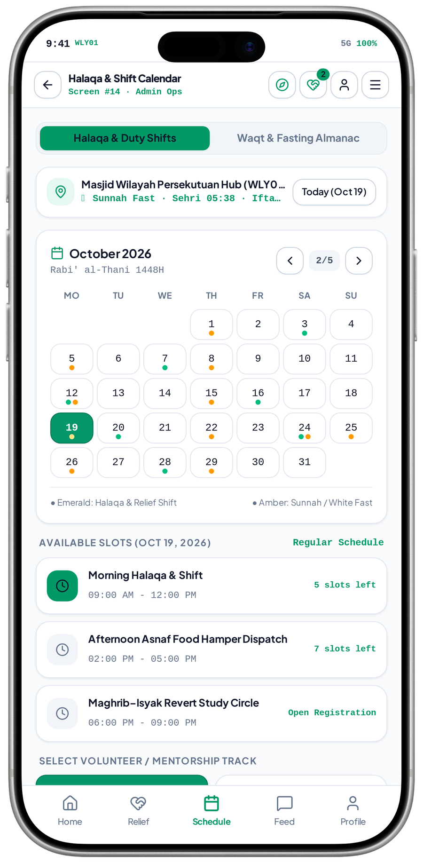
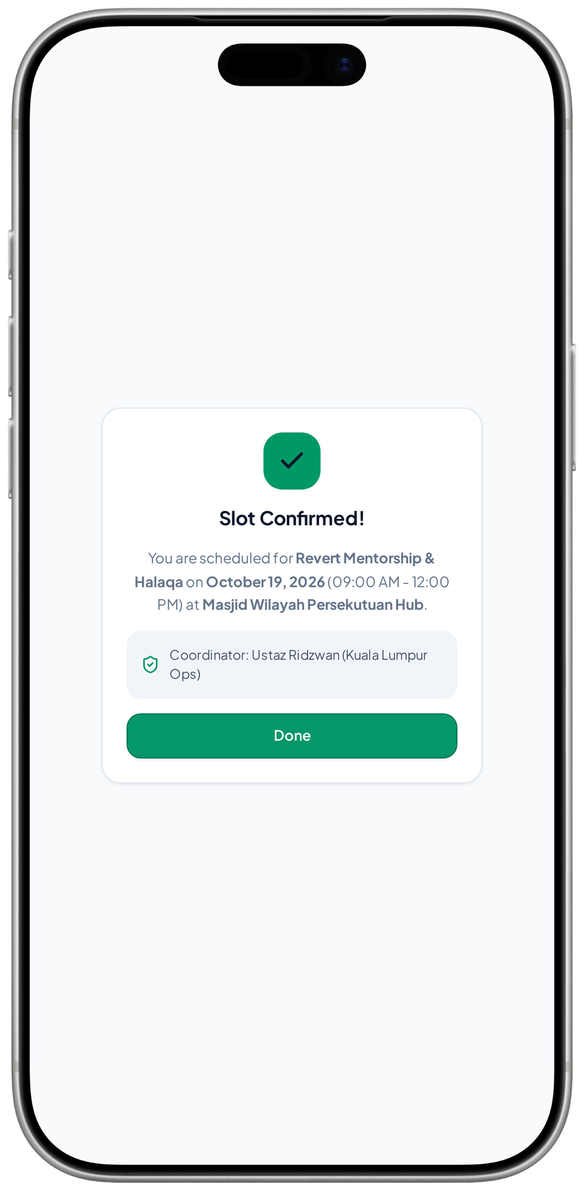
FEATURE NETWORK / MRM DIGITAL COMMUNITY PLATFORM
Scheduling connects learning, volunteer capacity and reminders
One calendar can coordinate participation while keeping a class enrolment separate from a volunteer duty assignment.
Observed calendar list and slot-confirmation modal
Approved class / duty event
Calendar & availability
Registration / shift request
schedules
selects
Programme or service opportunity
Dates, tracks and available places
Capture the person’s participation
confirms
constrains
Role / capacity checks
Confirmed participation
Reminder & activity update
reminds
Apply access rules and available capacity
Record the class or duty relationship
Open the right programme or shift
CRITICAL CONNECTION TO GET RIGHT
MVP 14 · Halaqa & duty calendar
MVP 40 · Slot-confirmation modal
Role / capacity checks → Calendar & availability → Registration / shift request
Measure after implementation: Slot availability; registration conflict; shift / class reminders
MRM / ZYLAX TECHNOLOGIES
PROPOSED CONNECTIONS / MVP UI DOES NOT VERIFY BACKEND BEHAVIOUR
40 / 72
Notes:
{
"feature": "schedule",
"owner": "MRM + Zylax",
"scope": "Observed calendar list and slot-confirmation modal",
"why": "One calendar can coordinate participation while keeping a class enrolment separate from a volunteer duty assignment.",
"measure": "Slot availability; registration conflict; shift / class reminders",
"decision": "A calendar slot does not prove attendance, approval or a guaranteed dispatch time.",
"screen_evidence": [
"Halaqa & duty calendar",
"Slot-confirmation modal"
],
"connections": [
[
"Approved class / duty event",
"schedules",
"Calendar & availability"
],
[
"Role / capacity checks",
"constrains",
"Calendar & availability"
],
[
"Calendar & availability",
"selects",
"Registration / shift request"
],
[
"Registration / shift request",
"confirms",
"Confirmed participation"
],
[
"Confirmed participation",
"reminds",
"Reminder & activity update"
]
]
}
Screen UI is evidence of a visual state, not tested persistence, permissions, live APIs, religious approval, tax certification, payment or production impact. Only corrected Drive images are used.

Slide 65
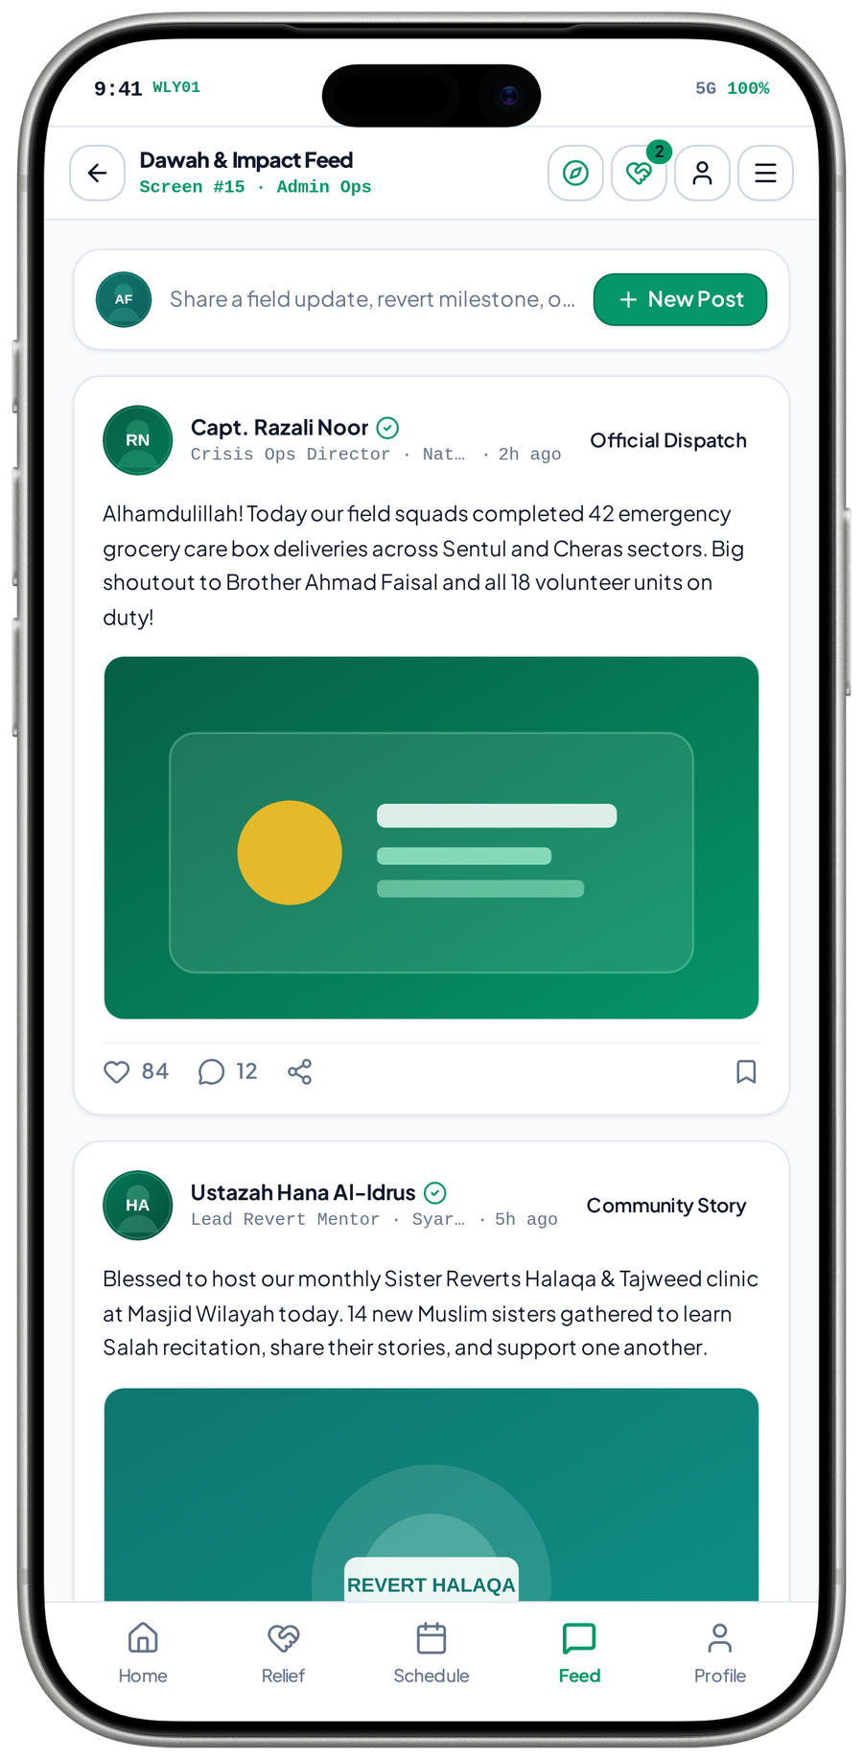
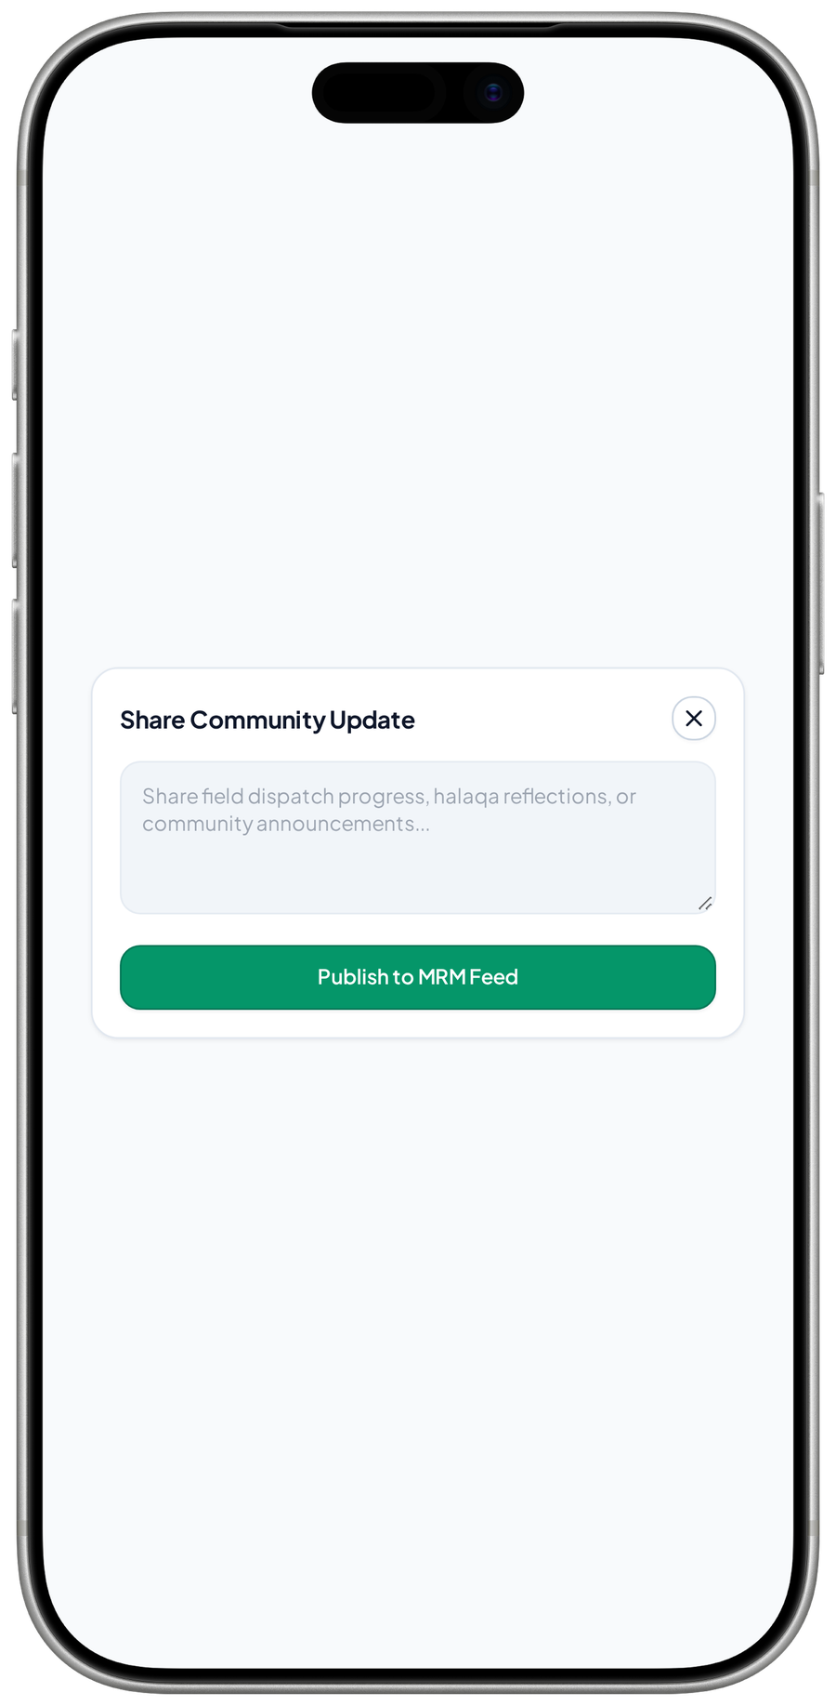
FEATURE NETWORK / MRM DIGITAL COMMUNITY PLATFORM
Community updates connect approved stories to participation
A moderated public update can build trust and point people toward programmes without exposing private cases.
Observed feed and composer · moderation controls proposed
Approved staff / teacher post
Moderated community update
Public programme discovery
submits
publishes
Author and publication rights are checked
Review text, media and consent
Link to approved participation information
protects
labels
invites
Privacy / beneficiary consent
Approved sponsor recognition
Participation / learning action
Never expose private case circumstances
Use agreed creatives and display period
A clear destination beyond the post
CRITICAL CONNECTION TO GET RIGHT
MVP 15 · Dawah & Impact Feed
MVP 41 · Community-post composer
Privacy / beneficiary consent → Moderated community update → Public programme discovery
Measure after implementation: Moderation decisions; privacy review; programme follow-through
MRM / ZYLAX TECHNOLOGIES
PROPOSED CONNECTIONS / MVP UI DOES NOT VERIFY BACKEND BEHAVIOUR
41 / 72
Notes:
{
"feature": "feed",
"owner": "MRM + Zylax",
"scope": "Observed feed and composer \u00b7 moderation controls proposed",
"why": "A moderated public update can build trust and point people toward programmes without exposing private cases.",
"measure": "Moderation decisions; privacy review; programme follow-through",
"decision": "The earlier proposal excludes unrestricted public social networking; comments and sharing controls need agreement.",
"screen_evidence": [
"Dawah & Impact Feed",
"Community-post composer"
],
"connections": [
[
"Approved staff / teacher post",
"submits",
"Moderated community update"
],
[
"Privacy / beneficiary consent",
"protects",
"Moderated community update"
],
[
"Moderated community update",
"publishes",
"Public programme discovery"
],
[
"Moderated community update",
"labels",
"Approved sponsor recognition"
],
[
"Public programme discovery",
"invites",
"Participation / learning action"
]
]
}
Screen UI is evidence of a visual state, not tested persistence, permissions, live APIs, religious approval, tax certification, payment or production impact. Only corrected Drive images are used.

Slide 66
FEATURE NETWORK / MRM DIGITAL COMMUNITY PLATFORM
Sponsor recognition connects approved support to visible placements
Scheduled placements create accountable sponsor value without influencing private care or assistance decisions.
Approved scope · proposed connections
Sponsor agreement & assets
Placement configuration
App / website recognition
defines
publishes
MRM confirms claims, creatives and terms
Location, link, dates and approval
Clearly identify sponsored material
measures
restricts
expires
Content / privacy rules
Aggregate views / clicks
Renewal / expiry
informs
No targeting from sensitive case data
Report agreed non-identifying performance
Remove or renew under MRM configuration
CRITICAL CONNECTION TO GET RIGHT
Content / privacy rules → Placement configuration → App / website recognition
Measure after implementation: Placement start / expiry; approved asset use; aggregate delivery
MRM / ZYLAX TECHNOLOGIES
PROPOSED CONNECTIONS / MVP UI DOES NOT VERIFY BACKEND BEHAVIOUR
42 / 72
Notes:
{
"feature": "sponsors",
"owner": "MRM + Zylax",
"scope": "Approved scope \u00b7 proposed connections",
"why": "Scheduled placements create accountable sponsor value without influencing private care or assistance decisions.",
"measure": "Placement start / expiry; approved asset use; aggregate delivery",
"decision": "External marketing posts and launch-day publication remain agreed MRM responsibilities.",
"screen_evidence": [],
"connections": [
[
"Sponsor agreement & assets",
"defines",
"Placement configuration"
],
[
"Content / privacy rules",
"restricts",
"Placement configuration"
],
[
"Placement configuration",
"publishes",
"App / website recognition"
],
[
"App / website recognition",
"measures",
"Aggregate views / clicks"
],
[
"App / website recognition",
"expires",
"Renewal / expiry"
],
[
"Aggregate views / clicks",
"informs",
"Renewal / expiry"
]
]
}
Screen UI is evidence of a visual state, not tested persistence, permissions, live APIs, religious approval, tax certification, payment or production impact. Only corrected Drive images are used.

Slide 67
FEATURE NETWORK / MRM DIGITAL COMMUNITY PLATFORM
The website connects public discovery to the correct app journey
Immediate link access introduces MRM’s work and brings the right audience into learning, volunteering or support.
Approved scope · proposed connections
Approved public content
Responsive website
Relevant participation route
publishes
directs
Mission, resources, programmes and policies
Discover MRM without app installation
Support, volunteer or teacher information
maintains
explains
hands off
CMS & migration inventory
Programme / resource detail
App / account entry
continues
Agree pages, assets and accessible content
Public information matches approved records
Continue when a personal service is needed
CRITICAL CONNECTION TO GET RIGHT
CMS & migration inventory → Responsive website → Relevant participation route
Measure after implementation: Public-route completion; content currency; app / service handoff
MRM / ZYLAX TECHNOLOGIES
PROPOSED CONNECTIONS / MVP UI DOES NOT VERIFY BACKEND BEHAVIOUR
43 / 72
Notes:
{
"feature": "website",
"owner": "MRM + Zylax",
"scope": "Approved scope \u00b7 proposed connections",
"why": "Immediate link access introduces MRM\u2019s work and brings the right audience into learning, volunteering or support.",
"measure": "Public-route completion; content currency; app / service handoff",
"decision": "Legacy private-record or account migration needs assessment; public-page migration is separately inventoried.",
"screen_evidence": [],
"connections": [
[
"Approved public content",
"publishes",
"Responsive website"
],
[
"CMS & migration inventory",
"maintains",
"Responsive website"
],
[
"Responsive website",
"directs",
"Relevant participation route"
],
[
"Responsive website",
"explains",
"Programme / resource detail"
],
[
"Relevant participation route",
"hands off",
"App / account entry"
],
[
"Programme / resource detail",
"continues",
"App / account entry"
]
]
}
Screen UI is evidence of a visual state, not tested persistence, permissions, live APIs, religious approval, tax certification, payment or production impact. Only corrected Drive images are used.

Slide 68
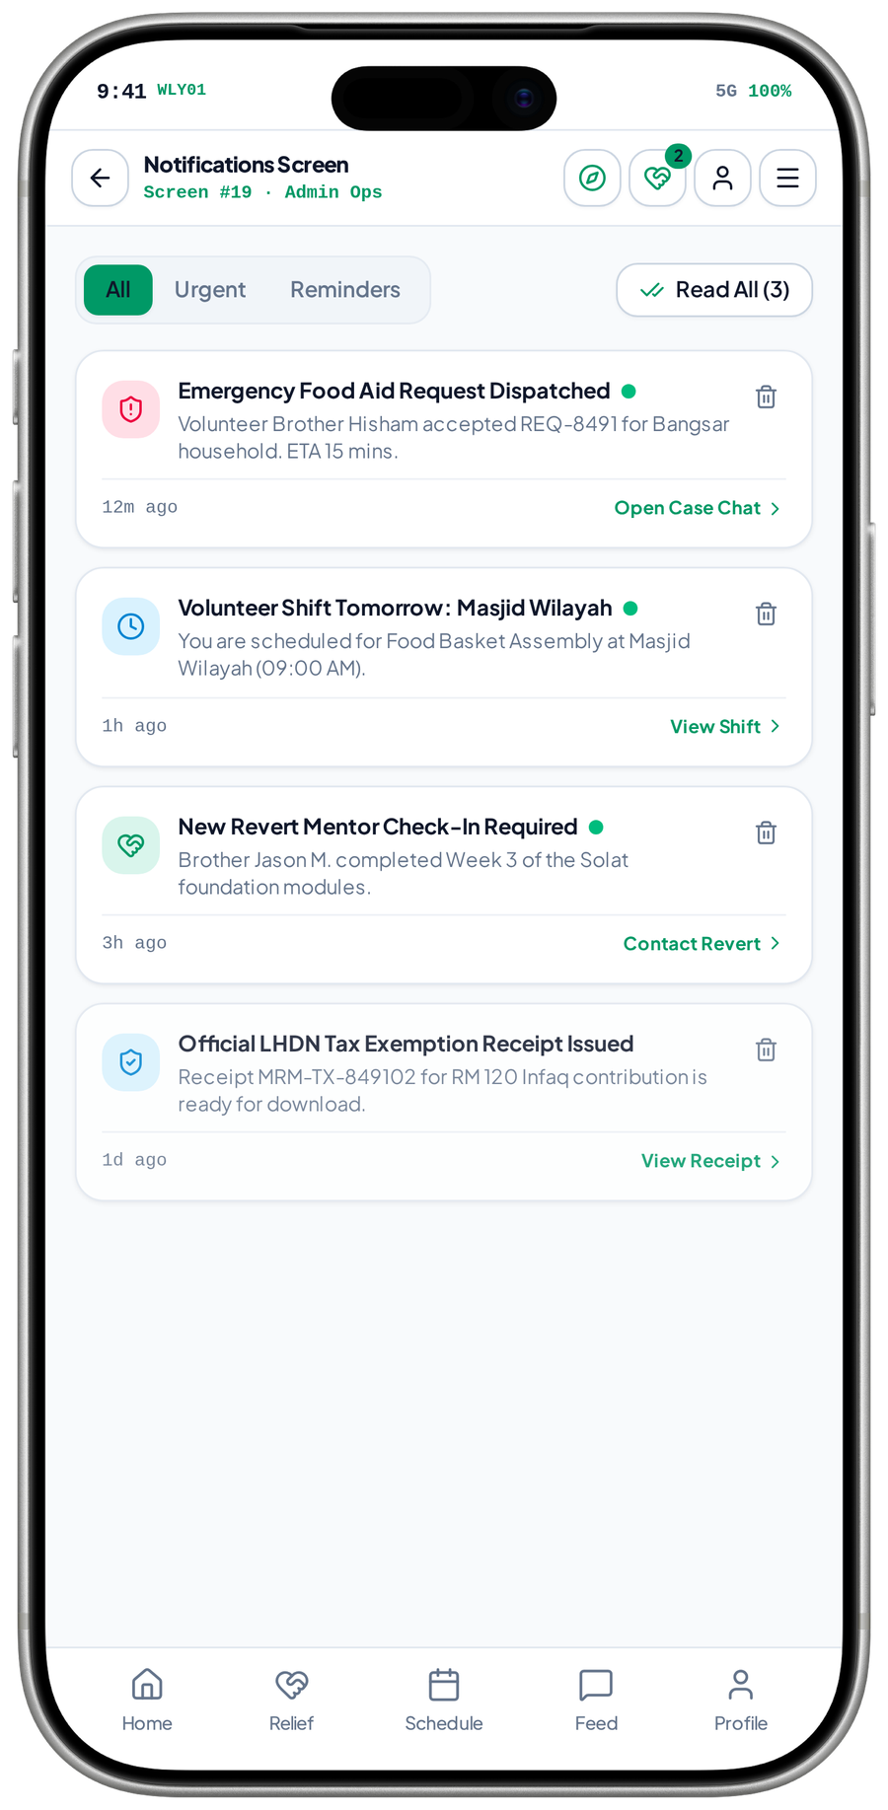
FEATURE NETWORK / MRM DIGITAL COMMUNITY PLATFORM
Notifications connect a service event to the next safe action
A useful alert opens the correct authorised case, programme or shift without exposing sensitive details on a lock screen.
Observed notification list · demo events / receipt claims unverified
Case / class / shift event
Eligibility & preferences
Privacy-safe notification
triggers
sends
A relevant state or schedule changes
Select the permitted recipient
Minimal context and approved wording
filters
links
prompts
Current role / record access
Authorised destination
Personal activity / follow-up
records
Recheck permission at send and open
Case, programme, shift or account status
Record state and review unattended work
CRITICAL CONNECTION TO GET RIGHT
Current role / record access → Eligibility & preferences → Privacy-safe notification
MVP 19 · In-app notification list
Measure after implementation: Relevant delivery; consent; authorised deep link; failed-send handling
MRM / ZYLAX TECHNOLOGIES
PROPOSED CONNECTIONS / MVP UI DOES NOT VERIFY BACKEND BEHAVIOUR
44 / 72
Notes:
{
"feature": "alerts",
"owner": "MRM + Zylax",
"scope": "Observed notification list \u00b7 demo events / receipt claims unverified",
"why": "A useful alert opens the correct authorised case, programme or shift without exposing sensitive details on a lock screen.",
"measure": "Relevant delivery; consent; authorised deep link; failed-send handling",
"decision": "Prototype tax-receipt alerts are not proof of authority approval or a working donation service.",
"screen_evidence": [
"In-app notification list"
],
"connections": [
[
"Case / class / shift event",
"triggers",
"Eligibility & preferences"
],
[
"Current role / record access",
"filters",
"Eligibility & preferences"
],
[
"Eligibility & preferences",
"sends",
"Privacy-safe notification"
],
[
"Eligibility & preferences",
"links",
"Authorised destination"
],
[
"Privacy-safe notification",
"prompts",
"Personal activity / follow-up"
],
[
"Authorised destination",
"records",
"Personal activity / follow-up"
]
]
}
Screen UI is evidence of a visual state, not tested persistence, permissions, live APIs, religious approval, tax certification, payment or production impact. Only corrected Drive images are used.

Slide 69
FEATURE NETWORK / MRM DIGITAL COMMUNITY PLATFORM
Personal activity connects applications and service status over time
A coherent history reduces uncertainty and keeps users connected to the action that needs their attention.
Approved scope · proposed connections
Application / case changes
Authorised activity record
Next action / detail
records
opens
Verification, assignment or referral updates
Store the person’s relevant event history
Open the current permitted record
filters
connects
continues
Role & record permissions
Learning / volunteer schedule
Safe reminder / follow-up
reminds
Only the correct person can see it
Programme and duty updates stay relevant
Notify or route overdue work appropriately
CRITICAL CONNECTION TO GET RIGHT
Role & record permissions → Authorised activity record → Next action / detail
Measure after implementation: Correct own-record visibility; status accuracy; actionable updates
MRM / ZYLAX TECHNOLOGIES
PROPOSED CONNECTIONS / MVP UI DOES NOT VERIFY BACKEND BEHAVIOUR
45 / 72
Notes:
{
"feature": "activity",
"owner": "MRM + Zylax",
"scope": "Approved scope \u00b7 proposed connections",
"why": "A coherent history reduces uncertainty and keeps users connected to the action that needs their attention.",
"measure": "Correct own-record visibility; status accuracy; actionable updates",
"decision": "An activity view is not a public record of sensitive cases or beneficiary identities.",
"screen_evidence": [],
"connections": [
[
"Application / case changes",
"records",
"Authorised activity record"
],
[
"Role & record permissions",
"filters",
"Authorised activity record"
],
[
"Authorised activity record",
"opens",
"Next action / detail"
],
[
"Authorised activity record",
"connects",
"Learning / volunteer schedule"
],
[
"Next action / detail",
"continues",
"Safe reminder / follow-up"
],
[
"Learning / volunteer schedule",
"reminds",
"Safe reminder / follow-up"
]
]
}
Screen UI is evidence of a visual state, not tested persistence, permissions, live APIs, religious approval, tax certification, payment or production impact. Only corrected Drive images are used.

Slide 70
FEATURE NETWORK / MRM DIGITAL COMMUNITY PLATFORM
Administration connects decisions to real operational state
The staff system is the operating layer that turns applications, requests and content into accountable outcomes.
Approved scope · proposed connections
Applications / cases / content
Duty-based staff queues
Recorded staff decision
enters
decides
Work arrives through approved journeys
Verification, triage and moderation
Reason, responsible staff and time
changes
governs
audits
MRM policies & responsibilities
Updated feature state
User update / report
updates
Define decision rights and coverage
Approval, assignment or publication changes
Communicate permitted outcomes
CRITICAL CONNECTION TO GET RIGHT
MRM policies & responsibilities → Duty-based staff queues → Recorded staff decision
Measure after implementation: Decision history; queue ownership; correct role-limited staff actions
MRM / ZYLAX TECHNOLOGIES
PROPOSED CONNECTIONS / MVP UI DOES NOT VERIFY BACKEND BEHAVIOUR
46 / 72
Notes:
{
"feature": "admin",
"owner": "MRM + Zylax",
"scope": "Approved scope \u00b7 proposed connections",
"why": "The staff system is the operating layer that turns applications, requests and content into accountable outcomes.",
"measure": "Decision history; queue ownership; correct role-limited staff actions",
"decision": "No staff permission is gained from paying, earning rank or switching a demo persona.",
"screen_evidence": [],
"connections": [
[
"Applications / cases / content",
"enters",
"Duty-based staff queues"
],
[
"MRM policies & responsibilities",
"governs",
"Duty-based staff queues"
],
[
"Duty-based staff queues",
"decides",
"Recorded staff decision"
],
[
"Recorded staff decision",
"changes",
"Updated feature state"
],
[
"Recorded staff decision",
"audits",
"User update / report"
],
[
"Updated feature state",
"updates",
"User update / report"
]
]
}
Screen UI is evidence of a visual state, not tested persistence, permissions, live APIs, religious approval, tax certification, payment or production impact. Only corrected Drive images are used.

Slide 71
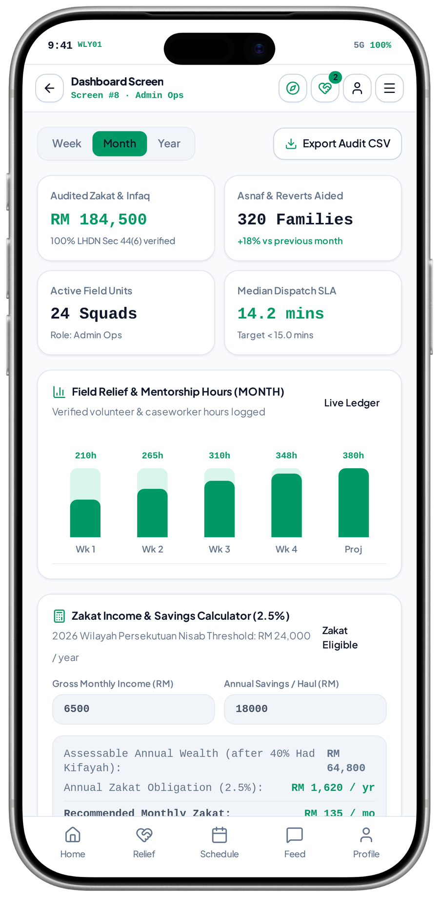
FEATURE NETWORK / MRM DIGITAL COMMUNITY PLATFORM
Reports connect recorded activity to better decisions
Operational summaries are useful only when they derive from verified events and lead to a clear staff response.
Observed analytics + calculator concept · figures illustrative
Recorded case / programme events
Agreed operational summaries
MRM review & action
aggregates
informs
Outcome, status and participation
Service queues, capacity and referrals
Investigate bottlenecks and plan resources
governs
summarises
acts
Data quality & access rules
Learning / sponsor insight
Documented improvement
improves
Aggregate by default; restrict personal exports
Agreed programme and placement measures
Adjust policy, capacity or configuration
CRITICAL CONNECTION TO GET RIGHT
Data quality & access rules → Agreed operational summaries → MRM review & action
MVP 08 · Analytics + calculator concept
Measure after implementation: Metric definitions; source reconciliation; restricted export tests
MRM / ZYLAX TECHNOLOGIES
PROPOSED CONNECTIONS / MVP UI DOES NOT VERIFY BACKEND BEHAVIOUR
47 / 72
Notes:
{
"feature": "reports",
"owner": "MRM + Zylax",
"scope": "Observed analytics + calculator concept \u00b7 figures illustrative",
"why": "Operational summaries are useful only when they derive from verified events and lead to a clear staff response.",
"measure": "Metric definitions; source reconciliation; restricted export tests",
"decision": "The demo\u2019s amounts, beneficiary counts, audit claims and SLA figures are not production evidence.",
"screen_evidence": [
"Analytics + calculator concept"
],
"connections": [
[
"Recorded case / programme events",
"aggregates",
"Agreed operational summaries"
],
[
"Data quality & access rules",
"governs",
"Agreed operational summaries"
],
[
"Agreed operational summaries",
"informs",
"MRM review & action"
],
[
"Agreed operational summaries",
"summarises",
"Learning / sponsor insight"
],
[
"MRM review & action",
"acts",
"Documented improvement"
],
[
"Learning / sponsor insight",
"improves",
"Documented improvement"
]
]
}
Screen UI is evidence of a visual state, not tested persistence, permissions, live APIs, religious approval, tax certification, payment or production impact. Only corrected Drive images are used.

Slide 72
FEATURE NETWORK / MRM DIGITAL COMMUNITY PLATFORM
Privacy and audit connect policy to every data path
Access rules must remain effective in the API, files, exports and notifications, not only in visible screens.
Approved scope · proposed connections
Authenticated identity
Record-level authorisation
Protected case / evidence
checks
protects
Current roles and approved attributes
Check role, case and gender boundary
Restrict identity files and sensitive records
defines
constrains
audits
MRM privacy / retention policy
Safe notifications / exports
Audit / backup / recovery
records
Consent, sharing and retention decisions
Minimise disclosure outside the record
Accountable action and agreed recovery
CRITICAL CONNECTION TO GET RIGHT
MRM privacy / retention policy → Record-level authorisation → Protected case / evidence
Measure after implementation: Direct API denial; file permissions; audit / recovery checks
MRM / ZYLAX TECHNOLOGIES
PROPOSED CONNECTIONS / MVP UI DOES NOT VERIFY BACKEND BEHAVIOUR
48 / 72
Notes:
{
"feature": "security",
"owner": "MRM + Zylax",
"scope": "Approved scope \u00b7 proposed connections",
"why": "Access rules must remain effective in the API, files, exports and notifications, not only in visible screens.",
"measure": "Direct API denial; file permissions; audit / recovery checks",
"decision": "UI encryption badges or tax/audit labels are not independent security or compliance validation.",
"screen_evidence": [],
"connections": [
[
"Authenticated identity",
"checks",
"Record-level authorisation"
],
[
"MRM privacy / retention policy",
"defines",
"Record-level authorisation"
],
[
"Record-level authorisation",
"protects",
"Protected case / evidence"
],
[
"Record-level authorisation",
"constrains",
"Safe notifications / exports"
],
[
"Protected case / evidence",
"audits",
"Audit / backup / recovery"
],
[
"Safe notifications / exports",
"records",
"Audit / backup / recovery"
]
]
}
Screen UI is evidence of a visual state, not tested persistence, permissions, live APIs, religious approval, tax certification, payment or production impact. Only corrected Drive images are used.

Slide 73
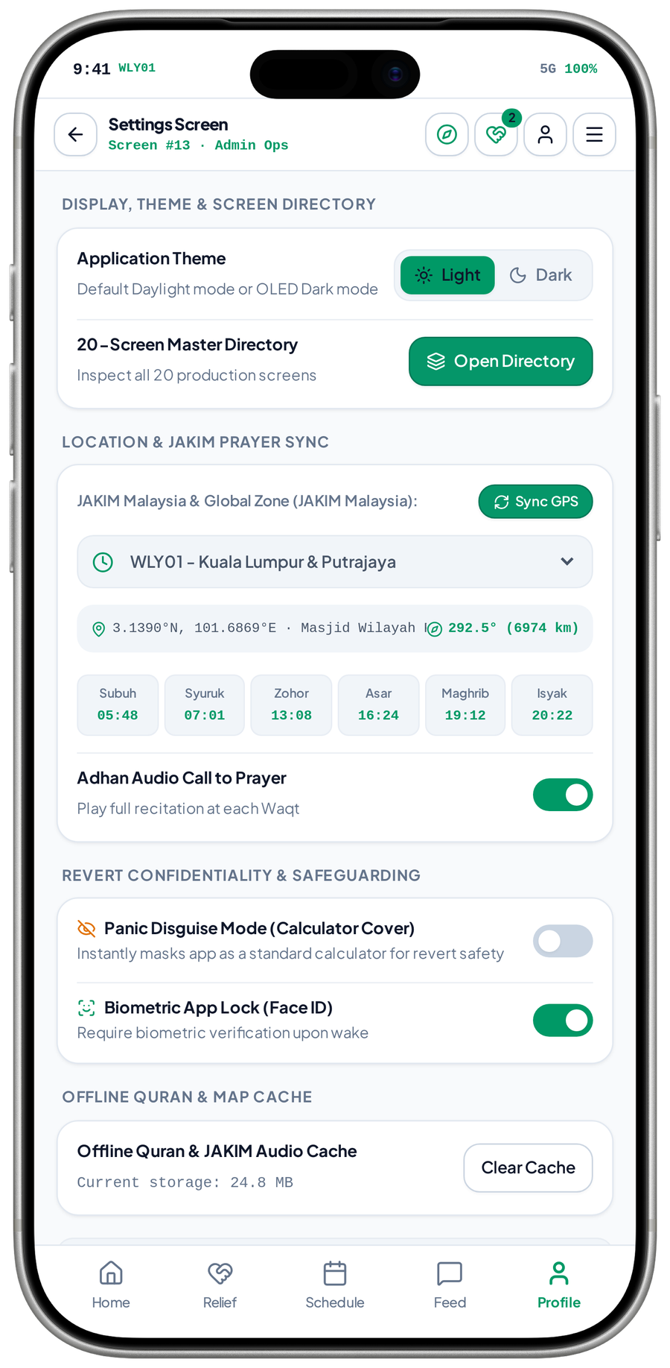
FEATURE NETWORK / MRM DIGITAL COMMUNITY PLATFORM
Settings connect local choices to reliable, private use
Preferences should change the intended experience consistently without silently changing role or record permissions.
Observed Settings; distinct dark-theme Home is shown on the main cover
User preferences
Settings & consent
Prayer / reminder behaviour
sets
configures
Language, theme and local area
Explicit choices and clear effects
Use the approved zone and notification choice
manages
controls
tests
Supported offline content
Device / privacy controls
Reliable repeated use
protects
Cache only approved / permitted material
Supported lock and safe local handling
Respect denied permissions and changed settings
CRITICAL CONNECTION TO GET RIGHT
Supported offline content → Settings & consent → Prayer / reminder behaviour
MVP 13 · Settings, zone, lock and cache
Measure after implementation: Prayer-zone changes; consent; cache and supported device-lock tests
MRM / ZYLAX TECHNOLOGIES
PROPOSED CONNECTIONS / MVP UI DOES NOT VERIFY BACKEND BEHAVIOUR
49 / 72
Notes:
{
"feature": "settings",
"owner": "MRM + Zylax",
"scope": "Observed Settings; distinct dark-theme Home is shown on the main cover",
"why": "Preferences should change the intended experience consistently without silently changing role or record permissions.",
"measure": "Prayer-zone changes; consent; cache and supported device-lock tests",
"decision": "The panic-disguise option is a concept needing policy and technical review; it does not itself establish safety.",
"screen_evidence": [
"Settings, zone, lock and cache"
],
"connections": [
[
"User preferences",
"sets",
"Settings & consent"
],
[
"Supported offline content",
"manages",
"Settings & consent"
],
[
"Settings & consent",
"configures",
"Prayer / reminder behaviour"
],
[
"Settings & consent",
"controls",
"Device / privacy controls"
],
[
"Prayer / reminder behaviour",
"tests",
"Reliable repeated use"
],
[
"Device / privacy controls",
"protects",
"Reliable repeated use"
]
]
}
Screen UI is evidence of a visual state, not tested persistence, permissions, live APIs, religious approval, tax certification, payment or production impact. Only corrected Drive images are used.

Slide 74
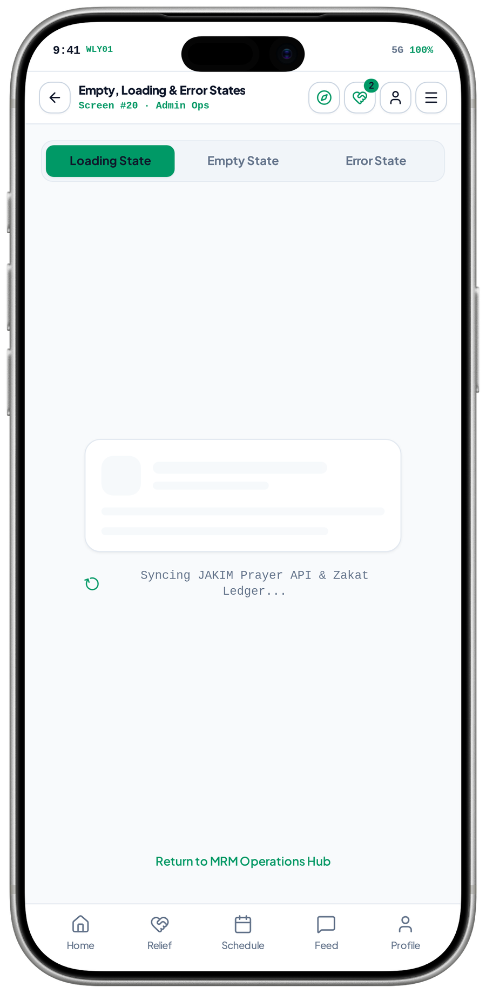
FEATURE NETWORK / MRM DIGITAL COMMUNITY PLATFORM
Loading, empty and error states connect trust to recovery
A failed request must explain what happened and offer the right recovery path without duplicating work.
Observed loading skeleton · empty/error tabs visible
API / content operation
Visible state feedback
Safe retry / next action
loads
guides
Load or submit a real service action
Loading, empty, success or error
Retry, correct input or return to a valid route
explains
checks
escalates
Permission / network outcome
Persistent operation status
Support / staff follow-up
prevents loss
Distinguish denied access from unavailable data
Check whether the action already completed
Escalate a genuine unresolved problem
CRITICAL CONNECTION TO GET RIGHT
Permission / network outcome → Visible state feedback → Safe retry / next action
MVP 20 · Loading-state skeleton
Measure after implementation: Retry correctness; no duplicate submissions; recoverable state tests
MRM / ZYLAX TECHNOLOGIES
PROPOSED CONNECTIONS / MVP UI DOES NOT VERIFY BACKEND BEHAVIOUR
50 / 72
Notes:
{
"feature": "reliability",
"owner": "MRM + Zylax",
"scope": "Observed loading skeleton \u00b7 empty/error tabs visible",
"why": "A failed request must explain what happened and offer the right recovery path without duplicating work.",
"measure": "Retry correctness; no duplicate submissions; recoverable state tests",
"decision": "Source 20 demonstrates a loading skeleton. Separate empty and error screenshots are reviewed on their own feature pages.",
"screen_evidence": [
"Loading-state skeleton"
],
"connections": [
[
"API / content operation",
"loads",
"Visible state feedback"
],
[
"Permission / network outcome",
"explains",
"Visible state feedback"
],
[
"Visible state feedback",
"guides",
"Safe retry / next action"
],
[
"Visible state feedback",
"checks",
"Persistent operation status"
],
[
"Safe retry / next action",
"escalates",
"Support / staff follow-up"
],
[
"Persistent operation status",
"prevents loss",
"Support / staff follow-up"
]
]
}
Screen UI is evidence of a visual state, not tested persistence, permissions, live APIs, religious approval, tax certification, payment or production impact. Only corrected Drive images are used.

Slide 75
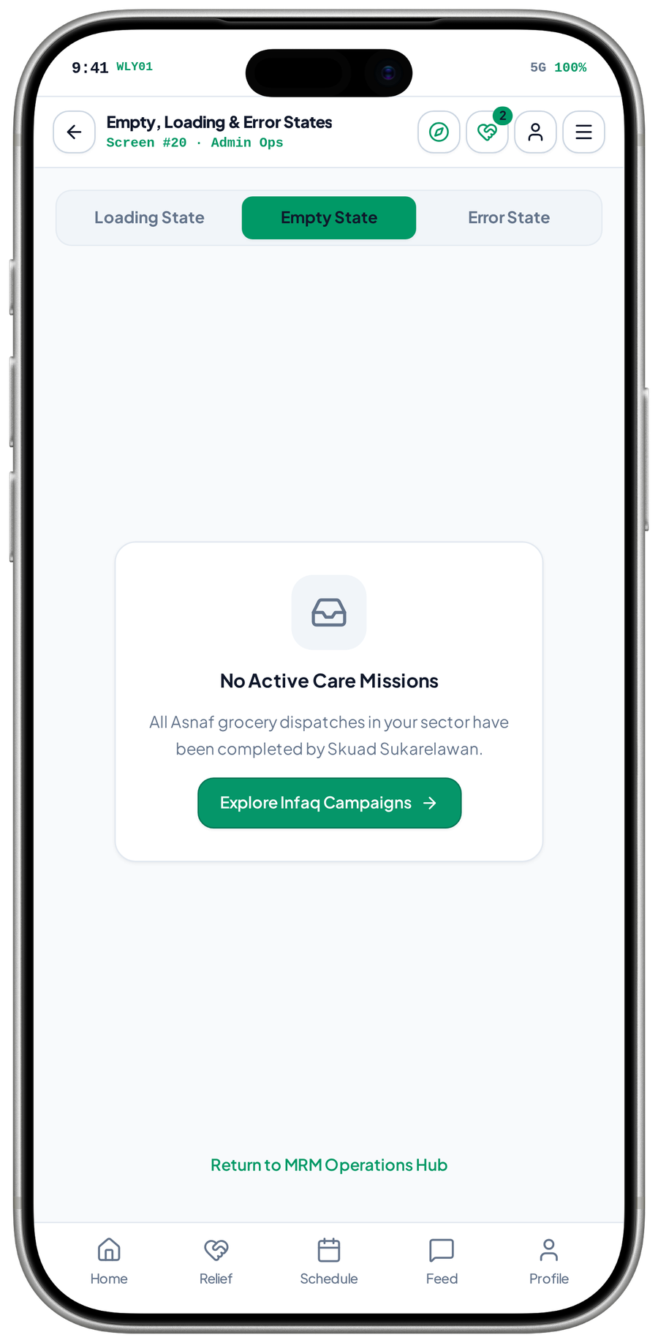
FEATURE NETWORK / MRM DIGITAL COMMUNITY PLATFORM
Empty states connect a valid zero result to a useful next action
A genuine empty state reduces confusion without claiming that work is completed simply because nothing is displayed.
Observed “No Active Care Missions” empty-state panel
Authorised query
Confirmed empty result
Useful next action
returns
guides
A permitted case or content list is loaded
Distinguish no data from network failure
Return to relevant tools or participation
distinguishes
offers
Record / network checks
Service / programme discovery
New valid activity
starts
Do not treat an error as an empty list
Offer only an appropriate permitted route
An explicit user action starts a real journey
CRITICAL CONNECTION TO GET RIGHT
Record / network checks → Confirmed empty result → Useful next action
MVP 43 · Empty-state panel
Measure after implementation: Correct zero-state wording; next-action eligibility; no false completion
MRM / ZYLAX TECHNOLOGIES
PROPOSED CONNECTIONS / MVP UI DOES NOT VERIFY BACKEND BEHAVIOUR
51 / 72
Notes:
{
"feature": "empty",
"owner": "MRM + Zylax",
"scope": "Observed \u201cNo Active Care Missions\u201d empty-state panel",
"why": "A genuine empty state reduces confusion without claiming that work is completed simply because nothing is displayed.",
"measure": "Correct zero-state wording; next-action eligibility; no false completion",
"decision": "\u201cAll dispatches completed\u201d is prototype copy, not a verified operational result.",
"screen_evidence": [
"Empty-state panel"
],
"connections": [
[
"Authorised query",
"returns",
"Confirmed empty result"
],
[
"Record / network checks",
"distinguishes",
"Confirmed empty result"
],
[
"Confirmed empty result",
"guides",
"Useful next action"
],
[
"Confirmed empty result",
"offers",
"Service / programme discovery"
],
[
"Service / programme discovery",
"starts",
"New valid activity"
]
]
}
Screen UI is evidence of a visual state, not tested persistence, permissions, live APIs, religious approval, tax certification, payment or production impact. Only corrected Drive images are used.

Slide 76
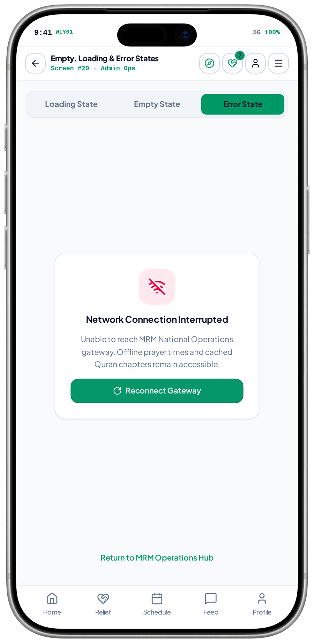
FEATURE NETWORK / MRM DIGITAL COMMUNITY PLATFORM
Error recovery connects service continuity to truthful feedback
A clear failure state should recover the correct operation and preserve data, rather than silently repeat a submission.
Observed network-error panel with reconnect control
Failed service operation
Visible error explanation
Safe reconnect / retry
fails
guides
Network or backend did not complete normally
State what is unavailable without overclaiming
Reconcile status before resubmitting
offers fallback
checks
recovers
Available offline content
Persistent operation record
Recovered permitted journey
reconciles
Only previously permitted cached material
Check whether submission already succeeded
Resume or route to support
CRITICAL CONNECTION TO GET RIGHT
Available offline content → Visible error explanation → Safe reconnect / retry
MVP 44 · Network-error panel
Measure after implementation: Reconnect; idempotent retry; cached access; status reconciliation
MRM / ZYLAX TECHNOLOGIES
PROPOSED CONNECTIONS / MVP UI DOES NOT VERIFY BACKEND BEHAVIOUR
52 / 72
Notes:
{
"feature": "error",
"owner": "MRM + Zylax",
"scope": "Observed network-error panel with reconnect control",
"why": "A clear failure state should recover the correct operation and preserve data, rather than silently repeat a submission.",
"measure": "Reconnect; idempotent retry; cached access; status reconciliation",
"decision": "The screen says cached Quran and prayer remain available; actual offline behaviour still needs testing.",
"screen_evidence": [
"Network-error panel"
],
"connections": [
[
"Failed service operation",
"fails",
"Visible error explanation"
],
[
"Available offline content",
"offers fallback",
"Visible error explanation"
],
[
"Visible error explanation",
"guides",
"Safe reconnect / retry"
],
[
"Visible error explanation",
"checks",
"Persistent operation record"
],
[
"Safe reconnect / retry",
"recovers",
"Recovered permitted journey"
],
[
"Persistent operation record",
"reconciles",
"Recovered permitted journey"
]
]
}
Screen UI is evidence of a visual state, not tested persistence, permissions, live APIs, religious approval, tax certification, payment or production impact. Only corrected Drive images are used.

Slide 77
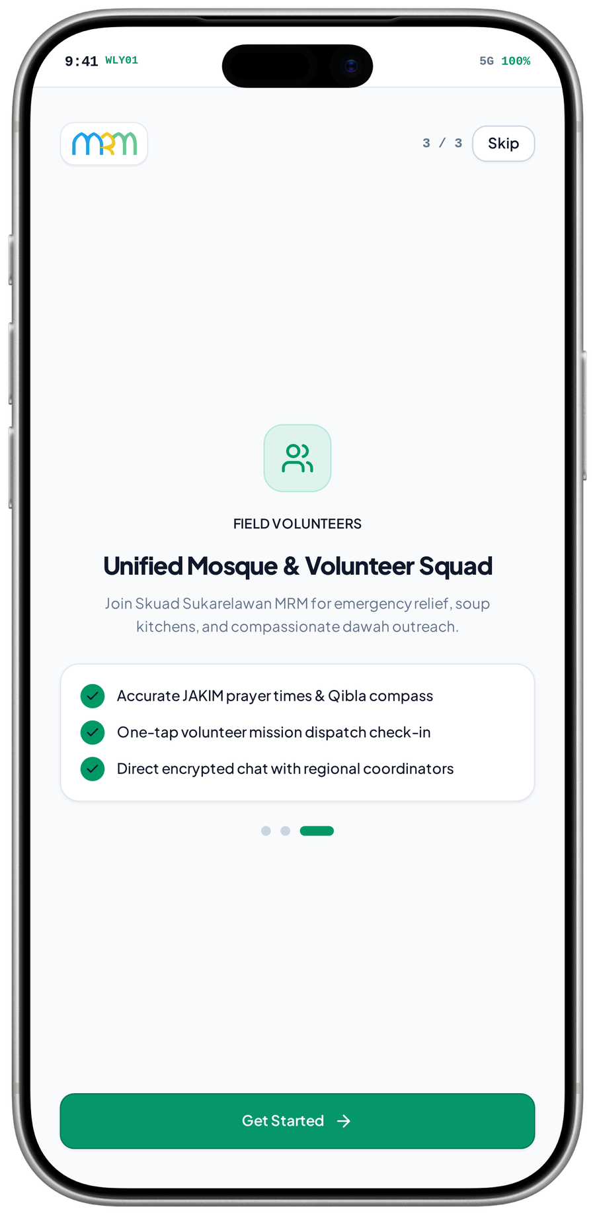
END-TO-END CARE NETWORK / MRM DIGITAL COMMUNITY PLATFORM
Care is a connected service, not a dispatch button
Verification, matching, contact, closure and recognition have distinct responsibilities and access boundaries.
Private request
Eligible matching
Confirmed assignment
triages
offers
Triage selects the routine or restricted route
Approved active volunteer + access rules
Record who is responsible for the work
permits
qualifies
confirms
Verification & interview
Permitted case contact
Closure & recognition
records
Review evidence before eligible service
Progress, report concerns and follow up
Verify outcome before service credit
MVP 36 · Onboarding · volunteer pillar
Restricted faith / family cases go to designated personnel, not the general volunteer broadcast route.
MRM / ZYLAX TECHNOLOGIES
PROPOSED CONNECTIONS / MVP UI DOES NOT VERIFY BACKEND BEHAVIOUR
53 / 72

Slide 78
END-TO-END LEARNING NETWORK / MRM DIGITAL COMMUNITY PLATFORM
Learning connects content, entitlement, time and participation
Teacher approval, payment verification and moderation are independent controls serving one learner journey.
Teacher approval
Plan entitlement
Content moderation
qualifies
allows submission
MRM confirms credentials and role
Verify designated publishing privileges
Religious / rights and publication review
lists
publishes
Discovery & guidance
Programme registration
Session / recording
registers
permits
Daily tools and public content open learning
Schedule and access rules are explicit
Permitted access, reminders and continuation
No teacher payment grants private-case access. No proposed subscription paywall for ordinary members or volunteers.
MRM / ZYLAX TECHNOLOGIES
PROPOSED CONNECTIONS / MVP UI DOES NOT VERIFY BACKEND BEHAVIOUR
54 / 72

Slide 79
EVERYDAY MUSLIM JOURNEY / MRM DIGITAL COMMUNITY PLATFORM
Daily tools make the platform valuable between service events
A person can practise, learn and discover relevant participation without needing an assistance case.
Location / source settings
Daily Islamic utilities
Approved explanations
configures
explains
Approved local and content conventions
Prayer, Quran, Qibla and remembrance
Guides, references and programmes
personalises
discovers
invites
Private personal choices
Relevant discovery
Voluntary participation
continues
Consent, logs and supported cache
Mosques, classes and support routes
Join a programme or begin a request
Personal worship logs stay private. Community participation is a choice, not a condition of using daily tools.
MRM / ZYLAX TECHNOLOGIES
PROPOSED CONNECTIONS / MVP UI DOES NOT VERIFY BACKEND BEHAVIOUR
55 / 72

Slide 80
SHARED EVENT NETWORK / MRM DIGITAL COMMUNITY PLATFORM
One event connects state, notification and accountable follow-up
An alert is useful only when it points to the right record and preserves the current access boundary.
Application / case / class
Recipient & privacy checks
Safe alert delivery
triggers
filters
A legitimate service state changes
Role, record and notification preference
Minimal copy and relevant destination
opens
records
prompts
Persistent event history
Authorised next action
Follow-up & reports
reconciles
updates
Record the actual transition and owner
Recheck access when the user opens it
Review unattended work; aggregate outcomes
Failed notification delivery does not erase the case; application state and staff follow-up remain authoritative.
MRM / ZYLAX TECHNOLOGIES
PROPOSED CONNECTIONS / MVP UI DOES NOT VERIFY BACKEND BEHAVIOUR
56 / 72

Slide 81
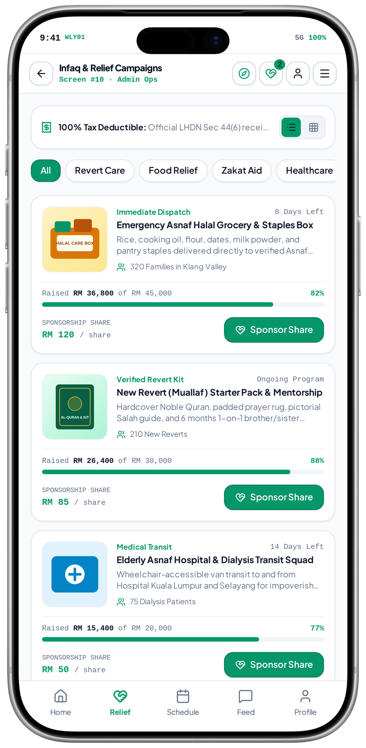
EXTENDED CONCEPT / MRM DIGITAL COMMUNITY PLATFORM
Relief campaigns connect public interest to a defined purpose
A transparent campaign should explain its purpose and owner before a person considers a contribution.
Extended concept · fundraising / authority approval required
Approved programme / purpose
Campaign discovery
Purpose / provisions detail
publishes
explains
MRM defines the intended relief initiative
Categories, information and display period
Explain what is being supported
selects
approves
Authority & claim review
Contribution allocation
Recorded contribution status
continues
Check permissions, tax wording and rights
A separate conditional financial journey
Only verified transaction outcomes
CRITICAL CONNECTION TO GET RIGHT
Authority & claim review → Campaign discovery → Purpose / provisions detail
MVP 10 · Infaq & Relief Campaigns
Measure after implementation: Approved campaign information; correct status; purpose clarity
MRM / ZYLAX TECHNOLOGIES
PROPOSED CONNECTIONS / MVP UI DOES NOT VERIFY BACKEND BEHAVIOUR
57 / 72
Notes:
{
"feature": "campaigns",
"owner": "MRM + Zylax",
"scope": "Extended concept \u00b7 fundraising / authority approval required",
"why": "A transparent campaign should explain its purpose and owner before a person considers a contribution.",
"measure": "Approved campaign information; correct status; purpose clarity",
"decision": "The filename says catalog; the visible screen is Infaq & Relief Campaigns, not a marketplace.",
"screen_evidence": [
"Infaq & Relief Campaigns"
],
"connections": [
[
"Approved programme / purpose",
"publishes",
"Campaign discovery"
],
[
"Authority & claim review",
"approves",
"Campaign discovery"
],
[
"Campaign discovery",
"explains",
"Purpose / provisions detail"
],
[
"Purpose / provisions detail",
"selects",
"Contribution allocation"
],
[
"Contribution allocation",
"continues",
"Recorded contribution status"
]
]
}
Screen UI is evidence of a visual state, not tested persistence, permissions, live APIs, religious approval, tax certification, payment or production impact. Only corrected Drive images are used.

Slide 82
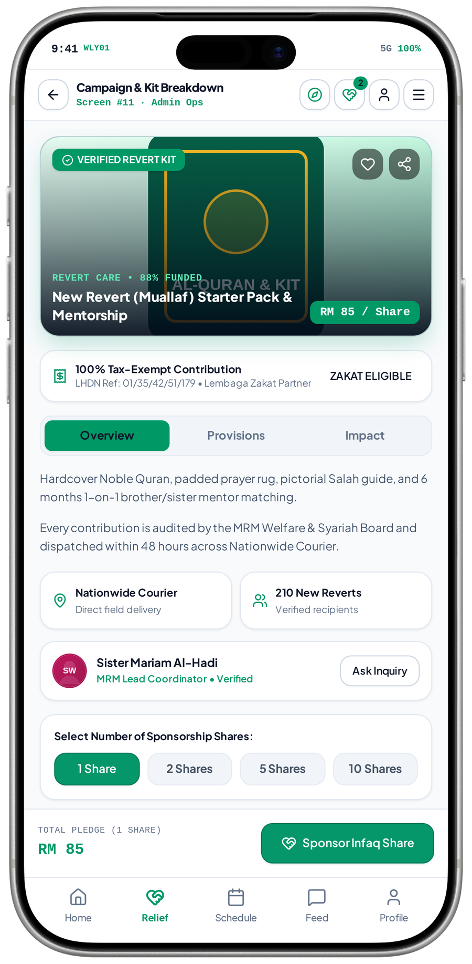
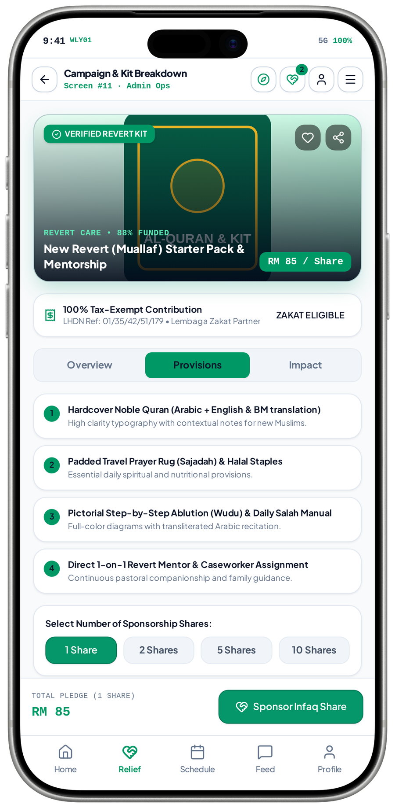
EXTENDED CONCEPT / MRM DIGITAL COMMUNITY PLATFORM
Campaign detail connects a pledge to explicit provisions
Clear provisions and responsible ownership help supporters understand the intended purpose without relying on unsupported impact claims.
Extended concept · distinct Overview and Provisions tabs
Campaign selection
Purpose & provision detail
Contribution selection
opens
selects
Choose an approved relief initiative
Overview, contents and responsible contact
Quantity or supported allocation choice
reviews
explains
continues
Claims / rights approval
Permitted impact information
Verified status / confirmation
No assumed tax status or guaranteed delivery
Only approved, consented and evidenced material
Do not claim completion before verification
CRITICAL CONNECTION TO GET RIGHT
MVP 11 · Campaign detail · Overview
MVP 37 · Campaign detail · Provisions
Claims / rights approval → Purpose & provision detail → Contribution selection
Measure after implementation: Approved provisions; amount calculation; correct purpose selection
MRM / ZYLAX TECHNOLOGIES
PROPOSED CONNECTIONS / MVP UI DOES NOT VERIFY BACKEND BEHAVIOUR
58 / 72
Notes:
{
"feature": "campaign_detail",
"owner": "MRM + Zylax",
"scope": "Extended concept \u00b7 distinct Overview and Provisions tabs",
"why": "Clear provisions and responsible ownership help supporters understand the intended purpose without relying on unsupported impact claims.",
"measure": "Approved provisions; amount calculation; correct purpose selection",
"decision": "\u201cProduct detail\u201d is a generic filename. These are relief-purpose tabs; delivery, tax and partnership claims are unverified.",
"screen_evidence": [
"Campaign detail \u00b7 Overview",
"Campaign detail \u00b7 Provisions"
],
"connections": [
[
"Campaign selection",
"opens",
"Purpose & provision detail"
],
[
"Claims / rights approval",
"reviews",
"Purpose & provision detail"
],
[
"Purpose & provision detail",
"selects",
"Contribution selection"
],
[
"Purpose & provision detail",
"explains",
"Permitted impact information"
],
[
"Contribution selection",
"continues",
"Verified status / confirmation"
]
]
}
Screen UI is evidence of a visual state, not tested persistence, permissions, live APIs, religious approval, tax certification, payment or production impact. Only corrected Drive images are used.

Slide 83
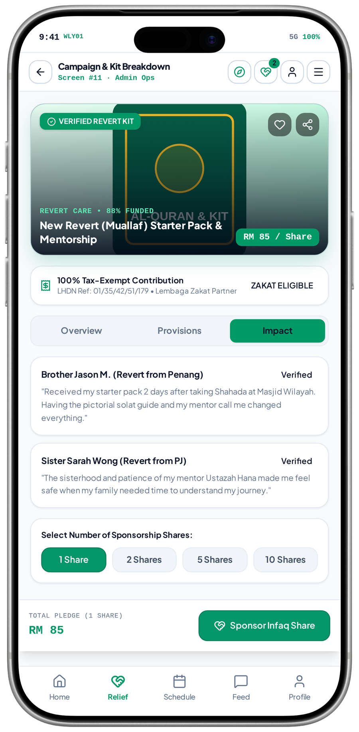
EXTENDED CONCEPT / MRM DIGITAL COMMUNITY PLATFORM
Impact information connects an outcome to trustworthy communication
Verified and consented evidence can explain value; a sample testimonial must never be presented as a proven result.
Extended concept · sample Impact tab, not verified testimonials
Verified service outcome
Approved impact record
Public campaign / report
evidences
publishes
An accountable event and confirmation exist
Check evidence, privacy and consent
Use only permitted, supported statements
permits
aggregates
corrects
Beneficiary consent & privacy
Aggregate programme insight
Content correction / withdrawal
Exclude identifying private case details
MRM reviews responsible summaries
Remove material when permission changes
CRITICAL CONNECTION TO GET RIGHT
Beneficiary consent & privacy → Approved impact record → Public campaign / report
MVP 38 · Campaign detail · sample Impact
Measure after implementation: Evidence traceability; consent; approval and correction records
MRM / ZYLAX TECHNOLOGIES
PROPOSED CONNECTIONS / MVP UI DOES NOT VERIFY BACKEND BEHAVIOUR
59 / 72
Notes:
{
"feature": "impact",
"owner": "MRM + Zylax",
"scope": "Extended concept \u00b7 sample Impact tab, not verified testimonials",
"why": "Verified and consented evidence can explain value; a sample testimonial must never be presented as a proven result.",
"measure": "Evidence traceability; consent; approval and correction records",
"decision": "The statements and verification badges in this capture are illustrative; no testimonial has been independently confirmed.",
"screen_evidence": [
"Campaign detail \u00b7 sample Impact"
],
"connections": [
[
"Verified service outcome",
"evidences",
"Approved impact record"
],
[
"Beneficiary consent & privacy",
"permits",
"Approved impact record"
],
[
"Approved impact record",
"publishes",
"Public campaign / report"
],
[
"Approved impact record",
"aggregates",
"Aggregate programme insight"
],
[
"Public campaign / report",
"corrects",
"Content correction / withdrawal"
]
]
}
Screen UI is evidence of a visual state, not tested persistence, permissions, live APIs, religious approval, tax certification, payment or production impact. Only corrected Drive images are used.

Slide 84
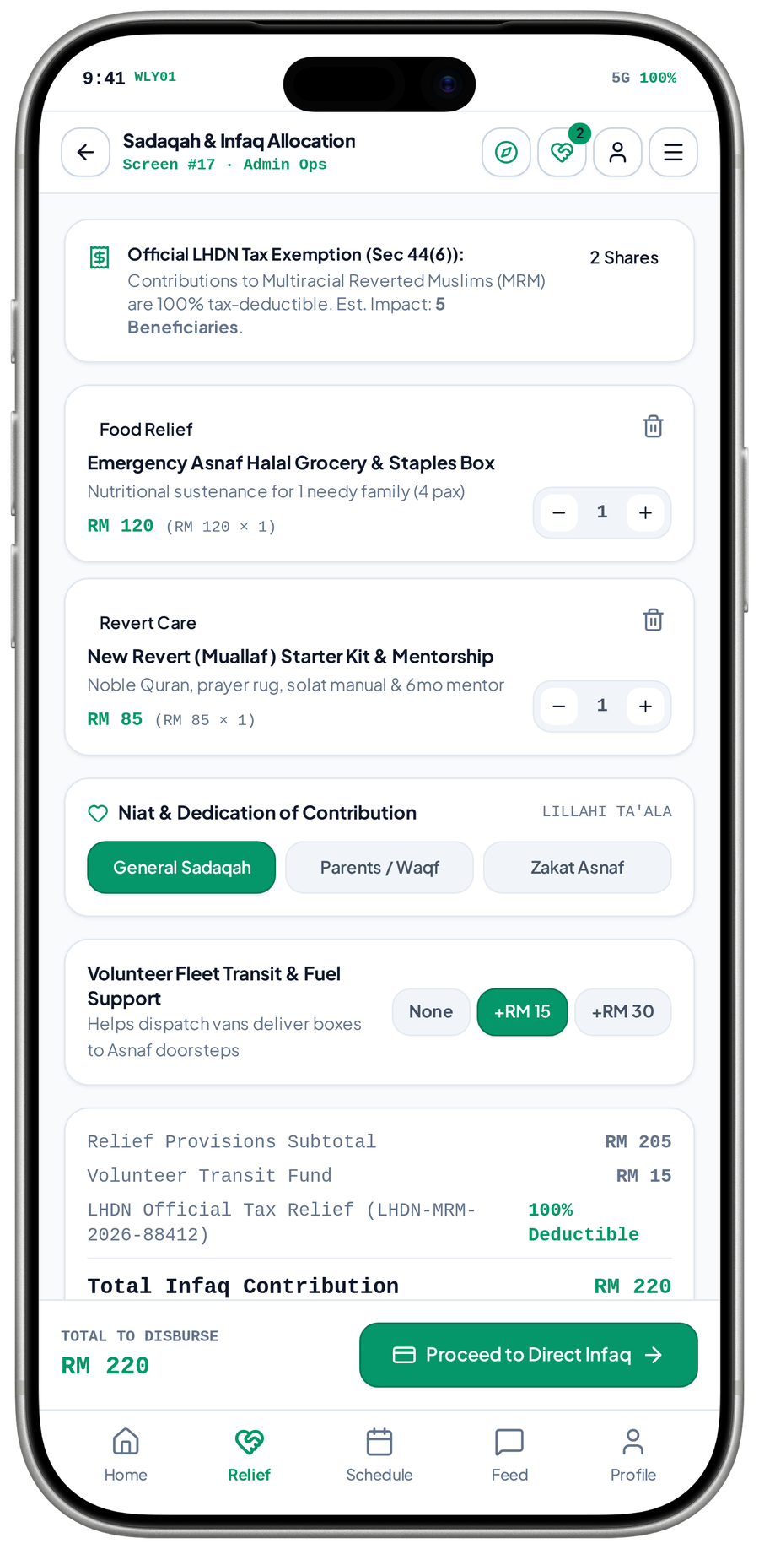
EXTENDED CONCEPT / MRM DIGITAL COMMUNITY PLATFORM
Contribution allocation connects intention, purpose and amount
An explicit allocation and transparent total reduce confusion between donations, business sponsorship and teacher subscriptions.
Extended concept · Sadaqah / Infaq allocation, not retail cart
Approved campaign / provision
Contribution allocation
Amount / purpose review
selects
calculates
An authorised purpose is selected
Purpose, quantity and optional support
Make the intended commitment clear
confirms
governs
Financial policy & permission
Conditional payment journey
Receipt / status record
verifies
Terms, handling and authority requirements
A separately authorised financial service
Only after verified transaction evidence
CRITICAL CONNECTION TO GET RIGHT
Financial policy & permission → Contribution allocation → Amount / purpose review
MVP 17 · Sadaqah & Infaq Allocation
Measure after implementation: Amount consistency; purpose consent; valid financial-state transition
MRM / ZYLAX TECHNOLOGIES
PROPOSED CONNECTIONS / MVP UI DOES NOT VERIFY BACKEND BEHAVIOUR
60 / 72
Notes:
{
"feature": "allocation",
"owner": "MRM + Zylax",
"scope": "Extended concept \u00b7 Sadaqah / Infaq allocation, not retail cart",
"why": "An explicit allocation and transparent total reduce confusion between donations, business sponsorship and teacher subscriptions.",
"measure": "Amount consistency; purpose consent; valid financial-state transition",
"decision": "Prototype amounts are examples. Religious purpose, handling and tax wording require approval; this is not goods checkout.",
"screen_evidence": [
"Sadaqah & Infaq Allocation"
],
"connections": [
[
"Approved campaign / provision",
"selects",
"Contribution allocation"
],
[
"Financial policy & permission",
"governs",
"Contribution allocation"
],
[
"Contribution allocation",
"calculates",
"Amount / purpose review"
],
[
"Amount / purpose review",
"confirms",
"Conditional payment journey"
],
[
"Conditional payment journey",
"verifies",
"Receipt / status record"
]
]
}
Screen UI is evidence of a visual state, not tested persistence, permissions, live APIs, religious approval, tax certification, payment or production impact. Only corrected Drive images are used.

Slide 85
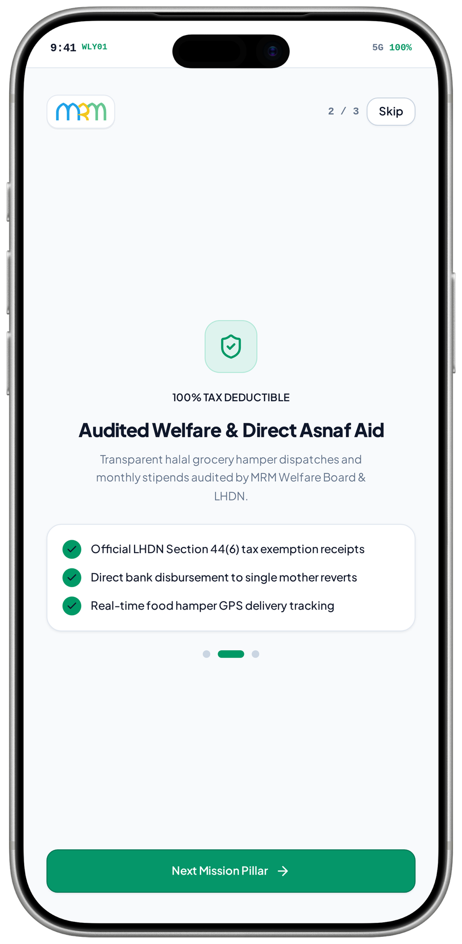
EXTENDED CONCEPT / MRM DIGITAL COMMUNITY PLATFORM
Donation payment is separate from teacher billing and zakat referral
Financial confirmation needs verified transactions, approved authority wording and reconciliation before any receipt or disbursement claim.
Extended concept · earlier proposal excludes zakat collection / disbursement
Approved allocation
Authorised payment process
Verified transaction state
initiates
verifies
A permitted purpose and amount are confirmed
Provider, account ownership and controls
Resolve success, failure or pending
confirms
authorises
Authority / financial approval
Permitted receipt / update
Reconciliation / staff oversight
reconciles
Collection, tax and disbursement permissions
Only issue what is legally authorised
Track the verified financial state
CRITICAL CONNECTION TO GET RIGHT
Authority / financial approval → Authorised payment process → Verified transaction state
MVP 35 · Onboarding · welfare / aid pillar
Measure after implementation: Payment verification; failed / duplicate handling; reconciliation
MRM / ZYLAX TECHNOLOGIES
PROPOSED CONNECTIONS / MVP UI DOES NOT VERIFY BACKEND BEHAVIOUR
61 / 72
Notes:
{
"feature": "donation_payment",
"owner": "MRM + Zylax",
"scope": "Extended concept \u00b7 earlier proposal excludes zakat collection / disbursement",
"why": "Financial confirmation needs verified transactions, approved authority wording and reconciliation before any receipt or disbursement claim.",
"measure": "Payment verification; failed / duplicate handling; reconciliation",
"decision": "The visible image is onboarding pillar 2, not checkout. Payment / receipt captures are withheld; gateway, tax and transfer claims remain unverified.",
"screen_evidence": [
"Onboarding \u00b7 welfare / aid pillar"
],
"connections": [
[
"Approved allocation",
"initiates",
"Authorised payment process"
],
[
"Authority / financial approval",
"authorises",
"Authorised payment process"
],
[
"Authorised payment process",
"verifies",
"Verified transaction state"
],
[
"Verified transaction state",
"confirms",
"Permitted receipt / update"
],
[
"Permitted receipt / update",
"reconciles",
"Reconciliation / staff oversight"
]
]
}
Screen UI is evidence of a visual state, not tested persistence, permissions, live APIs, religious approval, tax certification, payment or production impact. Only corrected Drive images are used.

Slide 86
DELIVERY STRATEGY / MRM DIGITAL COMMUNITY PLATFORM
Delivery follows dependencies, not disconnected screen counts
The earlier proposal estimates 3–4 months for agreed scope, subject to required inputs and external readiness.
Foundation
Working service flows
Source / licence audit, journeys, access matrix, content and acceptance specification.
Identity, verification, requests, teachers, learning and private records as complete vertical journeys.
Connected platform
Acceptance & release
Utilities, website, sponsors, notifications, reports and operational configuration.
Meaningful permissions / device / billing checks, MRM UAT, training and client-owned submissions.
Extended collection / payment / receipt concepts require separate authority, technical assessment and written scope decisions.
MRM / ZYLAX TECHNOLOGIES
PROPOSED CONNECTIONS / MVP UI DOES NOT VERIFY BACKEND BEHAVIOUR
62 / 72

Slide 87
OPERATING MODEL / MRM DIGITAL COMMUNITY PLATFORM
The software and the operating service need clear owners
MRM defines policies and owns its operational decisions; Zylax implements and verifies the agreed software.
MRM programme owners
MRM service operators
Approval criteria, safeguarding policy, content rights, teacher terms and sponsor agreements.
Case queues, interviews, follow-up, moderation, learning programmes and partner relationships.
Zylax delivery team
Client-owned accounts
Template-consistent implementation, server permissions, persistence, testing, documentation and training.
Hosting, domain, store verification, billing setup and third-party access with authorised collaboration.
Store submission is a delivery milestone. Public approval and release dates remain controlled by the stores.
MRM / ZYLAX TECHNOLOGIES
PROPOSED CONNECTIONS / MVP UI DOES NOT VERIFY BACKEND BEHAVIOUR
63 / 72

Slide 88
ACCEPTANCE EVIDENCE / MRM DIGITAL COMMUNITY PLATFORM
Acceptance should prove the connections actually work
Each check follows an end-to-end journey and attempts the important denied, failed and recovery paths.
Identity → correct records
Applicant → eligible service
Request → confirmed outcome
Recovery, role activation and direct API denial.
Evidence / interview / decision and immediate suspension.
Triage, matching, assignment, reassignment and closure.
Teacher → permitted publication
Programme → participant access
Confidential case → safe follow-up
Approval, billing state, allowance and independent moderation.
Registration, reminder, session and recording rights.
Unrelated accounts, evidence files, exports and safe notifications.
Acceptance follows proven journeys, permission boundaries and recoverable failures, with findings recorded and retested.
MRM / ZYLAX TECHNOLOGIES
PROPOSED CONNECTIONS / MVP UI DOES NOT VERIFY BACKEND BEHAVIOUR
64 / 72

Slide 89
IMPORTANCE & PRIORITIES / MRM DIGITAL COMMUNITY PLATFORM
Why every capability belongs in the overall product
Different features create different kinds of value; their dependencies determine the implementation sequence.
Trust foundation
Service outcomes
Identity, permissions, approved sources, file access, reliable state and audit make other features safe to operate.
Triage, verification, assignment and follow-up turn a need into an accountable outcome.
Everyday engagement
Sustainable growth
Prayer, Quran, guidance, search and programmes keep the platform useful for the wider Muslim community.
Teacher entitlements and sponsor delivery connect revenue to explicit privileges and accountable recognition.
Sequence by dependency and operational readiness; keep approved modules visible rather than silently dropping difficult work.
MRM / ZYLAX TECHNOLOGIES
PROPOSED CONNECTIONS / MVP UI DOES NOT VERIFY BACKEND BEHAVIOUR
65 / 72

Slide 90
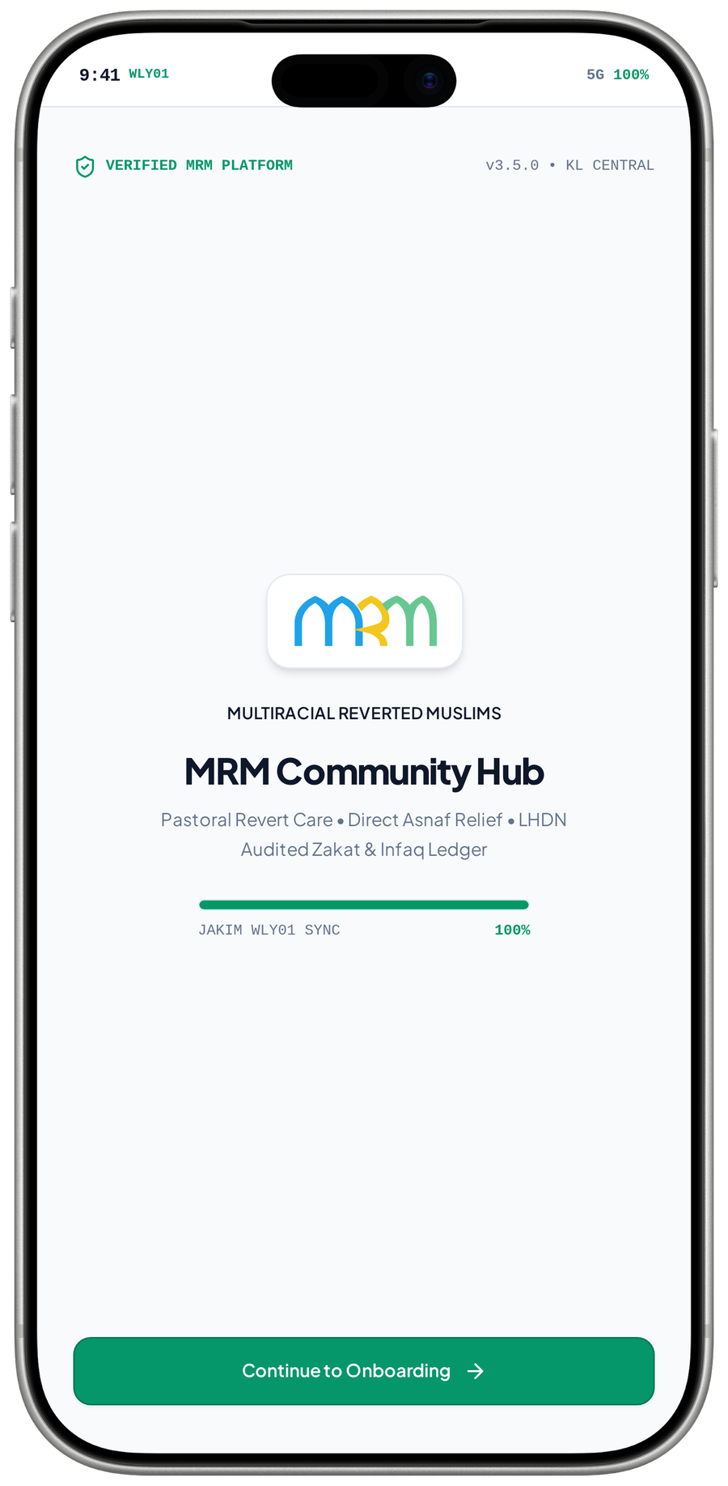
SCREENSHOT EVIDENCE / MRM DIGITAL COMMUNITY PLATFORM
What the MVP images establish, and what they do not
All 48 corrected Drive captures were reviewed as UI states, not as independent proof of operational results.
Visible evidence
The images establish labels, screen structure, selected tabs, role states and the controls that are visible.
Not yet verified
Persistence, working APIs, live biometrics, encrypted chat, payments, tax status and operational impact need separate checks.
Religious / policy approval
Sources, local conventions, classifications, verification rules and safeguarding coverage require responsible approval.
MVP 01 · Brand / loading screen
No statistics, audit badge, testimonial or “sync” label in a prototype is represented here as a proven result.
MRM / ZYLAX TECHNOLOGIES
PROPOSED CONNECTIONS / MVP UI DOES NOT VERIFY BACKEND BEHAVIOUR
66 / 72

Slide 91
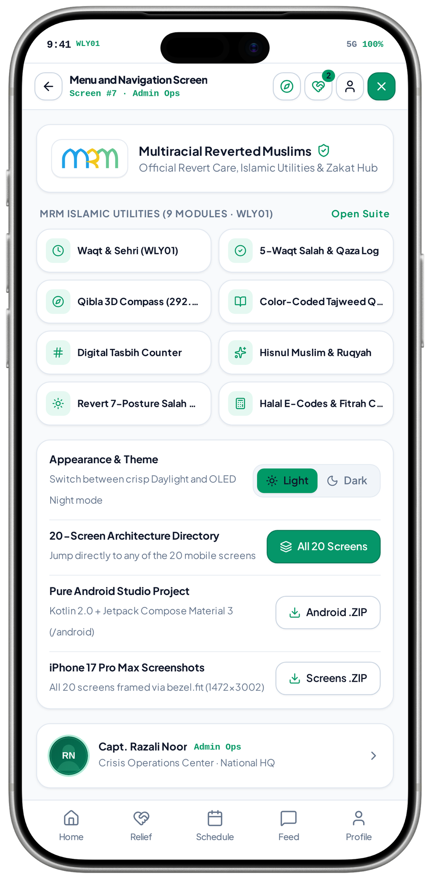
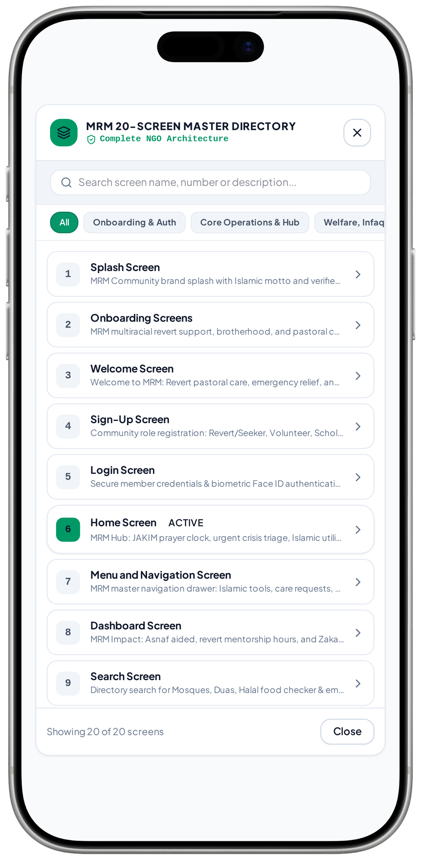
SOURCE / ARCHITECTURE REVIEW / MRM DIGITAL COMMUNITY PLATFORM
Internal navigation is not a new technology commitment
The directory and menu are useful audit views; development helpers do not establish the delivered app framework.
Preserve the chosen source strategy
The prior requirement is Zabi v4.3 / Flutter and template preservation. A menu saying Kotlin or a PWA helper is not approval to replace it.
Audit before implementation claims
Inspect the actual source, licence, dependencies, routes, backend and platform targets before reconciling the prototype with release requirements.
MVP 07 · Menu and utility directory
MVP 46 · Screen-directory modal
Capture 47 is developer installation help and is excluded from client feature imagery. No source architecture was validated here.
MRM / ZYLAX TECHNOLOGIES
PROPOSED CONNECTIONS / MVP UI DOES NOT VERIFY BACKEND BEHAVIOUR
67 / 72

Slide 92
IMAGE AUDIT & COVERAGE / MRM DIGITAL COMMUNITY PLATFORM
Every corrected capture has one deliberate use or exclusion
Variants are identified by what changes on screen; no image is relabelled to imply a different completed feature.
48 images reviewed
45 distinct visual uses
Content labels, hashes, selected states and use locations are recorded in the accompanying screen register.
Distinct screens, roles, tabs, modals and theme states are used once each in this deck.
3 explicit exclusions
Corrected explanations
Payment form 18 and receipt 42 contain a full identity number. Image 47 is developer installation help.
Catalog / product / cart are relief-purpose views. Mentor roster is not subscription approval; a simulation is not a live sensor test.
See Screen_Audit.json / Screen_Audit.md for the full file-to-page register and capture-specific findings.
MRM / ZYLAX TECHNOLOGIES
PROPOSED CONNECTIONS / MVP UI DOES NOT VERIFY BACKEND BEHAVIOUR
68 / 72

Slide 93
TRACEABLE FEATURE INDEX / MRM DIGITAL COMMUNITY PLATFORM
Feature connection index 1 / 2
Choose an entry to open its individual network; each page explains the connection value and what to verify.
06 Entry
19 Salahguide
07 Registration
20 Asma
08 Authentication
21 Halal
09 Roles
22 Islamic Calendar
10 Home
23 Estimate
11 Search
24 Requests
12 Prayer
25 Vetting
13 Tracker
26 Gender
14 Mosques
27 Matching
15 Quran
28 Assignments
16 Tasbih
29 Private
17 Dua
30 Safeguard
18 Remembrance
31 Chat
The separate 52-map atlas uses the same connection model, with larger diagrams and its own feature navigation.
MRM / ZYLAX TECHNOLOGIES
PROPOSED CONNECTIONS / MVP UI DOES NOT VERIFY BACKEND BEHAVIOUR
69 / 72

Slide 94
TRACEABLE FEATURE INDEX / MRM DIGITAL COMMUNITY PLATFORM
Feature connection index 2 / 2
Choose an entry to open its individual network; each page explains the connection value and what to verify.
32 Referral
45 Activity
33 Recognition
46 Admin
34 Teacher
47 Reports
35 Posts
48 Security
36 Subscriptions
49 Settings
37 Billing
50 Reliability
38 Learning
51 Empty
39 Mentoring
52 Error
40 Schedule
57 Campaigns
41 Feed
58 Campaign Detail
42 Sponsors
59 Impact
43 Website
60 Allocation
44 Alerts
61 Donation Payment
The separate 52-map atlas uses the same connection model, with larger diagrams and its own feature navigation.
MRM / ZYLAX TECHNOLOGIES
PROPOSED CONNECTIONS / MVP UI DOES NOT VERIFY BACKEND BEHAVIOUR
70 / 72

Slide 95
DECISION RECORD / MRM DIGITAL COMMUNITY PLATFORM
Resolve the remaining decisions without inventing scope
A strong delivery specification separates agreed capabilities, operating configuration and genuinely new obligations.
Source & platform
Service & teaching policies
Confirm current Zabi source, licence, template reference and Android / iOS release architecture.
Agree access exceptions, interview evidence, case escalation, mentor permissions, teacher plans and historical-content visibility.
External inputs
Extended financial concepts
Confirm religious sources, partner sharing, mapping, streaming / recordings and applicable store billing.
Confirm collection authority, payment provider, reconciliation, disbursement and lawful receipt wording before a scope commitment.
Screen concepts inform discussion. They do not by themselves amend an approved SOW or establish authority access.
MRM / ZYLAX TECHNOLOGIES
PROPOSED CONNECTIONS / MVP UI DOES NOT VERIFY BACKEND BEHAVIOUR
71 / 72

Slide 96
NEXT STEPS / MRM DIGITAL COMMUNITY PLATFORM
A platform MRM can use, govern and grow
The goal is a coherent service for the wider Muslim community, with focused care and accountable delivery.
Useful daily. Trusted in learning.
Responsible in care.
Confirm
Implement
Demonstrate
Launch responsibly
Agree journeys, policy owners and acceptance criteria.
Build the connected flows with real permissions and persistence.
Review evidence against meaningful end-to-end checks.
Train MRM staff and submit through client-owned accounts.
Next step: nominate MRM’s decision makers and conduct the source, service-policy and implementation workshop.
MRM / ZYLAX TECHNOLOGIES
PROPOSED CONNECTIONS / MVP UI DOES NOT VERIFY BACKEND BEHAVIOUR
72 / 72

