Slide 1



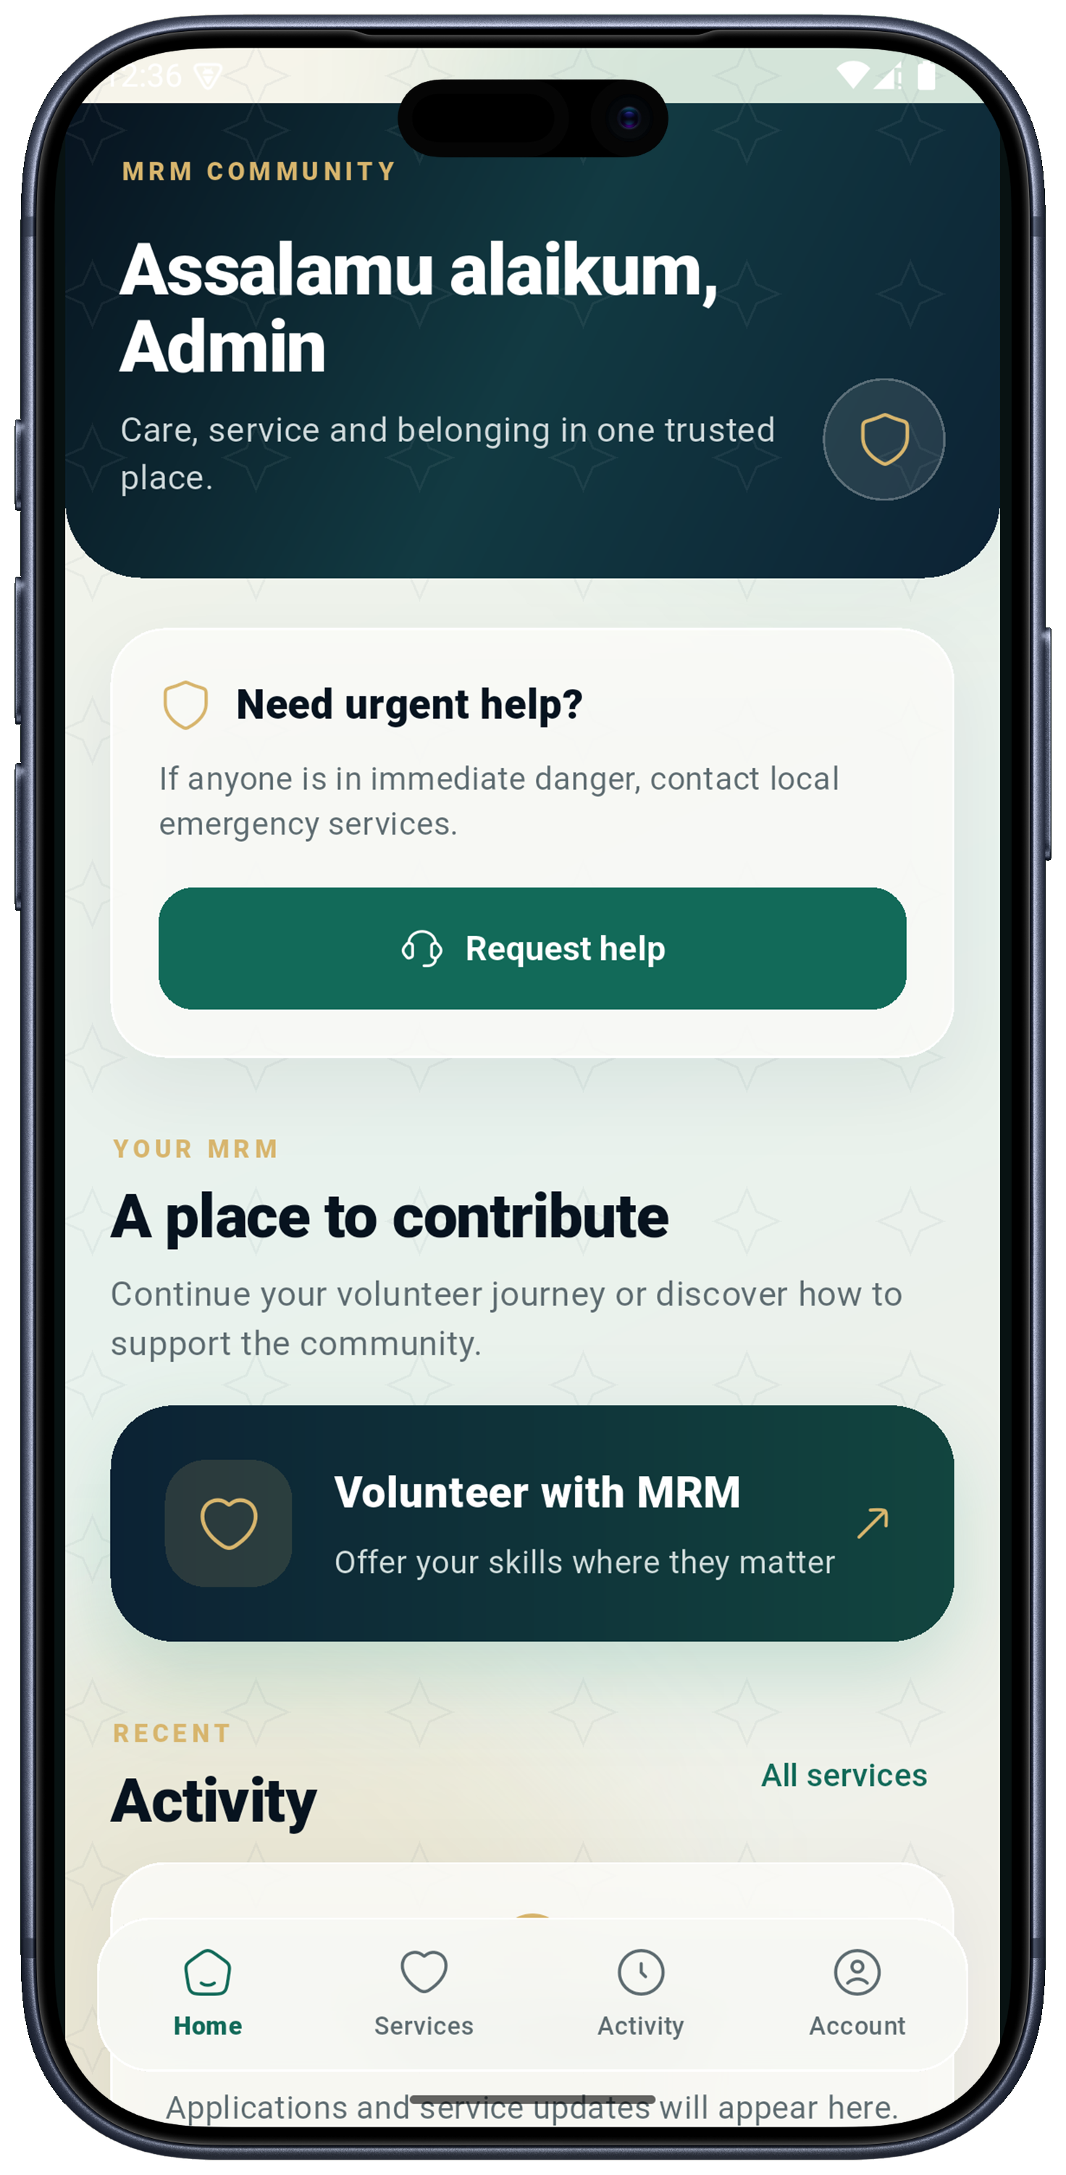
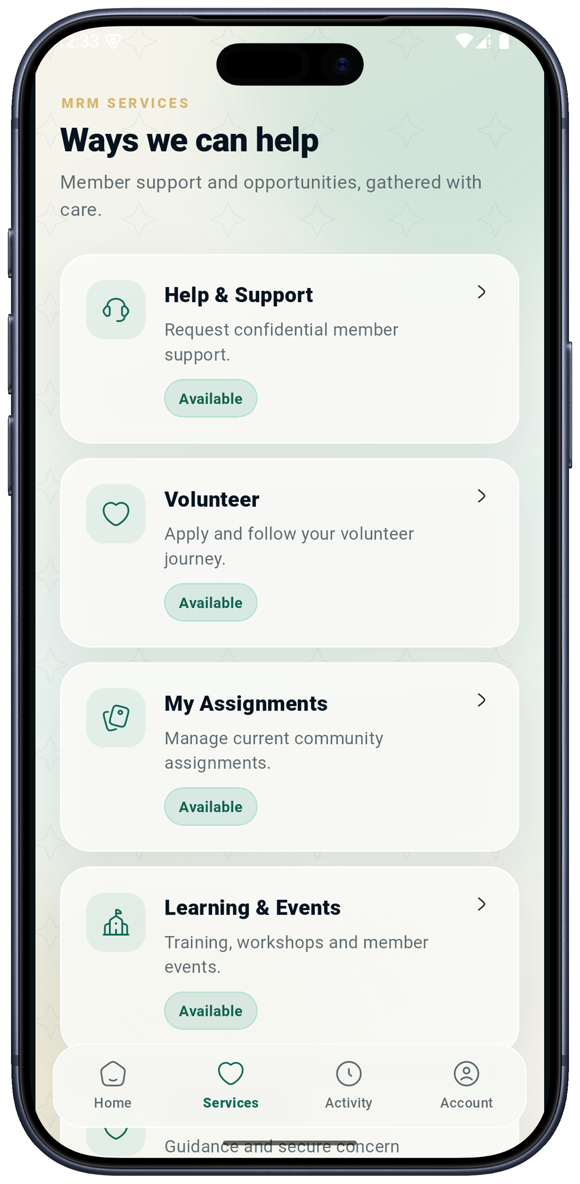
INTRODUCTION / MRM DIGITAL COMMUNITY PLATFORM
MRM Digital Community Platform
Faith, learning and community care for all Muslims.
Bismillahirrahmanirrahim
One community.
Connected through care.
Daily Islamic tools, trusted learning and coordinated assistance, with dedicated support for reverts and people who need it.
ANDROID + iOS
PUBLIC WEBSITE
MRM OPERATIONS
MRM / ZYLAX TECHNOLOGIES
PRODUCT VISION / PROPOSED DELIVERY
01 / 58
Notes:
Prepared from the supplied handoff, eight-page proposal, 29-slide presentation and screenshots.zip. Audience expanded to all Muslims per the current user request. No project pricing or fabricated operational outcomes. Screenshots show provided demo/capture states, not verified production behaviour.
Evidence: mobile/09_loaded_alt.png, mobile/03_services.png
Screenshots are provided interface/demo evidence. No running application or production data was validated. Diagrams specify proposed journeys; they do not certify implementation. Audience is all Muslims, with specialised MRM revert support. Marketplace excluded; subscriptions apply only to teachers.

Slide 2



VISION / MRM DIGITAL COMMUNITY PLATFORM
Built for the wider Muslim community
Universal daily value, with focused services where additional support is needed.
Everyday faith
Lifelong learning
Community care
Prayer, Quran, Qibla and remembrance give Muslims a reason to return throughout the week.
Approved teachers, live classes and recorded resources connect learners with trusted content.
Members seek help, volunteers contribute and MRM coordinates safe follow-up.
Revert support remains a core MRM service. It sits within a platform that welcomes all Muslims.
Audience → daily use → learning → participation → coordinated support
MRM / ZYLAX TECHNOLOGIES
PROPOSED WORKFLOW
02 / 58
Notes:
Evidence: Native diagram / proposed capability, based on supplied scope documents.
Screenshots are provided interface/demo evidence. No running application or production data was validated. Diagrams specify proposed journeys; they do not certify implementation. Audience is all Muslims, with specialised MRM revert support. Marketplace excluded; subscriptions apply only to teachers.

Slide 3



VISION / MRM DIGITAL COMMUNITY PLATFORM
One platform, clearly defined roles
An account can hold more than one authorised role; access follows the role and the individual record.
Muslim users
Members / support seekers
Volunteer applicants
Use daily tools and approved learning; register where a personal service requires an account.
Submit requests, choose safe contact preferences and follow their own case updates.
Apply, supply evidence and attend an interview before restricted service access.
Approved volunteers
Approved teachers
MRM staff
Receive eligible work, manage assigned service and view verified recognition.
Submit learning and advertisements; subscriptions govern designated publishing privileges.
Verify, triage, safeguard, moderate and administer within duty-based permissions.
Discover freely • Authenticate for personal records • Approve before privileged access
MRM / ZYLAX TECHNOLOGIES
PROPOSED WORKFLOW
03 / 58
Notes:
Evidence: Native diagram / proposed capability, based on supplied scope documents.
Screenshots are provided interface/demo evidence. No running application or production data was validated. Diagrams specify proposed journeys; they do not certify implementation. Audience is all Muslims, with specialised MRM revert support. Marketplace excluded; subscriptions apply only to teachers.

Slide 4




CONTENTS / MRM DIGITAL COMMUNITY PLATFORM
Explore the complete platform
Click a section card in PowerPoint or the PDF to jump to its opening page.
01 Experience
02 Care & volunteering
03 Learning & revenue
Pages 05–12
Ecosystem, features, app navigation and current mobile screens.
Pages 13–23
Assistance, verification, safe discovery, private cases and zakat referrals.
Pages 24–31
Teachers, subscription flows, classes, sponsors and website journeys.
04 Islamic utilities
05 MRM operations
06 Delivery & evidence
Pages 32–41
Prayer, Qibla, Quran, remembrance, calendar and content administration.
Pages 42–47
Dashboard, accounts, configuration, policies, reports and security.
Pages 48–50
Milestones, screen coverage and acceptance responsibilities.
Every page footer returns to this contents page. Feature chips link related journeys.
NEW 07 FEATURE CONNECTIVITY MIND MAPS / PAGES 51–58 / SELECT TO EXPLORE
MRM / ZYLAX TECHNOLOGIES
INTERACTIVE CONTENTS
04 / 58
Notes:
Evidence: Native diagram / proposed capability, based on supplied scope documents.
Screenshots are provided interface/demo evidence. No running application or production data was validated. Diagrams specify proposed journeys; they do not certify implementation. Audience is all Muslims, with specialised MRM revert support. Marketplace excluded; subscriptions apply only to teachers.

Slide 5
EXPERIENCE / MRM DIGITAL COMMUNITY PLATFORM
How every feature connects
Shared identity, content and permissions connect public discovery, daily use and community service.
Islamic utilities
Public website
Learning
Prayer • Quran • Qibla • remembrance
Discover • participate • download
Teachers • classes • recordings
MRM PLATFORM
Shared identity • permissions • content
Community care
MRM operations
Sustainable support
Requests • volunteers • zakat
Moderation • cases • reports
Teacher subscriptions • sponsors
Public information supports discovery; private records remain within authorised service journeys.
MRM / ZYLAX TECHNOLOGIES
PROPOSED FEATURE ARCHITECTURE
05 / 58
Notes:
Evidence: Native diagram / proposed capability, based on supplied scope documents.
Screenshots are provided interface/demo evidence. No running application or production data was validated. Diagrams specify proposed journeys; they do not certify implementation. Audience is all Muslims, with specialised MRM revert support. Marketplace excluded; subscriptions apply only to teachers.

Slide 6


EXPERIENCE / MRM DIGITAL COMMUNITY PLATFORM
Complete feature landscape
The proposed service scope and the supplied template functions are shown with their distinct purposes.
Daily Islamic practice
Assistance & volunteering
Teachers & learning
Prayer times • Qibla • Quran • dua • dhikr
Hadith • Hijri/Ramadan • nearby mosques
Informational zakat estimate
Requests • alerts • assignment • case tracking
Evidence review • online interview • discovery
Gender access • ranks • safeguarding
Teacher approval • posts • teaching ads
Teacher-only plans • verified entitlements
Live sessions • recordings • classes/events
Zakat & confidential support
Public engagement & sponsors
Operations & template library
Private faith/family intake • restricted staff
Consent • review • referral • follow-up
Authority-controlled eligibility/disbursement
Website • participation routes • content
Sponsor profiles • scheduled placements
Recognition • aggregate performance
Accounts • permissions • audit • reports
Categories • Sifat Names • Haram Codes
Existing donation/payment configuration
Marketplace excluded • Core participation stays free • Template-only functions are labelled on pages 40–41
MRM / ZYLAX TECHNOLOGIES
PROPOSED WORKFLOW
06 / 58
Notes:
Evidence: Native diagram / proposed capability, based on supplied scope documents.
Screenshots are provided interface/demo evidence. No running application or production data was validated. Diagrams specify proposed journeys; they do not certify implementation. Audience is all Muslims, with specialised MRM revert support. Marketplace excluded; subscriptions apply only to teachers.

Slide 7


EXPERIENCE / MRM DIGITAL COMMUNITY PLATFORM
A connected app journey
Navigation keeps daily use, personal service and role-specific work within one coherent experience.
01
02
03
04
Open the app
Choose a purpose
Use the right access
Follow progress
Daily tools and approved public resources.
Learn, seek support or contribute.
Sign in; verified roles unlock relevant work.
Requests, applications and learning updates.
Home
Services
My account
Daily value and service entry points
Assistance, volunteering and learning
Preferences and authorised role journeys
Daily tools ↔ learning • Services ↔ personal activity • Role changes ↔ authorised access
MRM / ZYLAX TECHNOLOGIES
PROPOSED WORKFLOW
07 / 58
Notes:
Evidence: Native diagram / proposed capability, based on supplied scope documents.
Screenshots are provided interface/demo evidence. No running application or production data was validated. Diagrams specify proposed journeys; they do not certify implementation. Audience is all Muslims, with specialised MRM revert support. Marketplace excluded; subscriptions apply only to teachers.

Slide 8
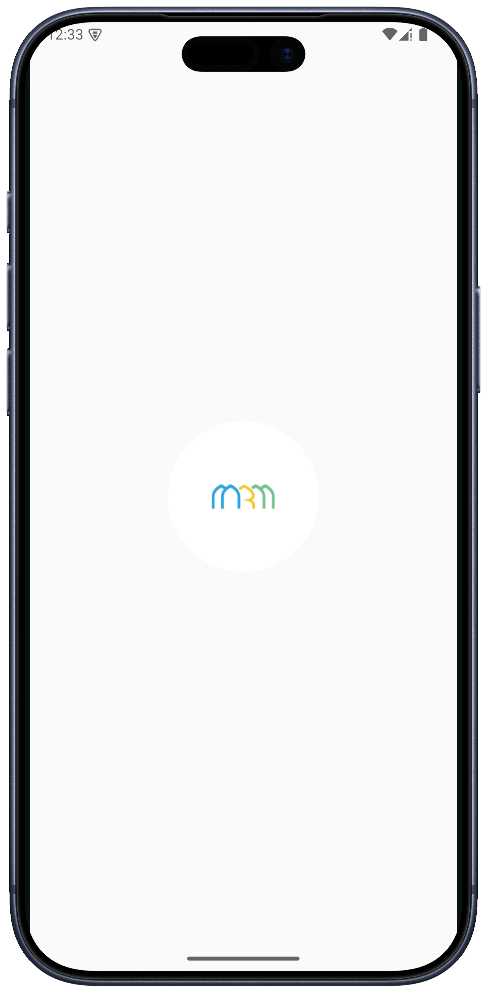
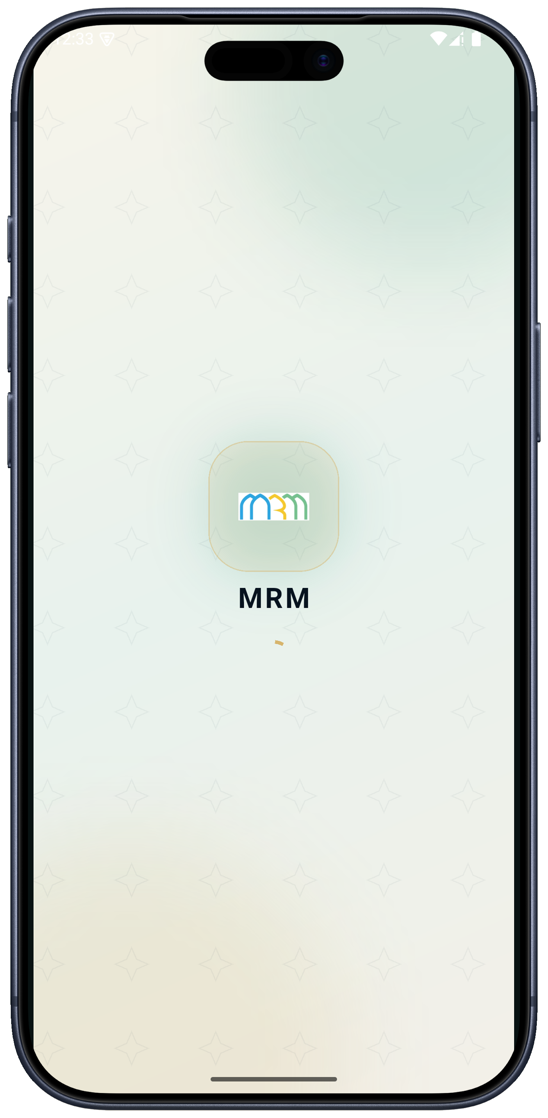
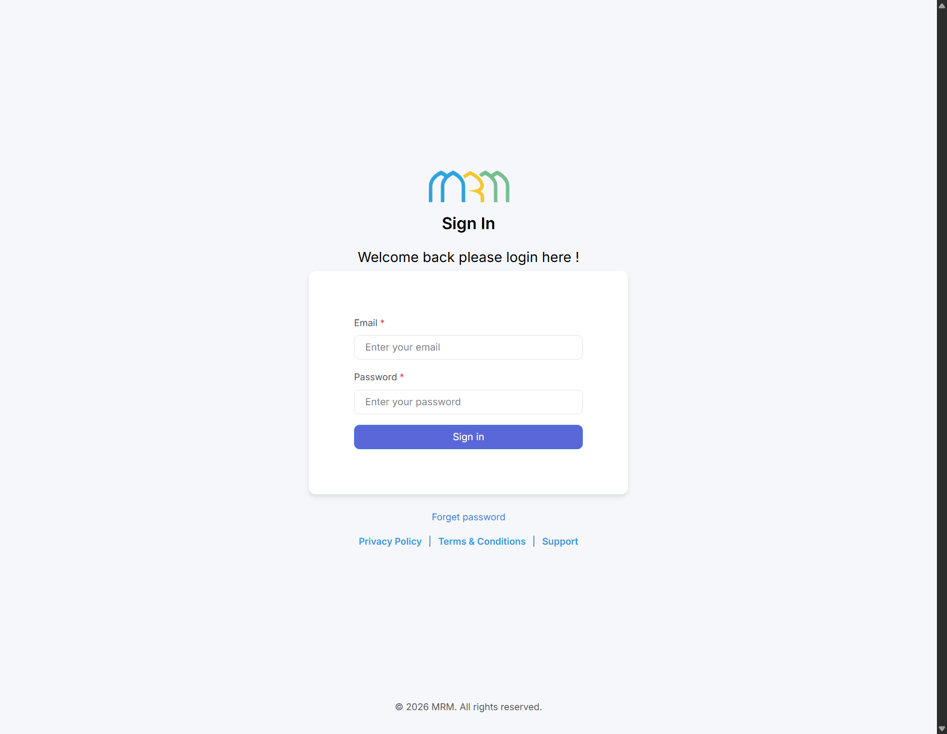
EXPERIENCE / MRM DIGITAL COMMUNITY PLATFORM
Entry, identity and session access
Brand introduction and authentication are separate stages in the user journey.
Account › 12
MRM / BACKEND
Personal access
Contact verification and recovery support personal records. Consent, location and notification choices remain explicit.
These mobile captures show entry states, not a completed sign-in form.
Provided administration sign-in screen
Capture 01 · logo / splash
Capture 02 · loading state
Identity → account → role eligibility → permitted records
MRM / ZYLAX TECHNOLOGIES
PROVIDED SCREENS + PROPOSED ACCOUNT FLOW
08 / 58
Notes:
Evidence: mobile/01_login.png, mobile/02_home.png, backend/01_login.png
Screenshots are provided interface/demo evidence. No running application or production data was validated. Diagrams specify proposed journeys; they do not certify implementation. Audience is all Muslims, with specialised MRM revert support. Marketplace excluded; subscriptions apply only to teachers.

Slide 9

EXPERIENCE / MRM DIGITAL COMMUNITY PLATFORM
Home: a clear route to participate
The loaded home capture combines a welcome, help entry point, volunteer participation and recent activity.
Assistance › 13
Daily tools › 32
Daily value
Connect Islamic tools and learning to recurring use.
Request assistance
Open a safe intake route and follow your own case.
Volunteer with MRM
Apply, verify and contribute to suitable service.
Provided loaded home screen
Home → daily tools [32] • Home → requests [13] • Home → volunteer onboarding [15]
MRM / ZYLAX TECHNOLOGIES
PROVIDED MOBILE SCREEN + PROPOSED CONNECTIONS
09 / 58
Notes:
Evidence: mobile/09_loaded_alt.png
Screenshots are provided interface/demo evidence. No running application or production data was validated. Diagrams specify proposed journeys; they do not certify implementation. Audience is all Muslims, with specialised MRM revert support. Marketplace excluded; subscriptions apply only to teachers.

Slide 10

EXPERIENCE / MRM DIGITAL COMMUNITY PLATFORM
Services: clear paths into community care
The supplied service captures show help, volunteering, assignments and learning entry points.
Volunteer › 15
Learning › 24
Help & support
Private intake with triage and controlled follow-up.
Volunteer & assignments
Verification precedes eligible work and assigned access.
Learning & events
Discover approved programmes and participation details.
Capture 03 · service hub
Capture 06 · same hub state
A service-menu capture does not demonstrate the request form, assignment detail or learning flow.
MRM / ZYLAX TECHNOLOGIES
PROVIDED MOBILE SCREENS + PROPOSED ROUTING
10 / 58
Notes:
Evidence: mobile/03_services.png, mobile/06_help_requests.png
Screenshots are provided interface/demo evidence. No running application or production data was validated. Diagrams specify proposed journeys; they do not certify implementation. Audience is all Muslims, with specialised MRM revert support. Marketplace excluded; subscriptions apply only to teachers.

Slide 11
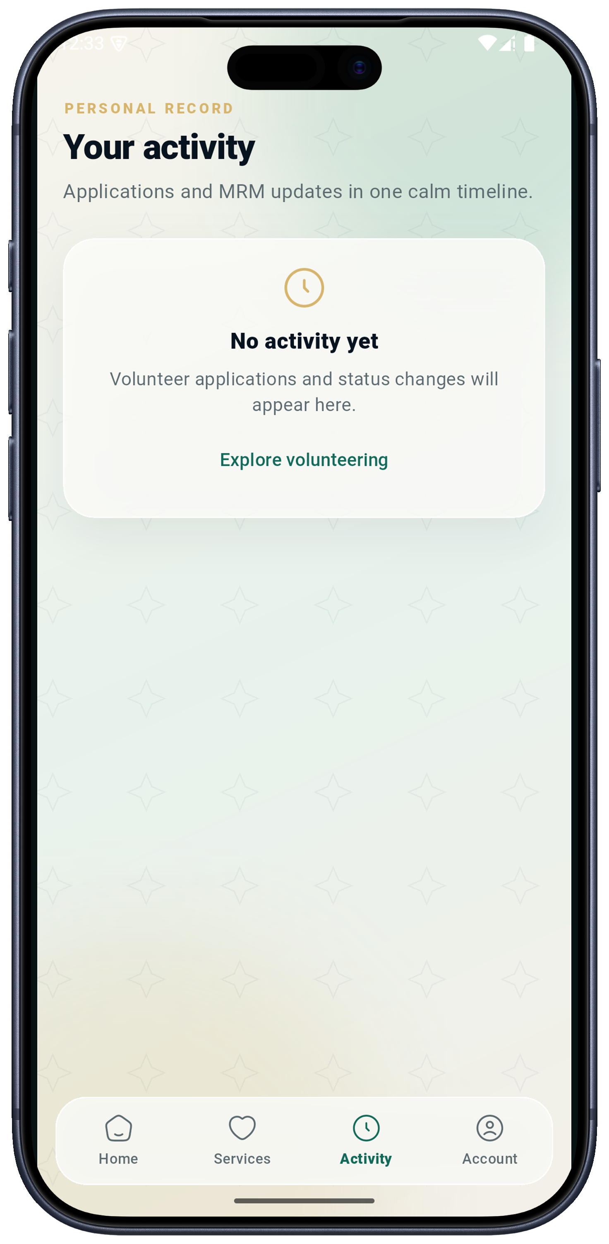

EXPERIENCE / MRM DIGITAL COMMUNITY PLATFORM
Activity: a personal service timeline
The current capture is an empty state; the proposed journey connects it to meaningful updates.
Alerts › 23
Requests & referrals
Applications & service
Acknowledgement, assignment changes and referral progress visible to the person concerned.
Verification outcomes and authorised assignment updates with a clear next action.
Learning updates
Controlled notifications
Class reminders and relevant publication updates link to approved content.
Open the app for details; sensitive descriptions stay out of lock-screen alerts.
Provided activity screen · empty state
Event → authorised recipient → notification → relevant detail → updated personal timeline
MRM / ZYLAX TECHNOLOGIES
PROVIDED EMPTY STATE + PROPOSED STATUS FLOW
11 / 58
Notes:
Evidence: mobile/04_activity.png
Screenshots are provided interface/demo evidence. No running application or production data was validated. Diagrams specify proposed journeys; they do not certify implementation. Audience is all Muslims, with specialised MRM revert support. Marketplace excluded; subscriptions apply only to teachers.

Slide 12
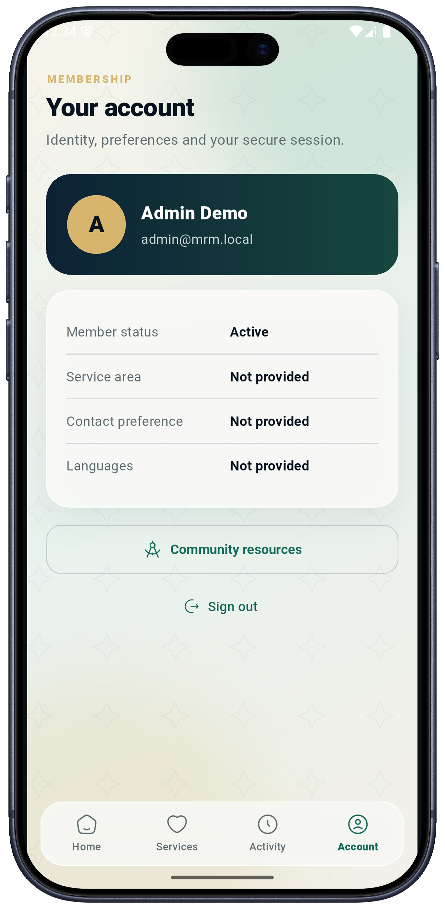
EXPERIENCE / MRM DIGITAL COMMUNITY PLATFORM
Account: identity, preferences and permissions
Account settings support safe participation without conflating membership, approval and paid entitlement.
Roles › 43
Member preferences
Service area, language and safe contact preferences inform support.
Consent & permissions
Location and notifications are separate choices; allow manual area selection.
Authorised roles
MRM approves roles. Subscription entitlement never grants staff access.
Provided demo account screen
Account identity ≠ volunteer approval ≠ teacher approval ≠ subscription entitlement
MRM / ZYLAX TECHNOLOGIES
PROVIDED ACCOUNT SCREEN + PROPOSED ACCESS RULES
12 / 58
Notes:
Evidence: mobile/05_account.png
Screenshots are provided interface/demo evidence. No running application or production data was validated. Diagrams specify proposed journeys; they do not certify implementation. Audience is all Muslims, with specialised MRM revert support. Marketplace excluded; subscriptions apply only to teachers.

Slide 13




CARE & VOLUNTEERING / MRM DIGITAL COMMUNITY PLATFORM
Assistance: from request to resolution
The service is coordinated by MRM, with limited alerts and private details shared only when authorised.
01
02
03
04
05
Submit
Triage
Offer
Assign
Resolve
Category, safe description, urgency and approximate area.
MRM reviews need, sensitivity and eligibility.
Suitable approved volunteers receive limited alerts.
Seeker or coordinator confirms the assignment.
Progress, feedback, follow-up and closure.
Member control
Coordinator control
Stop contact, request reassignment or report a concern.
Review unanswered work and record accountable decisions.
Request → eligible match → confirmed assignment → progress → closure → verified recognition [21]
MRM / ZYLAX TECHNOLOGIES
PROPOSED WORKFLOW
13 / 58
Notes:
Evidence: Native diagram / proposed capability, based on supplied scope documents.
Screenshots are provided interface/demo evidence. No running application or production data was validated. Diagrams specify proposed journeys; they do not certify implementation. Audience is all Muslims, with specialised MRM revert support. Marketplace excluded; subscriptions apply only to teachers.

Slide 14
CARE & VOLUNTEERING / MRM DIGITAL COMMUNITY PLATFORM
Matching: eligibility before assignment
Category, service area, language, availability and access rules determine who can receive an offer.
Access is checked before a notification or case record is disclosed.
Reviewed request
Eligibility checks
Limited alert
Confirmed assignment
Routine request cleared for matching
Approved + active + suitable + permitted
Approximate area and safe summary
Volunteer offers; authorised party confirms
No eligible response
Return to coordinator queue for follow-up
Sensitive cases use the restricted staff route [18], rather than routine volunteer matching.
MRM / ZYLAX TECHNOLOGIES
PROPOSED MATCHING FLOWCHART
14 / 58
Notes:
Evidence: Native diagram / proposed capability, based on supplied scope documents.
Screenshots are provided interface/demo evidence. No running application or production data was validated. Diagrams specify proposed journeys; they do not certify implementation. Audience is all Muslims, with specialised MRM revert support. Marketplace excluded; subscriptions apply only to teachers.

Slide 15
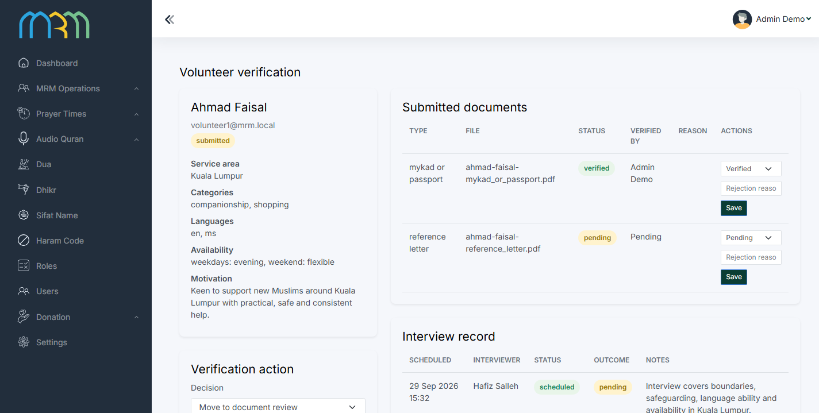
CARE & VOLUNTEERING / MRM DIGITAL COMMUNITY PLATFORM
Volunteer approval is a complete workflow
Application, evidence review and online interview precede approval for service.
Assignments › 17
MRM / MRM ADMIN FINAL
Apply & provide evidence
Skills, languages, service area, availability and MRM-required documents.
Review & interview
Staff examine documents and record an online interview; request clarification when needed.
Approve, decline or suspend
Only approved active volunteers receive eligible new work. Decisions retain a reason and history.
Provided demo capture · top viewport; full capture in screenbook
Applicant → document review → online interview → MRM decision → eligible service [17]
MRM / ZYLAX TECHNOLOGIES
PROVIDED ADMINISTRATION SCREEN + PROPOSED FLOW
15 / 58
Notes:
Evidence: mrm-admin-final/04_volunteer_verification.png
Screenshots are provided interface/demo evidence. No running application or production data was validated. Diagrams specify proposed journeys; they do not certify implementation. Audience is all Muslims, with specialised MRM revert support. Marketplace excluded; subscriptions apply only to teachers.

Slide 16


CARE & VOLUNTEERING / MRM DIGITAL COMMUNITY PLATFORM
Nearby discovery, with privacy boundaries
Approved volunteer discovery uses approximate areas and server-enforced visibility rules.
01
02
03
04
Choose an area
Filter eligible profiles
View permitted detail
Take a safe action
Location permission or manual service-area selection.
Approved, active and permitted under MRM gender rules.
General area, skills and approved profile fields.
Permitted contact or a coordinated service request.
Gender visibility
Controlled exceptions
Male and female profiles remain separated in the agreed discovery/contact scope.
MRM defines staff/teacher exceptions before enabling them.
Apply rules to search, map markers, detail routes, notifications and direct API requests.
MRM / ZYLAX TECHNOLOGIES
PROPOSED DISCOVERY FLOWCHART
16 / 58
Notes:
Evidence: Native diagram / proposed capability, based on supplied scope documents.
Screenshots are provided interface/demo evidence. No running application or production data was validated. Diagrams specify proposed journeys; they do not certify implementation. Audience is all Muslims, with specialised MRM revert support. Marketplace excluded; subscriptions apply only to teachers.

Slide 17
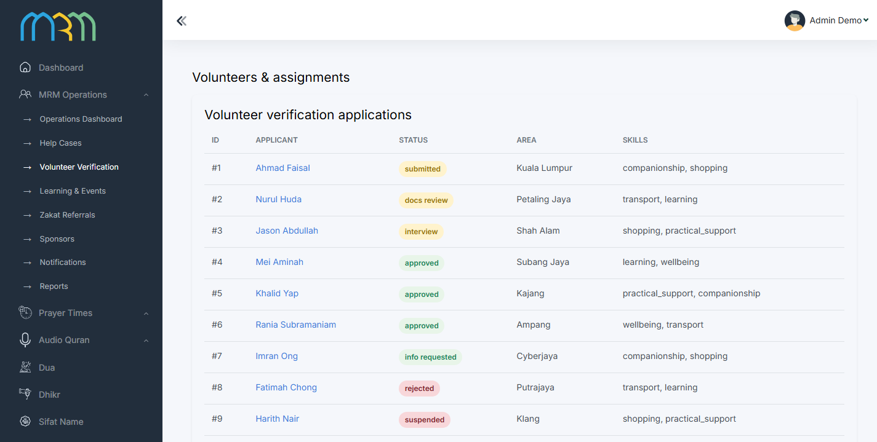
CARE & VOLUNTEERING / MRM DIGITAL COMMUNITY PLATFORM
Assignments: controlled service delivery
Offers and assignments connect verified volunteers to suitable requests and accountable progress.
Recognition › 21
MRM / MRM ADMIN FINAL
Offer is not assignment
A volunteer response becomes service access only after confirmation.
Assigned access
Permitted case details support contact, progress updates and completion.
Changes stay accountable
Reassignment, cancellation and suspension return affected work to staff review.
Provided demo capture · top viewport; full capture in screenbook
Verified volunteer [15] → eligible offer [14] → assignment → outcome → service credit [21]
MRM / ZYLAX TECHNOLOGIES
PROVIDED DEMO ADMINISTRATION + PROPOSED SERVICE FLOW
17 / 58
Notes:
Evidence: mrm-admin-final/03_volunteers_assignments.png
Screenshots are provided interface/demo evidence. No running application or production data was validated. Diagrams specify proposed journeys; they do not certify implementation. Audience is all Muslims, with specialised MRM revert support. Marketplace excluded; subscriptions apply only to teachers.

Slide 18
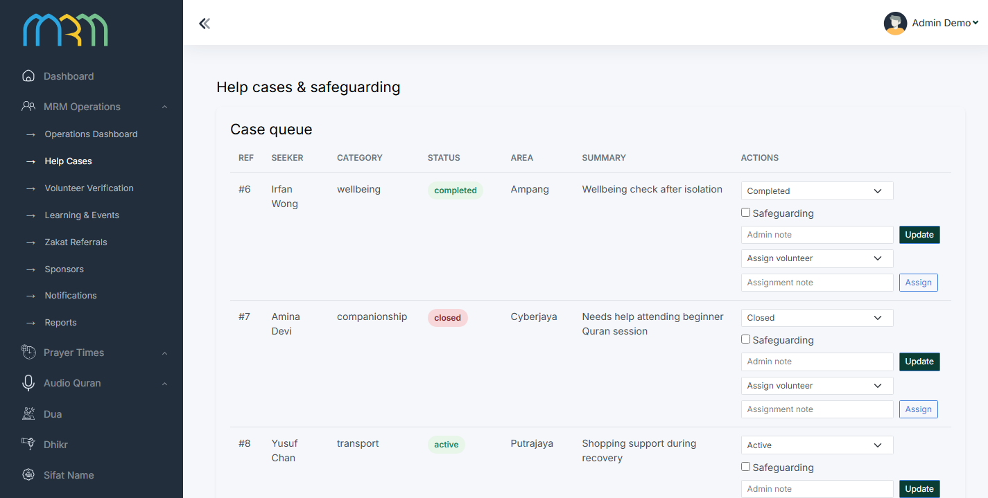
CARE & VOLUNTEERING / MRM DIGITAL COMMUNITY PLATFORM
Private cases require a restricted route
Confidential faith and family concerns are handled by designated MRM personnel.
Safeguarding › 19
MRM / MRM ADMIN FINAL
Confidential intake
The person chooses safe contact details and submits the concern privately.
Designated staff review
Restricted queues, adviser assignment and controlled follow-up protect case information.
Responsible closure
Record outcome or referral under MRM policy; no automated religious judgement.
Provided demo capture · top viewport; full capture in screenbook
Private intake → designated staff → authorised follow-up → controlled closure / referral
MRM / ZYLAX TECHNOLOGIES
PROVIDED DEMO CASE SCREEN + PROPOSED SAFEGUARDING
18 / 58
Notes:
Evidence: mrm-admin-final/02_cases_safeguarding.png
Screenshots are provided interface/demo evidence. No running application or production data was validated. Diagrams specify proposed journeys; they do not certify implementation. Audience is all Muslims, with specialised MRM revert support. Marketplace excluded; subscriptions apply only to teachers.

Slide 19
CARE & VOLUNTEERING / MRM DIGITAL COMMUNITY PLATFORM
Safeguarding: clear escalation and user control
The platform supports coordination while MRM defines coverage, response procedures and escalation contacts.
Concern reported
Assess and restrict
Follow up and record action
Danger, misconduct or contact concern
Designated staff review; protect records
Escalation, account restriction or case reassignment
Immediate danger
Personal control
Show clear emergency contact guidance. The application does not guarantee emergency response.
A member can stop contact, report behaviour or request reassignment without public exposure.
MRM supplies incident classifications, response hours, authorised staff and escalation contacts.
MRM / ZYLAX TECHNOLOGIES
PROPOSED SAFEGUARDING FLOWCHART
19 / 58
Notes:
Evidence: Native diagram / proposed capability, based on supplied scope documents.
Screenshots are provided interface/demo evidence. No running application or production data was validated. Diagrams specify proposed journeys; they do not certify implementation. Audience is all Muslims, with specialised MRM revert support. Marketplace excluded; subscriptions apply only to teachers.

Slide 20
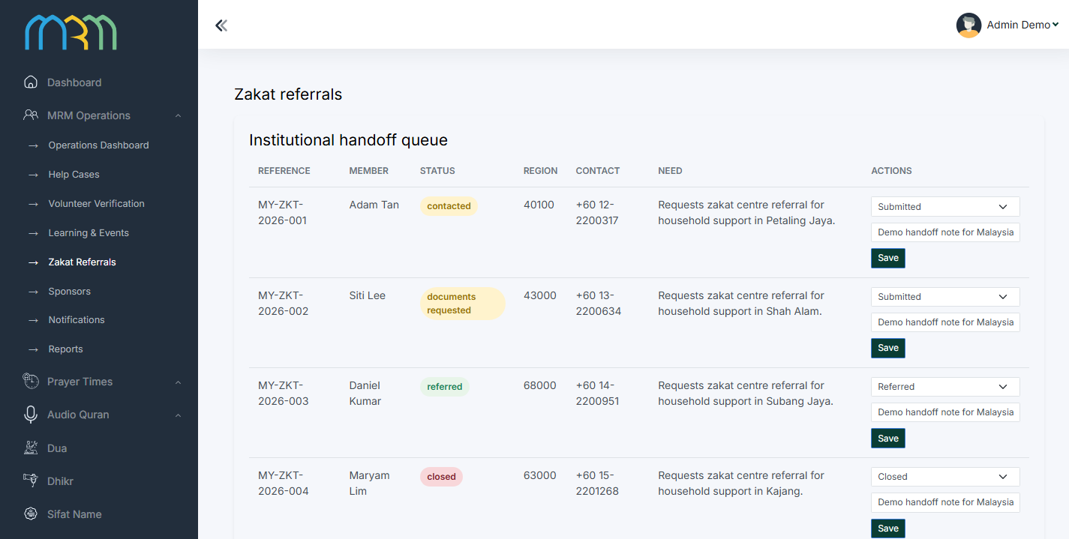
CARE & VOLUNTEERING / MRM DIGITAL COMMUNITY PLATFORM
Zakat assistance: referral, not an eligibility decision
Consent, review and institutional handoff connect members to the relevant zakat authority.
Zakat estimate › 40
MRM / MRM ADMIN FINAL
Submit with consent
Need, region and safe contact preference enter the MRM review queue.
Coordinate referral
Record recipient, reference, authorised sharing and partner follow-up.
Authority decision
Eligibility, approval and disbursement remain with the zakat authority. API access is conditional.
Provided demo capture · top viewport; full capture in screenbook
Enquiry → review → referral → partner response → closure • No zakat collection/disbursement included
MRM / ZYLAX TECHNOLOGIES
PROVIDED DEMO REFERRAL SCREEN + PROPOSED FLOW
20 / 58
Notes:
Evidence: mrm-admin-final/06_zakat_referrals.png
Screenshots are provided interface/demo evidence. No running application or production data was validated. Diagrams specify proposed journeys; they do not certify implementation. Audience is all Muslims, with specialised MRM revert support. Marketplace excluded; subscriptions apply only to teachers.

Slide 21



CARE & VOLUNTEERING / MRM DIGITAL COMMUNITY PLATFORM
Recognition follows verified contribution
Badges and ranks acknowledge service without overriding safeguarding or access permissions.
01
02
03
04
Record service
Verify contribution
Apply MRM criteria
Recognise
Assignment outcome, approved event or training.
Coordinator or permitted confirming party validates credit.
Configured thresholds, award basis and eligibility.
Show badges and service summary without beneficiary details.
Correction & appeal
Safe incentives
Staff can correct or revoke credit and retain the reason.
No sensitive-case priority from rank; no reward for risk or speed alone.
Assignments [17] + verified participation [29] → contribution history → recognition
MRM / ZYLAX TECHNOLOGIES
PROPOSED WORKFLOW
21 / 58
Notes:
Evidence: Native diagram / proposed capability, based on supplied scope documents.
Screenshots are provided interface/demo evidence. No running application or production data was validated. Diagrams specify proposed journeys; they do not certify implementation. Audience is all Muslims, with specialised MRM revert support. Marketplace excluded; subscriptions apply only to teachers.

Slide 22


CARE & VOLUNTEERING / MRM DIGITAL COMMUNITY PLATFORM
The volunteer participation loop
A sustainable service connects preparation, suitable work, support and recognition.
Prepare
Serve
Follow up
Apply, verify and learn MRM conduct rules
Respond to suitable work and confirm assignment
Record progress and escalate concerns safely
Recognise & improve
Verified service and approved learning support growth
Availability and approval remain current; suspension immediately withholds eligible new work.
MRM / ZYLAX TECHNOLOGIES
PROPOSED PARTICIPATION FLOWCHART
22 / 58
Notes:
Evidence: Native diagram / proposed capability, based on supplied scope documents.
Screenshots are provided interface/demo evidence. No running application or production data was validated. Diagrams specify proposed journeys; they do not certify implementation. Audience is all Muslims, with specialised MRM revert support. Marketplace excluded; subscriptions apply only to teachers.

Slide 23
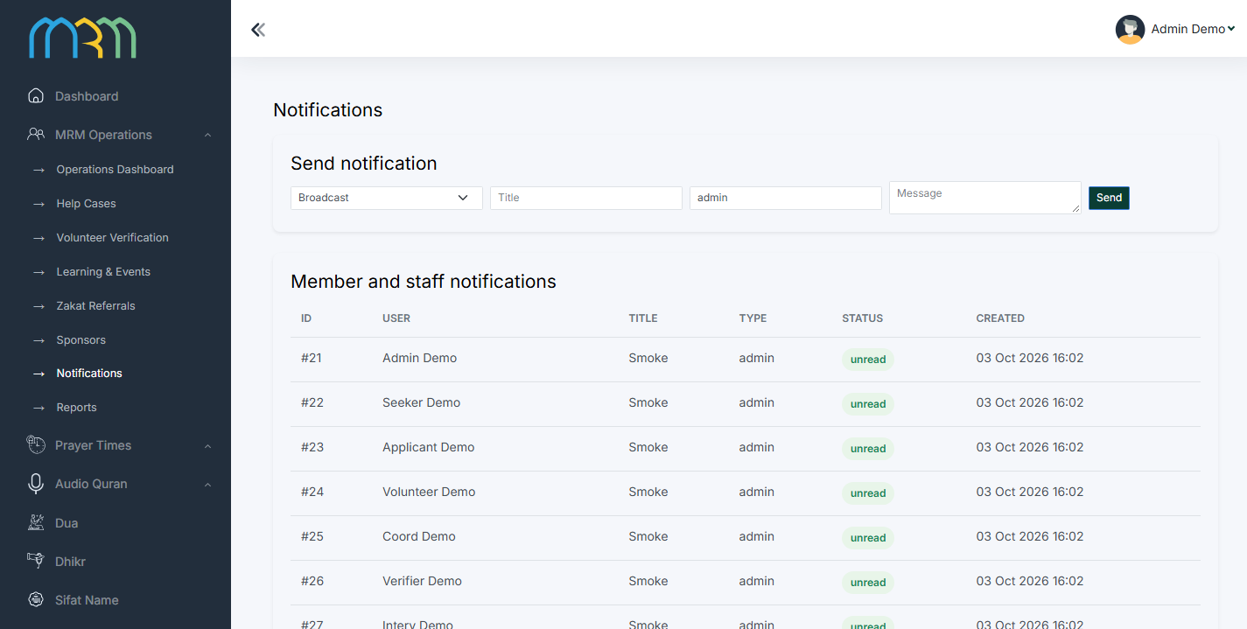
CARE & VOLUNTEERING / MRM DIGITAL COMMUNITY PLATFORM
Notifications connect people to the next action
Alerts are role-aware and privacy-safe, with relevant detail opened inside the app.
Activity › 11
MRM / MRM ADMIN FINAL
Relevant triggers
Eligible request offers, assignment changes, class reminders and application updates.
Safe payloads
Use approximate areas and limited summaries. Keep sensitive descriptions off lock screens.
Accountable delivery
Record send status, respect preferences and return unattended cases to staff follow-up.
Provided demo capture · top viewport; full capture in screenbook
Service event → eligibility check → safe alert → authorised detail → activity update [11]
MRM / ZYLAX TECHNOLOGIES
PROVIDED DEMO NOTIFICATION SCREEN + PROPOSED DELIVERY
23 / 58
Notes:
Evidence: mrm-admin-final/08_notifications.png
Screenshots are provided interface/demo evidence. No running application or production data was validated. Diagrams specify proposed journeys; they do not certify implementation. Audience is all Muslims, with specialised MRM revert support. Marketplace excluded; subscriptions apply only to teachers.

Slide 24



LEARNING & REVENUE / MRM DIGITAL COMMUNITY PLATFORM
Learning for every Muslim
Approved programmes connect discovery, participation and continued learning.
01
02
03
04
Discover
Understand
Participate
Continue
Browse by topic, language, teacher and programme.
View schedule, access rules and approved details.
Register where required and open the live session.
Use approved recordings and relevant resources.
Trusted publication
Daily practice connection
MRM approves religious material and teacher permissions.
Learning links to Quran, dua, prayer guidance and approved resources.
Approved teacher [25] → moderated content [26] → programme [29] → member participation
MRM / ZYLAX TECHNOLOGIES
PROPOSED WORKFLOW
24 / 58
Notes:
Evidence: Native diagram / proposed capability, based on supplied scope documents.
Screenshots are provided interface/demo evidence. No running application or production data was validated. Diagrams specify proposed journeys; they do not certify implementation. Audience is all Muslims, with specialised MRM revert support. Marketplace excluded; subscriptions apply only to teachers.

Slide 25




LEARNING & REVENUE / MRM DIGITAL COMMUNITY PLATFORM
Teachers: approval before publishing
Teaching opportunities are governed by credentials, moderation and appropriate entitlements.
01
02
03
04
05
Apply
Review
Approve
Enable privileges
Moderate
Profile, subjects, languages, experience and evidence.
MRM examines credentials and requests clarification.
Teacher role enables a permitted workspace.
Applicable plan controls designated publishing.
Submitted material is reviewed before publication.
Professional presence
Role boundary
Approved profile and teaching opportunities connect learners to teachers.
Teacher approval or payment never provides private support-case access.
Teacher approval and payment entitlement are separate checks; neither substitutes for moderation.
MRM / ZYLAX TECHNOLOGIES
PROPOSED TEACHER APPROVAL FLOWCHART
25 / 58
Notes:
Evidence: Native diagram / proposed capability, based on supplied scope documents.
Screenshots are provided interface/demo evidence. No running application or production data was validated. Diagrams specify proposed journeys; they do not certify implementation. Audience is all Muslims, with specialised MRM revert support. Marketplace excluded; subscriptions apply only to teachers.

Slide 26

LEARNING & REVENUE / MRM DIGITAL COMMUNITY PLATFORM
Teaching opportunities and moderated content
Teachers submit educational material and clearly identified teaching advertisements.
Educational posts
Teaching advertisements
Approved articles and posts organised by subject and language.
Teacher, offer, approved media and a clear enquiry route in learning areas.
Classes & recordings
Publication control
Proposed programmes and lessons enter MRM’s review queue.
Approve, return, schedule, reject, withdraw or archive with recorded outcomes.
Submit → review → revise if needed → publish → monitor • No teacher ads in private case screens
MRM / ZYLAX TECHNOLOGIES
PROPOSED WORKFLOW
26 / 58
Notes:
Evidence: Native diagram / proposed capability, based on supplied scope documents.
Screenshots are provided interface/demo evidence. No running application or production data was validated. Diagrams specify proposed journeys; they do not certify implementation. Audience is all Muslims, with specialised MRM revert support. Marketplace excluded; subscriptions apply only to teachers.

Slide 27
LEARNING & REVENUE / MRM DIGITAL COMMUNITY PLATFORM
Teacher subscriptions: approval, payment, entitlement
Only approved teachers use paid publishing plans. Member assistance and volunteering remain free.
Approved teacher
Select plan
Applicable billing
Verify entitlement
MRM approval is required
MRM-defined period and allowances
Client-owned app-store products
Server verifies active paid privileges
A no-charge teacher plan can be configured initially. Paid activation depends on MRM policy and store readiness.
Payment not verified
Submit for moderation
No paid publishing privileges
Allowances checked before publication
Teacher approval → plan → verified entitlement → allowance checks → content moderation → publication
MRM / ZYLAX TECHNOLOGIES
PROPOSED TEACHER SUBSCRIPTION FLOWCHART
27 / 58
Notes:
Evidence: Native diagram / proposed capability, based on supplied scope documents.
Screenshots are provided interface/demo evidence. No running application or production data was validated. Diagrams specify proposed journeys; they do not certify implementation. Audience is all Muslims, with specialised MRM revert support. Marketplace excluded; subscriptions apply only to teachers.

Slide 28


LEARNING & REVENUE / MRM DIGITAL COMMUNITY PLATFORM
Subscription lifecycle: clear states and recovery
Renewal, cancellation, failed payment and expiry require visible outcomes and verified entitlement.
01
02
03
04
Active
Renew / cancel
Verify changes
Apply entitlement
Publishing within plan allowances; show status and renewal.
Use applicable store management and confirmation.
Process payment, cancellation and expiry updates.
Pause paid privileges when entitlement ends.
Restore eligible purchases
Preserve history
Reconnect a permitted purchase to the approved teacher account.
Keep the account and approved historical content; confirm visibility policy before launch.
Plan prices and allowances are configured by MRM; the deck does not invent subscription tiers or prices.
MRM / ZYLAX TECHNOLOGIES
PROPOSED SUBSCRIPTION STATE MODEL
28 / 58
Notes:
Evidence: Native diagram / proposed capability, based on supplied scope documents.
Screenshots are provided interface/demo evidence. No running application or production data was validated. Diagrams specify proposed journeys; they do not certify implementation. Audience is all Muslims, with specialised MRM revert support. Marketplace excluded; subscriptions apply only to teachers.

Slide 29
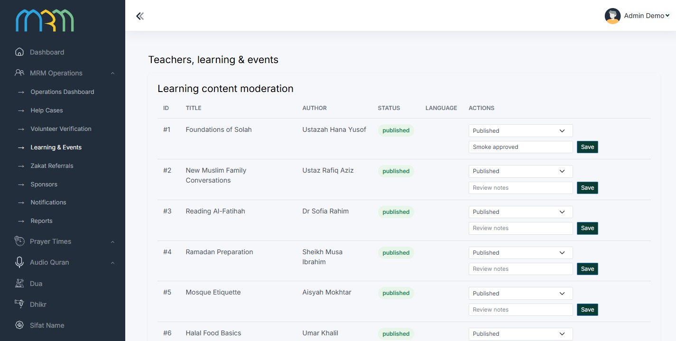
LEARNING & REVENUE / MRM DIGITAL COMMUNITY PLATFORM
Classes, events and approved recordings
Live sessions and recorded resources are connected through moderated programme information.
Learner journey › 24
MRM / MRM ADMIN FINAL
Prepare programme
Subject, teacher, language, schedule, access rules and approved media.
Review & publish
MRM approves content and rights before users browse or register.
Attend & revisit
Reminders link to sessions; approved recordings support later learning. External meeting links may be used.
Provided demo capture · top viewport; full capture in screenbook
Teacher workspace [25] → MRM moderation [26] → programme → reminders [23] → learner access [24]
MRM / ZYLAX TECHNOLOGIES
PROVIDED DEMO LEARNING SCREEN + PROPOSED JOURNEY
29 / 58
Notes:
Evidence: mrm-admin-final/05_learning_events.png
Screenshots are provided interface/demo evidence. No running application or production data was validated. Diagrams specify proposed journeys; they do not certify implementation. Audience is all Muslims, with specialised MRM revert support. Marketplace excluded; subscriptions apply only to teachers.

Slide 30
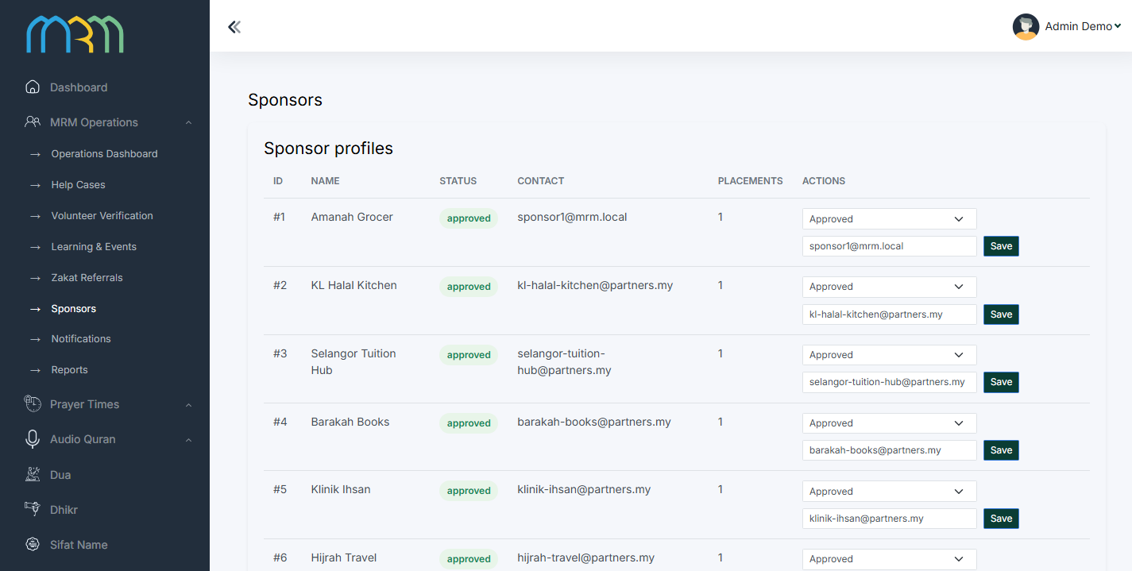
LEARNING & REVENUE / MRM DIGITAL COMMUNITY PLATFORM
Sponsors: recognition with clear boundaries
Approved sponsor placements support MRM without influencing care, guidance or zakat decisions.
Reporting › 46
MRM / MRM ADMIN FINAL
Approve sponsor assets
MRM confirms sponsor details, logos, creatives and destination links.
Schedule recognition
Set placement, start/end dates and publication state; identify sponsor material clearly.
Report responsibly
Aggregate views/clicks only. External marketing and launch publication remain MRM responsibilities.
Provided demo capture · top viewport; full capture in screenbook
Sponsor agreement → approved assets → time-limited placement → aggregate reporting [46]
MRM / ZYLAX TECHNOLOGIES
PROVIDED DEMO SPONSOR SCREEN + PROPOSED PLACEMENTS
30 / 58
Notes:
Evidence: mrm-admin-final/07_sponsors.png
Screenshots are provided interface/demo evidence. No running application or production data was validated. Diagrams specify proposed journeys; they do not certify implementation. Audience is all Muslims, with specialised MRM revert support. Marketplace excluded; subscriptions apply only to teachers.

Slide 31

LEARNING & REVENUE / MRM DIGITAL COMMUNITY PLATFORM
The website opens the door to the platform
Public discovery supports all Muslims, prospective volunteers, teachers, partners and sponsors.
Discover MRM
Participate
Home, mission, programmes, approved resources and public contact information.
Support routes, volunteer information, teacher applications and app download links.
Learn & attend
Trust & maintain
Public classes, events and approved articles connected to platform content.
Policies, partner/sponsor information and staff-managed public content.
Public website → relevant service / app • Agreed public content migration; private records need assessment
MRM / ZYLAX TECHNOLOGIES
PROPOSED WEBSITE INFORMATION ARCHITECTURE
31 / 58
Notes:
Evidence: Native diagram / proposed capability, based on supplied scope documents.
Screenshots are provided interface/demo evidence. No running application or production data was validated. Diagrams specify proposed journeys; they do not certify implementation. Audience is all Muslims, with specialised MRM revert support. Marketplace excluded; subscriptions apply only to teachers.

Slide 32
ISLAMIC UTILITIES / MRM DIGITAL COMMUNITY PLATFORM
Daily Islamic tools create everyday value
A complete utility set supports Muslims at different stages of knowledge and practice.
Prayer & direction
Quran & learning
Prayer times, approved local adjustments, Qibla and nearby mosques.
Quran reading, approved translations and recitation sources.
Remembrance
Dates & guidance
Dua, dhikr and hadith with approved religious references.
Hijri calendar, Ramadan schedule and informational zakat estimate.
MRM approves religious references, translations, calculation methods, rights and local conventions.
MRM / ZYLAX TECHNOLOGIES
PROPOSED WORKFLOW
32 / 58
Notes:
Evidence: Native diagram / proposed capability, based on supplied scope documents.
Screenshots are provided interface/demo evidence. No running application or production data was validated. Diagrams specify proposed journeys; they do not certify implementation. Audience is all Muslims, with specialised MRM revert support. Marketplace excluded; subscriptions apply only to teachers.

Slide 33
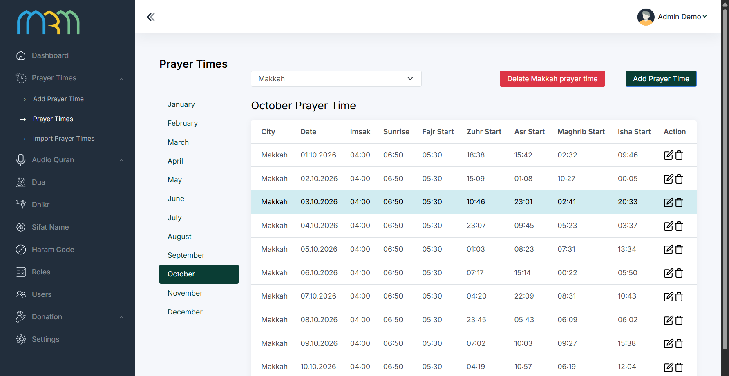
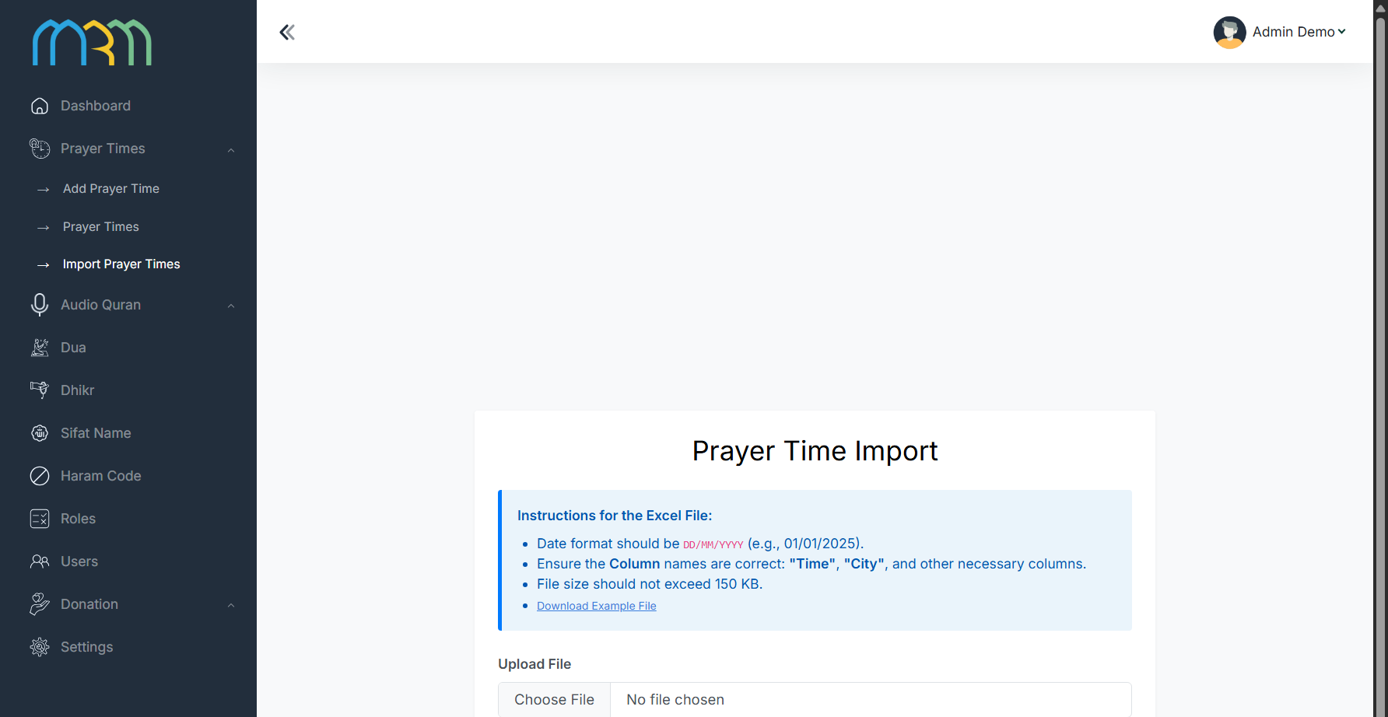
ISLAMIC UTILITIES / MRM DIGITAL COMMUNITY PLATFORM
Prayer times: local settings and controlled imports
Prayer schedules connect approved calculation conventions with location and user preferences.
MRM / BACKEND
MRM / BACKEND
Provided demo capture · top viewport; full capture in screenbook
Provided demo capture · top viewport; full capture in screenbook
Select area → use approved schedule / method → display prayer times → apply permitted adjustments
Import and source validation [41] → approved schedule → daily app experience [32]
MRM / ZYLAX TECHNOLOGIES
PROVIDED UTILITY ADMINISTRATION + PROPOSED MOBILE FLOW
33 / 58
Notes:
Evidence: backend/10_prayer_times.png, backend/11_prayer_time_import.png
Screenshots are provided interface/demo evidence. No running application or production data was validated. Diagrams specify proposed journeys; they do not certify implementation. Audience is all Muslims, with specialised MRM revert support. Marketplace excluded; subscriptions apply only to teachers.

Slide 34
ISLAMIC UTILITIES / MRM DIGITAL COMMUNITY PLATFORM
Qibla and nearby mosques
Permission-aware direction and area discovery support practical daily use.
01
02
03
04
Choose location
Find direction
Discover mosques
Continue learning
Device permission or supported manual area input.
Qibla uses device/location capability with calibration guidance.
Approved places by area; review relevant details.
Connect to prayer guidance and approved programmes.
Clear device guidance
Curated information
Handle denied permissions and sensor limitations without a misleading result.
Confirm map provider, source accuracy and place data before release.
Location preferences [12] → prayer / Qibla / mosque discovery • Volunteer profiles remain separately restricted
MRM / ZYLAX TECHNOLOGIES
PROPOSED UTILITY FLOWS / MOBILE CAPTURES NOT SUPPLIED
34 / 58
Notes:
Evidence: Native diagram / proposed capability, based on supplied scope documents.
Screenshots are provided interface/demo evidence. No running application or production data was validated. Diagrams specify proposed journeys; they do not certify implementation. Audience is all Muslims, with specialised MRM revert support. Marketplace excluded; subscriptions apply only to teachers.

Slide 35
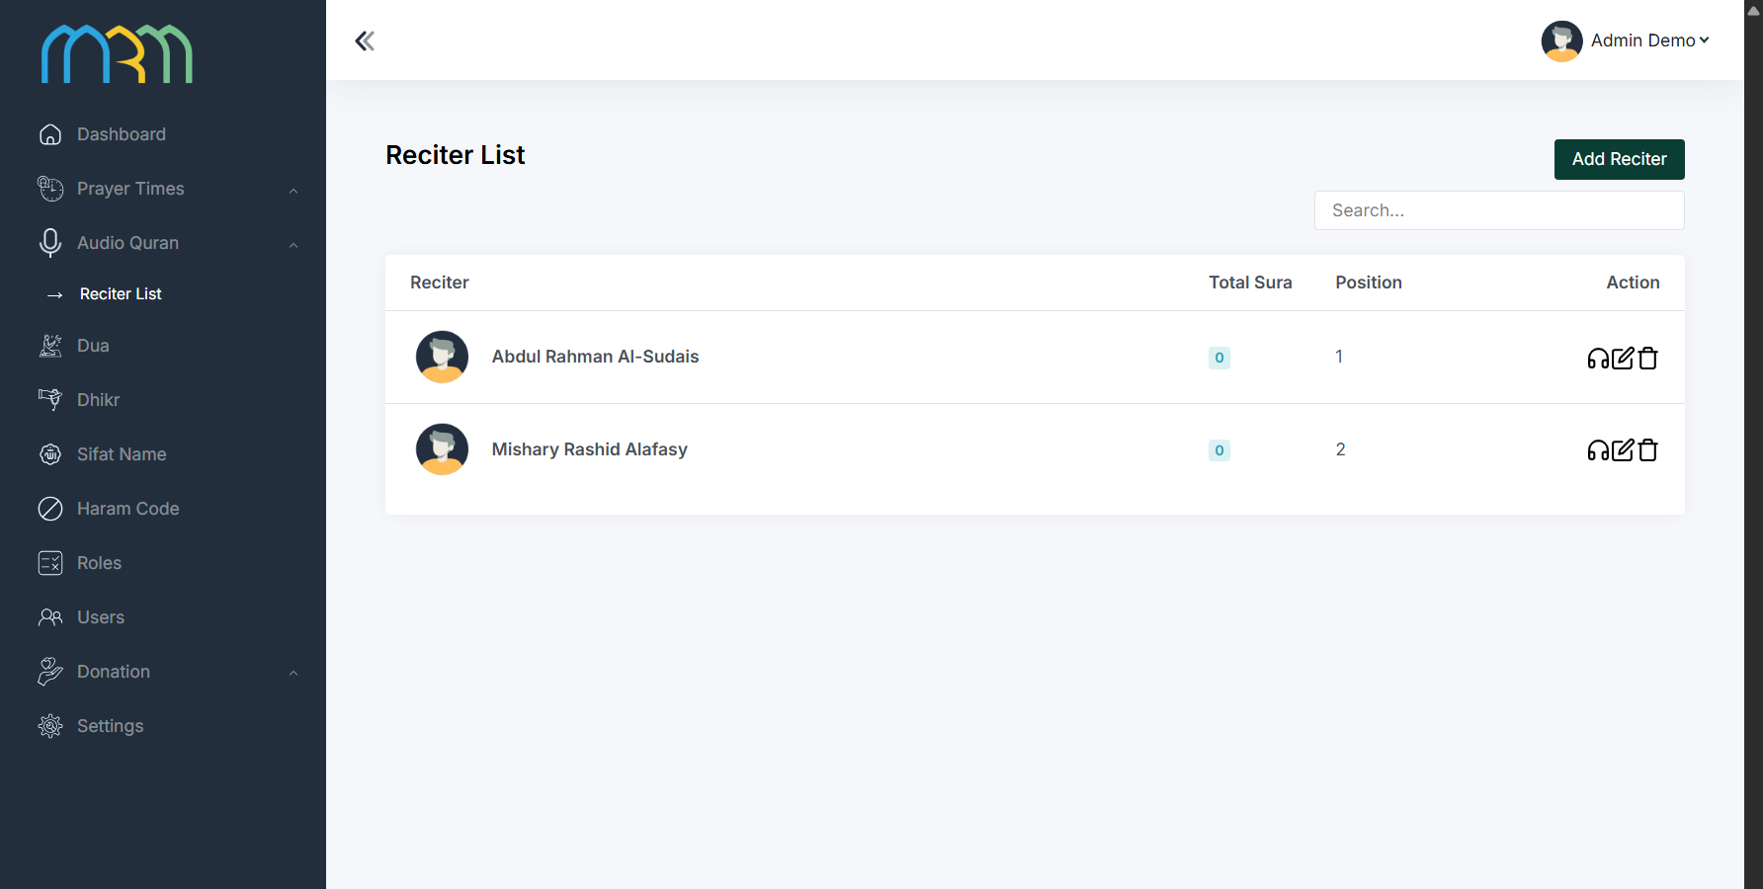
ISLAMIC UTILITIES / MRM DIGITAL COMMUNITY PLATFORM
Quran reading and recitation
Approved reading, translation and audio sources connect to daily learning.
Learning › 24
MRM / BACKEND
Read & understand
Quran text and approved translations must be checked against selected licensed sources.
Listen
Reciter and audio administration support approved recitation delivery.
Connect to learning
Relevant lessons and resources deepen understanding. Mobile reader captures were not supplied.
Provided demo capture · top viewport; full capture in screenbook
Approved Quran sources → reading / recitation → learning resources [24] • Technical reciter capture indexed [49]
MRM / ZYLAX TECHNOLOGIES
PROVIDED RECITER ADMINISTRATION + PROPOSED QURAN JOURNEY
35 / 58
Notes:
Evidence: backend/13_audio_reciters.png
Screenshots are provided interface/demo evidence. No running application or production data was validated. Diagrams specify proposed journeys; they do not certify implementation. Audience is all Muslims, with specialised MRM revert support. Marketplace excluded; subscriptions apply only to teachers.

Slide 36
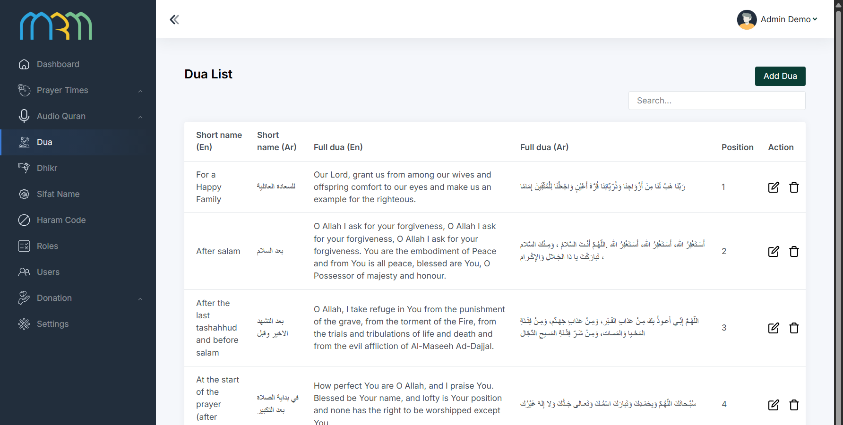
ISLAMIC UTILITIES / MRM DIGITAL COMMUNITY PLATFORM
Dua: discover approved supplications
Dua content is managed by category and published from reviewed references.
Categories › 41
MRM / BACKEND
Browse by need
Categories help users find relevant supplications.
Understand the content
Use approved Arabic, translation and reference data where available in the supplied component.
Maintain accuracy
MRM reviews religious sources, edits and publication rights before use.
Provided demo capture · top viewport; full capture in screenbook
Content categories [41] → approved dua → daily practice • Learning links use approved content [24]
MRM / ZYLAX TECHNOLOGIES
PROVIDED DUA ADMINISTRATION + PROPOSED CONTENT JOURNEY
36 / 58
Notes:
Evidence: backend/04_dua.png
Screenshots are provided interface/demo evidence. No running application or production data was validated. Diagrams specify proposed journeys; they do not certify implementation. Audience is all Muslims, with specialised MRM revert support. Marketplace excluded; subscriptions apply only to teachers.

Slide 37
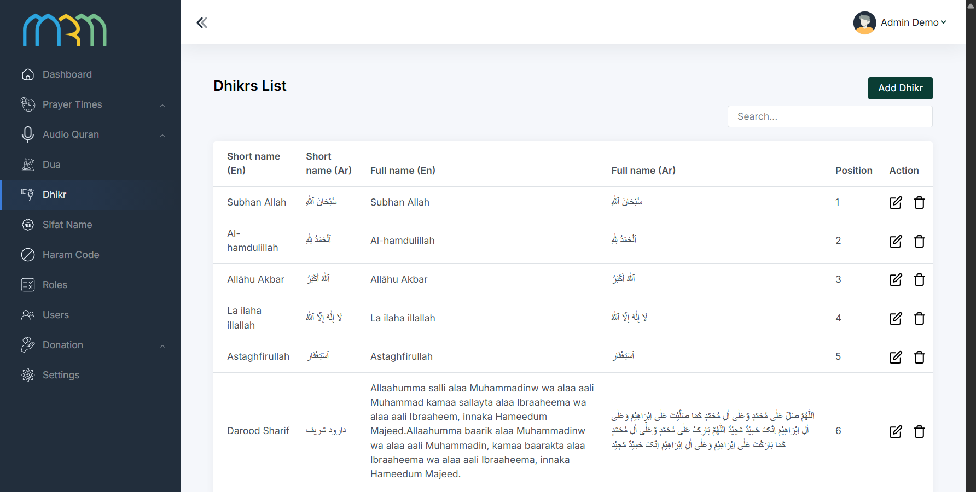
ISLAMIC UTILITIES / MRM DIGITAL COMMUNITY PLATFORM
Dhikr: consistent remembrance content
The content library supports clear, approved guidance for daily remembrance.
Governance › 41
MRM / BACKEND
Find relevant dhikr
Reviewed entries and categories organise remembrance content.
Use approved wording
Religious text, translation and repetition guidance require MRM approval.
Stay consistent
Template components and content governance maintain a coherent utility experience.
Provided demo capture · top viewport; full capture in screenbook
Approved dhikr library → daily practice → related learning [24] • No fabricated religious claims
MRM / ZYLAX TECHNOLOGIES
PROVIDED DHIKR ADMINISTRATION + PROPOSED CONTENT JOURNEY
37 / 58
Notes:
Evidence: backend/05_dhikr.png
Screenshots are provided interface/demo evidence. No running application or production data was validated. Diagrams specify proposed journeys; they do not certify implementation. Audience is all Muslims, with specialised MRM revert support. Marketplace excluded; subscriptions apply only to teachers.

Slide 38
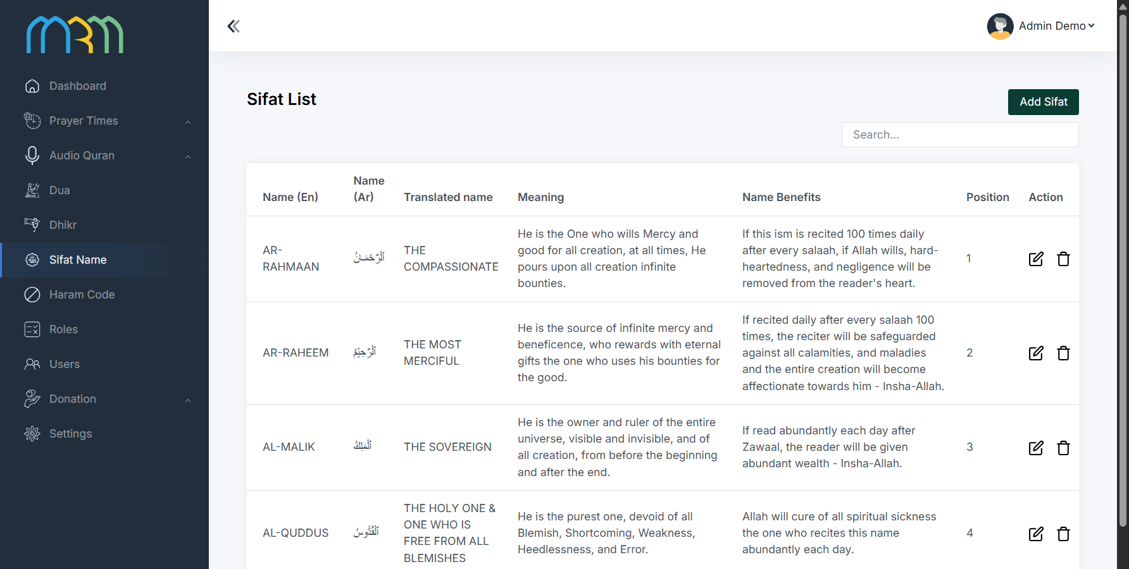
ISLAMIC UTILITIES / MRM DIGITAL COMMUNITY PLATFORM
Hadith and Sifat Names: trusted references
Hadith is in the proposed utility scope; the supplied template also includes Sifat Names administration.
Utility set › 32
MRM / BACKEND
Hadith content
Confirm approved sources, translations, licensing and the supplied component capability.
Sifat Names library
The provided administration screen shows a distinct existing template content function.
Separate evidence
This screenshot does not demonstrate a mobile hadith reader. Each source requires review before publication.
Provided demo capture · top viewport; full capture in screenbook
Religious source approval → content review [41] → appropriate daily tool [32]
MRM / ZYLAX TECHNOLOGIES
PROVIDED TEMPLATE SCREEN + PROPOSED HADITH CAPABILITY
38 / 58
Notes:
Evidence: backend/06_sifat_names.png
Screenshots are provided interface/demo evidence. No running application or production data was validated. Diagrams specify proposed journeys; they do not certify implementation. Audience is all Muslims, with specialised MRM revert support. Marketplace excluded; subscriptions apply only to teachers.

Slide 39
ISLAMIC UTILITIES / MRM DIGITAL COMMUNITY PLATFORM
Hijri dates and Ramadan guidance
Approved calendar conventions and local prayer schedules connect seasonal use to daily practice.
01
02
03
04
Choose convention
View the date
Plan Ramadan
Participate
MRM-approved Hijri and local calendar settings.
Clear Hijri display with applicable local adjustment.
Use approved local schedule and relevant learning.
Discover MRM classes and community events.
Local accuracy
Relevant content
Calendar and prayer-time conventions must be explicit and reviewed.
Connect seasonal guidance to approved programmes and resources.
Approved calendar → Ramadan schedule → prayer settings [33] → learning/events [29]
MRM / ZYLAX TECHNOLOGIES
PROPOSED CALENDAR FLOWS / MOBILE CAPTURES NOT SUPPLIED
39 / 58
Notes:
Evidence: Native diagram / proposed capability, based on supplied scope documents.
Screenshots are provided interface/demo evidence. No running application or production data was validated. Diagrams specify proposed journeys; they do not certify implementation. Audience is all Muslims, with specialised MRM revert support. Marketplace excluded; subscriptions apply only to teachers.

Slide 40
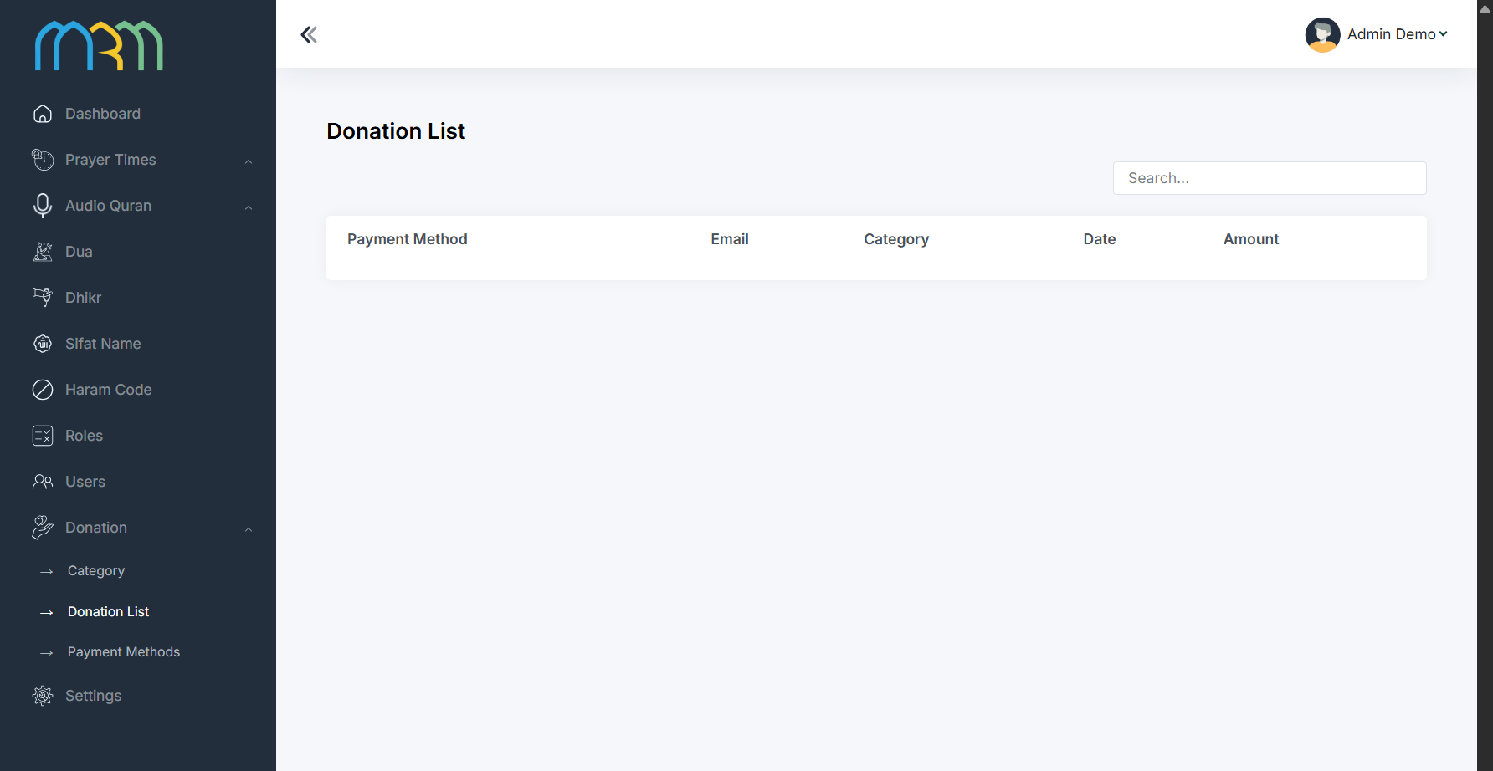
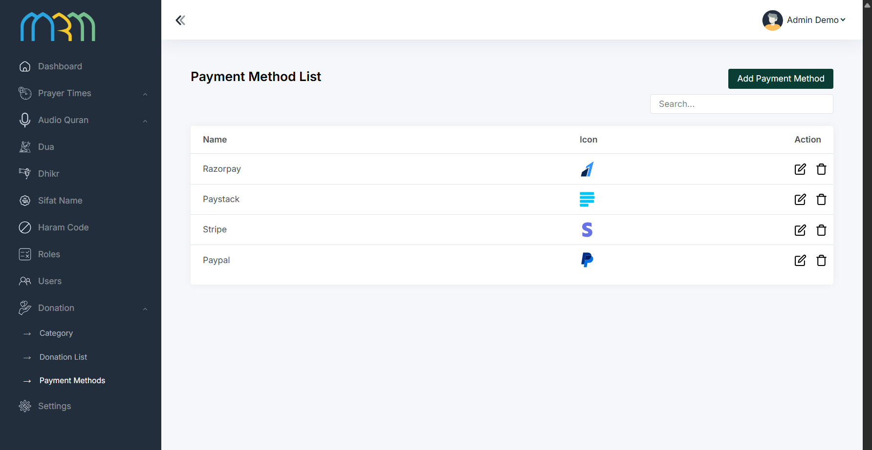
ISLAMIC UTILITIES / MRM DIGITAL COMMUNITY PLATFORM
Zakat estimate and payment boundaries
The utility estimate, assistance referral and existing template payment screens serve different purposes.
MRM / BACKEND
MRM / BACKEND
Provided demo capture · top viewport; full capture in screenbook
Provided demo capture · top viewport; full capture in screenbook
Zakat estimate = informational guidance. Zakat referral = staff coordination. Neither proves payment collection.
Donation/payment configuration is present in the template; it is not evidence of an approved live payment flow.
MRM / ZYLAX TECHNOLOGIES
PROVIDED TEMPLATE SCREENS / PAYMENT CAPABILITY NOT VERIFIED
40 / 58
Notes:
The supplied proposal excludes zakat collection and disbursement. These existing template donation and payment-method screens are included for completeness, not as a new commitment to enable general donation processing. Teacher subscriptions use applicable verified billing flows. Informational zakat calculator sources and rules require approval.
Evidence: backend/08_donations.png, backend/09_payment_methods.png
Screenshots are provided interface/demo evidence. No running application or production data was validated. Diagrams specify proposed journeys; they do not certify implementation. Audience is all Muslims, with specialised MRM revert support. Marketplace excluded; subscriptions apply only to teachers.

Slide 41
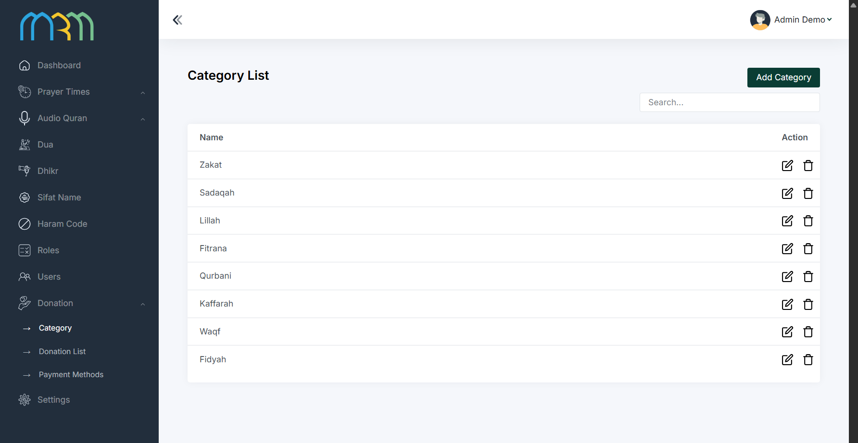
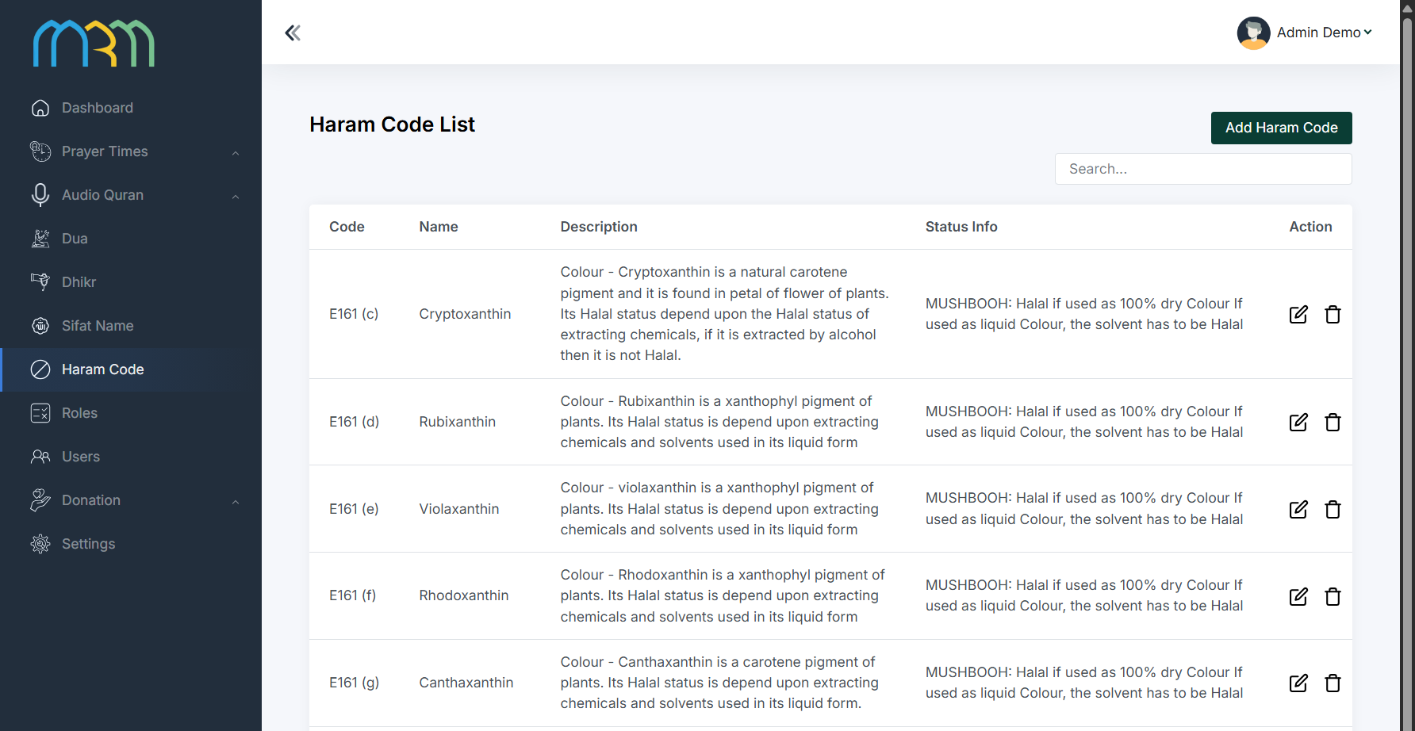
ISLAMIC UTILITIES / MRM DIGITAL COMMUNITY PLATFORM
Content governance and template library
Categories and reviewed references connect administration to reliable published utilities.
MRM / BACKEND
MRM / BACKEND
Provided demo capture · top viewport; full capture in screenbook
Provided demo capture · top viewport; full capture in screenbook
Source → rights and religious review → category → approved publication → correction / withdrawal
Haram Codes is a supplied template function; its public use and claims need explicit MRM review.
MRM / ZYLAX TECHNOLOGIES
PROVIDED TEMPLATE SCREENS + PROPOSED MODERATION
41 / 58
Notes:
Evidence: backend/03_categories.png, backend/07_haram_codes.png
Screenshots are provided interface/demo evidence. No running application or production data was validated. Diagrams specify proposed journeys; they do not certify implementation. Audience is all Muslims, with specialised MRM revert support. Marketplace excluded; subscriptions apply only to teachers.

Slide 42
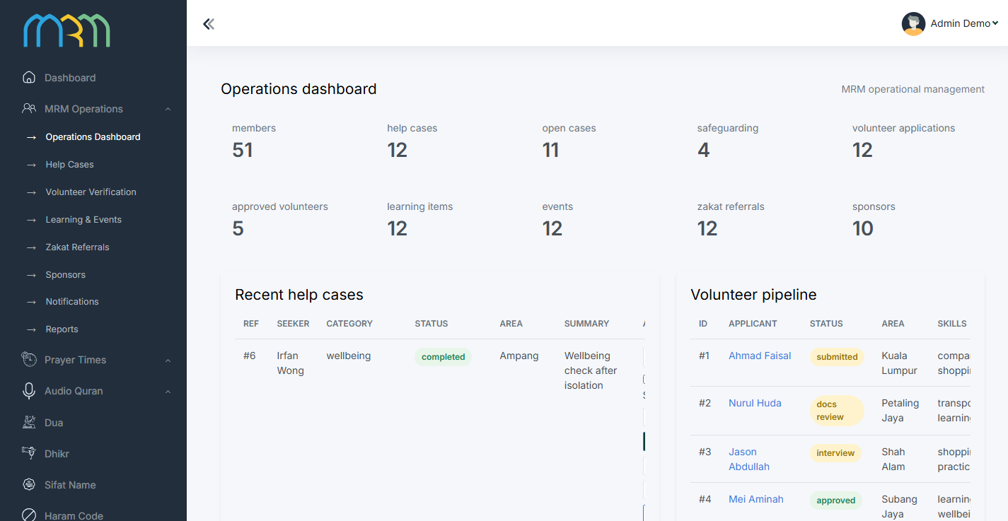
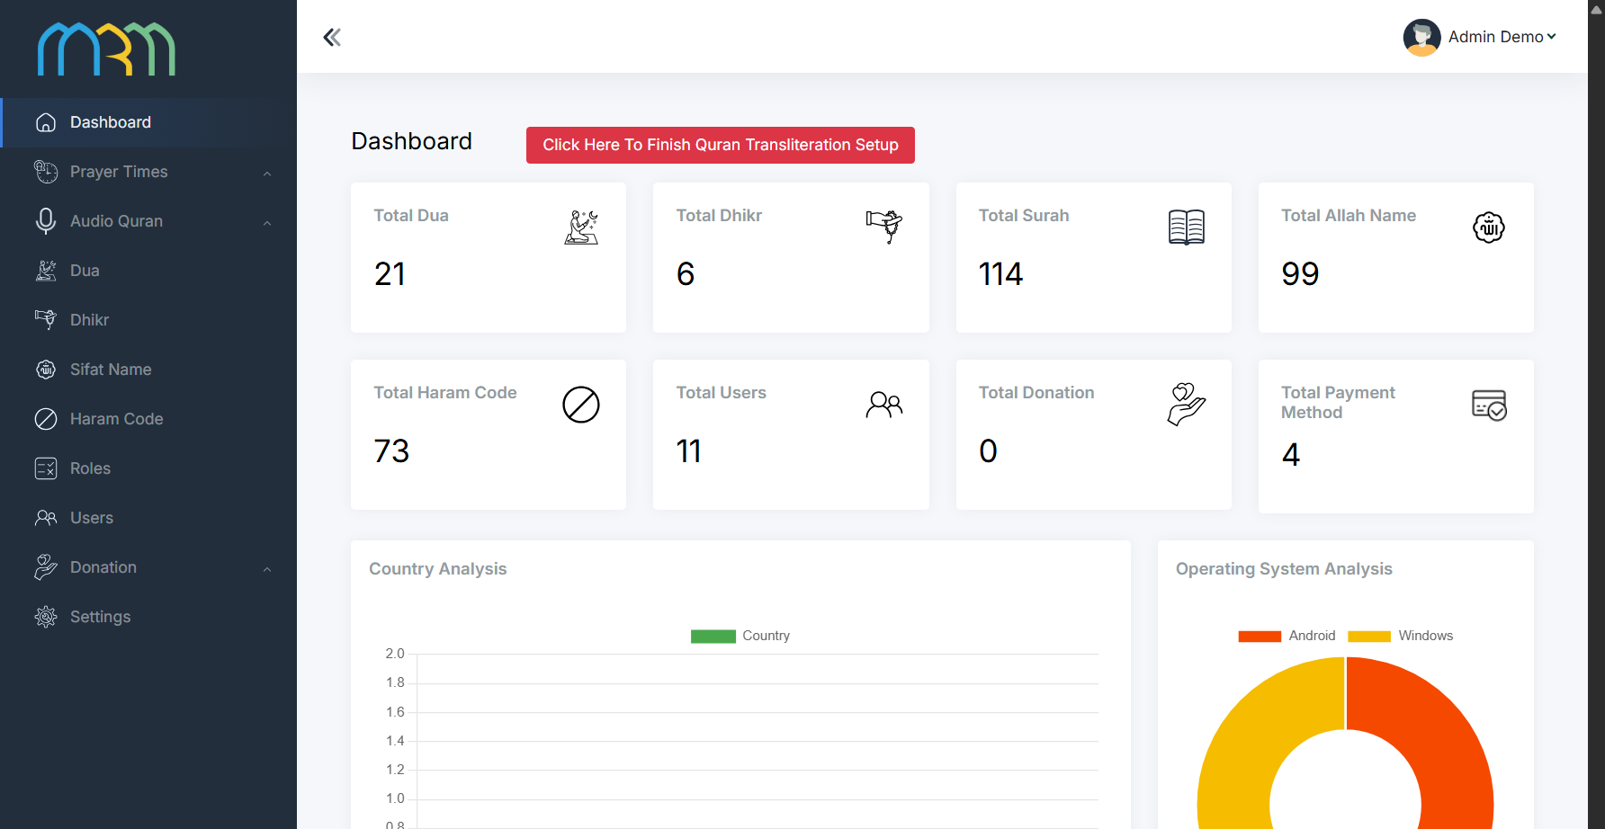
MRM OPERATIONS / MRM DIGITAL COMMUNITY PLATFORM
MRM dashboard: a coordinated operating centre
Operational queues connect care, verification, learning and sponsorship.
Reports › 46
MRM / MRM ADMIN FINAL
MRM / BACKEND
Provided demo capture · top viewport; full capture in screenbook
Provided demo capture · top viewport; full capture in screenbook
Review queues → authorised action → recorded outcome → operational reporting
Supplied dashboard figures are demo evidence. Existing setup banners must be resolved before release.
MRM / ZYLAX TECHNOLOGIES
PROVIDED DEMO DASHBOARDS / COUNTS ARE NOT PRODUCTION RESULTS
42 / 58
Notes:
Evidence: mrm-admin-final/01_mrm_dashboard.png, backend/02_dashboard.png
Screenshots are provided interface/demo evidence. No running application or production data was validated. Diagrams specify proposed journeys; they do not certify implementation. Audience is all Muslims, with specialised MRM revert support. Marketplace excluded; subscriptions apply only to teachers.

Slide 43
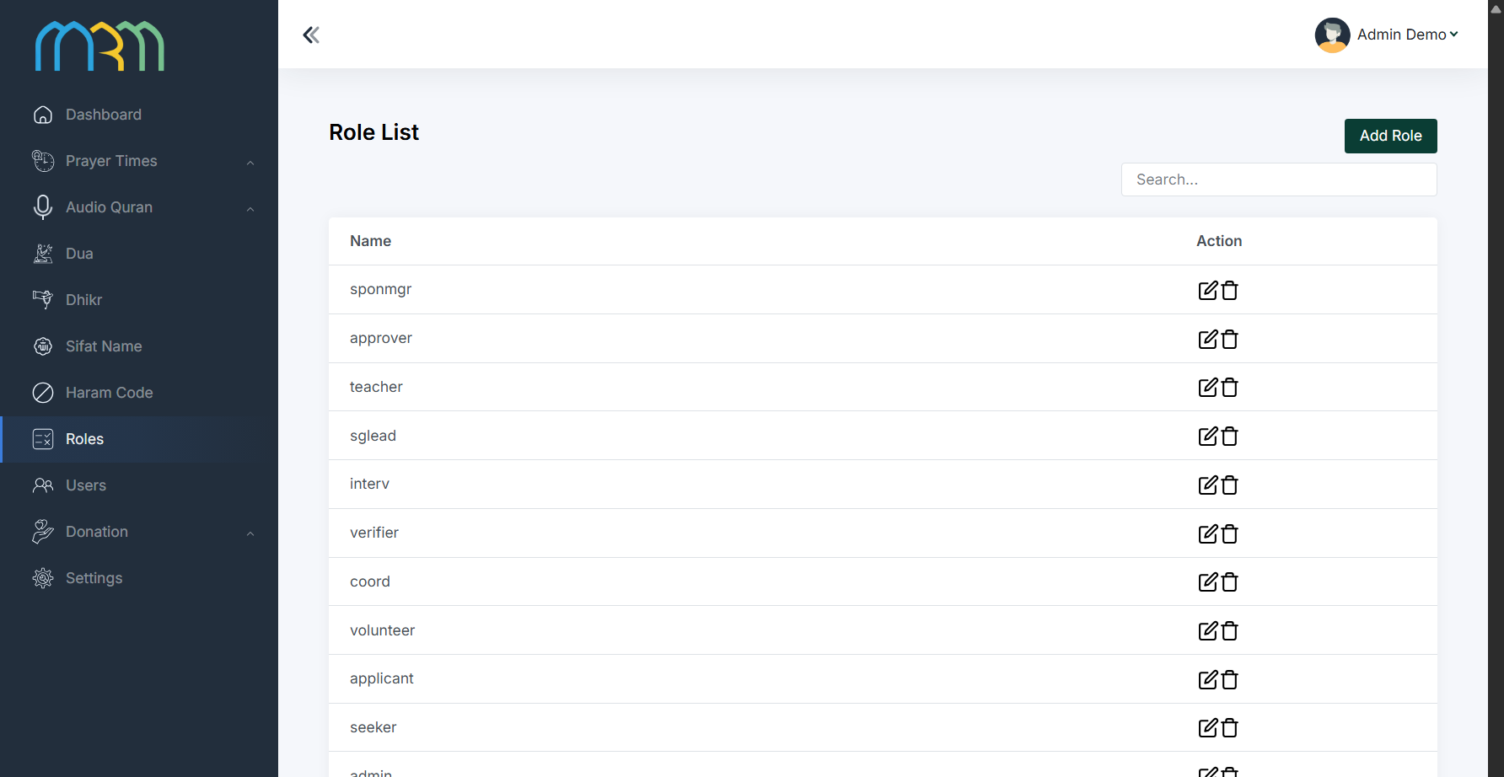
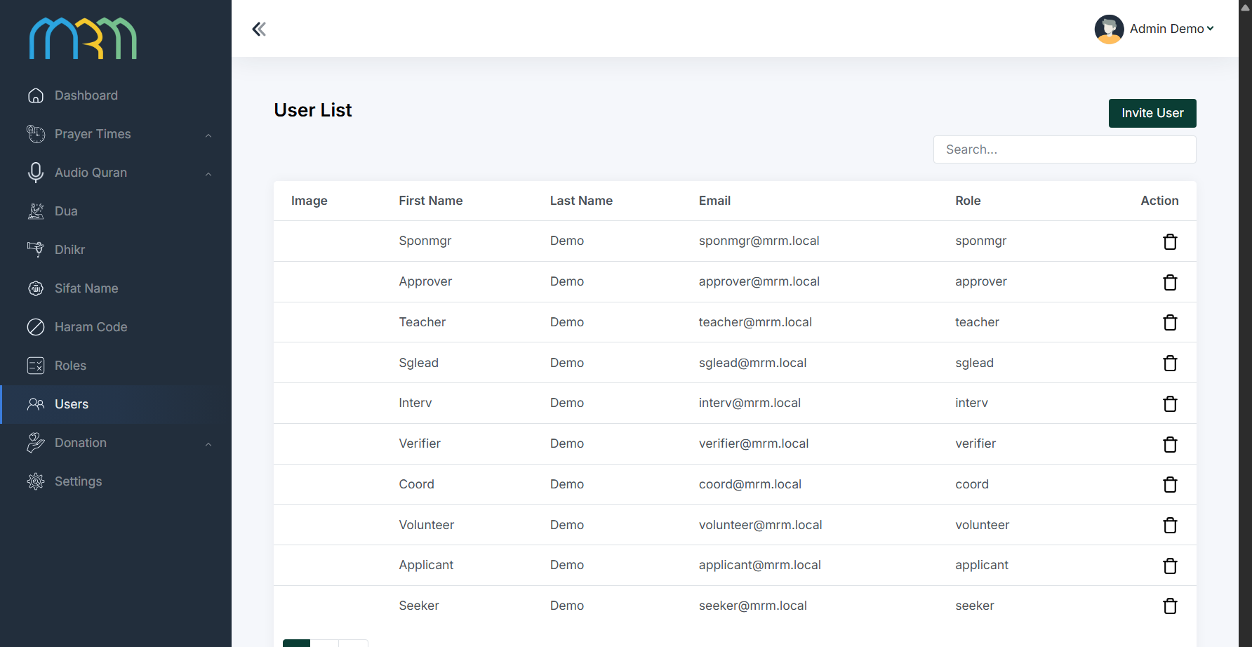
MRM OPERATIONS / MRM DIGITAL COMMUNITY PLATFORM
Accounts, roles and restricted access
Role and record-level permissions control who can act and which information they receive.
MRM / BACKEND
MRM / BACKEND
Provided demo capture · top viewport; full capture in screenbook
Provided demo capture · top viewport; full capture in screenbook
Member → own records | Volunteer → eligible/assigned work | Teacher → content | Staff → duty-based access
Gender boundaries [16] + confidential-case rules [18] + approved role + individual record permission
MRM / ZYLAX TECHNOLOGIES
PROVIDED ACCOUNT ADMINISTRATION + PROPOSED ACCESS CONTROLS
43 / 58
Notes:
Evidence: backend/14_roles.png, backend/15_users.png
Screenshots are provided interface/demo evidence. No running application or production data was validated. Diagrams specify proposed journeys; they do not certify implementation. Audience is all Muslims, with specialised MRM revert support. Marketplace excluded; subscriptions apply only to teachers.

Slide 44
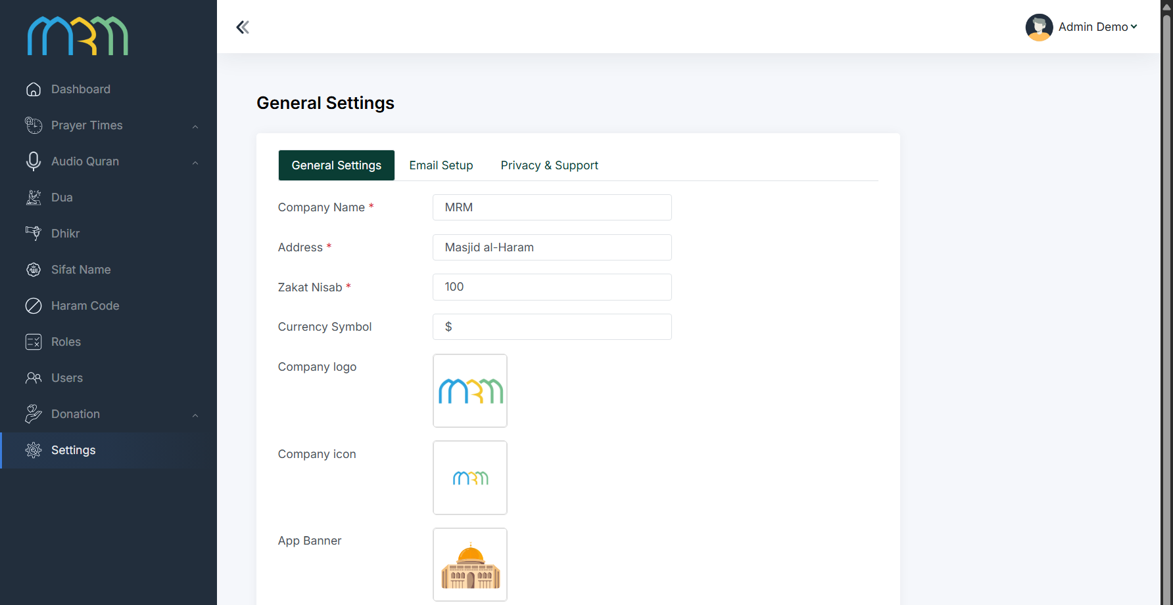
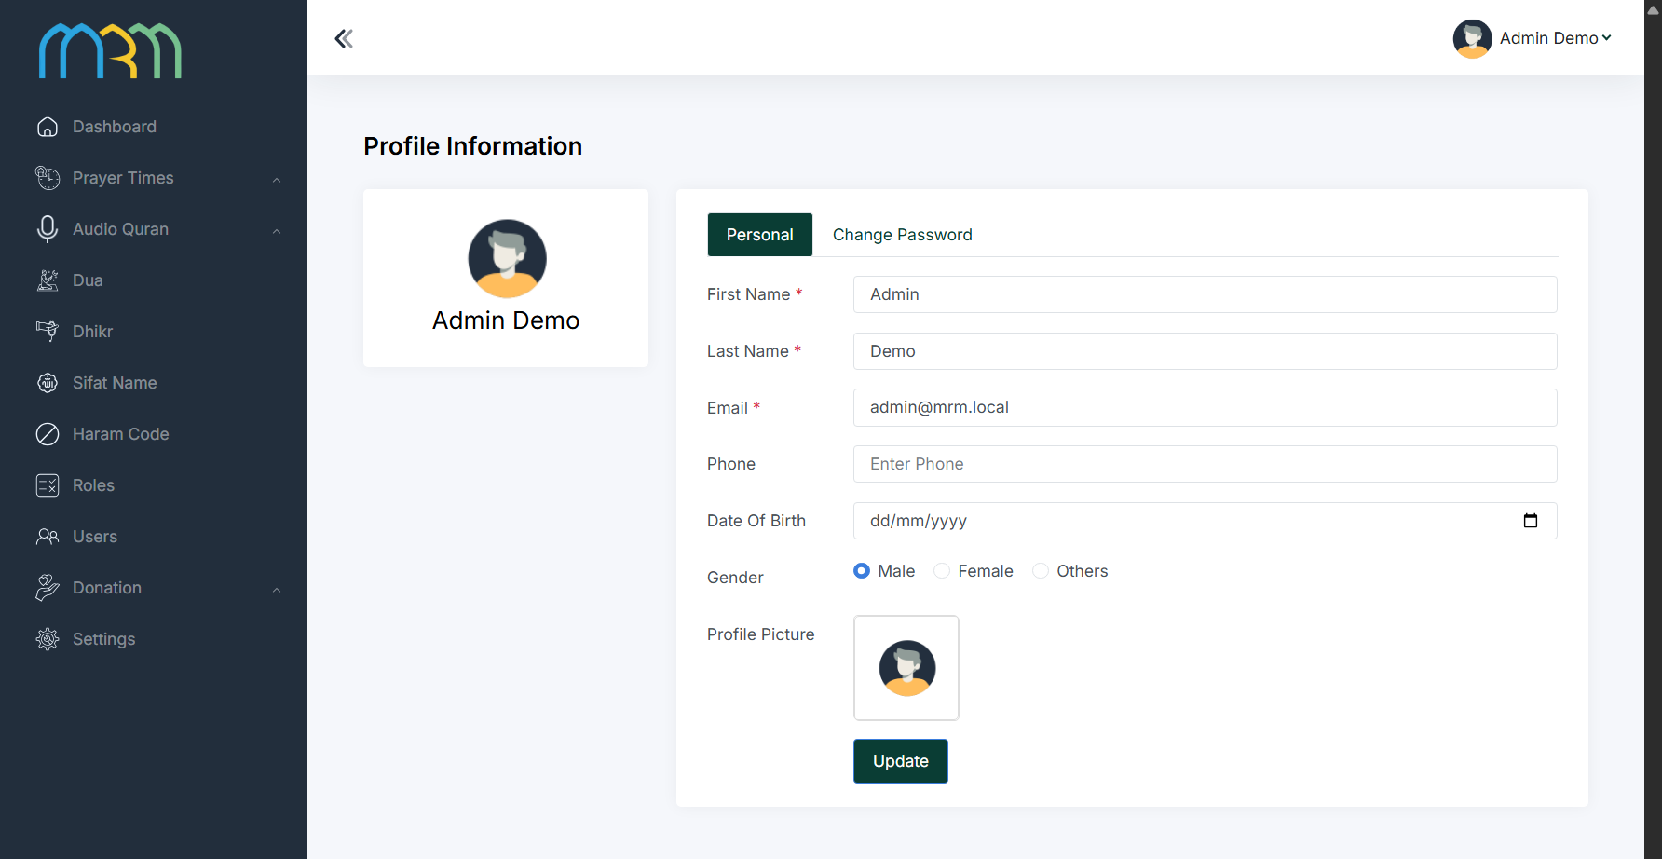
MRM OPERATIONS / MRM DIGITAL COMMUNITY PLATFORM
Configuration and administrator profiles
Settings and staff identity support consistent operation across the platform.
MRM / BACKEND
MRM / BACKEND
Provided demo capture · top viewport; full capture in screenbook
Provided demo capture · top viewport; full capture in screenbook
Approve configuration → restrict staff access → record sensitive changes → validate affected journeys
Brand assets, operational settings and staff responsibilities are configured without changing account permissions.
MRM / ZYLAX TECHNOLOGIES
PROVIDED CONFIGURATION SCREENS + PROPOSED OPERATING RULES
44 / 58
Notes:
Evidence: backend/16_settings.png, backend/17_profile.png
Screenshots are provided interface/demo evidence. No running application or production data was validated. Diagrams specify proposed journeys; they do not certify implementation. Audience is all Muslims, with specialised MRM revert support. Marketplace excluded; subscriptions apply only to teachers.

Slide 45
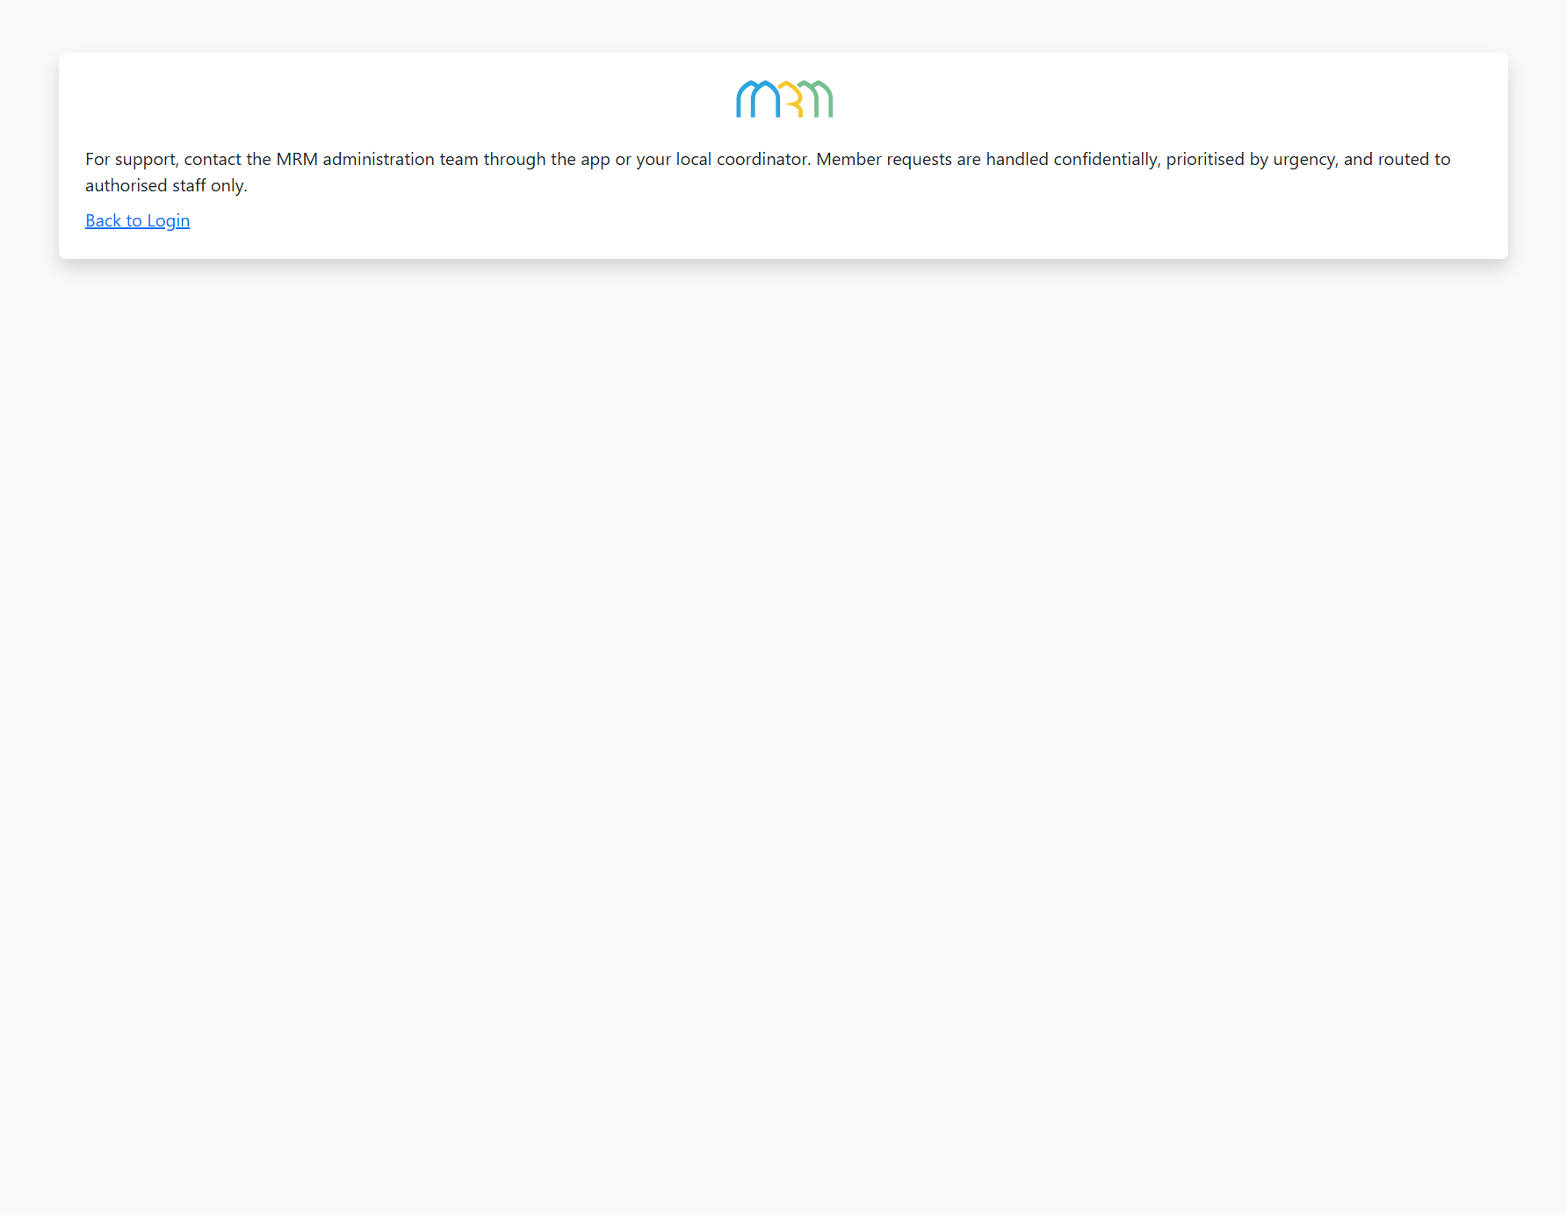
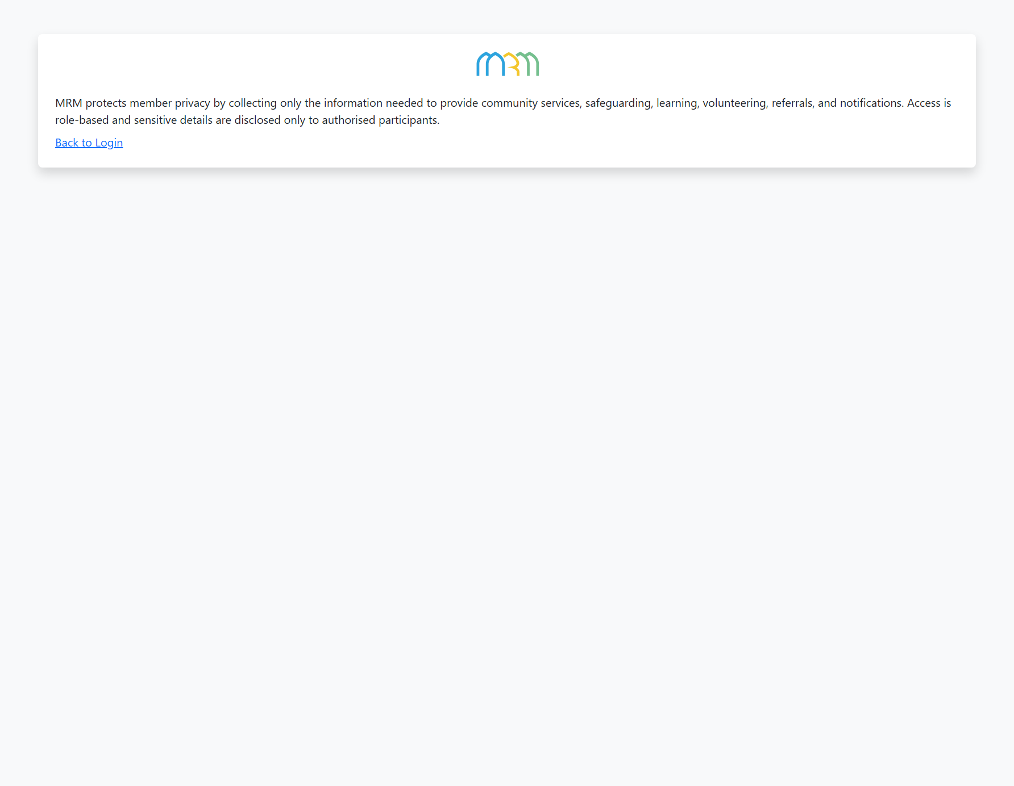
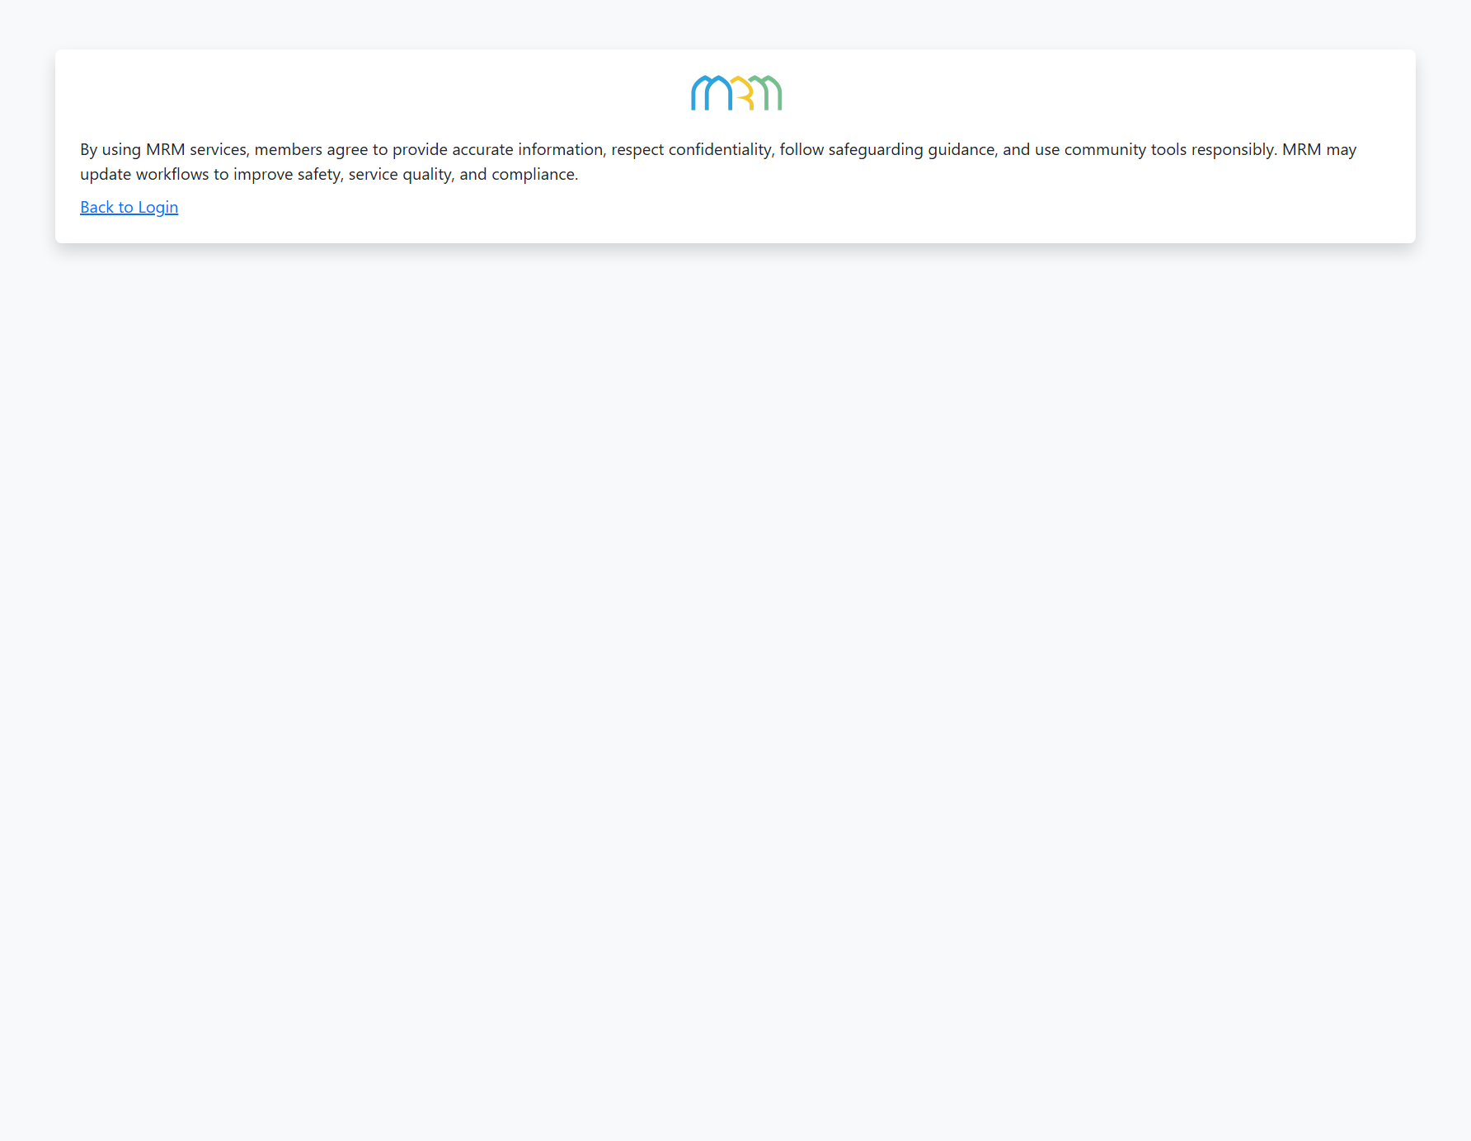
MRM OPERATIONS / MRM DIGITAL COMMUNITY PLATFORM
Support, privacy and terms
Public policy pages must reflect real service boundaries and approved handling of personal information.
MRM / BACKEND
MRM / BACKEND
MRM / BACKEND
Provided demo capture · top viewport; full capture in screenbook
Provided demo capture · top viewport; full capture in screenbook
Provided demo capture · top viewport; full capture in screenbook
MRM supplies notices, retention decisions and support contacts; final pages replace template placeholder copy.
Privacy / consent [12] → restricted data [47] • Support and conduct reporting → designated MRM staff [19]
MRM / ZYLAX TECHNOLOGIES
PROVIDED POLICY PLACEHOLDERS + REQUIRED CONTENT INPUTS
45 / 58
Notes:
Evidence: backend/18_support.png, backend/19_privacy_policy.png, backend/20_terms.png
Screenshots are provided interface/demo evidence. No running application or production data was validated. Diagrams specify proposed journeys; they do not certify implementation. Audience is all Muslims, with specialised MRM revert support. Marketplace excluded; subscriptions apply only to teachers.

Slide 46
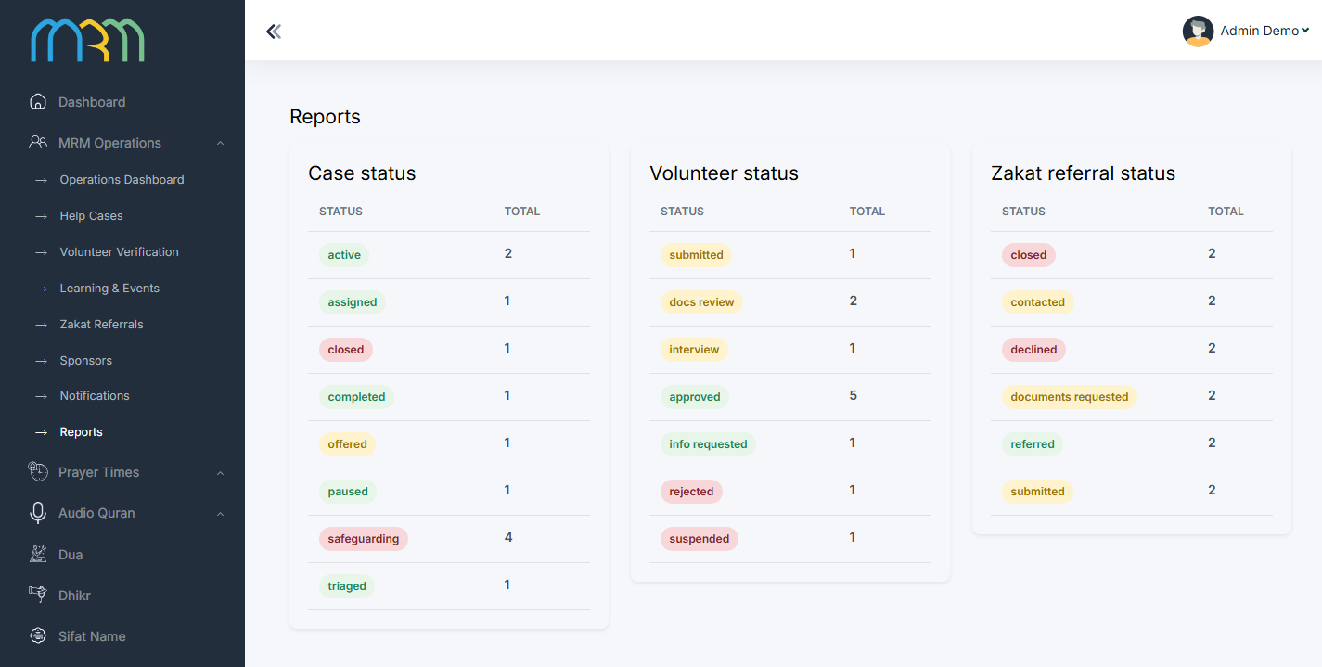
MRM OPERATIONS / MRM DIGITAL COMMUNITY PLATFORM
Reports: understand service without exposing people
Operational reporting connects case outcomes, volunteer capacity, referrals and programme activity.
Security › 47
MRM / MRM ADMIN FINAL
Service oversight
Review request and referral status, open work and volunteer capacity.
Programme insights
Agreed learning participation, teacher activity and sponsor performance summaries.
Controlled export
Aggregate by default; identifiable exports require authorised duties and approved sharing.
Provided demo capture · top viewport; full capture in screenbook
Recorded service events → aggregated summaries → MRM action • Demo counts are not operational performance
MRM / ZYLAX TECHNOLOGIES
PROVIDED DEMO REPORT SCREEN + PROPOSED REPORTING
46 / 58
Notes:
Evidence: mrm-admin-final/09_reports.png
Screenshots are provided interface/demo evidence. No running application or production data was validated. Diagrams specify proposed journeys; they do not certify implementation. Audience is all Muslims, with specialised MRM revert support. Marketplace excluded; subscriptions apply only to teachers.

Slide 47

MRM OPERATIONS / MRM DIGITAL COMMUNITY PLATFORM
Security is part of every connected flow
Permissions and data handling apply across the app, public website, administration and backend.
01
02
03
04
Authenticate
Authorise
Protect
Record & recover
Verify identity and current authorised roles.
Check role, record, gender and case sensitivity.
Encrypted transport and restricted verification files.
Audit sensitive actions; backup and retention controls.
Private data paths
Real validation
Identity evidence, case details and location require separate access policies.
Test direct API access, role changes, denied permissions and billing states.
Safe notifications [23] • Limited exports [46] • MRM policy + server controls + meaningful tests
MRM / ZYLAX TECHNOLOGIES
PROPOSED SECURITY ARCHITECTURE
47 / 58
Notes:
Evidence: Native diagram / proposed capability, based on supplied scope documents.
Screenshots are provided interface/demo evidence. No running application or production data was validated. Diagrams specify proposed journeys; they do not certify implementation. Audience is all Muslims, with specialised MRM revert support. Marketplace excluded; subscriptions apply only to teachers.

Slide 48

DELIVERY & EVIDENCE / MRM DIGITAL COMMUNITY PLATFORM
Delivery: staged evidence over 3–4 months
The proposed schedule depends on required inputs, timely decisions and external service readiness.
01
02
03
04
05
Weeks 1–2
Weeks 3–5
Weeks 6–10
Weeks 11–13
Weeks 14–16
Source audit, journeys, policy matrix and acceptance checklist.
Template-consistent design, foundation and roles.
Care, volunteers, teachers, learning and subscriptions.
Utilities, website, sponsors, notifications and reports.
Security/device tests, UAT, training and submissions.
MRM dependencies
Release qualification
Policies, content rights, partner contacts and client-owned accounts.
Store submission is a milestone; approval dates remain store-controlled.
Review at each stage • Scope changes recorded • No silent removal of agreed modules
MRM / ZYLAX TECHNOLOGIES
INDICATIVE DELIVERY PLAN
48 / 58
Notes:
Evidence: Native diagram / proposed capability, based on supplied scope documents.
Screenshots are provided interface/demo evidence. No running application or production data was validated. Diagrams specify proposed journeys; they do not certify implementation. Audience is all Muslims, with specialised MRM revert support. Marketplace excluded; subscriptions apply only to teachers.

Slide 49
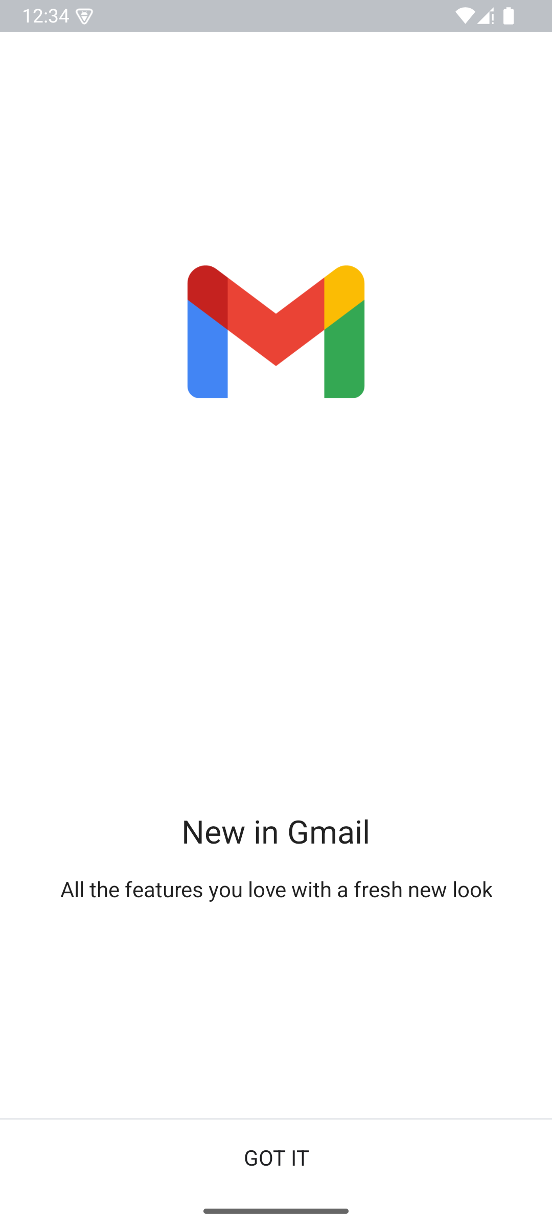

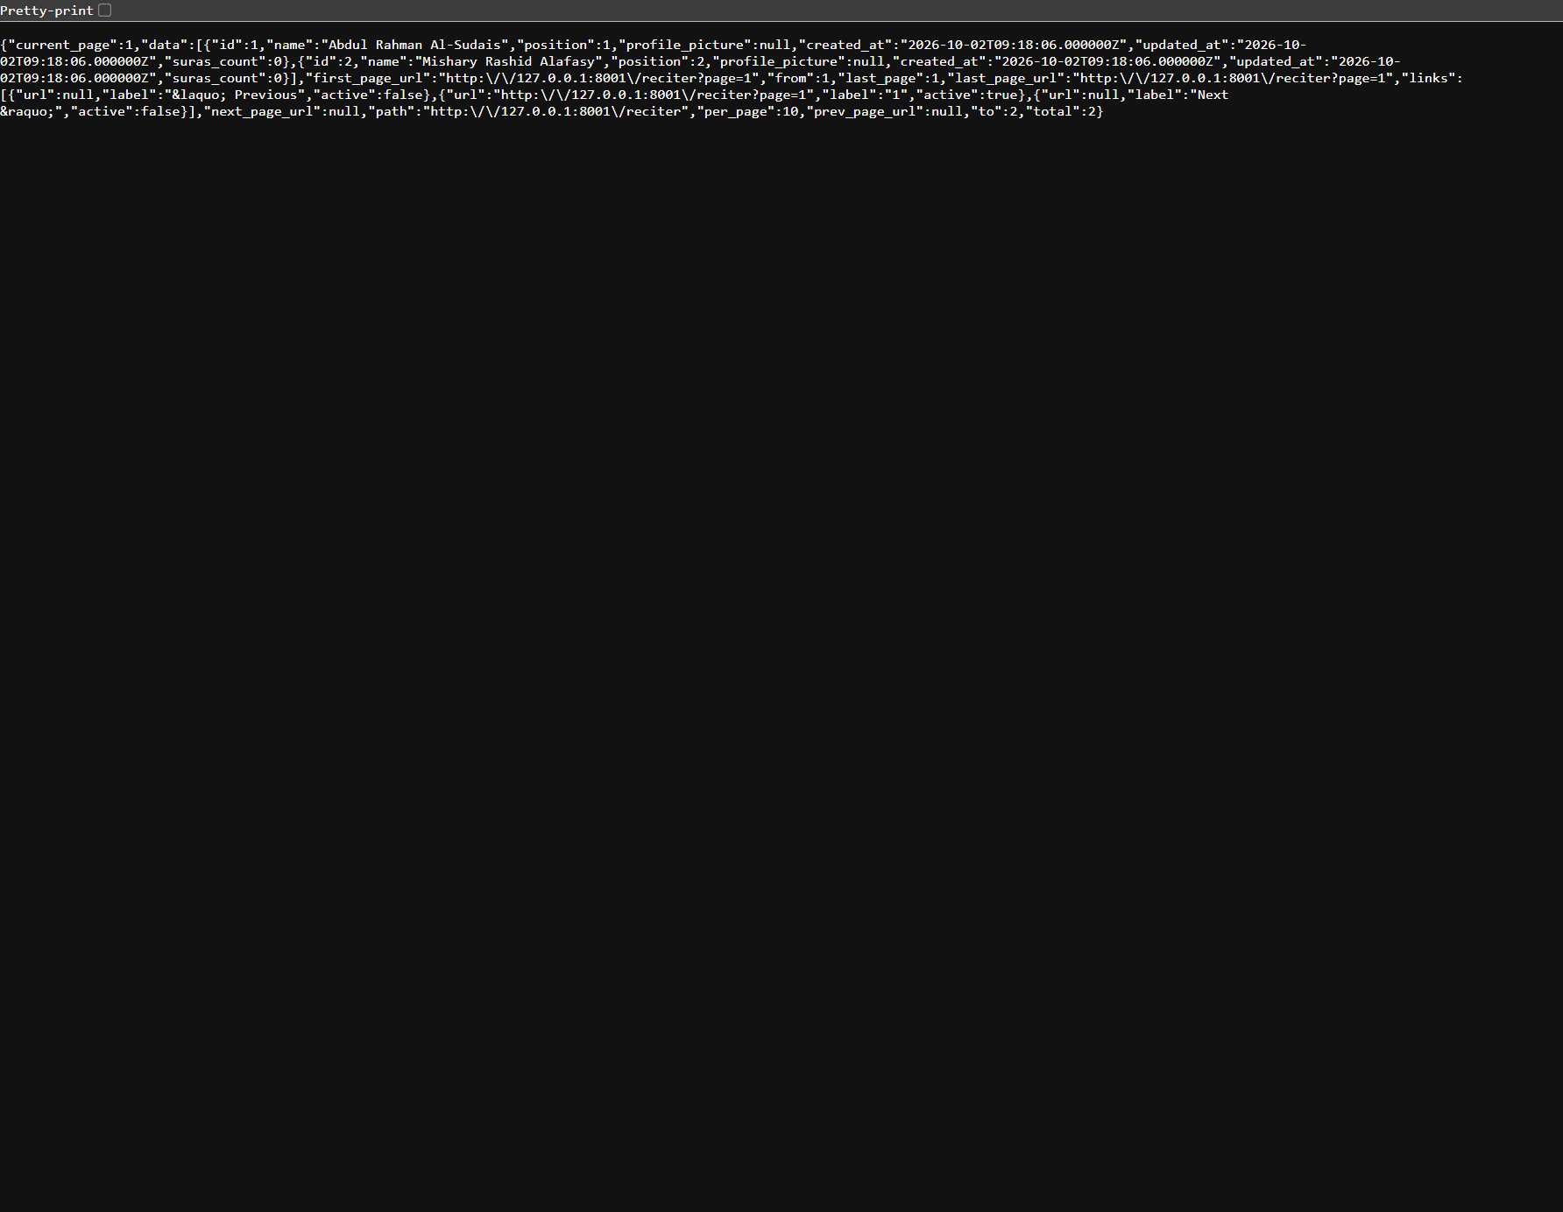
DELIVERY & EVIDENCE / MRM DIGITAL COMMUNITY PLATFORM
Screen coverage and evidence boundaries
All 38 primary captures are indexed; duplicate export variants are retained in the companion screenbook.
9 mobile captures
20 backend captures
9 MRM final captures
Home, services, activity, account and entry states. Some filenames do not match the captured screen.
Content, prayer, accounts, settings, policies and template payment configuration.
Cases, verification, assignments, learning, referrals, sponsors, alerts and reports. Demo records.
Captures requiring replacement or a fresh functional demonstration
Volunteer filename → Gmail
Assignment/learning → blank state
Reciters → raw API response
Missing mobile detail views are described as proposed flows; the deck does not fabricate completed screens.
MRM / ZYLAX TECHNOLOGIES
SCREENSHOT AUDIT / NOT AN IMPLEMENTATION CERTIFICATION
49 / 58
Notes:
Evidence: mobile/07_volunteer.png, mobile/08_assignments_or_learning.png, backend/12_reciters.png
Screenshots are provided interface/demo evidence. No running application or production data was validated. Diagrams specify proposed journeys; they do not certify implementation. Audience is all Muslims, with specialised MRM revert support. Marketplace excluded; subscriptions apply only to teachers.

Slide 50
DELIVERY & EVIDENCE / MRM DIGITAL COMMUNITY PLATFORM
Acceptance, handover and next steps
Confirm the detailed specification, validate the real journeys and release through MRM-owned accounts.
Confirm the specification
Verify complete journeys
Final naming, permissions, plans, content sources, capacity and partner handoff. Preserve Zabi’s visual patterns.
Requests, verification, restricted cases, referrals, learning, subscriptions and sponsor expiry.
Handover to MRM
Prepare client-owned releases
Operating guide, staff training, deployment notes and acceptance checklist. Critical defects resolved before release.
Android/iOS submissions, applicable store billing and account readiness. Proposal includes 30-day stabilisation.
Next step: detailed requirements and source audit → staged implementation → evidence-based acceptance
MRM / ZYLAX TECHNOLOGIES
PROPOSED WORKFLOW
50 / 58
Notes:
This deck reflects proposal language, not evidence of a signed contract. The proposal includes a 30-day post-acceptance stabilisation period; confirm it in the commercial agreement. Apple account charge recorded in supplied proposal: USD 99/year; Google Play USD 25 one-time, subject to current policy. No project price has been included. User requested all-Muslim positioning. No marketplace and no member/volunteer subscription paywall.
Evidence: Native diagram / proposed capability, based on supplied scope documents.
Screenshots are provided interface/demo evidence. No running application or production data was validated. Diagrams specify proposed journeys; they do not certify implementation. Audience is all Muslims, with specialised MRM revert support. Marketplace excluded; subscriptions apply only to teachers.

Slide 51
FEATURE CONNECTIVITY / MRM DIGITAL COMMUNITY PLATFORM
The complete platform, connected
A mind map of daily practice, learning, community care and the services that make them work together.
01
Daily Islamic practice
02
Learning & teachers
Prayer • Qibla • mosques • Quran
Dua • dhikr • hadith • Hijri / Ramadan
Informational zakat estimate
Teacher approval • posts • teaching ads
Classes • recordings • events
Teacher-only publishing subscriptions
03
Care & volunteering
MRM PLATFORM
04
Confidential support & zakat
Help requests • matching • assignments
Verification • interview • gender rules
Nearby discovery • badges / ranks
For all Muslims
Shared identity • safe access
Restricted faith / family cases
Consent • referral • partner follow-up
Authority decides zakat outcomes
05
Website & sponsors
06
MRM operations
Public information • participation routes
Approved resources • sponsor recognition
Scheduled app / website placements
Accounts • moderation • configurations
Alerts • activity • audit • reports
Privacy • backups • restricted exports
Select a branch to visit its feature pages. Detailed maps label approvals, handoffs, access and feedback.
MRM / ZYLAX TECHNOLOGIES
PROPOSED CONNECTIONS / EDITABLE NATIVE DIAGRAM
51 / 58
Notes:
Master mind map. Each branch is a capability family rather than an unrestricted data path. Sifat Names, Haram Codes and donation/payment administration remain supplied template functions with the scope qualifications recorded on pages 38–41.
This is a proposed feature-connectivity specification based on supplied scope documents and the current audience correction: all Muslims may use the platform. It is not proof of implemented behaviour. Marketplace excluded. Teacher subscriptions do not gate member assistance or volunteering. Religious sources, MRM policies, billing configuration and partner access require the agreed approvals. Solid directed arrows indicate a service relationship or handoff; dashed arrows indicate an explicit conditional/feedback path. These diagrams do not imply unrestricted data sharing.

Slide 52
FEATURE CONNECTIVITY / MRM DIGITAL COMMUNITY PLATFORM
One Muslim user, many ways to participate
Daily tools welcome the wider community; personal services and privileged roles use the appropriate access checks.
01
Practise daily
02
Discover & learn
Prayer, Quran and remembrance
Location choices for relevant tools
Approved programmes and teachers
Register where required; revisit recordings
ALL MUSLIM USERS
03
Seek support
04
Contribute as a volunteer
Daily value • community care
Account for personal services
Private request, safe contact preference
Track only your authorised case details
Evidence + interview + MRM approval
Eligible offers and assigned service
05
Follow personal updates
06
Teach through the platform
Application / request status and reminders
Safe alerts open the authorised detail
Teacher approval + valid plan entitlement
Submit educational content for review
Core member assistance and volunteer participation remain free. Teacher subscription privileges stay separate.
MRM / ZYLAX TECHNOLOGIES
PROPOSED CONNECTIONS / EDITABLE NATIVE DIAGRAM
52 / 58
Notes:
Member and role participation map. Account identity, volunteer approval, teacher approval and subscription entitlement are separate controls. Public website discovery connects users to app entry and relevant participation routes.
This is a proposed feature-connectivity specification based on supplied scope documents and the current audience correction: all Muslims may use the platform. It is not proof of implemented behaviour. Marketplace excluded. Teacher subscriptions do not gate member assistance or volunteering. Religious sources, MRM policies, billing configuration and partner access require the agreed approvals. Solid directed arrows indicate a service relationship or handoff; dashed arrows indicate an explicit conditional/feedback path. These diagrams do not imply unrestricted data sharing.

Slide 53
FEATURE CONNECTIVITY / MRM DIGITAL COMMUNITY PLATFORM
How care, volunteering and recognition connect
Routine assignments and restricted concerns follow distinct access paths, with MRM coordinating the outcome.
Member request
MRM triage
Restricted concern
Designated personnel
submit
private
assign
Need, urgency and safe contact
Review sensitivity and suitability
Private faith / family intake
Controlled advice and follow-up
routine
Approved volunteer
Eligible matching
Confirmed assignment
Progress & closure
eligible
offer
serve
Active status and permitted service
Area, category, language, gender
Seeker / coordinator confirmation
Verified outcome; escalation if needed
verify
no response
updates
verify credit
Evidence & interview
Coordinator oversight
Alerts & activity
Service recognition
Evidence and MRM decision
Reassign or follow up unanswered work
Only authorised status / action
MRM criteria; correction / appeal
Approval gates access; assignment gates case detail. Rank never grants sensitive-case or administrator access.
MRM / ZYLAX TECHNOLOGIES
PROPOSED CONNECTIONS / EDITABLE NATIVE DIAGRAM
53 / 58
Notes:
Care network. MRM triage routes routine requests to eligible matching, while restricted faith/family matters go to designated personnel. Volunteer evidence review and online interview precede approval. Confirmation precedes assigned details. Unanswered work returns to coordinator oversight. Service credit requires verified outcomes.
This is a proposed feature-connectivity specification based on supplied scope documents and the current audience correction: all Muslims may use the platform. It is not proof of implemented behaviour. Marketplace excluded. Teacher subscriptions do not gate member assistance or volunteering. Religious sources, MRM policies, billing configuration and partner access require the agreed approvals. Solid directed arrows indicate a service relationship or handoff; dashed arrows indicate an explicit conditional/feedback path. These diagrams do not imply unrestricted data sharing.

Slide 54
FEATURE CONNECTIVITY / MRM DIGITAL COMMUNITY PLATFORM
From approved teacher to trusted learning
Teacher plans enable publishing allowances; MRM moderation controls what learners can actually see.
Teacher application
MRM teacher approval
Select teacher plan
Verified entitlement
Credentials, subjects and evidence
Authorised professional role
MRM terms; applicable store billing
Active paid / configured free plan
enables
Approved publication
MRM moderation
Teacher submission
Publishing allowance
Posts, teaching ads and programmes
Approve, return, schedule or withdraw
Content, class proposal or recording
Apply active plan limits
publish
return for revision
Learner discovery
Programme & access
Live class / event
Approved recordings
Topic, language and teacher
Details and registration rules
Reminder and permitted session access
Continue learning after the session
Payment does not approve content or grant staff access. Learners and volunteers do not need teacher subscriptions.
MRM / ZYLAX TECHNOLOGIES
PROPOSED CONNECTIONS / EDITABLE NATIVE DIAGRAM
54 / 58
Notes:
Teacher-to-learner connectivity. Teacher approval precedes plan selection. Verified entitlements gate publishing allowances, while moderation independently gates publication. Revision is a feedback path. Expiry pauses paid privileges and preserves history; confirm historical-content visibility. Live sessions may use approved external meeting links; no custom conferencing infrastructure is implied.
This is a proposed feature-connectivity specification based on supplied scope documents and the current audience correction: all Muslims may use the platform. It is not proof of implemented behaviour. Marketplace excluded. Teacher subscriptions do not gate member assistance or volunteering. Religious sources, MRM policies, billing configuration and partner access require the agreed approvals. Solid directed arrows indicate a service relationship or handoff; dashed arrows indicate an explicit conditional/feedback path. These diagrams do not imply unrestricted data sharing.

Slide 55
FEATURE CONNECTIVITY / MRM DIGITAL COMMUNITY PLATFORM
Daily utilities connect through approved inputs
Location, religious content and local conventions feed the right tools without mixing unrelated permissions.
INPUT / USER CHOICE
VALIDATION / CONFIGURATION
CONNECTED EXPERIENCE
Location or manual area
Local prayer & map settings
Prayer • Qibla • nearby mosques
Consent and device capability
Local times, direction and place sources
Useful daily guidance; permission handling
Religious sources & rights
Reviewed content library
Quran • dua • dhikr • hadith
Approved references and translations
Quran text / recitation and utility content
Connect practice to approved learning
Calendar / zakat sources
Display & calculation rules
Hijri • Ramadan • zakat estimate
MRM-approved local conventions
Source review; local adjustment policy
Guidance only; referral is a separate service
Daily content ↔ approved learning. Zakat estimate ↔ referral information; eligibility stays with the authority.
MRM / ZYLAX TECHNOLOGIES
PROPOSED CONNECTIONS / EDITABLE NATIVE DIAGRAM
55 / 58
Notes:
Utility dependencies. Location choices affect location-related tools, not blanket access to personal information. Religious references, translations and recitation rights are reviewed separately. Calendar conventions and calculator sources require approval. Utility-to-learning links reference approved content. A zakat estimate does not automate assistance eligibility or disbursement.
This is a proposed feature-connectivity specification based on supplied scope documents and the current audience correction: all Muslims may use the platform. It is not proof of implemented behaviour. Marketplace excluded. Teacher subscriptions do not gate member assistance or volunteering. Religious sources, MRM policies, billing configuration and partner access require the agreed approvals. Solid directed arrows indicate a service relationship or handoff; dashed arrows indicate an explicit conditional/feedback path. These diagrams do not imply unrestricted data sharing.

Slide 56
FEATURE CONNECTIVITY / MRM DIGITAL COMMUNITY PLATFORM
Confidential support and zakat: controlled handoffs
These journeys share access controls and case accountability, not unrestricted volunteer or teacher visibility.
CONSENT + MINIMUM NECESSARY DATA
ROLE + RECORD-LEVEL AUTHORISATION
SAFE ALERTS + RESTRICTED EVIDENCE + AUDIT
CONFIDENTIAL FAITH / FAMILY SUPPORT
Private concern
Designated MRM review
Authorised guidance & follow-up
Safe contact and permitted information
Private queue and appropriate assignment
Controlled closure or permitted referral
ZAKAT ENQUIRY / REFERRAL
Enquiry + referral consent
MRM completeness review
Zakat authority handoff
Need, region and safe contact preference
Approved forms, sharing method and contact
Authority decides eligibility and disbursement
Authorised status → case history → permitted user update → aggregate reporting. Partner API access is conditional.
No automated religious judgement. No guaranteed partner API. No zakat collection or disbursement in the proposal.
MRM / ZYLAX TECHNOLOGIES
PROPOSED CONNECTIONS / EDITABLE NATIVE DIAGRAM
56 / 58
Notes:
Two restricted service lanes. General volunteers and teacher subscriptions do not grant access to confidential cases. Zakat referrals use consent and approved data sharing. Status feedback is recorded only where permitted. Relevant authority decisions are external; direct integration depends on authorisation, supported API, documentation and test access.
This is a proposed feature-connectivity specification based on supplied scope documents and the current audience correction: all Muslims may use the platform. It is not proof of implemented behaviour. Marketplace excluded. Teacher subscriptions do not gate member assistance or volunteering. Religious sources, MRM policies, billing configuration and partner access require the agreed approvals. Solid directed arrows indicate a service relationship or handoff; dashed arrows indicate an explicit conditional/feedback path. These diagrams do not imply unrestricted data sharing.

Slide 57
FEATURE CONNECTIVITY / MRM DIGITAL COMMUNITY PLATFORM
MRM operations connect content, revenue and oversight
Staff actions create controlled outputs across the app and website; service records feed aggregate reporting.
01
Public website & discovery
02
Sponsors & placements
Approved pages, resources and events
Volunteer / teacher / support entry routes
Approved assets + start / end dates
App / website recognition; aggregate metrics
03
Content & learning publication
MRM OPERATIONS
04
Teacher plans & entitlements
Teacher proposals and utility references
Moderation controls visible material
Duty-based staff access
Configure • review • record
Client-owned store billing configuration
Verified plan state → publishing allowances
05
Alerts • activity • audit
06
Reports & service oversight
Service event → permitted recipient
Safe alert → authorised detail / next action
Case / volunteer / referral status
Agreed programme and sponsor summaries
Sponsors cannot access private cases. Sponsorship never changes assignment, confidential guidance or zakat decisions.
MRM / ZYLAX TECHNOLOGIES
PROPOSED CONNECTIONS / EDITABLE NATIVE DIAGRAM
57 / 58
Notes:
Operations map. MRM supplies governance, content approval, teacher plan rules and sponsor campaign inputs. Staff publishing feeds app/website experiences; billing state enables teacher entitlements, not content approval or staff privileges. Safe event delivery and audit support accountability. Aggregate reports inform staff oversight; identifiable exports remain restricted.
This is a proposed feature-connectivity specification based on supplied scope documents and the current audience correction: all Muslims may use the platform. It is not proof of implemented behaviour. Marketplace excluded. Teacher subscriptions do not gate member assistance or volunteering. Religious sources, MRM policies, billing configuration and partner access require the agreed approvals. Solid directed arrows indicate a service relationship or handoff; dashed arrows indicate an explicit conditional/feedback path. These diagrams do not imply unrestricted data sharing.

Slide 58
FEATURE CONNECTIVITY / MRM DIGITAL COMMUNITY PLATFORM
Connection index: what links to what
Use this index to trace a feature dependency back to the detailed scope pages in the full presentation.
FEATURE
CONNECTS TO
CONNECTION PURPOSE
ACCESS / POLICY CHECK
PAGE
Accounts & roles
Personal records / staff tools
Authorises appropriate access
Role + record + gender / sensitivity
43
Volunteer verification
Discovery / request matching
Enables eligible service
Approved and active only
15
Triage & matching
Assignment / case progress
Offers, confirms and follows up
Sensitive route stays restricted
13
Teacher approval + plan
Posts / ads / programme proposals
Enables publishing allowances
Valid entitlement; no staff access
27
MRM moderation
Learning / website / utility content
Approves visible material
Religious review and content rights
26
Service events
Alerts / activity / case detail
Prompts the permitted next action
Privacy-safe alert; authorise detail
23
Zakat enquiry
Authority referral / follow-up
Coordinates approved handoff
Consent; authority decides outcome
20
Verified service outcome
Badges / ranks / service history
Awards evidence-based credit
MRM criteria; access unchanged
21
Sponsor configuration
App / website placements
Schedules recognition / expiry
Approved assets; aggregate metrics
30
Recorded outcomes
Operational reports / staff review
Aggregates service information
Restricted identifiable exports
46
Solid arrows = directed relationship / handoff. Dashed arrows = conditional path or revision feedback.
MRM / ZYLAX TECHNOLOGIES
PROPOSED CONNECTIONS / EDITABLE NATIVE DIAGRAM
58 / 58
Notes:
Dependency index with ten key cross-feature relationships. Each row links to the corresponding detailed original deck page. The chapter maps the proposed product specification and does not certify deployment or complete implementation.
This is a proposed feature-connectivity specification based on supplied scope documents and the current audience correction: all Muslims may use the platform. It is not proof of implemented behaviour. Marketplace excluded. Teacher subscriptions do not gate member assistance or volunteering. Religious sources, MRM policies, billing configuration and partner access require the agreed approvals. Solid directed arrows indicate a service relationship or handoff; dashed arrows indicate an explicit conditional/feedback path. These diagrams do not imply unrestricted data sharing.

