Slide 1


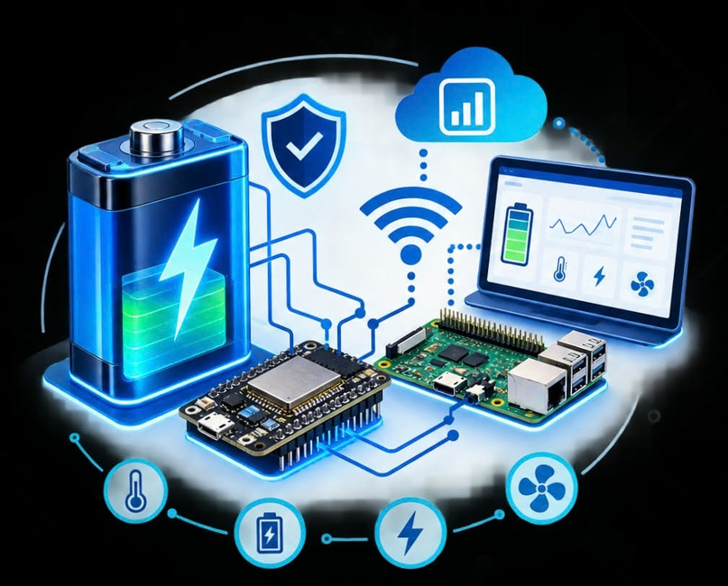
SMART AUTOMATIC BATTERY MANAGEMENT
MONITORING AND PROTECTION
SYSTEM
Using ESP32 and Raspberry Pi with Real-Time IoT Dashboard
BATCH NO:09
E. Harshini (25P85A0402)
B. Pranay Kumar (25P85A0401)
S. Prasad (24P81A0448)
N. Akanksha (24P81A0441)
GUIDE
Ms. V. Sharvani Mam
(ASSISTANT PROFESSOR)

Slide 2


ABSTRACT
The proposed system is a smart and automated battery management solution for real-time monitoring and protection. ESP32 continuously monitors battery voltage, current, and temperature and sends the data through Wi-Fi to Raspberry Pi. Raspberry Pi provides real-time visualization through an IoT dashboard and enables automatic control of the cooling fan and relay based on predefined safety limits.
Battery → ESP32 → Wi-Fi → Raspberry Pi → IoT Dashboard

Slide 3

OBJECTIVES
  Monitor voltage, current and temperature in real time.
  Transmit battery data through Wi-Fi.
  Provide real-time IoT-based monitoring.
  Automatically control fan and relay.
  Improve battery safety and reduce manual monitoring

Slide 4

INTRODUCTION
  Batteries are widely used in electric vehicles, UPS systems, renewable energy systems, and portable electronics.
  Improper battery operation can cause overheating, over-voltage, over-current, and battery damage.
  ESP32 and sensors continuously monitor important battery parameters.
  Wi-Fi and Raspberry Pi enable real-time monitoring and automatic protection

Slide 5
HARDWARE COMPONENTS
Component | Function
Battery | Provides power to the system
ESP32 | Collects and processes sensor data
Voltage Sensor | Measures battery voltage
Current Sensor (ACS712) | Measures charging/discharging current
Temperature Sensor | Monitors battery temperature
Wi-Fi Communication | Wireless data transfer between ESP32 and Raspberry Pi
Raspberry Pi | Processes and displays battery data
Relay Module | Provides automatic protection control
DC Fan | Provides cooling during high temperature
Battery → ESP32 → Wi-Fi → Raspberry Pi → IoT Dashboard

Slide 6
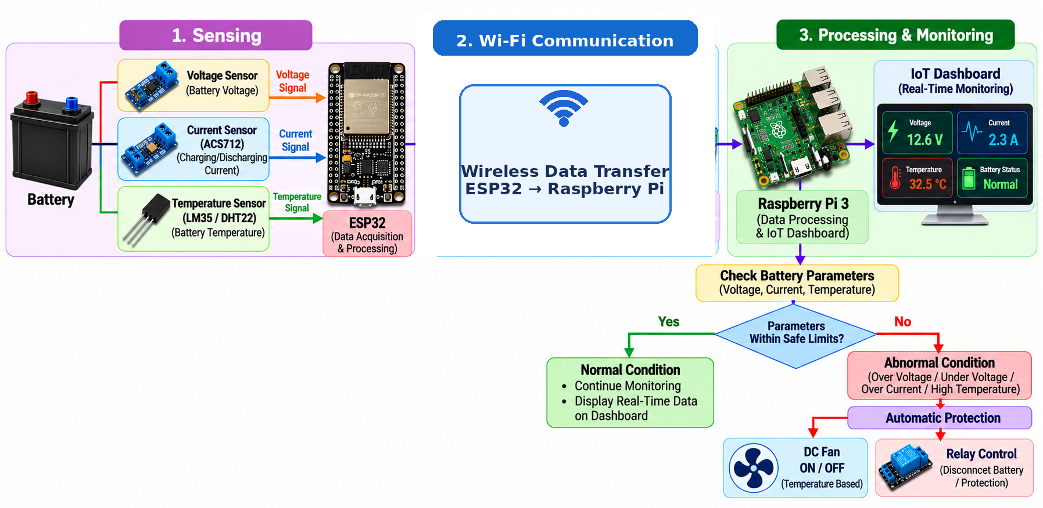
WORKING PRINCIPLE
The system continuously monitors battery parameters and automatically activates protection when unsafe conditions are detected.

Slide 7
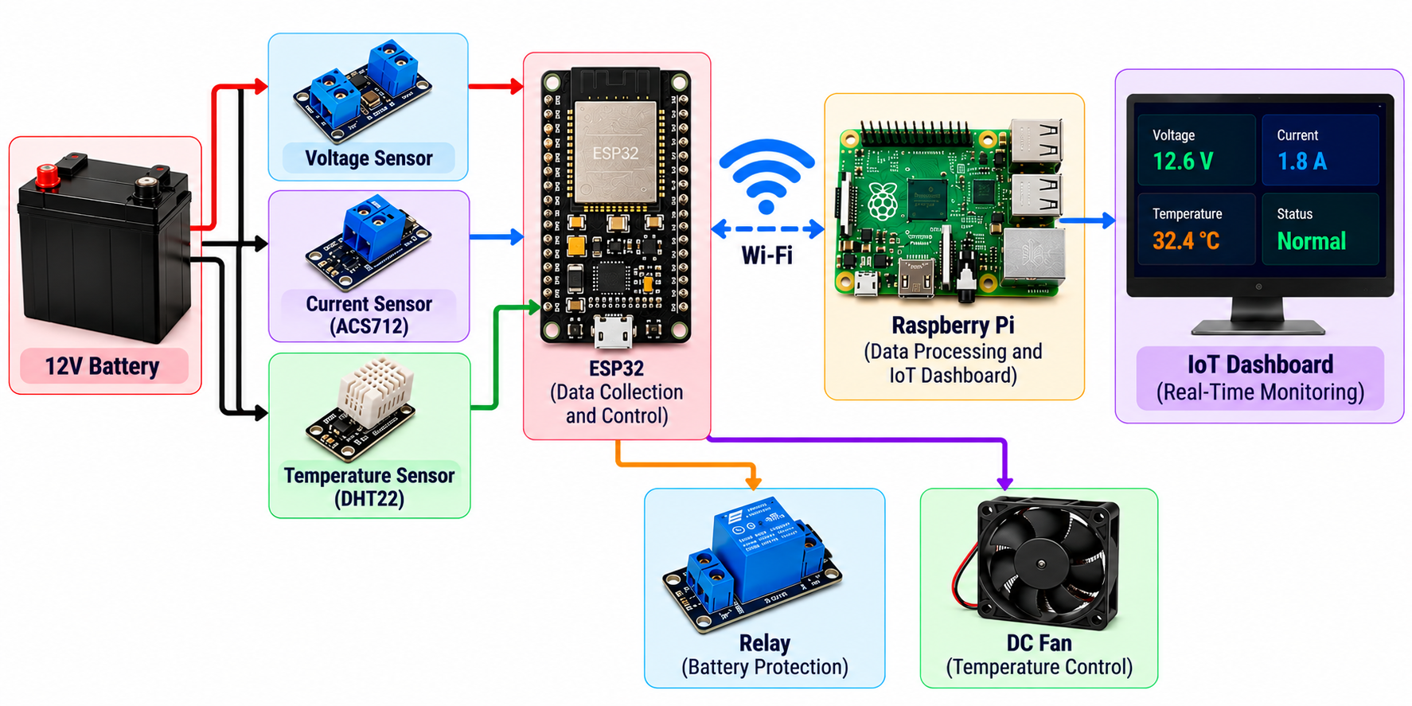
SYSTEM ARCHITECTURE
Battery → ESP32 → Wi-Fi → Raspberry Pi → IoT Dashboard

Slide 8
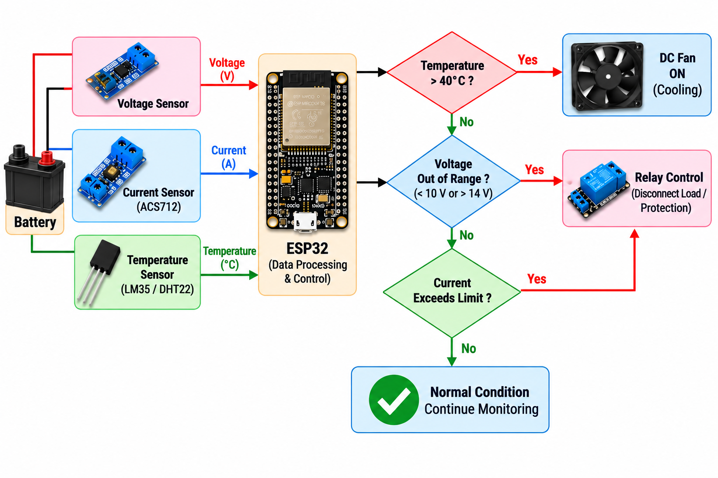
BATTERY PROTECTION & CONTROL

Slide 9
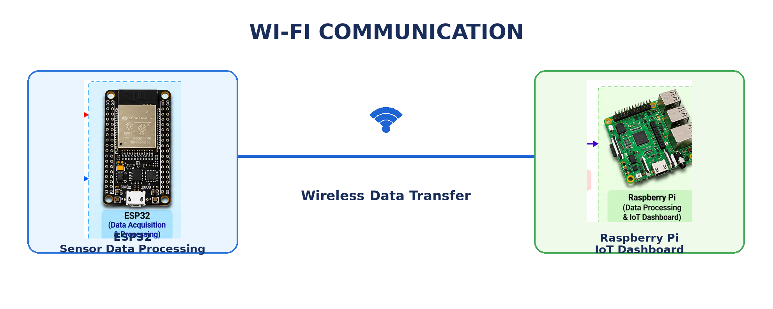
WI-FI COMMUNICATION
Key Features:
  Wireless data transmission
  Built-in Wi-Fi connectivity
  No additional wired communication bus required
  Suitable for real-time IoT monitoring
  Flexible and convenient connectivity
ESP32 → Wi-Fi → Raspberry Pi → Real-Time IoT Monitoring.

Slide 10
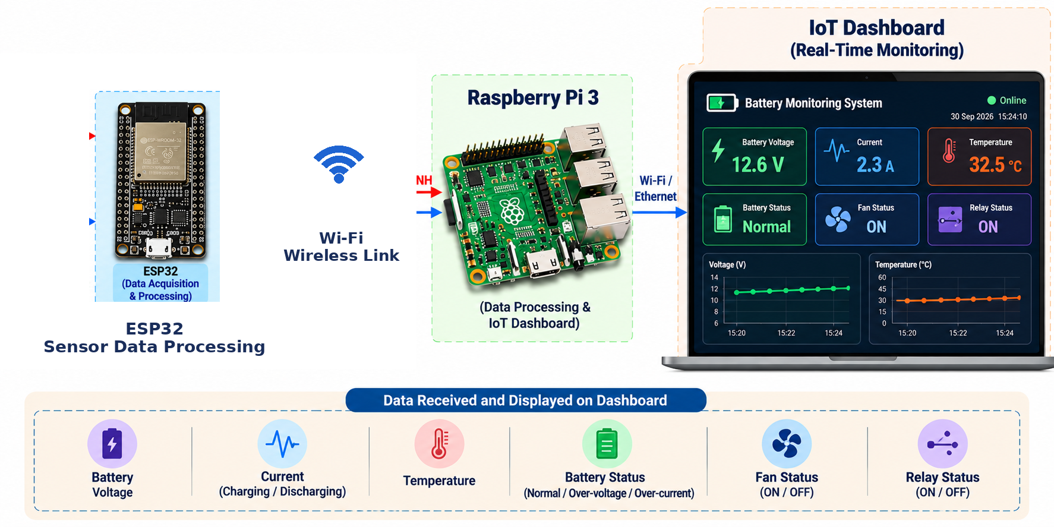
RASPBERRY PI & IOT DASHBOARD
  Raspberry Pi Functions
  Receives battery data from ESP32 through Wi-Fi
  Processes and analyzes the sensor readings
  Displays voltage, current and temperature in real time
  Monitors battery status and safety conditions
  Provides control/status of the fan and relay
ESP32 → Wi-Fi → Raspberry Pi → Real-Time IoT Dashboard

Slide 11
RESULTS AND OUTPUTS
Integrated System:
Combines battery monitoring, Wi-Fi communication, Raspberry Pi processing, IoT visualization, and automatic protection.
• Real-Time Monitoring:
Continuously monitors battery voltage, charging/discharging current, and temperature and displays the values on the IoT dashboard.
• Automatic Protection:
Transfers sensor data through Wi-Fi ad automatically controls the fan and relay based on battery conditions

Slide 12


FUTURE SCOPE
Advanced Monitoring
SOC & SOH estimation for accurate battery health monitoring.
Cell-level monitoring and battery balancing.
Cloud storage and mobile app for remote access
Smart Protection
Fault prediction using AI/ML.
Automatic alerts through SMS, email, or mobile app.
Integration with EVs and advanced energy-storage systems.

Slide 13
CONCLUSION
  The proposed system provides a smart and automated solution for battery monitoring and protection using ESP32, sensors, Wi-Fi communication, and Raspberry Pi.
  It enables real-time monitoring, IoT visualization, and automatic protection through fan and relay control.
  The system reduces manual intervention and provides a reliable and scalable platform for various battery-powered applications.

Slide 14

