Slide 1
All areas
Period: 2002-2014
Age range: 1:6+
Survey object:
-Aggregated DEPM dataset
-Aggregated Acoustic dataset
-Egg count (BoB)
Yesterday’s options
fmodel <- ~ te(age, year, k=c(6,7))
qmod<- list(~s(age,k=4),~1,~1)
Final options
fmodel <- ~ te(age, year, k=c(3,7)) + s(age, k=5)
qmodel <- list(~factor(replace(age,age>1,2)), ~year,~1)

Slide 2
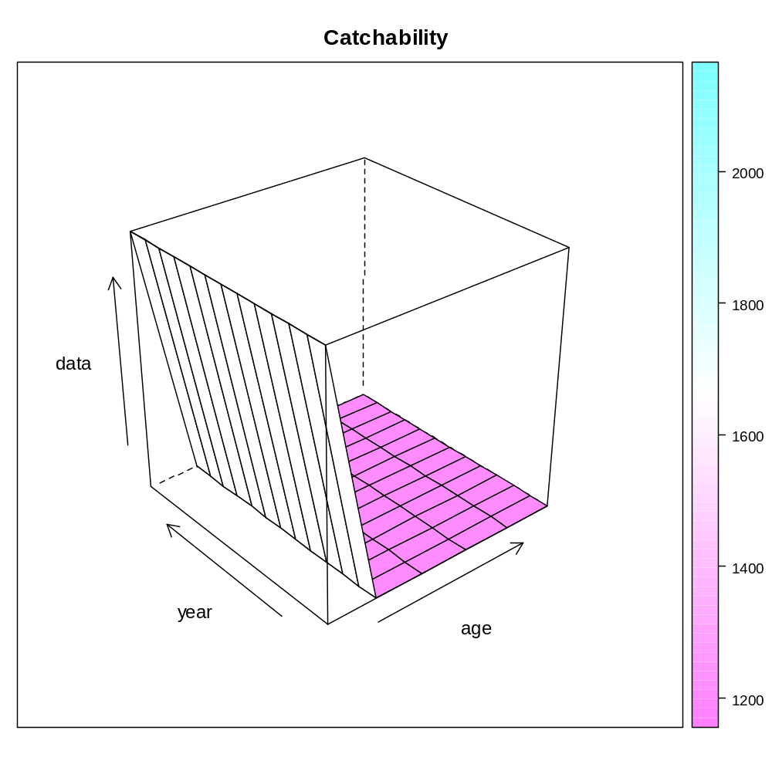

Slide 3
> fitSumm(fit)
iters
1
nopar 5.400000e+01
nlogl 8.784250e+00
maxgrad 2.645010e-05
nobs 1.880000e+02
gcv 5.031374e-02
convergence 0.000000e+00
accrate NA
> AIC(fit)
[1] 125.5685
> BIC(fit)
[1] 300.3364
>

Slide 4
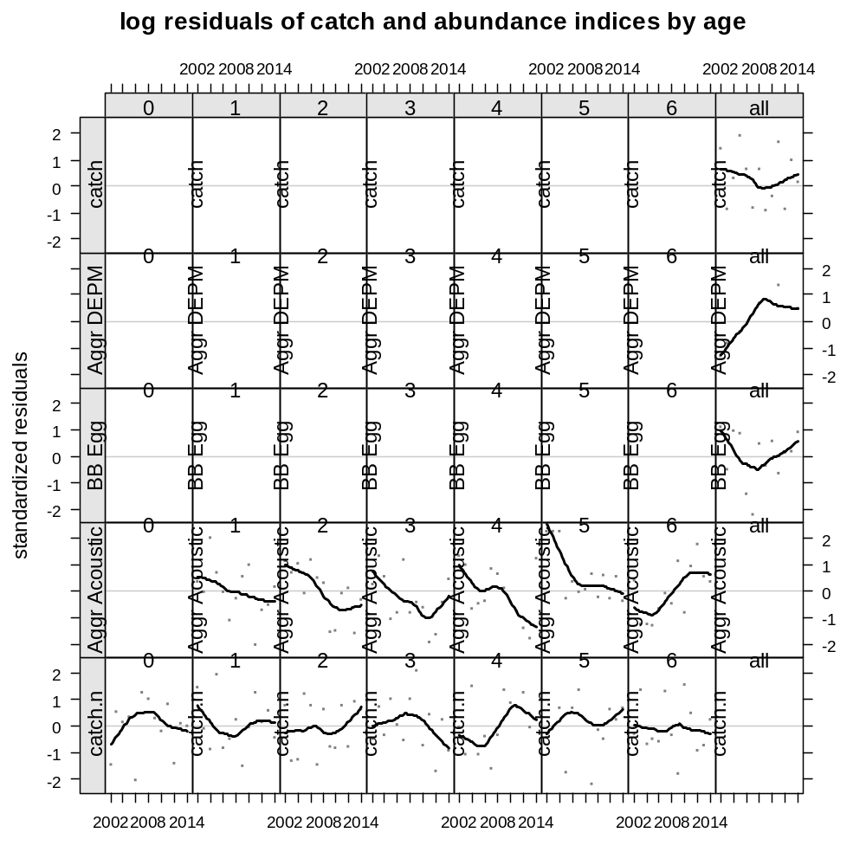

Slide 5
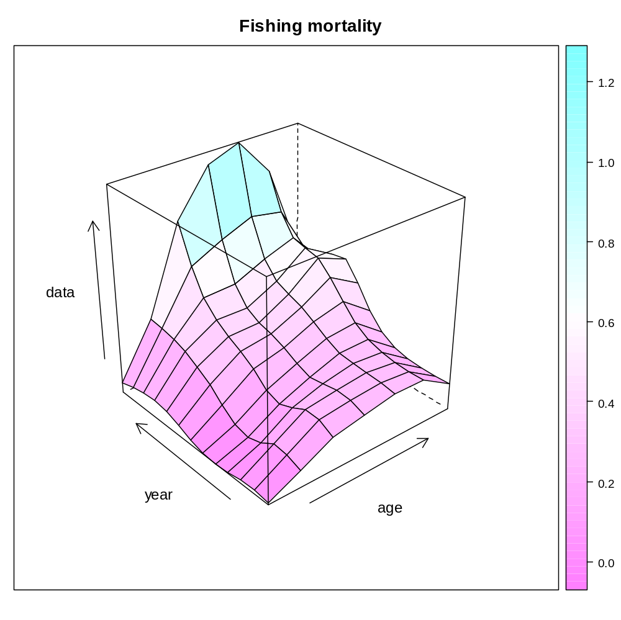

Slide 6
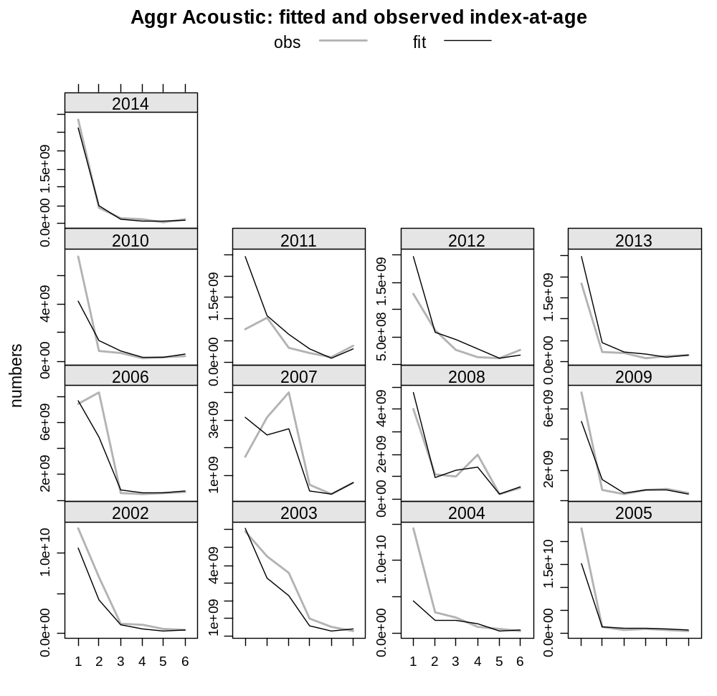

Slide 7
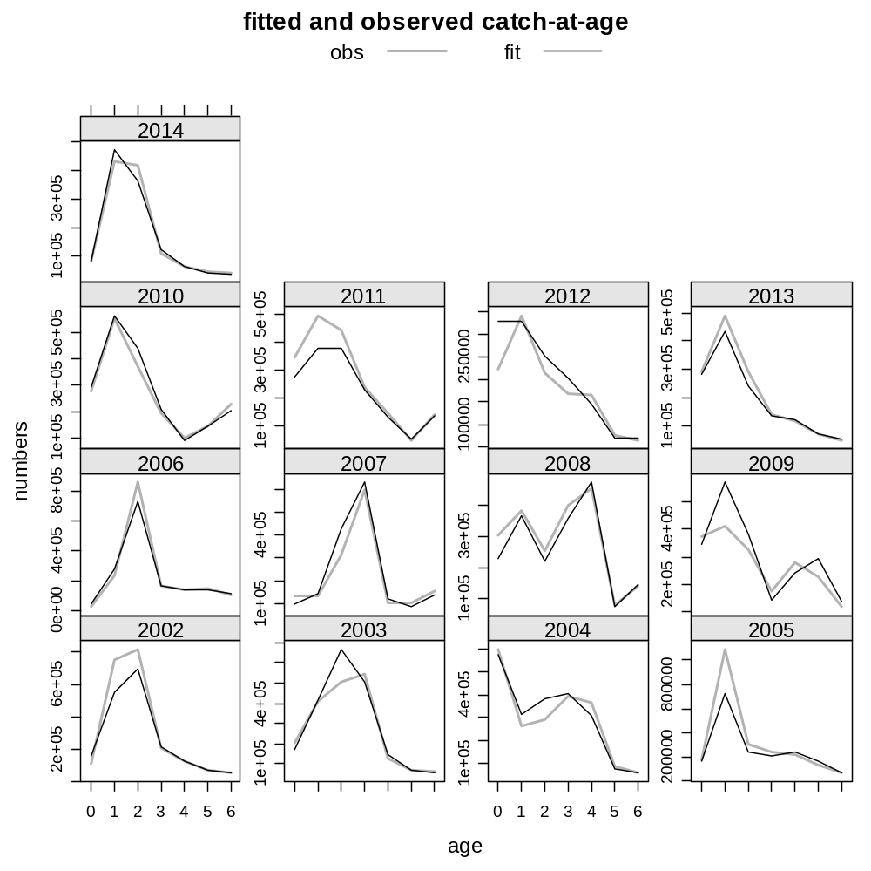

Slide 8
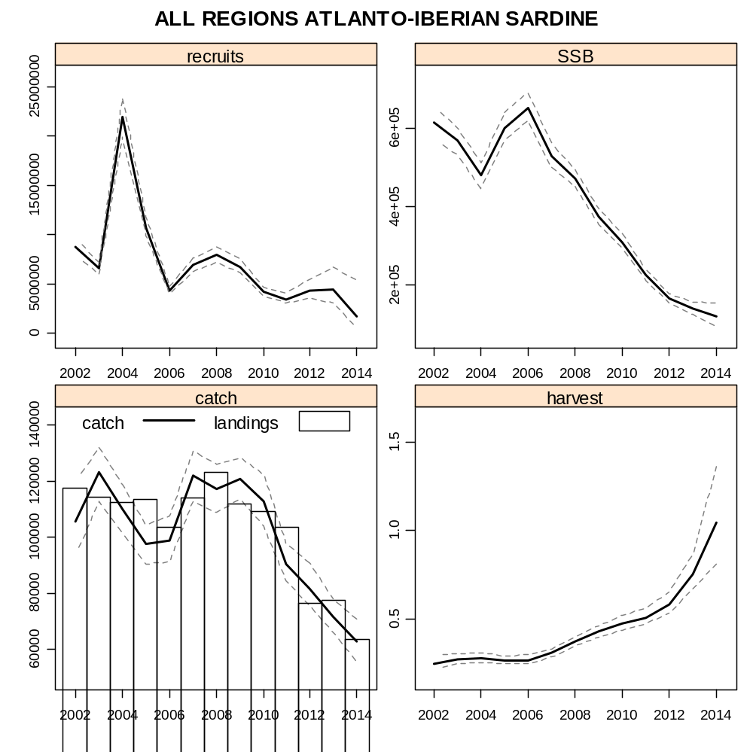

Slide 9
Change in survey weights
No change
With weight
> fitSumm(fit)
iters
1
nopar 5.400000e+01
nlogl 8.784250e+00
maxgrad 2.645010e-05
nobs 1.880000e+02
gcv 5.031374e-02
convergence 0.000000e+00
accrate NA
> AIC(fit)
[1] 125.5685
> BIC(fit)
[1] 300.3364
> fitSumm(fit)
iters
1
nopar 5.400000e+01
nlogl 4.823530e+01
maxgrad 6.592190e-05
nobs 1.880000e+02
gcv 5.056011e-02
convergence 0.000000e+00
accrate NA
> AIC(fit)
[1] 204.4706
> BIC(fit)
[1] 379.2385

Slide 10
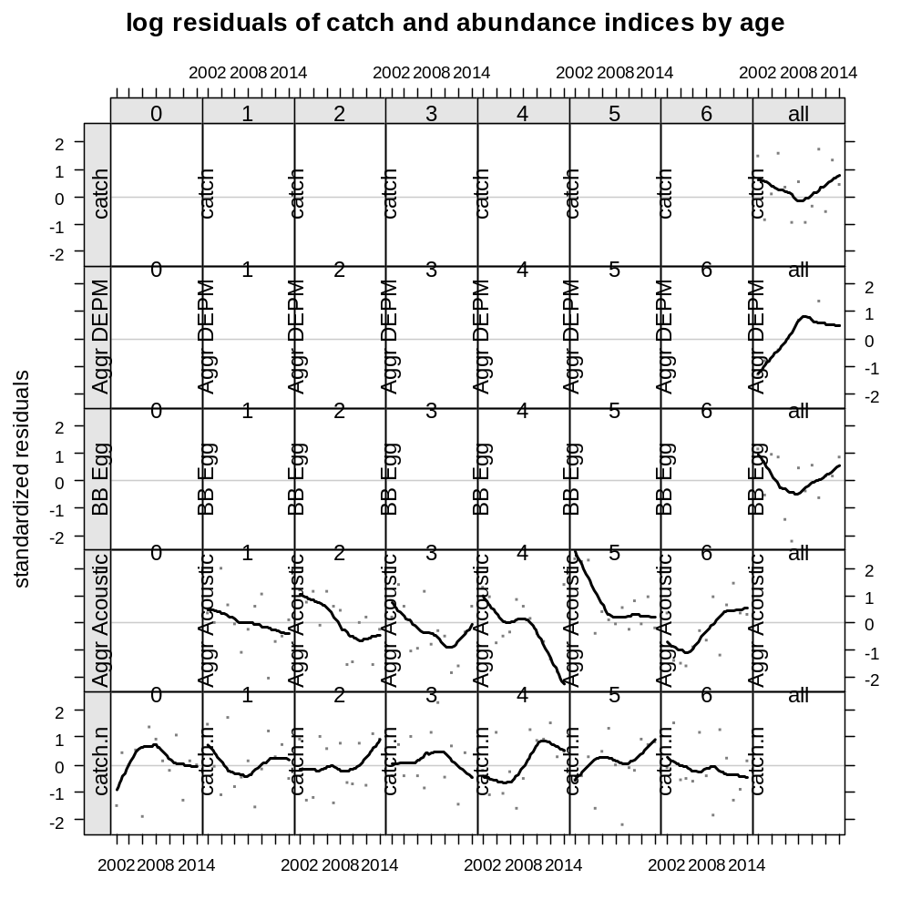
Weight

Slide 12

Weight

Slide 14

Weight

Slide 16
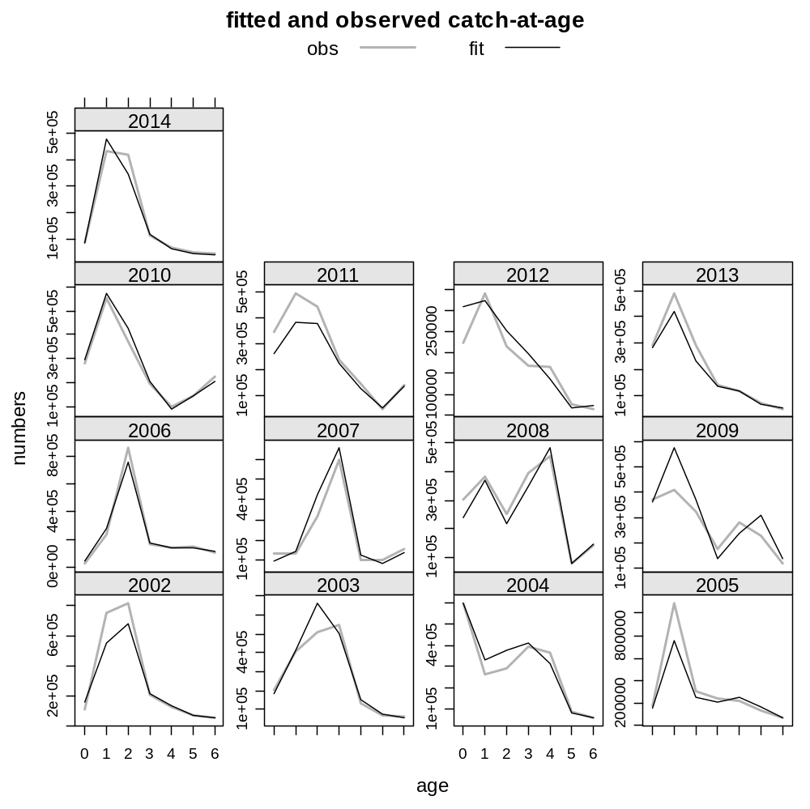
Weight

Slide 18
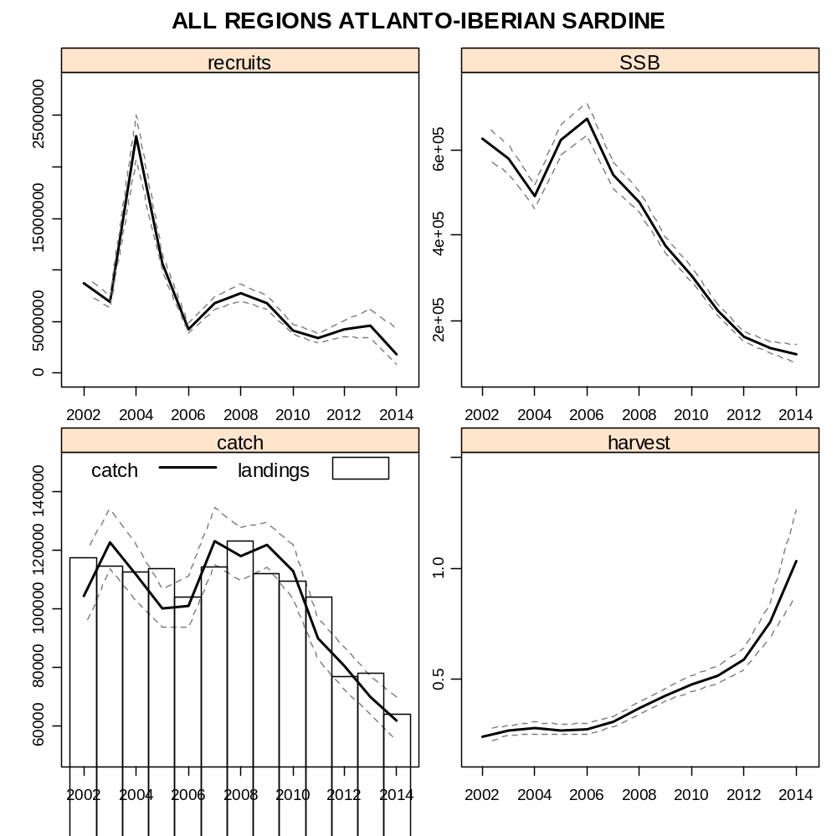
Weight

