Slide 1
All area run
Single A.stk object from BB, NW, S stock files
  2002:2014
  Age 0 to 6+
  Added N@age
  CW@age, SW@age recomputed
  consistency of units checked between areas
A.idx object
  Added acoustic numbers from BB, NW, S
  consistency of units checked between areas
  Separate DEPM survey

Slide 2
Initial run : A.fit1<-sca(A.stk, FLIndices(A.idx), fit='assessment')
a4a model fit for: ALL REGIONS ATLANTO-IBERIAN SARDINE
Call:
.local(stock = stock, indices = indices, fmodel = ..1, qmodel = ..2,
srmodel = ..3, n1model = ..4, vmodel = ..5, fit = ..6)
Time used:
Pre-processing Running a4a Post-processing Total
0.76440191 0.59280109 0.07800007 1.43520308
Submodels:
fmodel: ~te(age, year, k = c(3, 6), bs = "tp")
srmodel: ~factor(year)
n1model: ~factor(age)
qmodel:
Aggr Acoustic: ~s(age, k = 4)
BB Egg: ~1
NW DEPM: ~1
S DEPM: ~1
vmodel:
catch: ~s(age, k = 3)
Aggr Acoustic: ~1
BB Egg: ~1
NW DEPM: ~1
S DEPM: ~1

Slide 3
Initial run
> fitSumm(fit)
iters 1
nopar 5.100000e+01
nlogl 3.799510e+01
maxgrad 6.896920e-08
nobs 1.920000e+02
gcv 1.670463e-01
convergence 0.000000e+00
accrate NA
> AIC(fit)
[1] 177.9902
> BIC(fit)
[1] 344.1225

Slide 4
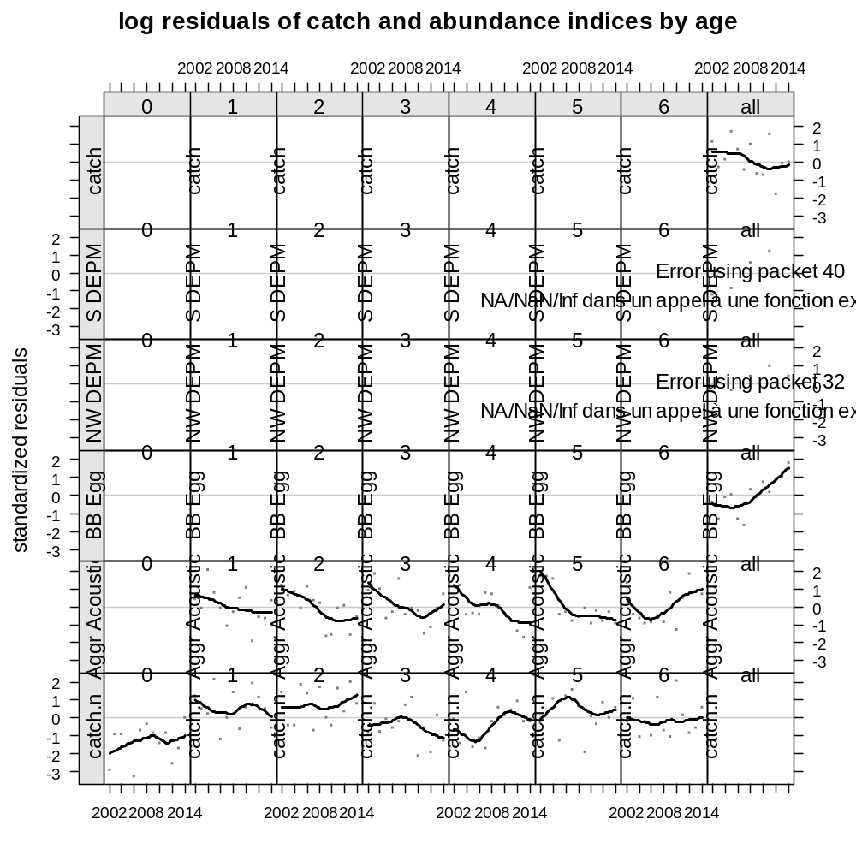
Initial run

Slide 5
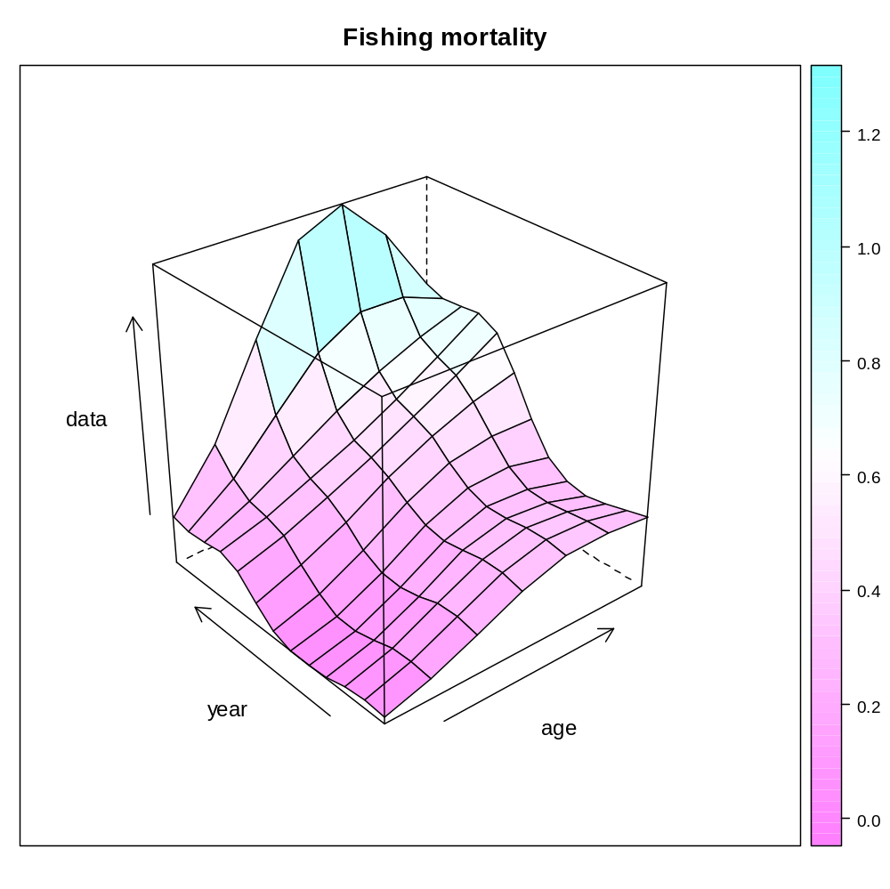
Initial run

Slide 6
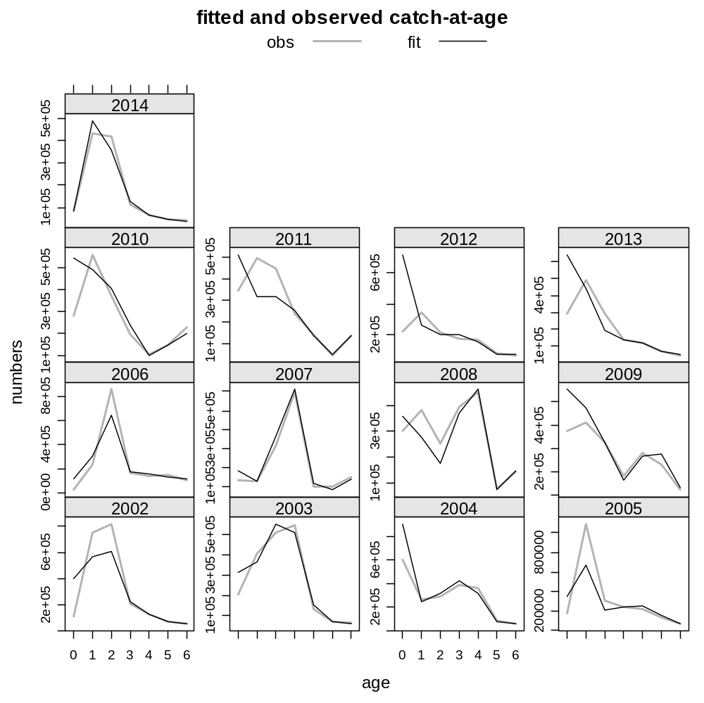
Initial run

Slide 7
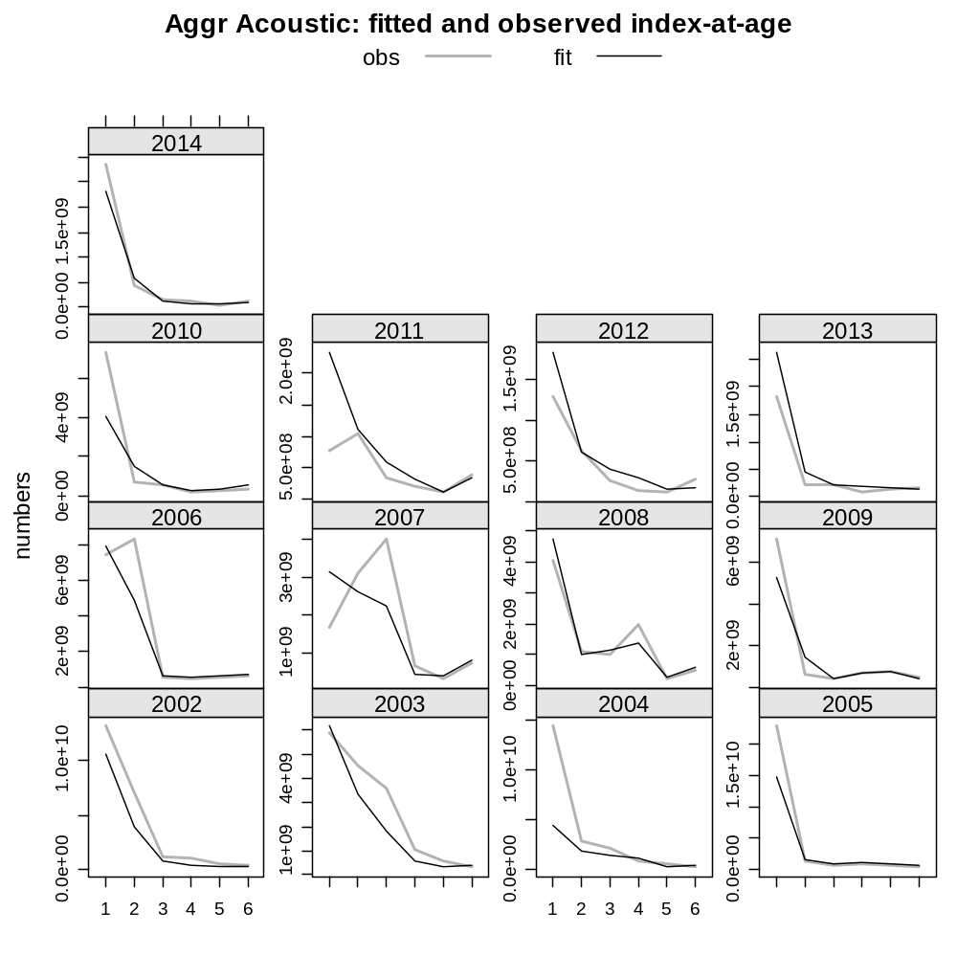
Initial run

Slide 8
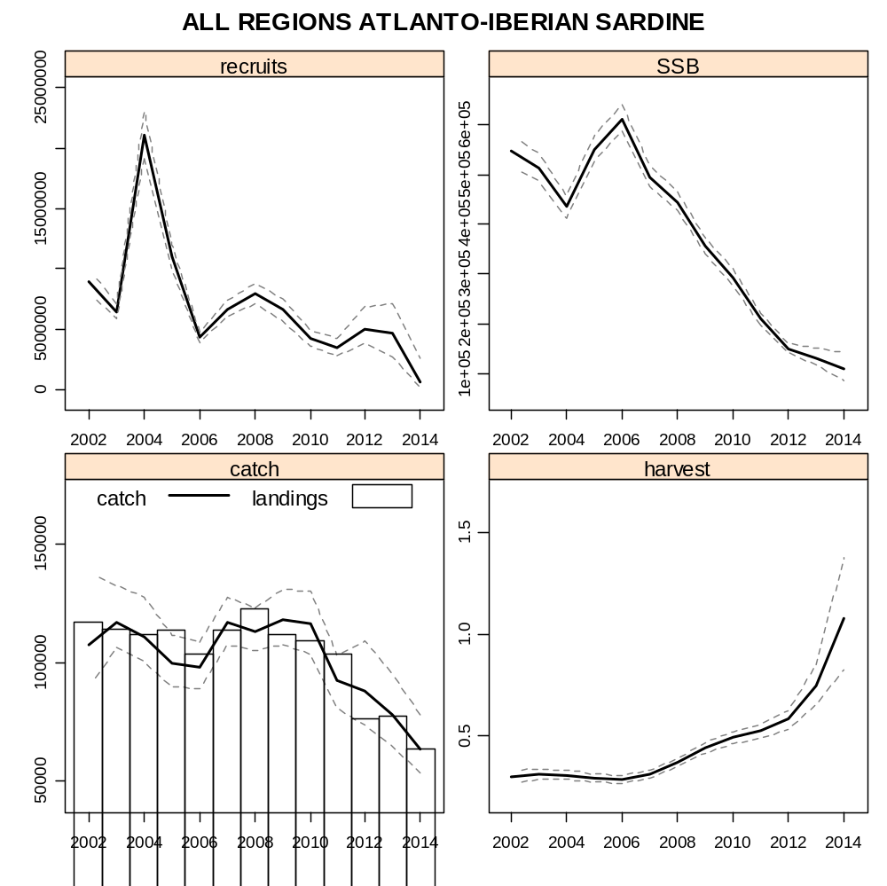
Initial run

Slide 9
Separable model (fmodel <- ~ s(age, k=6) + s(year, k=12)
A.fit2 <- sca(A.stk, A.idx, fmodel=fmodel, fit="assessment")
)
Time used:
Pre-processing Running a4a Post-processing Total
0.81904697 0.53703117 0.07200384 1.42808199
Submodels:
fmodel: ~s(age, k = 7) + s(year, k = 12)
srmodel: ~factor(year)
n1model: ~factor(age)
qmodel:
Aggr Acoustic: ~s(age, k = 4)
BB Egg: ~1
NW DEPM: ~1
S DEPM: ~1
vmodel:
catch: ~s(age, k = 3)
Aggr Acoustic: ~1
BB Egg: ~1
NW DEPM: ~1
S DEPM: ~1

Slide 10
Separable model (fmodel <- ~ s(age, k=6) + s(year, k=12)
A.fit2 <- sca(A.stk, A.idx, fmodel=fmodel, fit="assessment")
)
> fitSumm(fit)
iters
1
nopar 5.100000e+01
nlogl 3.365910e+01
maxgrad 4.369700e-07
nobs 1.920000e+02
gcv 1.402771e-01
convergence 0.000000e+00
accrate NA
> AIC(fit)
[1] 169.3182
> BIC(fit)
[1] 335.4505

Slide 11
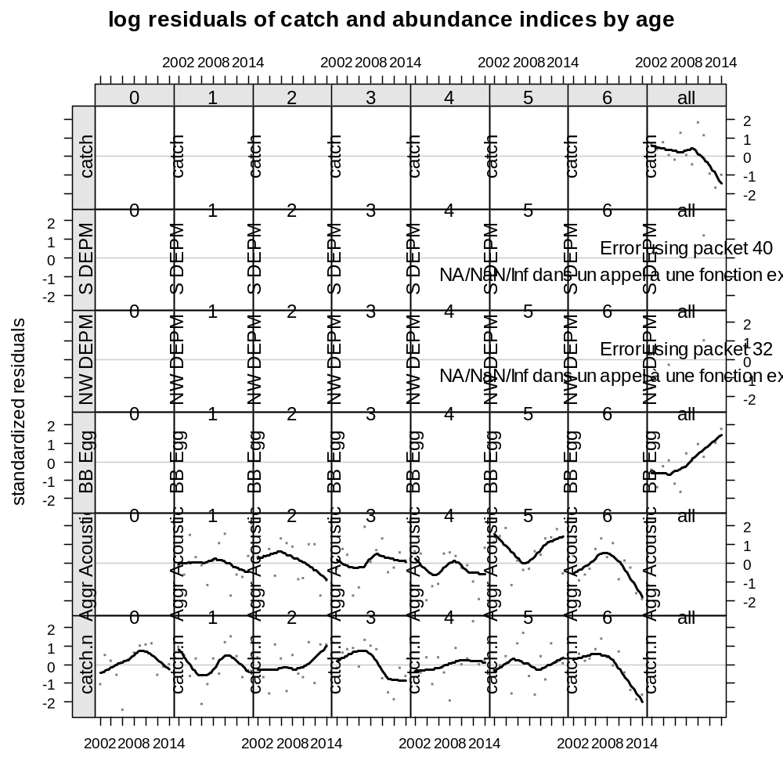
Separable model

Slide 12
So far… : fmodel <- ~ te(age, year, k=c(6,7))
Submodels:
fmodel: ~te(age, year, k = c(6, 7))
srmodel: ~factor(year)
n1model: ~factor(age)
qmodel:
Aggr Acoustic: ~s(age, k = 4)
BB Egg: ~1
NW DEPM: ~1
S DEPM: ~1
vmodel:
catch: ~s(age, k = 3)
Aggr Acoustic: ~1
BB Egg: ~1
NW DEPM: ~1
S DEPM: ~1

Slide 13
> fitSumm(fit)
iters
1
nopar 7.500000e+01
nlogl -1.292410e+01
maxgrad 1.130060e-05
nobs 1.920000e+02
gcv 5.993157e-02
convergence 0.000000e+00
accrate NA
> AIC(fit)
[1] 124.1518
> BIC(fit)
[1] 368.464
>

Slide 14
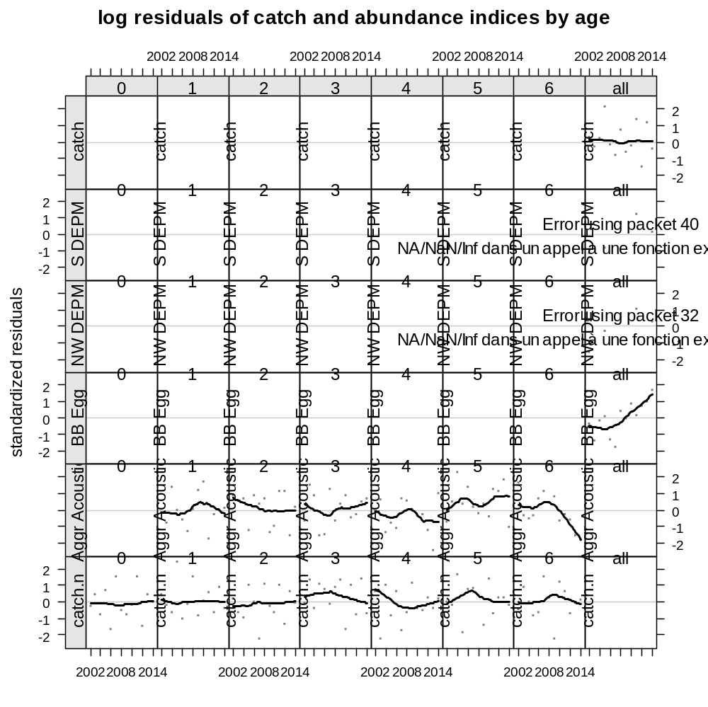

Slide 15
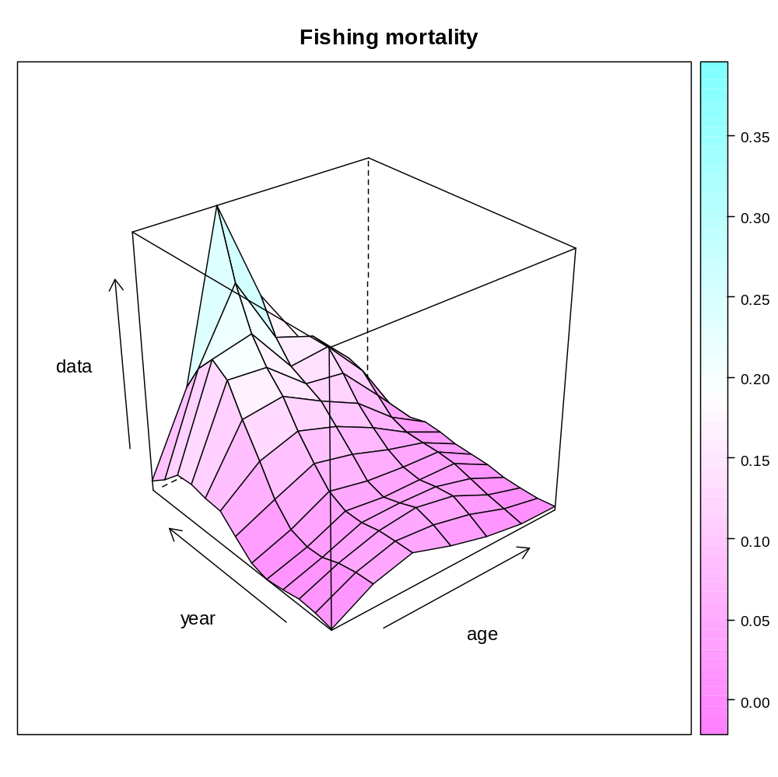

Slide 16
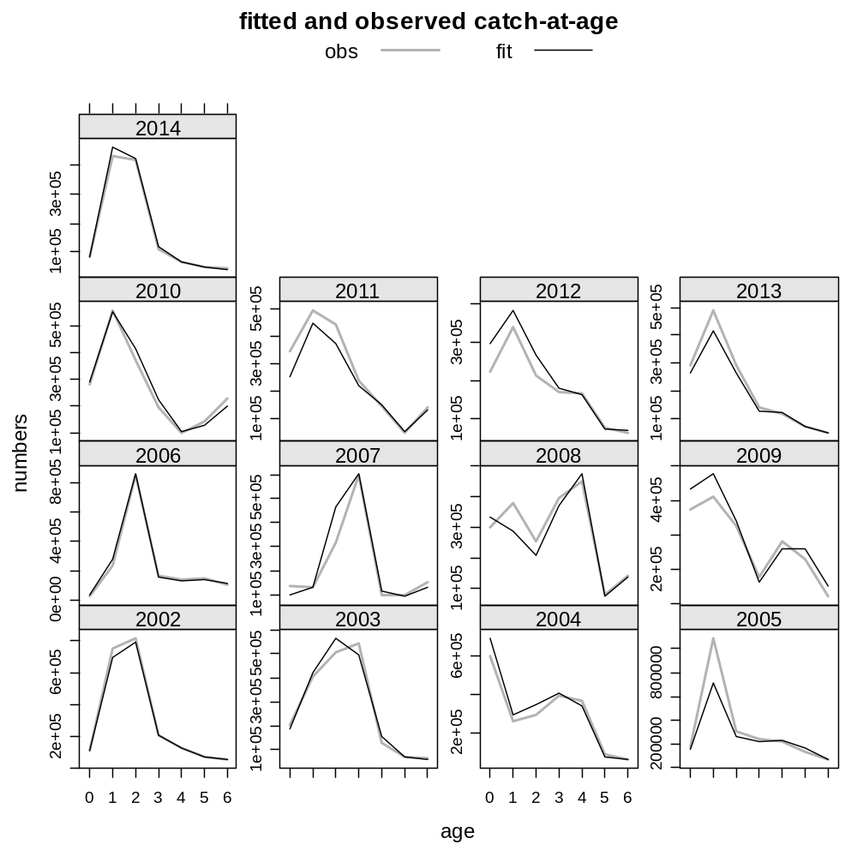

Slide 17
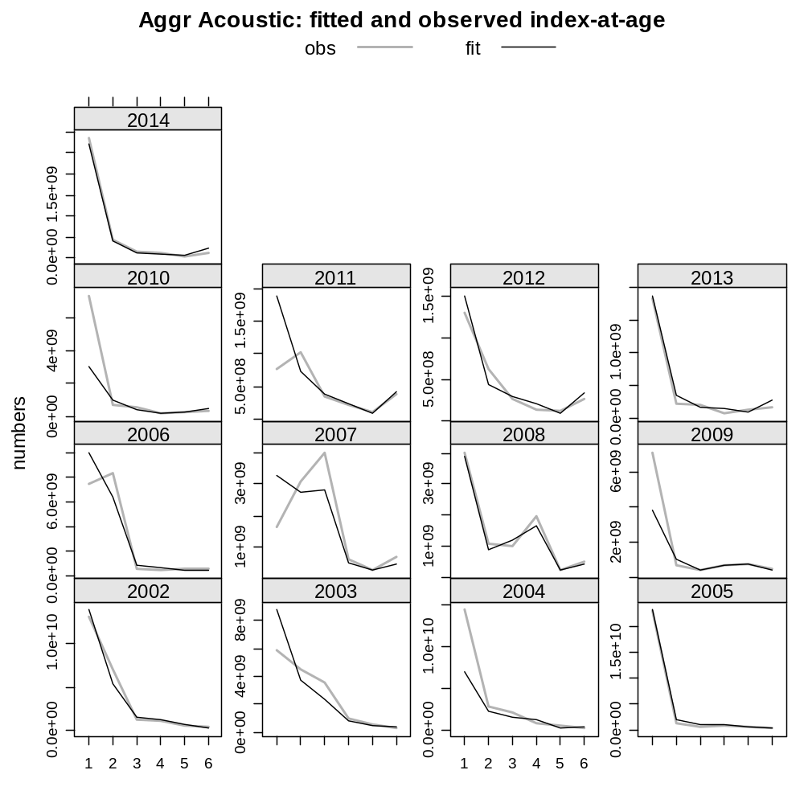

Slide 18
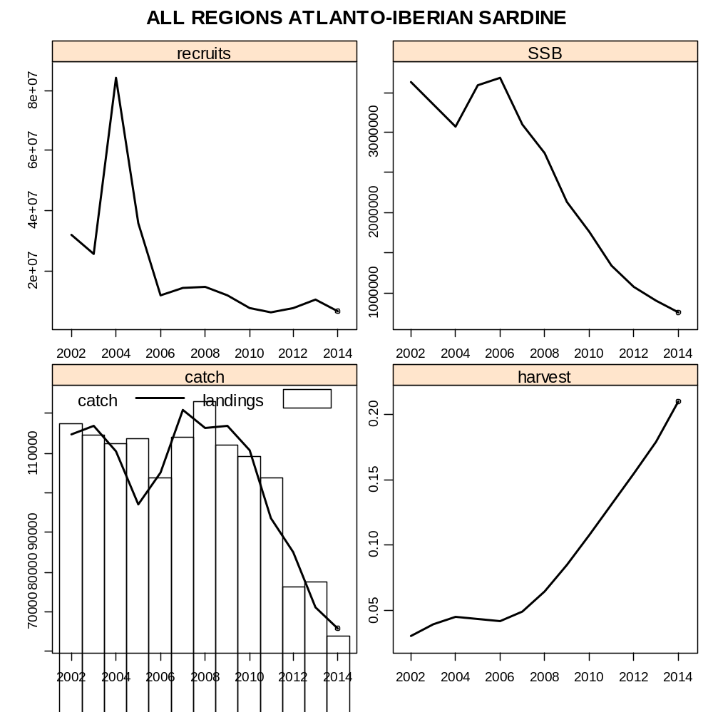

Slide 19
