Slide 1
FINAL ANALYSIS PROJECT
Presented by
Elizabeth Arredondo

Slide 2
Insight 1
When do most purchases occur?

Slide 3
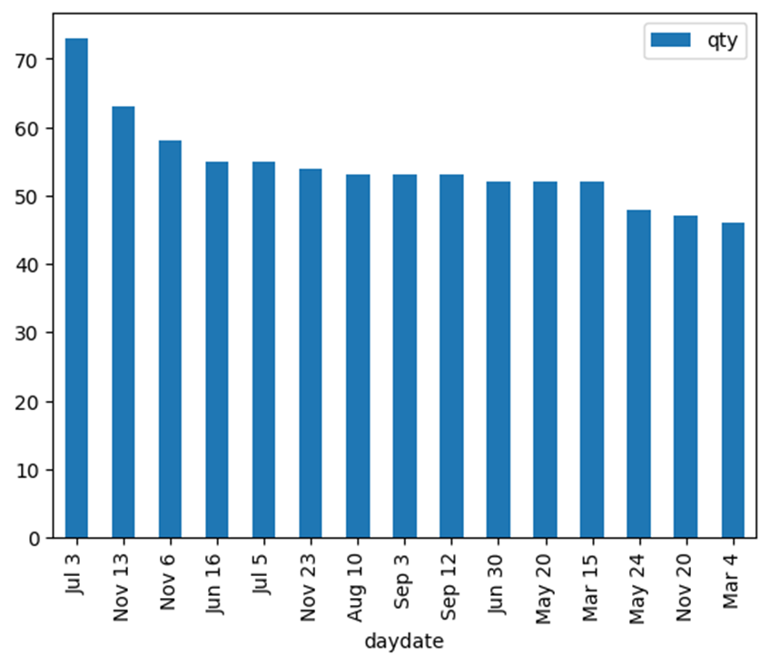
Findings
Higher number of purchases tend to occur
closer to major holidays
during the summer months when school is not in session (May – August)

Slide 4
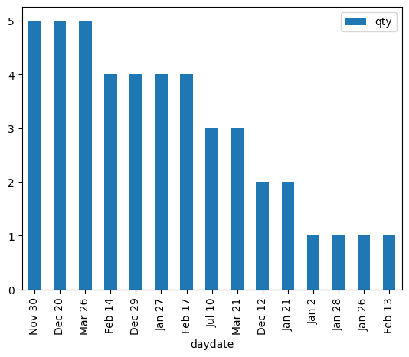
Findings
Lowest number of purchases tend to occur
Q1 (Jan – Mar)
Q4 (Oct – Dec)

Slide 5
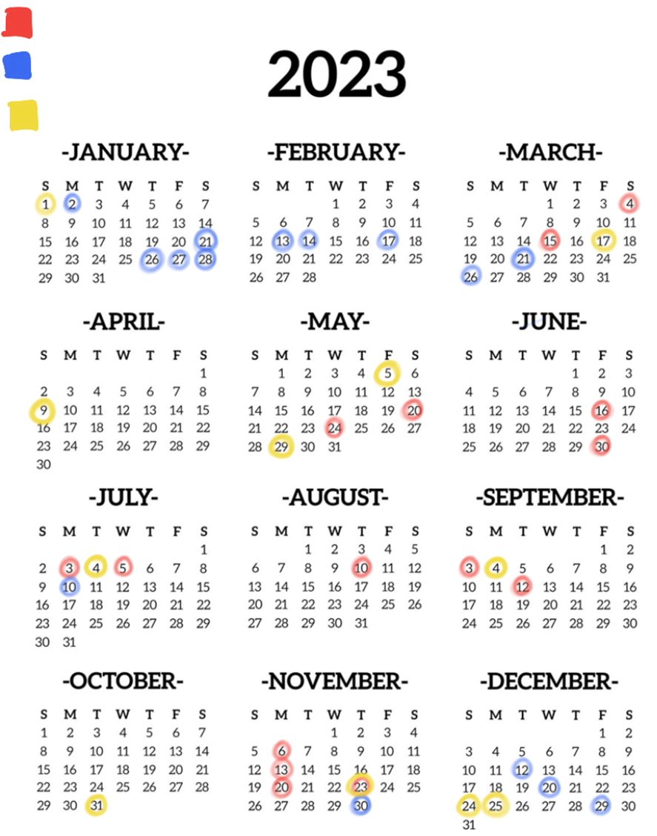
highest number of purchases
lowest number of purchases
major American holidays
Findings
Higher number of purchases contain –
Soft drinks
Cheese
Bag snacks
Baked bread/buns/rolls
Candy – packaged
Higher number of purchases tend to not contain –
Miscellaneous seafood
Tomatoes
Stationery and school supplies
Water
yogurt
Notes:
Highlight assumptions whenever made in analysis and timeframes

Slide 6

Insight for Businesses
Grocery stores should increase stock of
Soft drinks
Cheese
Bag snacks
Baked bread, buns, rolls
Packaged candy
Closer to major holidays and during the summer months
Grocery stores should decrease stock of
Miscellaneous seafood
Tomatoes
Stationery and school supplies
Water
yogurt
Closer to major holidays and during summer months

Slide 7
Insight 2
Are there advertisement events that coincide with high item purchasing dates? Where are these items’ display locations? Are items purchased most on low purchasing dates from similar display locations?

Slide 8
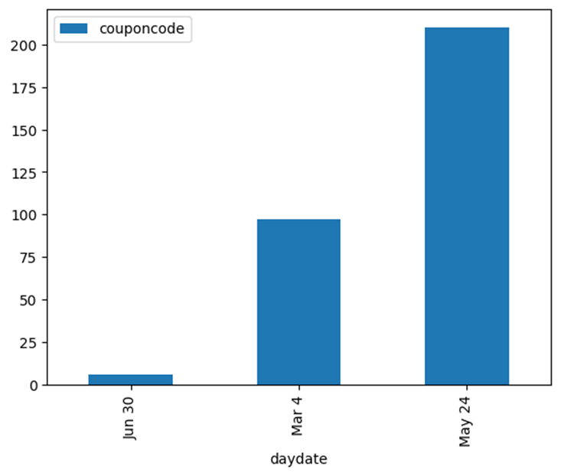
Findings
Dates that coincide with total number of coupon campaigns –
June 30 – 6
March 4 – 97
May 24 – 210
Top products bought –
Milk
Frozen premium entrees, dinners
Single cheese
Shredded cheese
Frozen French fries

Slide 9
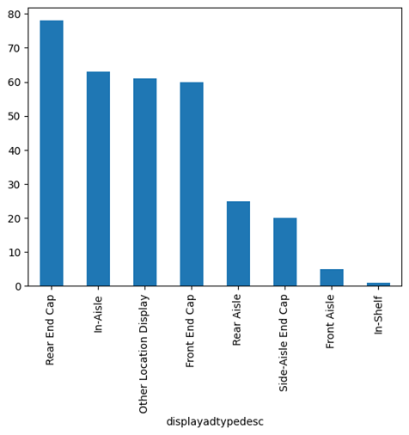
Findings - High Item Purchasing Dates
Top product locations –
Rear end cap - 78
In-Aisle - 63
Other Location Display - 61
Front End Cap - 60

Slide 10
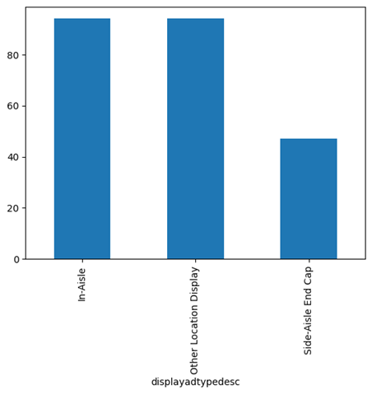
Findings - Low Item Purchasing Dates
Top product locations –
In-aisle - 94
Other location display - 94
Side-aisle end cap - 47
Notes:
Disclaimer - includes purchases with items sold during slowest days (includes during and not during those days) and purchases that occurred during slowest days

Slide 11
Insight for Businesses
Grocery stores should prioritize keeping consistent, year-round stock of items located in
In aisles
Other location displays
Grocery stores should also emphasize increasing stock of the following items when coupon events occur during high purchasing times -
Milk
Frozen dinners
Cheese

Slide 12
Insight 3
How often does each age group shop at stores (aka purchase frequency)? Is this consistent with other sources?

Slide 13
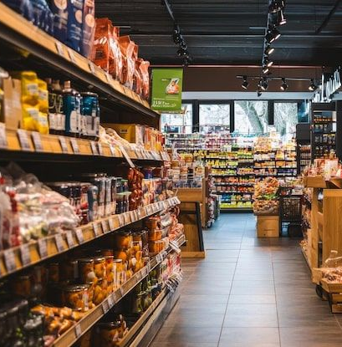
Findings - Acme Dataset
Acme Dataset –
45-54-year-old customers have highest purchase frequency over one year
35-44-year-old customers have lowest purchase frequency over one year

Slide 14
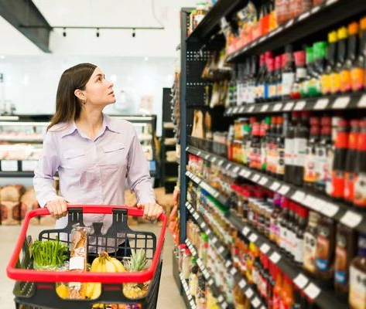
Findings - Outside Dataset
Outside Dataset –
55–64-year-old customers have highest purchase frequency over one year
> 25-year-old customers have lowest purchase frequency over one year
Notes:
Disclaimer – only one data point for 55-64 group and only two data points for > 25 group

Slide 15
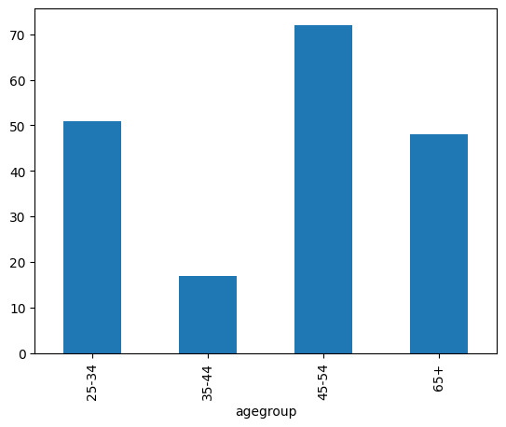
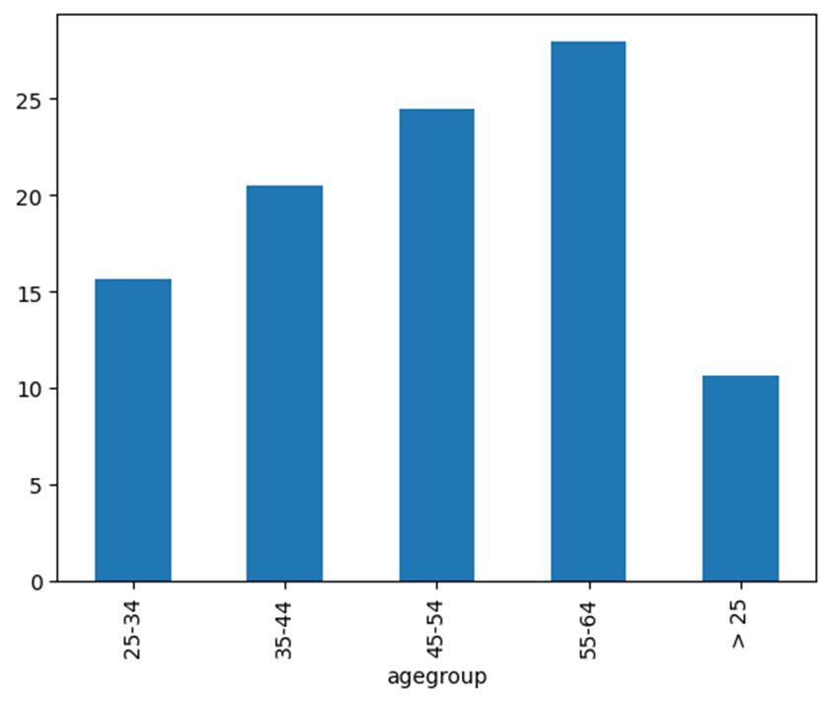
Findings - Visual Comparison
above - Acme Dataset chart
shows age group vs. purchase frequency (number of purchases per year)
right - Outside Dataset chart
shows age group vs. median purchase frequency
Conclusion – for the most part, as customers increase in age, so does their purchase frequency

Slide 16
Insight for Businesses
Grocery stores should cater more towards older demographics since they frequent their stores more often than other age demographics
Could include
Accommodations for mobility-challenged
Easy-to-read signage
Plenty of seating areas, such as benches, around store if they are large box stores

Slide 17
Thank you!
Sources
Outside Dataset - https://www.kaggle.com/datasets/hanaksoy/customer-purchasing-behaviors
Pandas Documentation Reference - https://pandas.pydata.org/docs/index.html

