Slide 1

The faint young Sun problem (2012)
Rev. Geophys., 50
Georg Feulner

Slide 2
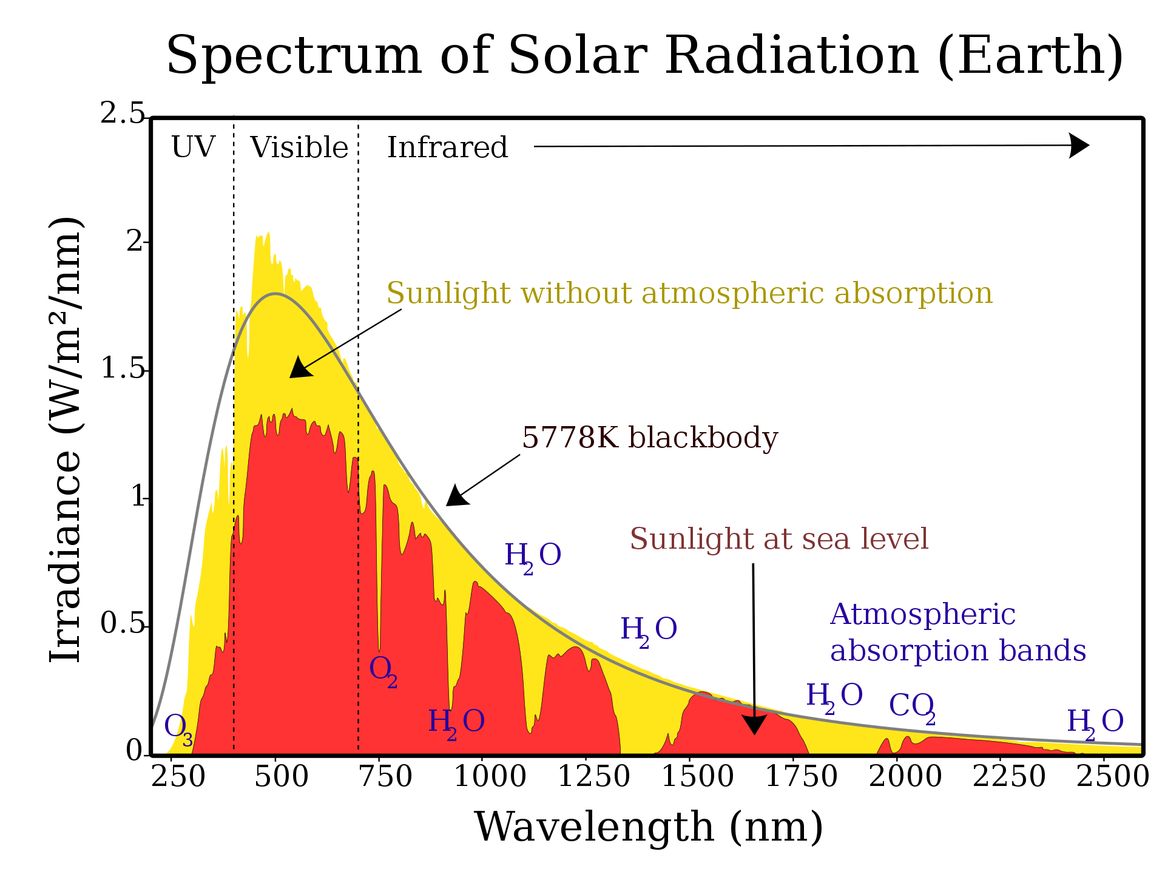
Q: How has the Sun’s radiation
spectrum evolved over time…?
When the Sun was younger,
did it emit a different spectrum?
Important since “things”
reflect/absorb different amounts
of light depending on incoming
wavelength…
**BOLOMETRIC** luminosity…

Slide 3
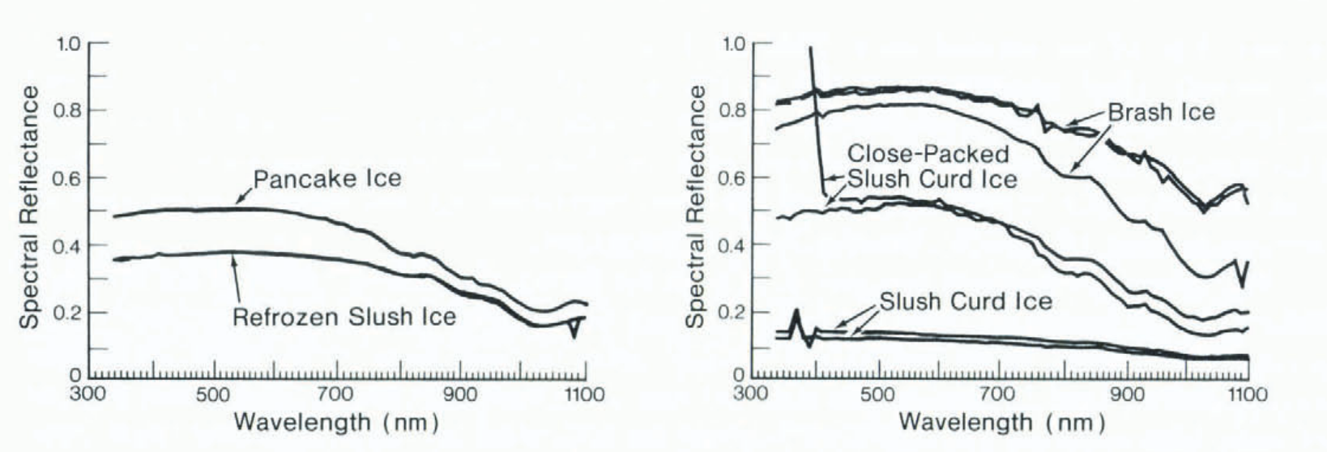
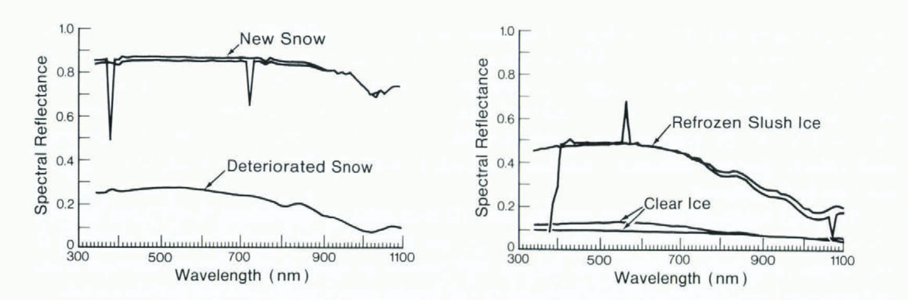
Wavelength-dependent albedo…
https://en.wikipedia.org/wiki/Solar_irradiance
Bolsenga SJ. Spectral Reflectances of Snow and Fresh-Water Ice from 340 Through
1 100 nm. Journal of Glaciology. 1983;29(102):296-305. doi:10.3189/S0022143000008352

