Slide 1
Perspectives on the Future of Land Surface Models and the Challenges of Representing Complex Terrestrial Systems
(2020) Journal of Advances in Modeling Earth Systems

Slide 2
Perspectives on the Future of Land Surface Model Challenges s and the Challenges of Representing Complex Terrestrial Systems

Slide 3
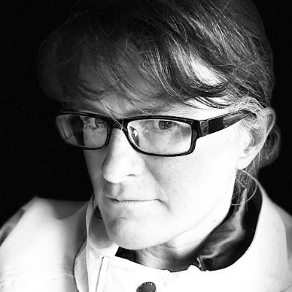

Authors Perspectives on the Future of Land Surface Models and the Challenges of Representing Complex Terrestrial Systems
Rosie A. Fisher
Charles D. Koven

Slide 4
