Slide 1


CAPSTONE FINAL DEFENSE
Market Segmentation for Philippine Airlines Through Machine Learning
Martin Yamzon Jeremy Jay Lim Arien Jadd Versoza Edyll Joshua Binaday
Advisers: Jose Miguel Bautista, PhD · Rebecca R. Ricalde
MS in Artificial Intelligence and Data Analytics · Asian Institute of Management · August 2026
Notes:
Good afternoon. We're the PAL segmentation team. Over the next forty minutes we'll show you what we promised the airline, what the data made us change, and what we're handing over. Short version: we went in expecting clusters, the data said no, and the model we ship is better for it.

Slide 2

Market Segmentation for Philippine Airlines Through Machine Learning
AGENDA
The plan for the next forty minutes
1
Problem statement
Martin
2
Terms of reference — what we promised PAL, and the risks
Martin
3
EDA — more data, and no natural clusters
Josh
4
Methodology — the iterations and the workarounds
Josh
5
Dashboard development
Jadd
6
Findings
Josh & Jadd
7
Limitations, and what we're fixing before handover
Josh
8
Recommendations
Martin
9
Conclusion
Josh
Notes:
Three voices today. Martin opens with the business side, Josh carries the data and modelling story, Jadd walks the dashboards, and then we split the findings between us.

Slide 3
Market Segmentation for Philippine Airlines Through Machine Learning
PROBLEM STATEMENT · MARTIN
One economy fare hides very different passengers
Contract worker
Corporate
Leisure
One-way ticket, heavy bags, the employer picked the date.
Booked this week and will pay what it costs.
Booked months ago, chasing the promo fare.
All that Sabre gives PAL is the booking — no name, no loyalty tier, no CRM record. Every question about who is actually on the plane has to be answered from booking behaviour alone. That constraint shaped everything we built.
When you can't tell these passengers apart, discounting becomes the default defence against low-cost carriers.
Promo inventory quietly eats the yield of the passengers who never needed the promo.
The ask: a trip-purpose × value segmentation on anonymous bookings, at a scale of 38.1 million coupon rows across 2024–2027 — segments a revenue manager would recognise, not statistical artifacts.
Notes:
Anchor the constraint early: anonymous PNRs only. If the panel wonders why we never used loyalty data, the answer is on this slide — PAL's Sabre lens simply doesn't carry it. Also plant the seed for later: the point of segmentation here is targeting and communication. That's why we'll be relaxed when a later slide shows the label adds little raw predictive power.

Slide 4
Market Segmentation for Philippine Airlines Through Machine Learning
TERMS OF REFERENCE · MARTIN
What we signed up for, and where the risks landed
Promised | Where it landed
Segmentation model on anonymized booking data | Delivered — 11 named segments + a short-lead flag + value bands, on 22.9M bookings
Validated, defensible segments | Delivered differently — no ground truth existed, so we built four non-circular tests instead
Executive dashboard | Delivered — Power BI star schema, 38.1M rows in and out, reconciled on every build
Documentation and handover | Delivered — methodology spec, study guides, a defence brief where every claim carries its caveat
THE RISK REGISTER, REVISITED
No natural clusters
No ground-truth labels
Ambiguous units
SME availability
Happened — and became the central finding of the project rather than a failure.
Still open. Designed around it; an SME-labelled sample is requested.
Real. Revenue was only confirmed as USD on 18 August.
Came through: 39 rules returned, all 24 follow-up questions answered.
Notes:
The honest line on this slide: every risk we flagged in the TOR fired to some degree. The difference is what we did about each one. The clustering risk turned into the project's main result — Josh picks that thread up next.

Slide 5
Market Segmentation for Philippine Airlines Through Machine Learning
EDA · JOSH
A coupon is one journey; a booking is one decision
Problem
Solution
Limitations
The given data set was on a coupon level (a single journey) which is not representative of the booker's decision
Rolling-up the data into the ticketed booking level, using the unique ID field.
We were not allowed to use PII.
AS GIVEN · COUPON LEVEL
AS MODELLED · BOOKING LEVEL
CEB → MNL
MNL → DXB
DXB → MNL
MNL → CEB
1 booking · one round trip, one purchase decision
unique ID
Four rows. Counting these as four customers over-counts the cheapest journeys and hides the decision.
One row, one trip purpose — the grain every rule, chart and segment in this deck is built on.
38,116,259 coupons became 22,911,450 bookings — one purchase decision, one trip purpose — rolling up again to 13.4M customers.

Slide 6
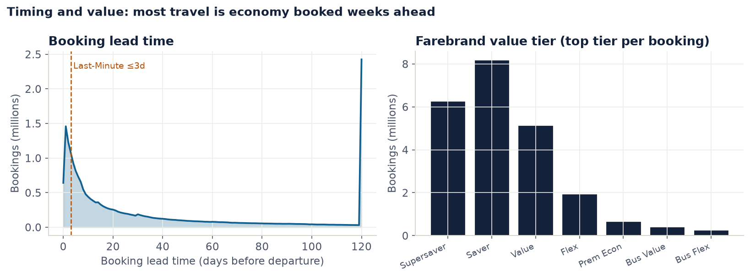
Market Segmentation for Philippine Airlines Through Machine Learning
EDA · JOSH
Short-lead, economy-heavy — and the data has edges
The spike inside 3 days seeded the Last-Minute question; the pile-up at 120 days is a data cap, not behaviour — the kind of edge a 30k sample never shows.
The farebrand ladder is PAL's own value axis. We adopted it as the value dimension rather than inventing one.
Notes:
This is the real distribution over 22.9M bookings — the 30k sample gave us averages and none of these edges. Scale for the panel: 38.1M coupons → 22.9M bookings → 13.4M customers, rebuilt on DuckDB/Parquet so a full pass takes seconds, not minutes. Both bullet points are design decisions born directly from this chart.

Slide 7
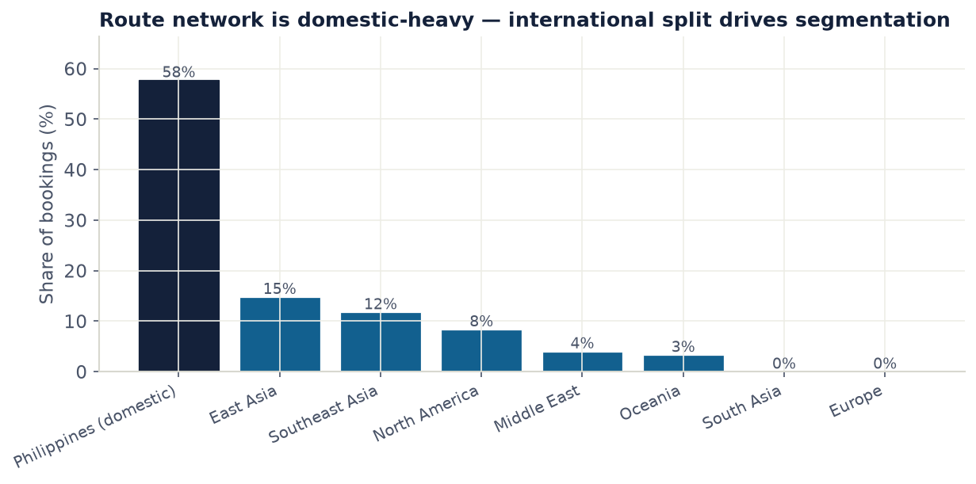
Market Segmentation for Philippine Airlines Through Machine Learning
EDA · JOSH
A domestic-heavy network, and a base that rarely comes back
58% of bookings are domestic — so domestic vs international is the first cut in the waterfall, not an afterthought.
The Middle East is 4% of bookings and nothing like 4% of the story — it anchors the OFW segment and a fifth of revenue.
Only 26% of customers ever book twice. A 'customer profile' for the other 74% is just their one booking restated — so the booking is the modelling row.
38.1M coupon rows → 22.9M bookings → 13.4M customers, 2024–2027. Figures drawn from the full extract by src/report_figures.py.
Notes:
The 30k sample couldn't answer our questions — trip purpose lives in patterns like these, and they only exist at full volume. That's why we asked PAL for the whole extract and rebuilt on DuckDB/Parquet. The trench-coat line for the 74%: a customer profile for most of the base is one booking wearing a trench coat.

Slide 8
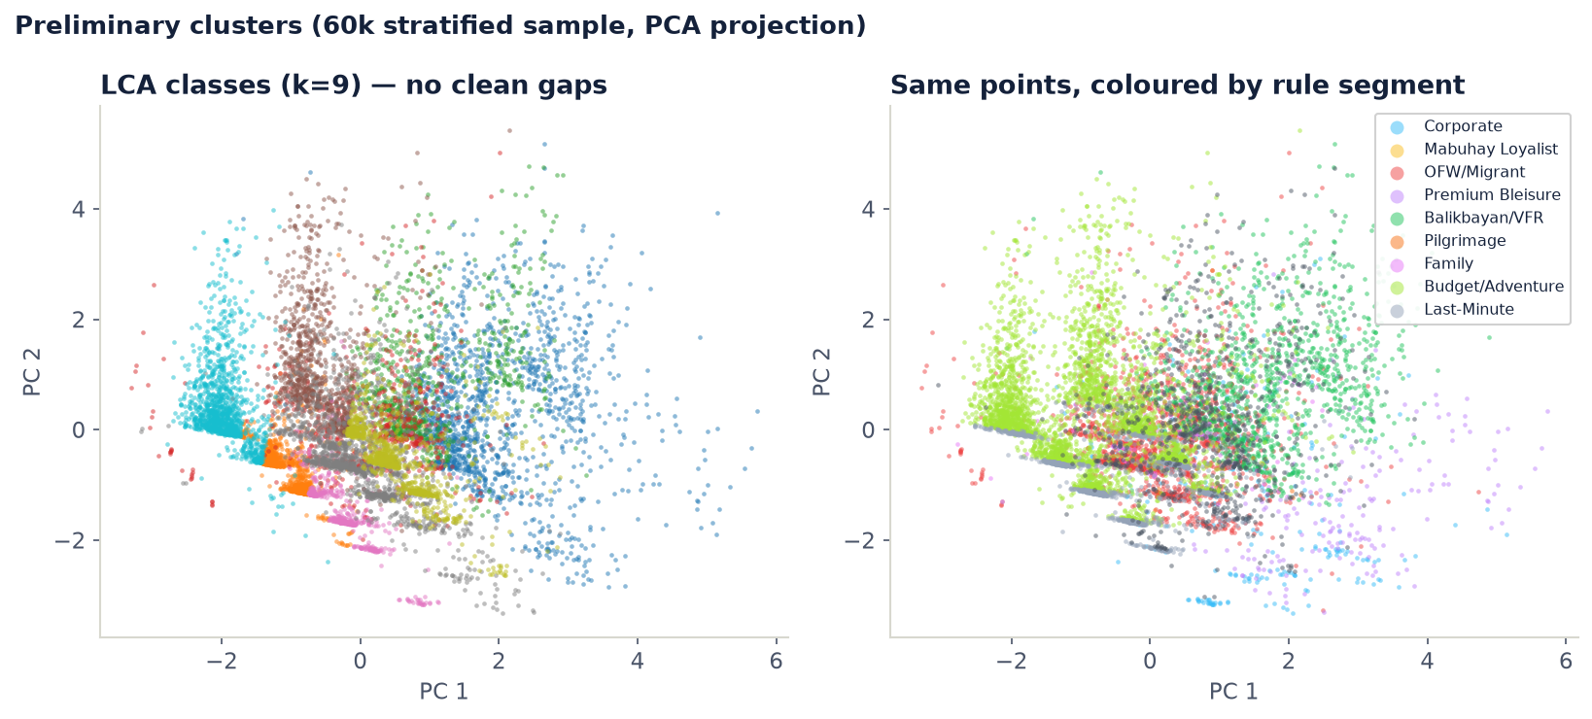
Market Segmentation for Philippine Airlines Through Machine Learning
EDA · JOSH
Our first clustering attempt — everything overlaps
60k stratified sample, PCA projection. Left: the classes LCA finds on its own. Right: the same points coloured by rule segment. There is no empty space anywhere — every segment bleeds into its neighbours. This picture is why the design changed.
Notes:
Let the panel stare at this one. Two honest readings: the algorithm's own classes (left) don't separate cleanly either, and our rule segments (right) overlap heavily in feature space. Neither is a failure of technique — the base is a continuum. If someone asks why PCA: it's a 2-D shadow for the eyes; the formal tests on the next slide work in the full feature space.

Slide 9
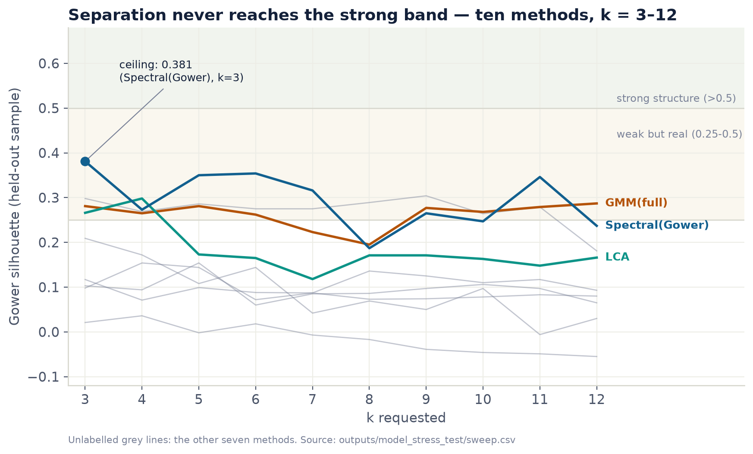
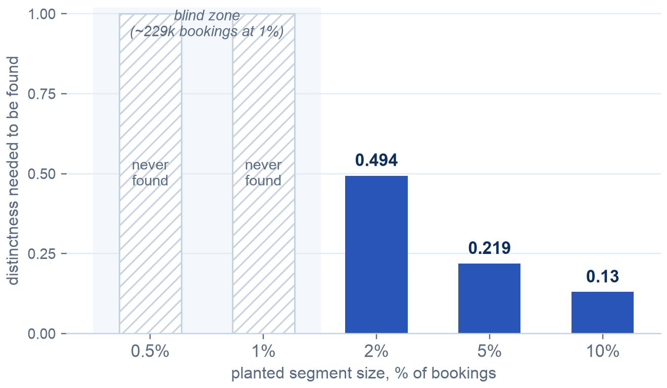
Market Segmentation for Philippine Airlines Through Machine Learning
EDA · JOSH
We went looking for clusters and found a continuum
TEN METHODS, SIX FAMILIES, k = 3–12 — SAME CEILING
AND WE'D SEE A SEGMENT IF ONE EXISTED
SO: RULES, NOT CLUSTERS
Customers come on a dial, not in boxes. The business draws the lines; the algorithms' job became proving the lines sit in sensible places.
No method, at any k, reaches the 0.50 'strong structure' band. BIC shows no elbow; HDBSCAN collapses outright — no density gaps to find.
Notes:
This is the hinge of the whole defence. Give the planted-segment test its moment — it answers the one objection that could sink the continuum claim. One guardrail: if asked for the detection floor, quote the majority-rule numbers (roughly 0.49 distinctness at 2% prevalence), never the luckiest single method.

Slide 10
Market Segmentation for Philippine Airlines Through Machine Learning
METHODOLOGY · JOSH
The rules label every booking; ML checks the rules
STAGE 01
STAGE 02
STAGE 03
STAGE 04
STAGE 05
Extract
Ingest
Clean + flag
Rule waterfall
Check + ship
38.1M coupon rows, anonymized with PAL. Four gzipped CSVs.
Typed, partitioned Parquet. One pass, about 90 seconds.
Coupon grain: fare tiers, award and non-rev flags, parsed routes.
First match wins. 11 segments + Unassigned at booking grain — the deliverable.
Four validation stages, LCA sub-segments, drift monitor, Power BI export.
Every 'cannot-be' rule from PAL's revenue managers is asserted in code on every build — the rules and the pipeline physically can't drift apart.
Notes:
One picture, one idea: the waterfall is the deliverable, and machine learning has three jobs around it — refine, test, monitor. It never assigns the label. If someone asks where the clustering went: it's in stage five, working as an instrument.

Slide 11
Market Segmentation for Philippine Airlines Through Machine Learning
METHODOLOGY · JOSH
The model we're defending is the fourth design, not the first
v0 — HDBSCAN prototype
v1 — the benchmark
v2 — first waterfall
v3 — waterfall v2, shipped
Won a 7-algorithm compare on the 30k sample (silhouette 0.435 vs KMeans 0.167). Then the real extract arrived — categorical-heavy, no density gaps — and it collapsed.
Ten methods, six families, one verdict: a continuum. We flipped the design — rules become primary, ML becomes the checker.
Worked, but left 9.6% of bookings Unassigned. PAL's revenue managers sent back 39 rules and answered all 24 of our follow-ups.
Four segments added, three retired, Last-Minute became a flag. Unassigned fell to 2.47%. PAL approved the taxonomy on 17 August.
What the iterations cost us, honestly: weeks on a prototype whose results we now quote nowhere, and a first waterfall draft that satisfied only 4 of PAL's 6 hard rules — ordering rules by priority turned out not to be the same thing as enforcing them. Both mistakes are documented in the repo, because the next team will be tempted by the same shortcuts.
Notes:
Panels like hearing what a wrong turn cost. The prototype wasn't wasted — it's the reason we knew exactly which questions to ask of the real data — but no number from it survives into any deliverable, and we say that out loud.

Slide 12
Market Segmentation for Philippine Airlines Through Machine Learning
METHODOLOGY · JOSH
Eleven dated iterations, every verdict written down
11 May
7 clustering algorithms on the 30k sample; 5 resampling strategies
HDBSCAN wins the sample. Resampling rejected — F1 of 0.99 meant re-learning our own rules
Jul
The real 38M-coupon extract lands; full EDA
Mixed categorical + numerical features; loyalty invisible. Features go behaviour-only
23 Jul
LCA + k-prototypes diagnostic on the real data
THE PIVOT — no BIC elbow, ARI ≤ 0.34. HDBSCAN dropped: categorical-heavy, not density-separable. Rules become primary
27 Jul
k-prototypes vs k-modes vs LCA head-to-head, k = 3–12
LCA keeps the refinement job. Lesson logged: stability without separation is not structure
27 Jul
Stage X — Power BI export built
38,116,259 rows in = out. Two BI traps surfaced and designed out
28 Jul
Circularity contract + validation stages V1–V2
Validation unblocked without SME labels — anchors only, enforced in code
28 Jul
10-method, 6-family, 8-axis stress test
GMM wins the benchmark — pipeline unchanged, different job. Ceiling 0.381 stands
29 Jul
Detection power — planted segments (V3)
The null becomes falsifiable; blind spot below ~1% stated; one instrument retired
29 Jul
Out-of-time stability (V4)
Shares hold across a 12-month step; the departure-filter censoring trap recorded
12 Aug
Rule-confidence diagnostics
Corporate is the most contested label — it becomes the SME sampling frame
17–18 Aug
SME programme lands → waterfall v2
39 rules in, 24 answers. Unassigned 9.58% → 2.47%. PAL approves the taxonomy
Each row is a script in the repo with its output report — the trail is re-runnable, not remembered.
Notes:
This slide is the effort argument, so don't rush it — but don't read it either. Point at three rows: 11 May (we backed HDBSCAN when the evidence supported it), 23 Jul (we dropped it the day the real data said otherwise — mixed categorical and numerical features, nothing for a density method to grip), and 28 Jul (GMM beat our refinement layer on a benchmark and we still didn't switch, because the benchmark scored a different job than the layer performs). Change of mind driven by evidence, both directions.

Slide 13
Market Segmentation for Philippine Airlines Through Machine Learning
METHODOLOGY · JOSH
Validation built so it can't fool us — or you
Circularity contract
Right-censoring handled
Controls with teeth
Rules asserted at build
A rule label is a function of its inputs, so those inputs can validate nothing. A code contract lists which fields the rules consumed and raises an error — not a warning — if validation ever touches one.
Flights that haven't happened yet look exactly like churn. Outcome fields near the extract boundary are excluded, and the censoring curve is published so the exclusion is visible.
Random splits must score a coin-flip 0.50 before any real number is read. One instrument returned between 2 and 131 'components' on identical data — we retired it and said so.
The six hard SME rules are checked against every build, reading PAL's own CSV. The check has already caught a draft that quietly violated two of them.
A retired instrument and a withdrawn number are not embarrassments. They're evidence the harness bites.
Notes:
If there's one slide that earns the methodology grade, it's this one. The H0 story is worth thirty seconds: a statistic that ranges from 2 to 131 on unchanged data cannot detect anything, so we stopped letting it vote — and went back and qualified the earlier report that had used it.

Slide 14
Market Segmentation for Philippine Airlines Through Machine Learning
DASHBOARD DEVELOPMENT · JADD
The dashboards PAL's teams will actually open
Segment scorecards
Volume and revenue mix
Persona cards
Value bands
Short-lead flag
Drift monitor
Notes:
Handoff to Jadd. If the venue allows, this is where the live Power BI demo goes; the recording is the fallback.

Slide 15
Market Segmentation for Philippine Airlines Through Machine Learning
DASHBOARD DEVELOPMENT · JADD
38,116,259 rows in. 38,116,259 rows out.
A star schema PAL's BI team can reconcile, not a notebook. The fact table carries 20.6M flight rows; a 1,835-row scorecard table feeds the KPI tiles so no visual ever aggregates twenty million rows to show one number.
The persona dimension splits its columns three ways on purpose: measured behaviour (recomputed from the data on every build), editorial persona text (labelled as inference, not findings), and governance — every card shows its own Trust level and DataCaveat. Persona cards persuade; a cropped caveat is how a 0.03% segment becomes a boardroom fact.
TRAPS WE DESIGNED OUT
Months still filling with bookings draw a fake cliff — trend visuals default to complete travel months only.
No stored percentages. A share is only valid in the filter context that computed it, so shares are DAX measures.
Flags are never NULL — a NULL silently drops rows from every filter and breaks reconciliation.
The build fails if the scorecard stops tying to the fact table. That's the regression test.
One seam we won't hide: the .pbip project is generated by code, but saving it as .pbix takes one manual step in Power BI Desktop — Microsoft keeps that format proprietary.
Notes:
The row-count headline is the trust argument: nothing dropped, nothing invented, and the build asserts it. The traps box is worth walking through slowly — each one is a way a correct model produces a wrong chart.

Slide 16
Market Segmentation for Philippine Airlines Through Machine Learning
FINDINGS · JOSH & JADD
Eleven segments, and an honest Unassigned at 2.47%
Segment | Bookings | Revenue | Avg / booking
Leisure (was Budget/Adventure) | 50.6% | 15.0% | $80
OFW / Migrant | 17.1% | 19.6% | $312
Balikbayan / VFR | 12.5% | 28.4% | $615
Outbound International Leisure · new | 9.5% | 14.0% | $398
Corporate | 5.1% | 8.7% | $460
Premium Bleisure | 1.5% | 6.6% | $1,188
Ultra Wealthy Leisure · new | 0.7% | 5.0% | $1,968
Pilgrimage · Intl. Student · MICE · Mabuhay | 0.5% | 1.2% | —
Unassigned | 2.5% | 1.6% | $177
Riding alongside the segments: a short-lead flag on 19.3% of bookings, and value bands (Budget 63% · Mid 31% · Premium 6%). Retired: Family — every booking in it was just 'a group nothing else claimed' — and Digital Nomad, which anonymous data can never see.
Notes:
Read the shape, not the rows: Leisure is half the bookings and a seventh of the revenue; Balikbayan is an eighth of the bookings and well over a quarter of the revenue. That asymmetry is the whole commercial story. All figures are the PAL-approved v2 taxonomy on the full 22.9M bookings, revenue confirmed USD.

Slide 17
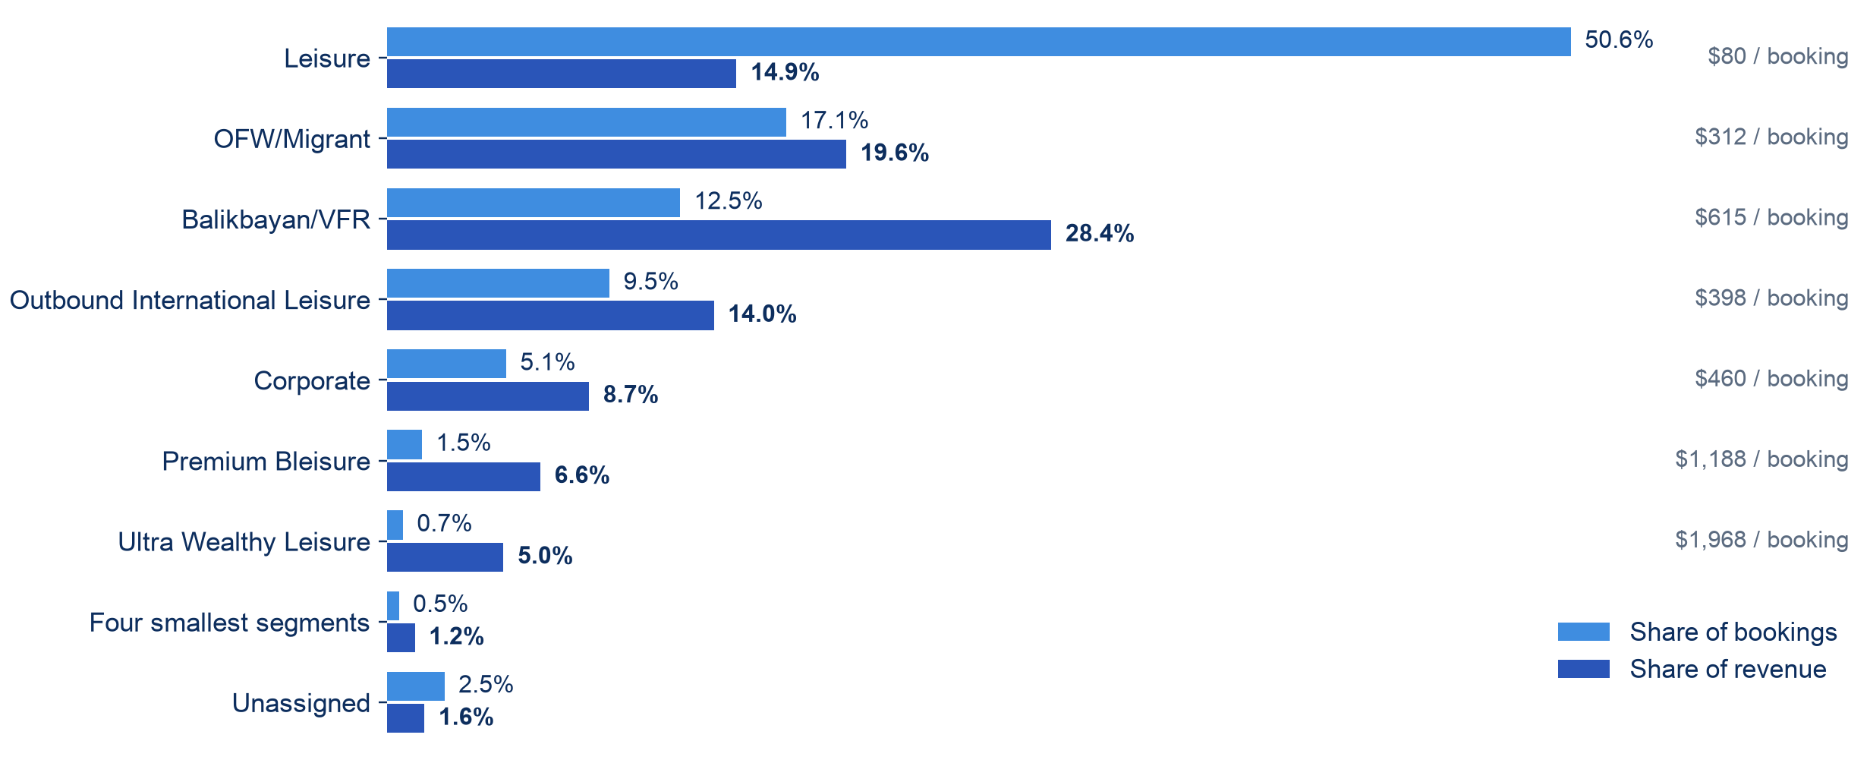
Market Segmentation for Philippine Airlines Through Machine Learning
FINDINGS · JOSH & JADD
Half the bookings earn a seventh of the money
Aggregated in DuckDB over all 22,911,450 bookings on every build, so the chart cannot drift from the model. Where headcount and money disagree this much, a segment-blind route review mis-ranks routes — the dashboard now shows both lenses.
Notes:
Let the picture sit for a few seconds before talking. The two bars tell the whole commercial story: Leisure dominates headcount and almost nothing else; Balikbayan and the premium segments carry revenue far above their size. If a panelist asks where these numbers come from: outputs/segment_charts/segment_summary.csv, rebuilt from the full booking table on every run.

Slide 18
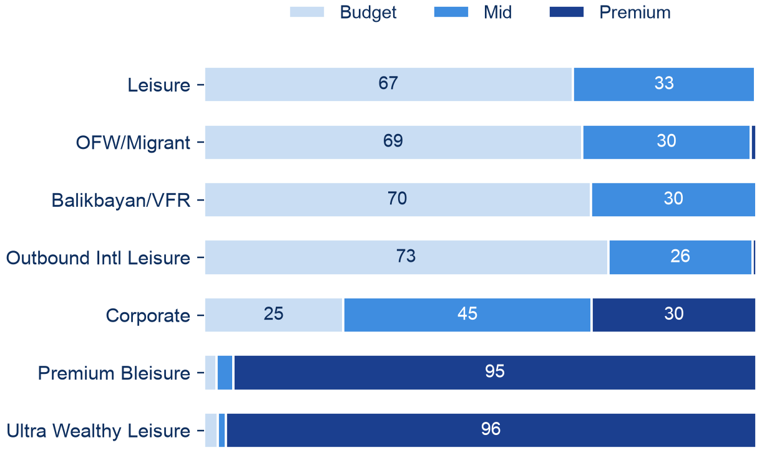
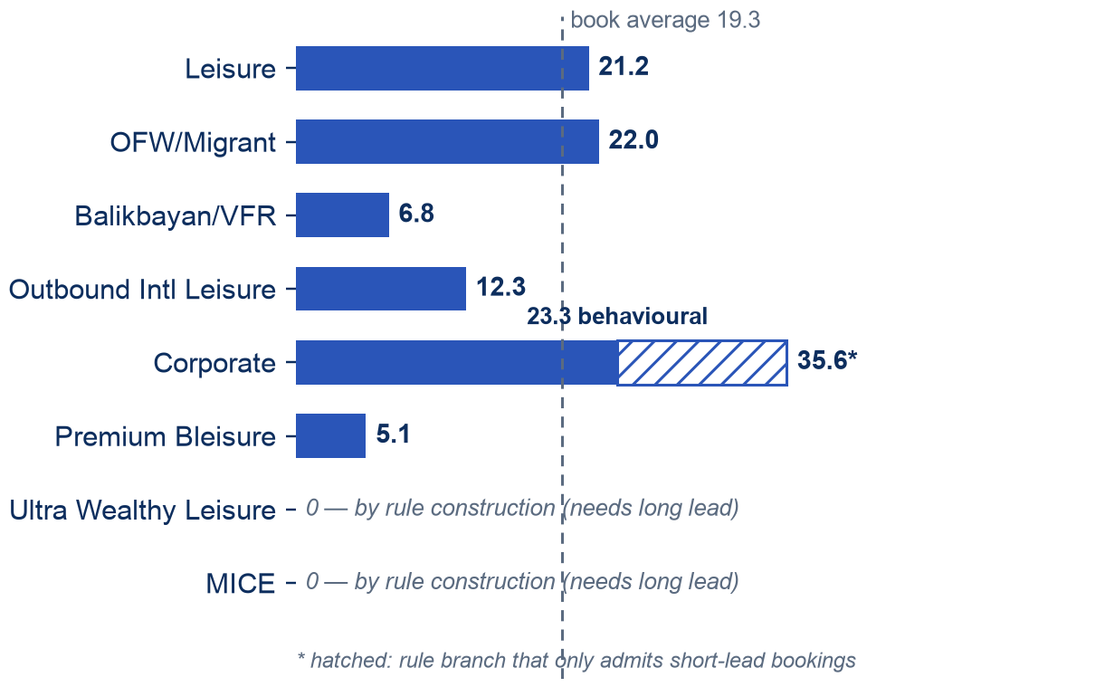
Market Segmentation for Philippine Airlines Through Machine Learning
FINDINGS · JOSH & JADD
What each segment buys, and how late they book
FAREBRAND VALUE-BAND MIX, %
SHORT-LEAD RATE BY SEGMENT, %
Premium cabins don't make premium segments. Balikbayan out-earns every big segment from 70% Budget-band fares — its value is route length and season, not cabin. The two segments that are ~95% Premium are partly defined by fare tier, so read their bars as rule echo.
Short-lead is not a leisure quirk. OFW books later than the book average — support tickets, not promo-chasing — while Balikbayan plans furthest ahead at 6.8%. That contrast is a pricing lever the old taxonomy couldn't see.
Notes:
Two insights the panel won't expect. First: the value-band chart kills the lazy equation of 'premium segment = premium cabin' — Balikbayan is the revenue engine and it flies on Budget-band fares; long international routes do the earning. Be honest about the two ~95% Premium rows: fare tier is part of those segments' rule definitions, so that pattern is partly circular and we say so on the slide. Second: the short-lead chart shows behaviour cutting across segments — which is exactly why Last-Minute works better as a flag than as a segment. Both charts from segment_summary.csv, full 22.9M bookings.

Slide 19
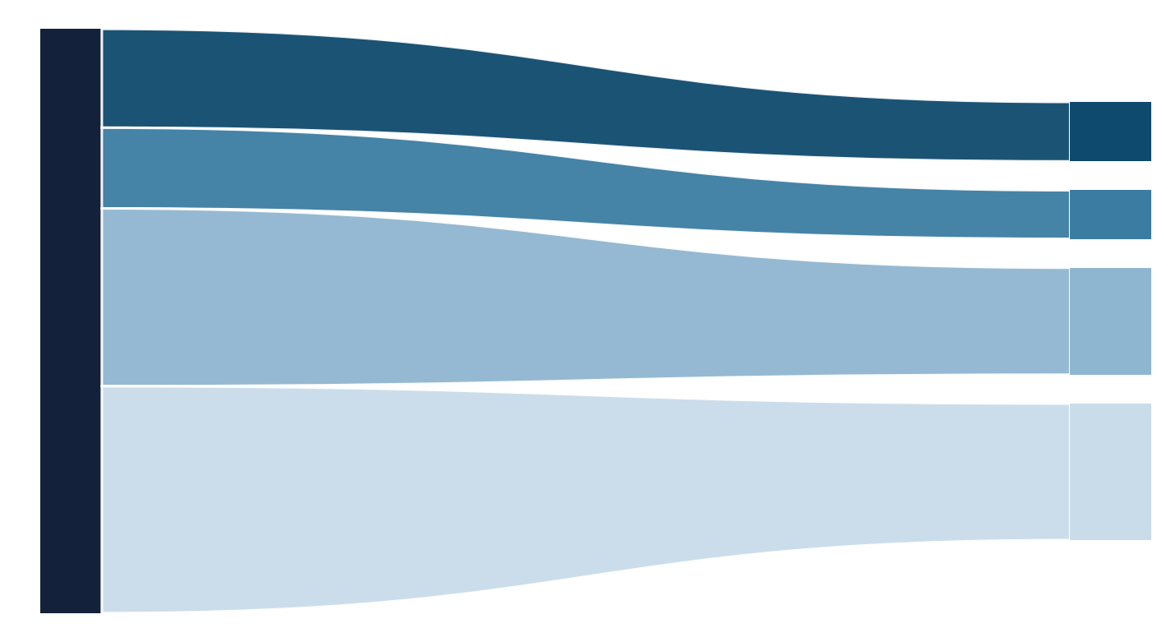
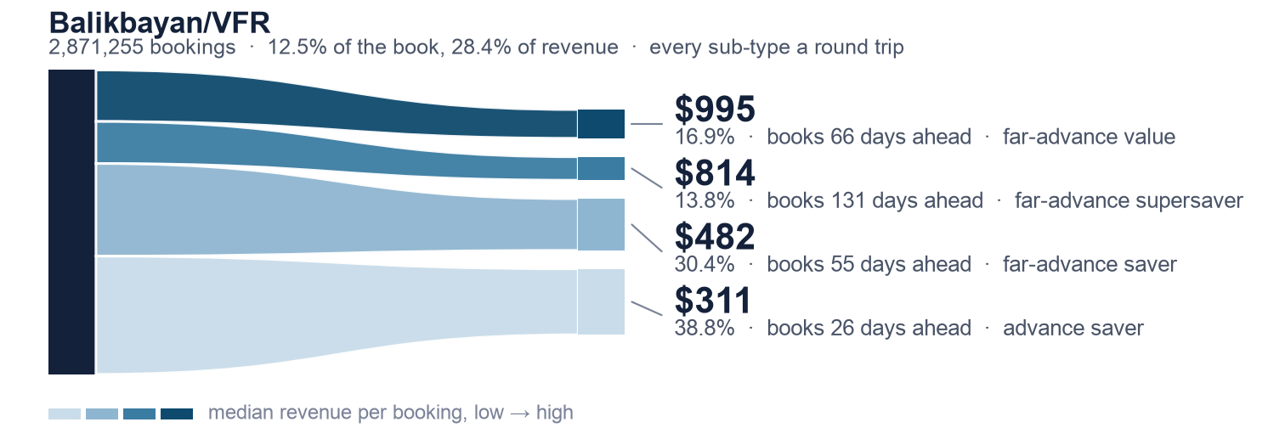
Market Segmentation for Philippine Airlines Through Machine Learning
FINDINGS · JOSH
Inside Balikbayan/VFR, the thinnest flows earn the most
2,871,255 bookings · 12.5% of the book, 28.4% of revenue · every sub-type a round trip
$995
16.9% · books 66 days ahead · far-advance value
$814
13.8% · books 131 days ahead · far-advance supersaver
$482
30.4% · books 55 days ahead · far-advance saver
$311
38.8% · books 26 days ahead · advance saver
median revenue per booking, low → high
Volume and value invert inside a segment exactly as they do across the book: the two thinnest flows are 30.7% of Balikbayan and its best-earning customers. ML never assigns a segment — it divides one.
The other four parents split the same way — Leisure $24–$97 · OFW/Migrant $170–$295 · Outbound Intl Leisure $285–$339 · Corporate $112–$656. Twenty cells in all.
Notes:
This is ML's job 1 — refinement — and the only slide that shows what the machine learning actually produced. Slides 8, 10 and 12 promise it; this delivers it. One worked example beats five columns of text: let the picture sit for a beat before talking.
The reading: ribbon WIDTH is share of the segment, ribbon colour and position are median revenue. So the eye sees the inversion immediately — the thinnest flow, 16.9%, earns the most at $995, and the fattest, 38.8%, earns the least at $311. Same volume-versus-value asymmetry as slide 17, one level down, inside a single segment.
Why Balikbayan/VFR is the example: 12.5% of bookings, 28.4% of revenue, and recommendation 1 tells PAL to protect it. Every sub-type here is a round trip, so the axis that varies is booking horizon — $311 at 26 days out to roughly $900 at 66 to 131 days. A 3.2x spread on one dial, inside one segment, which is a pricing lever the top-level taxonomy cannot see.
If asked about the other four: the line under the chart has the ranges. Corporate is widest at $112 to $656, but every sub-type there is short-lead, so its spread is direction and fare rather than timing. OFW at 1.7x and Outbound International at 1.2x are nearly flat — a useful negative: those two do not need sub-segment pricing.
GUARDRAIL — do not say 'BIC chose four'. sub_segment.py has K_RANGE = range(2,5), so four is the TOP of the search range and BIC preferred the maximum in all five parents. That is the continuum one level down: no natural number of types inside a segment either. Four is a granularity choice we made, not a structure we discovered. Same trap as k=9 on the PCA slide.
Other guardrails: 40,000 bookings per parent, hash-ordered and reproducible (NOT reservoir sampling, which had a threads>1 defect). Sub-types are descriptive only — they change no top-level label and nothing downstream reads them. Chart: src/sankey_subsegment.py, which parses outputs/sub_segments/summary.md so it cannot drift from the report.

Slide 20
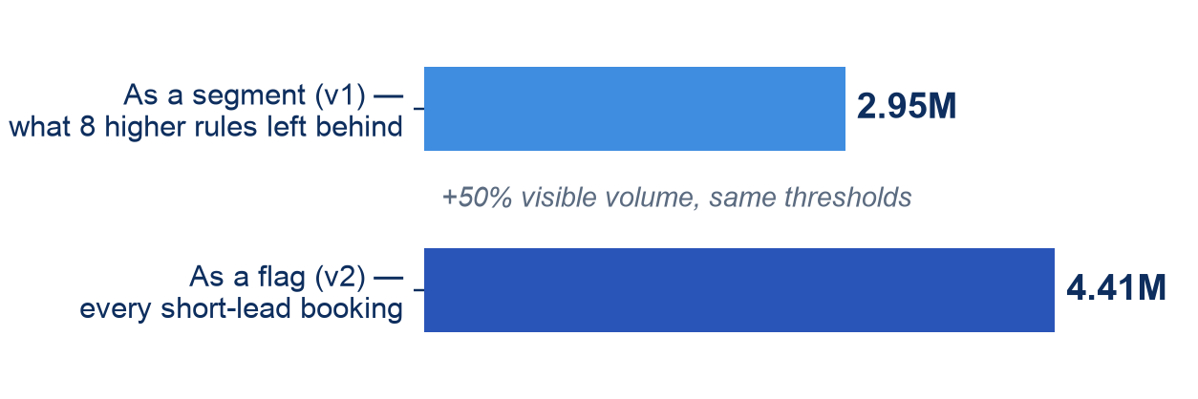
Market Segmentation for Philippine Airlines Through Machine Learning
FINDINGS · JOSH
The real change is 23.4% — the rest is mostly a rename
74%
5.36M
4.41M
drop in Unassigned — from 9.58% to 2.47%, our largest known gap closed
bookings genuinely reclassified under the approved taxonomy
short-lead bookings the flag now sees — the old segment caught only 2.95M
THE FLAG VS THE SEGMENT IT REPLACED
NUMBERS WE REFUSE TO QUOTE
62.7% 'reclassified' — mostly the Budget/Adventure → Leisure rename.
Corporate, 35.6% short-lead — one of its rule branches only admits short-lead bookings. The honest figure is 23.3%.
Three-quarters of the old Unassigned was Filipinos buying international economy tickets — now a segment of its own.
Includes 864k OFW and 315k corporate bookings that were short-lead all along, invisible inside their segments.
Notes:
This slide exists partly to pre-empt our own earlier documents. If a panelist has seen 62.7% somewhere, we said it here first and explained why we don't use it. The flag chart uses the v1-label composition — the counts that were invisible before the change.

Slide 21
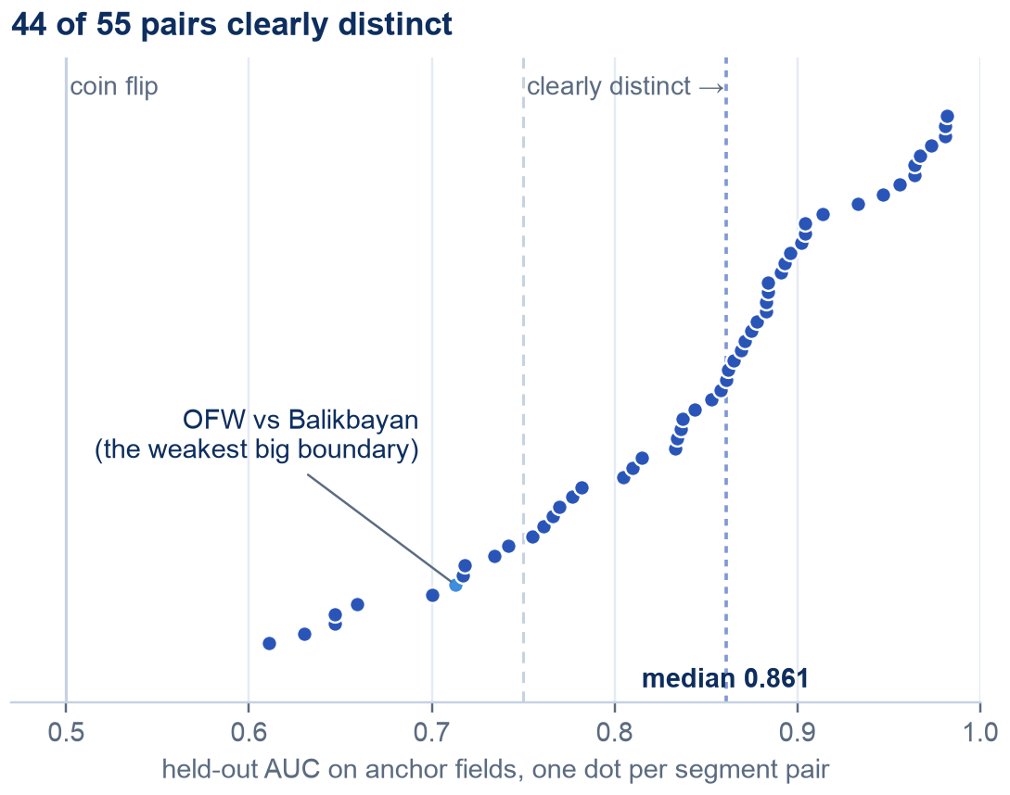
Market Segmentation for Philippine Airlines Through Machine Learning
FINDINGS · JOSH
Four independent checks, and 44 of 55 boundaries hold
V1–V4, our four validation stages — construct · criterion · detection power · out-of-time. None may read a field the rules consumed.
V1 · Construct
44 of 55 pairs clearly distinct, none indistinguishable — median AUC 0.861 on fields the rules never consumed.
V1, DRAWN — ALL 55 PAIRS
Are they distinguishable?
V2 · Criterion
The label alone: ~0.60 vs a 0.50 coin flip. On top of the raw features it adds almost nothing — expected for a compression. Its value is targeting.
Do they predict anything?
V3 · Detection power
Planted segments ≥2% of bookings are found by a majority of methods. Below ~1%, nothing is — a stated blind spot.
Could we have missed one?
V4 · Stability
Shares hold across a twelve-month step — 8 of 12 labels stable (the 11 segments plus Unassigned), carrying 98.1% of bookings. The four that drift are 1.9% of the book between them.
A year later?
How to read it — hand the model one booking from each of two segments and ask which is which; AUC is how often it gets the order right. 0.50 is a coin flip, above 0.75 is clearly distinct. These are the per-pair adaptive anchors: for every pair we withhold any field that encodes the rule bit separating those two segments, so the test never sees what built the label.
Owning the weak spot before you find it: the OFW–Balikbayan boundary did not improve with the new taxonomy — 0.730 before, 0.728 after, same test. The change that touched it moves 1.4% of the branch.
Notes:
OPEN WITH THE FRAMING, NOT THE NUMBER. This slide is Plan B. Our methodology has three routes to validation: circular (measure agreement against our own rule output — unavoidable today, worthless as proof), Plan A (about 1,000 SME-labelled bookings, a real answer key, still outstanding), and Plan B, which needs no labels at all. So the honest one-liner is: 'we wrote these labels ourselves and we do not have an answer key yet, so here are four checks that do not need one.'
V is a validation stage. V1 construct validity and V2 criterion validity are the standard validity types from measurement theory; V3 is statistical power; V4 is reliability across time. If asked why these four, that is the answer — a recognised framework adapted to our problem, not four checks we invented. The kicker line prints it, so you do not have to spell it out unless asked.
Two guardrails live here. Say which V1 measure you're quoting — 0.861 is the adaptive column. And never present '0.608 to 0.72' as an improvement on the weak boundary; those are two different tests, and like-for-like it went down.
Where the 11 weak pairs actually sit (from outputs/validate_construct/pairs.csv): Corporate is in 6 of its 10 boundaries and Leisure in 5 of its 10; every other segment has at most one or two. Two readings, both worth having. Leisure's softness IS the missing middle rung, measured — half the book in one segment is hard to tell from anything. And Corporate is the least well-defined segment on TWO independent diagnostics: most contested by the rules internally (only 6.4% uncontested, 12 Aug) and most weak boundaries on evidence the rules never saw. That is why Corporate is first in line for the SME sample. Guardrail: the lowest bar on this chart is Ultra Wealthy Leisure vs Leisure at 0.611 — NOT the OFW-Balikbayan boundary, which sits at 0.713 in this matrix. The 0.730/0.728 figures come from the isolated round-trip test, a different population. If someone points at the lowest bar: a brand-new segment carved off the top of a segment holding half the book is exactly where the softest edge belongs.
The explainer strip is there so a non-technical panellist can follow every number above it. Do NOT read it aloud — it exists to be read, not narrated. If someone asks what AUC is, point at it and give the one-line version: hand the model one booking from each of two segments, ask which is which, and AUC is how often it gets the order right. 0.50 is a coin flip. Above 0.75 we call the pair clearly distinct.
The strip also does the guardrail work for you: it states on the slide that these are the per-pair ADAPTIVE anchors, so you no longer have to remember to say it. And it says why the anchors are withheld per pair, which is the circularity contract from slide 13 doing visible work — a good place to link the two slides if the panel is engaged.
V4's line was corrected on 20 Aug: it used to read 'drift sits in the three smallest segments', which was the v1 count. Under v2 four labels drift — Mabuhay Loyalist, Pilgrimage, MICE and Premium Bleisure — and Premium Bleisure at 1.49% is not one of the smallest. The slide now says 8 of 12 stable carrying 98.1%, with the four drifters at 1.9% of the book between them, which is both accurate and the stronger framing.
If anyone asks why V1 says 55 pairs from 11 segments while V4 counts 12: 11 segments plus Unassigned is 12 labels. V1 tests the 11 — 11 times 10 over 2 is 55 — and excludes Unassigned because it has no positive definition; it is 'nothing else claimed this', so there is no claim to validate. V4 tests all 12, because drift in the residual bucket IS meaningful: if the leftovers change composition, the rules are losing grip on something. Unassigned came back stable. Same taxonomy, different denominators, both deliberate — and the slide now says '(the 11 segments plus Unassigned)' so it does not have to be explained.
One wording care point: of the four drifters, Premium Bleisure at 1.49% is the seventh-largest of the twelve — bigger than the other three drifters combined. So 'the four that drift are 1.9% of the book' is safe; 'the drift is in the tiny segments' is not.

Slide 22
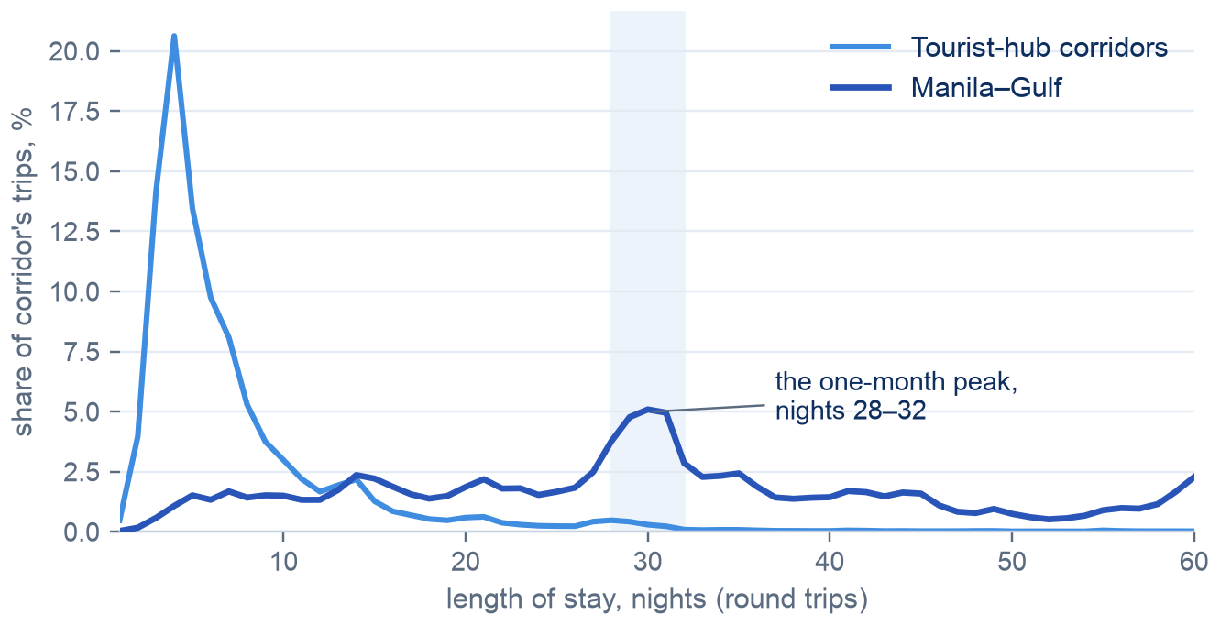
Market Segmentation for Philippine Airlines Through Machine Learning
FINDINGS · JOSH & JADD
Manila–Gulf runs on a one-month clock no other corridor has
$495 – $9,784
annual value at risk per misclassified customer, by segment — the first sourced dollar spread this project has had.
It replaces a penalty ladder whose dollar column was penalty × $4,000 — and which ranked two segments backwards against measured revenue.
PAL's answer so far is 'show us a run first', so the new weights are a proposal, not a decision.
Real trip data, PH-issued Gulf labour corridors vs tourist hubs. 19.11% of Gulf round trips sit at 28–32 nights against 8.48% at a fortnight; no other corridor's month-to-fortnight ratio tops 0.60.
The confound we haven't killed yet: a one-month maximum-stay fare rule would paint this identical picture. Fare basis codes settle it; until then, pattern, not cause.
Notes:
The Gulf finding is the best domain result we have, and the discipline is to stop one step short of the causal claim. If a panelist pushes on why: the fare-rule confound is open, and we'd rather be right later than interesting now. Also worth volunteering: two pieces of the SME's own claim failed our tests — no 45-day leave spike exists, and pooling Hong Kong/Taipei with the Gulf drags discrimination below chance (0.375 vs 0.676 Gulf-only). We test what we're told, including by the client. Chart source: outputs/stay_length/histogram.csv.

Slide 23
Market Segmentation for Philippine Airlines Through Machine Learning
BEFORE HANDOVER · JOSH
The limits we own, and the fixes in flight
OWNED, NOT HIDDEN
IN FLIGHT
No loyalty field in the extract, so Mabuhay sits at 0.03% and can't be measured — only awaited.
Fare basis codes, requested — they settle the Gulf question and sharpen the value bands.
Blind below ~1% prevalence: a real segment of 229k bookings could exist and we would not find it.
Penalty weights await PAL's sign-off; they asked to see a scored run first.
The build moves by ±1 booking between runs — 1,830 tied sort keys; cause found, fix drafted.
An SME-labelled sample would give us a real accuracy number. The dashboard ships none today, because any accuracy we could print would be the model grading its own homework.
No ancillary revenue in the data, so per-booking value understates bag-heavy segments.
Segment labels add little incremental prediction — by design, not by failure.
No refit-cadence claim yet: V4 transfer needs a multi-seed spread.
Everything on this slide is also written down in the handover pack — with the receipts.
Notes:
The framing matters: these are limits we found, measured, and documented — not things a panelist discovered for us. The missing accuracy number is deliberate and we should say why with a straight face.

Slide 24
Market Segmentation for Philippine Airlines Through Machine Learning
RECOMMENDATIONS · MARTIN
Four strategies, in the order PAL should run them
1 · Act on the segments
2 · Enhance the model
Protect Balikbayan/VFR — 28% of revenue on an eighth of the bookings. Grow the two premium segments. Use the short-lead flag for willingness-to-pay plays across every segment, not a bucket of its own.
Data before algorithms: the loyalty join first, then fare basis codes, ancillary revenue, and an SME-labelled sample. Every proposed experiment already has a pre-registered decision rule and a stop condition.
3 · Deploy it
4 · Manage the dashboard
Deterministic rules mean no model server — a SQL job PAL's own stack can run. The PSI drift monitor is the tripwire; evidence so far says a yearly refit buys little, pending one multi-seed confirmation.
PAL BI takes ownership. The Trust and DataCaveat columns must survive every edit, and the scorecard-ties-to-facts assertion stays on as the regression test.
Notes:
These come straight from the manuscript's recommendations chapter. The one stance worth defending out loud: data investments beat algorithm work at this point — every model experiment we ran says the ceiling is in the features, not the method.

Slide 25
Market Segmentation for Philippine Airlines Through Machine Learning
CONCLUSION · JOSH
A continuum, drawn into segments PAL can defend
01
PAL's customers sit on a continuum. Ten algorithms agree. Drawing the lines by business rule and validating them independently was the right design, and we'd choose it again.
WHAT HAPPENS NEXT
Fare basis codes land the Gulf answer
02
The deliverable: eleven named, costed segments on 22.9 million bookings — each carrying its own trust level, on a dashboard that reconciles to the row.
SME gold sample — contested boundaries first
Penalty weights: PAL reviews a scored run
03
What makes the labels safe to use is the machinery around them: circularity contracts, controls that retired one of our own instruments, withdrawn numbers named in writing.
Phase 0 governance starts in parallel
Notes:
Close on the third point and stop — no recap. The strongest thing this project produced isn't the labels, it's the apparatus that says exactly how far to trust them. Then hand it to the panel.

Slide 26
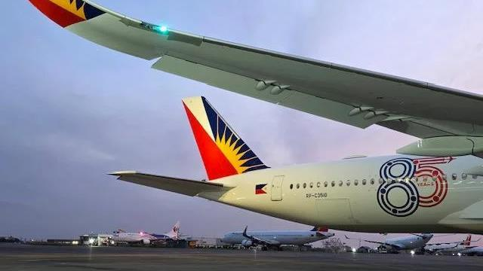
Thank you
Panel questions and discussion
Notes:
Backups on hand: the full 55-pair matrix, the detection grid, the withdrawn-numbers list, and the waterfall v2 before/after flows.

