Slide 1
Finance Finder
Team Projected Winner
June 8, 2017
Notes:
Template version: 9/26/2012

Slide 2
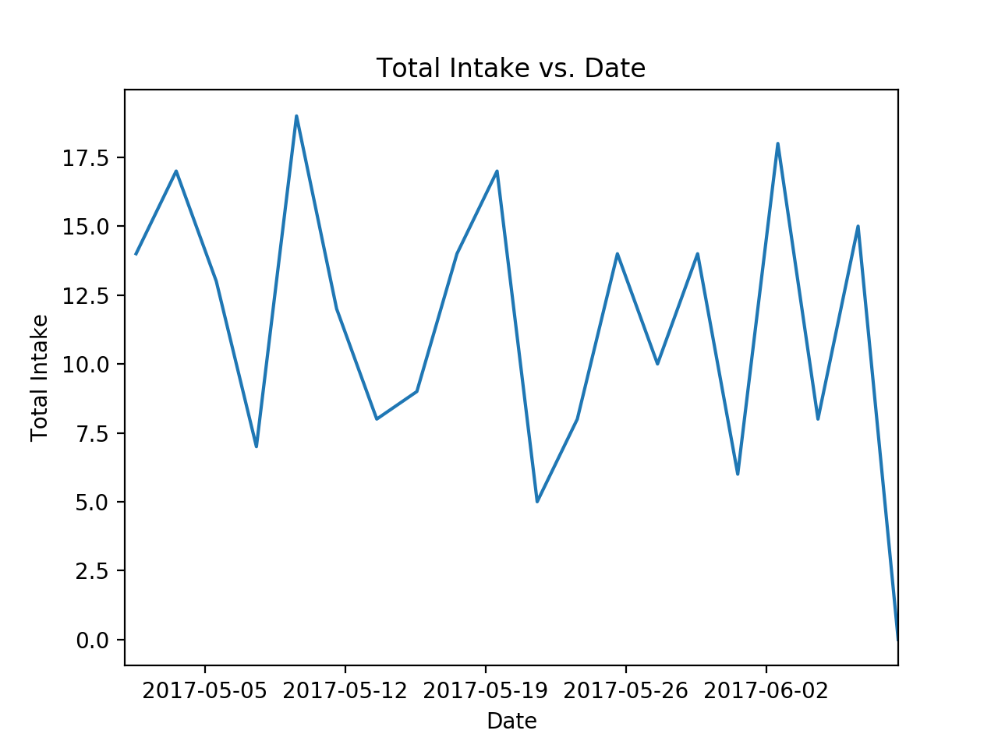
Graphs

Slide 3
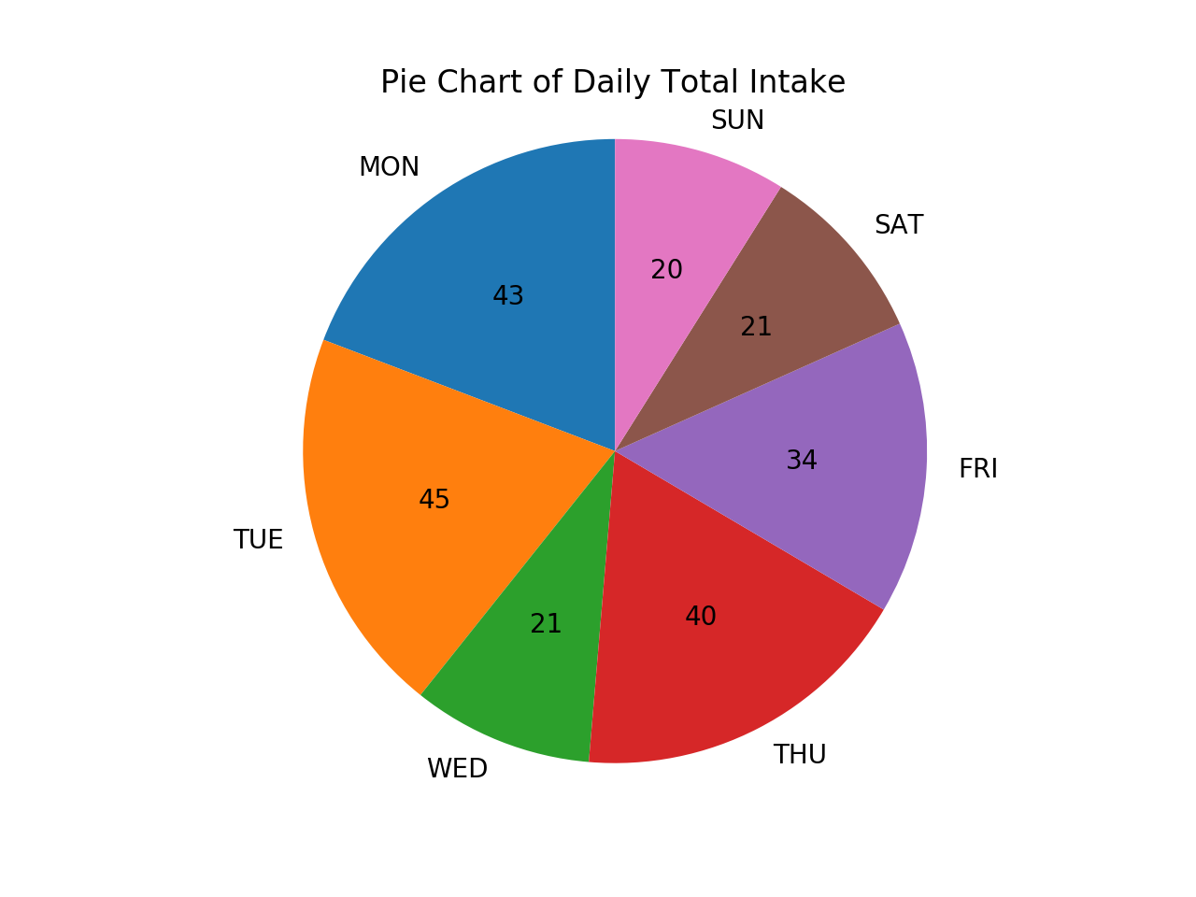
Graphs

Slide 4
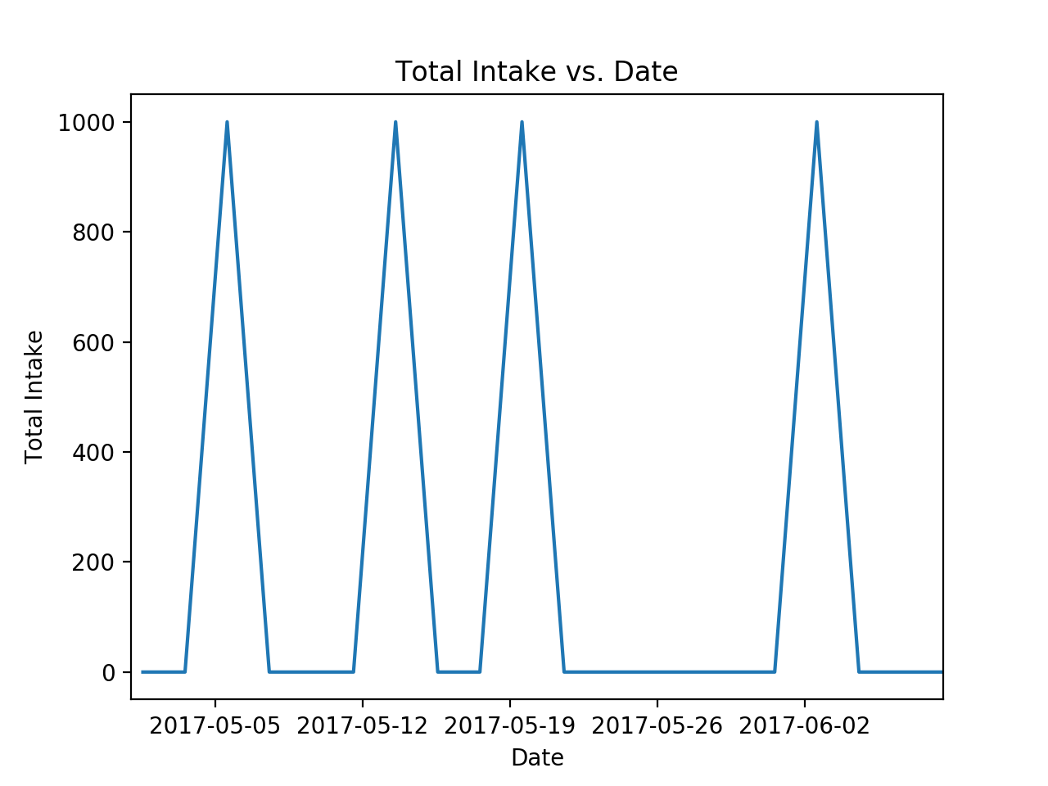
Graphs

Slide 5
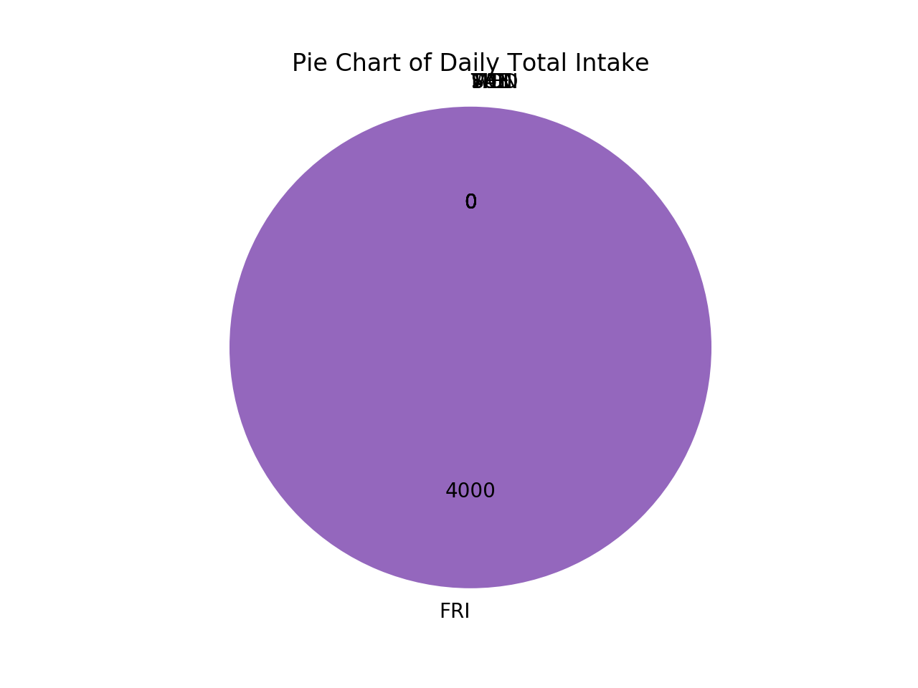
Graphs

Slide 6
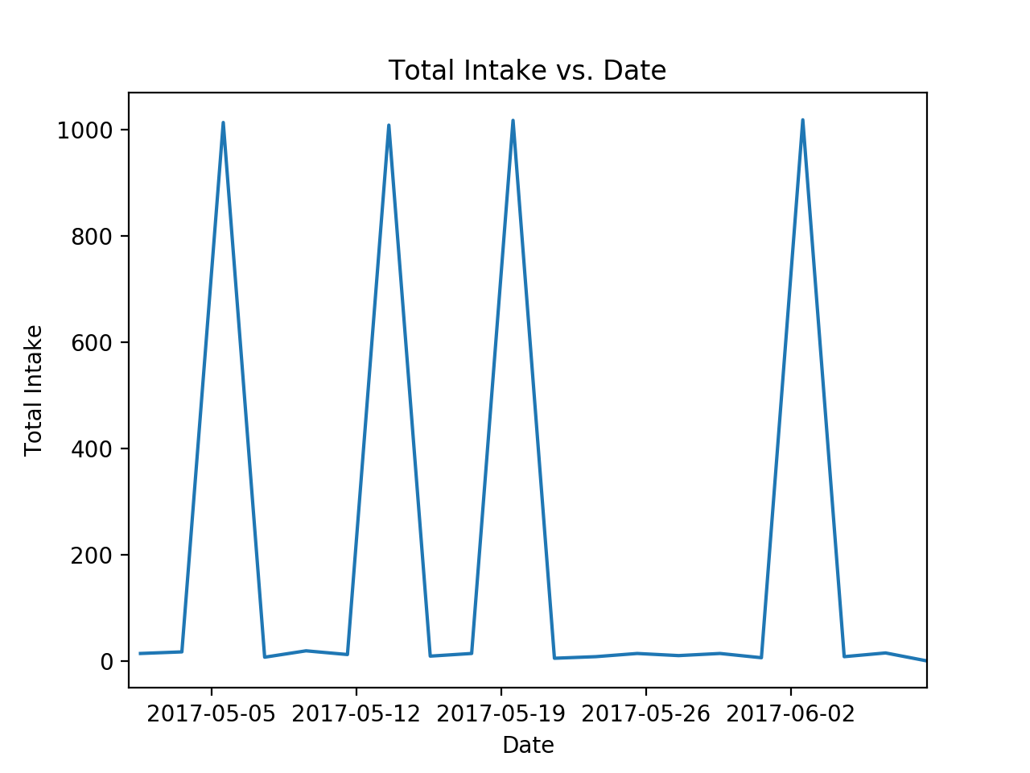
Graphs

Slide 7
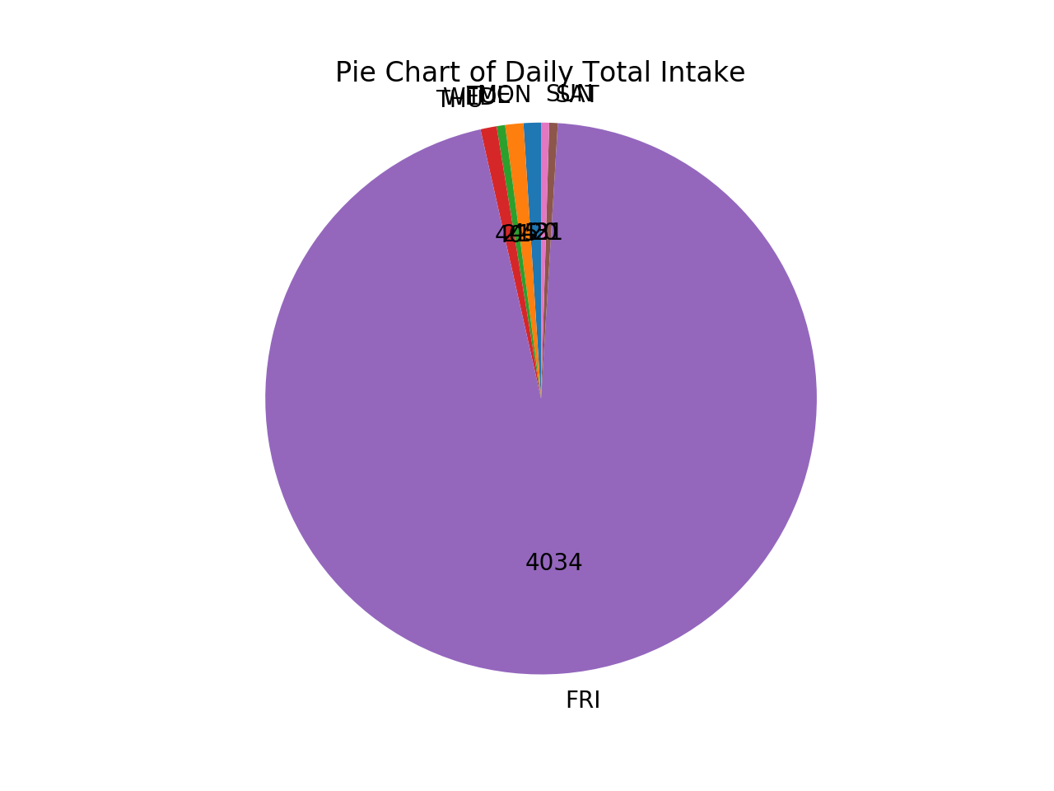
Graphs

