Slide 1
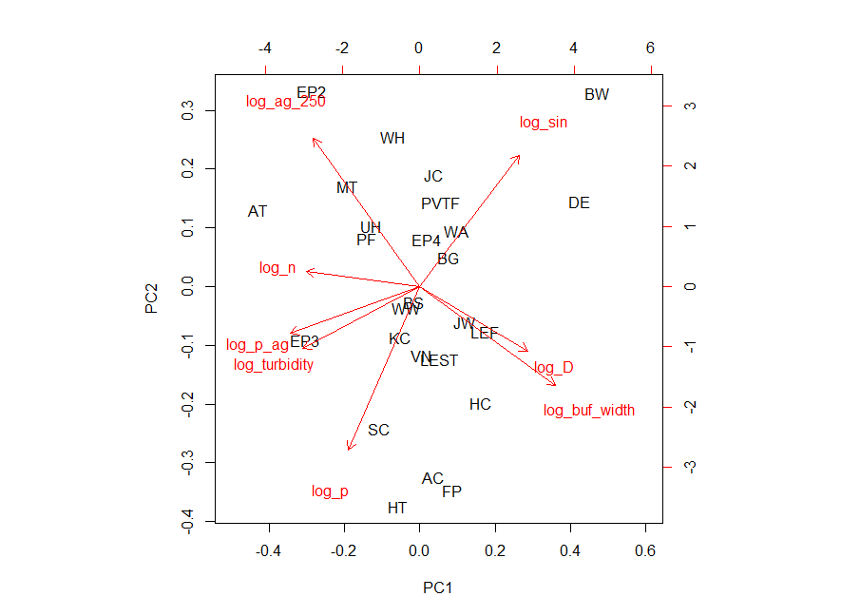
PCA of site attributes
Local (250 m radial buffer) % agriculture negatively correlated to stream buffer width
% watershed in entire watershed orthogonal to local % agriculture

Slide 2
PCA of site attributes
How does local vs. watershed level agriculture influence trophic ecology of stream-dwelling fishes?
Local (250 m radial buffer) % agriculture negatively correlated to stream buffer width
% watershed in entire watershed orthogonal to local % agriculture

Slide 3
Slide about the terrestrial energy hypothesis based on local % ag/buffer width – to add from stuff from Marie or Emily

Slide 4
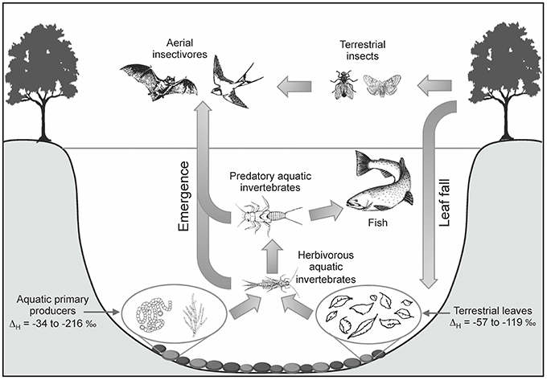
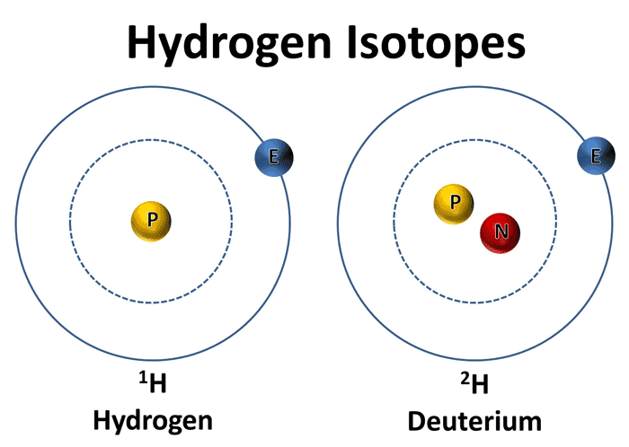
Stable hydrogen isotope (δ²H) to estimate % terrestrial vs. aquatic derived energy.

Slide 5
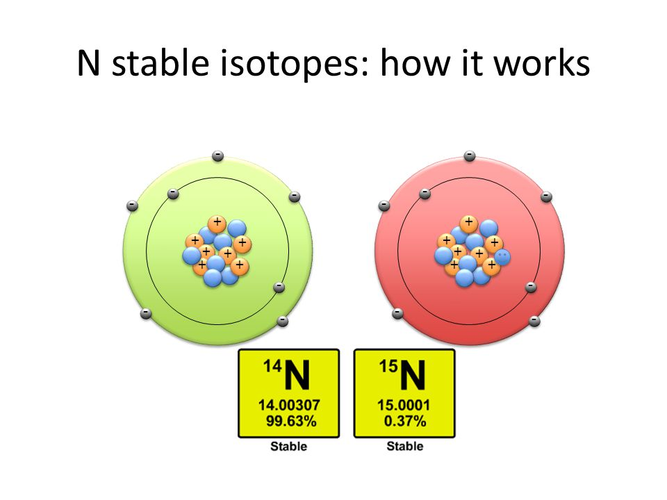
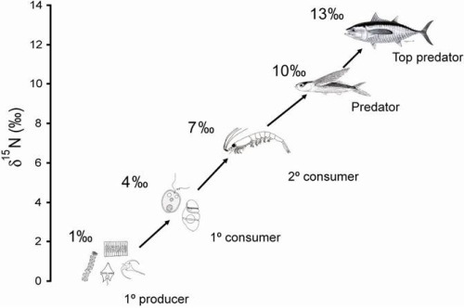
Stable nitrogen isotope (δ¹⁵N) to estimate trophic position.

Slide 6
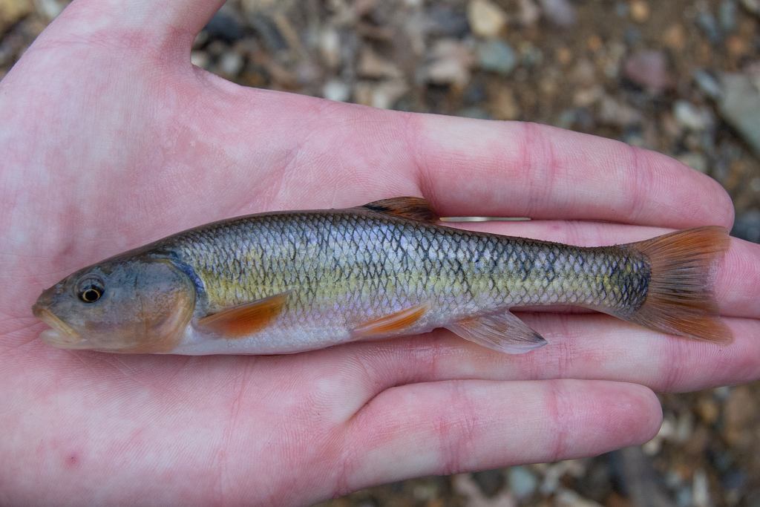
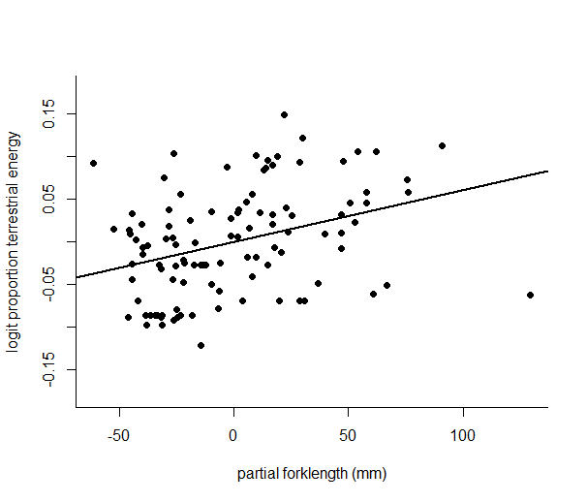
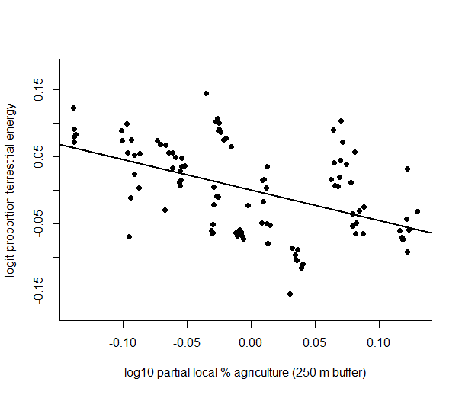
% terrestrial energy use of creek chub
P < 0.001
P < 0.001
Multiple regression indicated watershed level did not predict % terrestrial energy use, but fish length and local % agriculture did

Slide 7
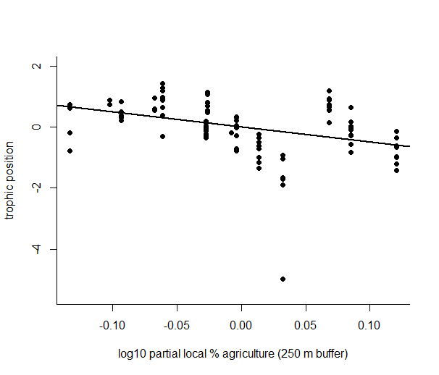
trophic position of creek chub
P < 0.001
Multiple regression indicated that watershed level and fish length did not predict trophic position, but local % agriculture did

Slide 8
trophic position of creek chub
P < 0.001
Multiple regression indicated that watershed level and fish length did not predict trophic position, but local % agriculture did

Slide 9
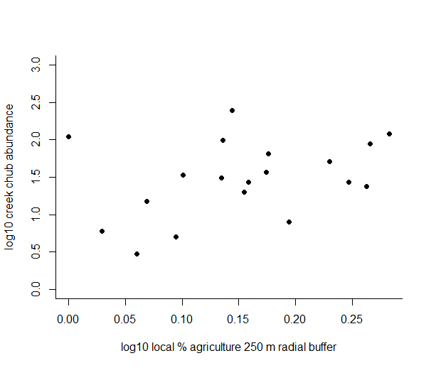
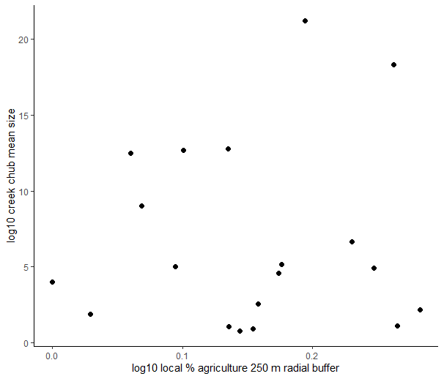
mean length and abundance of creek chub
P = 0.83
P = 0.13
Linear regression indicated creek chub mean size was not predicted by local % ag, but abundance marginally was (not that watershed % ag did not predict either)

