Slide 1
CS 372 Lecture #5
Overview of Networking:
  more about access networks
  physical media
Note: Many of the lecture slides are based on presentations that accompany
Computer Networking: A Top Down Approach, 6th edition,
by Jim Kurose & Keith Ross, Addison-Wesley, 2013.

Slide 2







Access networks: Home
Typical home network components:
cable or DSL modem
router/firewall/NAT
Ethernet
wireless access point
cabled/wireless devices
wireless
devices
to/from headend or central office
often combined
in single box
cable or DSL modem
wireless access
point (54 Mbps)
router, firewall, NAT
wired Ethernet (100 Mbps)

Slide 3









Access networks: Local Area Networks
institutional link to
ISP (Internet)
institutional router
Switch
institutional mail,
web servers
  Typically used in companies, universities, etc.
  Example: Ethernet
  local servers, public servers
  shared or dedicated link connects end systems to edge router
  10 Mbs, 100Mbps, 1 Gbps, 10 Gbps
Much more later about LANs

Slide 4









Access networks: Wireless
Shared wireless access network connects end system to router via base station (access point)
wireless LANs:
  within building (100 ft)
  802.11b/g (WiFi): 11 or 54 Mbps transmission rate
wide-area wireless access
  provided by phone company (cellular) 10 – 30 km
  1 to 10 Mbps transmission rate
  3G, 4G, LTE
to Internet
Discussion question: What are 3G, 4G, and LTE?
to Internet

Slide 5
Physical Media
Physical media
  provides the required link between sender & receiver
  propagates bits between sender/receiver pairs
Two types of physical media:
  guided media: signals propagate in solid media
  unguided media: signals propagate freely, e.g., wireless radio

Slide 6
Guided Media: twisted-pair copper wire
two insulated copper wires
  Category 3: 10Mbps Ethernet
  Category 5: 100Mbps, 1Gbps Ethernet
  Category 6: 1Gbps, 10GbpsEthernet
still used for high-speed LAN; e.g., ADSL
rate depends on thickness and distance
make up 99% of wired connections
may pick up interference (“noise”)
Discussion question: Why are the pairs twisted?

Slide 7
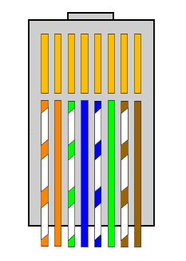
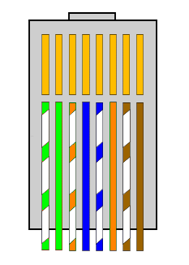
Twisted pair connectors (RJ-45)
connector: same on both ends of the cable; used with hubs, switches
crossover: one of each; direct connection
Pins 1, 2: transmit
Pins 3, 6: receive
Pins 4, 5, 7, 8: not used for network data
NOTE: other standards exist (not compatible, consistency essential)

Slide 8

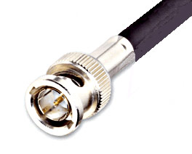
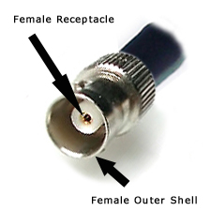
Guided Media: coaxial cable
coax cable and BNC connectors for Ethernet
two concentric copper conductors
baseband:
  single channel on cable
  legacy Ethernet
broadband:
  multiple channels on cable
  hybrid fiber-coax cable (HFC)
Cable TV
rate depends on thickness and distance
less interference than twisted pair

Slide 9
Baseband and broadband
Baseband uses a small part of the wave spectrum and sends only one signal at a time
Broadband uses a larger part of the wave spectrum and uses frequency division multiplexing to send multiple signals simultaneously

Slide 10
Frequency division multiplexing (FDM)
Achieves multiplexing by using different carrier frequencies
Frequencies must be separated to avoid interference
Receiver can "tune" to specific frequency and extract modulation for that one channel
Useful only in media that can carry multiple signals with different frequencies
  high-bandwidth required

Slide 11

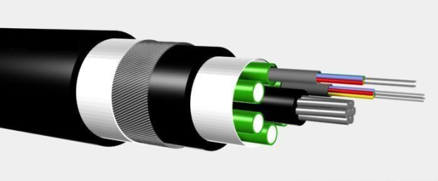
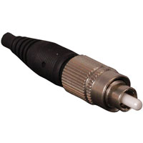
Guided Media: fiber optic cable
glass fiber carrying light pulses, each pulse represents one bit
high-speed operation:
  high-speed point-to-point transmission (e.g., 10’s-100’s Gbps)
low error rate:
  immune to electromagnetic noise and other interference
fiber optic cable and example connector

Slide 12
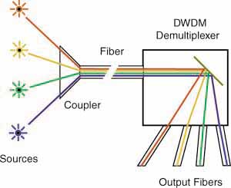
Wave-length division
Frequency division multiplexing can be applied to optical transmission
  known as wave-length division multiplexing (WDM)
  When many wavelengths are used, the term becomes Dense Wave Division Multiplexing (DWDM)
Informally, color division multiplexing
Receiver separates frequencies using a prism
  red, orange, etc
More information at http://www.thefoa.org/PPT/index.html
Source: http://www.thefoa.org

Slide 13
Unguided media: wireless radio
signal carried in electromagnetic spectrum
  in the “air”
no physical wire
effects of propagation environment:
  reflection
  obstruction by objects
  interference

Slide 14
Radio link types
terrestrial microwave (directional)
  up to 45 Mbps channels
LAN (e.g., Wifi)
  11Mbps, 54 Mbps
wide-area (e.g., cellular)
  3G, 4G, LTE: hundreds of Kbps
satellite
  1 Kbps to 45Mbps channel (or multiple smaller channels)
    Geostationary (36000 km) minimum 280 ms propagation delay
    Low-earth orbit (usually 300 – 600 km)
    Propagation delays depend on configuration
      Earth ⇔ Satellite ⇔ Earth
      Earth ⇔ Satellite ⇔ Satellite ⇔ … ⇔ Satellite ⇔ Earth

Slide 15
Summary Lecture #5
Definitions:
  baseband, broadband
  multiplexing
Physical media
  guided, unguided

