Slide 1
CS 372 Lecture #6
Overview of Networking:
  introduction to protocols
Note: Many of the lecture slides are based on presentations that accompany
Computer Networking: A Top Down Approach, 6th edition,
by Jim Kurose & Keith Ross, Addison-Wesley, 2013.

Slide 2
















Networks are complicated!
hosts
routers
links of various media types
applications
protocols
other hardware, software
mobile network
global ISP
home
network
regional ISP
institutional
network

Slide 3
Layering of functionality
Post Office example
Recipient (Destination)
Sender (Source)
Read letter
Remove from envelope
Destination P.O. delivers to address
Destination P.O. accepts envelope
Envelope arrives at destination P.O.
Write letter
Put into envelope
Address envelope
Take to P.O.
P.O. routes to destination P.O.
Delivery routing
Delivery routing
Layers: each layer implements a service
  via its own internal-layer actions
  relying on services provided by layer above/below

Slide 4
Internet protocol stack
application: supporting network applications
  e.g. FTP, SMTP, HTTP
transport: process-process data transfer
  e.g. TCP, UDP
network: routing of datagrams from source to destination
  e.g. IP, routing protocols
link: data transfer between neighboring network elements
  e.g. PPP, Ethernet
physical: carries actual signals between devices
  e.g. cable, wireless
application
transport
network
link
physical

Slide 5

Internet Stack end-to-end transport
Message is encapsulated at each layer
source
message
M
application
transport
network
link
physical
segment
H_{t}
M
H_{t}
datagram
H_{n}
H_{n}
H_{t}
M
frame
H_{l}
H_{n}
H_{t}
M
link
physical
switch
destination
H_{n}
H_{t}
M
network
link
physical
M
application
transport
network
link
physical
H_{l}
H_{n}
H_{t}
M
H_{n}
H_{t}
M
H_{t}
M
H_{n}
H_{t}
M
H_{l}
H_{n}
H_{t}
M
router

Slide 6
Why layering?
Dealing with complex systems:
explicit structure allows identification and relationship of complex system’s pieces
  layered reference model for discussion
modularization eases maintenance and updating of complex system
  change of implementation of layer’s service is transparent to rest of system
    e.g., change in “deliver to address” procedure doesn’t affect the rest of the system

Slide 7
Constraints
The software for each layer depends only on the services of the software provided by neighboring layers (well-defined interfaces)
The software at layer n at the destination receives exactly the same protocol message sent by layer n at the sender (consistency)
These constraints mean that protocols within a protocol stack can be
  tested independently
  modified/replaced independently

Slide 8
ISO/OSI reference model
presentation: allow applications to interpret meaning of data, e.g., encryption, compression, machine-specific conventions
session: synchronization, checkpointing, recovery of data exchange
Internet stack “missing” these layers
  these services, if needed, must be implemented in the application layer of the Internet protocol stack
application
presentation
session
transport
network
link
physical

Slide 9
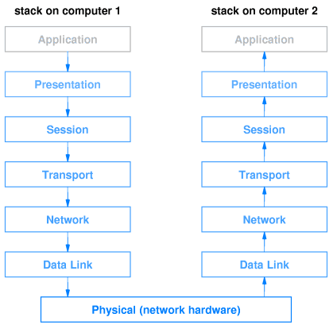
ISO model end-to-end transport

Slide 10
Summary Lecture #6
Definitions:
  protocol
  encapsulation
Internet protocol stack
ISO layering model

