Slide 1
CS 372 Lecture #25
The network layer
  hardware functions
    routing and forwarding
  forwarding tables
Note: Many of the lecture slides are based on presentations that accompany
Computer Networking: A Top Down Approach, 6th edition,
by Jim Kurose & Keith Ross, Addison-Wesley, 2013.

Slide 2
The network layer functions
Hosts
Application layer
Transport layer: TCP, UDP
Routers
Routing algorithms
path selection
Network layer protocols
addressing conventions
datagram format
datagram handling conventions
Network
layer
Forwarding
table
Other protocols
error reporting
router “collaboration”
Link layer
Physical layer

Slide 3
Router architecture overview
Two key router functions: routing and forwarding
Determine route (more later on algorithms/protocols)
forward datagrams from incoming to outgoing link
forwarding tables computed,
sent to input port memory
routing
processor
routing, management
(software)
forwarding data (hardware)
high-speed
switching
fabric
router input ports
router output ports

Slide 4
Input Port Functions
lookup,
forwarding
queueing
Physical layer:
bit-level
reception
line
termination
link
layer
protocol
(receive)
switch
fabric
Data link layer:
e.g., Ethernet
see chapter 5
Network layer (in):
Queuing: if datagrams arrive faster than forwarding rate into switch fabric
Lookup: given datagram destination, lookup output port using forwarding table in input port memory
Forwarding: forward to appropriate output port

Slide 5

Input Port Queuing
Fabric slower than combined input ports
  queuing may occur at any of the input ports
  output port contention
  Head-of-the-Line (HOL) blocking: queued datagram at front of queue prevents others in queue from moving forward
queuing delay and loss due to input buffer overflow

Slide 6
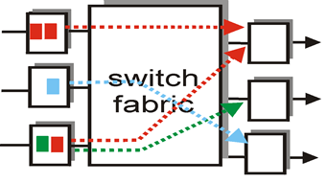
Switching fabric functions
Transfer datagram to selected output port
Prevent collisions

Slide 7
Output Port Functions
Physical layer:
bit-level
transmission
datagram
buffer
queueing
switch
fabric
link
layer
protocol
(send)
line
termination
Data link layer:
e.g., Ethernet
see chapter 5
Network layer (out):
Queuing required (at each output port) if datagrams arrive from fabric faster than the link’s transmission rate

Slide 8
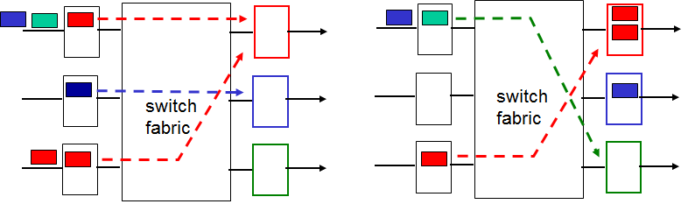
Output port queueing
Output link’s transmission rate slower than switching fabric
  queuing may occur at any of the output ports
  overloading of individual output ports
queuing delay and loss due to output port buffer overflow
Too much traffic on one output port

Slide 9
Datagram forwarding table
4 billion IP addresses, so rather than list individual destination address
list range of addresses
(aggregate table entries)
routing algorithm
local forwarding table
dest address
output link
address-range 1
address-range 2
address-range 3
address-range 4
3
2
2
1
IP destination address in
arriving packet’s header
1
3
2

Slide 10
Forwarding table
IPv4 has 4 billion
possible entries
Examples:
Destination Address Range Output Link
11001000 00010111 00010000 00000000
through 0
11001000 00010111 00010111 11111111
11001000 00010111 00011000 00000000
through 1
11001000 00010111 00011000 11111111
11001000 00010111 00011001 00000000
through 2
11001000 00010111 00011111 11111111
otherwise 3

Slide 11
Longest prefix matching
Forwarding Table
Prefix Match Link Interface
11001000 00010111 00010 0
11001000 00010111 00011000 1
11001000 00010111 00011 2
otherwise 3
Examples:
Destination address: 200.23.24.170
11001000 00010111 00011000 10101010
Which interface?
1
Destination address: 200.23.25.155
11001000 00010111 00011001 10011011
Which interface?
2
Destination address: 200.23.22.161
11001000 00010111 00010110 10100001
Which interface?
0
Destination address: 200.23.15.153
11001000 00010111 00001111 10011001
Which interface?
3

Slide 12
Summary Lecture #25
routing, forwarding
Router architecture
  input/output ports
  switching fabric
  queuing (at input/output ports)
  routing (forwarding) tables
longest prefix matching

