Slide 1
CS 372 Lecture #17
Reliable data transfer with TCP
  error detection/handling
  sequencing
  acknowledgements
  retransmission
See textbook for development of reliable data transfer (using finite state diagrams)
Note: Many of the lecture slides are based on presentations that accompany
Computer Networking: A Top Down Approach, 6th edition,
by Jim Kurose & Keith Ross, Addison-Wesley, 2013.

Slide 2
Error handling
How can sender know that an error has occurred?
  Bit flipped
  Missing packet
  Out-of sequence
What should the receiver do?
What should the sender do?
TCP uses acknowledgement and retransmission

Slide 3
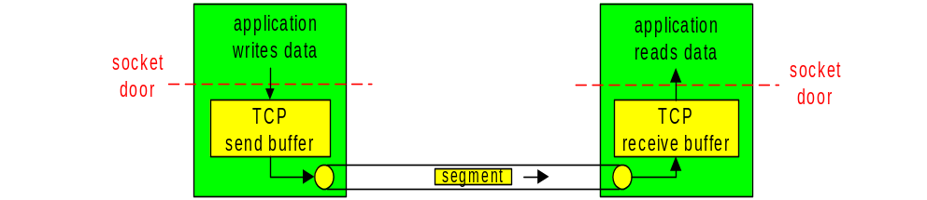
TCP: Overview [RFCs: 793, 1122, 1323, 2018, 2581]
connection-oriented:
  handshake (exchange of control messages) initializes sender/receiver state before data exchange
point-to-point:
  one sender, one receiver
  full duplex (bi-directional data flow in same connection)
in-order byte steam:
  cumulative byte count
  acknowledgement of bytes received
pipelined:
  TCP congestion and flow control
  send & receive buffers
flow controlled:
  sender will not overwhelm receiver
  MSS: maximum segment size

Slide 4
TCP segment structure
32 bits
source port #
destination port #
counting
by bytes
of data
(not segments!)
4-bit header size. Number of 32-bit “lines” (minimum=5, maximum=15)
sequence number
acknowledgement number
header
length
not
used
Receive window
U
A
P
R
S
F
# bytes
receiver is willing
to accept
checksum
Urgent data pointer
Flags for urgent data, ACK validity, push, reset, synchronize, final data
Options (variable length,
padded to 32 bits)
application
data
(variable length)
Internet
checksum
(as in UDP)

Slide 5
TCP sequence numbers
Segments are sent as a stream of bytes
  Not separated into records, data types, etc.
  Protocol keeps count of data bytes sent
    for each segment, protocol puts byte stream number of first byte in segment’s data into “sequence number” field
Sender keeps a copy of each segment until acknowledged by receiver
Sender’s segment also has “acknowledgement number”
  TCP is full-duplex. Data can flow in both directions simultaneously
  Typical (nothing to ACK) segment has a bogus number in the “acknowledgement number” field

Slide 6
TCP acknowledgement numbers
Receiver acknowledges all correct segments received.
  Error segments are not acknowledged at all
Header for acknowledgement segment (ACK) is the same as for other segments
  receiver calculates data bytes received by subtracting 4 x “header length” from TCP segment total byte-count
  “acknowledgement number” field contains the number of the next byte expected
ACK may also contain data
  TCP is full-duplex. Data can flow in both directions simultaneously
  Typical (no data) ACK has a bogus number in the “sequence number” field

Slide 7

Simple TCP scenario (no errors)
Host A sends “Hello!” to Host B. Suppose the ‘H’ is byte #42 in this sequence. ACK (#79) is bogus in this scenario
Host B receives segment, determines data length is 6, so next expected byte number is 42+6 = #48. Host B sends ACK, but sends no data.
Host A receives ACK, and sends “Goodbye!” to Host B. ‘G’ is byte #48 in this sequence.
Host B receives segment, determines data length is 8, so next expected byte number is 48+6 = #56. Host B sends ACK, but sends no data.
Host A receives ACK.
Host A
Host B
1.Host A
sends
‘Hello!’
Seq=42, ACK=79, data = ‘Hello!’
2.Host B ACKs
receipt of segment
time
Seq=79, ACK=48, data = ‘’
3.Host A receives ACK,
sends
‘Goodbye!’
Seq=48, ACK=79, data = ‘Goodbye!’
4.Host B ACKs
receipt of segment
Seq=79, ACK=56, data = ‘’
5.Host A
receives
ACK

Slide 8
TCP retransmission
Sender sets a count-down timer for each segment sent
  if timer expires before ACK received … re-send
  if segment error, ACK will never arrive
  Receiver can detect and discard duplicates
    if ACK is delayed (arrives after re-send)
    if ACK is lost

Slide 9
TCP retransmission scenarios
Host A
Host B
Host A
Host B
Seq=92, 8 bytes data
Seq=92, 8 bytes data
Error: no ACK sent
X
timeout
timeout
loss
Seq=92, 8 bytes data
Seq=92, 8 bytes data
ACK=100
ACK=100
next seq#
= 100
next seq#
= 100
time
time
segment error
segment lost

Slide 10
TCP retransmission scenarios
Host A
Host B
Host A
Host B
Seq=92, 8 bytes data
Seq=92, 8 bytes data
timeout
ACK=100
Seq=92 timeout
X
ACK=100
loss
Seq=92, 8 bytes data
Seq=92, 8 bytes data
ACK=100
Seq=92 timeout
ACK=100
Duplicate discarded
next seq#
= 100
next seq#
= 100
time
time
ACK lost
ACK delayed

Slide 11
Summary Lecture #17
TCP error handling
  error detection
  byte sequencing
  acknowledgement (ACK)
  retransmission

