Slide 1
CS 372 Lecture #18
Reliable data transfer with TCP
  efficiency
    stop-and-wait
    pipelining
    sliding-window
Note: Many of the lecture slides are based on presentations that accompany
Computer Networking: A Top Down Approach, 6th edition,
by Jim Kurose & Keith Ross, Addison-Wesley, 2013.

Slide 2
Efficiency considerations
TCP’s acknowledgement model is great for reliability …
… but with what tradeoffs?
  Segment overhead
  Each packet requires at least one RTT
    send segment, wait for ACK
  May increase queuing delay
  Increases network congestion

Slide 3
Performance of “stop-and-wait”
Example: R=1 Gbps, 15 ms end-to-end propagation delay, L=1000Byte packet:
sender
receiver
first packet bit transmitted, t = 0
last packet bit transmitted, t = L / R
first packet bit arrives
RTT
last packet bit arrives, send ACK
ACK arrives, send next
packet, t = RTT + L / R
L
8x10³ bits
transmission delay
=
=
= 0.008 ms
R
10⁹ bps
round-trip time (RTT) = 30 ms

Slide 4
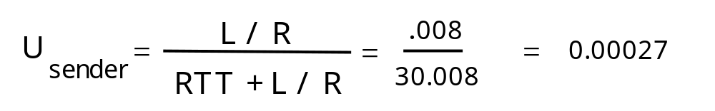
Performance of “stop-and-wait”
Example: R=1 Gbps, 15 ms end-to-end propagation delay, L=1000Byte packet:
sender
receiver
first packet bit transmitted, t = 0
last packet bit transmitted, t = L / R
first packet bit arrives
RTT
last packet bit arrives, send ACK
ACK arrives, send next
packet, t = RTT + L / R
  U _{sender}: utilization = fraction of time sender is busy sending

Slide 5
Performance of “stop-and-wait”
Example: R=1 Gbps, 15 ms end-to-end propagation delay, L=1000Byte packet:
sender
receiver
first packet bit transmitted, t = 0
last packet bit transmitted, t = L / R
first packet bit arrives
RTT
last packet bit arrives, send ACK
ACK arrives, send next
packet, t = RTT + L / R
1KB packet every 30 msec -> 33Kbps throughput over 1 Gbps link !!!
“stop-and-wait” protocol limits use of physical resources.

Slide 6

Pipelining: increased utilization
sender
receiver
first packet bit transmitted, t = 0
last bit transmitted, t = L / R
first packet bit arrives
RTT
last packet bit arrives, send ACK
last bit of 2nd packet arrives, send ACK
last bit of 3rd packet arrives, send ACK
ACK arrives, send next
packet, t = RTT + L / R
Increase utilization
by a factor of 3

Slide 7

Pipelined protocols
Pipelining: Sender transmits multiple packets.
Packets “in-flight” have yet to be acknowledged
Problem: receiver might not be able to handle that many packets as fast as they arrive.
Problem: packets might arrive out-of-order

Slide 8

TCP flow control
flow control
receive side of TCP connection has a receive buffer:
sender won’t overflow
receiver’s buffer by
transmitting too much,
too fast
speed-matching service: matching the send rate to the receiving application’s drain rate
      See animations on textbook’s website.
  receiver application layer process reading from buffer may be slow

Slide 9
TCP segment structure
32 bits
source port #
destination port #
counting
by bytes
of data
(not segments!)
Header size in bytes (always a multiple of 4)
sequence number
acknowledgement number
header
length
not
used
Receive window
U
A
P
R
S
F
# bytes
receiver is willing
to accept
checksum
Urgent data pointer
Flags for urgent data, ACK validity, push, reset, synchronize, final data
Options (variable length,
padded to 32 bits)
application
data
(variable length)
Internet
checksum
(as in UDP)

Slide 10
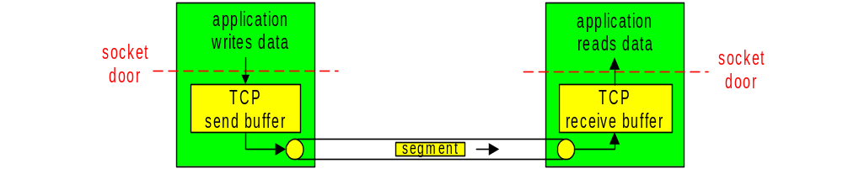
TCP flow control
TCP uses sliding window for flow control
Sender transmits one segment
Receiver specifies window size (window advertisement ) in ACK header “receive window”
  Specifies how many bytes in the data stream can be sent
Sender limits unACKed data to “receive window”
  guarantees receive buffer doesn’t overflow

Slide 11
Summary Lecture #18
Efficiency
  stop-and-wait
  pipelining
flow control
“receive window”
sliding-window protocol
Next hurdle:
  What happens if there are errors in the pipeline?

