Slide 1
CS 372 Lecture #41
Security
  threats
  policies
  mechanisms
Note: Many of the lecture slides are based on presentations that accompany
Computer Networking: A Top Down Approach, 6th edition,
by Jim Kurose & Keith Ross, Addison-Wesley, 2013.

Slide 2
Cyber Crime
Internet enables new types of crime
Explosive growth of the problem
  laws have been reactive instead of proactive
    types of activities not anticipated
    many “crimes” are not illegal yet
  cost of protection
  cost of security breaches
Perpetrators
  Criminal hackers (crackers)
  Terrorists
  Governments
  Unknowing accomplices

Slide 3
2012 Poneman Report
Most costly types of attacks
  Malicious code
  Denial of services
  Web-based attacks
  Stolen devices
  Malicious insiders
  Social Engineering, Phishing
  Viruses, worms, trojans
  Botnets
  Malware
Wireless/mobility makes crimes easier to commit, harder to trace
Costs of attacks
  Norton/Symantec estimates cost of internet theft
    to US companies $250 billion/year
    to US consumers $110 billion/year (not including costs passed on from companies)
    globally $388 billion (including downtime)
  McAfee estimates that $1 trillion was spent globally for remediation.
  National security
    cyber attacks now considered greater threat than terrorism
  Personal security
    identity theft, privacy
  Interruption of essential services
    power, water, medical, etc.
  etc.

Slide 4
Security policies
"Secure" is not an absolute term
Need to define security policy for organization
Costs and benefits of security policies must be assessed
  What is the value of information?
Policies must consider stored information as well as transmitted information.
Users must be educated
  Security policy is useless if users respond to “phishing”, etc.

Slide 5
Maintaining security
Data integrity
  Data should be transmitted unchanged
  Stored data should be "safe"
Data availability
  Authorized users should have access
  Access should not be interrupted
Data confidentiality
  Only authorized users should have access
  No snooping, wiretapping, etc.
Privacy
  User identity is protected
  Private transactions are protected

Slide 6
Security mechanisms
Perimeter security
Password / data encryption
Others
  Virtual private networks
    Use Internet to transfer data among organization’s sites but ensure that data cannot be read by others
  Message authentication codes (MAC)
  Digital signatures
  etc.

Slide 7
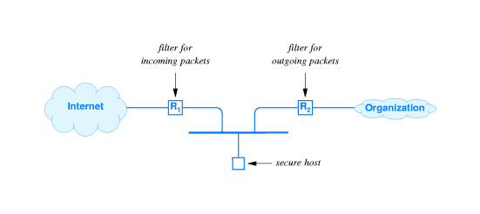
Perimeter security
Firewalls can’t protect against …
Malicious insiders
Connections that don’t go through it
  E.G., dial-up connections
Completely new threats
Unknown viruses
Using packet filters to create a firewall
Secure host ("bastion" host) runs application-layer gateways or proxies
There are many variations.

Slide 8
Commercial / open-source security systems
IDS Intrusion Detection System
Kerberos from MIT
SSH and OpenSSH Secure Shell
SSL and OpenSSL Secure Socket Layer
… and many others

Slide 9
Summary Lecture #41
Cyber crime
  scope of the problem
  types of attacks
Security
  policies
  mechanisms

